Slide 1

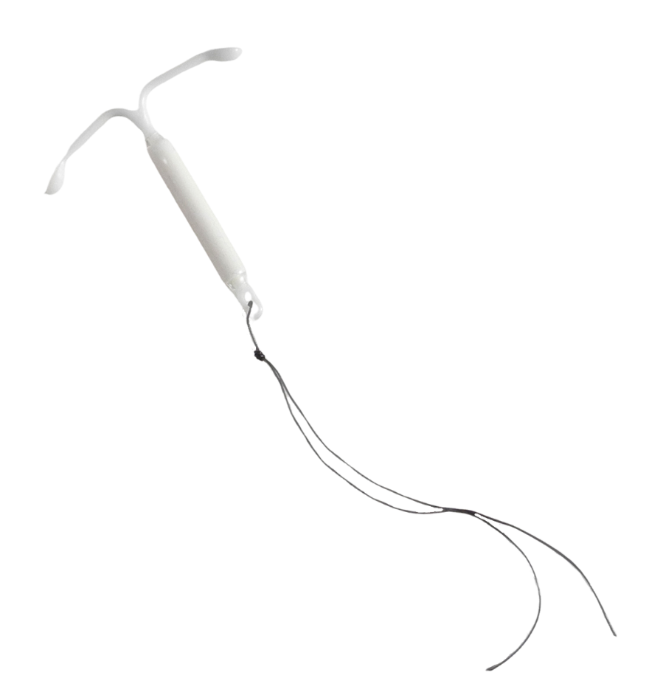

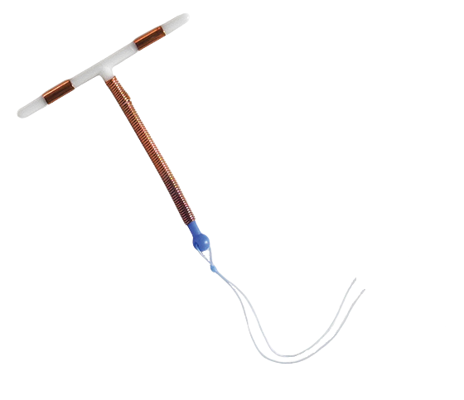
INTRAUTERINE DEVICES (IUDS)
DISPELLING THE MYTHS
Notes:
Updated 11/2022

Slide 2
LEARNING OBJECTIVES.
  Participants will be able to:
  Understand IUD indications and contraindications
  Describe the differences between hormonal and non-hormonal IUDs
  Understand patient-centered counseling

Slide 3

Contraceptive Method Use: U.S.
3
Daniels K, Daugherty J and Jones J, Current contraceptive status among women aged 15–44: United States, 2011–2013, National Health Statistics Reports, 2014, No. 173, http://www.cdc.gov/nchs/data/databriefs/db173.pdf.
Kavanaugh ML, Jerman J and Finer LB, Changes in use of long-acting reversible contraceptive methods among United States women, 2009–2012, Obstetrics & Gynecology, 2015, 126(5):917–927.
Finer LB, Jerman J and Kavanaugh ML, Changes in use of long-acting contraceptive methods in the United States, 2007–2009, Fertility and Sterility, 2012, 98(4):893–897.
Notes:
-In 2012, about 12% of women using contraceptives relied on a long-acting reversible contraceptive method, or LARC.
-The proportion using LARCs has risen over the past decade, from 2% in 2002 to 6% in 2007 and 9% in 2009.
*RHAP recognizes that not only women can get pregnant. Instances in which gendered language is used is a reflection of the methods used by researchers when conducting studies.
References:
Daniels K, Daugherty J and Jones J, Current contraceptive status among women aged 15–44: United States, 2011–2013, National Health Statistics Reports, 2014, No. 173, http://www.cdc.gov/nchs/data/databriefs/db173.pdf.
Kavanaugh ML, Jerman J and Finer LB, Changes in use of long-acting reversible contraceptive methods among United States women, 2009–2012, Obstetrics & Gynecology, 2015, 126(5):917–927.
Finer LB, Jerman J and Kavanaugh ML, Changes in use of long-acting contraceptive methods in the United States, 2007–2009, Fertility and Sterility, 2012, 98(4):893–897.

Slide 4

PATIENT CASE:
Diane
21-years-old
Post-partum 4 weeks
Thinking about tubal sterilization
4
Image: College Student Smiling In Class With Students Behind Her by Jacob Lund Photography from NounProject.com
Notes:
Diane is a 21 year old G2P2 single mother who returns for her 4 week post-partum visit, wants a very effective method, thinking about getting her tubes tied
Image: College Student Smiling In Class With Students Behind Her by Jacob Lund Photography from NounProject.com

Slide 5
Sterilization Disparities
5
https://www.guttmacher.org/fact-sheet/contraceptive-method-use-united-states
Notes:
In the US, Black people age 15-44 are much more likely to use tubal ligation than vasectomy.
Among white people, the difference is less stark.
Vasectomy use is highest among people with income above 300% poverty level and those with advanced degrees.
Why is this?
https://www.guttmacher.org/fact-sheet/contraceptive-method-use-united-states

Slide 6

What about an IUD for Diane?
Lower discontinuation rates in post-partum patients
Fully reversible
6
Image: Students Chatting During Class by Jacob Lund Photography from NounProject.com
Notes:
Chi – immediately post partum had lower rates of expulsion than delayed PP
Chi, IC, et al, Performance of the copper T-380A intrauterine device in breastfeeding women, Contraception 39(6):603-18. 1989
Grimes, D et al. Immediate postpartum insertion of intrauterine devices. Cochrane Review, 2005
Image: Students Chatting During Class by Jacob Lund Photography from NounProject.com

Slide 7
IUD Duration
Brand name | Type | Duration: FDA | Duration: evidence
Mirena | Levonorgestrel | 8 years | 8 years
Liletta | Levonorgestrel | 8 years | 8 years
Skyla | Levonorgestrel | 3 years | 3 years
Kyleena | Levonorgestrel | 5 years | 5 years
Paragard | Copper | 10 years | 12 years
7
Sivin, I (1991). Prolonged intrauterine contraception: a seven-year randomized study of the levonorgestrel 20 mcg/day (LNg 20) and the Copper T380 Ag IUDS. Contraception. 44(5): 473-480.
UNDP. Long-term reversible contraception: Twelve years of experience with the TCu380A and TCu220C. (1997) Contraception. 56(6): 341-352.
Notes:
Studies support extended duration for several IUD types.
Sivin, I (1991). Prolonged intrauterine contraception: a seven-year randomized study of the levonorgestrel 20 mcg/day (LNg 20) and the Copper T380 Ag IUDS. Contraception. 44(5): 473-480.
UNDP. Long-term reversible contraception: Twelve years of experience with the TCu380A and TCu220C. (1997) Contraception. 56(6): 341-352.
Dethier, Divya, et al. “Society of Family Planning Clinical Recommendation: Extended Use of Long-Acting Reversible Contraception.” Contraception, June 2022, 10.1016/j.contraception.2022.06.003. Accessed 5 July 2022.
https://medicines360.org/2022/11/14/fda-approves-medicines360s-liletta-levonorgestrel-releasing-intrauterine-system-52-mg-to-prevent-pregnancy-for-up-to-eight-years/

Slide 8
Levonorgestrel IUDs: Dose, Cost
Brand name | Dose per day |  | Total dose | Device cost: commercial | Device cost: 340B | Size in mm | String color | Amenorrhea at 1 year
Mirena | 20 mcg |  | 52 mg | $954 |  | 32 x 32 | black | 20%
Liletta | 18.6 mcg |  | 52 mg |  | $50 | 32 x 32 | blue | 19%
Skyla | 14 mcg |  | 13.5 mg |  | $249 | 29 x 30 | black | 6%
Kyleena | 17.5 mcg |  | 19.5 mg | $954 |  | 28 x 30 | blue | 12%
8
Notes:
Apart from the inserter device, Mirena and Liletta IUDs are nearly identical. Liletta’s federal 340b pricing is $50, thereby making this option more affordable for patients regardless of income and/or insurance coverage.
Approximately 19-20% of patients experience amenorrhea with Liletta and Mirena IUDs, respectively.
Compared to Mirena and Liletta, Skyla and Kyleena are smaller in dose, size, and duration.
Fewer patients experience amenorrhea with Skyla and Kyleena.

Slide 9

Mechanism of Action
IUDs are NOT abortifacients!
Notes:
Photo: Announcement by Olivier Guin from NounProject.com

Slide 10
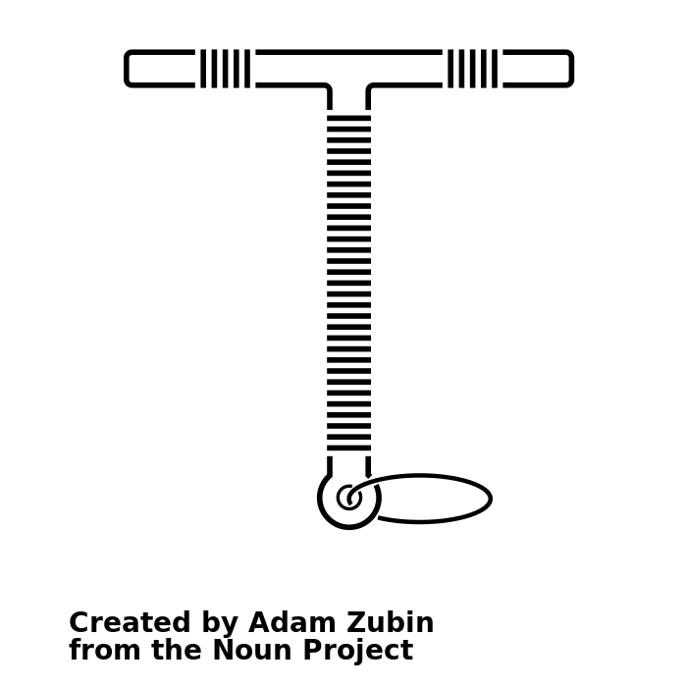
Mechanism of Action:
Copper IUD
380 mm² copper exposed on plastic T base
10
Notes:
The copper IUD:
Interferes with sperm motility.
Causes spermicidal foreign-body
reaction.
Alters uterine environment,
“hostile” to sperm.
Rivera, R. (1999). "The mechanism of action of hormonal contraceptives and intrauterine contraceptive devices." American Journal of Obstetrics & Gynecology 181(5): 1263-1269
Image: Intrauterine Device by Adam Zubin from NounProject.com

Slide 11
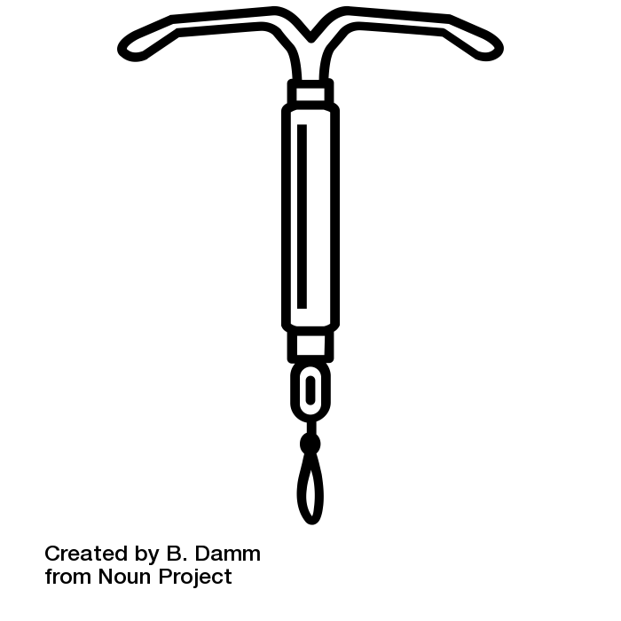
Mechanism of Action:
Levonorgestrel IUD
Hormone-releasing IUD - levonorgestrel on its arms and stem released at decreasing rate over time
11
Notes:
Thickens cervical mucus (acting as a
sperm barrier)
Inhibits sperm capacitation & survival.
Thins uterine lining.
Partial inhibition of ovulation.
Presence of plastic alone may have some
efficacy
Barbosa, I. (1995) Ovarian function after seven years' use of a levonorgestrel IUD. Advances in Contraception. 11(2):85-95.
Image: Iud by B. Damm from NounProject.com

Slide 12

PATIENT CASE:
Maggie
19-years-old
Heavy smoker
12
Image: Happy College Student Holding Backpack In Library by Jacob Lund Photography from NounProject.com
Notes:
Maggie is a 19 year old G2P2 heavy smoker with a new partner who wants to have a child with her. She does not want to have more children and wants a method he won’t notice.
Image: Happy College Student Holding Backpack In Library by Jacob Lund Photography from NounProject.com

Slide 13

Concerns with Maggie… and evidence for safety
Age
  CDC category “2” for patients under age 20 – Consider expulsion risk and baseline STI risk
Smoking
  No restrictions for any IUD
Image: Cigarettes On Pink Background by Bogdan Dreava from NounProject.com
Notes:
WHO gives women < 20 category 2. Concern centers around risk of expulsion, STI risk in younger populations
Also a “2” for nulliparity in 2009 edition
Still a “2” in the 2009 edition…
WHO. Medical eligibility criteria for contraceptive use - 4th edition, 2009.
Image: Cigarettes On Pink Background by Bogdan Dreava from NounProject.com

Slide 14
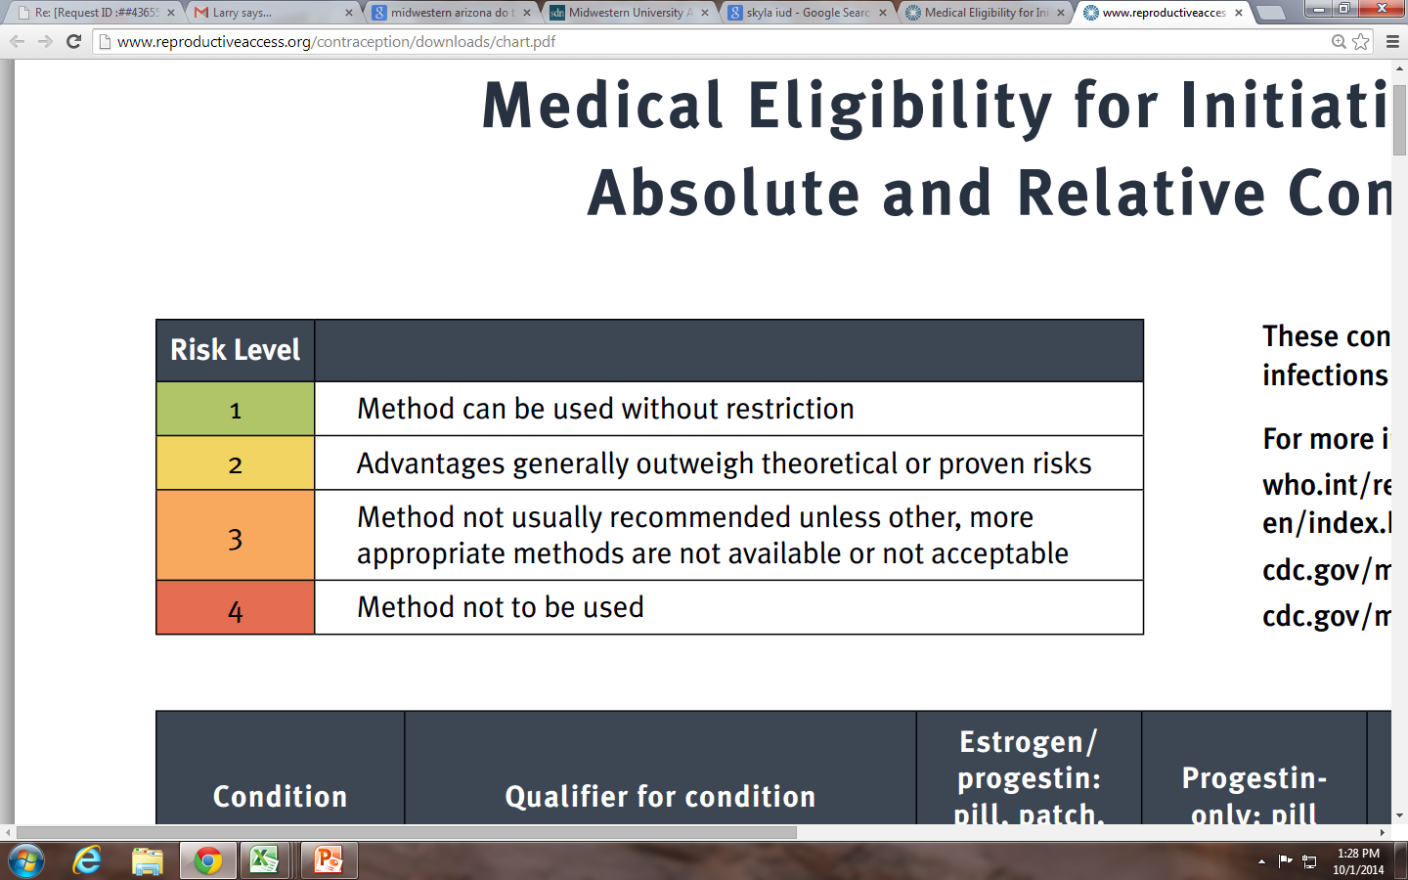
CDC Categories of Safety
14
Notes:
1 Method can be used without restriction
2 Advantages generally outweigh theoretical or proven risks
3 Method not usually recommended unless other, more appropriate methods are not available or not acceptable
4 Method not to be used

Slide 15
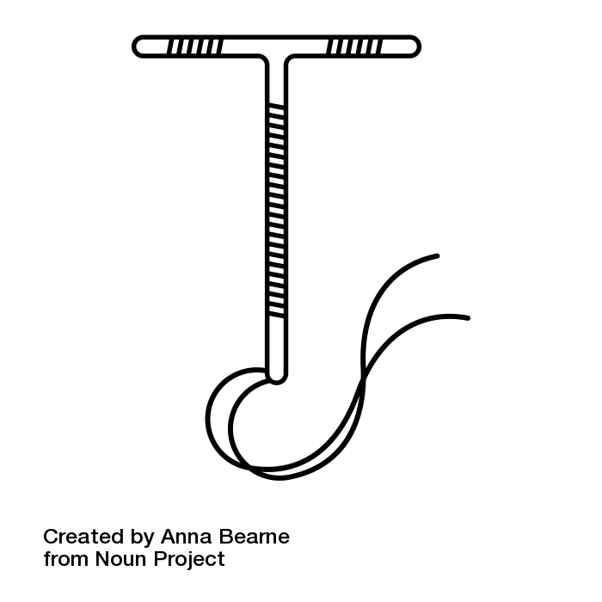
An IUD for Maggie
Is discreet
Patient and partner do not feel IUD body.
Partner may feel strings
Notes:
Data is out there for not being bothered by the IUD (or feeling the T), but some partners feel the strings.
Image: Iud by Anna Bearne from NounProject.com

Slide 16
CDC Contraindications to IUD Use
Pregnancy
Uterine infection
Unexplained vaginal bleeding ***
Cervical or endometrial cancer (awaiting treatment) ***
Breast cancer (Hormonal IUD only)
Trophoblastic disease
Current PID or STD ***
Pelvic Tuberculosis
*** Initiation is category 4, continuation is category 2
Notes:
There are few absolute contraindications to IUD use.
CDC medical eligibility 2016
Image: Iud by B. Damm from NounProject.com

Slide 17

PATIENT CASE:
Krystal
24 years-old
G2P1
History of Chlamydia as a teen
17
Image: Portrait Of Stylish Young Female Model Looking At Camera Against Blue Wall by Jacob Lund Photography from NounProject.com
Notes:
Krystal is a 24 year old G2P1 who presents to the office requesting birth control. She had chlamydia twice as a teenager.
Image: Portrait Of Stylish Young Female Model Looking At Camera Against Blue Wall by Jacob Lund Photography from NounProject.com

Slide 18

Sexually Transmitted Infections and Pelvic Inflammatory Disease
IUDs do NOT increase rates of STIs
PID may be transiently higher for 20 days after IUD insertion, then back to baseline population levels
Virus by Oleksandr Panasovskyi from NounProject.com
Notes:
STIs dependent on local prevalence
In high prevalence areas, reasonable to screen for STIs at IUD insertion
Do not remove IUD for STI treatment
No need for antibiotic prophylaxis at IUD insertion
Even lower PID rates with good insertion technique and low baseline STI rate
Modern IUD strings do not facilitate ascent of infection
Do not remove IUD for initial PID treatment
PID incidence <1 in 1000 women
Farley, TM (1992). Intrauterine devices and pelvic inflammatory disease: an international perspective. Lancet. 339: 785-788.
Grimes DA, et al (1999). Prophylactic antibiotics for intrauterine device insertion: a meta-analysis of the randomized controlled trials. Contraception. 60:57–63.
Cochrane review Oct 2009
Image: Virus by Oleksandr Panasovskyi from NounProject.com

Slide 19
Sexually Transmitted Infections
Condition | Qualifier for Condition | Hormonal IUD | Copper IUD
Pelvic Inflammatory Disease | Past, with subsequent pregnancy | 1 | 2
 | Past, without subsequent pregnancy | 2 | 2
 | Current | 4 | 4
Sexually Transmitted Infections | Vaginitis | 2 | 2
 | High Risk of STI | 2 | 2
 | Current GC/Chlamydia/Purulent Cervicitis | 4 | 4
19
CDC Medical eligibility criteria for contraceptive use - 2016
Notes:
Current PID, gonorrhea or chlamydia is “4” for insertion.
PID, gonorrhea, chlamydia is a “2” for continuation.
Trichimonas and Bacterial Vaginosis are a “2” for insertion.
HIV infected or clinically well on ARV: “2”
Very high risk for STI or HIV, not well, “3”
CDC Medical eligibility criteria for contraceptive use - 2016

Slide 20

PATIENT CASE:
Kerry
18 years-old
Type 1 diabetic
G0P0
20
Image: Portrait Of Female Muslim Student by Marko Subotin from NounProject.com
Notes:
Kerry is a 18 year old who has had one abortion and who has type 1 diabetes and borderline blood pressure.
She is in a steady relationship and does not want to get pregnant.
Image: Portrait Of Female Muslim Student by Marko Subotin from NounProject.com

Slide 21

Medical Eligibility
Image: Insulin by DailyPM from NounProject.com
Notes:
Levonorgestrel IUD does not alter glycemic control in patients with type 1 diabetes, does not affect blood pressure
Copper IUD is approved for almost all medical conditions: cardiovascular disease, hypertension, migraines, smoking, lipid disorders, diabetes…
Rogovskaya, S (2005). Effect of a levonorgestrel intrauterine system on women with type 1 diabetes: a randomized trial. Obstetrics and Gynecology. 105 (4): 811-815.
CDC Medical eligibility criteria for contraceptive use 2012
Image: Insulin by DailyPM from NounProject.com

Slide 22

PATIENT CASE:
Tammy
35 years-old
Very heavy periods
Anemia
22
Image: Image: https://www.flickr.com/photos/wocintechchat/25388942134/
Notes:
Tammy is a 35 y/o G8P3 with very heavy periods resulting in anemia, who is considering an IUD. She comes in today, LMP was 10 days ago.
How would you counsel her about which IUD to choose?
Image: https://www.flickr.com/photos/wocintechchat/25388942134/

Slide 23

Timing of IUD Insertion
All IUDs can be inserted at any point in menstrual cycle.
Copper IUD & high-dose hormonal IUDs (LNG-52) can be used for emergency contraception within 5-7 days of unprotected sex-with nearly 100% efficacy.
Image: Timing by Icongeek26 from NounProject.com
Notes:
IUDs may be inserted at any point of cycle if it is unlikely the patient is pregnant.
Urine HCG should be performed if there is any risk of pregnancy, but conversation with patient should guide insertion.
Image: Timing by Icongeek26 from NounProject.com

Slide 24

Proactive Contraception Rules for Success
Use patient-centered counseling to enhance adherence.
Image: https://thenounproject.com/photo/bethesda-md-usa-july-2006-a-black-doctor-speaks-with-a-patient-at-the-nci-0y7pW4/
Notes:
Inform about high-efficacy methods - don’t limit IUDs unnecessarily.
Educate about all contraceptive options:
let the patient choose the method unless contraindicated.
Image: https://thenounproject.com/photo/bethesda-md-usa-july-2006-a-black-doctor-speaks-with-a-patient-at-the-nci-0y7pW4/

Slide 25
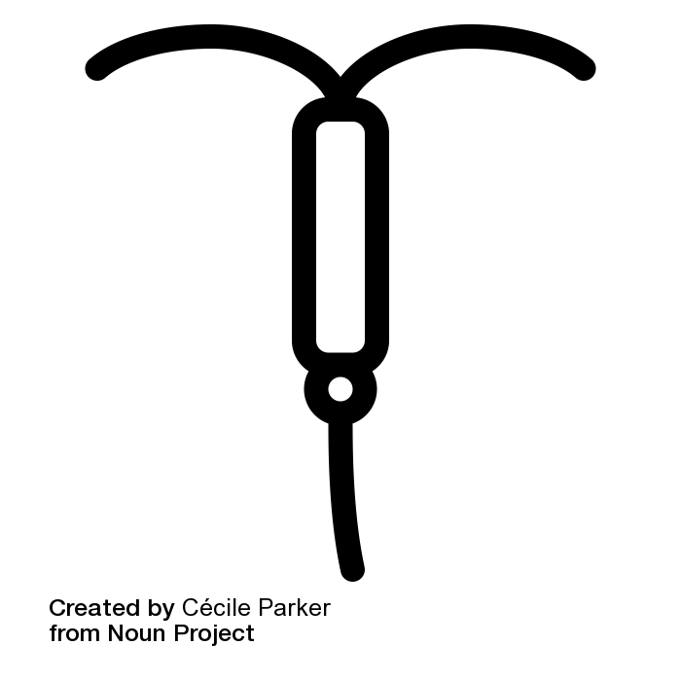
Take-home Message:
You can do this!
IUDs are good for your patients.
The risks are minimal.
The benefits are enormous.
25
Notes:
Image: Iud by Cécile Lanza Parker from NounProject.com

Slide 26

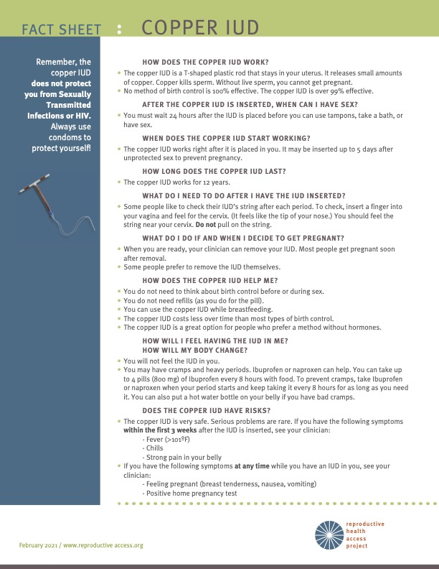

RESOURCES.
Your Birth Control Choices Fact Sheet
IUD Fact Sheet
Copper IUD User Guide
Progestin IUD User Guide
Notes:
Your Birth Control Choices Fact Sheet
IUD Fact Sheet
Copper IUD User Guide
Progestin IUD User Guide

Slide 27
REFERENCES.
Alan Guttmacher Institute (www.agi-usa.org)
Association of Reproductive Health Professionals (ARHP) (www.arhp.org)
Barbosa, I. (1995) Ovarian function after seven years' use of a levonorgestrel IUD. Advances in Contraception. 11(2):85-95.
CDC Medical eligibility criteria for contraceptive use 2012
Chi, IC, et al, Performance of the copper T-380A intrauterine device in breastfeeding women, Contraception 39(6):603-18. 1989
www.cochrane.org
www. contraceptiononline.org
Daniels K, Daugherty J and Jones J, Current contraceptive status among women aged 15–44: United States, 2011–2013, National Health Statistics Reports, 2014, No. 173, http://www.cdc.gov/nchs/data/databriefs/db173.pdf.
Farley, TM (1992). Intrauterine devices and pelvic inflammatory disease: an international perspective. Lancet. 339: 785-788.
Finer LB, Jerman J and Kavanaugh ML, Changes in use of long-acting contraceptive methods in the United States, 2007–2009, Fertility and Sterility, 2012, 98(4):893–897.
Grimes, D et al. Immediate postpartum insertion of intrauterine devices. Cochrane Review, 2005
Grimes DA, et al (1999). Prophylactic antibiotics for intrauterine device insertion: a meta-analysis of the randomized controlled trials. Contraception. 60:57–63.
https://www.guttmacher.org/fact-sheet/contraceptive-method-use-united-states
Hatcher RA. Contraceptive Technology. 20th ed. Ardent Media; 2011.
Kavanaugh ML, Jerman J and Finer LB, Changes in use of long-acting reversible contraceptive methods among United States women, 2009–2012, Obstetrics & Gynecology, 2015, 126(5):917–927.
www.Not-2-Late.com
www.plannedparenthood.org
Rivera, R. (1999). "The mechanism of action of hormonal contraceptives and intrauterine contraceptive devices." American Journal of Obstetrics & Gynecology 181(5): 1263-1269
Rogovskaya, S (2005). Effect of a levonorgestrel intrauterine system on women with type 1 diabetes: a randomized trial. Obstetrics and Gynecology. 105 (4): 811-815.
Sivin, I (1991). Prolonged intrauterine contraception: a seven-year randomized study of the levonorgestrel 20 mcg/day (LNg 20) and the Copper T380 Ag IUDS. Contraception. 44(5): 473-480.
UNDP. Long-term reversible contraception: Twelve years of experience with the TCu380A and TCu220C. (1997) Contraception. 56(6): 341-352.
WHO. Medical eligibility criteria for contraceptive use - 4th edition, 2009.
Zieman M, Hatcher RA, Allen AZ, Lathrop E, Haddad L. 2019-2020 Managing Contraception: For Your Pocket. 15th ed. Tiger, GA: Bridging the Gap Foundation; 2019.
Notes:
Alan Guttmacher Institute (www.agi-usa.org)
Association of Reproductive Health Professionals (ARHP) (www.arhp.org)
Barbosa, I. (1995) Ovarian function after seven years' use of a levonorgestrel IUD. Advances in Contraception. 11(2):85-95.
CDC Medical eligibility criteria for contraceptive use 2012
Chi, IC, et al, Performance of the copper T-380A intrauterine device in breastfeeding women, Contraception 39(6):603-18. 1989
www.cochrane.org
www. contraceptiononline.org
Daniels K, Daugherty J and Jones J, Current contraceptive status among women aged 15–44: United States, 2011–2013, National Health Statistics Reports, 2014, No. 173, http://www.cdc.gov/nchs/data/databriefs/db173.pdf.
Farley, TM (1992). Intrauterine devices and pelvic inflammatory disease: an international perspective. Lancet. 339: 785-788.
Finer LB, Jerman J and Kavanaugh ML, Changes in use of long-acting contraceptive methods in the United States, 2007–2009, Fertility and Sterility, 2012, 98(4):893–897.
Grimes, D et al. Immediate postpartum insertion of intrauterine devices. Cochrane Review, 2005
Grimes DA, et al (1999). Prophylactic antibiotics for intrauterine device insertion: a meta-analysis of the randomized controlled trials. Contraception. 60:57–63.
https://www.guttmacher.org/fact-sheet/contraceptive-method-use-united-states
Hatcher RA. Contraceptive Technology. 20th ed. Ardent Media; 2011.
Kavanaugh ML, Jerman J and Finer LB, Changes in use of long-acting reversible contraceptive methods among United States women, 2009–2012, Obstetrics & Gynecology, 2015, 126(5):917–927.
www.Not-2-Late.com
www.plannedparenthood.org
Rivera, R. (1999). "The mechanism of action of hormonal contraceptives and intrauterine contraceptive devices." American Journal of Obstetrics & Gynecology 181(5): 1263-1269
Rogovskaya, S (2005). Effect of a levonorgestrel intrauterine system on women with type 1 diabetes: a randomized trial. Obstetrics and Gynecology. 105 (4): 811-815.
Sivin, I (1991). Prolonged intrauterine contraception: a seven-year randomized study of the levonorgestrel 20 mcg/day (LNg 20) and the Copper T380 Ag IUDS. Contraception. 44(5): 473-480.
UNDP. Long-term reversible contraception: Twelve years of experience with the TCu380A and TCu220C. (1997) Contraception. 56(6): 341-352.
WHO. Medical eligibility criteria for contraceptive use - 4th edition, 2009.
Zieman M, Hatcher RA, Allen AZ, Lathrop E, Haddad L. 2019-2020 Managing Contraception: For Your Pocket. 15th ed. Tiger, GA: Bridging the Gap Foundation; 2019.

Slide 28
THANK YOU.
Notes:
Updated 1/2022

