Slide 1



CONTRACEPTION MANAGEMENT:
COMPLEXITIES IN CONTRACEPTIVE CARE
Notes:
Updated 11/2022

Slide 2
LEARNING OBJECTIVES.
  Apply evidenced-based guidelines to contraceptive provision using the CDC Medical Eligibility Criteria (MEC)
  Explore contraception options in patients with a complex medical history
  Accurately discuss the risks and benefits of medically complex contraception care with both patients and colleagues
Notes:
Overarching goal of supporting reproductive autonomy and the safe use of contraception for people with medical conditions

Slide 3
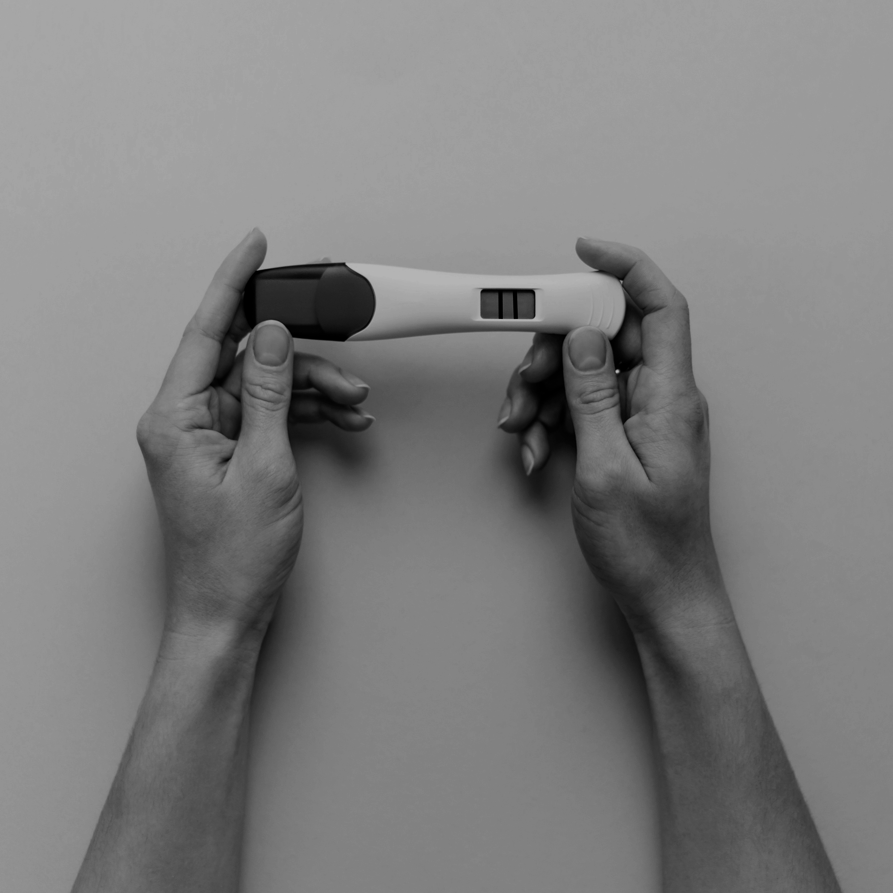
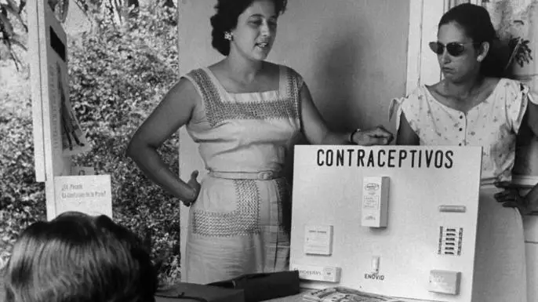
The Legacy of Puerto Rican Birth Control Trails
3
The teaching of birth control methods in Puerto Rico, 1960. (Credit: Hank Walker/The LIFE Picture Collection/Getty Images)
Notes:
Before we begin, it’s important to remember, acknowledge, and be informed by the history of how we got to where we are today in reproductive health care, especially contraception. Enovid was the world’s first birth control pill and was celebrated for ushering in an age of control and autonomy over reproduction (for some). But this discovery and the continued development of birth control pills and other methods originated at the expense of Puerto Rican women’s health and lives. It originated from Eugenic mindsets in the early 1900s with people like Margaret Sanger who argued that birth control could help wipe out “the greatest present menace to civilization”—people living in extreme poverty and those with mental illnesses and physical disabilities. She met and supported Gregory Pincus and John Rock, who went on to conduct the birth control trials in Puerto Rico. Puerto Rico was chosen because: the scientists knew they couldn’t do clinical trials on the mainland US, Puerto Rico was already home to many birth control clinics funded by eugenicists who wanted to reduce the Puerto Rican population to make room for more “fit” members of society. 1/3 of Puerto Rican women were sterilized, many involuntarily, after their second child’s birth. This set the stage for Pincus’s trials. The women who attended the trials were from the poorest areas of San Juan and just wanted to avoid pregnancy and avoid sterilization - but they had no idea that the pills they were receiving were part of an experiment and clinical trial. They weren’t given any information about safety. Many experienced serious side effects like blood clots. Despite the importance of the pill and the reproductive autonomy it has given to those wanting to avoid pregnancy, it’s history is marked by a lack of autonomy - a lack of true informed choice and information and the exploitation of impoverished women. This is this history and legacy of contraception that we are working in.
So our jobs is to stop this legacy from perpetuating and make sure that everyone has true autonomy, choice, information, and access to the reproductive health care they need.
Optional 5 minute video: scenes from the Documentary “La Operacion”: https://www.youtube.com/watch?v=tShnkBmoe3Y
Resources:
https://www.thecrimson.com/article/2017/9/28/the-bitter-pill/
https://www.history.com/news/birth-control-pill-history-puerto-rico-enovid
https://www.bese.com/how-puerto-rican-women-made-birth-control-possible-at-the-expense-of-their-health/

Slide 4

Reproductive Autonomy
The power to decide and control birth control use, pregnancy, and childbearing
4
Notes:
Today, the legacy of coercion and bias is happening more frequently through counseling on long-acting reversible contraception (LARC). LARC should be included as part of a well-balanced mix of contraceptive options to prevent pregnancy and to manage other health conditions not related to pregnancy. But, LARC options should be made more accessible and available to patients not because of their effectiveness in preventing pregnancy, but for the overall goal of enhancing reproductive autonomy. Reproductive autonomy means that people themselves have the power to decide and control contraceptive use, pregnancy, and childbearing.
In the past and present, LARC methods have often been over-promoted among communities that are BIPOC, low-income, and have lower education, as well as for adolescents and so-called “high-risk” populations. This over-emphasis on pregnancy prevention in these communities undermines reproductive autonomy and perpetuates inequities in who gets to have quality, dignified, and patient-centered care.
Patient-centered contraceptive counseling for all people can enhance reproductive autonomy and prevent coercion by supporting patients with information and counseling to help them make the best decision for their health and unique circumstances. LARC may or may not be that option.
Summary of key principles from the LARC Statement of Principles
-Rather than emphasize “effectiveness above all”, offer counseling based on the person’s needs, preferences, and experiences so that they have enough information to make the best decision about their birth control method
-Acknowledge the complex history of LARC provision and ensure counseling is provided in a consistent, respectful manner that neither denies access nor coerces anyone into using a specific method
-Provide comprehensive, scientifically accurate information about the full range of methods in a medically ethical and culturally competent manner so that each person is supported in identifying the method that best meets their needs
-The decision to stop using LARC should be made by each individual with support from their clinician without judgement or obstacles
Sources:
1. Sister Song & National Women’s Health Network. Long-Acting Reversible Contraception Statement of Principles. https://www.nwhn.org/wp-content/uploads/2017/02/LARCStatementofPrinciples.pdf
2. Gomez AM, Fuentes L, Allina A. Women or LARC first? Reproductive autonomy and the promotion of long-acting reversible contraceptive methods. Perspect Sex Reprod Health. 2014;46(3):171-175. doi:10.1363/46e1614

Slide 5

COMPLEX CONTRACEPTION
In one study, only 40% of women aged 15-34 and 32% of women aged 35-44 with chronic medical conditions were using contraception.
Image: RHAP
Notes:
With our framing of reproductive autonomy, now let’s think about what we mean by complex contraception.
By this, we mean contraception for people with one (or more than one) medical condition such as hypertension and diabetes that make both pregnancy and contraceptive use potentially higher risk.
Increasingly relevant as pregnancy later in reproductive life is becoming more common, increasing rates of chronic conditions such as hypertension and diabetes
High proportion of pregnancies that are unintended in the United States; higher among people with medical conditions compared with those not having medical conditions.
However, many of these medical problems that make pregnancy higher risk can make some types of contraception higher risk. We’re going to review the framework that we use to provide contraception care to these patients.
One study of a large, national claims database found that only 40% of women aged 15-34 and 32% of women aged 35-44 with selected medical problems were using either sterilization or reversible contraception. However, these patients are at higher risk of maternal and fetal complications of unintended pregnancy when it does occur. So this is a population where optimizing contraceptive use may be important.
Citation: Champaloux, Steven W., et al. "Contraceptive use among women with medical conditions in a nationwide privately insured population." Obstetrics & Gynecology 126.6 (2015): 1151-1159.
Image: RHAP

Slide 6
US Medical Eligibility Criteria
Risk Level
1 | Method can be used without restriction
2 | Advantages generally outweigh theoretical or proven risk
3 | Method usually not recommended unless other, more appropriate methods are not available or not acceptable
4 | Method not to be used
6
Curtis KM, Tepper NK, Jatlaoui TC, et al. U.S. Medical Eligibility Criteria for Contraceptive Use, 2016. MMWR Recomm Rep 2016;65(No. RR-3):1–104.
Notes:
The United States Medical Eligibility Criteria for Contraceptive Use or MEC is a great resource for providing contraception in patients with medical conditions. These recommendations are published by the CDC who reviews available evidence, consults experts when necessary, and assigns a risk level to each contraceptive method for patients with specific medical conditions that can be used by providers to counsel patients.
Category 1 is used freely
Category 4 is contraindicated
Category 2 benefits generally outweigh the risk
Category 3 risks generally outweigh the benefits.
But more often, patients have multiple medical problems, that might (or might not) increase the risk of different contraceptive methods. In these instances, we may have to assess multiple conditions that are an MEC 2, and will need to ask ourselves if the risk of 2+2 = 2, 3, 4?
Citation: Curtis KM, Tepper NK, Jatlaoui TC, et al. U.S. Medical Eligibility Criteria for Contraceptive Use, 2016. MMWR Recomm Rep 2016;65(No. RR-3):1–104.

Slide 7

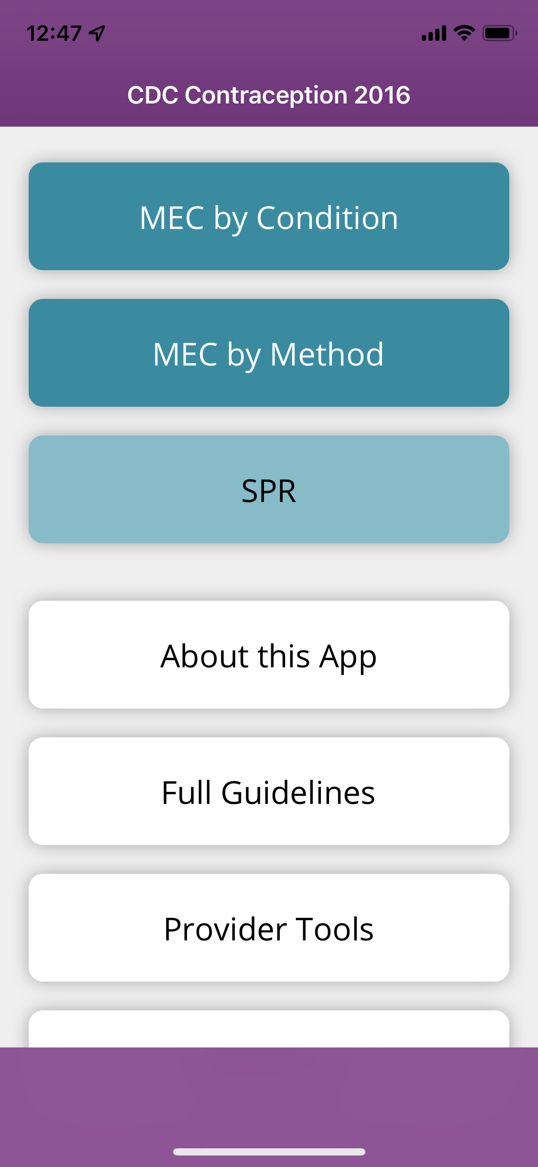
There’s an App for That:
Can be downloaded on iOS and Android operating systems (https://www.cdc.gov/mobile/mobileapp.html)
7
Notes:
Search for “CDC contraception” in the app store on your mobile device
Download the free CDC contraception app
We will refer to this app during the presentation

Slide 8

PATIENT CASE:
Amy
24 year old patient comes to the office with a UTI
8
https://images.nappy.co/uploads/large/1201596163328jobrbcny1ufkf0a9zeeyfeiai65csgmuomvx5ubdr90odwwvbfmfzbqvzzf8btxfwvkq6vbfsyegf10cx8ddwkl24kqood83jifb.jpg?auto=format&fm=jpg&w=1280&q=75
Notes:
You recognize that UTIs in young people are often due to recent, new onset of sexual activity. So, in addition to providing an antibiotic, what else do you do?
Image: https://images.nappy.co/uploads/large/1201596163328jobrbcny1ufkf0a9zeeyfeiai65csgmuomvx5ubdr90odwwvbfmfzbqvzzf8btxfwvkq6vbfsyegf10cx8ddwkl24kqood83jifb.jpg?auto=format&fm=jpg&w=1280&q=75

Slide 9
PATIENT CASE:
Amy
You ask:
                “Can we help you today with birth control or pregnancy planning?”
9
https://images.nappy.co/uploads/large/1201596163328jobrbcny1ufkf0a9zeeyfeiai65csgmuomvx5ubdr90odwwvbfmfzbqvzzf8btxfwvkq6vbfsyegf10cx8ddwkl24kqood83jifb.jpg?auto=format&fm=jpg&w=1280&q=75
Notes:
There are a variety of ways to screen for pregnancy intention- “One key question” is probably the most well known and validated, however is copyrighted.
The specific language can be tailored to your setting/patient population. Can be asked of menstruating people or their partners
Screening for pregnancy intention can help identify either unmet need for contraception or pre-pregnancy counseling.
Photo Credit: https://images.nappy.co/uploads/large/1201596163328jobrbcny1ufkf0a9zeeyfeiai65csgmuomvx5ubdr90odwwvbfmfzbqvzzf8btxfwvkq6vbfsyegf10cx8ddwkl24kqood83jifb.jpg?auto=format&fm=jpg&w=1280&q=75
Citation: Seema D Shah, Linda Prine, Eve Waltermaurer, Susan E Rubin. Feasibility study of family planning services screening as clinical decision support at an urban Federally Qualified Health Center network. Contraception. 2019 Jan;99(1):27-31.

Slide 10
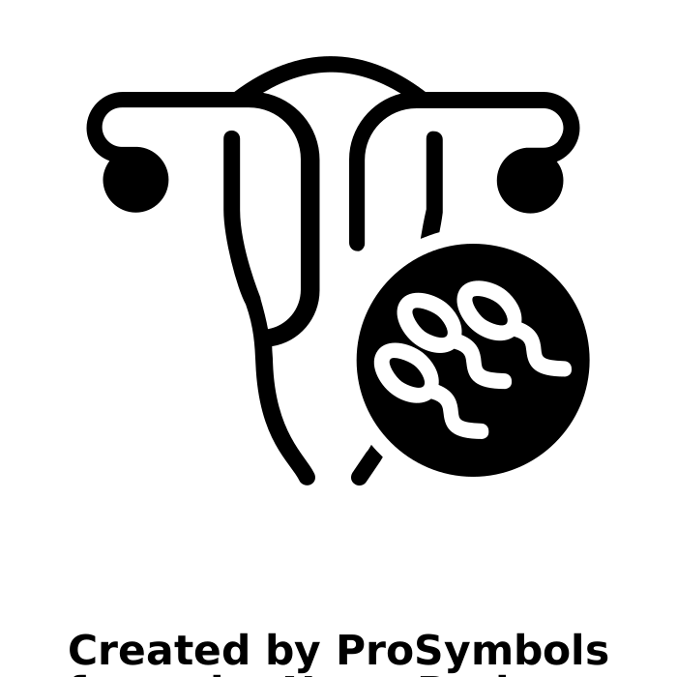
Screening for Pregnancy Intention
“Can we help you today with birth control or pregnancy planning?”
  Offer preconception care vs birth control
  Plus Screen for DV (domestic violence, smoking, and depression
  Discuss exercise and diet
10
Notes:
Regularly screening for pregnancy intention in primary care, not just during reproductive health focused visits, is especially important for patients with chronic medical conditions.
To support reproductive autonomy, attention should not only be given to her contraceptive needs, but to her overall health and to support her if she is interested in becoming pregnant.
Photo Credit: Pregnancy by ProSymbols from NounProject.com

Slide 11
Amy: Medical History
Medical History
        BMI = 34
        History of pregnancy-related cholestasis
11
https://images.nappy.co/uploads/large/1201596163328jobrbcny1ufkf0a9zeeyfeiai65csgmuomvx5ubdr90odwwvbfmfzbqvzzf8btxfwvkq6vbfsyegf10cx8ddwkl24kqood83jifb.jpg?auto=format&fm=jpg&w=1280&q=75
Notes:
Amy wants to go back on combined oral contraceptive pills (COCs)
Photo Credit: https://images.nappy.co/uploads/large/1201596163328jobrbcny1ufkf0a9zeeyfeiai65csgmuomvx5ubdr90odwwvbfmfzbqvzzf8btxfwvkq6vbfsyegf10cx8ddwkl24kqood83jifb.jpg?auto=format&fm=jpg&w=1280&q=75

Slide 12
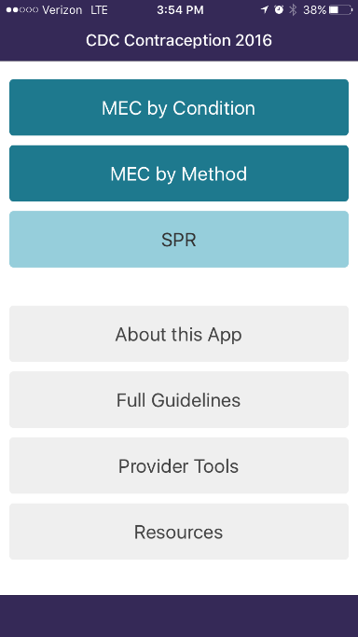
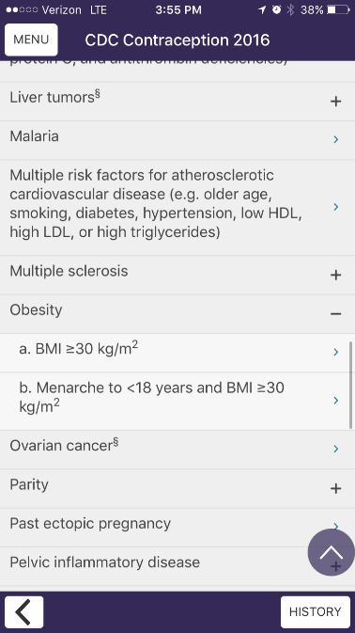
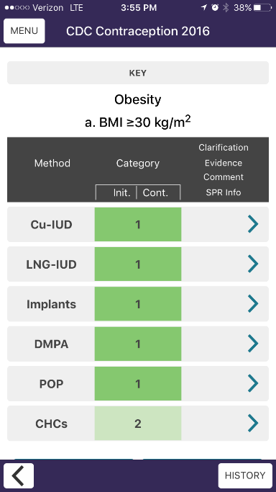
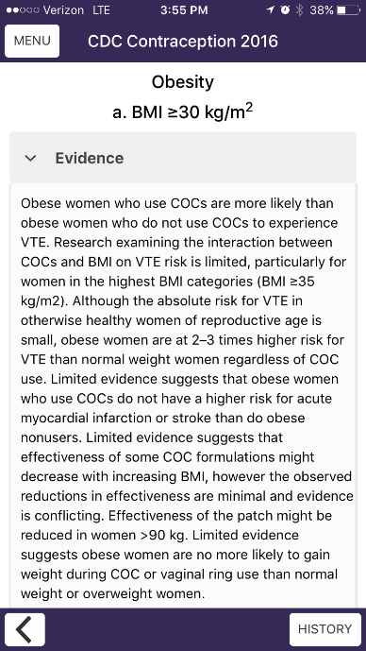



Look at the US MEC:
BME > 30 = 2
12
Notes:
People with obesity who use COCs are more likely than those who do not use COCs to experience VTE. The absolute risk for VTE in this population is still small, so this is an MEC 2.
People with obesity tend to use birth control less than those without obesity- may be due to provider bias, safety concerns, subfertility/infertility concerns, patient preferences, etc.- however providers should not be the barriers
MEC Clarifications:
“Limited evidence suggests that people with obesity who use COCs do not have a higher risk for acute myocardial infarction or stroke than do those with obesity who do not use COCs.”
“Limited evidence is inconsistent about whether hormonal contraceptive effectiveness varies by body weight or BMI.”
“Limited evidence suggests people with obesity are no more likely to gain weight after 3 cycles of the vaginal ring or COC than overweight or normal weight women. A similar weight gain during the 3 months was noted between the COC group and the vaginal ring group across all BMI categories. The effectiveness of the patch decreased among women who weighed >90 kg; however, no association was found between pregnancy risk and BMI.”
In 2020, the FDA changed the label to cite obesity (BMI >30) to be a contraindication to patch use due to VTE risk, however the CDC still considers obesity to be a 2 for all CHCs.

Slide 13
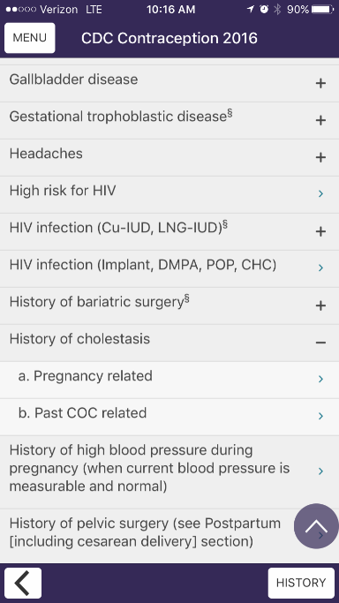
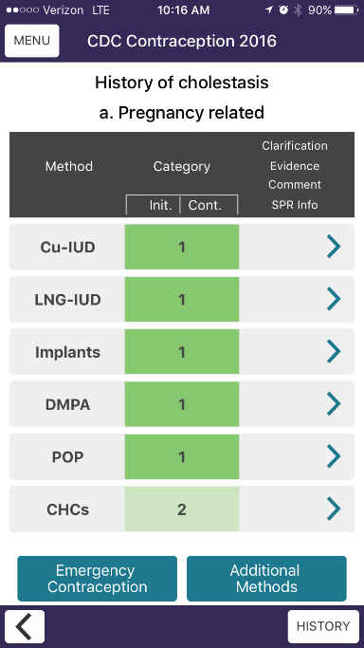
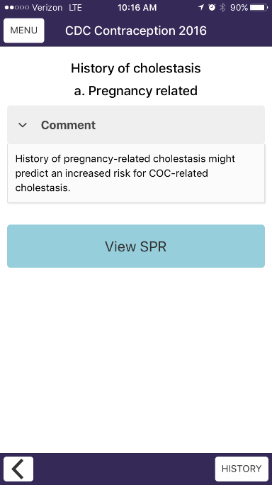


Look at the US MEC:
13
Notes:
The 2 for someone with a history of pregnancy-related cholestasis is due to an increased risk of cholestasis with CHC use.

Slide 14
US Medical Eligibility Criteria
Risk Level
1 | Method can be used without restriction
2 | Advantages generally outweigh theoretical or proven risk
3 | Method usually not recommended unless other, more appropriate methods are not available or not acceptable
4 | Method not to be used
14
Notes:
Just a reminder:
Category 1 is used freely
Category 4 is contraindicated
Category 2 Benefits traditionally outweigh the risk
Category 3 risks generally outweigh the benefits.

Slide 15

Is it safe for Amy to restart her COCs?
Does 2 + 2 =
2 or 3 or 4?
Notes:
Amy has obesity and a history of cholestasis of pregnancy, both of which are MEC 2s for the use of COCs. What we need to consider is whether or not these risks additive.
In this case, these two risks are unrelated, so we don’t need to worry about an additive risk.
Slightly increased risk of VTE in people with obesity on COCs + slightly increased risk of cholestasis with COC use, which are unrelated risks, so in this case, 2 + 2 = 2
Image source: pills by Made from the Noun Project

Slide 16
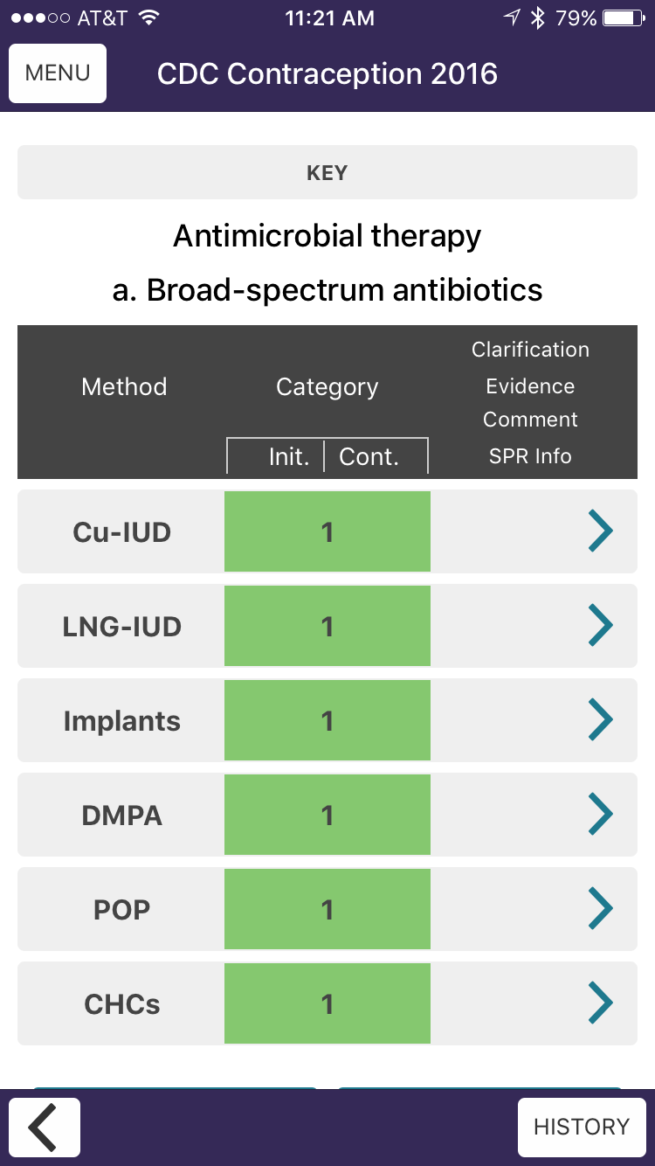
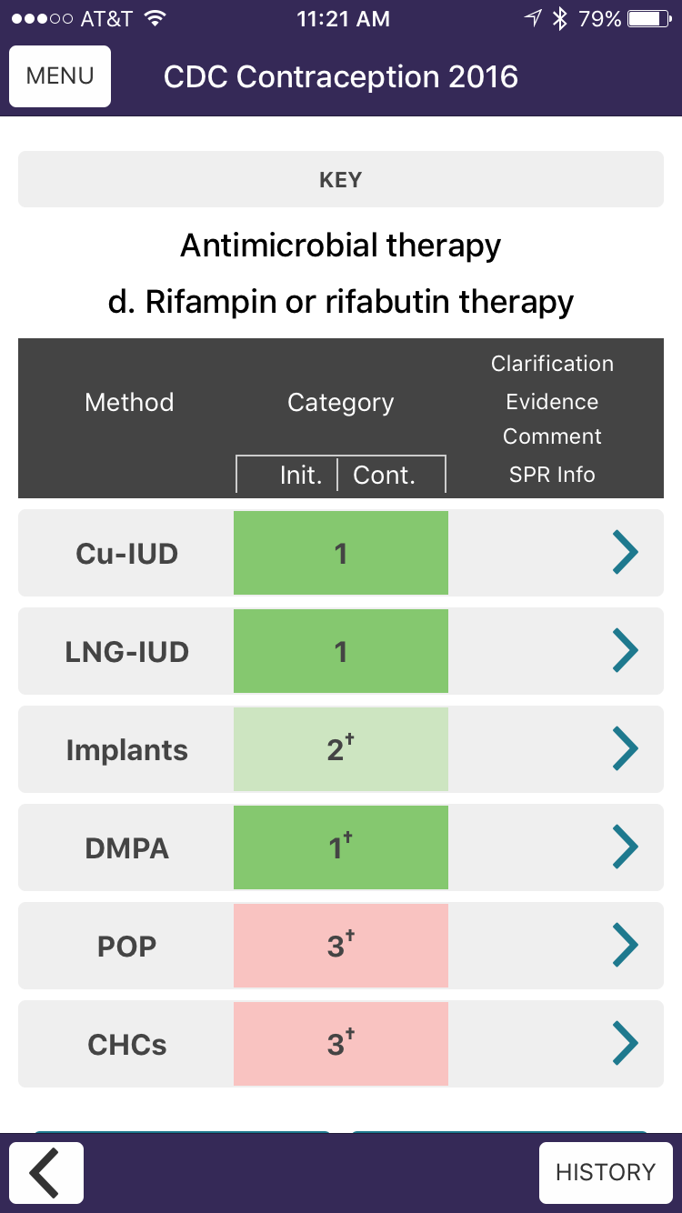


What about antibiotics and COCS
16
Notes:
Do the antibiotics for her UTI influence contraceptive safety? No!

Slide 17

Learning Points
Screening for pregnancy intention in primary care can start important conversations
When risks are unrelated, 2 + 2 = 2
Most antibiotics do not decrease effectiveness of contraceptives
Image: Learning by Tippawan Sookruay from NounProject.com
Notes:
Use every opportunity to ask about family planning to prevent unintended pregnancies
Assess pathophysiology of medical contraindications
Most antibiotics are fine with birth control!
Image: Learning by Tippawan Sookruay from NounProject.com

Slide 18

PATIENT CASE:
Doreen
46 year-old G2P2.
She/Her
Would like to remove her copper IUD and try “the shot.”
18
Image: https://www.flickr.com/photos/wocintechchat/25720977190/
Notes:
Emphasize: If she wants to have her IUD removed, remove her IUD!
Image: https://www.flickr.com/photos/wocintechchat/25720977190/

Slide 19

PATIENT CASE:
Doreen
Age (46)
Gallstones
BMI > 30
19
Image: https://www.flickr.com/photos/wocintechchat/25720982610/in/photostream/
Notes:
Let’s consider each of her risk factors. Take a look in the app now, where you can view up to 3 medical conditions at the same time.
Depo in patients over 45: there is a theoretical risk of affecting bone density
For patients with gallstones the app lists the risk as a 2 with no evidence (theoretical risk of increased inflammatory response)
And for her weight, there is no risk according to MEC; for some people, depo is associated with weight gain
Image: https://www.flickr.com/photos/wocintechchat/25720982610/in/photostream/

Slide 20
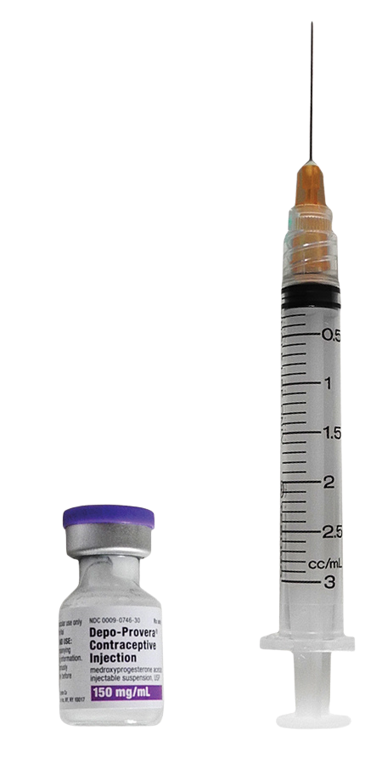
Can Doreen safely use DMPA?
What does 2 + 2 + 1 equal?
Image: RHAP
Notes:
Correct answer is (a) - 2 + 2 + 1 = 2
From the MEC:
Age > 45 is a “2” for depo because lose BMD, but recovers after discontinuation, and she is not in the high risk groups for osteoporosis in any case
Asymptomatic gallstones are a 2 – no evidence per MEC; theoretical concern for increased inflammatory response
Obesity is a 1 – some evidence for weight gain, but doesn’t happen for everyone, and if it does, usually 5-10lbs
DMPA = depo-medroxyprogesterone acetate
Image: RHAP

Slide 21

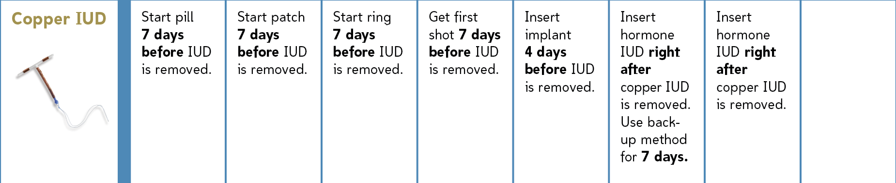
How should she switch methods?
21
Image: RHAP
Notes:
We also want to talk about switching methods – essentially how to ensure that patients use methods so they are most likely to prevent unintended pregnancy, and less likely to have gaps in coverage.
www.reproductiveaccess.org is a great resource.
Generally a good rule of thumb: plan ahead by 1 week, or use back-up (condoms or abstinence) for 1 week after switching
Image: RHAP

Slide 22

Learning Points
2 + 2 + 1 can still = 2!
Reference RHAP’s resource, How to Switch Birth Control Methods when switching birth control methods.
Notes:
Again, unrelated risks are not “additive”
Counsel about switching methods- planning ahead is great, but otherwise can recommend up to 1 week of back-up when switching
Image: Learning by Victoruler from NounProject.com

Slide 23

PATIENT CASE:
Rosa
20 year old G0 with sickle cell anemia wants to try the IUD “without hormones.”
23
Image: https://www.flickr.com/photos/wocintechchat/25703120551/
Notes:
Stable hemoglobin of 11
Treated for PID last year
LMP was 3 weeks ago
Unprotected sex 4 days ago
Image: https://www.flickr.com/photos/wocintechchat/25703120551/

Slide 24
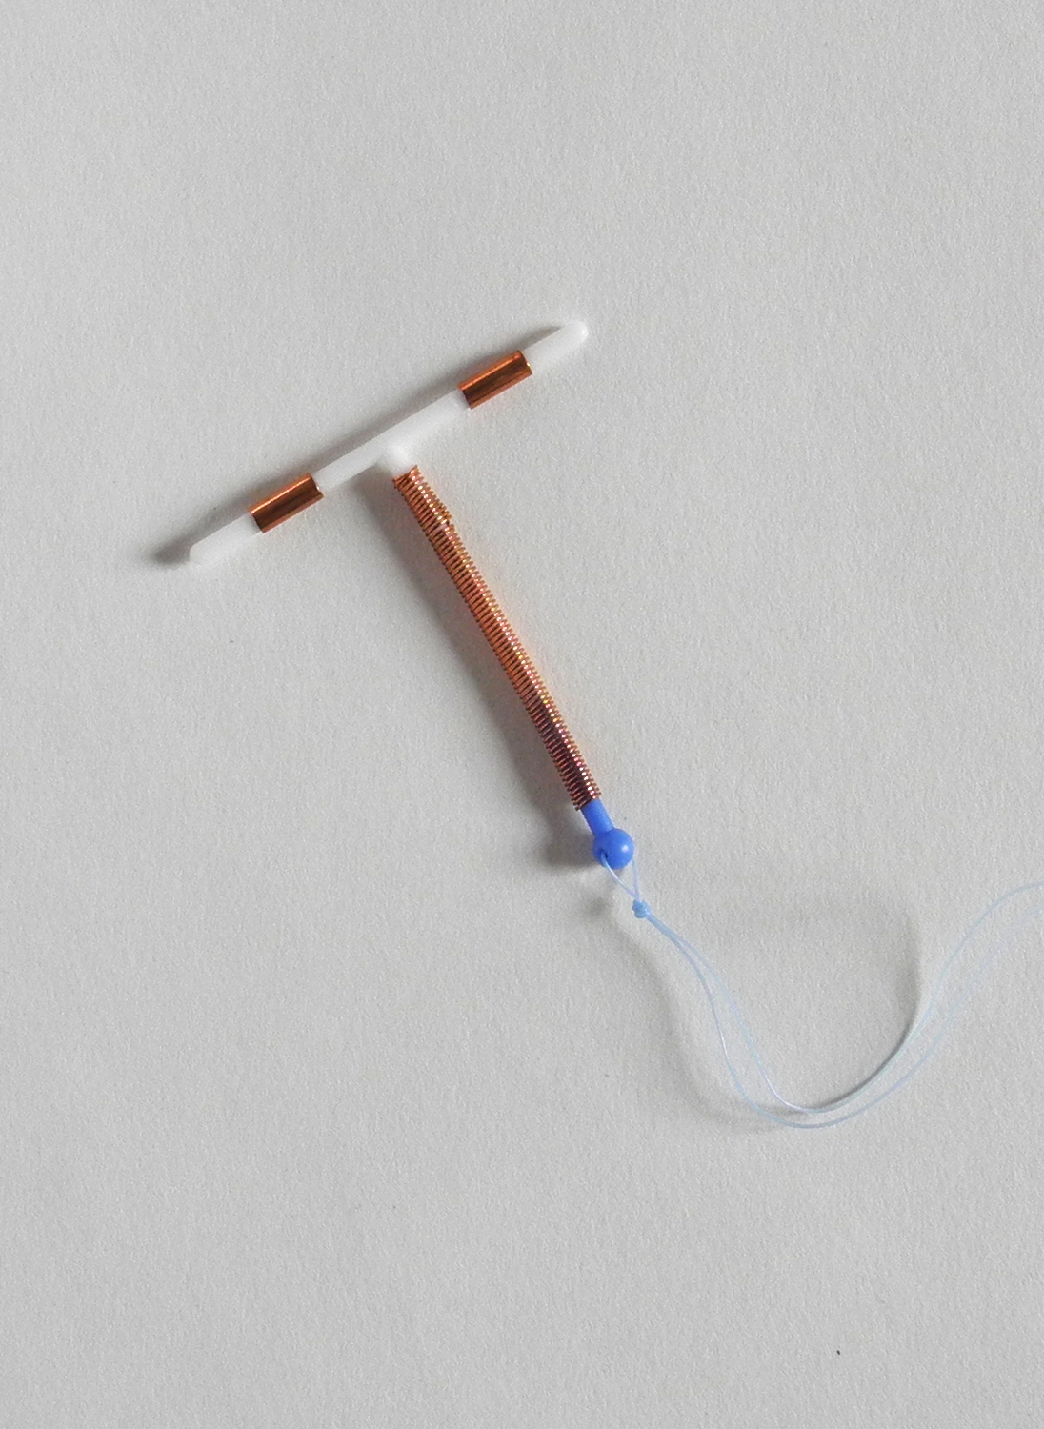
Category 4 Conditions for IUDS
Current PID, gonorrhea, chlamydia
  Category 4 for initiation only
Certain anatomic abnormalities
  May interfere with proper IUD placement
Endometrial cancer
  Initiation only
Cervical cancer awaiting treatment
  Initiation only
Active pregnancy
Unexplained vaginal bleeding
  Suspicious for serious condition
Image: RHAP
Notes:
We just wanted to take a moment to step aside and talk about IUDs because they are so effective at preventing pregnancy (over 99% effective, in fact), so are good for women who want to prioritize effectiveness. Let’s discuss each of these conditions.
Given the more local effects, there are actually very few medical contraindications for IUDs and even fewer for copper IUD
Image: RHAP

Slide 25

PATIENT CASE:
Rosa
She can get a copper IUD, as it is a “2” for sickle cell disease.
History of PID also a “2”
25
Image: https://www.flickr.com/photos/wocintechchat/25171589413/
Notes:
A best practice is to insert the IUD the same day she asks, and especially if it is also being used for EC
For patients with sickle cell the MEC an increased risk for blood loss with Cu-IUDs. But only a “2.” Should be counseled about the risks, and individualized to her preferences and medical history.
We also have to remember that IUDs do not protect against STI/HIV/PID – so risk of STIs and desire for future pregnancy are relevant. In women at low risk for STIs, IUD insertion poses little risk for PID. We should discuss these risks with her and use a patient-centered model for decision-making
Image: https://www.flickr.com/photos/wocintechchat/25171589413/

Slide 26
Emergency Contraception
Copper IUD | LNG IUD (Mirena, Liletta) | Levonorgestrel 1.5 mg | Ulipristal Acetate 30 mg
5 days after unprotected intercourse | 5 days after unprotected intercourse | 5 days after unprotected intercourse; more effective if taken as soon as possible | 5 days after unprotected intercourse; more effective if taken as soon as possible
No BMI restrictions | No BMI restrictions | Decreased effectiveness with BMI > 25, Weight > 155 pounds | Decreased effectiveness with BMI > 35
26
Notes:
Another issue to consider when prescribing EC is co-administration with a progestin. There is some evidence that if Ella is administered at the same time as starting a progestin-containing method, Ella may be less effective.

Slide 27

Learning Points
Again, 2 + 2 = 2 if the risks are unrelated
There are multiple options for emergency contraception
IUDs for EC are the most effective and least time-sensitive, and can often be quick-started safely
Notes:
Quick starting IUDs includes the option for using them as EC
The most effective EC is the IUD (Cu or 52-mg LNG); next is Ulipristal Acetate
Image: Delwar Hossain from Noun Project

Slide 28

PATIENT CASE:
Audrey
38 year old G3P3
They/Them
Is happy with their combined oral contraceptives and is here for a refill.
28
Image: https://www.flickr.com/photos/wocintechchat/25497475240/
Notes:
past medical history is notable for migraines without aura, recently diagnosed with Lupus which is so far, uncomplicated.
Image: https://www.flickr.com/photos/wocintechchat/25497475240/

Slide 29
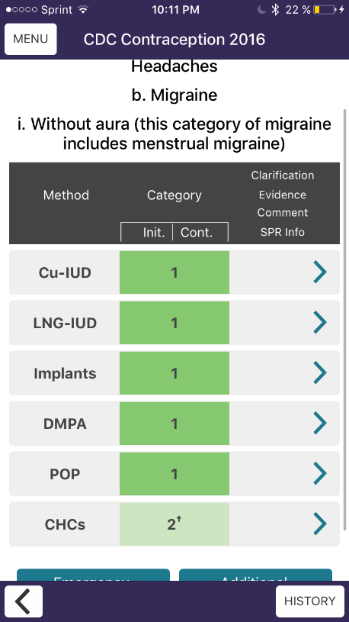
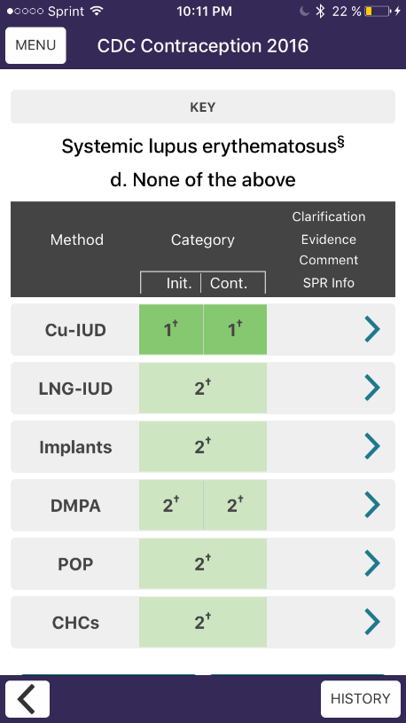


Let’s Refer to the US MEC
29
Notes:
So let’s take a look at our MEC app. You can search by medical condition and find migraines without aura. Noting that migraines with aura are a separate category.
You can also search for lupus and select lupus without comorbidities.
When you do that, you’ll find that CHCs receive a score of 2 for both migraines without aura and Lupus without comorbidities.
You can click on the arrow to see the rationale behind the level 2 recommendation.
From the MEC:
Migraines without aura are a 2
Lupus is a 2 if uncomplicated
Both increase risk of stroke
2+2 = 3 …

Slide 30
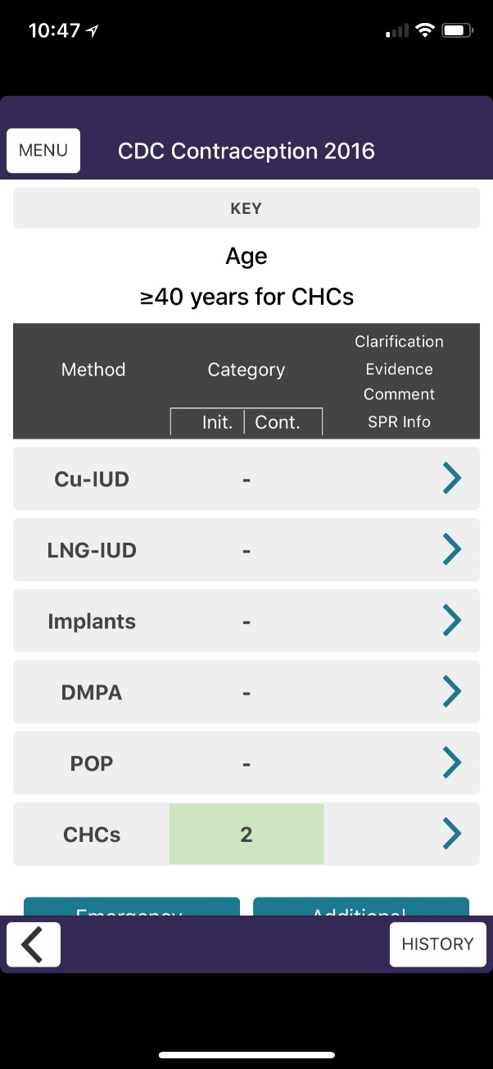
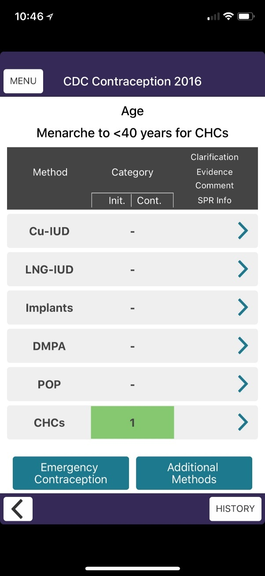
What about their age?
30
Notes:
What role does her age play in the risk factors for estrogen containing contraception?
What if she had been 42 or 45?
In the US, the median age of menopause is 51, but the range is wide spanning from 40-60 (Klein, David A., James J. Arnold, and Erika S. Reese. "Provision of Contraception: Key Recommendations from the CDC." American family physician 91.9 2015). Although fertility does decrease after age 40, it’s not as much as is generally assumed and 75% of pregnancies in women over age 40 are unplanned (Long, Margaret E., et al. "Contraception and hormonal management in the perimenopause." Journal of Women's Health 24.1 (2015): 3-10.). Women over age 40 are also at greater risk of complications from pregnancy includes gestational diabetes and preeclampsia.
There is a higher risk of VTE and likely MI in the population over 40 on estrogen containing contraception. However, the absolute risk of VTE and MI remains low in patients without comorbid medical problems and is much lower than that in the postpartum or prenatal periods.
There are also many benefits to CHCs including decreased risk of endometrial and ovarian cancer that must be considered.
Long, Margaret E., et al. "Contraception and hormonal management in the perimenopause." Journal of Women's Health 24.1 (2015): 3-10.
Expert Rec – screen patients for comorbid medical conditions that affect risk, choose low estrogen (20 mcg) pills, continue until onset of menopause. Do not use CHCs for HRT.

Slide 31
Should you refill Audrey’s COCs?
What does 2 + 2 + 1 equal?
Notes:
So if CHCs receive a 2 recommendation for both of these conditions and a 1 for age, what does 2 + 2 + 1 equal in Audrey’s case?
So in this case, the rationale for the level 2 recommendation for migraines without aura and uncomplicated SLE is increased risk of stroke. Since the risks are the same, we should be concerned that the risks could be additive, so in this case, 2 + 2 ≈ 3
In the vast majority of cases, it would be difficult to say that 2 + 2 = 4, because combining risks in this way is theoretical. Either way, it is important to communicate the theoretical concerns and the uncertainty surrounding safety for your patient and their unique combination of medical conditions
From the MEC:
Migraines without aura are a 2
Lupus is a 2 if uncomplicated
Both increase risk of stroke
So again for this case, 2+2 ≈ 3 but the other issue is Audrey’s age which is approaching 40, when COCs become a “2” pretty much because all medical risks start to go up at that point…
Image source: pills by Made from the Noun Project

Slide 32
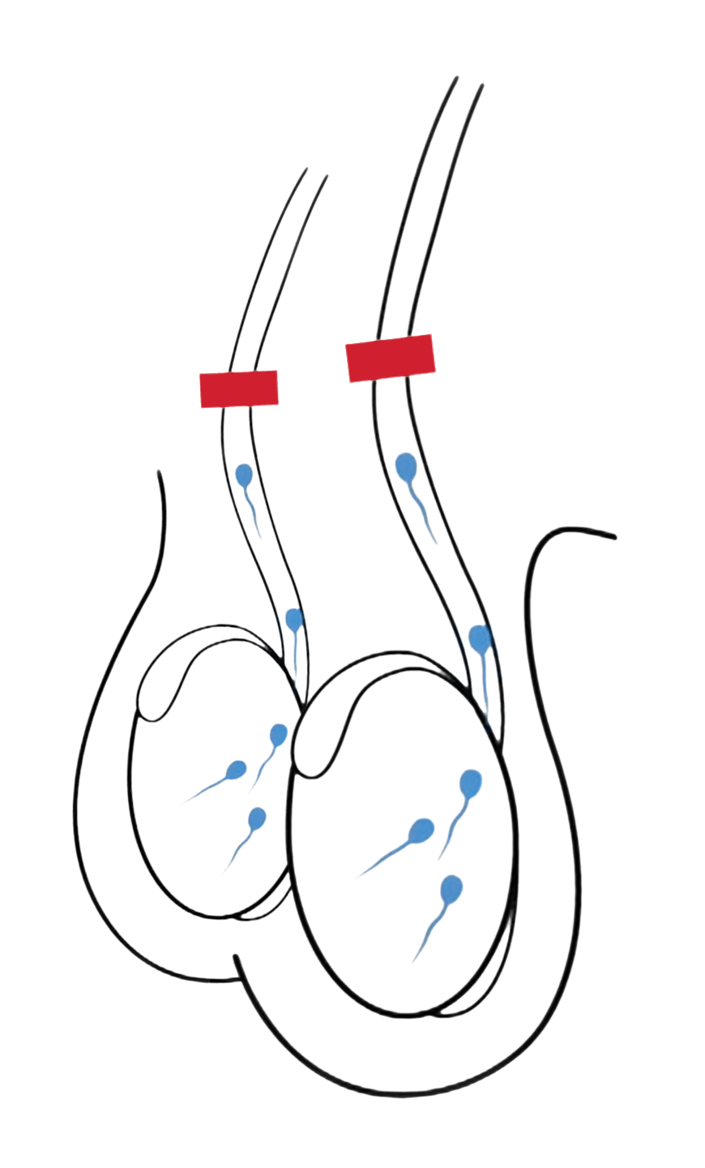
Consider Vasectomy?
Often overlooked during contraceptive counseling
Safer than tubal ligation, especially for people with medical conditions
Consider for people in stable relationships who have completed childbearing
32
Image: RHAP
Notes:
As people start to have increasing numbers of medical conditions, finding an acceptable contraceptive method that is safe for the patient can get harder. Don’t forget to discuss permanent methods, even if you don’t provide them yourself
Photo Credit: RHAP

Slide 33
Learning Points
Minor contraindications can be additive if they have the same pathway
2 + 2 can sometimes ≈ 3
Don’t forget about options for permanent contraception
Notes:
So remember, to assess the pathway of 2 recommendations! When both medical conditions increase risk via the same physiologic pathway, risk is additive. This is in contrast to cases earlier in this session when risk was not additive as the pathways were different.
However, it’s important to keep in mind that pregnancy is always a higher risk than birth control method. If Audrey’s risk of stroke is increased with the estrogen component in combined hormonal contraception, increases in hormone levels with pregnancy are much higher and more risky.
There are safer methods of contraception for Audrey, specifically progesterone only methods including pills, the depo injection, Implant and IUDs and nonhormonal methods including the copper IUD. In this patient encounter, a discussion of the risks of CHCs would be incomplete without a discussion of the risk of pregnancy and alternative methods of contraception.
And we haven’t really mentioned it yet during this lecture, but vasectomy is an important option to discuss with patients. Audrey and her partner may be done with child bearing and vasectomy is a much simpler, safer procedure than female sterilization especially for women with medical comorbidities!
Image: Learning by Victoruler from NounProject.com

Slide 34

PATIENT CASE:
Julie
17 year old G2P0.
She is interested in learning more about IUDs
34
Image: https://www.flickr.com/photos/wocintechchat/21911139353/
Notes:
Our next case is Julie. Julie is a 17 year old G2P0 with past medical history notable for 2 abortions and depression which is stable on sertraline
She comes to the office interested in learning more about the IUD.
So for Julie, the important factors to consider are that she is nulliparous, a teenager, has a history of an STI and has a history of depression.
When you do that, you’ll see the IUDs in nulliparous women are a “2” for conflicting evidence around the risks of infertility although well-conducted studies do not find a link.
It’s also safe for teenagers to have IUDs, though this is an MEC 2 because of slightly increased risk of expulsion and increased incidence of STIs in this age group.
When you look at the MEC for depression, you’ll see that all contraceptive methods receive a risk rating of “1”.
Image: https://www.flickr.com/photos/wocintechchat/21911139353/

Slide 35
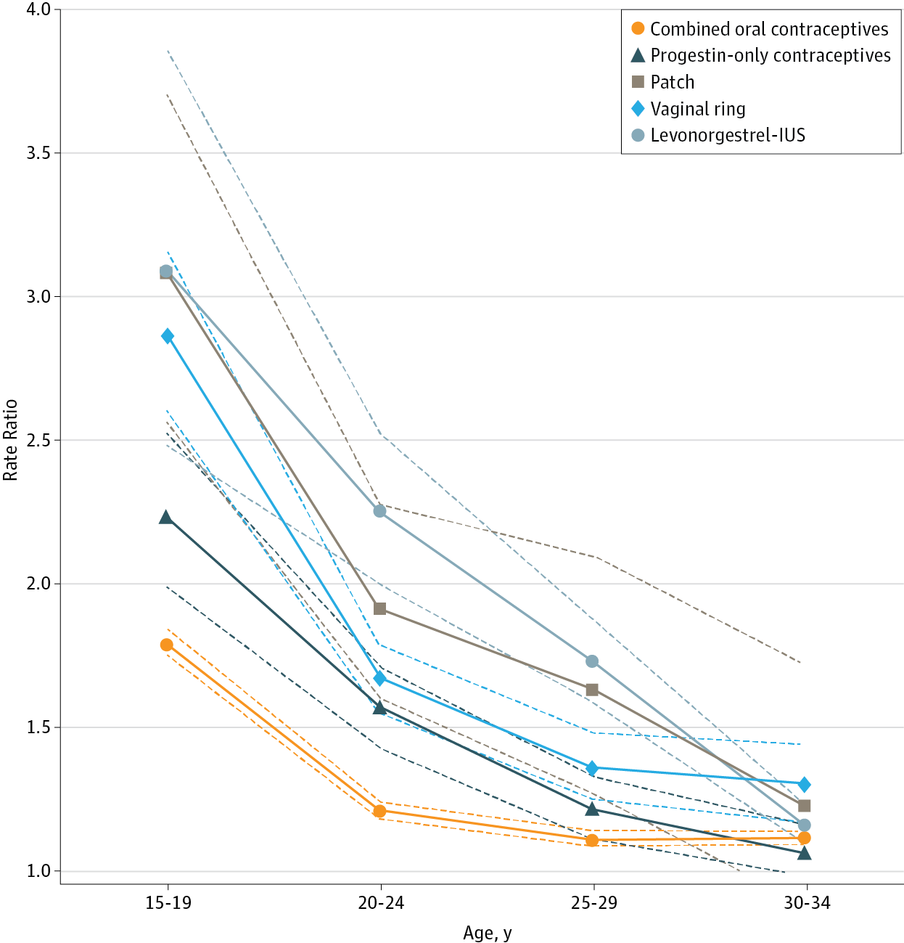
Contraception and Depression
Skovlund, Charlotte Wessel, et al. "Association of hormonal contraception with depression." JAMA psychiatry 73.11 (2016)
35
Notes:
The CDC’s MEC states that all contraceptive methods are safe (cat 1) for patients with a history of depression, citing studies that show no increased risk of hospitalization for mood disorders or worsening of symptoms on validated scales on patients who use contraception including combined hormonal contraception.
A study published in JAMA psychiatry in 2016 using data from a Danish Registry found an increased risk of depression with all hormonal contraception use. RR varied based on age and type of contraception as seen in above graph. However, whenever you are looking at a study, it’s important to consider absolute risk, not just relative risk. When you look at absolute risk, never contraceptive users develop depression at a rate of 2.2 per 100 person-years. The corresponding crude incidence rates in nonusers of hormonal contraception were 1.7 per 100 person-years. So the absolute risk increase of ever using contraceptives is 0.5 per 100 person years. Overall, the effect is small.
Epidemiologists have also cautioned us against using these huge studies with small findings to guide practice, as there can be so many confounding variables that are not accounted for. Some argue that a RR of 2.0 or less in a study like this is likely a result of unmeasured confounding.
Nevertheless, this study resonates strongly with some, and patients may report experiencing changes in mood related to use of hormonal contraception. Clinicians should watch for depressive symptoms and honor patients’ preferences. A safe method chosen by the patient is the one that’s most likely to succeed. I wouldn’t disqualify Julie from using hormonal contraception due to her history of depression, but I would certainly listen to her is she felt that her symptoms were worsening and make sure to counsel her on how to remove/stop whatever method she choses.

Slide 36
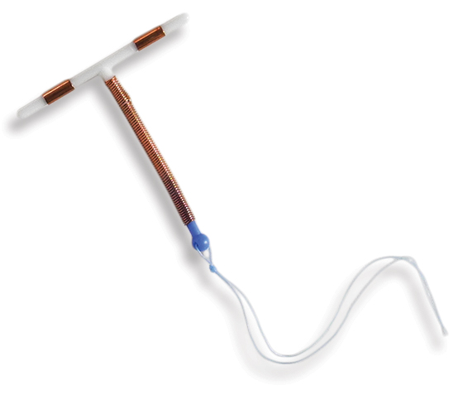
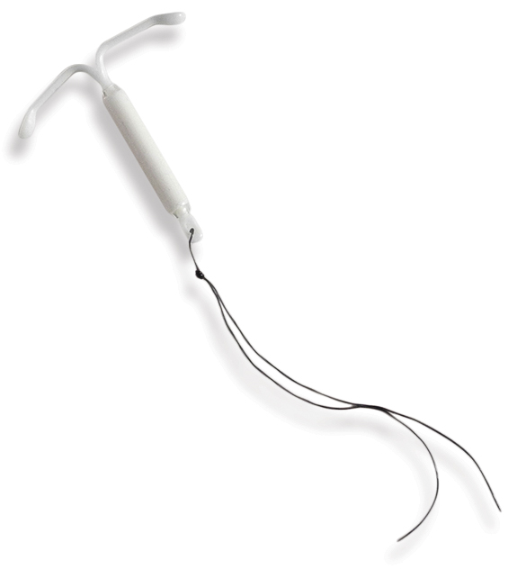
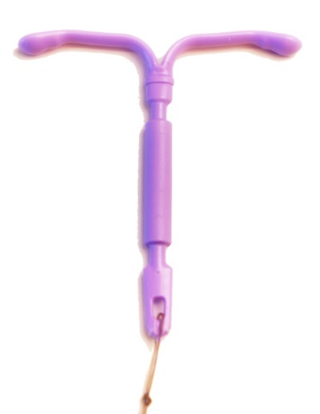
Different Types of IUD
Paragard
Skyla Kyleena Mirena/Liletta
Non-Hormonal
Hormonal
36
Image: RHAP
Notes:
So now that we’ve determined that it’s safe for Julie to have an IUD, let’s talk about the types of IUDs and how to counsel Julie.
Our previous patient knew that she wanted the copper IUD, but Julie is undecided so I would counsel her differently.
There are 2 main categories of IUDs – hormonal and non-hormonal.
The non-hormonal IUD on the market in the US is the copper IUD, brand name Paragard which is FDA approved for 10 years and we have good evidence that it works for at least 12 years.
The hormonal IUDs are all progesterone only and include the brand names Skyla, Kyleena, Mirena and Liletta.
Skyla is the lowest dose IUD at 13.5 mg Levonorgestrel and is FDA approved for 3 years. Kyleena is 19.5 mg Levonorgestrel and is FDA approved for 5 years.
Mirena and Liletta are both 52 mg Levonorgestrel. Mirena is FDA approved for 8 years. Liletta is FDA approved for 8 years.
The distinction between Mirena and Liletta is that they are made by different companies and Liletta can be purchased by FQHCs and other clinics who use 340B pricing for $100. Mirena can cost upwards of $800 and is close to $400 with 340B pricing.
The main difference between the IUDs is duration of action and bleeding profile.
The Cu-IUD tends to make periods heavier and more crampy.
The hormonal IUDs tend to make periods lighter and less painful. People on the higher dose IUD are more likely to have no period at all as compared to the Skyla and Kyleena.
The Skyla is the least likely to make menses go away altogether.
Some people do experience progestin-associated side effects such as acne and mood changes although the circulating dose of progestin for any of the hormonal IUDs is much lower than the other methods. We do not have evidence that the lower dose IUDs reduce these side effects, however it would be reasonable to try a lower dose IUD if these side effects have been an issue for a patient in the past.
Images: RHAP

Slide 37
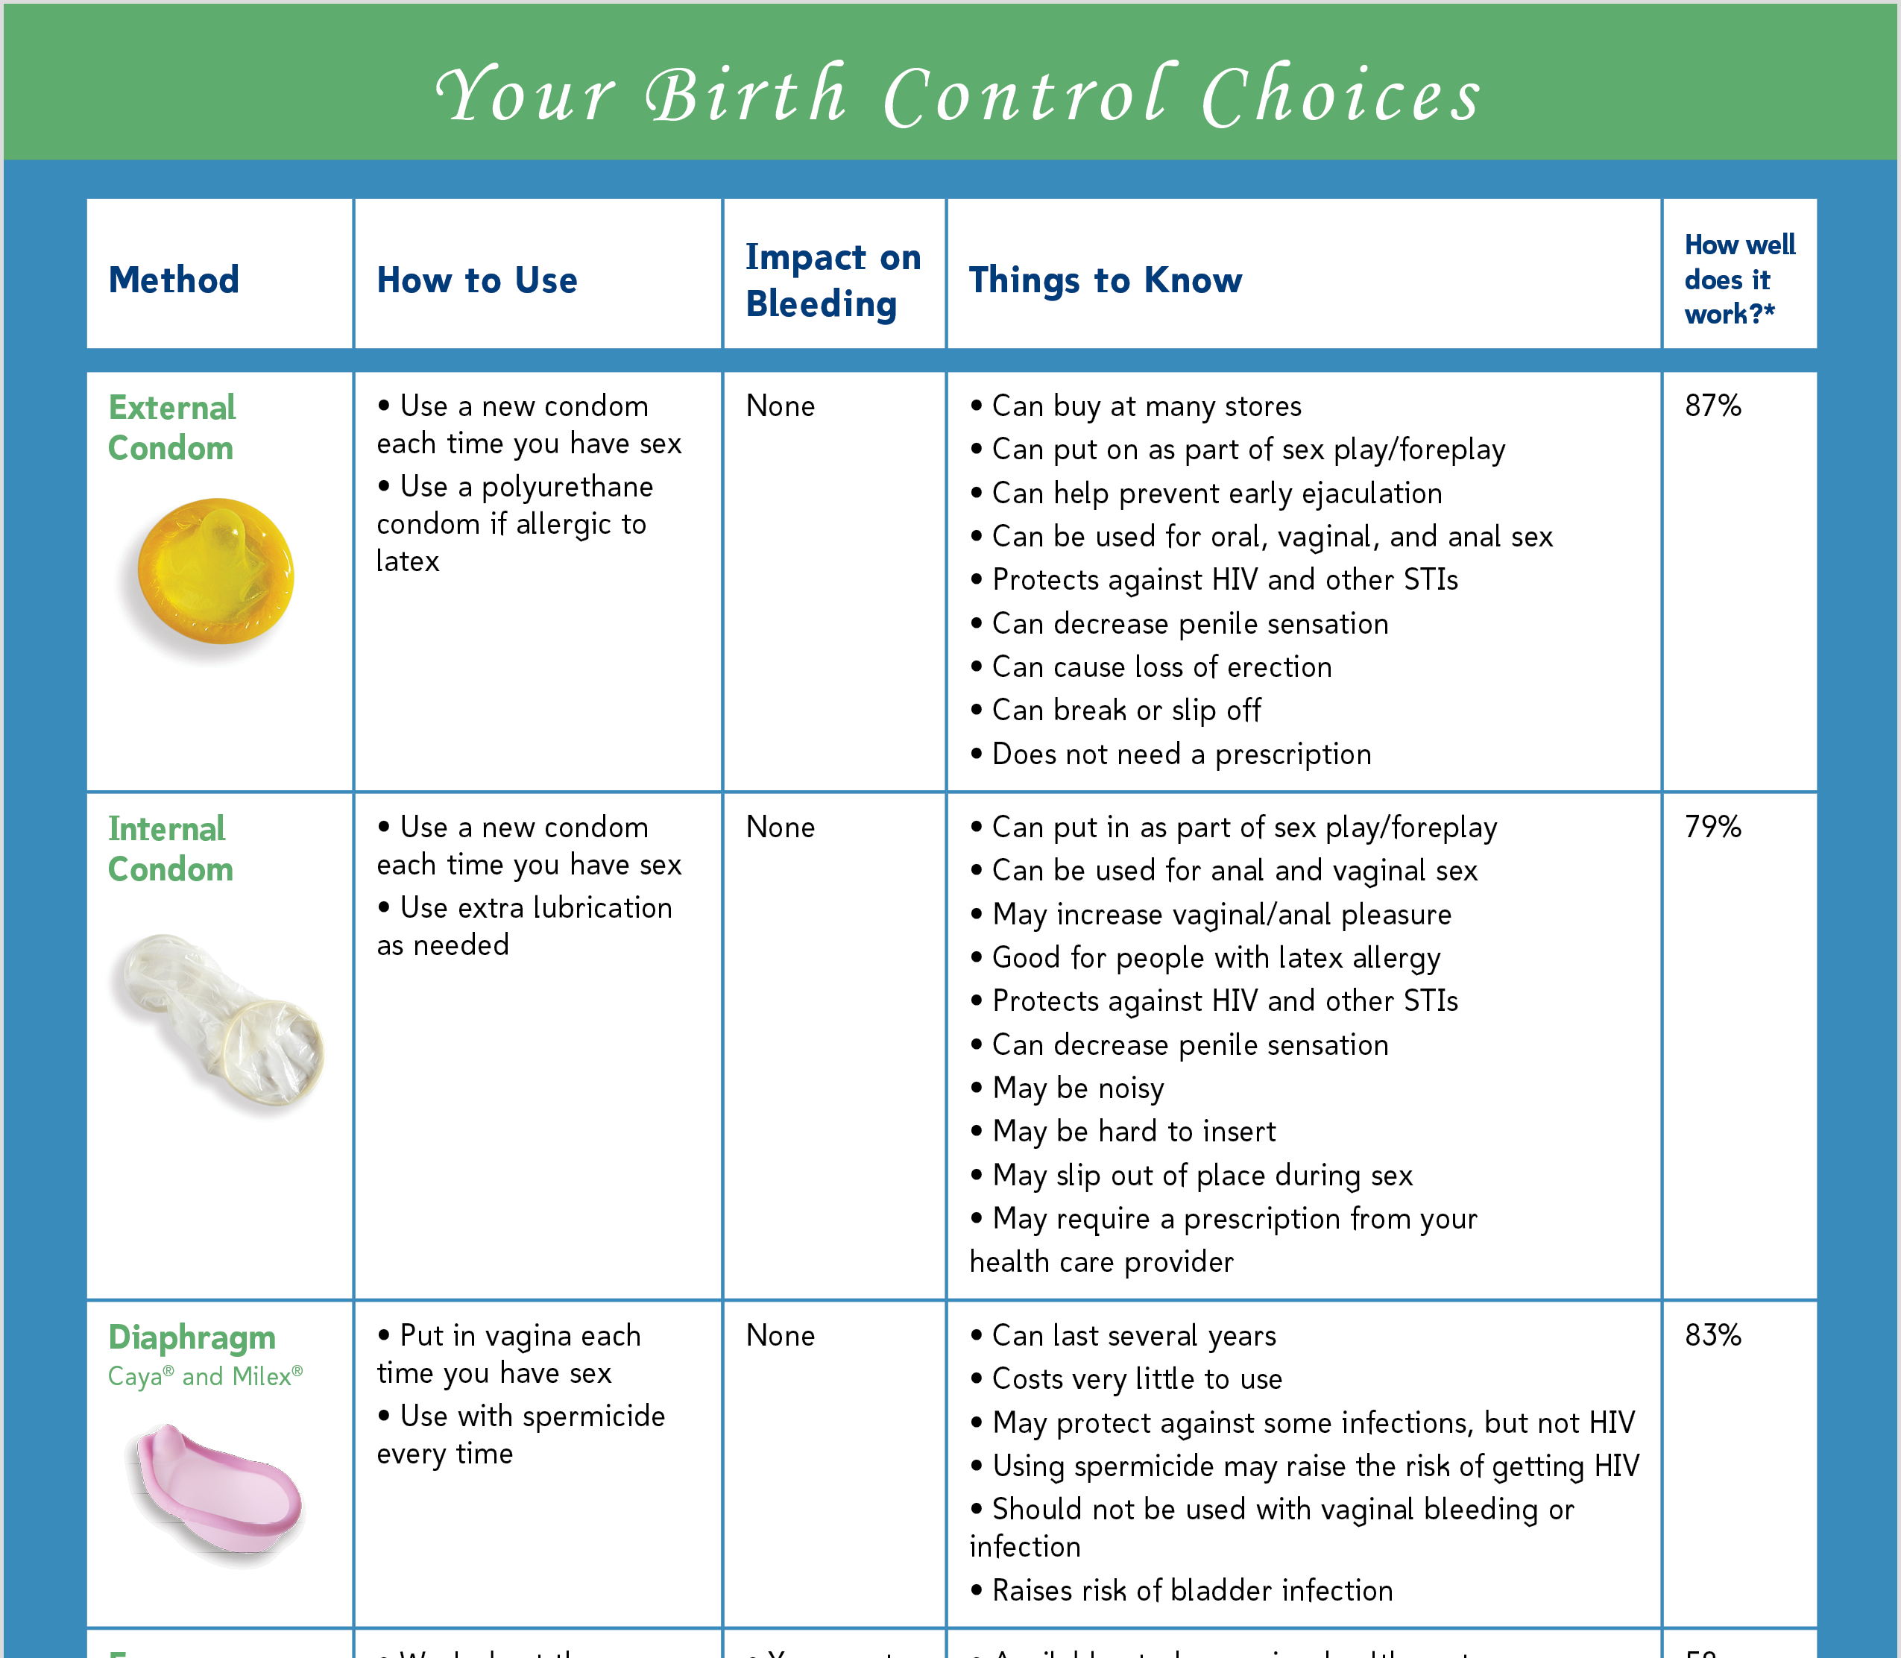
Counseling Tools
37
Image: RHAP
Notes:
When I’m counseling patients on contraceptive method choice I find it helpful to use an options sheet such as this one which can be found on reproductiveaccess.org.
https://www.reproductiveaccess.org/resource/bc-fact-sheet/
www.bedsider.org
Images: RHAP

Slide 38

Patient-Centered Care
Trust patients to be experts on themselves!
Avoid pushing a specific method
    Reduces trust and adherence
Notes:
When you are counseling any patient, especially an adolescent, on long acting reversible contraception it is important to employ shared decision-making.
You should assess what’s most important to the patient about their contraception and remember that it’s not always effectiveness
While you should definitely bust myths about contraception, such as it causes cancer, avoid pushing methods. This can lead to reduced trust and adherence, and often reflects your own biases.
You want to be nonjudgmental when presenting information and use patient materials at the appropriate literacy level as shown in the previous slide.
You also want to remove LARC upon request. If a patient comes to me and wants a contraceptive method removed, I always find out why they want it removed and offer troubleshooting and counseling. However, if after that, they still want the method removed – I take it out. Even if I don’t agree with their reasoning. It’s important to avoid reproductive coercion.
Image: Trust by Andreas Vögele from NounProject.com

Slide 39
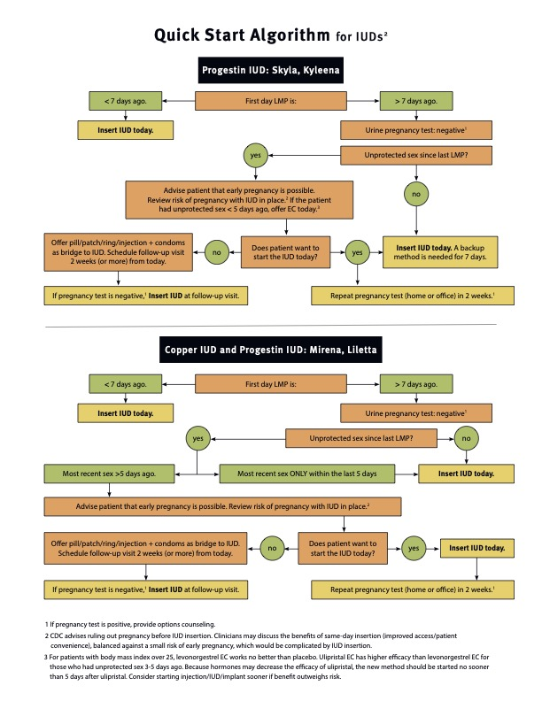
What if Julie Decides on an IUD?
39
Image: RHAP
Notes:
If Julie decides on a progestin IUD, when do we start it?
The Select Practice Recommendations state that we can insert an IUD any time in the cycle as long as pregnancy has been reasonably excluded, however you don’t always need a pregnancy test in order to do this!
How do we know if the patient is not currently pregnant? www.reproductiveaccess.org
If patient is <=7 days from LMP, we can go ahead and insert the IUD today
If patient is >7 days from LMP, you can do a pregnancy test. If this is negative, and patient has not had unprotected sex since LMP, you are in the clear!
However, if patient is >7 days from LMP with a negative pregnancy test, but has had unprotected sex since LMP, it’s a bit more complicated. First you should assess for need for emergency contraception as we discussed in the previous case.
If the patient is out of the window for emergency contraception, then we need to discuss the risk of pregnancy and employ our shared decision making.
What I usually say is “Your pregnancy test today is negative, but it can take up to 2 weeks to turn positive. Since you have had sex without a condom since your last period, there is a slight chance that you are pregnant. There are two IUDs that can work as EC, the Paragard and the Mirena. You can choose to get the IUD today, and come back for pregnancy test in 2 weeks or we can use another method and have you come back for another pregnancy test and insert your IUD in 2 weeks. If you are early pregnant and we put the IUD in, there is a risk of infection and miscarriage. Usually the best plan is to remove the IUD, do an abortion and reinsert the IUD.”
When I provide this counseling, most of my patients opt for same day LARC insertion.
Review of Quick start method and shared decision making – done a few slides back as well
Image Credit: http://www.reproductiveaccess.org/resource/quick-start-algorithm/

Slide 40
What if Julie Decides on an IUD? Continued…
40
Image: RHAP
Notes:
This continued from the previous slide. If the patient prefers to have the IUD today, then you need to assess for need for emergency contraception
Image Credit: http://www.reproductiveaccess.org/resource/quick-start-algorithm/
Note, while this is the CDC’s recommendation, we also have to weigh how likely it is that someone will come back in 5 days and discuss that frankly with her. Also important to look really closely at when that unprotected sex was and where she was in her cycle at that time. Also, there are studies going on about whether or not the progestin IUDs work as EC and it is looking promising…

Slide 41
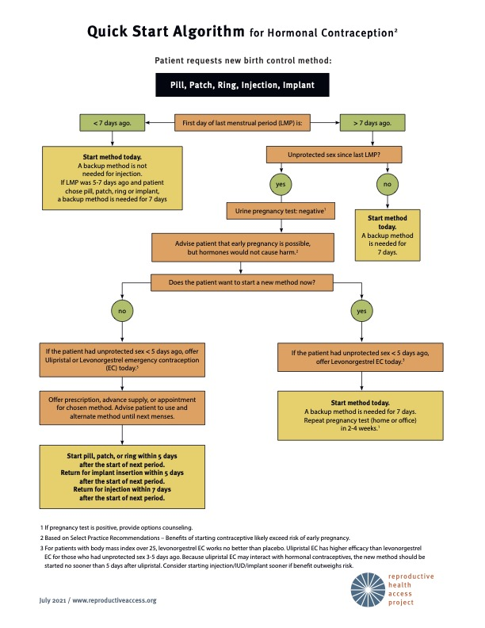
Quick Start Method
Same day insertion is safe
Screen for STIs at the time of insertion based on patient history and CDC recommendations
Do not insert an IUD with purulent cervicitis
41
Image: RHAP
Notes:
Some additional points about quick-starting contraception
Test for GC/Chlamydia at the time of insertion
If results come back positive, and the patient is asymptomatic, treat with the IUD in place
No need to delay insertion to wait for results or remove the IUD if the results come back positive
Photo Credit: https://www.reproductiveaccess.org/resource/quick-start-algorithm/

Slide 42
Learning Points
Hormonal contraception is safe for people with depression
Use shared decision-making to prioritize patient preferences and minimize provider bias
IUDs can be inserted any time during the cycle if pregnancy has been reasonably ruled out or for EC
Learning by Tippawan Sookruay from NounProject.com
Notes:
Image: Learning by Tippawan Sookruay from NounProject.com

Slide 43

PATIENT CASE:
Katie
28yo G0 comes to your office for contraception she doesn’t have to think about
                Likes the idea of the implant
                History of a seizure d/o (stable on carbamazepine)
                Type 1 DM diagnosed age 12
43
Image: https://www.flickr.com/photos/wocintechchat/22517894562/
Notes:
Katie, is a 28 year old nulliparous women who comes to your office to discuss contraception. She would like something that she doesn’t have to think about and is uncomfortable with the idea of anything in her uterus so she is specifically interested in the Implant.
Her past medical history is notable for a seizure disorder, stable on carbamazepine and type 1 DM diagnosed at age 12.
Look at the CDC MEC by Method type
Implant
Diabetes is a 2: It’s the theoretical risk for thrombosis with POCs, but less than with COCs (concern for hypoestrogenic effects, particularly with depo; but that evidence is weak)
Carbemazepine is a 2 for implant: likely to reduce the effectiveness of POPs and implants
Both are a 2 for different reasons, therefore 2 + 2 = 2
Image: https://www.flickr.com/photos/wocintechchat/22517894562/

Slide 44
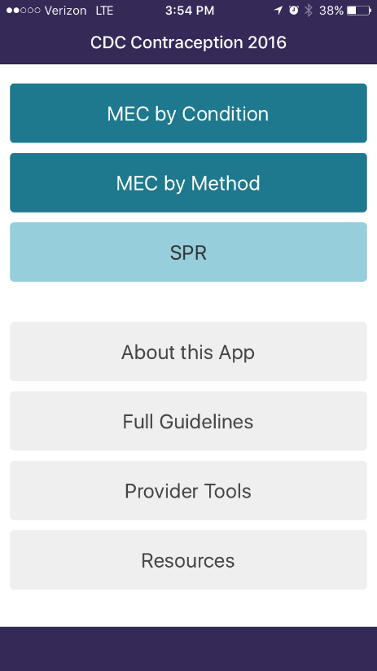

A Different Way to Look at the US MEC
44
Notes:
So let’s use the MEC in a different way. In your app, click on MEC by method instead of condition and then select progestin-only contraception. The Implant falls into this category.
You can then look at diabetes and anticonvulsant therapy. I’ll give everyone a minute to look at the recommendations…
Look at the CDC MEC by Method type
Implant
Diabetes is a 2: It’s the theoretical risk for thrombosis with POCs, but less than with COCs (concern for hypoestrogenic effects, particularly with depo; but that evidence is weak)
Carbemazepine is a 2 for implant: likely to reduce the effectiveness of POPs and implants
Both are a 2 for different reasons, therefore 2 + 2 = 2

Slide 45
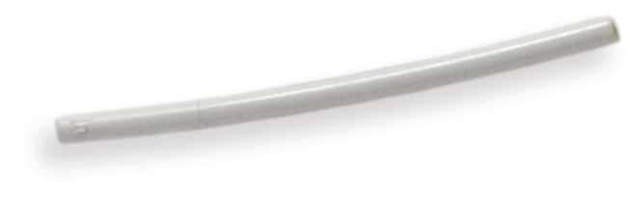
Are we Okay With the Implant for Katie?
What does 2 + 2 equal?
2
3
4
Image: RHAP
Notes:
So insulin dependent Diabetes without complications is a 2 and epilepsy on anticonvulsant therapy is a 2.
In this case, what does 2 + 2 equal?
Implant
Diabetes is a 2: It’s the theoretical increased risk for thrombosis with progestin-only contraception, but less than with combined (concern for hypoestrogenic effects, particularly with depo; but that evidence is weak)
Carbemazepine is a 2 for implant: likely to reduce the effectiveness of POPs and implants
Both are a 2 for different reasons, therefore 2 + 2 = 2
Image: RHAP

Slide 46
Learning Points
The danger of many anticonvulsants (except lamotrigine) is decreasing effectiveness of contraceptives
Long term diabetes is a “2” for all progestin methods, a “3-4” for estrogen containing products
Notes:
Image: Learning by Victoruler from NounProject.com

Slide 47
Practice Recommendations
Use CDC contraception guidance to provide individualized recommendations
Particularly when patients have multiple medical problems, progestin methods are safer than estrogen + progestin
Copper IUD has the fewest safety concerns
Don’t forget about vasectomy!
47

Slide 48

Questions?
Notes:
Image: Question by Adrien Coquet from NounProject.com

Slide 49

Billing and Coding
ICD 10 Codes to Know:
    Z30.011 Initial, contraceptive pills
    Z30.012 EC prescription
    Z30.013 Initial, Injection
    Z30.014 Initial, IUC
    Z30.015 Initial, Ring
    Z30.016 Initial, Patch
    Z30.017 Initial, Implant
    Z30.41 surveillance, contraceptive pills
    Z30.42 Surveillance, Injection
    Z30.43 Surveillance, IUC
    Z30.44 Surveillance, Ring
    Z30.45 Surveillance, Patch
    Z30.46 Surveillance, Implant
Coding by ahmad bahrudi from NounProject.com
Notes:
Basics of Contraceptive Billing and coding:
Visits for counseling regarding contraception without a procedure can be billed as a 992XX based on new vs established patient and level of complexity. You will need to use the correct specific ICD 10 code for initiation vs surveillance of the specific contraceptive method e.g. ICD Z30.01X
Photo Credit: Coding by ahmad bahrudi from NounProject.com
Resources:
Coding for implant insertion and removal: https://www.reproductiveaccess.org/resource/implant-coding/
Coding for IUD insertion and removal: https://www.reproductiveaccess.org/resource/iud-coding/
Coding for vasectomy: https://www.reproductiveaccess.org/resource/coding-vasectomy/

Slide 50
Billing and Coding
Procedure (CPT) Codes to Know:
58300 Insertion of IUD
    Z30.430 encounter for insertion of IUC
    J7298 Mirena, J7297 Liletta, J7300 Paragard, J7301 Skyla, J7296 Kyleena
58301 IUD removal
    Z30.432 encounter for removal of IUC
58300 & 58301 for IUD removal & reinsertion
    Z30.433 & relevant J code
Coding by ahmad bahrudi from NounProject.com
Notes:
If you do a procedure such as an IUD insertion, you can bill for the procedure using the correct CPT code. This will need to be associated with the correct ICD 10 code for payment. For example CPT code 58300 can be used to bill for an IUD insertion and will need to be associated with the diagnosis code Z30.430 (encounter for insertion of an IUD). If the IUD is supplied by the office, you will also need to order the device itself. This is done with the appropriate J-code.
If a patient has been previously counseled and presents for the procedure only (e.g IUD insertion) you would just bill for the procedure. If the patient presents for counseling and then decides on the IUD, you can bill for the office visit with a 992XX code as well as the CPT code for the procedure. A 25 modifier can be used to indicate this added complexity.
*Not all insurers will pay for this
Photo Credit: Coding by ahmad bahrudi from NounProject.com
Resources:
Coding for implant insertion and removal: https://www.reproductiveaccess.org/resource/implant-coding/
Coding for IUD insertion and removal: https://www.reproductiveaccess.org/resource/iud-coding/
Coding for vasectomy: https://www.reproductiveaccess.org/resource/coding-vasectomy/

Slide 51
Billing and Coding
CPT Codes to Know Continued:
11981 Insertion Implant
    Z30.017 encounter for insertion of Implant
    J7307 Nexplanon
11982 Removal Implant
    Z30.46 encounter for surveillance of Implant
    J7307
11983 Removal & Reinsertion Implant
    Z30.46
Coding by ahmad bahrudi from NounProject.com
Notes:
The implant is similar in that you bill the specific CPT code to get paid for the procedure and associate with the appropriate ICD 10 diagnosis code and use the J-code for Nexplanon to bill for the device.
The main difference is that removal and reinsertion of the implant has it’s own CPT code. This is unlike the IUD where you just use both the removal and reinsertion codes.
Resources:
Coding for implant insertion and removal: https://www.reproductiveaccess.org/resource/implant-coding/
Coding for IUD insertion and removal: https://www.reproductiveaccess.org/resource/iud-coding/
Coding for vasectomy: https://www.reproductiveaccess.org/resource/coding-vasectomy/

Slide 52
Billing and Coding
Other helpful codes to know:
J2000 Lidocaine
A4550 Surgical Tray
53 modifier can be used for attempted, but unsuccessful, IUD insertions
22 modifier can be used for a procedure that is more difficult or time consuming than usual (e.g. stringless IUD, deep implant)
Coding by ahmad bahrudi from NounProject.com
Notes:
Additionally, many IUD manufacturers will replace IUDs used for unsuccessful insertions. Retain the device, and contact the company in this case.
Resources:
Coding for implant insertion and removal: https://www.reproductiveaccess.org/resource/implant-coding/
Coding for IUD insertion and removal: https://www.reproductiveaccess.org/resource/iud-coding/
Coding for vasectomy: https://www.reproductiveaccess.org/resource/coding-vasectomy/

Slide 53

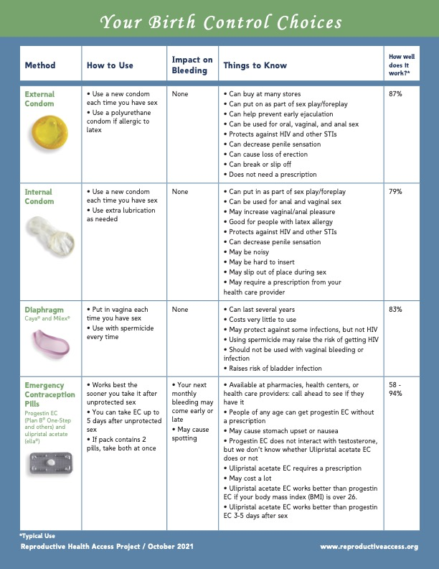
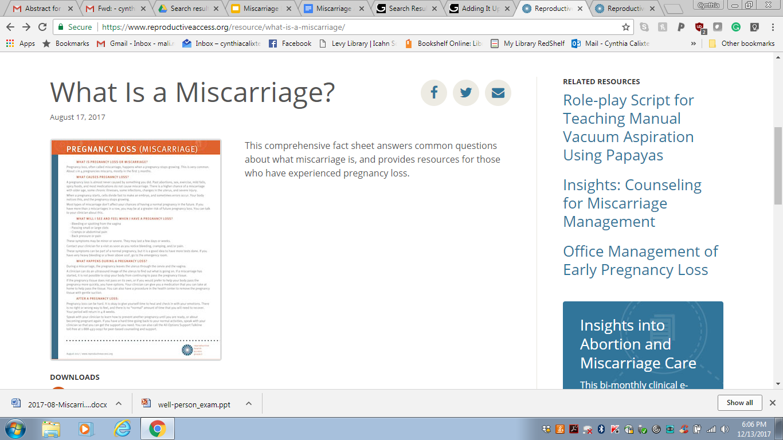
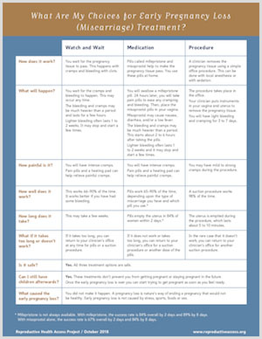
RESOURCES.
Your Birth Control Choices
Quick Start Algorithm
Medical Eligibility Criteria
Notes:
https://www.reproductiveaccess.org/resource/bc-fact-sheet/
https://www.reproductiveaccess.org/resource/quick-start-algorithm/
https://www.reproductiveaccess.org/resource/medical-eligibility-initiating-contraception/

Slide 54
REFERENCES.
Blakemore E. The First Birth Control Pill Used Puerto Rican Women as Guinea Pigs. History.com. https://www.history.com/news/birth-control-pill-history-puerto-rico-enovid. Published May 9, 2018. Accessed October 1, 2021
Centers for Disease Control and Prevention (CDC). U.S. Medical Eligibility Criteria for Contraceptive Use and U.S. Selected Practice Recommendations for Contraceptive Use: https://www.cdc.gov/reproductivehealth/contraception/contraception_guidance.htm
Champaloux, Steven W., et al. "Contraceptive use among women with medical conditions in a nationwide privately insured population." Obstetrics & Gynecology 126.6 (2015): 1151-1159.
Contraceptive Technology and Managing Contraception: www.managingcontraception.com
Curtis KM, Tepper NK, Jatlaoui TC, et al. U.S. Medical Eligibility Criteria for Contraceptive Use, 2016. MMWR Recomm Rep 2016;65(No. RR-3):1–104.
Gomez AM, Fuentes L, Allina A. Women or LARC first? Reproductive autonomy and the promotion of long-acting reversible contraceptive methods. Perspect Sex Reprod Health. 2014;46(3):171-175. doi:10.1363/46e1614
Jackson J. How Puerto Rican Women Made Birth Control Possible-At the Expense of Their Health. BESE. https://www.bese.com/how-puerto-rican-women-made-birth-control-possible-at-the-expense-of-their-health/. Published April 27, 2018. Accessed October 1, 2021.
Pendergrass DC, Raji MY. The bitter pill: Harvard and the dark history of birth control: Magazine: The Harvard Crimson. The Harvard Crimson. https://www.thecrimson.com/article/2017/9/28/the-bitter-pill/. Published September 28, 2017. Accessed October 1, 2021.
Seema D Shah, Linda Prine, Eve Waltermaurer, Susan E Rubin. Feasibility study of family planning services screening as clinical decision support at an urban Federally Qualified Health Center network. Contraception. 2019 Jan;99(1):27-31.
Sister Song & National Women’s Health Network. Long-Acting Reversible Contraception Statement of Principles. https://www.nwhn.org/wp-content/uploads/2017/02/LARCStatementofPrinciples.pdf
Skovlund, Charlotte Wessel, et al. "Association of hormonal contraception with depression." JAMA psychiatry 73.11 (2016)
Society of Family Planning https://www.societyfp.org/
Notes:
Blakemore E. The First Birth Control Pill Used Puerto Rican Women as Guinea Pigs. History.com. https://www.history.com/news/birth-control-pill-history-puerto-rico-enovid. Published May 9, 2018. Accessed October 1, 2021
Centers for Disease Control and Prevention (CDC). U.S. Medical Eligibility Criteria for Contraceptive Use and U.S. Selected Practice Recommendations for Contraceptive Use: https://www.cdc.gov/reproductivehealth/contraception/contraception_guidance.htm
Champaloux, Steven W., et al. "Contraceptive use among women with medical conditions in a nationwide privately insured population." Obstetrics & Gynecology 126.6 (2015): 1151-1159.
Contraceptive Technology and Managing Contraception: www.managingcontraception.com
Curtis KM, Tepper NK, Jatlaoui TC, et al. U.S. Medical Eligibility Criteria for Contraceptive Use, 2016. MMWR Recomm Rep 2016;65(No. RR-3):1–104.
Gomez AM, Fuentes L, Allina A. Women or LARC first? Reproductive autonomy and the promotion of long-acting reversible contraceptive methods. Perspect Sex Reprod Health. 2014;46(3):171-175. doi:10.1363/46e1614
Jackson J. How Puerto Rican Women Made Birth Control Possible-At the Expense of Their Health. BESE. https://www.bese.com/how-puerto-rican-women-made-birth-control-possible-at-the-expense-of-their-health/. Published April 27, 2018. Accessed October 1, 2021.
Pendergrass DC, Raji MY. The bitter pill: Harvard and the dark history of birth control: Magazine: The Harvard Crimson. The Harvard Crimson. https://www.thecrimson.com/article/2017/9/28/the-bitter-pill/. Published September 28, 2017. Accessed October 1, 2021.
Seema D Shah, Linda Prine, Eve Waltermaurer, Susan E Rubin. Feasibility study of family planning services screening as clinical decision support at an urban Federally Qualified Health Center network. Contraception. 2019 Jan;99(1):27-31.
Sister Song & National Women’s Health Network. Long-Acting Reversible Contraception Statement of Principles. https://www.nwhn.org/wp-content/uploads/2017/02/LARCStatementofPrinciples.pdf
Skovlund, Charlotte Wessel, et al. "Association of hormonal contraception with depression." JAMA psychiatry 73.11 (2016)
Society of Family Planning https://www.societyfp.org/

Slide 55
THANK YOU.
Notes:
Updated 12/2021

