Slide 1



WELL-PERSON EXAM
RETHINKING THE CHECK UP
Physician Doing Routine Check Up Of Hospitalized Patient by Jacob Lund Photography from NounProject.com
Notes:
Updated 12/2021

Slide 2
GOALS OF
THE CHECK
UP
  PROMOTE HEALTH
  IDENTIFY RISK FACTORS
  DETECT DISEASE

Slide 3

WHERE DO WE GET OUR INFORMATION?
Photo: Group Of College Students Researching Information by Jacob Lund Photography from NounProject.com
Notes:
Major recommending bodies:
Primarily USPSTF, also AAFP, ACOG, ACS, CDC, WHO, etc
Distinguish between organizations with a vested interest and those that create evidence-based guidelines.
Photo Credit: Group Of College Students Researching Information by Jacob Lund Photography from NounProject.com

Slide 4
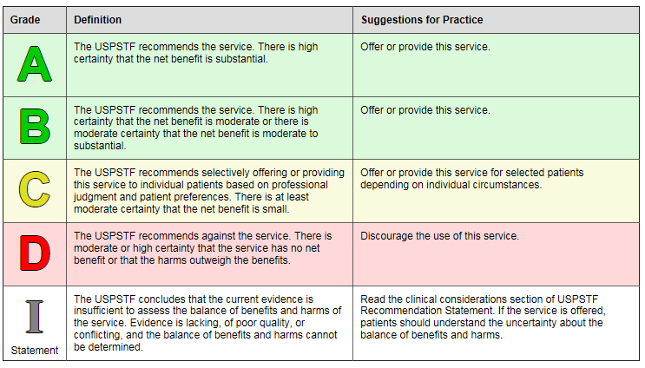
USPSTF Grades
Notes:
The Affordable Care Act gives USPSTF ratings special importance: services rated A & B must be covered by insurers with no deductibles or co-pays.
“A” – Recommends service:
High certainty that net benefit substantial
B – Recommends service:
Moderate-high certainty that net benefit moderate-substantial
C – Recommend against routinely providing service:
Moderate-high certainty of no net benefit or harm outweighs risk;
consider in certain individuals
D – Recommend against service:
Moderate-high certainty harms outweigh benefits
I – Insufficient evidence
If offered patients should understand uncertainty about balance of harms / benefits

Slide 5
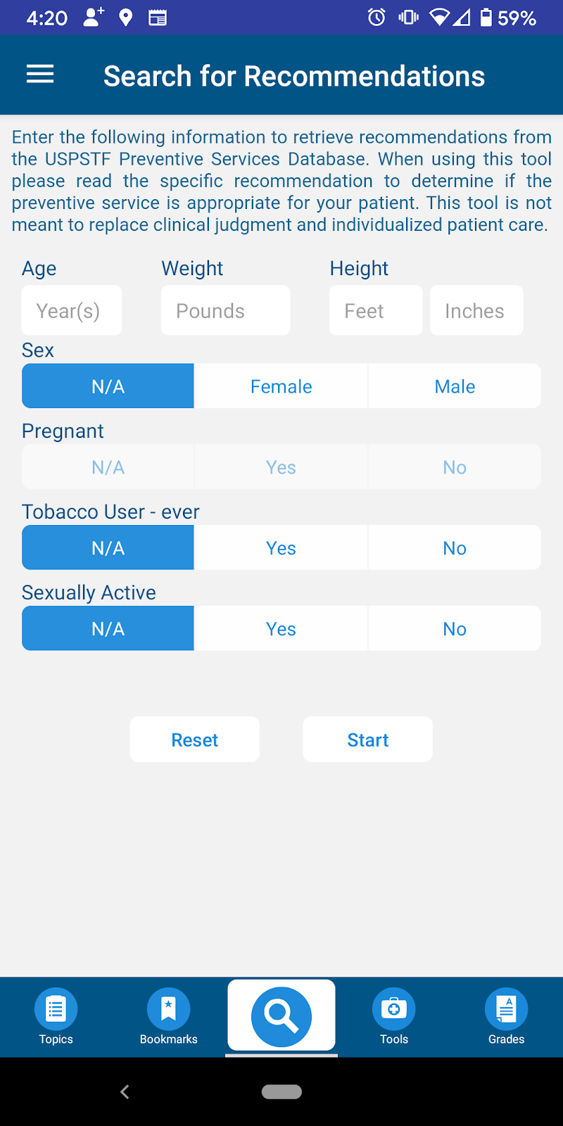
There’s an App for That:
Can be downloaded on iOS and Android operating systems
5
Notes:
And there’s an app for that! [USPTSF]

Slide 6

PATIENT CASE:
Lucia
She/her pronouns
17 years-old
High school senior
Loves Pizza
Runs track
6
Photo: Teenage Girl With Schoolbag Walking Through The High
School Corridor by Jacob Lund Photography from NounProject.com
Notes:
Lucia is a teenager who has come to you today for a pre-college physical.
She has no complaints and no significant past medical history.
What should you do for her?
Photo Credit: Teenage Girl With Schoolbag Walking Through The High School Corridor by Jacob Lund Photography from NounProject.com

Slide 7
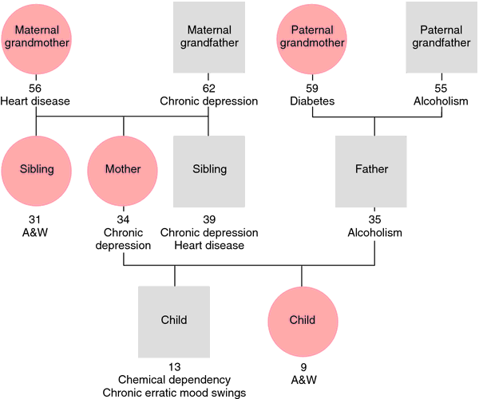


First Priority: Complete History
Photos: Pizza Slice by Vectors Market from NounProject.com
Notes:
Lucia has no significant family or past medical history.
She eats lots of pizza and chips, few fruits/vegetables.
She runs track.
She has had 2 male sexual partners, and she uses condoms “sometimes.”
Photo Credit:
Pizza Slice by Vectors Market from NounProject.com
Running by Eugen Belyakoff from NounProject.com

Slide 8


Physical Exam:
What Elements are Needed?
Notes:
BMI? Caution against focusing on BMI and weight loss; instead focus on healthy eating and physical habits
BP? Yes
Heart/lung/breast exam? No
Scoliosis screen? No
Pelvic and/or cervical exam/screen? No
Other?
Photo Credit:
Blood Pressure by Amethyst Studio from NounProject.com
Scale by Linseed Studio from NounProject.com

Slide 9
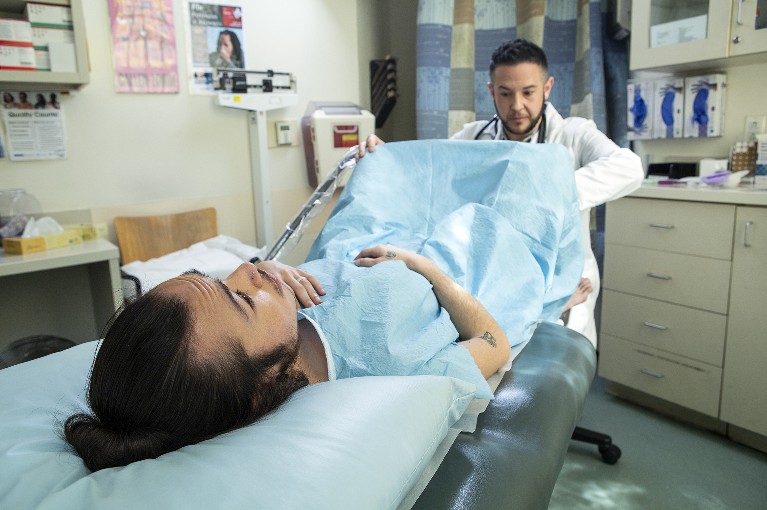

Does Lucia need a pelvic exam?
What about a scoliosis screening?
Photo: https://genderphotos.vice.com/#Health
Notes:
Routine pelvic examination
ACOG: not unless clinically indicated (that is, for evaluation of symptoms)
Pelvic exam not needed before initiating hormonal contraception
WHO and other experts concur
ACOG concurs for adolescents
Pap smear:
Start at age 21 (ACOG, USPSTF, ASCCP)
Scoliosis screening
USPSTF: I recommendation - The USPSTF says there is insufficient evidence to assess the benefits and/or harms of screening for idiopathic scoliosis.
Photo Credit:
- https://genderphotos.vice.com/#Health
- Spine by N.Style from NounProject.com

Slide 10

Does Lucia need STI testing?
Photo Teenage Girl Wearing Eyeglasses Sitting At Desk In Classroom
In High School by Jacob Lund Photography from NounProject.com
Notes:
Yes! She needs testing for chlamydia & gonorrhea (level B recommendation), & HIV (level A recommendation). Routine screening for syphilis isn’t recommended for non-pregnant, low-risk people, but should be considered (level A recommendation) depending on your local epidemiology, practice setting, or her sexual history.
Photo Credit:
- Teenage Girl Wearing Eyeglasses Sitting At Desk In Classroom In High School by Jacob Lund Photography from NounProject.com

Slide 11
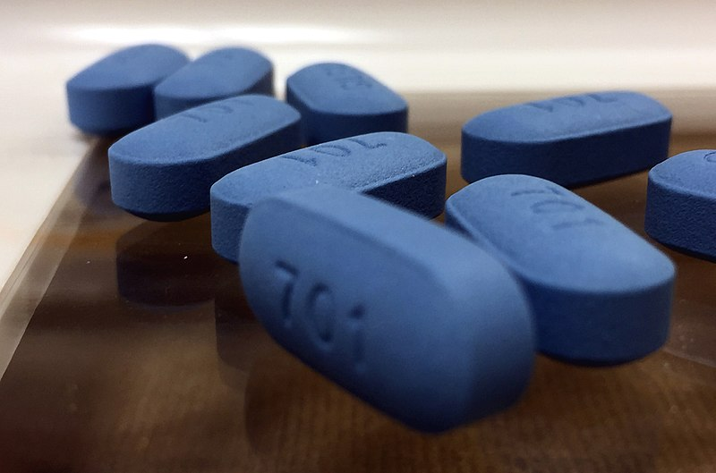
Counsel on PrEP
Preexposure prophylaxis against HIV
Photo: https://flickr.com/photos/54591706@N02/32514377531
Notes:
Level A recommendation: offer to those who are at high-risk for HIV acquisition
PrEP is for people without HIV who are at risk of acquisition from sex or injection drug use. People at risk who should be assessed for PrEP include:
Sexually active gay and bisexual men without HIV
Sexually active heterosexual men and women without HIV
Sexually active transgender persons without HIV
Persons without HIV who inject drugs
Persons who have been prescribed non-occupational post-exposure prophylaxis (PEP) and report continued risk behavior, or who have used multiple courses of PEP
For the category of sexually-Active Adults and Adolescents
Anal or vaginal sex in the past 6 months; and
HIV-positive sexual partner (especially if partner has unknown or detectable viral load); or
Recent bacterial STI; or
History of inconsistent or no condom use with sexual partner(s)
Photo Credit:
- https://flickr.com/photos/54591706@N02/32514377531

Slide 12

What About Contraception?
Notes:
Contraception or emergency contraception?
Discuss -- what do we need to examine or what info do we need before prescribing contraception?
Remember patient-centered counseling: Patient-centered contraceptive counseling for all people can enhance reproductive autonomy and prevent coercion by supporting patients with information and counseling to help them make the best decision for their health and unique circumstances. LARC may or may not be that option. Our goal should be to enhance reproductive autonomy - the power to decide and control birth control use, pregnancy, and childbearing - NOT unintended pregnancy.
See the CDC contraception guidelines- selected practice recommendations. Exams and tests needed before initiation of contraception.
The USPSTF recommends that all women planning or capable of pregnancy take a daily supplement containing 0.4 to 0.8 mg (400 to 800 µg) of folic acid.
“A” recommendation.
Photo Credit:
- Contraception by Wichai Wi from NounProject.com

Slide 13

Patient Centered Counseling
10 minute video
Notes:
Highest efficacy should not be the only factor that guides contraceptive counseling and decision-making, unless it’s what the patient is looking for in their birth control.
Watch part of video to model patient-centered contraceptive counseling
Ask: What did you notice about this contraceptive counseling example? How did the clinician model patient-centeredness?
- Asks pt questions about what matters in birth control method
- Counsel on removing IUD at any time
- Provider talking to other provider about removing IUD “early”
- Advanced EC Rx offered
Source: Contraceptive Counseling: Patient/Provider Perspectives: Get LARC. Accessed: https://www.youtube.com/watch?v=OP9klE0JLLU. Published June 12, 2017.
Source:
Contraceptive Counseling: Patient/Provider Perspectives: Get LARC. Accessed: https://www.youtube.com/watch?v=OP9klE0JLLU. Published June 12, 2017.

Slide 14

Immunizations
Notes:
Don’t forget to update immunizations.
CDC immunization app: https://www.cdc.gov/vaccines/schedules/hcp/schedule-app.html
Photo Credit:
- https://thenounproject.com/icon/immunizations-580/

Slide 15
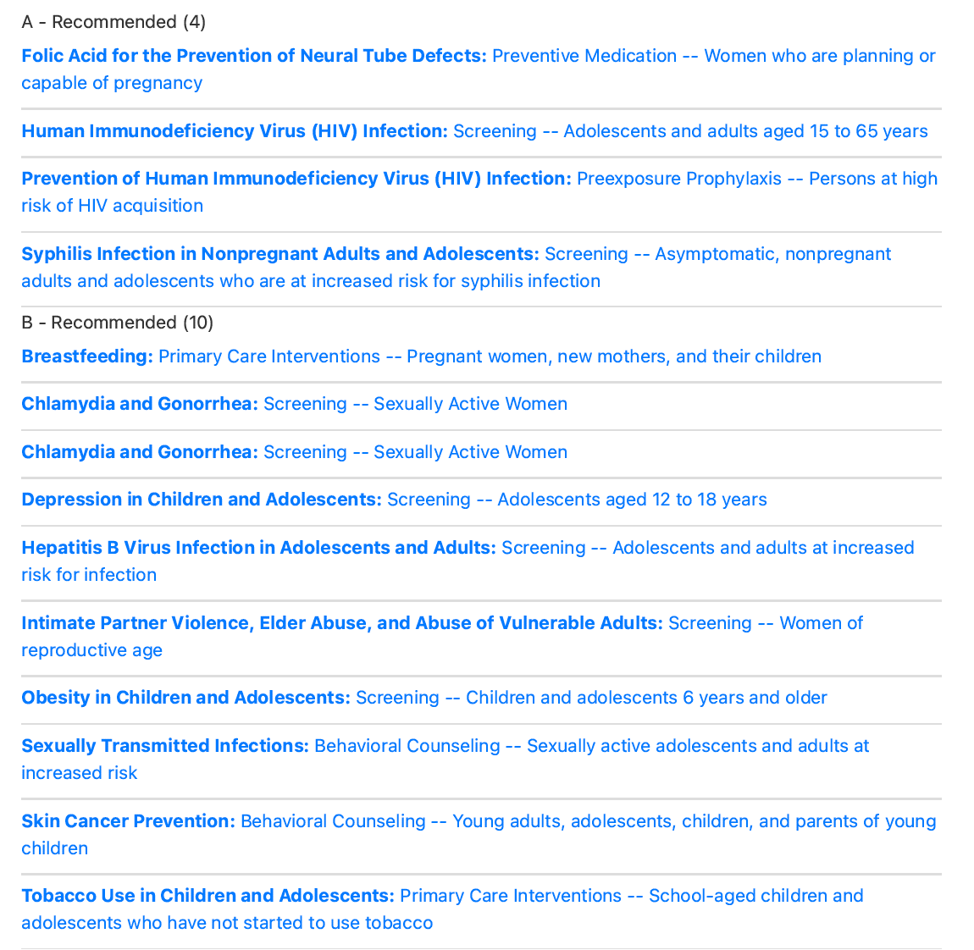
Summary
What Lucia Needs
Notes:
Complete history, including depression screening
Exam:
BMI (Caution) & BP
No pelvic exam even if Lucia gets hormonal contraception today
Consider scoliosis screening (this gets an “I” recommendations from USPSTF)
Lab tests:
Urine gonorrhea and Chlamydia test, HIV test, maybe syphilis test
Prevention:
Immunizations (including HPV)
Contraception
Summary from USPSTF web app: https://www.uspreventiveservicestaskforce.org/webview/#!/

Slide 16
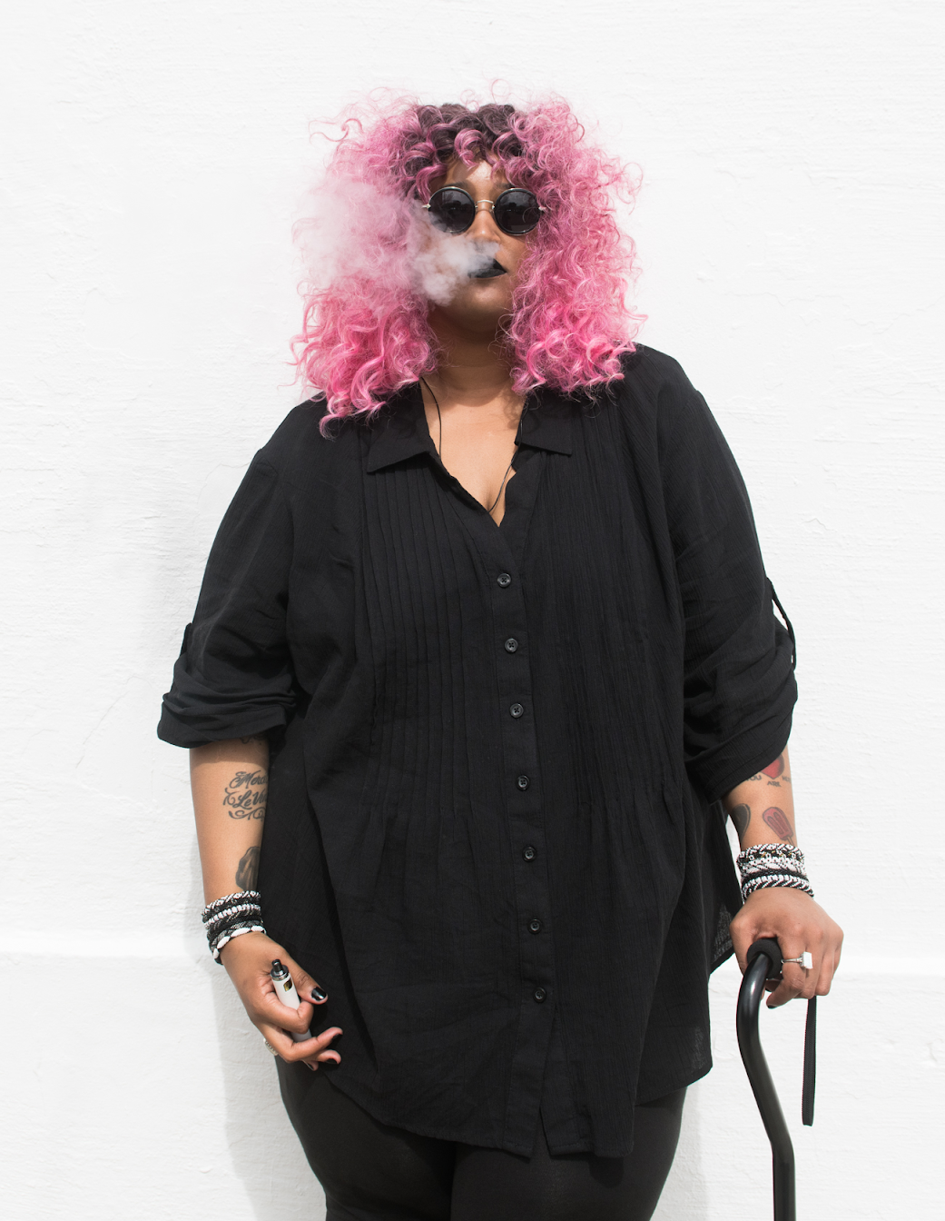
PATIENT CASE:
ELIZABETH
She/her pronouns
36-year-old bartender
Smokes half a pack per day
Disabled person
“Check me for everything!”
16
Photo: https://affecttheverb.com/gallery/disabledandhere/vaping/
Notes:
Elizabeth is a 36-year-old bartender.
She smokes ½ pack per day of cigarettes.
She wants a “complete physical with blood tests.”
Photo Credit: https://affecttheverb.com/gallery/disabledandhere/vaping/
Note: Disabled and here states: We ask that you be thoughtful in how you put our collection images to use. With captions, we prefer identity-first language, as in “disabled person” rather than “person with a disability.”

Slide 17


Does Elizabeth need a pap smear?
Photo Pap Smear by Eucalyp from NounProject.com
https://affecttheverb.com/gallery/disabledandhere/tangleportrait/
Notes:
Her last pap smear was 2 years ago.
All of her pap smears have been normal.
Answer: No
ASCCP has a (paid) mobile app and free web app to help manage any history of abnormal pap smears: https://app.asccp.org/
Photo Credit:
Pap Smear by Eucalyp from NounProject.com
https://affecttheverb.com/gallery/disabledandhere/tangleportrait/

Slide 18
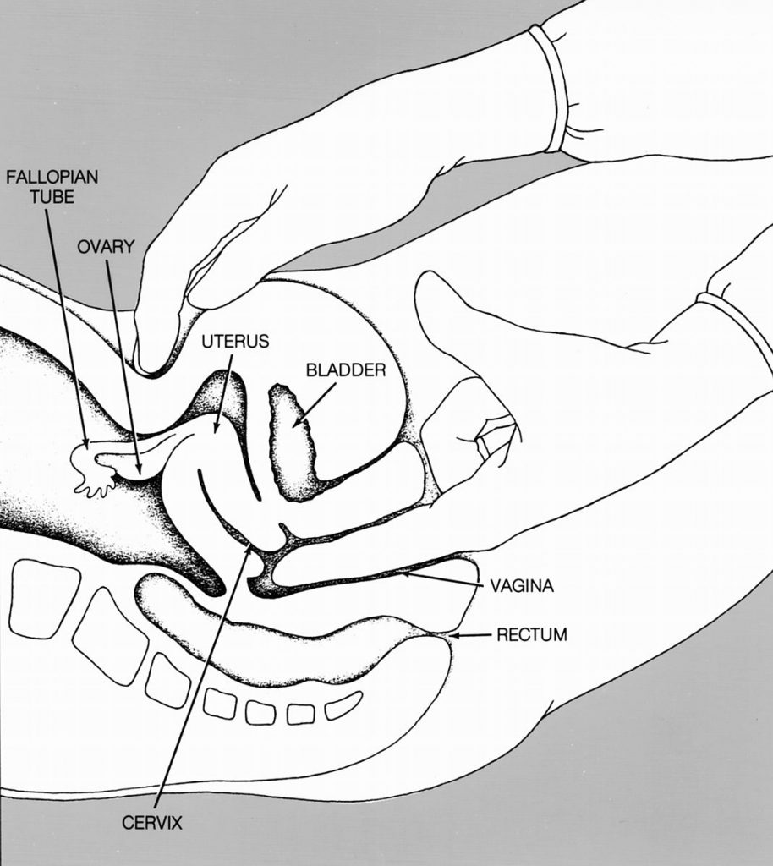
Bimanual Exam
18
Photo: https://teachmeobgyn.com/history-taking-examinations/examinations/bimanual/
Notes:
Don’t do a pelvic exam unless you are going to get some useful information (that is, unless you’re evaluating symptoms or sizing a pregnancy)
Screening for ovarian cancer gets a “D” from USPSTF.
Reasons to do a bimanual exam:
*Sizing a uterus, positioning, feeling ovaries, fibroids
Photo Credit: https://teachmeobgyn.com/history-taking-examinations/examinations/bimanual/

Slide 19

Smoking Cessation
Notes:
Smoking interventions
The USPSTF recommends that clinicians ask all adults about tobacco use, advise them to stop using tobacco, and provide behavioral interventions and U.S. Food and Drug Administration (FDA)–approved pharmacotherapy for cessation to adults who use tobacco. Grade: A Recommendation.
The USPSTF recommends that clinicians ask all pregnant women about tobacco use, advise them to stop using tobacco, and provide behavioral interventions for cessation to pregnant women who use tobacco. Grade: A Recommendation.
Photo Credit:
No Smoking by Creative Mania from NounProject.com

Slide 20
What about “routine blood tests?”
Photo: https://affecttheverb.com/gallery/disabledandhere/tangleportrait/
Notes:
Elizabeth wants blood tests.
Like our last case, we should offer her an HIV test, and maybe a syphilis test, too.
Lipid screening?
The USPSTF found evidence that statin use is beneficial for some adults ages 40 to 75 years who are at increased risk for cardiovascular disease, with the decision to start statins based on a 10-year ASCVD risk. Elizabeth is under age 40, and there is not a strong recommendation for screening, though some would consider based on her risk factor of smoking.
Hep C screening: USPSTF recs one-time screening for adults 18-79 without known liver disease (level “B” evidence)
Photo Credit:
https://affecttheverb.com/gallery/disabledandhere/tangleportrait/

Slide 21
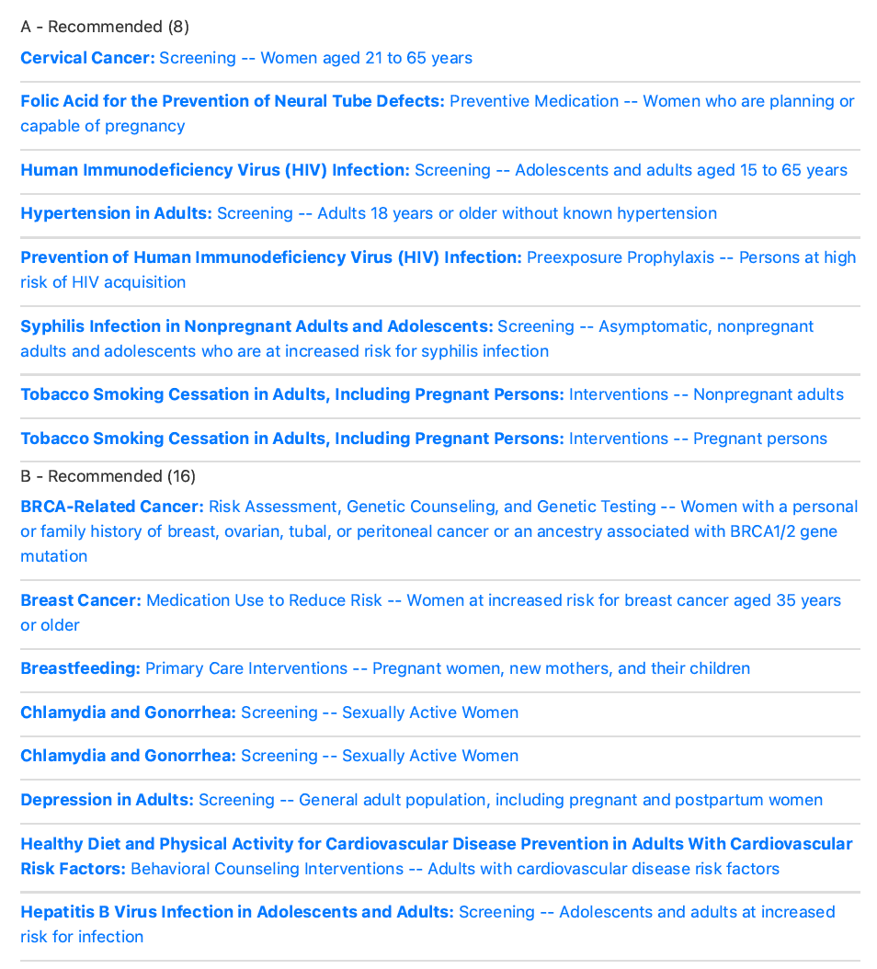
Summary
What does Elizabeth need?

Slide 22
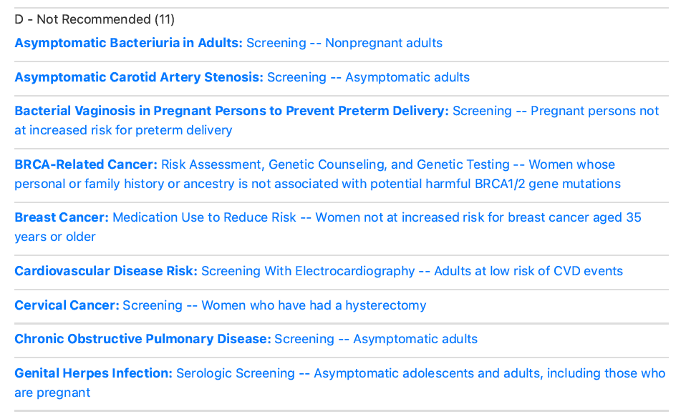
What is NOT recommended for Elizabeth?
HSV
serology
Notes:
Many things, including herpes simplex blood tests, which gets a “D” recommendation for asymptomatic teens and adults.

Slide 23

PATIENT CASE:
Sam
He/Him pronouns
53-year-old
“I need this form filled out for work.”
23
Photo: Underprivileged Middle Aged Man Standing Against A Brick
Wall In The City by Jacob Lund Photography from NounProject.com
Notes:
Sam came to your office because he needs a form filled out for a new job.
He hasn’t seen a doctor in 6 years.
Photo Credit: Underprivileged Middle Aged Man Standing Against A Brick Wall In The City by Jacob Lund Photography from NounProject.com

Slide 24

Sam’s complete history reveals…
Photo: Underprivileged Man Standing Against A Brick Wall In The City by Jacob Lund Photography from NounProject.com
Notes:
No chronic medical problems or surgeries
Negative family history: Parents died of pneumonia & Alzheimer’s disease
No smoking, moderate alcohol, no drugs
Divorced 5 years ago, not sexually active now
Eats out often
Drives everywhere, does not exercise
Photo Credit:
Underprivileged Man Standing Against A Brick Wall In The City by Jacob Lund Photography from NounProject.com

Slide 25
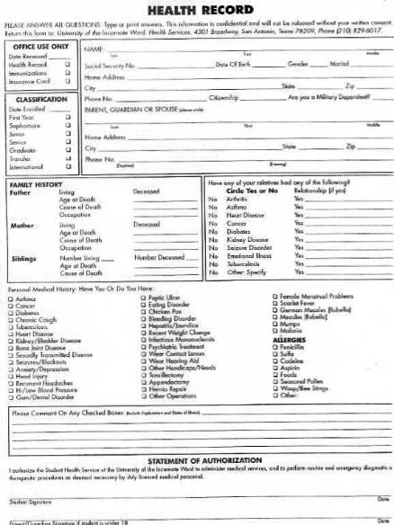

Photo: https://pix4free.org/
Notes:
Form for work asks for:
Urinalysis
CBC
Basic metabolic, LFT’s
Hepatitis B
PPD: “level A recommendation” if at high risk: HIV,close contacts of persons with TB, immigrants from countries with high TB prevalence, low income populations, and residents of long-term care facilities, healthcare workers and people with alcoholism.
-CDC no longer recommends annual TB testing for these high risk work places, though some employers may still require this
Photo Credit:
Blood Test Image: https://pix4free.org/

Slide 26
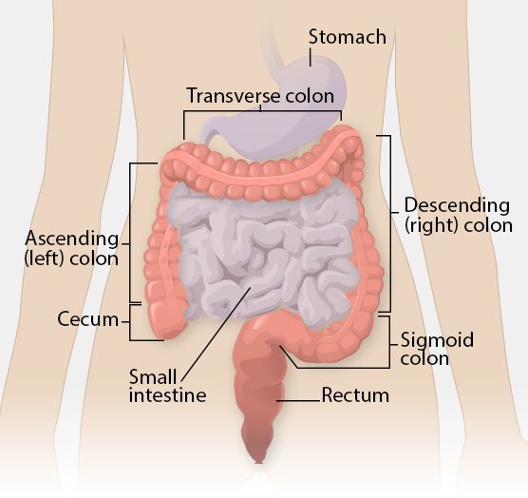
Colon Cancer Screening
Fecal occult blood testing
Flexible sigmoidoscopy
Colonoscopy
Photo: https://www.cdc.gov/cancer/colorectal/basic_info/what-is-colorectal-cancer.htm
Notes:
Choice of method:
Stool cards are simpler, with higher false positive rate – also need to be done more often than colonoscopy – every 1-2 years
Need to restrict diet is unclear
However, a single sample done in office w/ rectal exam is NOT considered adequate screening
2. Colonoscopy – higher cost/complication rate and lower adherence – but much longer interval
3. Sigmoidoscopy – alone or in combination with FOBT
4. Digital rectal exam is NOT recommended for colon CA screening
When to start: USPST “A” recommendation for ages 50-75, “B” recommendation for ages 45-49.
Who needs screening early?
Only those with a 1st-degree relative who had colon cancer diagnosed before age 60 – and those with familial polyposis, IBD, etc.
Photo: https://www.cdc.gov/cancer/colorectal/basic_info/what-is-colorectal-cancer.htm

Slide 27
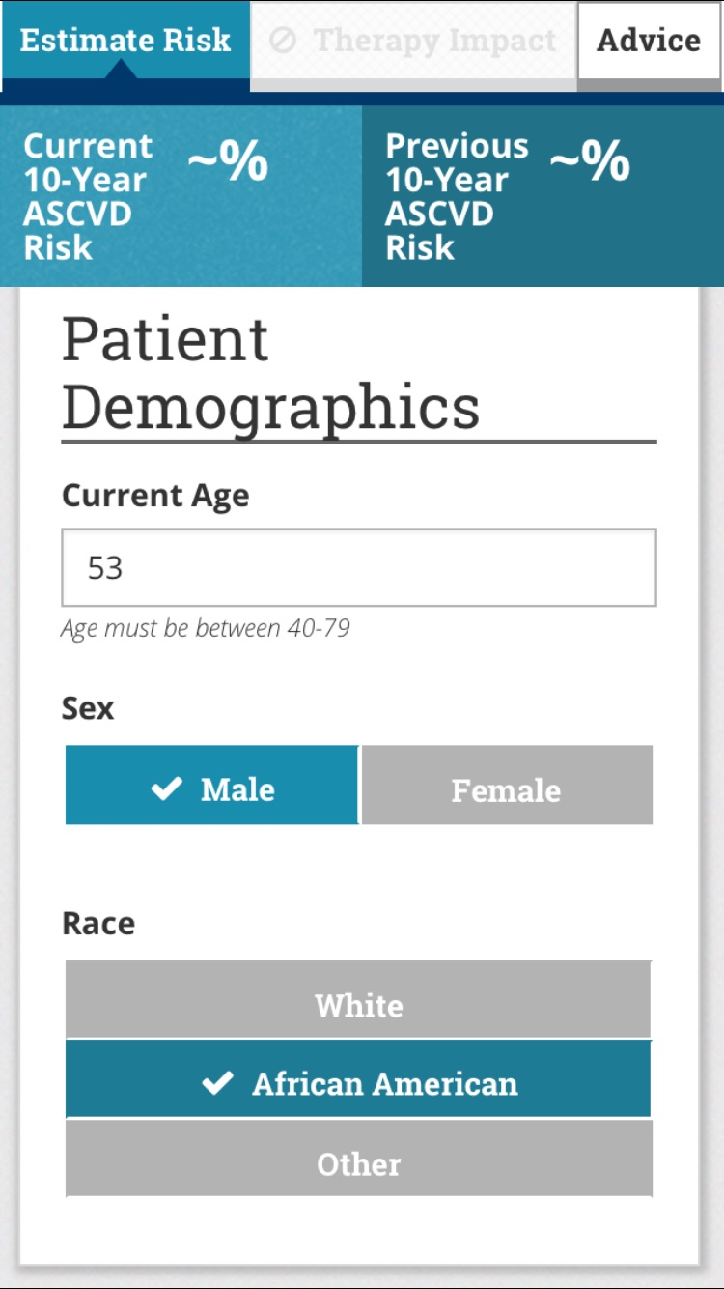
Lipid screening and coronary heart disease prevention
Notes:
All adults age 40-75 should have lipid screening.
Use a risk calculator to decide whether Sam should get a statin or aspirin to lower his risk of coronary artery disease.

Slide 28
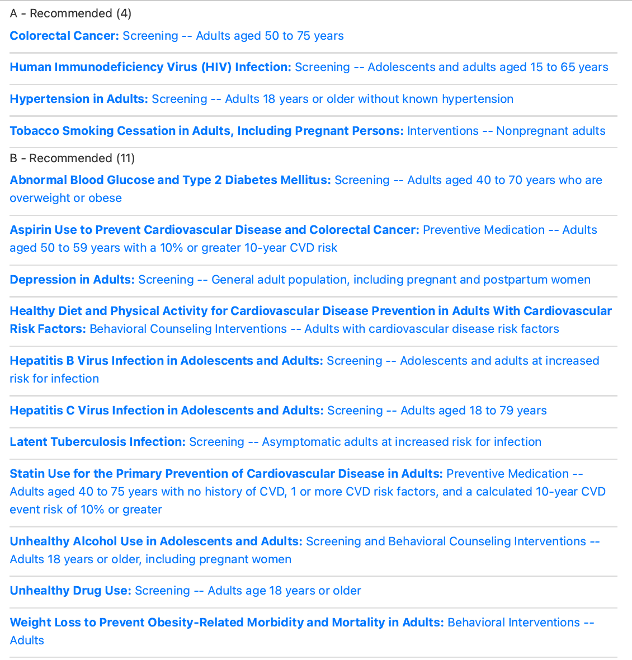
Summary for Sam
Notes:
Sam needs:
Complete history – including depression screening and screening for tobacco/alcohol/drug use
Height/weight
Blood pressure
Lipids
HIV/RPR: if indicated
Hep C: if not done previously
Colon cancer screening
Discussion of prostate cancer screening

Slide 29

PATIENT CASE:
David
He/Him pronouns
52-year-old
Transgender Man
No surgery
Takes testosterone
Not sexually active
29
Photo: Transgender Man Laughing With Eyes Closed Isolated On
Dark Background by Jacob Lund Photography from NounProject.com
Notes:
What does he need?
Screening needs depend on which organs he has.
Photo Credit: Transgender Man Laughing With Eyes Closed Isolated On Dark Background by Jacob Lund Photography from NounProject.com

Slide 30
What does David need?
Pap Smear by Eucalyp from NounProject.com
https://www.cdc.gov/cancer/colorectal/basic_info/what-is-colorectal-cancer.htm
Notes:
David has breasts and a cervix, so he needs mammography and a pap smear.
These kinds of exams can be triggering and exacerbate gender dysphoria. Use universal trauma precautions = assume everyone is traumatized.
He also needs:
Colorectal cancer screening
Blood pressure screening
Lipid screening
Photo Credit:
Blood Pressure by Amethyst Studio from NounProject.com
Pap Smear by Eucalyp from NounProject.com
https://www.cdc.gov/cancer/colorectal/basic_info/what-is-colorectal-cancer.htm

Slide 31
Mammograms: When and How Often?
 | Age to start | Age to stop | Frequency
USPSTF, AAFP, ACP | 50 | 75 | Every 2 years
American Cancer Society | 45 | When life expectancy is under 10 years | Every year age 45-54 Every 2 years over age 55
American College of Radiology | 40 | At least to age 75, individualized after that | Every year
ACOG | 40 or 50 | 75 or older | Every 1-2 years

Slide 32
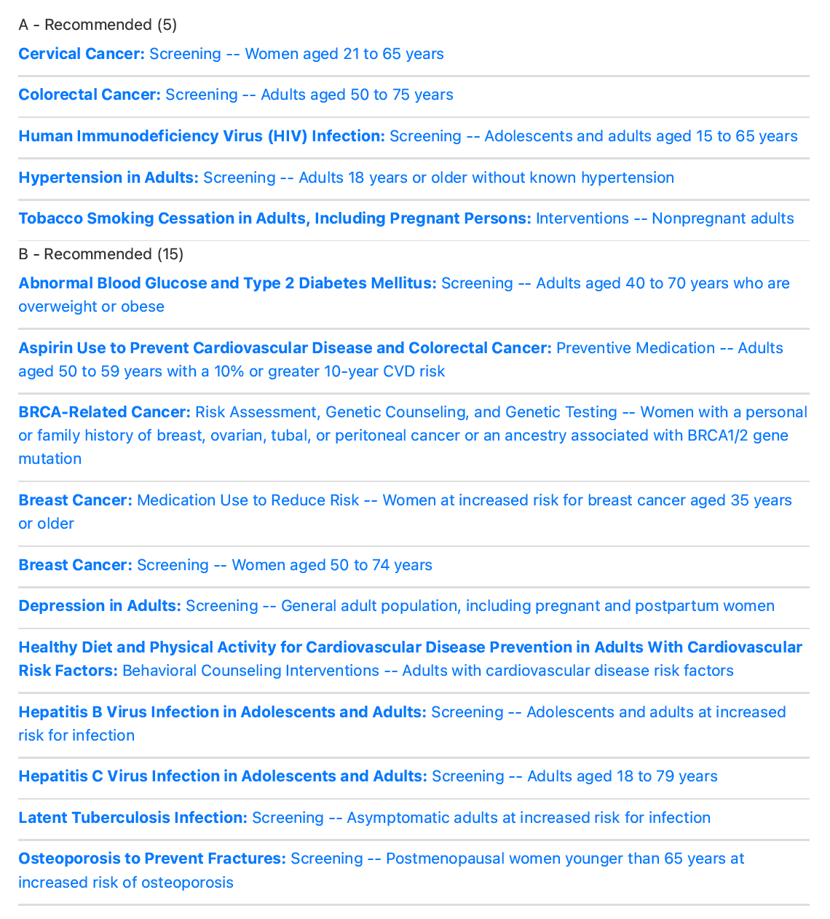
Summary for David
Notes:
USPSTF app uses the gender binary, so it doesn’t completely fit, however the important thing is to do relevant screening for the organs the person has.

Slide 33
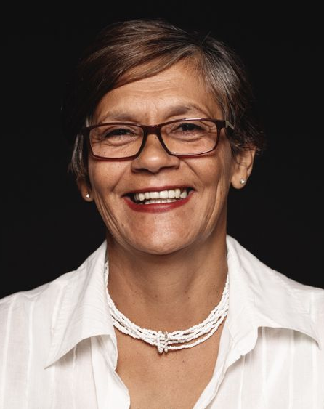
PATIENT CASE:
Blair
New to your practice
77-year-old grandmother
Here for “my yearly pap.”
33
Photo: Smiling Mature Woman Looking At Camera Isolated On Dark
Background by Jacob Lund Photography from NounProject.com
Notes:
Blair has had yearly check-ups with Pap smears since she had her first child at age 27.
Her pap smear have been normal each year.
Photo Credit: Smiling Mature Woman Looking At Camera Isolated On Dark Background by Jacob Lund Photography from NounProject.com

Slide 34
When Should We Stop Cervical Cancer Screening?
Age 65 if adequate prior screening
Exceptions:
    Screening for 20 years after appropriate management of a precancerous lesion
    Individualized care if history of high grade lesion or cancer, immunocompromised, DES exposure
Notes:
From USPSTF: “Joint guidelines from the American Cancer Society, American Society for Colposcopy and Cervical Pathology, and American Society for Clinical Pathology (ACS/ASCCP/ASCP) define adequate prior screening as 3 consecutive negative cytology results or 2 consecutive negative cotesting results within 10 years before stopping screening, with the most recent test occurring within 5 years. The guidelines further state that routine screening should continue for at least 20 years after spontaneous regression or appropriate management of a precancerous lesion, even if this extends screening past age 65 years. Once screening has stopped, it should not resume in women older than 65 years, even if they report having a new sexual partner.”
Screening may be clinically indicated in older women with an inadequate or unknown screening history. Recent data suggest that one-fourth of women aged 45 to 64 years have not been screened for cervical cancer in the preceding 3 years.⁹ In particular, women with limited access to care, women from racial/ethnic minority groups, and women from countries where screening is not available may be less likely to meet criteria for adequate prior screening. Certain considerations may also support screening in women older than 65 years who are otherwise at high risk (ie, women with a history of high-grade precancerous lesions or cervical cancer, in utero exposure to diethylstilbestrol, or a compromised immune system).^{2”}
ASCCP’s app can help you manage a history of abnormal pap smears

Slide 35
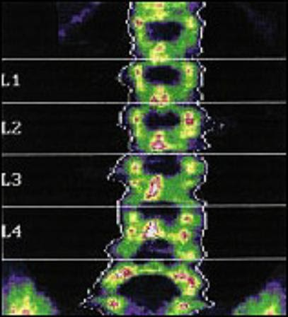
Osteoporosis Screening
35
Notes:
The USPSTF recommends (level B) screening for osteoporosis in women aged 65 years or older and in younger women whose fracture risk is equal to or greater than that of a 65-year-old white woman who has no additional risk factors.
Frequency of Service:
The potential value of rescreening women whose initial screening test did not detect osteoporosis is to improve fracture risk prediction. A lack of evidence exists about optimal intervals for repeated screening and whether repeated screening is necessary in a woman with normal BMD. Because of limitations in the precision of testing, a minimum of 2 years may be needed to reliably measure a change in BMD; however, longer intervals may be necessary to improve fracture risk prediction.
Risk Factor Information:
Based on the U.S. FRAX tool, a 65-year-old white woman with no other risk factors has a 9.3% 10-year risk for any osteoporotic fracture. White women between the ages of 50 and 64 years with equivalent or greater 10-year fracture risks based on specific risk factors include but are not limited to the following persons: 1) a 50-year-old current smoker with a BMI less than 21 kg/m², daily alcohol use, and parental fracture history; 2) a 55-year-old woman with a parental fracture history; 3) a 60-year-old woman with a BMI less than 21 kg/m² and daily alcohol use; and 4) a 60-year-old current smoker with daily alcohol use. The FRAX tool also predicts 10-year fracture risks for black, Asian, and Hispanic women in the United States. In general, estimated fracture risks in nonwhite women are lower than those for white women of the same age.
Photo Credit:

Slide 36
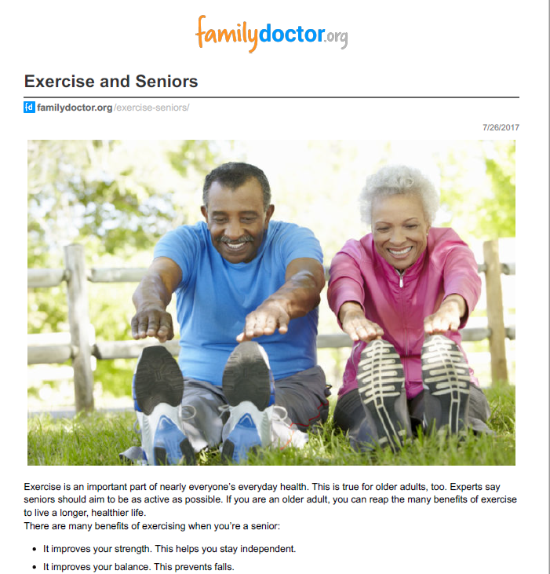
Exercise and fall prevention
Notes:
Specific Recommendations:
The USPSTF recommends (level B) exercise or physical therapy to prevent falls in community-dwelling adults aged 65 years or older who are at increased risk for falls.
No single recommended tool or brief approach can reliably identify older adults at increased risk for falls, but several reasonable and feasible approaches are available for primary care clinicians. See the Clinical Considerations section for additional information on risk assessment.
Frequency of Service:
No Frequency of Service information currently available.
Risk Factor Information:
Age itself is strongly related to risk for falls. Several clinical factors, including a history of falls, a history of mobility problems, and poor performance on the timed Get-Up-and-Go test also identify persons at increased risk for falling.
Photo Credit:

Slide 37
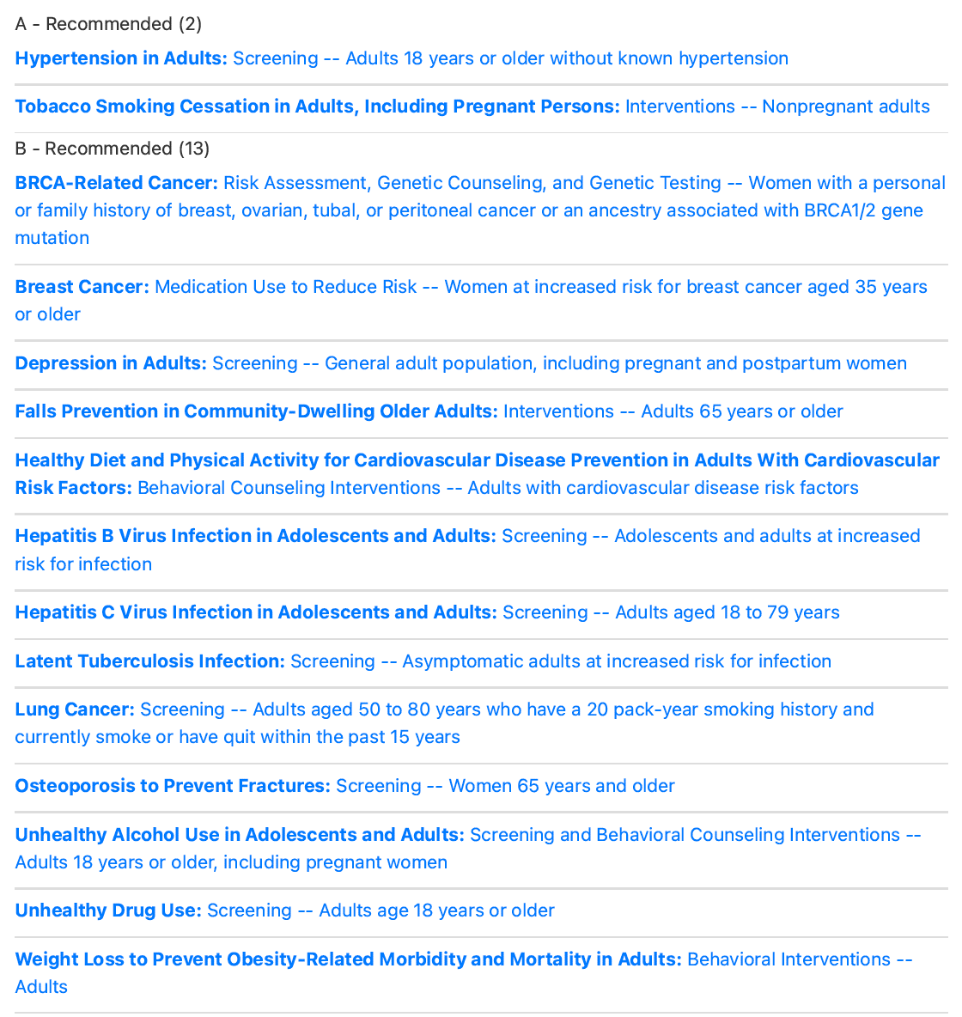
Summary for Blair

Slide 38
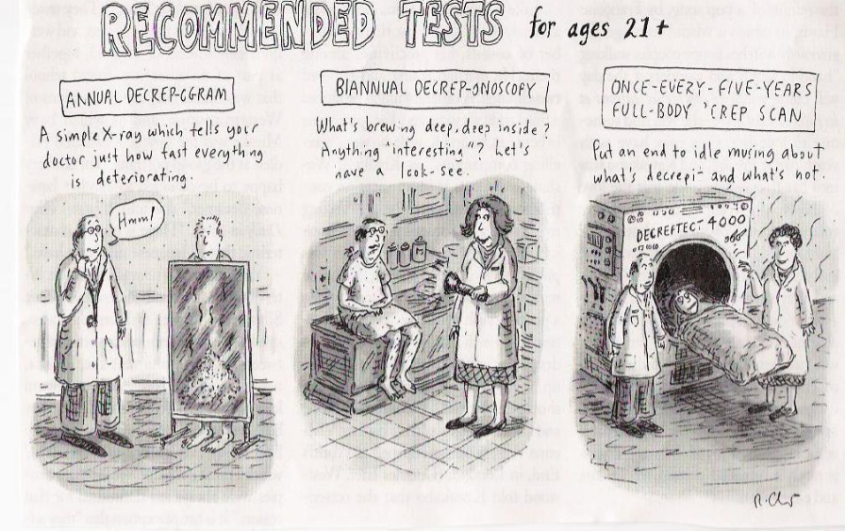
Notes:
Photo Credit:

Slide 39

RESOURCES.
US Preventive Services Task Force: https://www.uspreventiveservicestaskforce.org/
CDC Vaccines: https://www.cdc.gov/vaccines/schedules/hcp/index.html
Patient education from the American Academy of Family Physicians: https://familydoctor.org/

Slide 40

THANK YOU.
Notes:
Updated 12/2021

