Slide 1
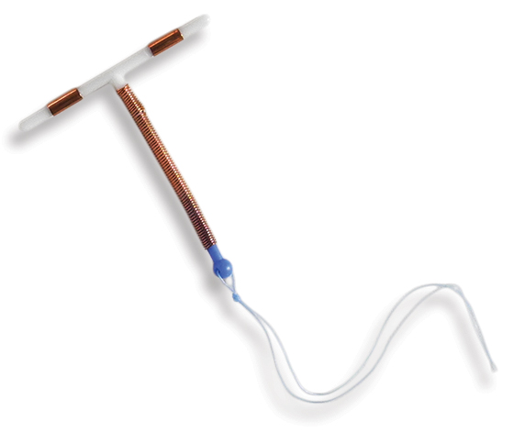


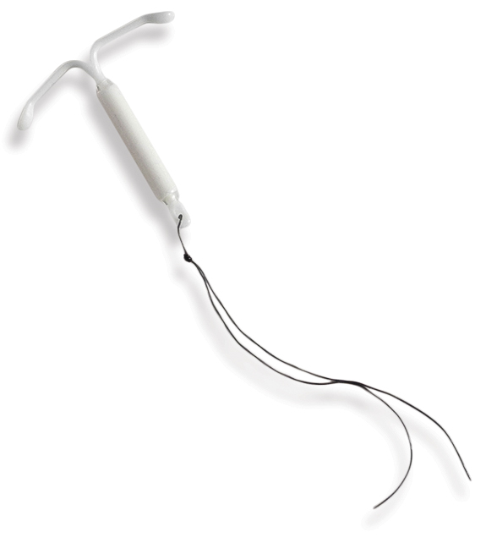
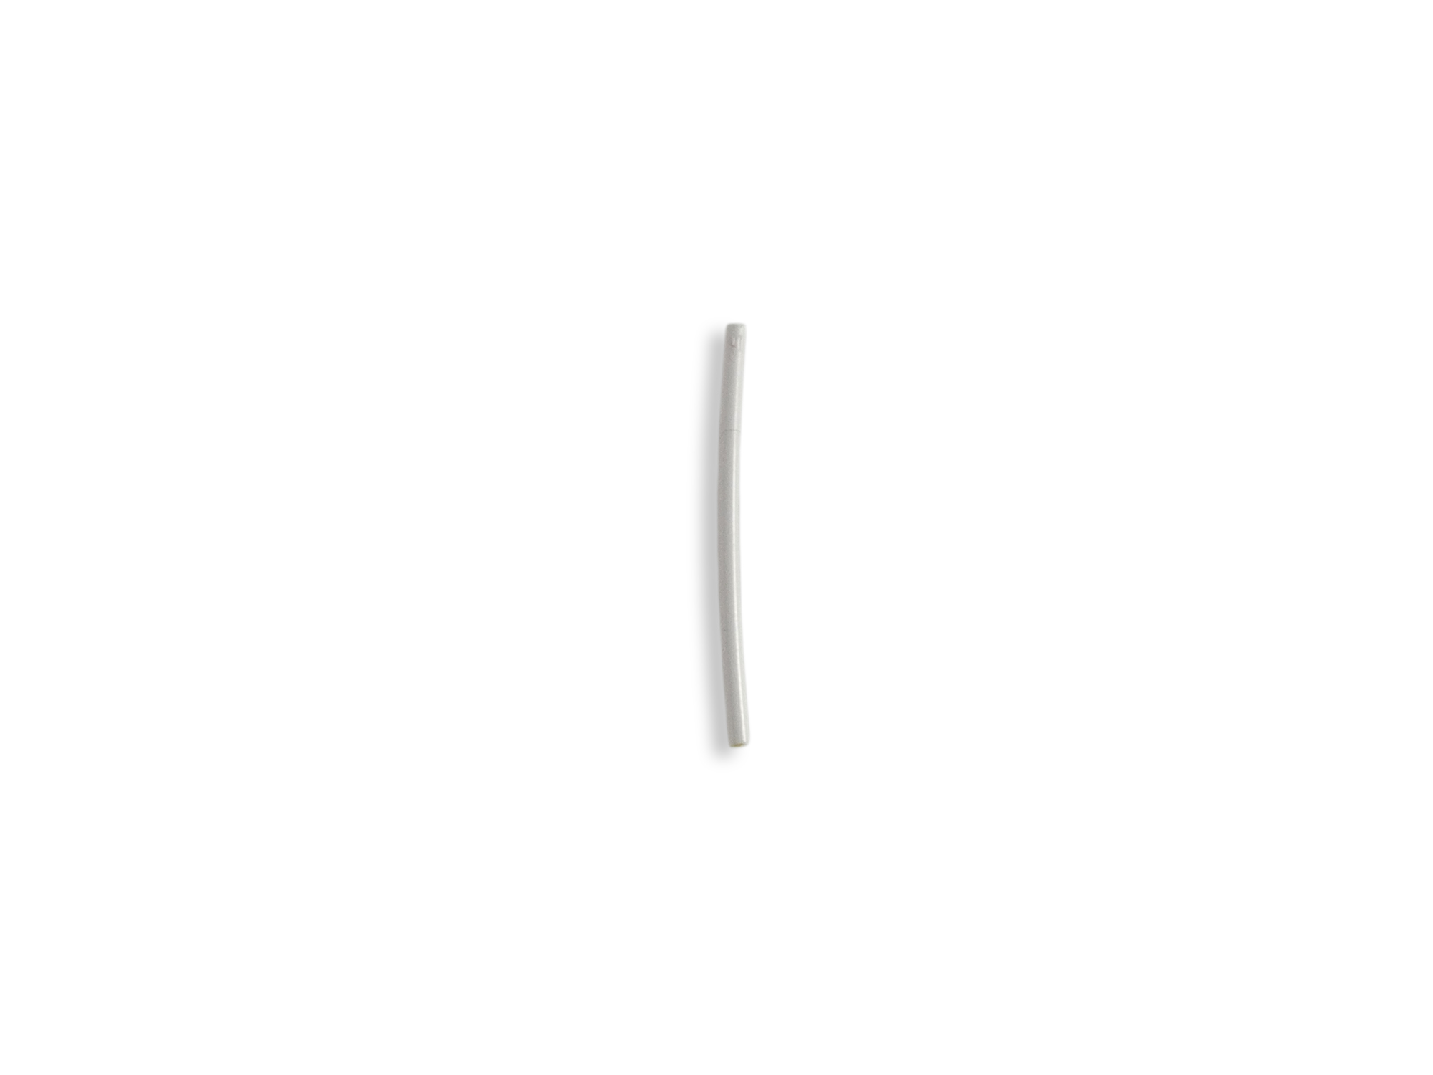
LONG ACTING REVERSIBLE CONTRACEPTIVES
ADVANCED: Troubleshooting in difficult insertions and removals
Notes:
Updated 12/2021

Slide 2
LEARNING OBJECTIVES.
  Effectively provide anticipatory guidance to patients
  Anticipate difficulties with LARC insertion and removals
  List instruments and techniques needed to address these difficulties with step by step strategies
  Describe non-coercive counseling approach when a patient requests a removal

Slide 3

BEDSIDER – “Does Getting an IUD Hurt?”
Notes:
https://www.bedsider.org/features/1032-does-it-hurt-to-get-an-iud

Slide 4



What Helps Patients?
4
Photos: https://genderphotos.vice.com/
Unsplash.com
Notes:
From the video and your own experiences, what helps patients?
Provider told them what to expect:
Provider told them what was happening:
People are counseled about the procedure before it happens and told what’s happening each step of the way
Some patients prefer not to be told what each step is. Important to ASK
Pre-medication with ibuprofen 800 mg or APA 1 g or naproxen 440 mg: Premedication w/NSAIDs or acetaminophen is helpful with post-procedure pain
Saw the device when counseled
Photo Sources: https://genderphotos.vice.com/

Slide 5
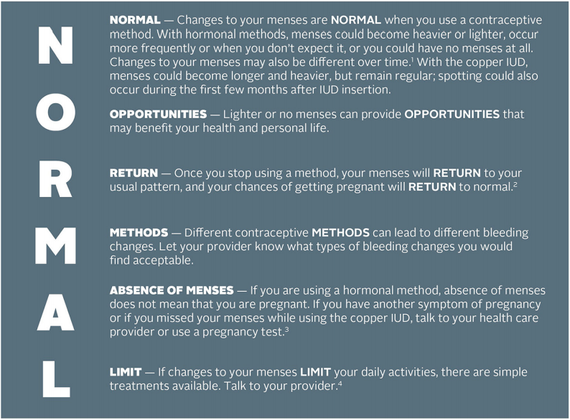
Counseling About Bleeding Changes
5
Citation: Rademacher KH, Sergison J, Glish L, et al. Menstrual Bleeding Changes Are NORMAL: Proposed Counseling
Tool to Address Common Reasons for Non-Use and Discontinuation of Contraception. Glob Health Sci Pract.
2018;6(3):603-610. Published 2018 Oct 4. doi:10.9745/GHSP-D-18-00093
Notes:
Pts need more anticipatory guidance than “you’ll have irregular bleeding” or “you’ll have some spotting”
Remember that patients have values around menstrual bleeding.
Ex. While it can be helpful to inform someone that amenorrhea while on contraception is safe, it’s important to respect whether or not patients are comfortable with that
Ask patients how they would feel if different bleeding patterns were to happen
Citation: Rademacher KH, Sergison J, Glish L, et al. Menstrual Bleeding Changes Are NORMAL: Proposed Counseling Tool to Address Common Reasons for Non-Use and Discontinuation of Contraception. Glob Health Sci Pract. 2018;6(3):603-610. Published 2018 Oct 4. doi:10.9745/GHSP-D-18-00093

Slide 6

One Year Failure Rates
Effectiveness | Contraceptive | Typical-use pregnancy rate
Ineffective | Chance | 85%
Less effective | Condoms | 14%
More effective | Pill/patch/Ring | 8%
Highly effective | IUDs | 0.8 – 2%
 | Injectable | 0.1 – 0.3%
 | Implant | 0.1 – 0.3%
 | Sterilization (tubal methods, vasectomy) | 0.1 – 0.3%
6
Sonfield A, Hasstedt K and Gold RB, Moving Forward: Family Planning in the Era of Health Reform, New York: Guttmacher Institute, 2014.
Notes:
User-dependent contraceptive methods have higher pregnancy rates.
References:
Sonfield A, Hasstedt K and Gold RB, Moving Forward: Family Planning in the Era of Health Reform, New York: Guttmacher Institute, 2014.

Slide 7
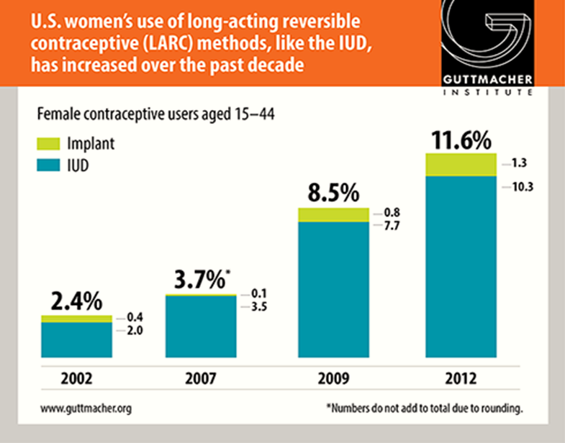
Increase in LARC Use
7
https://www.guttmacher.org/news-release/2015/use-long-acting-reversible-contraceptive-methods-continues-increase-united-states
Notes:
IUD use among females 15-44, 2012 10% continued rise since 2002 (Guttmacher 2015)
Choice Project, St Louis: 58% baseline chose IUD (12% Paragard, 46% Mirena) (Peipert, 2012)
LARC advocated as first-line by societies (ACOG, AAP, AAFP)
With more IUD insertions, expect more challenges
Note for facilitator on gender inclusive language:
We recognize that not only women can get pregnant. Instances in which gendered language is used is a reflection of the methods used by researchers when conducting studies.
References:
Guttmacher Institute. Use of Long-Acting Reversible Contraceptive Methods Continues to Increase in the United States. Accessed: https://www.guttmacher.org/news-release/2015/use-long-acting-reversible-contraceptive-methods-continues-increase-united-states. Published 10/2015.
Guttmacher Institute. Contraceptive Use in the United States. Accessed: https://www.guttmacher.org/fact-sheet/contraceptive-use-united-states Published 9/2016.
Winner, Brooke, et al. "Effectiveness of long-acting reversible contraception." New England Journal of Medicine 366.21 (2012): 1998-2007.

Slide 8

Reproductive Autonomy
The power to decide and control birth control use, pregnancy, and childbearing
8
Notes:
LARC should be included as part of a well-balanced mix of contraceptive options to prevent pregnancy and to manage other health conditions not related to pregnancy. But, LARC options should be made more accessible and available to patients not because of their effectiveness in preventing pregnancy, but for the overall goal of enhancing reproductive autonomy. Reproductive autonomy means that people themselves have the power to decide and control contraceptive use, pregnancy, and childbearing.
In the past and present, LARC methods have often been over-promoted among communities that are BIPOC, low-income, and have lower education, as well as for adolescents and so called “high-risk” populations. This over-emphasis on pregnancy prevention in these communities undermines reproductive autonomy and perpetuates inequities in who gets to have quality, dignified, and patient-centered care. Patient-centered contraceptive counseling for all people can enhance reproductive autonomy and prevent coercion by supporting patients with information and counseling to help them make the best decision for their health and unique circumstances. LARC may or may not be that option.
Summary of key principles from the LARC Statement of Principles
Rather than emphasize “effectiveness above all”, offer counseling based on the person’s needs, preferences, and experiences so that they have enough information to make the best decision about their birth control method
Acknowledge the complex history of LARC provision and ensure counseling is provided in a consistent, respectful manner that neither denies access nor coerces anyone into using a specific method
Provide comprehensive, scientifically accurate information about the full range of methods in a medically ethical and culturally competent manner so that each person is supported in identifying the method that best meets their needs
The decision to stop using LARC should be made by each individual with support from their clinician without judgement or obstacles
Sources:
1. Sister Song & National Women’s Health Network. Long-Acting Reversible Contraception Statement of Principles. https://www.nwhn.org/wp-content/uploads/2017/02/LARCStatementofPrinciples.pdf
2. Gomez AM, Fuentes L, Allina A. Women or LARC first? Reproductive autonomy and the promotion of long-acting reversible contraceptive methods. Perspect Sex Reprod Health. 2014;46(3):171-175. doi:10.1363/46e1614

Slide 9
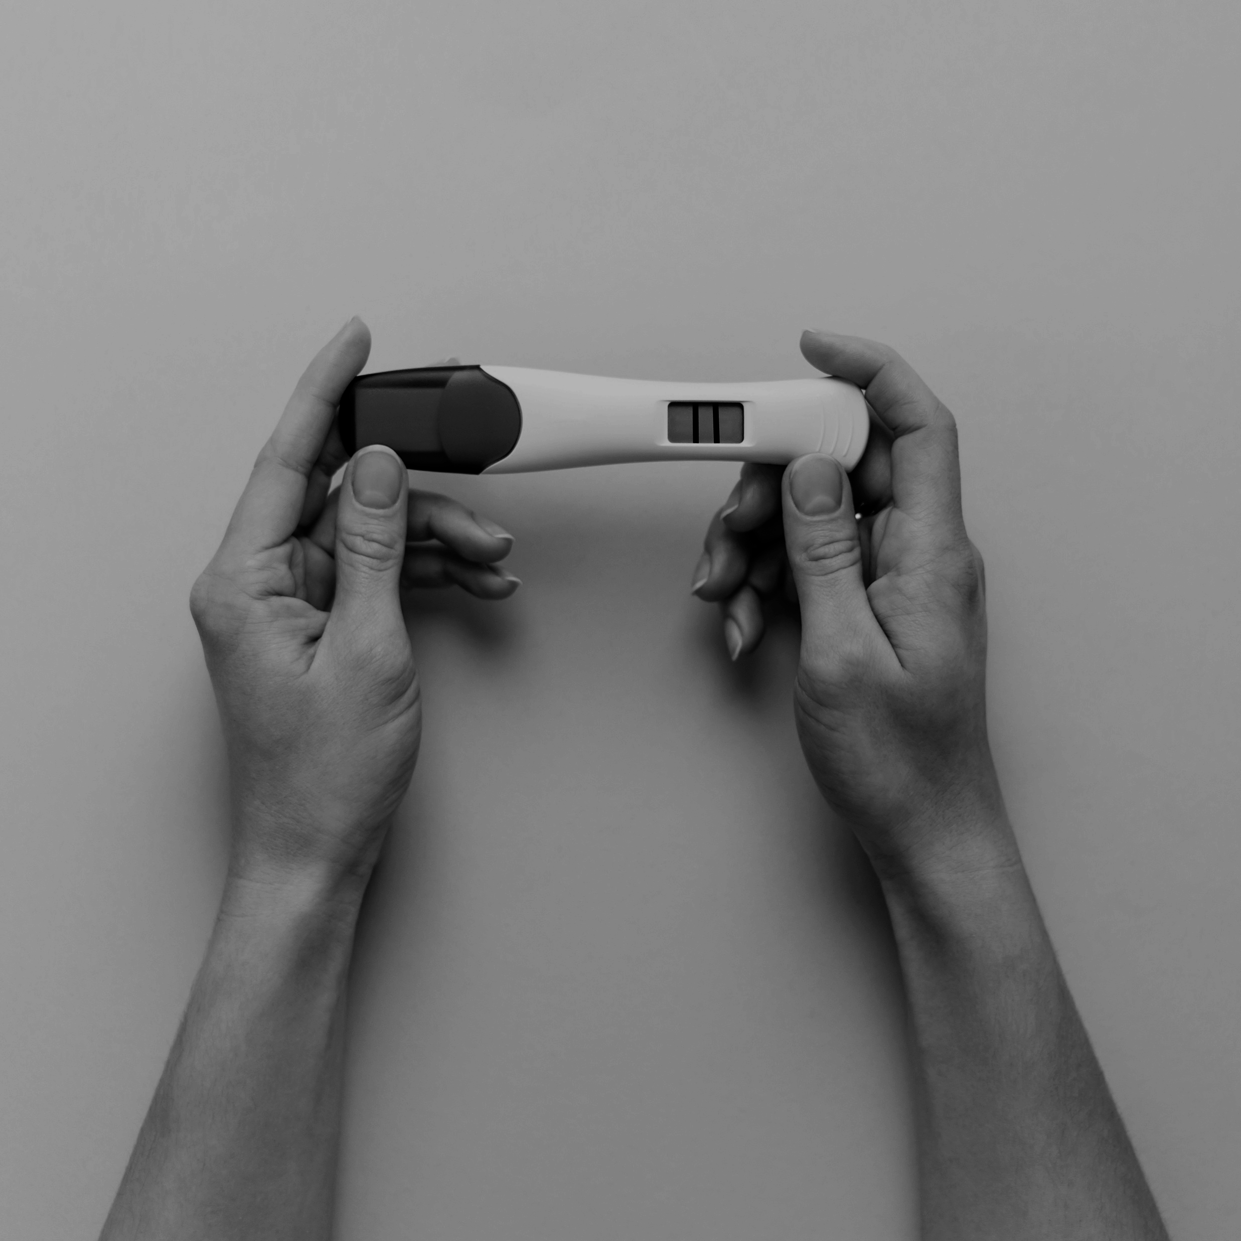
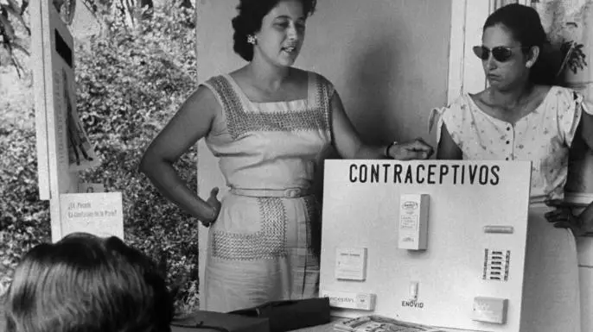
The Legacy of Puerto Rican Birth Control Trails
9
The teaching of birth control methods in Puerto Rico, 1960. (Credit: Hank Walker/The LIFE Picture Collection/Getty Images)
Notes:
It’s important to remember, acknowledge, and be informed by the history of how we got to where we are today in reproductive health care, especially contraception. Enovid was the world’s first birth control pill and was celebrated for ushering in an age of control and autonomy over reproduction (for some). But this discovery and the continued development of birth control pills and other methods originated at the expense of Puerto Rican women’s health and lives. It originated from Eugenic mindsets in the early 1900s with people like Margaret Sanger who argued that birth control could help wipe out “the greatest present menace to civilization”—people living in extreme poverty and those with mental illnesses and physical disabilities. She met and supported Gregory Pincus and John Rock, who went on to conduct the birth control trials in Puerto Rico. Puerto Rico was chosen because: the scientists knew they couldn’t do clinical trials on the mainland US, Puerto Rico was already home to many birth control clinics funded by eugenicists who wanted to reduce the Puerto Rican population to make room for more “fit” members of society. 1/3 of Puerto Rican women were sterilized, many involuntarily, after their second child’s birth. This set the stage for Pincus’s trials. The women who attended the trials were from the poorest areas of San Juan and just wanted to avoid pregnancy and avoid sterilization - but they had no idea that the pills they were receiving were part of an experiment and clinical trial. They weren’t given any information about safety. Many experienced serious side effects like blood clots. Despite the importance of the pill and the reproductive autonomy it has given to those wanting to avoid pregnancy, it’s history is marked by a lack of autonomy - a lack of true informed choice and information and the exploitation of impoverished women. This is this history and legacy of contraception that we are working in.
So our jobs is to stop this legacy from perpetuating and make sure that everyone has true autonomy, choice, information, and access to the reproductive health care they need.
Optional 5 minute video: scenes from the Documentary “La Operacion”: https://www.youtube.com/watch?v=tShnkBmoe3Y
Image is hyperlinked with link to video
Resources:
https://www.thecrimson.com/article/2017/9/28/the-bitter-pill/
https://www.history.com/news/birth-control-pill-history-puerto-rico-enovid
https://www.bese.com/how-puerto-rican-women-made-birth-control-possible-at-the-expense-of-their-health/

Slide 10

THE MEC
US Medical Eligibility Criteria (MEC)
CDC recommendations for specific contraceptive methods with certain medical conditions
Notes:
In counseling on contraception, one of the most important resources we use is the US Medical Eligibility Criteria (MEC).
This resource is the most evidenced based and up to date guideline on contraception options for patients with various medical conditions. Encourage participants to download the app or use the summary chart in their own practice.

Slide 11
MEC Categories of Safety
1 | No restriction for the use of the contraceptive method for a woman with that condition
2 | Advantages of using the method generally outweigh the theoretical or proven risks
3 | Theoretical or proven risks of the method usually outweigh the advantages - not usually recommended unless more appropriate methods are not available or acceptable
4 | Unacceptable health risk if the contraceptive method is used by a woman with that condition
11
Notes:
*Gendered language due to studies and evidence only assessing health and risks among cis-gender females

Slide 12
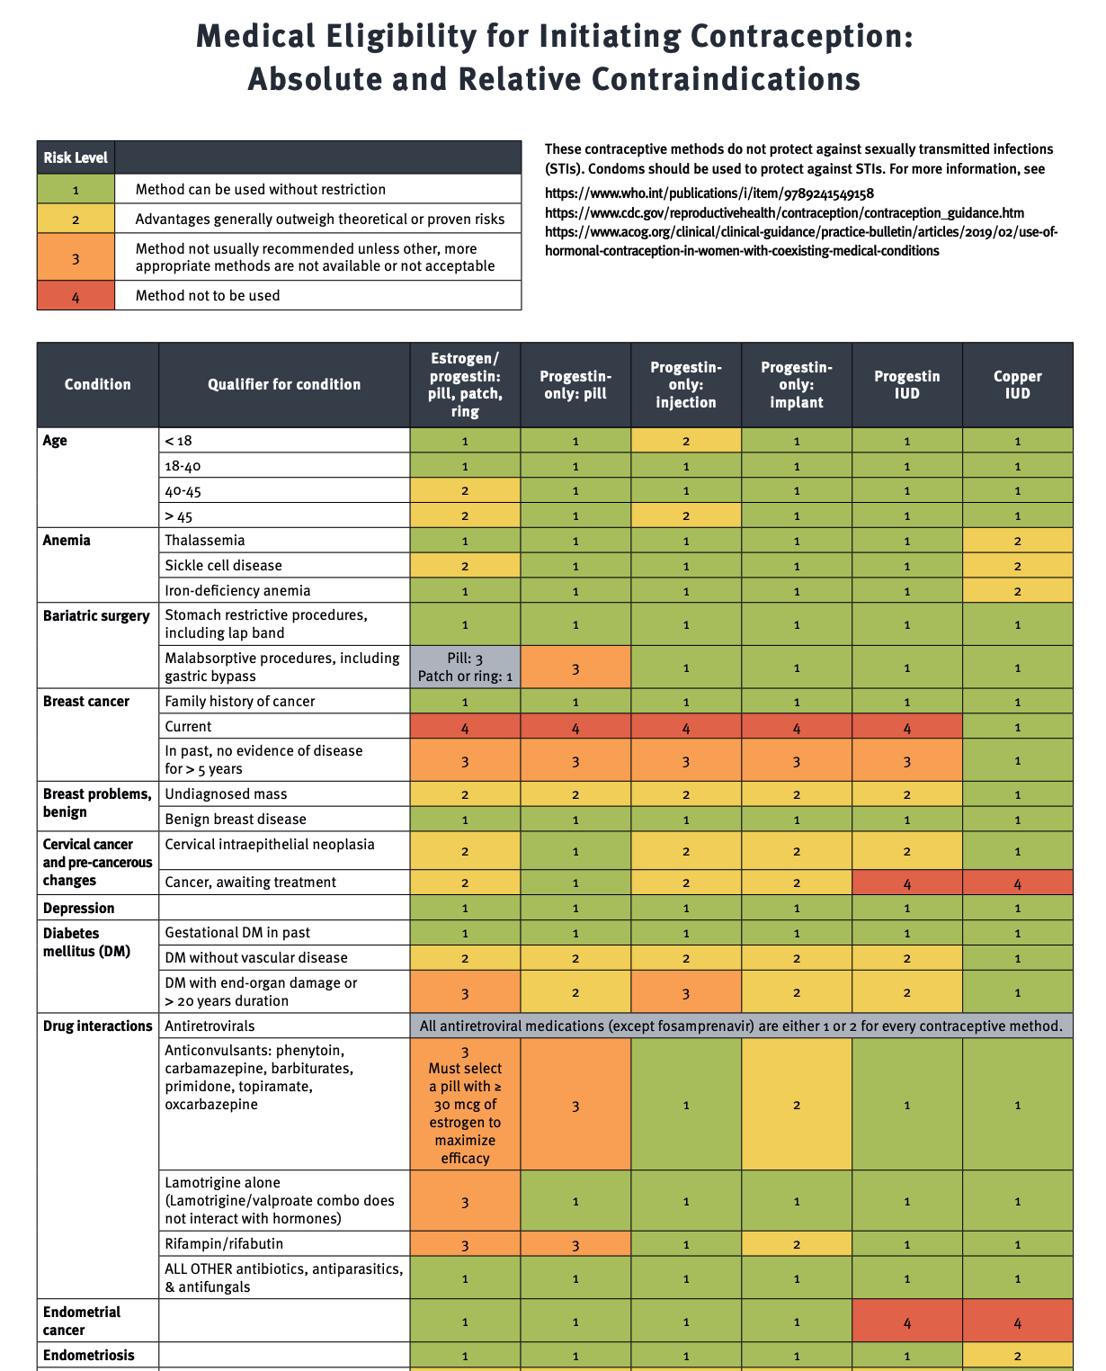
12
Image: RHAP
Notes:
This is just a snapshot of a part of the MEC, but notice all the green!
RHAP MEC: https://www.reproductiveaccess.org/resource/medical-eligibility-initiating-contraception/
CDC MEC: https://www.cdc.gov/reproductivehealth/contraception/mmwr/mec/summary.html
*Both have the same information, the RHAP one is organized with a RHAP color scheme for ease of viewing

Slide 13

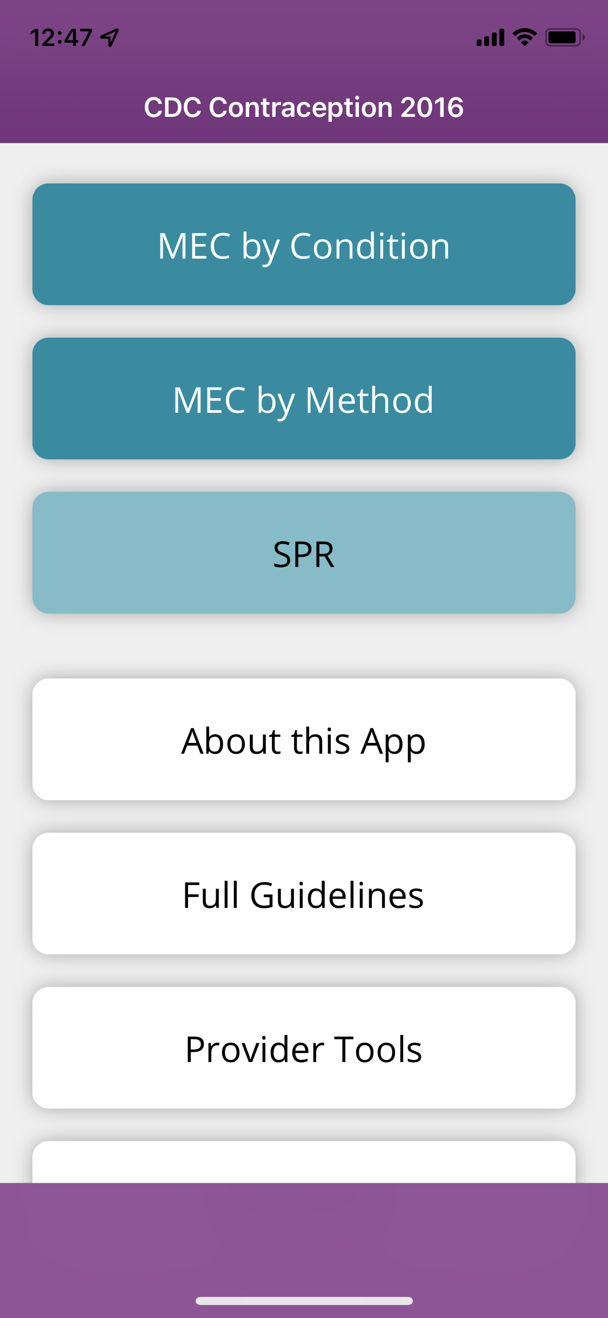
There’s an App for That:
Can be downloaded on iOS and Android operating systems https://www.cdc.gov/mobile/mobileapp.html
13
Notes:
Search for “CDC contraception” in the app store on your mobile device
Download the free CDC contraception app
We will refer to this app during the presentation

Slide 14
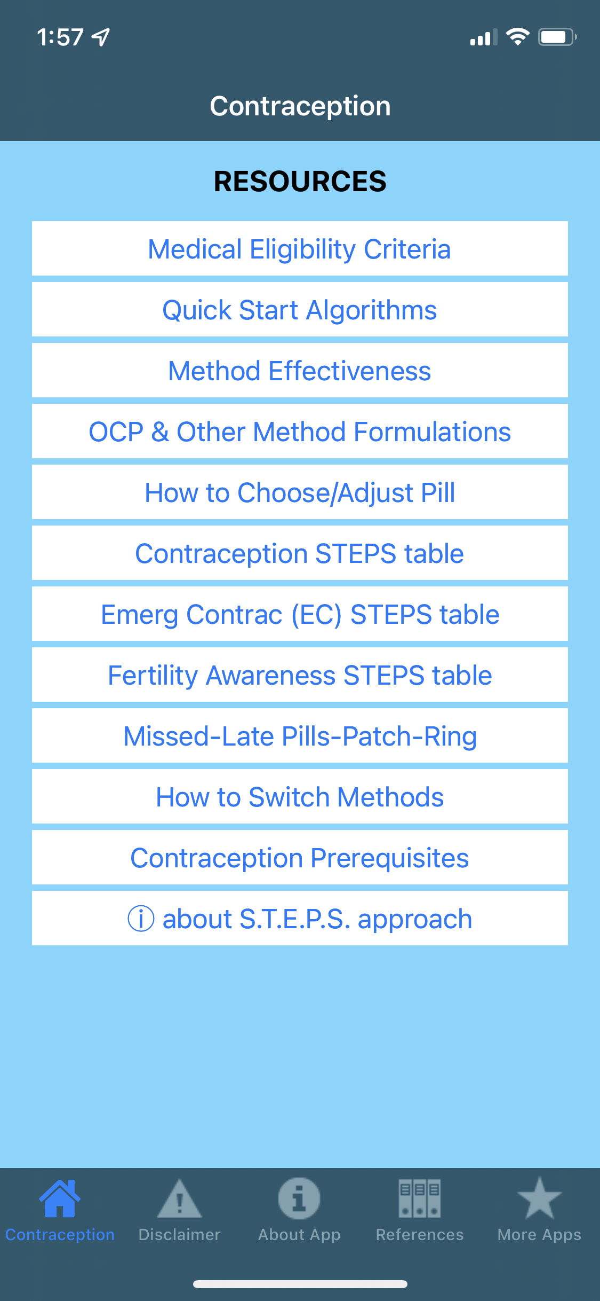

Another Helpful App:
Contraceptive Point-of-Care App
Notes:
Available for both iPhones and androids, free
Evidenced-based, user friendly resources including
How to use Quick Start
How to choose and adjust birth control pills
How to prevent gaps in coverage when switching methods.
A link to the MEC
Collaboration between RHAP and UHS Wilson Family Medicine Residency faculty clinicians Dr. Joshua Steinberg and Dr. Katherine Holmes.
To access: type in “contraceptive point-of-care” on users device and look for above icon.

Slide 15
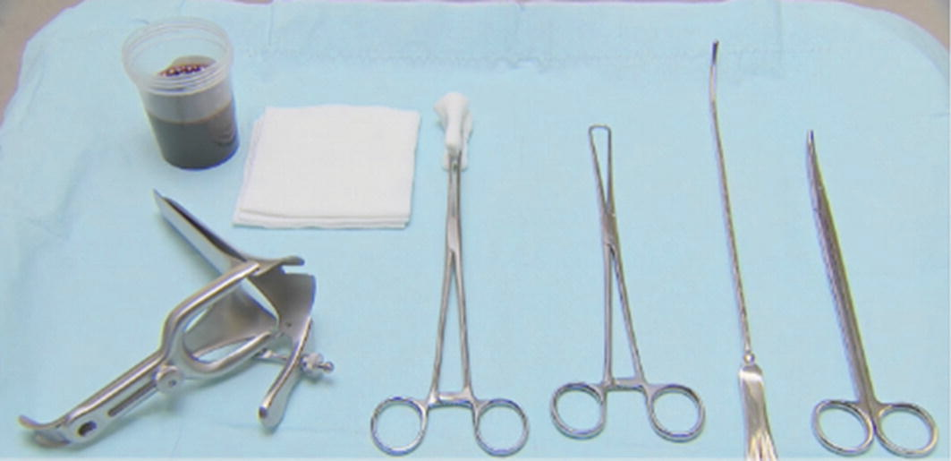
Easy Set Up
Photo: Google Images An article on integrating IUD use into your practice
Notes:
From Left to Right
Speculum
Cup with iodine
Gauze pads
Ring forceps to hold gauze
Tenaculum
Metal sound
Curved scissors
Image taken from: Google Images An article on integrating IUD use into your practice

Slide 16
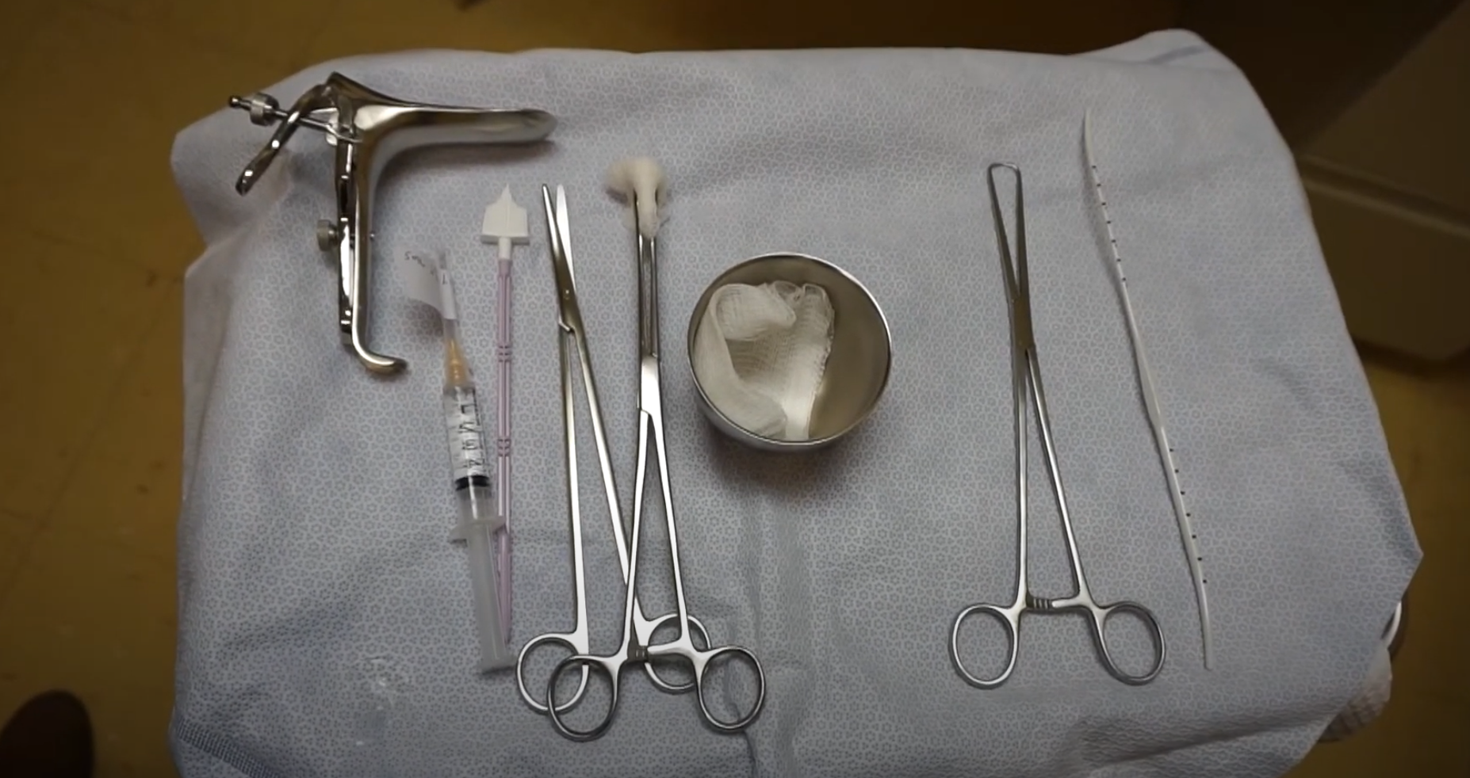
Easy Set Up
Video: https://www.youtube.com/watch?v=QxmhpowNKzI
Notes:
From left to right
Curved scissors
Metal sound
Plastic sound
Tenaculum
Ringed forceps
Packet of lubricant
Bottle of iodine
Gauze pads
Specula
OB Cotton Swabs
Watch short video on tray set up: https://www.youtube.com/watch?v=QxmhpowNKzI
Image is hyperlinked
Image is from video

Slide 17
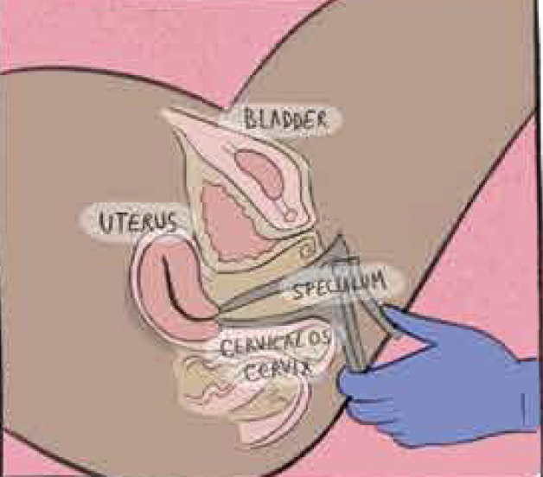
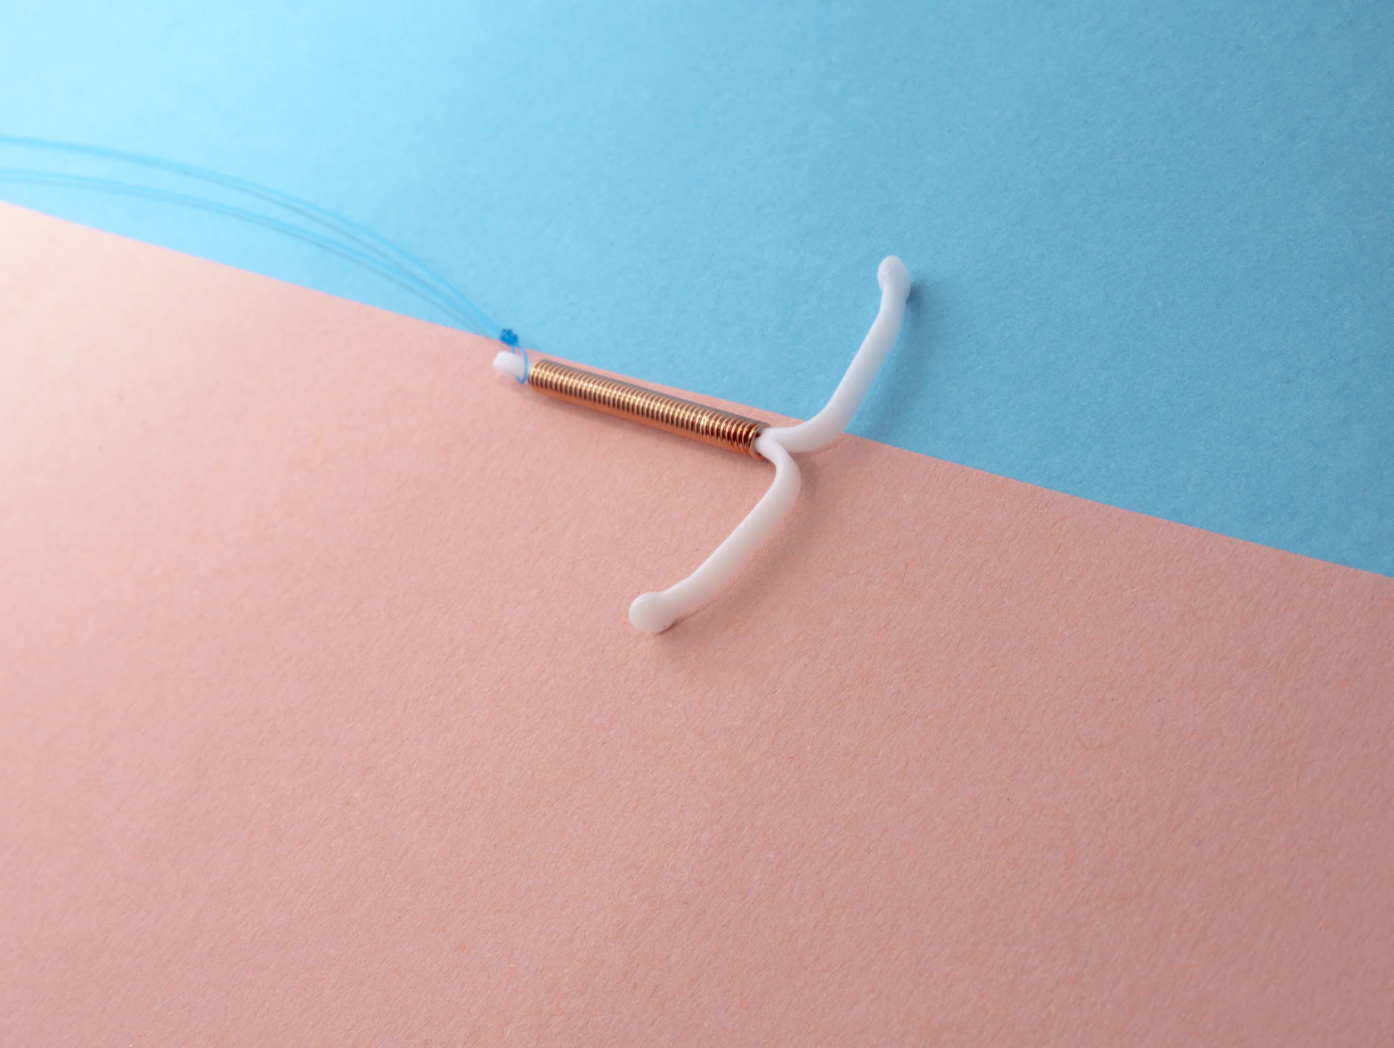
Challenges with IUD Insertions
Photos:
Ghazal Khadri, Elena’s Aspiration Abortion
Unsplash.com
Notes:
What challenges have you faced or heard about with IUD insertions?
Share examples:
Discomfort/difficulty with speculum placement
Visualizing the cervix
Extreme uterine position/uterine distortion
Prior c-sections
Tight cervical os
Vasovagal reaction
Perforation
Image Source:
Ghazal Khadri, Elena’s Aspiration Abortion
Unsplash.com

Slide 18


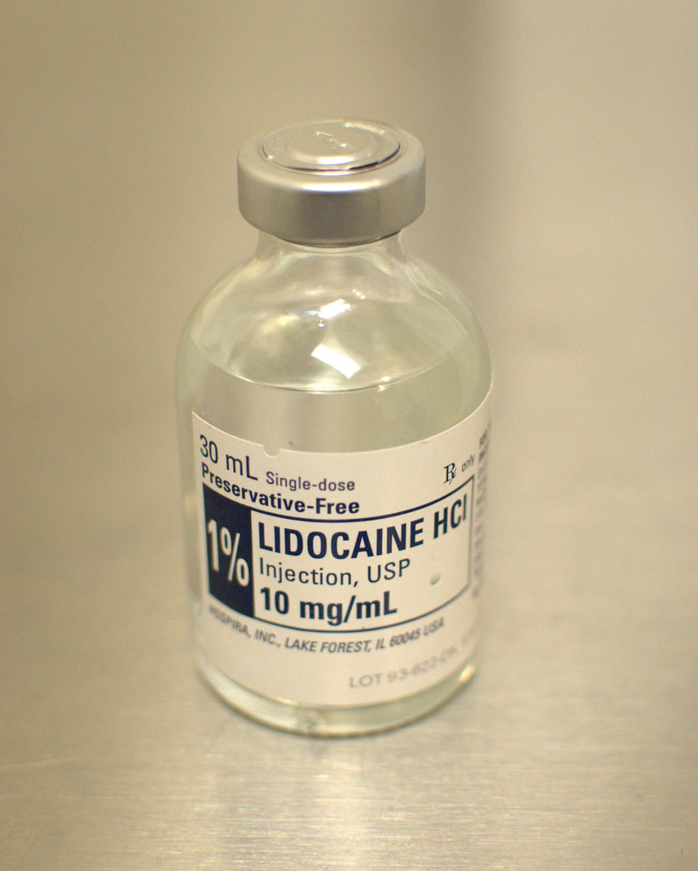
Comfort Measures for Patients
What are some ways you comfort and ease pain for LARC procedures?
Photos: https://pixabay.com/photos/painkillers-pills-medicine-drug-2525087/
https://www.flickr.com/photos/user47/5413108771/sizes/o/in/photostream/
https://www.genderphotos.vice.com
Notes:
Ask: What are some ways you comfort and ease pain for patients for LARC procedures?
2mL 1% lidocaine inj at tenaculum site
NSAIDs
Tramadol 50mg or naproxen 550mg
Ibuprofen found to be helpful w/post-procedure pain
Ibuprofen > Acetaminophen
Intermediate acting benzodiazepine (eg. Lorazepam)
Nitrous oxide?
Non-pharmacological comfort measures too
Marie Stopes “Vocal Local” technique - distraction therapy to support people going through procedures, managing anxiety verbally. You can introduce this method by saying; “I’m going to talk with you during the procedure because I know if you are talking, you are breathing; and if you are breathing, your body tends to be more relaxed.”
Recognize the patient’s pain: earn their trust by showing you believe their pain; acknowledge what they are feeling physically and emotionally. Do not discount anxiety, fear, or cramps
Distract the patient: Focus the patients’ attention elsewhere by engaging them in conversation. Asking open-ended questions may help. Safe topics include interests, plans for the day, career, and family. Comment on what you know about them: jewelry, tattoos, piercings, where they are from.
Play music. Several studies indicate that patients perceive less pain when listening to music.
Encourage the patient to breathe deeply and relax their muscles.
Offer a support person in the room
Heat pack
Ireland LD, Allen RH. Pain Management for Gynecologic Procedures in the Office. Obstet Gynecol Surv. 2016 Feb;71(2):89-98. doi: 10.1097/OGX.0000000000000272. PMID: 26894801.
Take oral meds 30-60 min before procedure
Pre-procedural miso ≠ effective in reducing pain
Ibuprofen has anti-prostaglandin effects which are helpful with uterine pain
NO needs additional study, few side effects, short duration (patients can drive selves home), easy to administer in office
Czarnecki ML, Turner HN, Collins PM, Doellman D, Wrona S, Reynolds J. Procedural pain management: a position statement with clinical practice recommendations. Pain Manag Nurs. 2011 Jun;12(2):95-111. Epub 2011 Apr 29. PMID: 21620311.
Renner RM, Jensen JT, Nichols MD, Edelman A. Pain control in first trimester surgical abortion. Cochrane Database of Systematic Reviews 2009, Issue 2. Art. No.: CD006712. DOI: 10.1002/14651858.DC006712.pub2.
Photo Credit:
https://pixabay.com/photos/painkillers-pills-medicine-drug-2525087/
https://www.flickr.com/photos/user47/5413108771/sizes/o/in/photostream/
https://www.genderphotos.vice.com

Slide 19
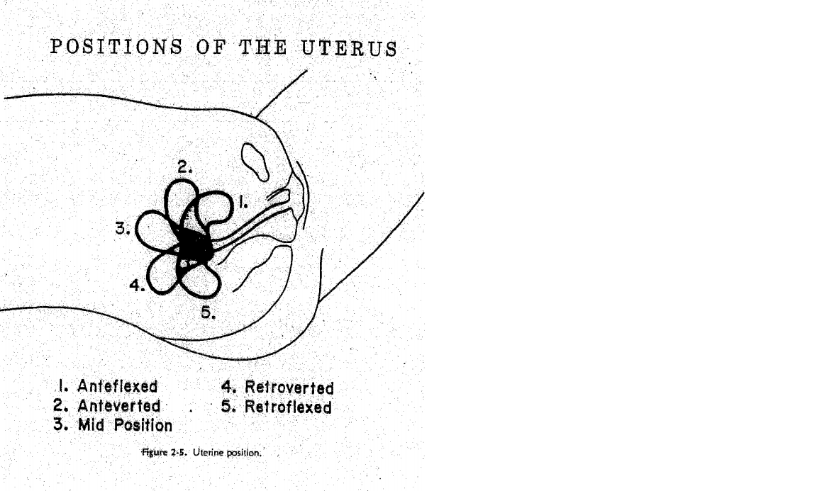
Position of the Uterus
Notes:
This is where difficulties can arise with the anteflexed and retroflexed uteri. A short speculum is extremely helpful in this case, as traction on the uterus can bring it into a straighter position.

Slide 20
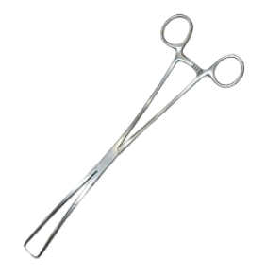
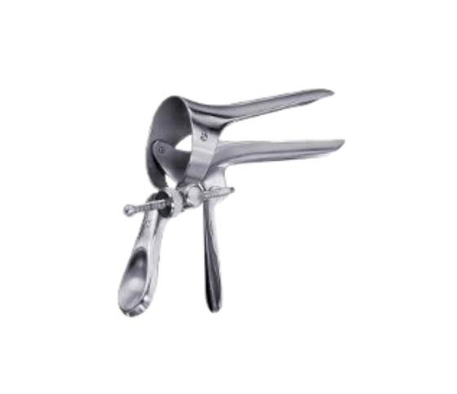
IUD Placement Tips
Use as short a speculum as possible
Give lidocaine 2-3cc prior to tenaculum placement, or use a paracervical block if especially difficult
Put traction on the tenaculum to straighten out the uterus
Very gently advance the sound, letting it follow the smooth surface of the canal

Slide 21
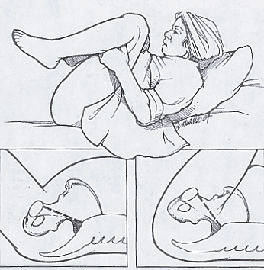
Cannot
Find
Cervix
Notes:
Repeat vaginal exam to check position of cervix if needed
Relaxation techniques: let bottom muscles sink down into table, pelvic tilt down, can show with finger inside vaginal canal; knees fall to sides; Position patient move further down on the exam table, with their hips off the edge
Remove redundant labial tissue from sides of speculum
Speculum handle close to perineum
Speculum: shorter Moore-Grave, Klopfer is useful; but may need to try longer speculum
Lateral wall traction (glove, condom, instrument)
Switch speculum size (length and width)
McRobert’s maneuver
TEACHING: May be able to do this hand-over-hand to show amount of pressure, etc - otherwise place for resident, if patient uncomfortable. Talk to patient while resident is attempting, or have doula present.

Slide 22

Post C-Section Uterus
Position of cervix can be very challenging as lower uterine segment often scarred to anterior abdominal wall
Uterus often seems initially anteverted and then fundus curves downwards midline to almost retroverted position

Slide 23
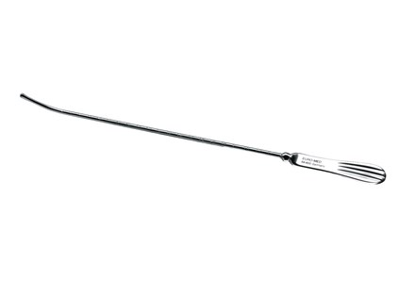
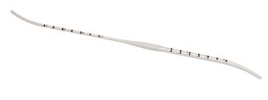
Sound vs Sound with Dilation
Notes:
Having a sound with dilation can make IUD insertion process easier

Slide 24
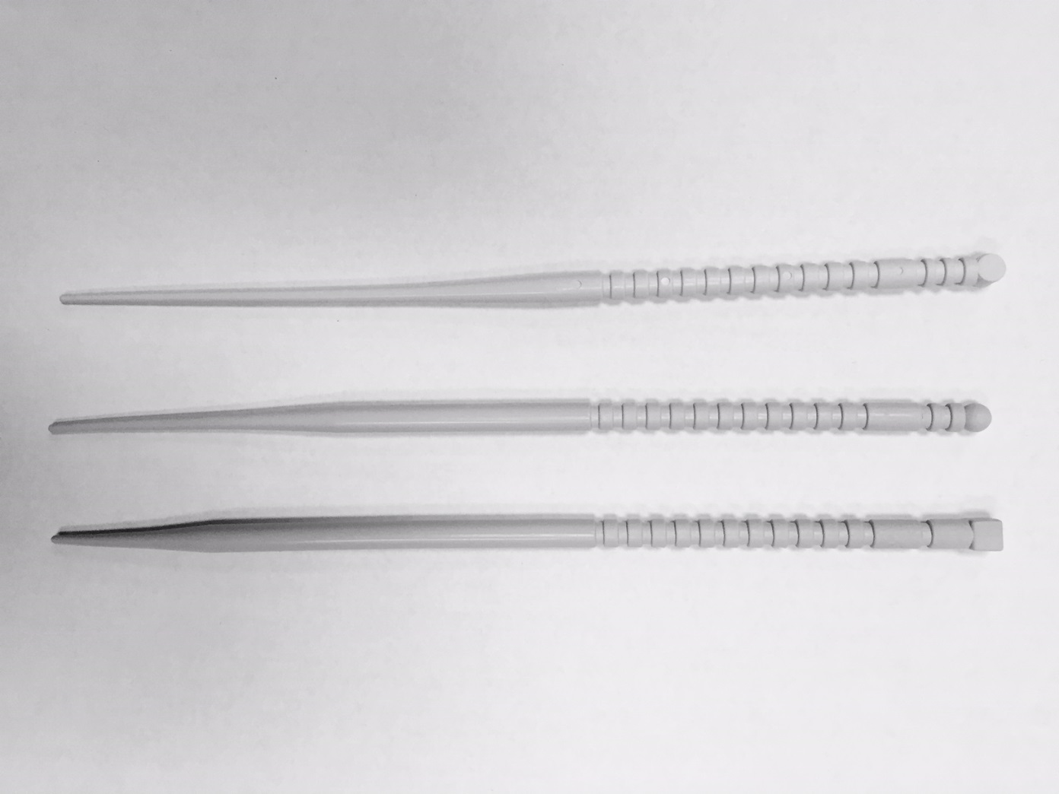
OS Finders
Notes:
Graduated, for stretching a tight inner cervical os

Slide 25
More Tips:
Have smelling salts available (for vasovagal reactions)
If perforation is suspected
  suspend procedure
  perform ultrasound
  Monitor vitals x 1 hour
  RTC w/fever, increased abdominal pain, increased bleeding
  Re-try insertion in 2 weeks with ultrasound guidance and more experienced provider
Notes:
Review what might have contributed to error – position of uterus? Metal sound? Inexperienced provider? Post-partum uterus

Slide 26

Use Caution With
Recently postpartum and breastfeeding
  Uterus is softer, higher risk of perforation
Prior c-section
Fibroids
Photo: Newborn Being Breast-fed At Home by Paulo Sousa from NounProject.com
Notes:
Ultrasound guidance may be helpful
Image source: Newborn Being Breast-fed At Home by Paulo Sousa from NounProject.com

Slide 27

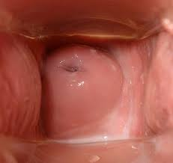
Challenges for IUD Removal
Can’t see strings
Embedded IUD
Malpositioned IUD

Slide 28
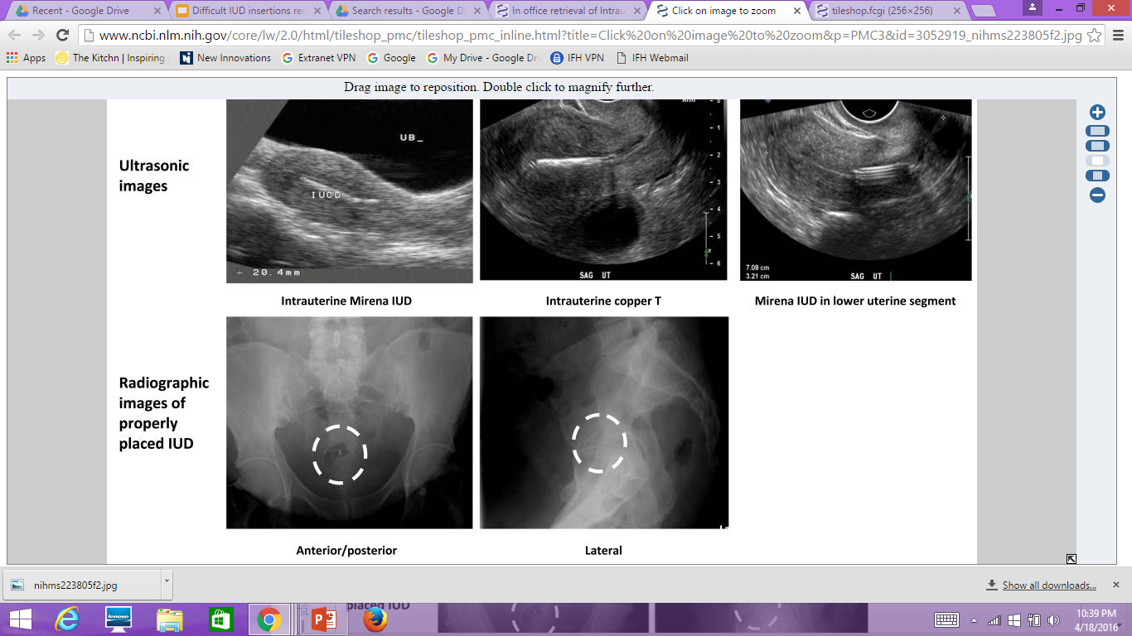
Ultrasound
To confirm if IUD in place, if patient returns with concerns.
Prabhakaran, Sujatha, and Alice Chuang. "In office retrieval of intrauterine c
ontraceptive devices with missing strings." Contraception 83.2 (2011): 102.
Notes:
Paragard easy to visualize on ultrasound due to copper, LNG-IUD more difficult- can see shadow beneath, 3-d ultrasound on left-easier to see Mirena
If IUD in uterus but not at fundus, consider rescanning in 2-4 weeks with backup contraception because may migrate into position.
References:
Prabhakaran, Sujatha, and Alice Chuang. "In office retrieval of intrauterine contraceptive devices with missing strings." Contraception 83.2 (2011): 102.

Slide 29
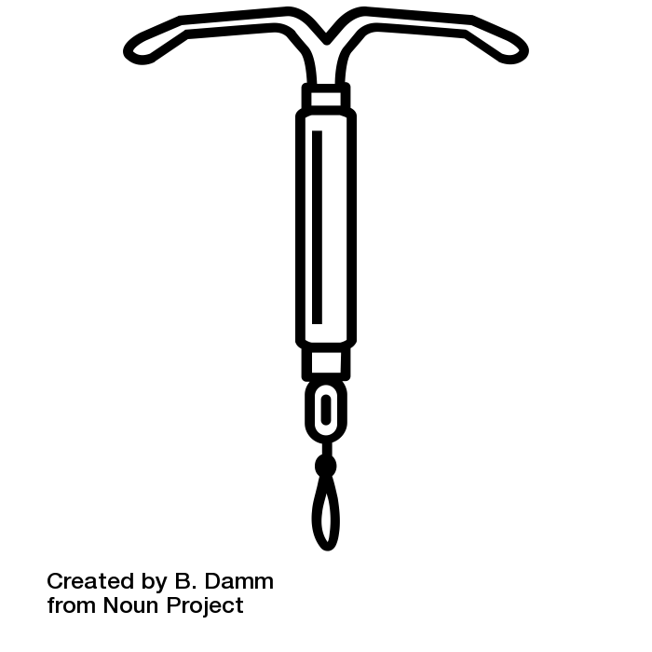
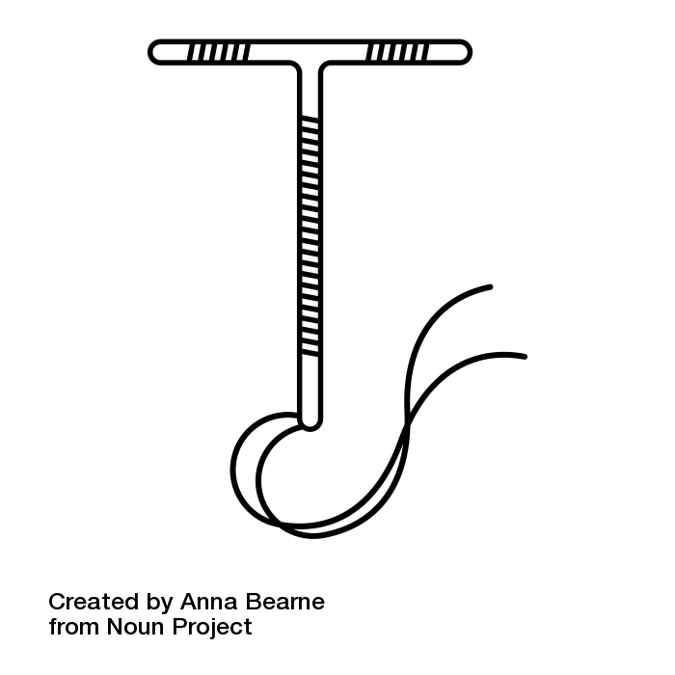
The Low-down on Low-down IUDS: Malposition and IUD Failure
IUDs in the Cervix:
  Copper IUD
    Odds ratio for pregnancy with intracervical insertion 13.93 (95%CI 4.13 – 48.96)
    Absolute risk increase of 1-2%
  LNG IUD
    Intracervical versus fundal placement found no difference in failure between groups
Notes:
Anteby 1993 study: “To investigate the possible role of position of the intrauterine device (IUD) in accidental pregnancies. METHODS: We examined the location of the IUD in 97 normal women 45-60 days post-insertion, and in 25 pregnant women with the device in situ. RESULTS: A cervically located IUD was identified in seven of 97 women (7.2%) after insertion and in 13 of 25 pregnant women (52%) with the device in situ. The odds ratio for a woman with an intracervical IUD to be pregnant compared with a woman with an IUD in the uterus was 13.93 (95% confidence limits 4.13-48.96).
References:
Anteby, Eyal, et al. "Intrauterine device failure: relation to its location within the uterine cavity." Obstetrics & Gynecology 81.1 (1993): 112-114.
Pakarinen, Päivi, and Tapani Luukkainen. "Five years' experience with a small intracervical/intrauterine levonorgestrel-releasing device." Contraception 72.5 (2005): 342-345.
Photo Credit:
IUD by Anna Bearne from the Noun Project
IUD by B. Damm from the Noun Project

Slide 30
Malposition Stats and Risk Factors
10% of IUD are malpositioned
Risk factors:
  Adenomyosis (OR 3.04 (1.08-8.52))
    Related to change in contractility of uterus?
  NOT associated with post-abortion or 6-9 week postpartum insertion
Protective factors:
  Prior vaginal delivery (OR 0.53 (0.32 – 0.87))
  Private Insurance (OR 0.38 (0.24 – 0.59))
Notes:
Braaten 2011 study: “retrospective case-control study compared 182 women with malpositioned IUDs shown by ultrasonography at a single institution from 2003 to 2008 with 182 women with properly positioned IUDs. We evaluated whether insertion at 6-9 weeks postpartum, postabortion placement, breastfeeding, type of IUD, pregnancy history, leiomyomas, suspected adenomyosis, and indication for placement were associated with malpositioning”
-univariate analysis of all types of IUD malpositioning also showed no differences according to type of IUD, breastfeeding status, indication for IUD placement, known leiomyomas, history of LEEP, or endometriosis.
**However, when examining specifically the 13 patients with intraperitoneal (perforated) IUDs, an increased risk was observed with insertion 6 –9 weeks postpartum (OR 8.77, 95% CI 2.41–31.88, P.001) and breastfeeding (OR 11.81, 95% CI 2.03– 68.79, P.008)
References:
Braaten, Kari P., et al. "Malpositioned intrauterine contraceptive devices: risk factors, outcomes, and future pregnancies." Obstetrics & Gynecology 118.5 (2011): 1014-1020.

Slide 31
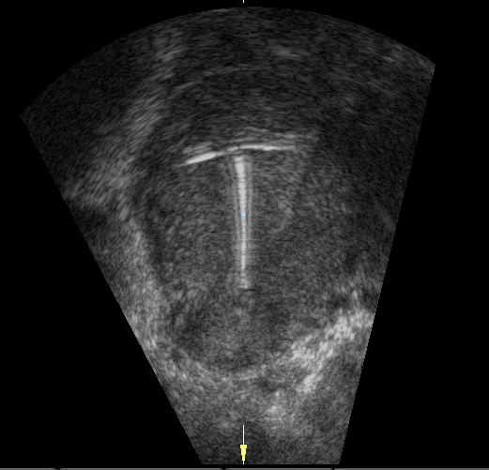
IUDs Move:
Most commonly, IUDs shift towards fundus after insertion
  Particularly true in people with lower parity
Most malpositioned IUDs will move into proper position within 3 months without any intervention
Watchful waiting is a reasonable option
Notes:
IUDs do move up and down the uterus after insertion
(Shimoni et al, 2014): IUD moved up and down throughout the 6 months (from 14 mm towards the fundus to 32 mm towards the cervix).
(Morales-Rosello, 2005): Study comparing position of IUD by US at insertion and 2-3 months after insertion – IUD moved upward mean of 4.9 mm, more commonly in people with fewer children – 97% moved up in 2-3 months
(Faundes 2000): Study evaluated IUD position by US in 214 people – 2/3 of misplaced IUDs at insertion will move to normal position within 3 months. Movement of IUD can be upward or downward, but more commonly upward.
References:
Shimoni, Noa ’a, Anne Davis, and Carolyn Westhoff. “Can Ultrasound Predict IUD Expulsion after Medical Abortion?” Contraception 89.5 (2014): 434–439.
Morales-Roselló, José. “Spontaneous Upward Movement of Lowly Placed T-Shaped IUDs.” Contraception 72.6 (2005): 430–431.
Faúndes, D. et al. “T-Shaped IUDs Accommodate in Their Position during the First 3 Months after Insertion.” Contraception 62.4 (2000): 165–168.

Slide 32
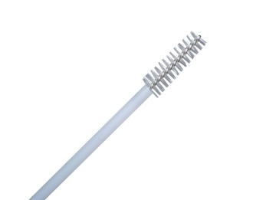
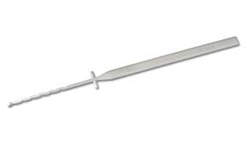
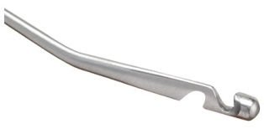
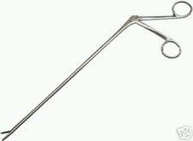
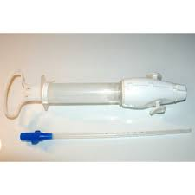
Removal: Missing Strings
Cytobrush
Ultrasound to confirm in uterus
Thread Retriever
IUD Hook
Alligator Forceps
MVA Aspirator with #5 or #6 cannula
Notes:
Doesn’t have to be removed BECAUSE strings are missing
Cytobrush- gently twist within the cervix to see if strings will catch and be removed this way
US recommended prior to any intrauterine procedure to confirm IUD in uterus
Thread retrievers, IUD hooks, alligator forceps, MVA aspirator can all be trialed. Consider premedicating with NSAIDs and paracervical block with lidocaine. US guidance also helpful.

Slide 33
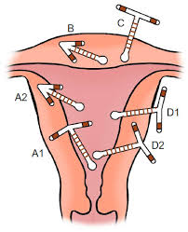
Embedded IUD
May only become apparent when removal efforts unsuccessful, feels “stuck” or strings break off
Ultrasound confirmation is the next step
Usually needs to be removed hysteroscopically
33
Photo: https://www.dovepress.com/
Notes:
Photo Credit: https://www.dovepress.com/

Slide 34

Contraceptive Implant
Notes:
Photo: Contraceptive Implant by Kristen Gee from NounProject.com

Slide 35
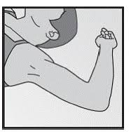
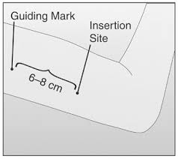
Implant Insertion
Proper Positioning
Proper Placement
Lidocaine
Anticipatory Guidance re: bruising
Insensitivity to Lidocaine
Notes:
Proper positioning- Implant should now be placed below (NOT IN) the bicipital groove (have patient flex their arm while making marks for placement) to avoid nerves and vessels
Be mindful of going to superficial or too deep when placing implant.
Anticipatory guidance to expect bruising helpful, use pressure bandage to try to prevent.
Insensitivity to lidocaine usually due to not waiting long enough – just use more and wait longer
If lido not effective, wait longer and use full 5cc– the volume of fluid itself with lead to anesthesia
Onset of injected lidocaine 1% <2min Achar S, Kundu S. Principles of office anesthesia: part I. Infiltrative anesthesia. Am Fam Physician. 2002 Jul 1;66(1):91-4. PMID: 12126036.
Onset of topical lidocaine 2.5% = 10-30m Kundu S, Achar S. Principles of office anesthesia: part II. Topical anesthesia. Am Fam Physician. 2002 Jul 1;66(1):99-102. PMID: 12126037.
Pt counseling important “You’ll be numb/You won’t feel anything.” Vs “You’ll feel pressure (me touching you) but not sharp pain.”
Image: Nexplanon

Slide 36
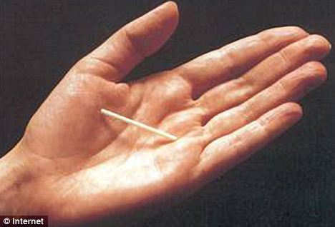
Removal: Pop Out Technique
Photo: https://www.merck.com/
Notes:
https://youtu.be/opnXt3m2Nno?t=92
Image has link embedded
Image Credit: https://www.merck.com/

Slide 37
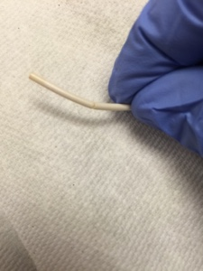
Removal Challenges
  Deep insertion/IM placement
  Migration
  Broken device
Notes:
Broken device- try to remove from the middle to make 1 incision for both parts. Still effective, if pt wants to keep it they can (though package info says to remove)
Image Credit:

Slide 38
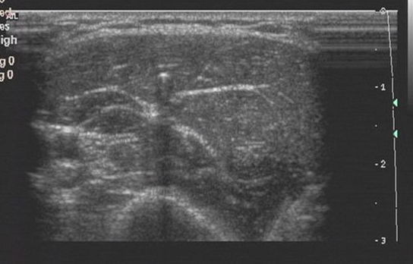
Deep Insertion
Implant and shadow
  If distal end more palpable, can remove from that end.
  US guidance helpful.
Notes:
Taken from the Nexplanon website:
Given the radiopaque nature of the implant, suitable methods for localization are two-dimensional X-ray and X-ray computerized tomography (CT scan). Ultrasound scanning (USS) with a high-frequency linear array transducer (10 MHz or greater) or magnetic resonance imaging (MRI) may be used. If these methods fail, call the Merck National Service Center at 1-877-888-4231 for information on the procedure for measuring etonogestrel blood levels which can be used for verification of the presence of the implant.

Slide 39
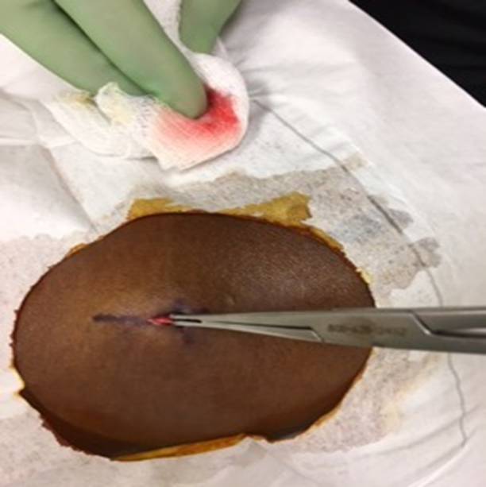
Removal of Deep Implant
Notes:
Incision is made over the middle of the device

Slide 40
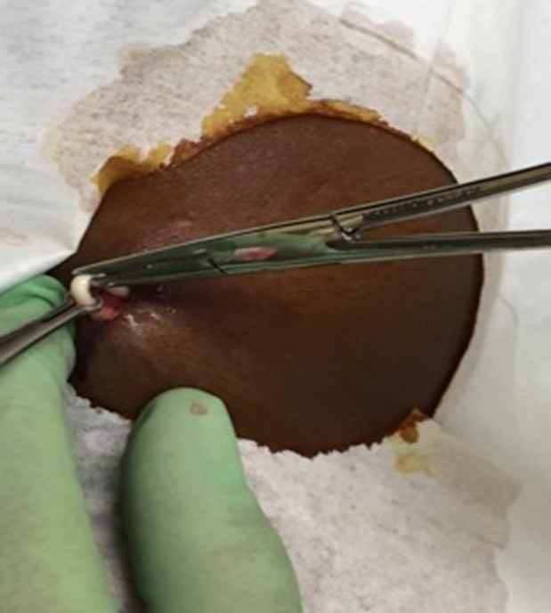
Removal of Deep Implant
Notes:
After dissection, the implant is grabbed by the vas clamp and then stabilized by a hemostat

Slide 41
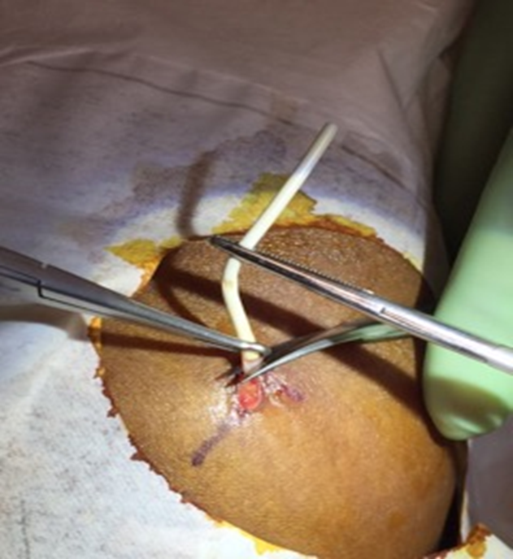
Removal of Deep Implant
Notes:
Adhesions scraped away with a scalpel or scissor.

Slide 42
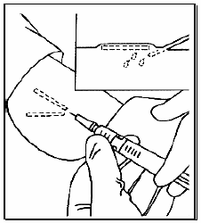
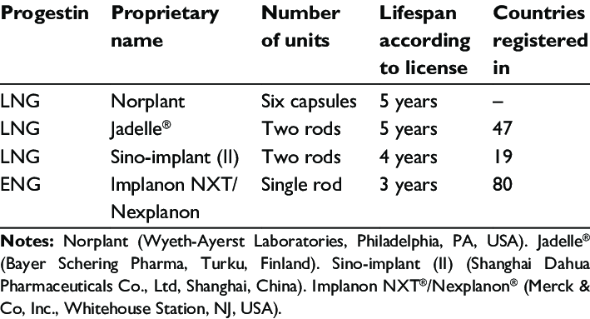
Implants Around the World
Rowlands, Sam & Searle, Stephen. (2014). Contraceptive implants: current perspectives.
Open Access Journal of Contraception. 2014. 73. 10.2147/OAJC.S55968.
Notes:
Make sure to thoroughly palpate a person’s upper arm
Ask pts if it was placed outside of the US
Usually implanted so that they can be removed through one incision
Rowlands, Sam & Searle, Stephen. (2014). Contraceptive implants: current perspectives. Open Access Journal of Contraception. 2014. 73. 10.2147/OAJC.S55968.

Slide 43

Patient Centered Counseling
10 minute video
43
Notes:
Optional video on modeling patient-centered counseling
Highest efficacy should not be the only factor that guides contraceptive counseling and decision-making, unless it’s what the patient is looking for in their birth control.
Watch part of video to model patient-centered contraceptive counseling
Ask: What did you notice about this contraceptive counseling example? How did the clinician model patient-centeredness?
Asks pt questions about what matters in birth control method
Counsel on removing IUD at any time
Provider talking to other provider about removing IUD “early”
Advanced EC Rx offered
Source:
Contraceptive Counseling: Patient/Provider Perspectives: Get LARC. Accessed: https://www.youtube.com/watch?v=OP9klE0JLLU. Published June 12, 2017.

Slide 44
RESOURCES: VIDEOS
“Pop out” Implant removal technique: https://youtu.be/opnXt3m2Nno?t=92
Liletta insertion video (this link doesn’t always work, you may have to google “Liletta insertion video”: https://www.lilettahcp.com/iud-product-features - insertion-video
ARHP Copper IUD insertion video: https://www.youtube.com/watch?v=FuPFbgSm0QQ
ARHP Mirena IUS insertion video: https://www.youtube.com/watch?v=hlfV8tKgw6E
Implant insertion video: https://www.acog.org/programs/long-acting-reversible-contraception-larc/video-series/insertion/implant-insertion
Notes:
“Pop out” Implant removal technique: https://youtu.be/opnXt3m2Nno?t=92
Liletta insertion video (this link doesn’t always work, you may have to google “Liletta insertion video”: https://www.lilettahcp.com/iud-product-features - insertion-video
ARHP Copper IUD insertion video: https://www.youtube.com/watch?v=FuPFbgSm0QQ
ARHP Mirena IUS insertion video: https://www.youtube.com/watch?v=hlfV8tKgw6E
Implant insertion video: https://www.acog.org/programs/long-acting-reversible-contraception-larc/video-series/insertion/implant-insertion

Slide 45

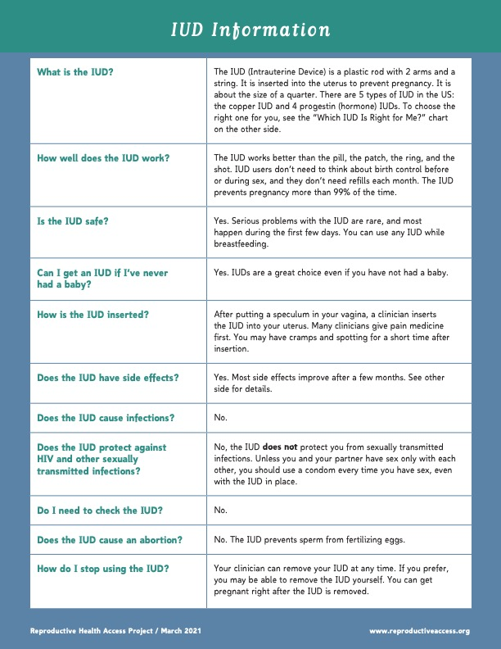
RESOURCES: PATIENT ED
Patient education on choosing between IUDs: http://www.reproductiveaccess.org/resource/iud-facts/
Patient education on implants: http://www.reproductiveaccess.org/resource/progestin-implant/
Take home information sheet after progestin IUD is placed: http://www.reproductiveaccess.org/resource/progestin-iud-user-guide/
Take home information sheet after copper IUD is placed: http://www.reproductiveaccess.org/resource/copper-iud-user-guide/
Take home information sheet after implant is placed: http://www.reproductiveaccess.org/resource/progestin-implant-user-guide/
Website for patients, especially adolescents, on contraception: https://www.bedsider.org/
Notes:
Patient education on choosing between IUDs: http://www.reproductiveaccess.org/resource/iud-facts/
Patient education on implants: http://www.reproductiveaccess.org/resource/progestin-implant/
Take home information sheet after progestin IUD is placed: http://www.reproductiveaccess.org/resource/progestin-iud-user-guide/
Take home information sheet after copper IUD is placed: http://www.reproductiveaccess.org/resource/copper-iud-user-guide/
Take home information sheet after implant is placed: http://www.reproductiveaccess.org/resource/progestin-implant-user-guide/
Website for patients, especially adolescents, on contraception: https://www.bedsider.org/

Slide 46
RESOURCES FOR CLINICIANS
How to switch methods and prevent gaps in contraceptive coverage: http://www.reproductiveaccess.org/wp-content/uploads/2014/12/switching_bc.pdf
CDC US Medical Eligibility Criteria long version: https://www.cdc.gov/reproductivehealth/contraception/usmec.htm
Quick start Algorithm: http://www.reproductiveaccess.org/wp-content/uploads/2014/12/QuickstartAlgorithm.pdf
Medical eligibility by the CDC for LARC and other methods: https://www.cdc.gov/reproductivehealth/contraception/pdf/summary-chart-us-medical-eligibility-criteria_508tagged.pdf
Notes:
List all LARC related resources

Slide 47
REFERENCES.
Achar S, Kundu S. Principles of office anesthesia: part I. Infiltrative anesthesia. Am Fam Physician. 2002 Jul 1;66(1):91-4. PMID: 12126036.
Barbosa, I. Ovarian function after seven years' use of a levonorgestrel IUD. Advances in Contraception. 11(2):85-95.
Berenson, Abbey B., Alai Tan, and Jacqueline M. Hirth. "Complications and continuation rates associated with 2 types of long-acting contraception." American journal of obstetrics and gynecology 212.6 (2015): 761-e1.
Blakemore E. The First Birth Control Pill Used Puerto Rican Women as Guinea Pigs. History.com. https://www.history.com/news/birth-control-pill-history-puerto-rico-enovid. Published May 9, 2018. Accessed October 1, 2021.
CDC - Summary - US SPR - Reproductive Health. Centers for Disease Control and Prevention. https://www.cdc.gov/reproductivehealth/contraception/mmwr/spr/summary.html. Published May 20, 2021. Accessed October 1, 2021.
Chi, IC, et al, Performance of the copper T-380A intrauterine device in breastfeeding women, Contraception 39(6):603-18.1989
Chiou CF, Trussell J, Reyes E, et al. Economic analysis of contraceptives for women. Contraception. 2003;68(1):3-10. doi:10.1016/s0010-7824(03)00078-7
Crosignani PG, Vercellini P, Mosconi P, Oldani S, Cortesi I, De Giorgi O. Levonorgestrel-releasing intrauterine device versus hysteroscopic endometrial resection in the treatment of dysfunctional uterine bleeding. Obstet Gynecol. 1997;90(2):257-263. doi:10.1016/S0029-7844(97)00226-3
Czarnecki ML, Turner HN, Collins PM, Doellman D, Wrona S, Reynolds J. Procedural pain management: a position statement with clinical practice recommendations. Pain Manag Nurs. 2011 Jun;12(2):95-111. Epub 2011 Apr 29. PMID: 21620311.
Farley, TM (1992). Intrauterine devices and pelvic inflammatory disease: an international perspective. Lancet. 339: 785-788.
Fasoli M, Parazzini F, Cecchetti G, La Vecchia C. Post-coital contraception: an overview of published studies. Contraception 1989;39:459-468.
Gomez AM, Fuentes L, Allina A. Women or LARC first? Reproductive autonomy and the promotion of long-acting reversible contraceptive methods. Perspect Sex Reprod Health. 2014;46(3):171-175. doi:10.1363/46e1614
Grimes, D et al. Immediate postpartum insertion of intrauterine devices. Cochrane Review, 2005
Grimes DA. Intrauterine device and upper-genital-tract infection. Lancet. 2000;356(9234):1013-1019. doi:10.1016/S0140-6736(00)02699-4
Grimes, D et al. Immediate postpartum insertion of intrauterine devices. Cochrane Review, 2005
Grimes DA. Intrauterine device and upper-genital-tract infection. Lancet. 2000;356(9234):1013-1019. doi:10.1016/S0140-6736(00)02699-4
Grimes DA, et al (1999). Prophylactic antibiotics for intrauterine device insertion: a meta-analysis of the randomized controlled trials. Contraception. 60:57–63. Cochrane review Oct 2009
Guttmacher Institute. Contraceptive Use in the United States. Accessed: https://www.guttmacher.org/fact-sheet/contraceptive-use-united-states Published 9/2016. Winner, Brooke, et al. "Effectiveness of long-acting reversible contraception." New England Journal of Medicine 366.21 (2012): 1998-2007.
Guttmacher Institute. Use of Long-Acting Reversible Contraceptive Methods Continues to Increase in the United States. Accessed: https://www.guttmacher.org/news-release/2015/use-long-acting-reversible-contraceptive-methods-continues-increase-united-states. Published 10/2015.
Hatcher RA. Contraceptive Technology. 20th ed. Ardent Media; 2011.
Hubacher D, Grimes DA. Noncontraceptive health benefits of intrauterine devices: a systematic review. Obstet Gynecol Surv. 2002;57(2):120-128. doi:10.1097/00006254-200202000-00024
Hurskainen R, Teperi J, Rissanen P, et al. Quality of life and cost-effectiveness of levonorgestrel-releasing intrauterine system versus hysterectomy for treatment of menorrhagia: a randomised trial. Lancet. 2001;357(9252):273-277. doi:10.1016/S0140-6736(00)03615-1
Jackson J. How Puerto Rican Women Made Birth Control Possible-At the Expense of Their Health. BESE. https://www.bese.com/how-puerto-rican-women-made-birth-control-possible-at-the-expense-of-their-health/. Published April 27, 2018. Accessed October 1, 2021.
Kaunitz, AM (2005). Beyond the pill: New data and options in hormonal and intrauterine contraception. Am J Obst Gyn 192(4):998-1004.
The Medical Letter: A New Low-Dose Levonorgestrel-Releasing IUD (Skyla). March 2013. Vol 55; 1412.
Pendergrass DC, Raji MY. The bitter pill: Harvard and the dark history of birth control: Magazine: The Harvard Crimson. The Harvard Crimson. https://www.thecrimson.com/article/2017/9/28/the-bitter-pill/. Published September 28, 2017. Accessed October 1, 2021.
Prabhakaran, Sujatha, and Alice Chuang. "In office retrieval of intrauterine contraceptive devices with missing strings." Contraception 83.2 (2011): 102.
Rademacher KH, Sergison J, Glish L, et al. Menstrual Bleeding Changes Are NORMAL: Proposed Counseling Tool to Address Common Reasons for Non-Use and Discontinuation of Contraception. Glob Health Sci Pract. 2018;6(3):603-610. Published 2018 Oct 4. doi:10.9745/GHSP-D-18-00093
Renner RM, Jensen JT, Nichols MD, Edelman A. Pain control in first trimester surgical abortion. Cochrane Database of Systematic Reviews 2009, Issue 2. Art. No.: CD006712. DOI: 10.1002/14651858.DC006712.pub2.
Rivera, R The mechanism of action of hormonal contraceptives and intrauterine contraceptive devices. American Journal of Obstetrics & Gynecology 181(5): 1263-1269
Rogovskaya, S (2005). Effect of a levonorgestrel intrauterine system on women with type 1 diabetes: a randomized trial. Obstetrics and Gynecology. 105 (4): 811-815.
Sivin, I (1991). Prolonged intrauterine contraception: a seven-year randomized study of the levonorgestrel 20 mcg/day (LNg 20) and the Copper T380 Ag IUDS. Contraception. 44(5): 473-480.
Sonfield A, Hasstedt K and Gold RB, Moving Forward: Family Planning in the Era of Health Reform, New York: Guttmacher Institute, 2014.
Stoddard, Amy, Colleen McNicholas, and Jeffrey F. Peipert. "Efficacy and safety of long-acting reversible contraception." Drugs 71.8 (2011): 969-980.
Turok DK, Gero A, Simmons RG, Kaiser JE, Stoddard GJ, Sexsmith CD, Gawron LM, Sanders JN. Levonorgestrel vs. copper intrauterine devices for emergency contraception. N Engl J Med. 2021;384:335-344. doi: 10.1056/NEJMoa2022141.
Turok DK, Sanders JN, Thompson IS, Royer PA, Eggebroten J, Gawron LM. Preference for and efficacy of oral levonorgestrel for emergency contraception with concomitant placement of a levonorgestrel IUD: A prospective cohort study. Contraception. 2016 Jun; 93(6):526-532. doi: 10.1016/j.contraception.2016.01.009.
UNDP. Long-term reversible contraception: Twelve years of experience with the TCu380A and TCu220C. (1997) Contraception. 56(6): 341-352.
Varila E, Wahlström T, Rauramo I. A 5-year follow-up study on the use of a levonorgestrel intrauterine system in women receiving hormone replacement therapy. Fertil Steril. 2001;76(5):969-973. doi:10.1016/s0015-0282(01)02846-1
Xu, Hanna, et al. "Contraceptive failure rates of etonogestrel subdermal implants in overweight and obese women." Obstetrics and gynecology 120.1 (2012): 21.
Zieman M, Hatcher RA, Allen AZ, Lathrop E, Haddad L. 2019-2020 Managing Contraception: For Your Pocket. 15th ed. Tiger, GA: Bridging the Gap Foundation; 2019.
Notes:
Achar S, Kundu S. Principles of office anesthesia: part I. Infiltrative anesthesia. Am Fam Physician. 2002 Jul 1;66(1):91-4. PMID: 12126036.
Barbosa, I. Ovarian function after seven years' use of a levonorgestrel IUD. Advances in Contraception. 11(2):85-95.
Berenson, Abbey B., Alai Tan, and Jacqueline M. Hirth. "Complications and continuation rates associated with 2 types of long-acting contraception." American journal of obstetrics and gynecology 212.6 (2015): 761-e1.
Blakemore E. The First Birth Control Pill Used Puerto Rican Women as Guinea Pigs. History.com. https://www.history.com/news/birth-control-pill-history-puerto-rico-enovid. Published May 9, 2018. Accessed October 1, 2021.
CDC - Summary - US SPR - Reproductive Health. Centers for Disease Control and Prevention. https://www.cdc.gov/reproductivehealth/contraception/mmwr/spr/summary.html. Published May 20, 2021. Accessed October 1, 2021.
Chi, IC, et al, Performance of the copper T-380A intrauterine device in breastfeeding women, Contraception 39(6):603-18.1989
Chiou CF, Trussell J, Reyes E, et al. Economic analysis of contraceptives for women. Contraception. 2003;68(1):3-10. doi:10.1016/s0010-7824(03)00078-7
Crosignani PG, Vercellini P, Mosconi P, Oldani S, Cortesi I, De Giorgi O. Levonorgestrel-releasing intrauterine device versus hysteroscopic endometrial resection in the treatment of dysfunctional uterine bleeding. Obstet Gynecol. 1997;90(2):257-263. doi:10.1016/S0029-7844(97)00226-3
Czarnecki ML, Turner HN, Collins PM, Doellman D, Wrona S, Reynolds J. Procedural pain management: a position statement with clinical practice recommendations. Pain Manag Nurs. 2011 Jun;12(2):95-111. Epub 2011 Apr 29. PMID: 21620311.
Farley, TM (1992). Intrauterine devices and pelvic inflammatory disease: an international perspective. Lancet. 339: 785-788.
Fasoli M, Parazzini F, Cecchetti G, La Vecchia C. Post-coital contraception: an overview of published studies. Contraception 1989;39:459-468.
Gomez AM, Fuentes L, Allina A. Women or LARC first? Reproductive autonomy and the promotion of long-acting reversible contraceptive methods. Perspect Sex Reprod Health. 2014;46(3):171-175. doi:10.1363/46e1614
Grimes, D et al. Immediate postpartum insertion of intrauterine devices. Cochrane Review, 2005
Grimes DA. Intrauterine device and upper-genital-tract infection. Lancet. 2000;356(9234):1013-1019. doi:10.1016/S0140-6736(00)02699-4
Grimes, D et al. Immediate postpartum insertion of intrauterine devices. Cochrane Review, 2005
Grimes DA. Intrauterine device and upper-genital-tract infection. Lancet. 2000;356(9234):1013-1019. doi:10.1016/S0140-6736(00)02699-4
Grimes DA, et al (1999). Prophylactic antibiotics for intrauterine device insertion: a meta-analysis of the randomized controlled trials. Contraception. 60:57–63. Cochrane review Oct 2009
Guttmacher Institute. Contraceptive Use in the United States. Accessed: https://www.guttmacher.org/fact-sheet/contraceptive-use-united-states Published 9/2016. Winner, Brooke, et al. "Effectiveness of long-acting reversible contraception." New England Journal of Medicine 366.21 (2012): 1998-2007.
Guttmacher Institute. Use of Long-Acting Reversible Contraceptive Methods Continues to Increase in the United States. Accessed: https://www.guttmacher.org/news-release/2015/use-long-acting-reversible-contraceptive-methods-continues-increase-united-states. Published 10/2015.
Hatcher RA. Contraceptive Technology. 20th ed. Ardent Media; 2011.
Hubacher D, Grimes DA. Noncontraceptive health benefits of intrauterine devices: a systematic review. Obstet Gynecol Surv. 2002;57(2):120-128. doi:10.1097/00006254-200202000-00024
Hurskainen R, Teperi J, Rissanen P, et al. Quality of life and cost-effectiveness of levonorgestrel-releasing intrauterine system versus hysterectomy for treatment of menorrhagia: a randomised trial. Lancet. 2001;357(9252):273-277. doi:10.1016/S0140-6736(00)03615-1
Jackson J. How Puerto Rican Women Made Birth Control Possible-At the Expense of Their Health. BESE. https://www.bese.com/how-puerto-rican-women-made-birth-control-possible-at-the-expense-of-their-health/. Published April 27, 2018. Accessed October 1, 2021.
Kaunitz, AM (2005). Beyond the pill: New data and options in hormonal and intrauterine contraception. Am J Obst Gyn 192(4):998-1004.
The Medical Letter: A New Low-Dose Levonorgestrel-Releasing IUD (Skyla). March 2013. Vol 55; 1412.
Pendergrass DC, Raji MY. The bitter pill: Harvard and the dark history of birth control: Magazine: The Harvard Crimson. The Harvard Crimson. https://www.thecrimson.com/article/2017/9/28/the-bitter-pill/. Published September 28, 2017. Accessed October 1, 2021.
Prabhakaran, Sujatha, and Alice Chuang. "In office retrieval of intrauterine contraceptive devices with missing strings." Contraception 83.2 (2011): 102.
Rademacher KH, Sergison J, Glish L, et al. Menstrual Bleeding Changes Are NORMAL: Proposed Counseling Tool to Address Common Reasons for Non-Use and Discontinuation of Contraception. Glob Health Sci Pract. 2018;6(3):603-610. Published 2018 Oct 4. doi:10.9745/GHSP-D-18-00093
Renner RM, Jensen JT, Nichols MD, Edelman A. Pain control in first trimester surgical abortion. Cochrane Database of Systematic Reviews 2009, Issue 2. Art. No.: CD006712. DOI: 10.1002/14651858.DC006712.pub2.
Rivera, R The mechanism of action of hormonal contraceptives and intrauterine contraceptive devices. American Journal of Obstetrics & Gynecology 181(5): 1263-1269
Rogovskaya, S (2005). Effect of a levonorgestrel intrauterine system on women with type 1 diabetes: a randomized trial. Obstetrics and Gynecology. 105 (4): 811-815.
Sivin, I (1991). Prolonged intrauterine contraception: a seven-year randomized study of the levonorgestrel 20 mcg/day (LNg 20) and the Copper T380 Ag IUDS. Contraception. 44(5): 473-480.
Sonfield A, Hasstedt K and Gold RB, Moving Forward: Family Planning in the Era of Health Reform, New York: Guttmacher Institute, 2014.
Stoddard, Amy, Colleen McNicholas, and Jeffrey F. Peipert. "Efficacy and safety of long-acting reversible contraception." Drugs 71.8 (2011): 969-980.
Turok DK, Gero A, Simmons RG, Kaiser JE, Stoddard GJ, Sexsmith CD, Gawron LM, Sanders JN. Levonorgestrel vs. copper intrauterine devices for emergency contraception. N Engl J Med. 2021;384:335-344. doi: 10.1056/NEJMoa2022141.
Turok DK, Sanders JN, Thompson IS, Royer PA, Eggebroten J, Gawron LM. Preference for and efficacy of oral levonorgestrel for emergency contraception with concomitant placement of a levonorgestrel IUD: A prospective cohort study. Contraception. 2016 Jun; 93(6):526-532. doi: 10.1016/j.contraception.2016.01.009.
UNDP. Long-term reversible contraception: Twelve years of experience with the TCu380A and TCu220C. (1997) Contraception. 56(6): 341-352.
Varila E, Wahlström T, Rauramo I. A 5-year follow-up study on the use of a levonorgestrel intrauterine system in women receiving hormone replacement therapy. Fertil Steril. 2001;76(5):969-973. doi:10.1016/s0015-0282(01)02846-1
Xu, Hanna, et al. "Contraceptive failure rates of etonogestrel subdermal implants in overweight and obese women." Obstetrics and gynecology 120.1 (2012): 21.
Zieman M, Hatcher RA, Allen AZ, Lathrop E, Haddad L. 2019-2020 Managing Contraception: For Your Pocket. 15th ed. Tiger, GA: Bridging the Gap Foundation; 2019.

Slide 48
THANK YOU.
Notes:
Updated 12/2021

