Slide 1



PATIENT-CENTERED CONTRACEPTION:
UPDATES ON THE EVIDENCE
Notes:
Updated 10/2022

Slide 2
LEARNING OBJECTIVES.
  Use the CDC MEC & SPR for an evidence-based approach to contraception
  Employ patient-centered counseling and decision-making

Slide 3
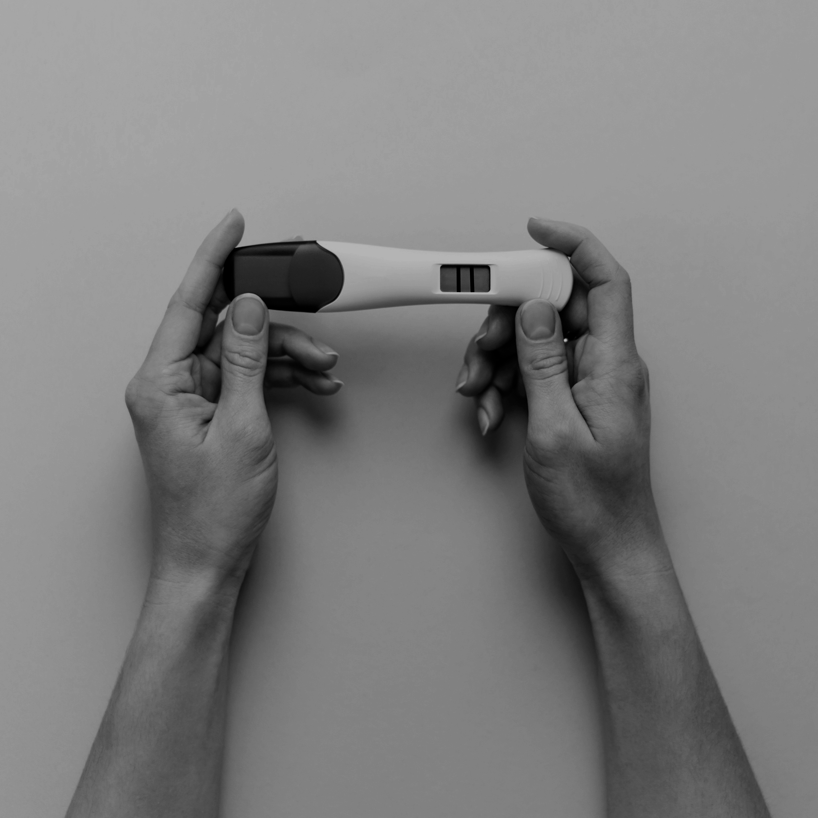
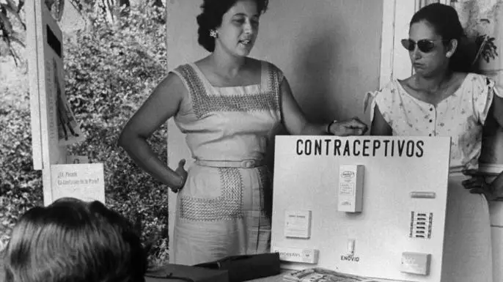
The Legacy of Puerto Rican Birth Control Trails
3
The teaching of birth control methods in Puerto Rico, 1960. (Credit: Hank Walker/The LIFE Picture Collection/Getty Images)
Notes:
It’s important to remember, acknowledge, and be informed by the history of how we got to where we are today in reproductive health care, especially contraception. Enovid was the world’s first birth control pill and was celebrated for ushering in an age of control and autonomy over reproduction (for some). But this discovery and the continued development of birth control pills and other methods originated at the expense of Puerto Rican women’s health and lives. It originated from Eugenic mindsets in the early 1900s with people like Margaret Sanger who argued that birth control could help wipe out “the greatest present menace to civilization”—people living in extreme poverty and those with mental illnesses and physical disabilities. She met and supported Gregory Pincus and John Rock, who went on to conduct the birth control trials in Puerto Rico. Puerto Rico was chosen because: the scientists knew they couldn’t do clinical trials on the mainland US, Puerto Rico was already home to many birth control clinics funded by eugenicists who wanted to reduce the Puerto Rican population to make room for more “fit” members of society. 1/3 of Puerto Rican women were sterilized, many involuntarily, after their second child’s birth. This set the stage for Pincus’s trials. The women who attended the trials were from the poorest areas of San Juan and just wanted to avoid pregnancy and avoid sterilization - but they had no idea that the pills they were receiving were part of an experiment and clinical trial. They weren’t given any information about safety. Many experienced serious side effects like blood clots. Despite the importance of the pill and the reproductive autonomy it has given to those wanting to avoid pregnancy, it’s history is marked by a lack of autonomy - a lack of true informed choice and information and the exploitation of impoverished women. This is this history and legacy of contraception that we are working in.
So our jobs is to stop this legacy from perpetuating and make sure that everyone has true autonomy, choice, information, and access to the reproductive health care they need.
Optional 5 minute video: scenes from the Documentary “La Operacion”: https://www.youtube.com/watch?v=tShnkBmoe3Y
Image is hyperlinked with link to video
Resources:
https://www.thecrimson.com/article/2017/9/28/the-bitter-pill/
https://www.history.com/news/birth-control-pill-history-puerto-rico-enovid
https://www.bese.com/how-puerto-rican-women-made-birth-control-possible-at-the-expense-of-their-health/

Slide 4

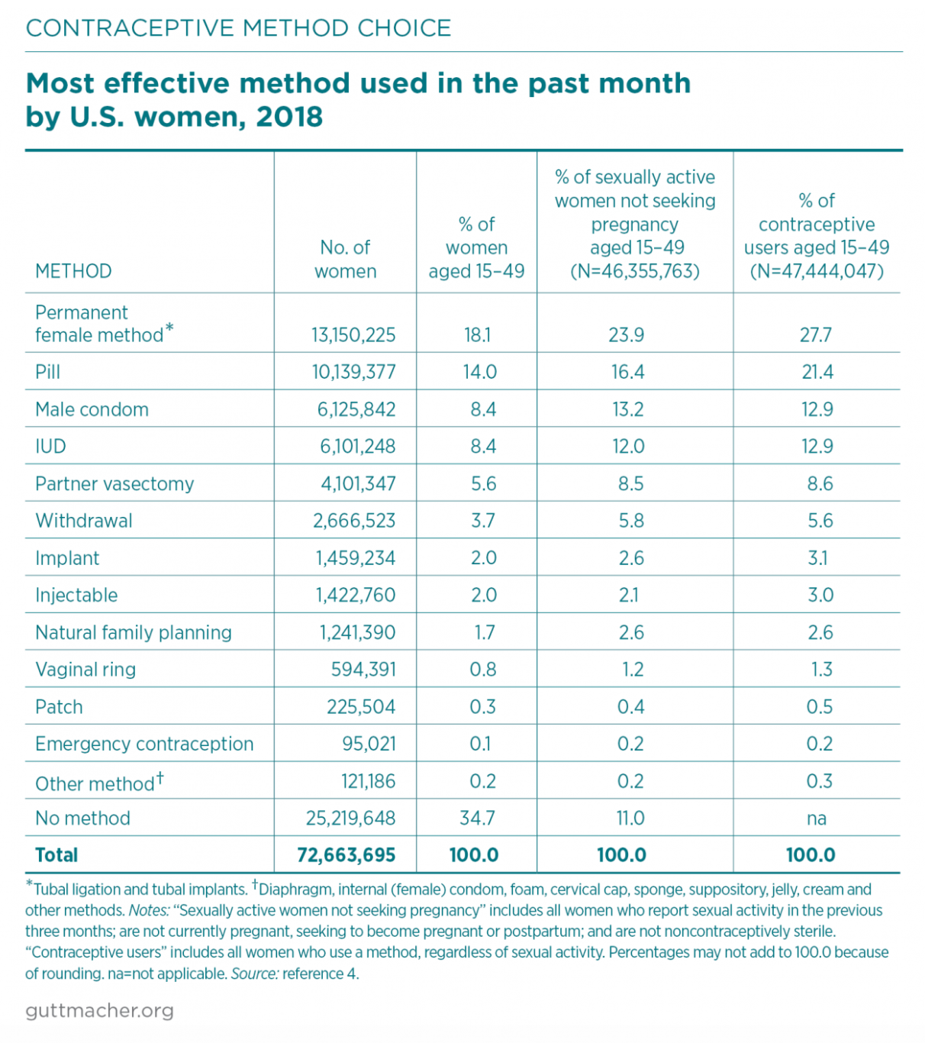
Contraceptive Methods in the US
4
https://www.guttmacher.org/fact-sheet/contraceptive-method-use-united-states
Notes:
Today, we have myriad contraceptive options available to people.
-IUDs and implants have gained traction.
-LARC use has risen from 2% in 2002 to 16% in 2018.
-Notable shifts within the overall method mix—especially since 2002—include increases in the use of long-acting reversible contraceptive (LARC) methods and decreases in the use of permanent methods and short-acting reversible contraceptives
-Some 16% of contraceptive users aged 15–49 in 2018 relied on LARC methods—IUDs and implants
Note to facilitator: Feel free to highlight other statistics and trends from here: https://www.guttmacher.org/fact-sheet/contraceptive-method-use-united-states
*RHAP recognizes that not only women can get pregnant. Instances in which gendered language is used is a reflection of the methods used by researchers when conducting studies.
References:
Daniels K, Daugherty J and Jones J, Current contraceptive status among women aged 15–44: United States, 2011–2013, National Health Statistics Reports, 2014, No. 173, http://www.cdc.gov/nchs/data/databriefs/db173.pdf.
Kavanaugh ML and Pliskin E, Use of contraception among reproductive-aged women in the United States, 2014 and 2016, F&S Reports, 2020, 1(2):83–93, https://www.fertstertreports.org/article/S2666-3341(20)30038-6/fulltext.
https://www.guttmacher.org/fact-sheet/contraceptive-method-use-united-states

Slide 5

Reproductive Autonomy
5
Image: Group Of Protestors With Their Fists Raised Up In The Air by Jacob Lund Photography from NounProject.com
Notes:
Educating patients on safety is part of making sure they can make the best decisions about their reproductive choices.
The true goal for us shouldn’t be reducing unintended pregnancy, it should be enhancing reproductive autonomy - that people themselves have the power to decide and control contraceptive use, pregnancy, and childbearing.
In the past and present, LARC methods have often been over-promoted among communities that are BIPOC, low-income, and have lower education, as well as for adolescents and so-called “high-risk” populations. This over-emphasis on LARC and pregnancy prevention in these communities undermines reproductive autonomy and perpetuates inequities in who gets to have quality, dignified, and patient-centered care.
Patient-centered contraceptive counseling for all people can enhance reproductive autonomy and prevent coercion by supporting patients with information and counseling to help them make the best decision for their health and unique circumstances.
Summary of key principles from the LARC Statement of Principles
-Rather than emphasize “effectiveness above all”, offer counseling based on the person’s needs, preferences, and experiences so that they have enough information to make the best decision about their birth control method
-Acknowledge the complex history of LARC provision and ensure counseling is provided in a consistent, respectful manner that neither denies access nor coerces anyone into using a specific method
-Provide comprehensive, scientifically accurate information about the full range of methods in a medically ethical and culturally competent manner so that each person is supported in identifying the method that best meets their needs
-The decision to stop using LARC should be made by each individual with support from their clinician without judgement or obstacles
Sources:
1. Sister Song & National Women’s Health Network. Long-Acting Reversible Contraception Statement of Principles. https://www.nwhn.org/wp-content/uploads/2017/02/LARCStatementofPrinciples.pdf
2. Gomez AM, Fuentes L, Allina A. Women or LARC first? Reproductive autonomy and the promotion of long-acting reversible contraceptive methods. Perspect Sex Reprod Health. 2014;46(3):171-175. doi:10.1363/46e1614
Photo: Group Of Protestors With Their Fists Raised Up In The Air by Jacob Lund Photography from NounProject.com

Slide 6

Patient Centered Counseling
10 minute video
Notes:
Highest efficacy should not be the only factor that guides contraceptive counseling and decision-making, unless it’s what the patient is looking for in their birth control.
Watch part of video to model patient-centered contraceptive counseling
Ask: What did you notice about this contraceptive counseling example? How did the clinician model patient-centeredness?
- Asks pt questions about what matters in birth control method
- Counsel on removing IUD at any time
- Provider talking to other provider about removing IUD “early”
- Advanced EC Rx offered
Source: Contraceptive Counseling: Patient/Provider Perspectives: Get LARC. Accessed: https://www.youtube.com/watch?v=OP9klE0JLLU. Published June 12, 2017.

Slide 7

THE MEC
US Medical Eligibility Criteria (MEC)
CDC recommendations for specific contraceptive methods with certain medical conditions
Notes:
*Ideally participants will download the app prior to the talk, also recommend to provide copies of the Summary Chart for those without app access.

Slide 8
MEC Categories of Safety
1 | No restriction for the use of the contraceptive method for a woman with that condition
2 | Advantages of using the method generally outweigh the theoretical or proven risks
3 | Theoretical or proven risks of the method usually outweigh the advantages - not usually recommended unless more appropriate methods are not available or acceptable
4 | Unacceptable health risk if the contraceptive method is used by a woman with that condition
8
Notes:
*Gendered language due to studies and evidence only assessing health and risks among cis-gender females

Slide 9
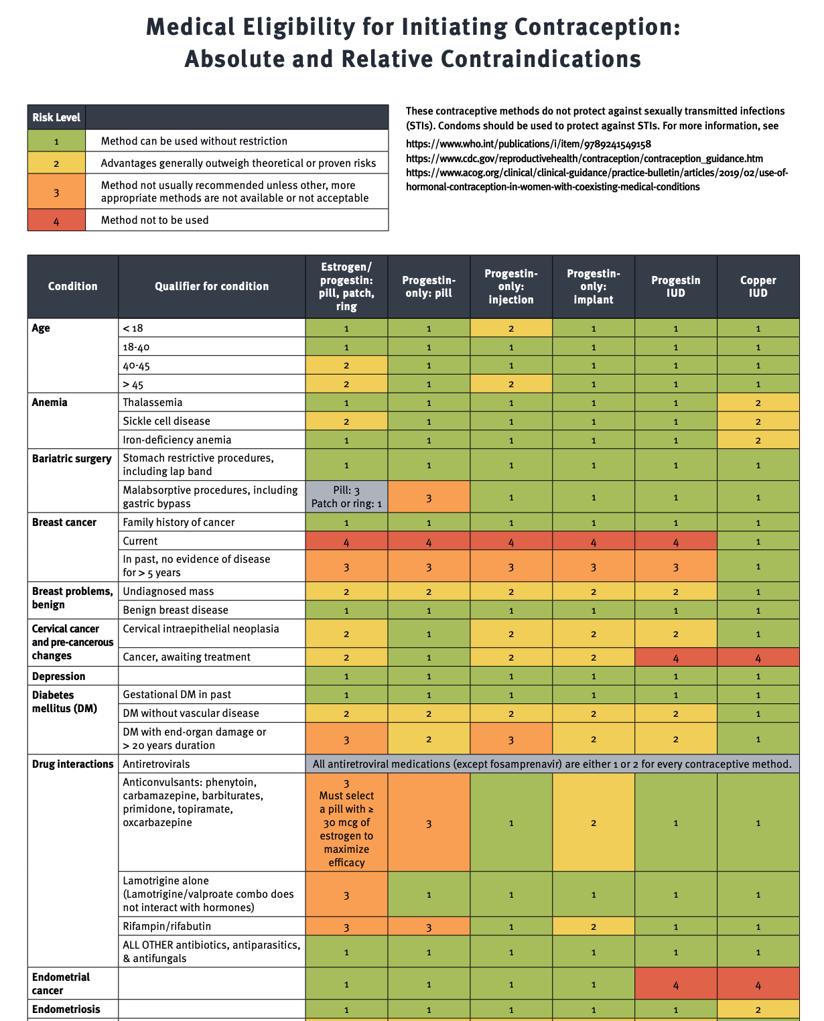
9
Image: RHAP
Notes:
This is just a snapshot of a part of the MEC, but notice all the green!
RHAP MEC: https://www.reproductiveaccess.org/resource/medical-eligibility-initiating-contraception/
CDC MEC: https://www.cdc.gov/reproductivehealth/contraception/mmwr/mec/summary.html
*Both have the same information, the RHAP one is organized with a RHAP color scheme for ease of viewing

Slide 10
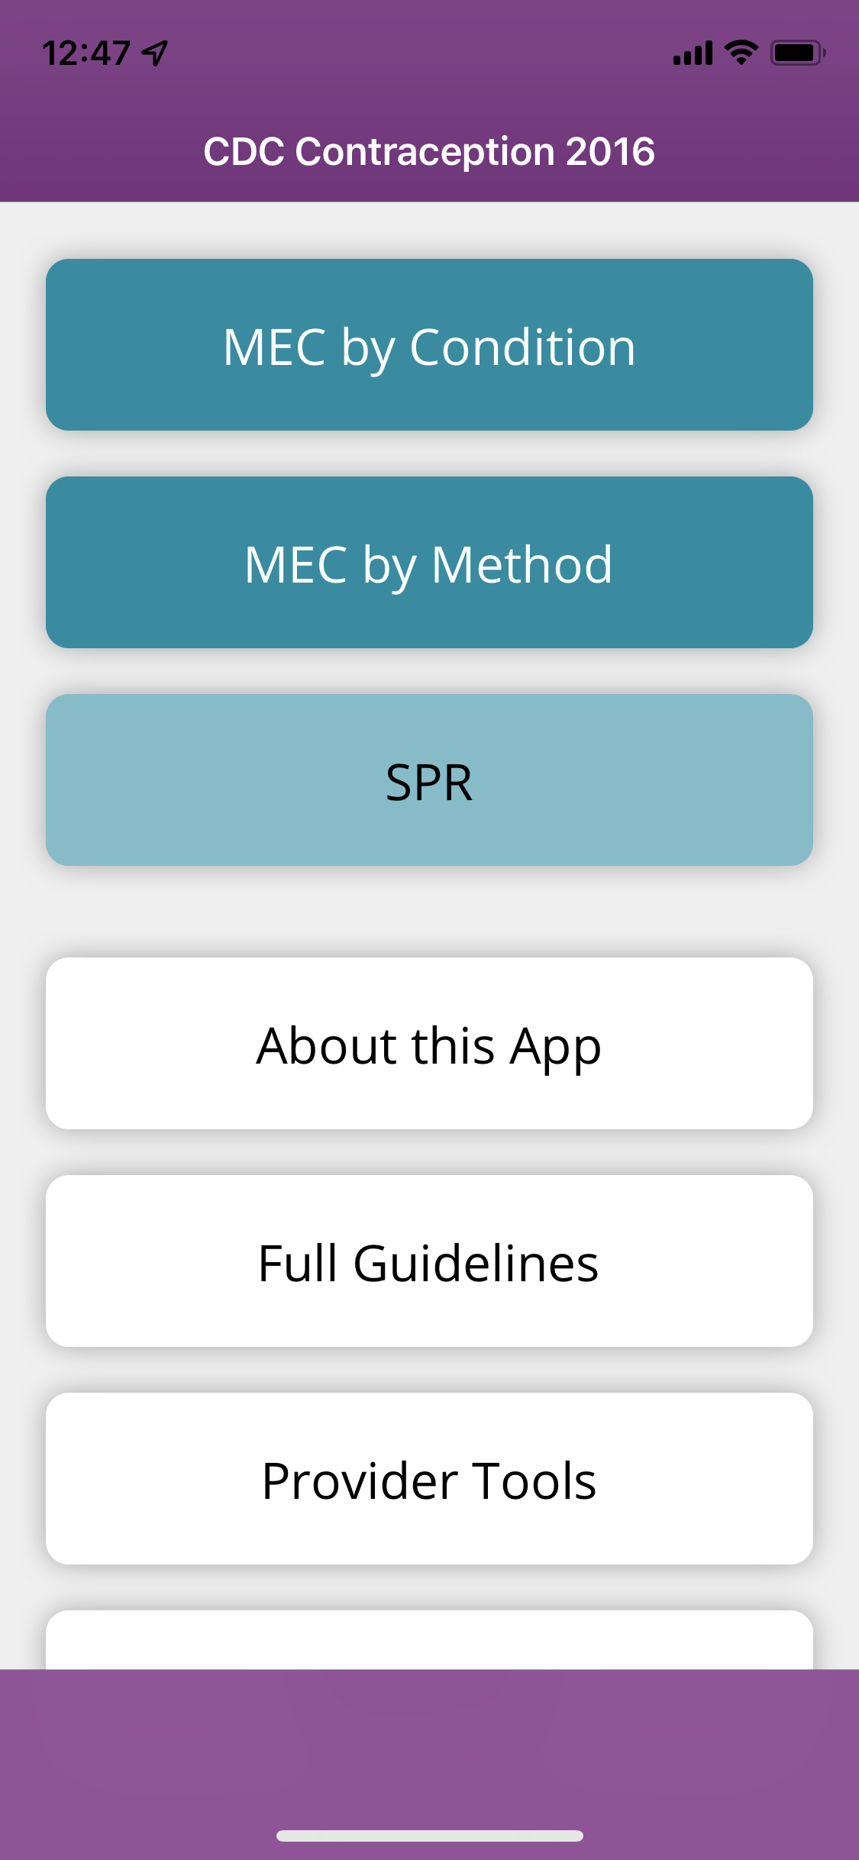

There’s an App for That:
Can be downloaded on iOS and Android operating systems
(https://www.cdc.gov/mobile/mobileapp.html)
Notes:
Participants will need the MEC App or Summary Chart for the talk, they will use it now!
SPR = Selected Practice Recommendations

Slide 11
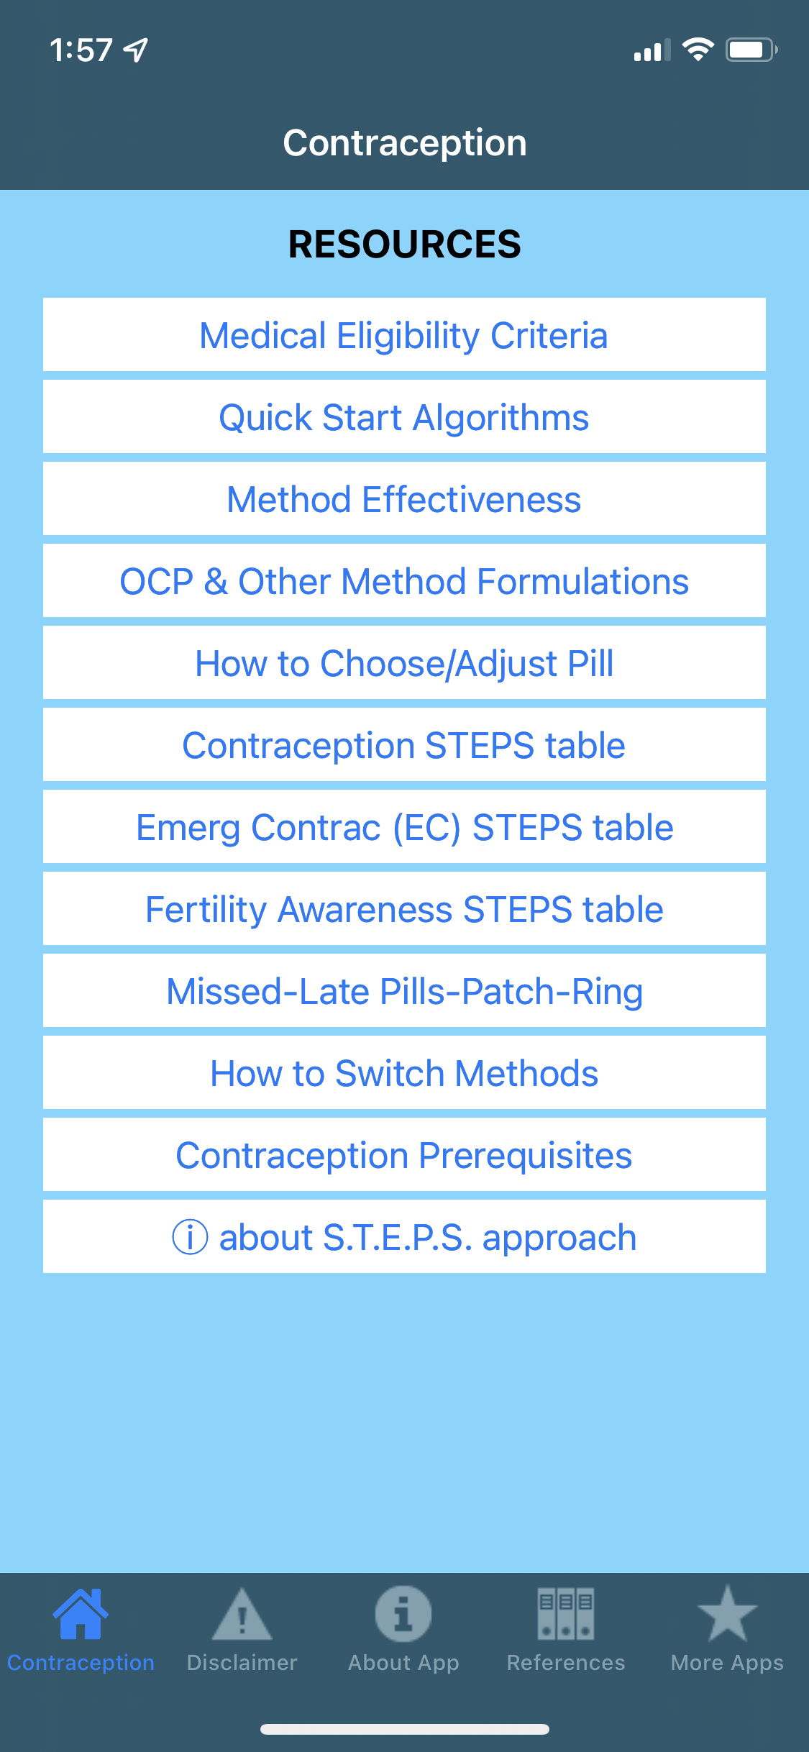

Another Helpful App:
Contraceptive Point-of-Care App
Notes:
Available for both I-phones and androids, free
Evidenced-based, user friendly resources including
How to use Quick Start
How to choose and adjust birth control pills
How to prevent gaps in coverage when switching methods.
A link to the MEC
Collaboration between RHAP and UHS Wilson Family Medicine Residency faculty clinicians Dr. Joshua Steinberg and Dr. Katherine Holmes.
To access: type in “contraceptive point-of-care” on users device and look for above icon.

Slide 12

PATIENT CASE:
Carrie
She/her pronouns
16-year old with urinary symptoms
Had unprotected sex 4 days ago
Urine pregnancy test is negative
What do you do next?
12
Image: https://www.flickr.com/photos/wocintechchat/25900646342
Notes:
Carrie comes into your office as a walk-in for a UTI
She asks for a pregnancy test and a prescription for birth control pills
Her pregnancy test is negative
On further questioning, she says she had vaginal sex without a condom 4 days ago
What do you do?
Photo accessed: https://www.flickr.com/photos/wocintechchat/25900646342/

Slide 13

Opportunity Knocks
Get medical history
Ask about contraceptive or preconception needs
13
Image: https://www.flickr.com/photos/wocintechchat/25388690154/
Notes:
Carrie has never been pregnant, doesn’t have any current medical illnesses, and is not taking any medication. She occasionally smokes cigarettes. Her BMI is 23 and her blood pressure is 110/76.
She’s not ready to become a parent now, and wants to know her contraceptive options
Photo accessed: https://www.flickr.com/photos/wocintechchat/25388690154/

Slide 14
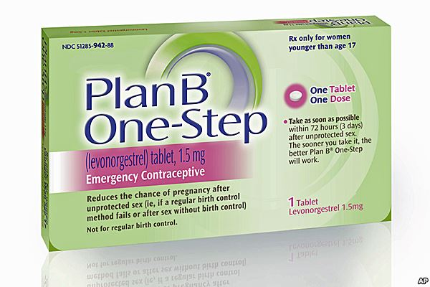
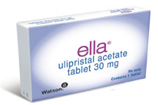
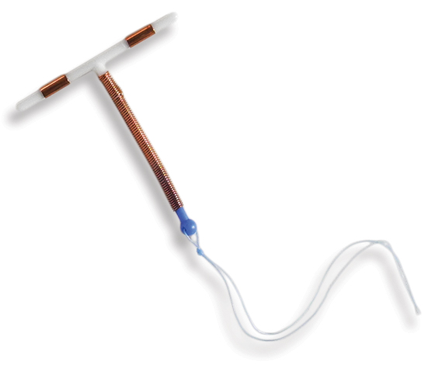
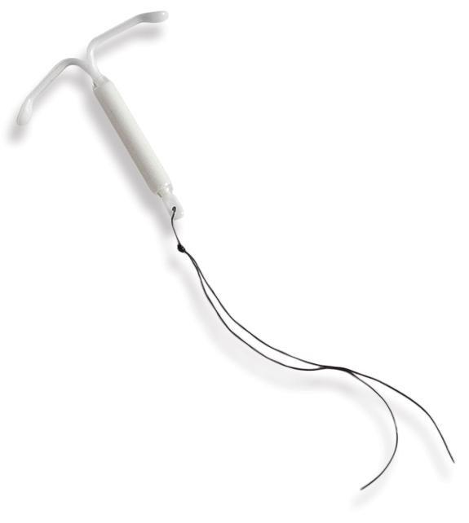
Emergency
Contraception
Factors that will affect the efficacy of the emergency contraception (EC) pill:
  LMP
  Timing of last instance of unprotected sex
  BMI
14
Image: RHAP
Notes:
Oral Levonorgestrel – effective up to 5 days after unprotected sex, loses efficacy in patients with BMI over 26 and efficacy decreases with time from unprotected sex.
Ulipristal acetate – more effective than oral levonorgestrel, maintains nearly full efficacy on 4th and 5th day. Used up to 5 days after unprotected sex. Loses efficacy in patients with BMI over 35.
IUD (copper or higher-dose progestin)- most effective, can be placed up to 5 days after unprotected sex.
Photo Credit: RHAP

Slide 15

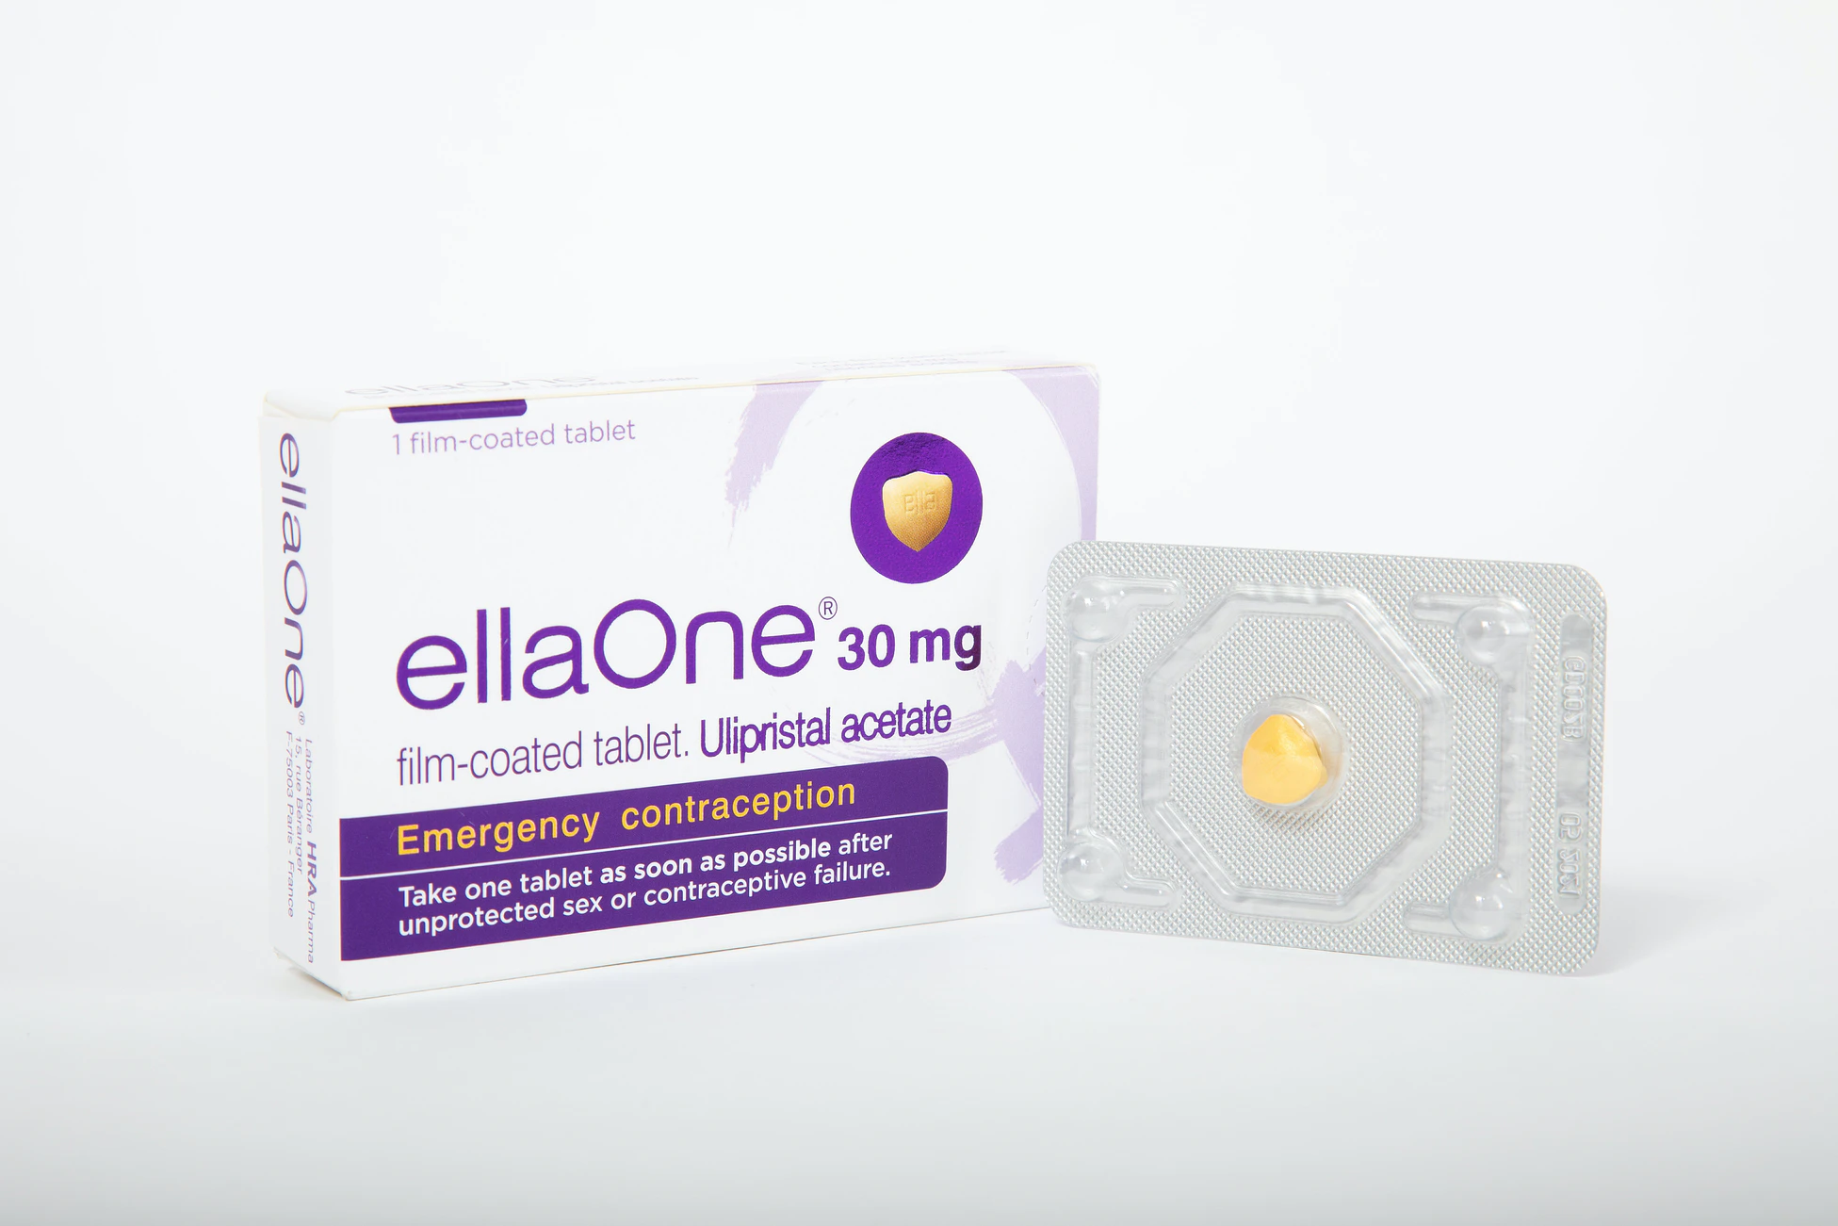
Carrie Choses her EC
Carrie choses ulipristal.
She wants to start contraception.
When should she start?
15
Image: RHAP
Notes:
Carrie chooses ulipristal. She chooses ulipristal because her last unprotected sex was 4 days ago and wants the most effective method, and she’s not interested in an IUD.
When to start contraception?
If EC IUD, no need for additional contraception. IUD is also immediately effective in preventing pregnancy once it is placed.
If EC ulipristal, wait 5 days to start any hormonal method, as progestin may decrease ulipristal’s efficacy
Use shared decision making, and if Carrie wants to start a method the same day, counsel on risks of early pregnancy and recommend taking a pregnancy test in 2 weeks.
If EC levonorgestrel, start ASAP
This includes the pill, patch, ring, progestin injection (Depo), and implant. Although some prefer to wait for a negative pregnancy test post-EC, there is no need to delay starting any of the hormonal methods mentioned above as they do not contain any hormones that will harm a pregnancy, and they don’t change the effectiveness of the LNG EC. It is important to counsel patients that they should still take a pregnancy test in 2-3 weeks. Prompt diagnosis of a pregnancy allows a person to consider their options and form a plan that’s best for them.
https://www.reproductiveaccess.org/resource/contraceptive-pearl-starting-hormonal-contraception-after-emergency-contraception/
Emergency Contraception. Cdc.gov. Published October 6, 2019. Accessed July 19, 2021. https://www.cdc.gov/reproductivehealth/contraception/mmwr/spr/emergency.html
Hatcher RA, Trussell J, Stewart FH, et al. Contraceptive Technology. 21st ed. Managing Contraception; 2018.
Turok DK, Gero A, Simmons RG, et al. Levonorgestrel vs. Copper Intrauterine Devices for Emergency Contraception. N Engl J Med. 2021;384(4):335-344. doi:10.1056/NEJMoa2022141
Image: birth control by Linseed Studio from the Noun Project

Slide 16
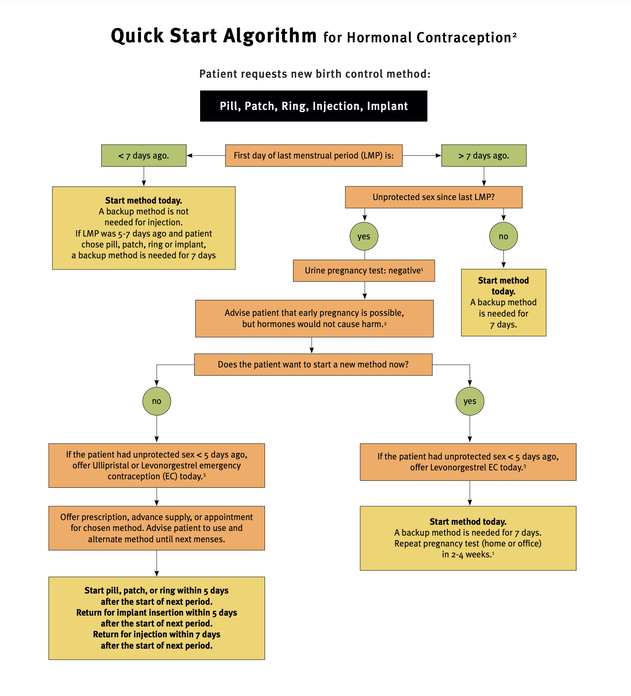
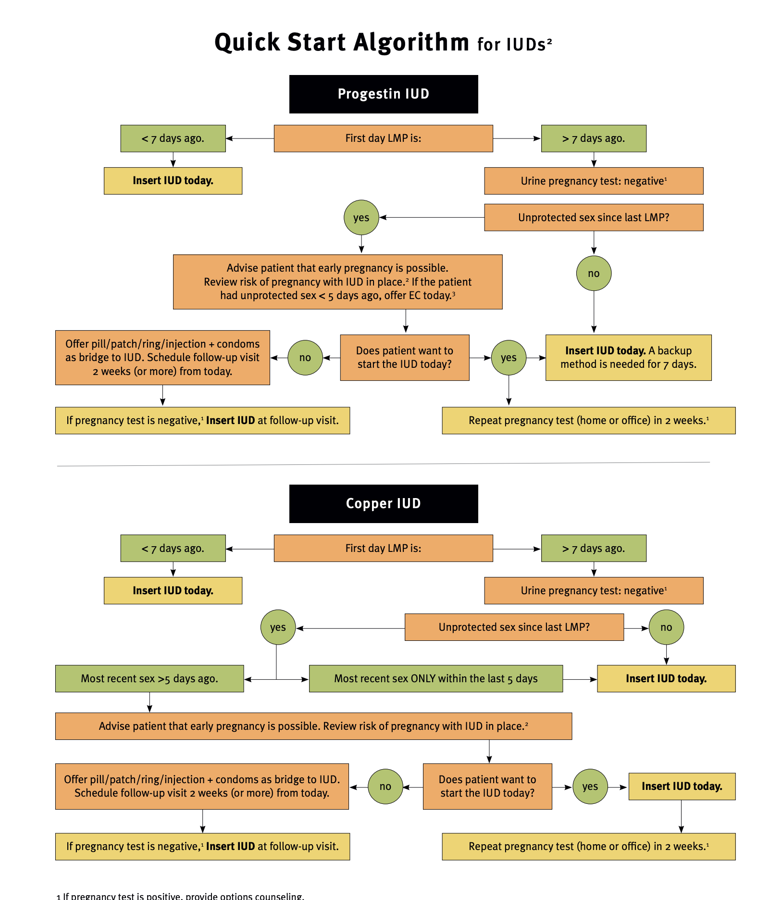
Quick Start Algorithm
16
Image: RHAP
Notes:
Accessed: https://www.reproductiveaccess.org/wp-content/uploads/2014/12/QuickstartAlgorithm.pdf
Explain Quick Start with pills:
After a negative urine pregnancy test:
Pills started on the day of the visit instead of the Sunday after the next period
Studies showed more people on the pill by month 3, and fewer pregnancies
-If OCs are prescribed with Sunday or 1st-day-of-menses start, about 25% of patients do not start.
-No increased bleeding or spotting
-Most birth control methods are not teratogenic
-Can use quickstart immediately following miscarriage or abortion
References:
Westhoff C, Kerns J, Morroni C, Cushman LF, Tiezzi L, Murphy PA. Quick start: novel oral contraceptive initiation method. Contraception. 2002 Sep;66(3):141-5.
Westhoff C, Morroni C, Kerns J, Murphy PA. Bleeding patterns after immediate vs. conventional oral contraceptive initiation: a randomized, controlled trial. Fertil Steril. 2003 Feb;79(2):322-9.

Slide 17

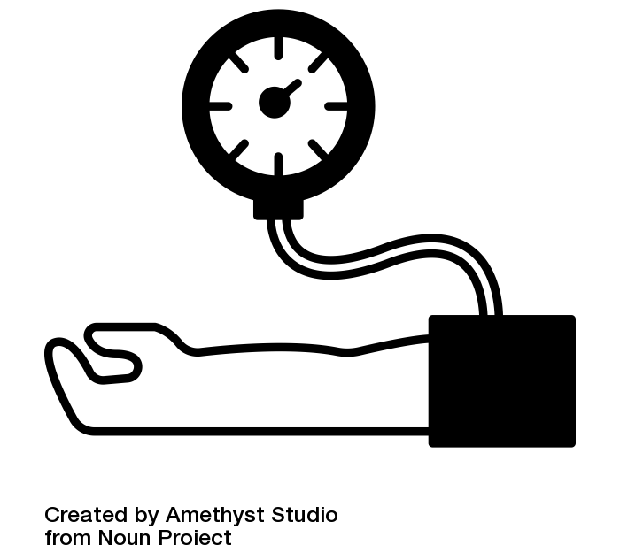

Contraceptives: What is needed before providing?
REQUIRED
RECOMMENDED
NOT REQUIRED
Pap Smear, Pelvic/Breast Exam, STI Testing, Hemoglobin
Medical History
Blood Pressure
17
Images:
https://genderphotos.vice.com/#Health
Blood Pressure by Amethyst Studio from the Noun Project
Notes:
A complete medical history is needed in order to rule out contraindications to hormonal contraception.
Physical exam, STI screening, Pap smear, etc… NOT REQUIRED. These interventions may be helpful for other reasons– but are not needed in order to prescribe hormonal contraception safely.
This applies to young teenagers who may be embarrassed or afraid of having a physical exam, and is particularly helpful in new patient or virtual visits. BP does not need to be done in the office- can be home or pharmacy.
ADD SPR app – quick guidance for initiating contraception in various clinical scenarios
References:
Stewart F, et al. Clinical breast and pelvic examination requirements for hormonal contraception: Current practice vs evidence. JAMA. 2001;285:2232-9.
Photo Credit:
https://genderphotos.vice.com/#Health
Blood Pressure by Amethyst Studio from the Noun Project

Slide 18


What About Estrogen?
Estrogen absolute contraindications:
    Migraine with aura
    Uncontrolled hypertension
    History of DVT/PE
    Tobacco use*
18
Notes:
CDC MEC Categories for use of CHCs
- Migraine with aura: category 4
Uncontrolled hypertension:
Systolic 140-159 or diastolic 90-99 – category 3
Systolic > 160 or diastolic > 100 – category 4
Postpartum < 21 days: Category 4
History of DVT/PE: category 3/4
Tobacco use:
Age < 35 – MEC category 2
Age > 35, <15 cigarettes/day – MEC category 3
Age > 35, > 15 cigarettes/day – MEC category 4
See MEC for full list of Cat 4 (e.g. active or recent breast cancer, immediate postpartum, known CAD, etc)
References:
Summary Chart of U.S. Medical Eligibility Criteria for Contraceptive Use: https://www.cdc.gov/reproductivehealth/contraception/pdf/summary-chart-us-medical-eligibility-criteria_508tagged.pdf. Updated July 2016.
Photo Credit: birth control pills by Sumana Chamrunworakiat from the Noun Project

Slide 19

What about treating Carrie’s UTI?
Notes:
What concerns should we have about antibiotics and interactions with contraceptives?
Image source: pills by Made from the Noun Project

Slide 20
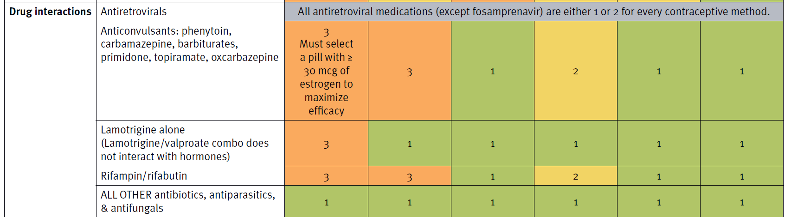
Medication Interactions
20
References: Summary Chart of U.S. Medical Eligibility Criteria for Contraceptive Use: https://www.cdc.gov/reproductivehealth/contraception/pdf/summary-chart-us-medical-eligibility-criteria_508tagged.pdf. Updated July 2016.
Notes:
Antiretroviral- mostly safe
Anticonvulsants- mostly safe
Antimicrobials- - ONLY RIFAMPIN AND RIFABUTIN DECREASE EFFICACY
SSRIs/St Johns wart- all effective
References:
Summary Chart of U.S. Medical Eligibility Criteria for Contraceptive Use: https://www.cdc.gov/reproductivehealth/contraception/pdf/summary-chart-us-medical-eligibility-criteria_508tagged.pdf. Updated July 2016.

Slide 21
PATIENT CASE:
Carrie
What does Carrie want?
21
Image: https://www.flickr.com/photos/wocintechchat/25900646342
Notes:
Shared decision making happens when a clinician provides balanced and unbiased information to patients with the goal of empowering patients’ decisions and building trust.
Find out which aspects of birth control matter most to Carrie:
Does she need a method she can hide from her parents?
Does she want to have periods?
How about cost?
Photo: https://www.flickr.com/photos/wocintechchat/25900646342

Slide 22
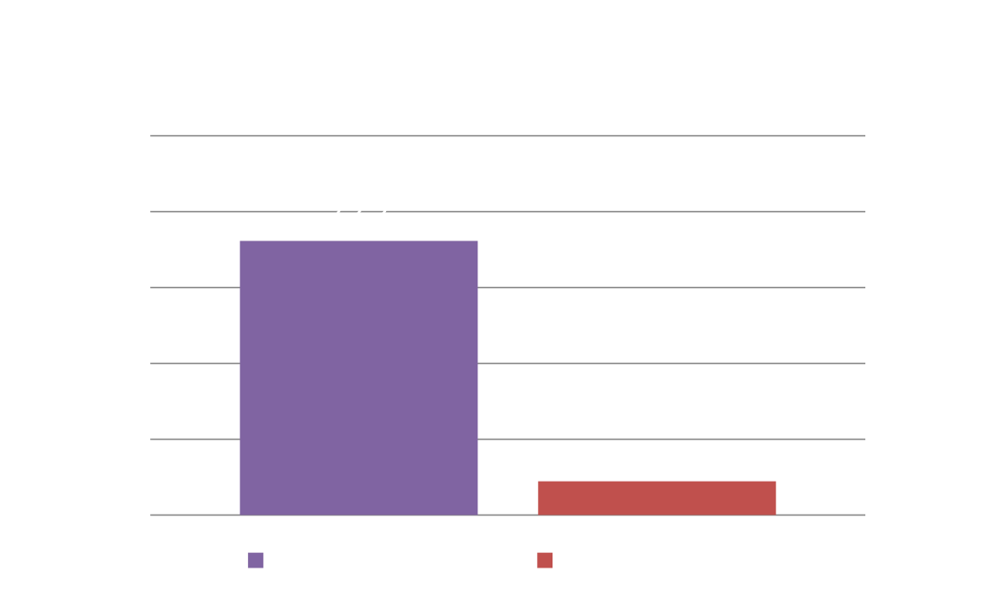
Impact of Choice
Trust patients to be the experts on themselves!
22
Pariani S, Heer D, van Arsdol M. Does choice make a difference to contraceptive use? Evidence from East Java. Stud Fam Plann 1991;22(6):384-390.
Kalmuss D, Davidson AR, Cushman LF, Heartwell S, Rulin M. Determinants of early implant discontinuation among low-income women. Fam Plann Perspect. 1996 Nov-Dec;28(6):256-60. Erratum in: Fam Plann Perspect 1997 Mar-Apr;29(2):60. PMID: 8959415.
Notes:
Trust patients to be the expert on themselves! Patients who are able to use their method of choice are more likely to continue use. You should assess what’s most important to the patient about their contraception and remember that it’s not always effectiveness. While you should definitely bust myths about contraception, such as it causes cancer, avoid pushing methods. This can lead to reduced trust and adherence, and often reflects your own biases.
A retrospective study of contraceptive discontinuation among 1,945 Indonesian women seen in family planning clinics in 1987–88 found that of 341 who discontinued use of the prescribed method within the first 12 months, 72.2% did not receive their method of choice. Only 8.9% of women who did receive their method of choice had discontinued use within 12 months.
In a longitudinal, multisite study of implant use in the US, researchers found that patients who felt more pressure from their clinician to use the implant were more likely to stop using it compared to patients who did not feel as pressured.
These findings imply that contraceptive continuation can be greater when providers pay more attention to the stated preferences of their clients or when policy allows clients to use their method of choice.
Source:
Pariani S, Heer D, van Arsdol M. Does choice make a difference to contraceptive use? Evidence from East Java. Stud Fam Plann 1991;22(6):384-390.
Kalmuss D, Davidson AR, Cushman LF, Heartwell S, Rulin M. Determinants of early implant discontinuation among low-income women. Fam Plann Perspect. 1996 Nov-Dec;28(6):256-60. Erratum in: Fam Plann Perspect 1997 Mar-Apr;29(2):60. PMID: 8959415.

Slide 23
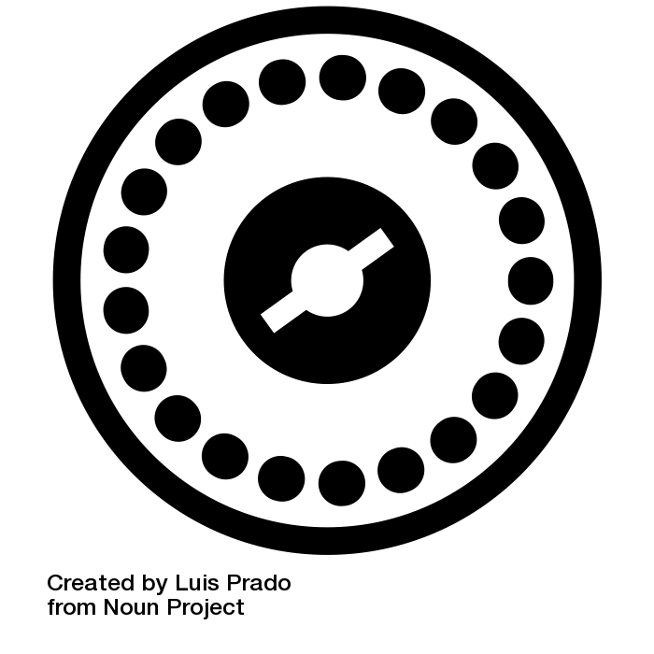
Carrie decides to start the pill
Does it matter which pill she starts?
BIG MAIN POINT
Notes:
Mostly all the same, despite marketing
Cycle control better with 30-35 EE than 20mcg – more breakthrough bleeding. But lower estrogen can reduce estrogen related side effects.
Extended cycle decreases days of bloating and menstrual cramping. Preparations can range from 84 to 365 days.
First generation progestins have higher discontinuation rates than 2nd/3rd generation and worse cycle control.
Monophasics recommended over di/triphasics – no differences in side effects.
No differences with acne, weight gain, adverse effects (conflicting studies)
References:
Szabo KA, Schaff E Oral Contraceptives, Does Formulation Matter? J Fam Prac 2013 Oct 62(10) E1-12
Images:
birth control by Linseed Studio from the Noun Project
birth control pills by Sumana Chamrunworakiat from the Noun Project
birth control pill by Luis Prado from the Noun Project

Slide 24


What about the patch and the ring?
Patch
Ring
Image: RHAP
Notes:
The patch has a higher dose than most pills, the ring has lower dose than most pills.
The patch is changed weekly, the ring changed every 3-4 weeks (with menstruation occurring the 4th week)
Theoretically better adherence
Ring has active hormone levels up to 35 days, patch up to 9 days.
References:
Dieben TO, Roumen FJ, Apter D. Efficacy, cycle control and user acceptability of a novel combined contraceptive vaginal ring. Obstet Gynecol. 2002 Sep;100(3):585-93.
Lesnewski R et al Preventing gaps when switching contraceptives 2011 Am Fam Phy Mar 1;83 (5)567-70
Zieman M, Hatcher RA. Managing Contraception. Tiger, Georgia: Bridging the Gap Foundation, 2012.
Photos: RHAP

Slide 25

How many refills should we give Carrie?
Should we dispense one pack at a time?
25
Notes:
To increase adherence, write for a full year’s supply: even if Carrie needs a follow-up visit.
That’s a 3-month supply with 4 refills.
Dispensing from the office may be even better than prescribing.
The more pills that are given, the longer the method is continued.
We have been taught to link refills to follow-up visits: but this stems from an authoritarian model of care.
Patient-centered practice = many refills on chronic medications.
Lots of support for the pill being OTC – “Free the Pill”
Judge-Golden CP, Smith KJ, Mor MK, et al. Financial implications of 12-month dispensing of oral contraceptive pills in the Veterans Affairs health care system [published correction appears in JAMA Intern Med. 2019;179(9):1303]. JAMA Intern Med. 2019;179(9):1201–1208.
Steenland MW, Rodriguez MI, Marchbanks PA, Curtis KM. How does the number of oral contraceptive pill packs dispensed or prescribed affect continuation and other measures of consistent and correct use? A systematic review. Contraception. 2019;87(5):605-610. doi: 10.1016/j.contraception.2012.08.004.
https://freethepill.org/
Images: birth control pill by Luis Prado from the Noun Project

Slide 26

Should Carrie get a prescription for EC, too?
26
Notes:
Advance prescription of EC doubles the rate of use
Having EC available does NOT decrease the use of the usual contraceptive method
Using EC does not increase the rate of STIs or unprotected intercourse, even in teens
Even teens who are given an ongoing prescription for pills might need EC, if they forget several days of pills or start their next pack late
References:
Bissel et al. Supplying emergency contraception via community pharmacies in the UK: reflections on the experiences of users and providers. Soc Sci Med.2003;57:2367-2378.
Raine et al. Direct access to emergency contraception through pharmacies and effect on unintended pregnancy and STIs: a randomized controlled trial. JAMA.2005;293:54-62.
Trussell J, Koenig J, Ellertson C, Stewart F. Preventing unintended pregnancy: the cost-effectiveness of three methods of emergency contraception. Am J Public Health 1997;87:932-7.
Gold, MA, Wolford JE, Smith KA, Parker AM The effects of advance prescription of emergency contraception on adolescent women’s sexual and contraceptive behaviors. J Pediatr Adolesc Gynecology 17(2):87-96.
Photo: Prescription by Made from the Noun Project

Slide 27

PATIENT CASE:
Mari
She/her pronouns
17-year old, G0P0
Doesn’t want to get pregnant until graduation
Wants a method that she can hide from her mom
Forgets daily pills
What are her options?
27
Image: https://affecttheverb.com/gallery/disabledandhere/filtermasknotebook/
Notes:
Lifestyle factors have a big impact on contraceptive choice.
Many patients have to hide their sexual activity from parents or other family members.
Some patients have limited privacy – they can’t risk having pill packs for someone to discover.
Photo: https://affecttheverb.com/gallery/disabledandhere/filtermasknotebook/

Slide 28

One Year Failure Rates
Effectiveness | Contraceptive | Typical-use pregnancy rate
Ineffective | Chance | 85%
Less effective | Condoms | 14%
More effective | Pill/patch/Ring | 8%
Highly effective | IUDs | 0.8 – 2%
 | Injectable | 0.1 – 0.3%
 | Implant | 0.1 – 0.3%
 | Sterilization (tubal methods, vasectomy) | 0.1 – 0.3%
28
Sonfield A, Hasstedt K and Gold RB, Moving Forward: Family Planning in the Era of Health Reform, New York: Guttmacher Institute, 2014.
Notes:
User-dependent contraceptive methods have higher pregnancy rates.
The most highly effective methods are those that are not user-dependent.
They keep working regardless of what the user does.
References:
Sonfield A, Hasstedt K and Gold RB, Moving Forward: Family Planning in the Era of Health Reform, New York: Guttmacher Institute, 2014.

Slide 29
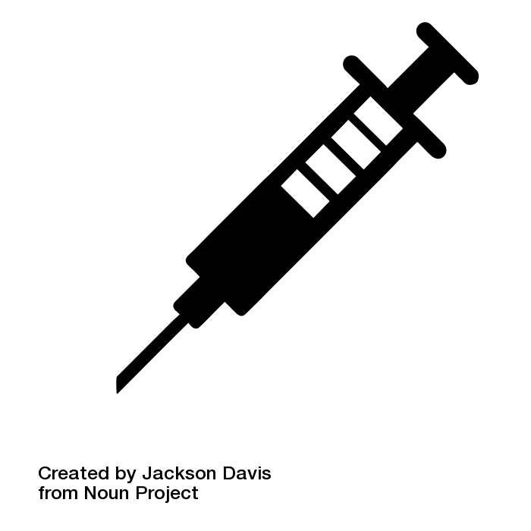
Progestin-Only Injection
Notes:
DEPO:
Highly effective - 0.3% failure rate!
QuickStart: if urine pregnancy negative, no need to wait for menses!
Amenorrhea: 50% by one year, 80% by 5 years
Private, not user-dependent
Users come to clinic ~ every 3 months, but now home injection available which may increase adherence
Photo: shot by Jackson Davis from the Noun Project

Slide 30
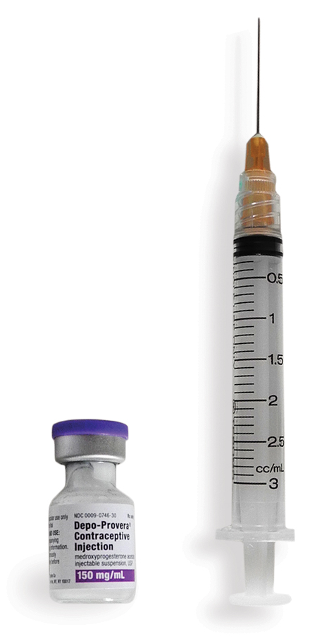
Depo and Bone Density
What are the real risks for teens?
  Exercise and diet have a big impact on bone density.
  Centers for Disease Control and Prevention. U.S. Selected Practice Recommendations for Contraceptive Use, 2013. MMWR 2013;62. http://www.cdc.gov/mmwr/pdf/rr/rr62e0614.pdf. June 14, 2013.
30
Image: RHAP
Notes:
Weighing risks and benefits:
Long term studies show no clinical significance to the bone loss, it is regained when depo stopped, no matter when, No need to restrict Depo Provera use
Risk “2” – benefits outweigh risks
Black box warning 2004: Depo-Provera use >2 years associated with BMD loss
No evidence, however, of increased in future fracture or osteoporosis risk
BMD loss temporary, recovers after discontinuation
Teen pregnancy causes more bone loss than teen Depo Provera use
Other lifestyle factors have greater impact on BMD: exercise, diet, weight
References:
ACOG Committee Opinion. Number 602, June 2014, reaffirmed 2016

Slide 31
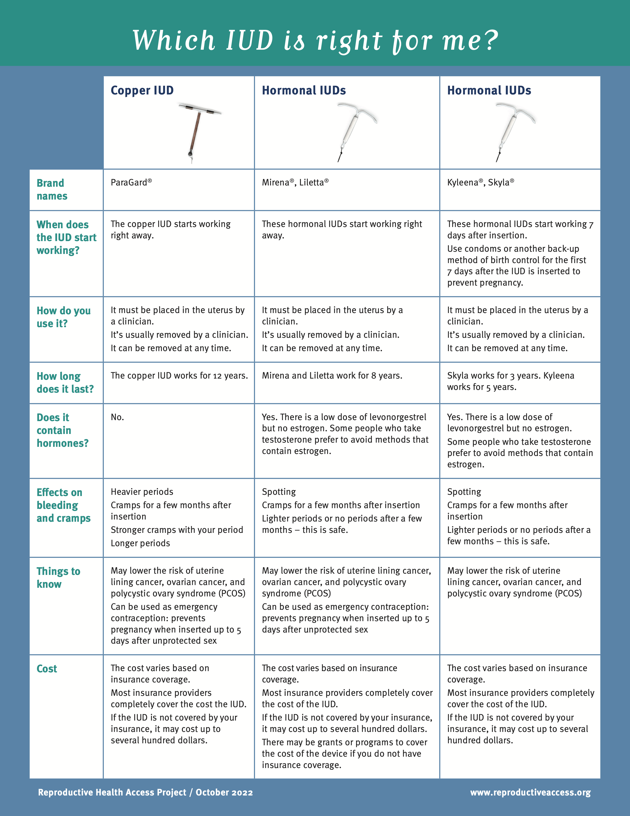
Intrauterine Devices
31
Image: RHAP
Notes:
There are 2 types of IUDS available in the US: the copper IUD and the progestin IUD.
Copper IUD (paragard) – non-hormonal, lasts 12 years
Hormonal IUD (levonogestrel - mirena 52 mg 8 years, liletta 52 mg 8 years, kylena 19.5 mg for 5 years, skyla 13.5 mg 3 years)
They’re both safe and highly effective.
RHAP uses a simple info sheet to help patients choose an IUD.
Accessed at: https://www.reproductiveaccess.org/wp-content/uploads/2014/06/IUD_facts.pdf
References:
Sivin, et al. Prolonged intrauterine contraception: a seven-year randomized study of the levonorgestrel 20 mcg/day (LNg 20) and the Copper T380 Ag IUDS. Contraception. 1991 Nov;44(5):473-80.
Chiou CF, Trussell J, Reyes E, Knight K, Wallace J, Udani J, Oda K, Borenstein J. Economic analysis of contraceptives for women. Contraception. 2003;68(1):3-10.
Hubacher D, Cheng D. Intrauterine devices and reproductive health: American women in feast and famine. Contraception. 2004 Jun;69(6):437-46.
Hatcher RA, Zieman M et al. A Pocket Guide to Managing Contraception. Tiger, Georgia: Bridging the Gap Foundation, 2004
.

Slide 32

IUD Considerations
Parity
STI Screening
Timing of Placement
Preferences regarding bleeding
32
Image: https://affecttheverb.com/gallery/disabledandhere/filtermaskfoliage/
Notes:
Things to consider
NULLIPARITY – not a contraindication to IUD, but important to keep in mind for your procedure (complications of difficulty with internal os, first pelvic exam, etc)
Screen for gonorrhea and chlamydia – universal screening (Grade B Recommendation USPSTF), concern for STI infection not contraindication for insertion or pull of IUD (however current PID yes per CDC MEC guidelines)
Do NOT need to wait for a person to have their monthly bleeding to insert an IUD (may medicate with misoprostol if especially difficult, but not common). IUDs can also be safely placed immediately post partum or 6 weeks post partum, or post abortion
References:
Grimes DA. Intrauterine device and upper-genital-tract infection.Lancet. 2000 Sep 16;356(9234):1013-9.
Andersson K, Odlind V, Rybo G. Levonorgestrel-releasing and copper-releasing (Nova T) IUDs during five years of use: a randomized comparative trial. Contraception. 1994 Jan;49(1):56-72.
Grimes D, et al, Immediate post-partum insertion of intruterine devices, Cochrane 2003 (1).
Hubacher D et al. Use of copper IUDs and the risk of infertility among nulligravid women NEJM, 2001, 108;304-14.
Grimes DA, Schulz KF. Antibiotic prophylaxis for intrauterine contraceptive device insertion. Cochrane Database Syst Rev. 2001;(1):CD001327.
Selected practice recommendations for contraceptive Use, 2nd edition, Geneva: WHO 2005.
Photo: https://affecttheverb.com/gallery/disabledandhere/filtermaskfoliage/

Slide 33

IUD Considerations
Family Planning Timeline
Cost
Insertion
33
Image: https://affecttheverb.com/gallery/disabledandhere/filtermaskcafe/
Notes:
Things to consider
IUD’s duration anywhere from 3 to 12 years, but can be removed at ANY time and not affect ability for pregnancy
Personal control can be barrier to IUD insertion, so important to make patients feel and live their autonomy - no coercion in placing or maintaining IUD; removal is an option at any time
If cost a barrier, look for a Title X family planning clinic or FQHC or non profit CHC near you, cost of Liletta is $50
Ectopic pregnancy: The very few pregnancies that occur with an IUD in place are more likely to be ectopic; but the overall pregnancy rate is so low that this scenario is rare.
References:
Andersson K, Odlind V, Rybo G. Levonorgestrel-releasing and copper-releasing (Nova T) IUDs during five years of use: a randomized comparative trial. Contraception. 1994 Jan;49(1):56-72.
Hubacher D et al. Use of copper IUDs and the risk of infertility among nulligravid women NEJM, 2001, 108;304-14.
Grimes DA, Schulz KF. Antibiotic prophylaxis for intrauterine contraceptive device insertion. Cochrane Database Syst Rev. 2001;(1):CD001327.
Selected practice recommendations for contraceptive Use, 2nd edition, Geneva: WHO 2005.
Photo: https://affecttheverb.com/gallery/disabledandhere/filtermaskcafe/

Slide 34

Progestin Implant
Highly effective and rapidly reversible
Discrete
Duration: 5 years
Causes spotting/irregular bleeding
Highly effective and rapidly reversible
34
Image: RHAP
Notes:
It prevents pregnancy by releasing a small amount of progestin
It works for 5 years. After 5 years, the patient can get a new implant if they want one.
Challenging features of implants include the associated irregular vaginal bleeding and the need for clinician visits for insertion and removal.
It can be removed at any time
Counsel on bleeding and other side effects. The implant causes periods to change. Most people have off-and-on spotting. Spotting may last until the implant is removed. A few people have: mood changes, weight gain, headache, acne, and/or skin changes in the upper arm. Most side effects go away when the implant is removed
References:
Peipert, J. F., Zhao, Q., Allsworth, J. E., Petrosky, E., Madden, T., Eisenberg, D., & Secura, G. (2011). Continuation and satisfaction of reversible contraception. Obstetrics and gynecology, 117(5), 1105.
Ravi, A., Prine, L., deFiebre, G., & Rubin, S. E. (2017). Beyond the Surface: Care Seeking Among Patients Initiating Contraceptive Implant in an Urban Federally Qualified Health Center Network. Journal of primary care & community health, 8(1), 20-25.
Photo: RHAP

Slide 35

PATIENT CASE:
Jamie
He/they 28 years old
Transgender man
Has partners with and without penises
What are Jamie’s options?
35
Image: https://unsplash.com/photos/thOsfLZM6X0
Notes:
Jamie is a 28 year old transgender man. He is interested in preventing pregnancy, and has partners with and without penises. He has not had any surgeries, and is not on hormone therapy but may be interested in the future.
Jamie should be offered all contraceptive options that are medically safe and conducive to their goals.
Considerations when providing contraceptive options in transgender care:
Multiple barriers exist for medical care for patients on the gender spectrum, including physical discomfort, emotional and gender dysphoria related discomfort, insurance difficulties, stigmatization and discrimination by other patients, staff, and medical providers.
Individuals on the gender spectrum vary a lot in their gender expressions, identities, and experiences. Don’t make assumptions, and ask open-ended questions. Being open, having clear and unbiased communication, and providing the patient with the most control will contribute to a successful visit. It’s ok to make mistakes, just recognize and apologize for any miscommunications
Language tips: ask about pronouns preferred (he/she/zie/they), anatomical term preferences (ie instead of vagina, use genital opening), avoid words with violent or sexual connotations (eg, use table instead of exam bed)
Special issues to keep in mind regarding contraception options:
Interactions with cross-gender hormonal therapy, ie- if on testosterone may not want estrogenic effects of birth control
Desire to have or not have monthly menses
Apprehension about pelvic exam, history of trauma
History of uterine or pelvic reconstructive surgery
Reference: Potter, J., Peitzmeier, S. M., Bernstein, I., Reisner, S. L., Alizaga, N. M., Agénor, M., & Pardee, D. J. (2015). Cervical cancer screening for patients on the female-to-male spectrum: a narrative review and guide for clinicians. Journal of general internal medicine, 30(12), 1857-1864.
Photo credit: https://unsplash.com/photos/thOsfLZM6X0

Slide 36

Office Barriers to Adherence
36
Notes:
Improve access to refills - phone refills, write for 12, don’t hold hostage to pap smear
Improve access to highly efficacious methods in-clinic for all people
Improve access to EC - have a phone in protocol for teens under 18 or others who need confidential services, have a list of pharmacies that carry it, use advance prescriptions at every opportunity
Improve training and education for all levels of staff on providing gender-affirming care and creating an inclusive environment for all people.
Photo: barrier by Econceptive from the Noun Project

Slide 37

Inconsistent Pill Use:
Linked to low satisfaction with clinician and low continuity of care
Percent of pill users who missed one or more pills during the past three months
37
Reference: Landry, David. Public and private providers involvement in improving their patients contraceptive use Contraception 2008 Jul 78 (1) 42-51.
Notes:
In addition, pill users who reported that they were not ‘very’ satisfied with their contraceptive service provider or that they did not usually see the same clinician at every contraceptive visit, were more likely to have been inconsistent in their pill use.
Reference: Landry, David. Public and private providers involvement in improving their patients contraceptive use Contraception 2008 Jul 78 (1) 42-51.

Slide 38
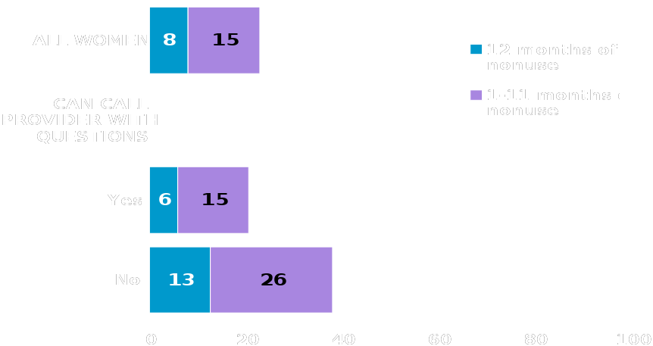
Feeling Unable to Reach a Provider With Questions is Linked to Contraceptive Non-Use
% of at-risk women experiencing contraceptive non-use in the past year
38
Reference: Landry, David. Public and private providers involvement in improving their patients contraceptive use Contraception 2008 Jul 78 (1) 42-51.
Notes:
Although providers universally report that they (or their staff) are available to answer contraceptive use questions phoned in by their patients, this is not the perception of all women. Six percent feel that they cannot call their provider with questions, and these women are more likely than those who feel otherwise to have a gap in method use while they are at risk.
Reference: Landry, David. Public and private providers involvement in improving their patients contraceptive use Contraception 2008 Jul 78 (1) 42-51.

Slide 39

Take-home Message:
Be Proactive with Contraception!
Ask about contraceptive or preconception needs at all types of visits
Discuss all methods - honor patient’s preferences and choice
De-link pap smears from contraception prescriptions
Dispense or prescribe one-year supply
Use Quick Start
39
Notes:
Ask about contraceptive or preconception needs at all types of office visits: including asking male patients
Provide patient-centered options counseling, using balanced information and avoiding coercion
Break the link between contraception and Pap smears
Break down barriers to same-day initiation of contraception
Write 90-day prescriptions with 3 refills if possible: always write for 1-year supply
Dispense contraceptives if possible
Use Quickstart methods
Photo: Contraception by Wichai Wi from the Noun Project

Slide 40

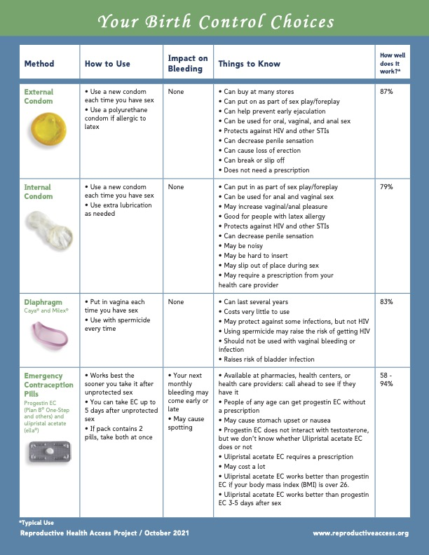
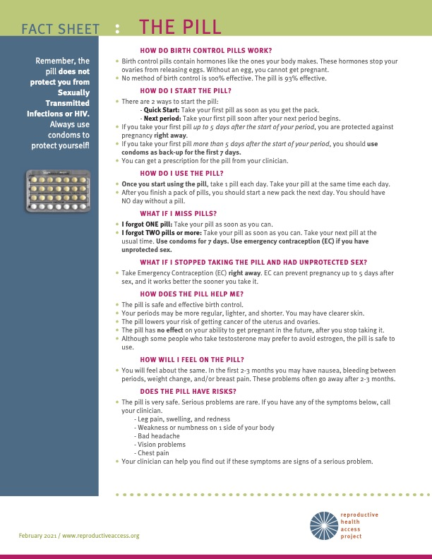
RESOURCES.
Contraceptive Pearls
Contraceptive Pearls Sign-up
Copper IUD User Guide
Depo-Provera Sub-Q User Guide
Emergency Contraception Pill User Guide
IUD Fact Sheet
Medical Eligibility Criteria for Initiating Contraception
Patch User Guide
Pill User Guide
Progestin Implant Fact Sheet
Progestin Implant User Guide
Progestin IUD User Guide
Progestin-Only Pill (Mini-Pill) User Guide
Quick Start Algorithm
Ring User Guide
The Shot (Depo Provera) User Guide
Your Birth Control Choices Fact Sheet
Notes:
Contraceptive Pearls
Contraceptive Pearls Sign-up
Copper IUD User Guide
Depo-Provera Sub-Q User Guide
Emergency Contraception Pill User Guide
IUD Fact Sheet
Medical Eligibility Criteria for Initiating Contraception
Patch User Guide
Pill User Guide
Progestin Implant Fact Sheet
Progestin Implant User Guide
Progestin IUD User Guide
Progestin-Only Pill (Mini-Pill) User Guide
Quick Start Algorithm
Ring User Guide
The Shot (Depo Provera) User Guide
Your Birth Control Choices Fact Sheet

Slide 41
REFERENCES.
ACOG Committee Opinion. Number 602, June 2014, reaffirmed 2016
Andersson K, Odlind V, Rybo G. Levonorgestrel-releasing and copper-releasing (Nova T) IUDs during five years of use: a randomized comparative trial. Contraception. 1994 Jan;49(1):56-72.
Bissel et al. Supplying emergency contraception via community pharmacies in the UK: reflections on the experiences of users and providers. Soc Sci Med.2003;57:2367-2378.
Blakemore E. The First Birth Control Pill Used Puerto Rican Women as Guinea Pigs. History.com. https://www.history.com/news/birth-control-pill-history-puerto-rico-enovid. Published May 9, 2018. Accessed October 1, 2021
Centers for Disease Control and Prevention. (2021, May 20). US Medical Eligibility Criteria (US MEC) for contraceptive use, 2016. Centers for Disease Control and Prevention. Retrieved November 22, 2021, from https://www.cdc.gov/reproductivehealth/contraception/mmwr/mec/summary.html.
Chiou CF, Trussell J, Reyes E, Knight K, Wallace J, Udani J, Oda K, Borenstein J. Economic analysis of contraceptives for women. Contraception. 2003;68(1):3-10.
Contraceptive Counseling: Patient/Provider Perspectives: Get LARC. Accessed: https://www.youtube.com/watch?v=OP9klE0JLLU. Published June 12, 2017.
Daniels K, Daugherty J and Jones J, Current contraceptive status among women aged 15–44: United States, 2011–2013, National Health Statistics Reports, 2014, No. 173, http://www.cdc.gov/nchs/data/databriefs/db173.pdf.
Dieben TO, Roumen FJ, Apter D. Efficacy, cycle control and user acceptability of a novel combined contraceptive vaginal ring. Obstet Gynecol. 2002 Sep;100(3):585-93
Emergency Contraception. Cdc.gov. Published October 6, 2019. Accessed July 19, 2021. https://www.cdc.gov/reproductivehealth/contraception/mmwr/spr/emergency.html
https://freethepill.org/
Gold, MA, Wolford JE, Smith KA, Parker AM The effects of advance prescription of emergency contraception on adolescent women’s sexual and contraceptive behaviors. J Pediatr Adolesc Gynecology 17(2):87-96.
Gomez AM, Fuentes L, Allina A. Women or LARC first? Reproductive autonomy and the promotion of long-acting reversible contraceptive methods. Perspect Sex Reprod Health. 2014;46(3):171-175. doi:10.1363/46e1614
Grimes DA. Intrauterine device and upper-genital-tract infection.Lancet. 2000 Sep 16;356(9234):1013-9.
Grimes D, et al, Immediate post-partum insertion of intruterine devices, Cochrane 2003 (1).
Grimes DA, Schulz KF. Antibiotic prophylaxis for intrauterine contraceptive device insertion. Cochrane Database Syst Rev. 2001;(1):CD001327.
Guttmacher Institute. Contraceptive Use in the United States. Accessed: https://www.guttmacher.org/fact-sheet/contraceptive-use-united-states Published 9/2016. Winner, Brooke, et al. "Effectiveness of long-acting reversible contraception." New England Journal of Medicine 366.21 (2012): 1998-2007.
Hatcher RA, Trussell J, Stewart FH, et al. Contraceptive Technology. 21st ed. Managing Contraception; 2018.
Hatcher RA, Zieman M et al. A Pocket Guide to Managing Contraception. Tiger, Georgia: Bridging the Gap Foundation, 2004
Hubacher D, Cheng D. Intrauterine devices and reproductive health: American women in feast and famine. Contraception. 2004 Jun;69(6):437-46.
Hubacher D et al. Use of copper IUDs and the risk of infertility among nulligravid women NEJM, 2001, 108;304-14.
Jackson J. How Puerto Rican Women Made Birth Control Possible-At the Expense of Their Health. BESE. https://www.bese.com/how-puerto-rican-women-made-birth-control-possible-at-the-expense-of-their-health/. Published April 27, 2018. Accessed October 1, 2021.
Judge-Golden CP, Smith KJ, Mor MK, et al. Financial implications of 12-month dispensing of oral contraceptive pills in the Veterans Affairs health care system [published correction appears in JAMA Intern Med. 2019;179(9):1303]. JAMA Intern Med. 2019;179(9):1201–1208.
Kalmuss D, Davidson AR, Cushman LF, Heartwell S, Rulin M. Determinants of early implant discontinuation among low-income women. Fam Plann Perspect. 1996 Nov-Dec;28(6):256-60. Erratum in: Fam Plann Perspect 1997 Mar-Apr;29(2):60. PMID: 8959415.
Kavanaugh ML and Pliskin E, Use of contraception among reproductive-aged women in the United States, 2014 and 2016, F&S Reports, 2020, 1(2):83–93, https://www.fertstertreports.org/article/S2666-3341(20)30038-6/fulltext.
Landry, David. Public and private providers involvement in improving their patients contraceptive use Contraception 2008 Jul 78 (1) 42-51.
Lesnewski R et al Preventing gaps when switching contraceptives 2011 Am Fam Phy Mar 1;83 (5)567-70
Pariani S, Heer D, van Arsdol M. Does choice make a difference to contraceptive use? Evidence from East Java. Stud Fam Plann 1991;22(6):384-390.
Peipert, J. F., Zhao, Q., Allsworth, J. E., Petrosky, E., Madden, T., Eisenberg, D., & Secura, G. (2011). Continuation and satisfaction of reversible contraception. Obstetrics and gynecology, 117(5), 1105.
Pendergrass DC, Raji MY. The bitter pill: Harvard and the dark history of birth control: Magazine: The Harvard Crimson. The Harvard Crimson. https://www.thecrimson.com/article/2017/9/28/the-bitter-pill/. Published September 28, 2017. Accessed October 1, 2021.
Potter, J., Peitzmeier, S. M., Bernstein, I., Reisner, S. L., Alizaga, N. M., Agénor, M., & Pardee, D. J. (2015). Cervical cancer screening for patients on the female-to-male spectrum: a narrative review and guide for clinicians. Journal of general internal medicine, 30(12), 1857-1864.
Raine et al. Direct access to emergency contraception through pharmacies and effect on unintended pregnancy and STIs: a randomized controlled trial. JAMA.2005;293:54-62.
Ravi, A., Prine, L., deFiebre, G., & Rubin, S. E. (2017). Beyond the Surface: Care Seeking Among Patients Initiating Contraceptive Implant in an Urban Federally Qualified Health Center Network. Journal of primary care & community health, 8(1), 20-25.
Selected practice recommendations for contraceptive Use, 2nd edition, Geneva: WHO 2005.
Sister Song & National Women’s Health Network. Long-Acting Reversible Contraception Statement of Principles. https://www.nwhn.org/wp-content/uploads/2017/02/LARCStatementofPrinciples.pdf
Sivin, et al. Prolonged intrauterine contraception: a seven-year randomized study of the levonorgestrel 20 mcg/day (LNg 20) and the Copper T380 Ag IUDS. Contraception. 1991 Nov;44(5):473-80.
Sonfield A, Hasstedt K and Gold RB, Moving Forward: Family Planning in the Era of Health Reform, New York: Guttmacher Institute, 2014.
Steenland MW, Rodriguez MI, Marchbanks PA, Curtis KM. How does the number of oral contraceptive pill packs dispensed or prescribed affect continuation and other measures of consistent and correct use? A systematic review. Contraception. 2019;87(5):605-610. doi: 10.1016/j.contraception.2012.08.004.
Stewart F, et al. Clinical breast and pelvic examination requirements for hormonal contraception: Current practice vs evidence. JAMA. 2001;285:2232-9.
Summary Chart of U.S. Medical Eligibility Criteria for Contraceptive Use: https://www.cdc.gov/reproductivehealth/contraception/pdf/summary-chart-us-medical-eligibility-criteria_508tagged.pdf. Updated July 2016.
Szabo KA, Schaff E Oral Contraceptives, Does Formulation Matter? J Fam Prac 2013 Oct 62(10) E1-12
Turok DK, Gero A, Simmons RG, et al. Levonorgestrel vs. Copper Intrauterine Devices for Emergency Contraception. N Engl J Med. 2021;384(4):335-344. doi:10.1056/NEJMoa2022141
Trussell J, Koenig J, Ellertson C, Stewart F. Preventing unintended pregnancy: the cost-effectiveness of three methods of emergency contraception. Am J Public Health 1997;87:932-7.
Westhoff C, Kerns J, Morroni C, Cushman LF, Tiezzi L, Murphy PA. Quick start: novel oral contraceptive initiation method. Contraception. 2002 Sep;66(3):141-5.
Westhoff C, Morroni C, Kerns J, Murphy PA. Bleeding patterns after immediate vs. conventional oral contraceptive initiation: a randomized, controlled trial. Fertil Steril. 2003 Feb;79(2):322-9.
Zieman M, Hatcher RA. Managing Contraception. Tiger, Georgia: Bridging the Gap Foundation, 2012.
Notes:
ACOG Committee Opinion. Number 602, June 2014, reaffirmed 2016
Andersson K, Odlind V, Rybo G. Levonorgestrel-releasing and copper-releasing (Nova T) IUDs during five years of use: a randomized comparative trial. Contraception. 1994 Jan;49(1):56-72.
Bissel et al. Supplying emergency contraception via community pharmacies in the UK: reflections on the experiences of users and providers. Soc Sci Med.2003;57:2367-2378.
Blakemore E. The First Birth Control Pill Used Puerto Rican Women as Guinea Pigs. History.com. https://www.history.com/news/birth-control-pill-history-puerto-rico-enovid. Published May 9, 2018. Accessed October 1, 2021
Centers for Disease Control and Prevention. (2021, May 20). US Medical Eligibility Criteria (US MEC) for contraceptive use, 2016. Centers for Disease Control and Prevention. Retrieved November 22, 2021, from https://www.cdc.gov/reproductivehealth/contraception/mmwr/mec/summary.html.
Chiou CF, Trussell J, Reyes E, Knight K, Wallace J, Udani J, Oda K, Borenstein J. Economic analysis of contraceptives for women. Contraception. 2003;68(1):3-10.
Contraceptive Counseling: Patient/Provider Perspectives: Get LARC. Accessed: https://www.youtube.com/watch?v=OP9klE0JLLU. Published June 12, 2017.
Daniels K, Daugherty J and Jones J, Current contraceptive status among women aged 15–44: United States, 2011–2013, National Health Statistics Reports, 2014, No. 173, http://www.cdc.gov/nchs/data/databriefs/db173.pdf.
Dieben TO, Roumen FJ, Apter D. Efficacy, cycle control and user acceptability of a novel combined contraceptive vaginal ring. Obstet Gynecol. 2002 Sep;100(3):585-93
Emergency Contraception. Cdc.gov. Published October 6, 2019. Accessed July 19, 2021. https://www.cdc.gov/reproductivehealth/contraception/mmwr/spr/emergency.html
https://freethepill.org/
Gold, MA, Wolford JE, Smith KA, Parker AM The effects of advance prescription of emergency contraception on adolescent women’s sexual and contraceptive behaviors. J Pediatr Adolesc Gynecology 17(2):87-96.
Gomez AM, Fuentes L, Allina A. Women or LARC first? Reproductive autonomy and the promotion of long-acting reversible contraceptive methods. Perspect Sex Reprod Health. 2014;46(3):171-175. doi:10.1363/46e1614
Grimes DA. Intrauterine device and upper-genital-tract infection.Lancet. 2000 Sep 16;356(9234):1013-9.
Grimes D, et al, Immediate post-partum insertion of intruterine devices, Cochrane 2003 (1).
Grimes DA, Schulz KF. Antibiotic prophylaxis for intrauterine contraceptive device insertion. Cochrane Database Syst Rev. 2001;(1):CD001327.
Guttmacher Institute. Contraceptive Use in the United States. Accessed: https://www.guttmacher.org/fact-sheet/contraceptive-use-united-states Published 9/2016. Winner, Brooke, et al. "Effectiveness of long-acting reversible contraception." New England Journal of Medicine 366.21 (2012): 1998-2007.
Hatcher RA, Trussell J, Stewart FH, et al. Contraceptive Technology. 21st ed. Managing Contraception; 2018.
Hatcher RA, Zieman M et al. A Pocket Guide to Managing Contraception. Tiger, Georgia: Bridging the Gap Foundation, 2004
Hubacher D, Cheng D. Intrauterine devices and reproductive health: American women in feast and famine. Contraception. 2004 Jun;69(6):437-46.
Hubacher D et al. Use of copper IUDs and the risk of infertility among nulligravid women NEJM, 2001, 108;304-14.
Jackson J. How Puerto Rican Women Made Birth Control Possible-At the Expense of Their Health. BESE. https://www.bese.com/how-puerto-rican-women-made-birth-control-possible-at-the-expense-of-their-health/. Published April 27, 2018. Accessed October 1, 2021.
Judge-Golden CP, Smith KJ, Mor MK, et al. Financial implications of 12-month dispensing of oral contraceptive pills in the Veterans Affairs health care system [published correction appears in JAMA Intern Med. 2019;179(9):1303]. JAMA Intern Med. 2019;179(9):1201–1208.
Kalmuss D, Davidson AR, Cushman LF, Heartwell S, Rulin M. Determinants of early implant discontinuation among low-income women. Fam Plann Perspect. 1996 Nov-Dec;28(6):256-60. Erratum in: Fam Plann Perspect 1997 Mar-Apr;29(2):60. PMID: 8959415.
Kavanaugh ML and Pliskin E, Use of contraception among reproductive-aged women in the United States, 2014 and 2016, F&S Reports, 2020, 1(2):83–93, https://www.fertstertreports.org/article/S2666-3341(20)30038-6/fulltext.
Landry, David. Public and private providers involvement in improving their patients contraceptive use Contraception 2008 Jul 78 (1) 42-51.
Lesnewski R et al Preventing gaps when switching contraceptives 2011 Am Fam Phy Mar 1;83 (5)567-70
Pariani S, Heer D, van Arsdol M. Does choice make a difference to contraceptive use? Evidence from East Java. Stud Fam Plann 1991;22(6):384-390.
Peipert, J. F., Zhao, Q., Allsworth, J. E., Petrosky, E., Madden, T., Eisenberg, D., & Secura, G. (2011). Continuation and satisfaction of reversible contraception. Obstetrics and gynecology, 117(5), 1105.
Pendergrass DC, Raji MY. The bitter pill: Harvard and the dark history of birth control: Magazine: The Harvard Crimson. The Harvard Crimson. https://www.thecrimson.com/article/2017/9/28/the-bitter-pill/. Published September 28, 2017. Accessed October 1, 2021.
Potter, J., Peitzmeier, S. M., Bernstein, I., Reisner, S. L., Alizaga, N. M., Agénor, M., & Pardee, D. J. (2015). Cervical cancer screening for patients on the female-to-male spectrum: a narrative review and guide for clinicians. Journal of general internal medicine, 30(12), 1857-1864.
Raine et al. Direct access to emergency contraception through pharmacies and effect on unintended pregnancy and STIs: a randomized controlled trial. JAMA.2005;293:54-62.
Ravi, A., Prine, L., deFiebre, G., & Rubin, S. E. (2017). Beyond the Surface: Care Seeking Among Patients Initiating Contraceptive Implant in an Urban Federally Qualified Health Center Network. Journal of primary care & community health, 8(1), 20-25.
Selected practice recommendations for contraceptive Use, 2nd edition, Geneva: WHO 2005.
Sister Song & National Women’s Health Network. Long-Acting Reversible Contraception Statement of Principles. https://www.nwhn.org/wp-content/uploads/2017/02/LARCStatementofPrinciples.pdf
Sivin, et al. Prolonged intrauterine contraception: a seven-year randomized study of the levonorgestrel 20 mcg/day (LNg 20) and the Copper T380 Ag IUDS. Contraception. 1991 Nov;44(5):473-80.
Sonfield A, Hasstedt K and Gold RB, Moving Forward: Family Planning in the Era of Health Reform, New York: Guttmacher Institute, 2014.
Steenland MW, Rodriguez MI, Marchbanks PA, Curtis KM. How does the number of oral contraceptive pill packs dispensed or prescribed affect continuation and other measures of consistent and correct use? A systematic review. Contraception. 2019;87(5):605-610. doi: 10.1016/j.contraception.2012.08.004.
Stewart F, et al. Clinical breast and pelvic examination requirements for hormonal contraception: Current practice vs evidence. JAMA. 2001;285:2232-9.
Summary Chart of U.S. Medical Eligibility Criteria for Contraceptive Use: https://www.cdc.gov/reproductivehealth/contraception/pdf/summary-chart-us-medical-eligibility-criteria_508tagged.pdf. Updated July 2016.
Szabo KA, Schaff E Oral Contraceptives, Does Formulation Matter? J Fam Prac 2013 Oct 62(10) E1-12
Turok DK, Gero A, Simmons RG, et al. Levonorgestrel vs. Copper Intrauterine Devices for Emergency Contraception. N Engl J Med. 2021;384(4):335-344. doi:10.1056/NEJMoa2022141
Trussell J, Koenig J, Ellertson C, Stewart F. Preventing unintended pregnancy: the cost-effectiveness of three methods of emergency contraception. Am J Public Health 1997;87:932-7.
Westhoff C, Kerns J, Morroni C, Cushman LF, Tiezzi L, Murphy PA. Quick start: novel oral contraceptive initiation method. Contraception. 2002 Sep;66(3):141-5.
Westhoff C, Morroni C, Kerns J, Murphy PA. Bleeding patterns after immediate vs. conventional oral contraceptive initiation: a randomized, controlled trial. Fertil Steril. 2003 Feb;79(2):322-9.
Zieman M, Hatcher RA. Managing Contraception. Tiger, Georgia: Bridging the Gap Foundation, 2012.

Slide 42
THANK YOU.

