Slide 1



TELEHEALTH FOR REPRODUCTIVE HEALTH CARE
Notes:
Updated: January 2023

Slide 2
LEARNING OBJECTIVES.
  Explore which reproductive health services really require in-person care and what can be done via video or phone
  Examine the technology and regulations that can be minimized in order to enhance patient-centeredness
  Discuss where our advocacy can be focused in order to provide and expand innovative and safe care
Notes:
*Note to facilitator: At RHAP we recommend mentioning that many times if we’re showing data or quoting studies they may describe their patient population as “women” – what they are referring to is cisgender women. We know that people of all genders get abortions, birth children, use contraception, and experience early pregnancy loss. That is why we talk about our patients and WE do not use the word WOMEN to describe the people who come to our clinics/offices, because that leaves out a significant portion of our patient population.

Slide 3
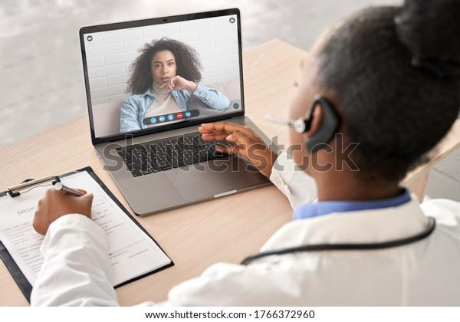
TELEHEALTH &
COVID-19
Notes:
Telehealth and telemedicine has been around for a long time. Many sites and organizations have provided telehealth and remote services for reproductive health care long before the COVID-19 pandemic. However, the pandemic and corresponding stay at home orders and other measures to minimize disease spread and risk really motivated health care providers to develop innovative ways to still provide comprehensive, patient-centered reproductive health care. We know that telehealth can help address unmet reproductive health needs in the US – especially for rural populations and those with childcare and transportation and financial barriers. But, telehealth isn’t the mode of care that is going to change access for everyone – barriers still remain especially when it comes to internet and phone connectivity, or the safety of taking a telehealth call at home or in one’s community.
So a lot of the telehealth care we are going to talk about today expanded and developed further because of COVID-19 – but it doesn’t mean these telehealth innovations will end with the end of the pandemic or only apply in public health emergencies. Telehealth can and should be an option offered to patients as another way to obtain care that meets patients where they are at.

Slide 4
BEST PRACTICES FOR PATIENT-CENTERED TELEHEALTH CARE
Encourage patient comfort with telehealth → trauma-informed care lens
Patient education considerations
Phone vs. video considerations
Assure/screen for privacy and confidentiality
Screening for safety, intimate partner violence
Notes:
Ask: what do you think are best practices for providing patient-centered telehealth care?
Optional resource from the Reproductive Health National Family Planning Training Center:
Tips for providing patient-centered contraceptive care using telehealth – four case studies: https://www.nationalfamilyplanning.org/telehealth-video-guide?srctid=1&erid=2521788&trid=4d1a9e24-c58c-4e23-9ab2-a8601869a50b and video discussion guide: https://www.nationalfamilyplanning.org/file/Member-Telehealth-Video-Discussion-Guide-04072021.pdf
In these four mock telehealth visits real clinicians and patient actors demonstrate strategies for adapting patient-centered contraceptive care to telehealth delivery. Each vignette provides examples of skills providers can use to create an environment of safety and confidentiality for the patient, build rapport, and support patient autonomy in the context of telehealth contraceptive care visits. This video aims to show you how to make a telehealth visit seem as personal and patient-centered as an in-person visit. You can choose 1-4 case studies in these videos and start discussion on best practices for patient-centered contraceptive counseling via telehealth
Potential discussion questions:
What strategies did you see in this video that you already use in delivering telehealth care?
What did you see that was new to you? Did anything surprise you?
Were there strategies depicted that you have questions or concerns about or would be hesitant to use? If so, describe.
Were there any strategies in the video that you think might be particularly effective?
Are there any strategies from the video that you would like to practice integrating into your own delivery of telehealth services? If so, which ones?

Slide 5
ENCOURAGE PATIENT COMFORT
Ask patients if they have used telehealth before
Explain telehealth and the process
Always offer in-clinic care if a patient wants or needs it
Acknowledge when something is different or potentially awkward
Build trust, rapport with patient as you do in-person
Allow support people, choice of place, pets!
Notes:
Ask patients if they have used telehealth before and their comfort with it, what worked and didn’t work for them
Explain telehealth, especially for patients new to it (process, that they can still come to clinic if want/need)
Acknowledge for the patient when something is different or potentially awkward about a telehealth visit
Just as though you were in-person, continue to facilitate a trusting relationship.
Allow and welcome any support people the patient wants or chooses (partner, friend, family member, doula, etc), wherever they want to take the call, any pets they want to have by their side!
Take advantage of the fact that you have more time in this visit - where you aren’t doing physical procedures or tests - to talk, counsel, provide information, answer questions, and build rapport. Spending time to talk and listen to your patient and making sure they understand things, that you’ve explained things well, and answered questions about their care.
Source:
Source: Reproductive Health National Family Planning Training Center, Telehealth Video Discussion Guide. https://www.nationalfamilyplanning.org/file/Member-Telehealth-Video-Discussion-Guide-04072021.pdf.

Slide 6
4 Rs OF TRAUMA-INFORMED CARE
Realizing the widespread impact of trauma
Recognizing signs and symptoms of trauma in people, including patients, their families, staff and clinical team members
Responding by fully integrating knowledge about trauma into policies, procedures, and practices, and
Seeking to actively resist Re-traumatization
^{Source:}
Trauma-Informed Approach and Trauma-Specific Interventions. http://www.samhsa.gov/nctic/trauma-interventions
Notes:
Trauma informed care is a lens through which we can apply when providing telehealth and in-person care to our patients.
Gynecological care can be very triggering for people who have experienced trauma. The best approach is to assume everyone may have had trauma and go about the care asking permission and explaining every step of the way, even virtually. With the expansion of remote and telehealth care, many patients are re-establishing care who may have been avoiding it in person. We can see it as an opportunity to create a comfortable space and build trust so that when or if the person wants to have an in-person visit, they can feel a little more safe.
Key principles to think about
Transparency
Initiating with consent
Assure that there is no one else in your room and make sure there is no one else in their room unless they explicitly want them to be there
Assure that they are not being recorded
Be honest
It’s okay to be a little humorous about tech issues -- this breaks down power dynamics and centers community of everyone involved in that call

Slide 7
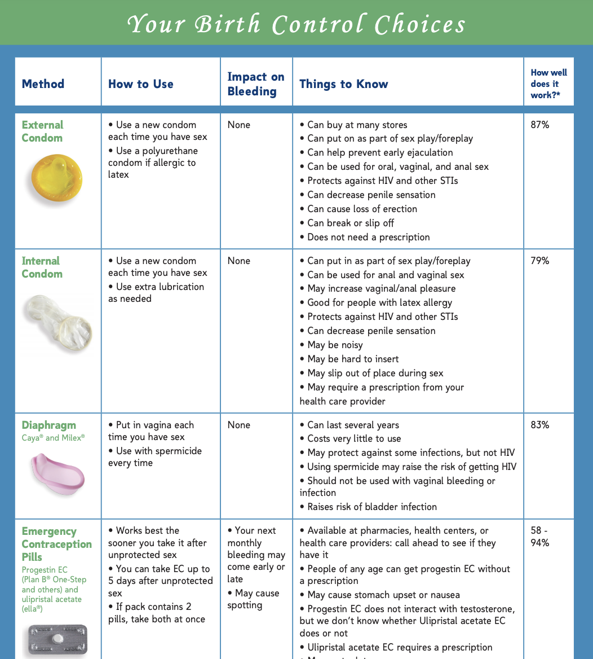
PATIENT EDUCATION CONSIDERATIONS
Hold models, diagrams, pictures up to camera
Share screen
Use descriptive phrases
Share links, documents
Use chat feature
Notes:
Strategies and skills
Hold models up to the camera
Hold diagrams or pictures up to the camera
Share screen
Use descriptive phrases and size comparisons to familiar objects
Share links and documents via text, email, portal
Use the platform’s chat feature to share links
Additional points
Provide person-centered contraceptive counseling that includes the full range of methods and patient priorities; counsel on method initiation and continuation, as well as method switching
Source: Reproductive Health National Family Planning Training Center, Telehealth Video Discussion Guide. https://www.nationalfamilyplanning.org/file/Member-Telehealth-Video-Discussion-Guide-04072021.pdf.

Slide 8

PHONE vs. VIDEO
Video
Camera at eye level
Look at camera
Warm, enthusiastic smile/wave
Avoid distracting backgrounds
Pause longer for reply
Phone
Smile while greeting patient to help make your tone warmer
More pronounced emotion with voice
Brief verbal cues
Encourage patient to ask questions, interrupt
Stop frequently to ask for questions
Pause longer for reply
Notes:
Skills and strategies VIDEO:
Place camera at eye level
Look at the camera, not screen
Start with a warm enthusiastic wave and/or smile
Avoid distracting backgrounds
Pause longer than usual for reply
Skills and strategies PHONE
Smile when greeting the patient to help automatically make the tone of your voice warmer
Demonstrate more pronounced emotion with voice
Use brief verbal cues to indicate listening and empathy
Encourage the patient to ask questions and/or interrupt
Stop more frequently than usual to ask if the patient has questions • Pause longer than usual for reply
Source: Reproductive Health National Family Planning Training Center, Telehealth Video Discussion Guide. https://www.nationalfamilyplanning.org/file/Member-Telehealth-Video-Discussion-Guide-04072021.pdf.
Image Sources:
https://unsplash.com/photos/bTfza0M0hCE

Slide 9

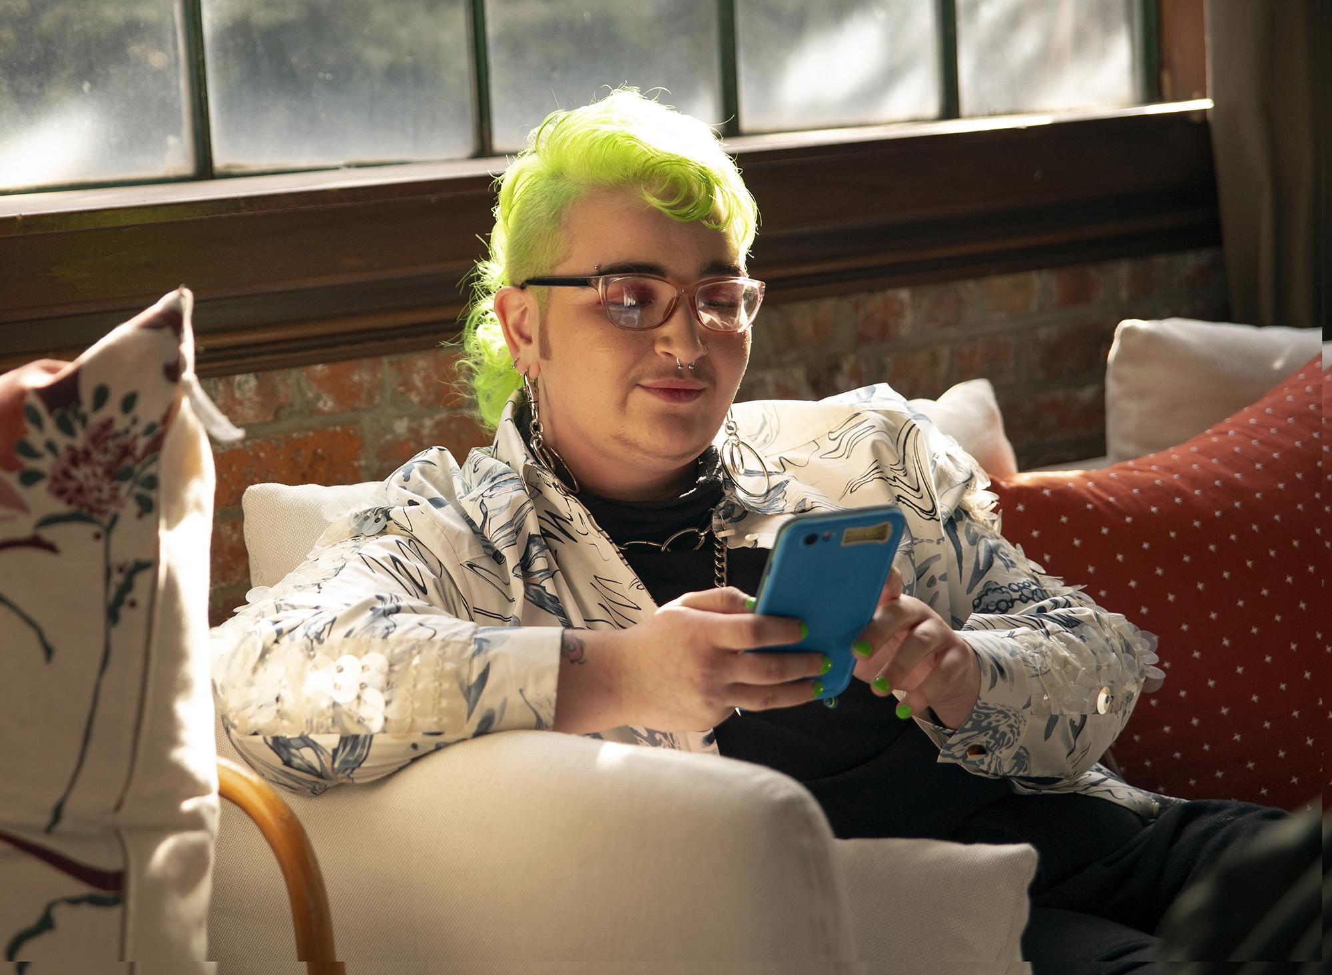
ASSURE PRIVACY & CONFIDENTIALITY
Image Source: The Gender Spectrum Collection
Notes:
Ensuring privacy and confidentiality is a really key best practice for telehealth. For all kind of remote care, remember to check with your patient right up front about whether or not they can talk freely and safely. We’ve heard from clinicians around the country that people are calling us from their bathrooms, or people are sitting in their cars. This is particularly an issue for young people and people who may not feel safe to talk about reproductive health care at home around family.
Skills and strategies:
Confirm with the patient that it is a good time for them to talk – offer to reschedule if it is not
Describe your setting to the patient, make clear it is private/confidential
Emphasize that the patient should think of this visit as the same as any other clinic
Ask about the patient’s space, where they are, who is with them – if they are in a good/safe place to talk
Offer yes/no questions so others can’t hear
Accept that patients may want to have a visit in a space that isn’t confidential – proceed if they want to even if someone else is there
Source: Reproductive Health National Family Planning Training Center, Telehealth Video Discussion Guide. https://www.nationalfamilyplanning.org/file/Member-Telehealth-Video-Discussion-Guide-04072021.pdf.
Image Source: The Gender Spectrum Collection, https://genderphotos.vice.com/

Slide 10
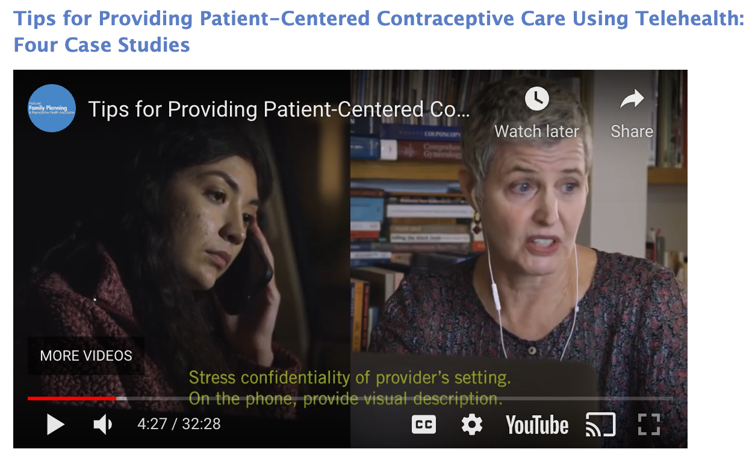
SAFETY & INTIMATE PARTNER VIOLENCE
Ensure if it is safe for patient to speak over phone/video
Initiate conversations with yes/no responses
Work with patient to support safety and privacy during telehealth visits
Offer universal education on stress, IPV, healthy relationships and how this affects health
Provide support, warm referrals if patients disclose violence
Brainstorm ways to stay connected when someone is controlling access to health care
Watch for non-verbal signs (bruises, changes in behavior)
Offer in-person visits and f/u to facilitate more private conversations
Notes:
Telehealth visits may not be a safe place for everyone. For those experiencing intimate partner violence and abuse, privacy may be compromised. Telehealth visits at home may enable abusive/controlling partners to overhear conversations.
Note to Facilitator: consider going through at least 1 of the 4 case studies from the NFHPRA’s telehealth guide (from slide 4): https://www.nationalfamilyplanning.org/telehealth-video-guide?srctid=1&erid=2521788&trid=4d1a9e24-c58c-4e23-9ab2-a8601869a50b
[Talk through clinical pathway on how to screen for safety and provide IPV support: https://www.futureswithoutviolence.org/wp-content/uploads/Telehealth-Covid-19-IPV_Clinical-Pathway.pdf (page 2)
CUES intervention for IPV
C: Prioritize confidentiality by ensuring it is safe for the patient to speak over the phone/video, and letting them know that their health information will be kept safe. Example language: “Your medical information is confidential, that doesn’t change just because you’re not in a clinic setting. I will not share anything we talk about here outside of with the care team [or if you tell me refer to your state law]. Are you somewhere where you can speak freely?”
If they are not somewhere they can speak privately, work with the patient to support their safety and privacy during telehealth visits. Example questions: “Are you able to move to a place where you feel more comfortable to talk freely?” “Can others in the room hear what I am saying?” “Would you prefer to find another time to talk or move our conversation to messaging through the health portal?”
UE: Offer universal education to all patients about how stress can affect relationships and relationships can affect health, and that there are support services and resources available. Share resources, if patient agrees, through text, health portal, message, or phone - even if there is no disclosure of violence/relationship troubles. Example language: ““Before we get started, I want to say that I know COVID19 has made things harder for everyone. Because people are stressed, we are sharing ideas about helping yourself and people you care about. For example, we may experience more stress now in our relationships including increased fighting or harm, and that can affect our health. There is free, confidential help available if you know someone who is being hurt in their relationship. Would it be okay if I sent you some resources for you to share? I will also send information on support around parenting, access to food, and stress. How are things going right now for you?”
S: Providing support if patients disclose experiences of violence or other needs, offer validating messages and a warm referral to an IPV survivor support agency, crisis text line, and health promotion information.
Even if a patient is not currently experiencing abuse, they may still be feeling triggered or in crisis. Validate these feelings, offer strategies for reducing stress, answer Qs, connect to support services for mental health, food access, etc.
You may also be able to brainstorm with patients who are experiencing violence about ways to stay connected when someone is controlling access to their health care and support networks. Connect this conversation to the reason for the health visit. Document referrals and care plans in a private part of the medical record and schedule a follow up visit.
Ask: What else might you do to enhance safety and support people who may be experiencing IPV?
Other recommendations
Initiate conversation with yes/no responses to ascertain if it is safe for the patient to answer questions about IPV and then provide subsequent supportive care resources through email or referral to online information
F/U with someone experiencing IPV is essential -- offer in-person visit if possible so you can control the setting
Offer universal education about IPV, healthy relationships, to patients and referring those who disclose IPV to a social worker or hotline
Watch for non-verbal signs -- like bruises, changes in behavior (like substance use or requests for testing) which could be an opportunity to ask for an in-clinic visit without explicitly asking for it.
Offer patients appropriate in-person visits to facilitate more private conversations and f/u
People experiencing IPV need to know that their clinicians are available to help and support them. Clinicians should know how to help refer them to people and organizations that can intervene. If a person experiencing IPV is not ready to seek help, refer them to a social worker who can assist them in creating a home safety plan.
See Box: Suggested Questions and Advisements for IPV Screening in Clinical Practice: https://jamanetwork.com/journals/jama/fullarticle/2780630#jit210005b1
Resources:
https://www.futureswithoutviolence.org/wp-content/uploads/Telehealth-Covid-19-IPV_Clinical-Pathway.pdf
https://www.statnews.com/2020/07/17/rising-to-the-challenge-of-screening-for-intimate-partner-violence-during-covid-19/
Simon MA. Responding to Intimate Partner Violence During Telehealth Clinical Encounters. JAMA. 2021;325(22):2307–2308. doi:10.1001/jama.2021.1071

Slide 11

TELEHEALTH MECHANICS FOR CLINICIANS
Lighting: natural light, warm light preferred. Avoid LED or colored lighting
Use Zoom filters (blur) and simple backgrounds for personal privacy
Ensure you are an quiet, private space
Strong, reliable internet connection
Notes:
What are some things you do to be prepared for a good telehealth visit?
Lighting tips:
Natural light is preferred if possible. Avoid lighting the space with LED or colored lighting. Natural artificial light is preferred as it is a warm light. 100% indirect lighting is recommended.
Put a piece of white paper on your desk, in line with under your face to add more brightness.
Add zoom filters (like blur) or simple background/clinic logo background for personal privacy. You can also set up a barrier behind your set up to block off the rest of your space (especially if you are at home)
Ensure you are in a quiet, private space. Ideally behind a locked door.
Ensure you have a strong, reliable internet connection. Test it ahead of time. Conduct a mock visit to assess equipment readiness.
Image Source: unsplash.com

Slide 12

TELEHEALTH FOR TRANSGENDER & GENDER EXPANSIVE PEOPLE
Importance of supporting transgender and gender expansive patients:
Frequent experiences of discrimination, mistreatment, harassment, denial of care, harm
High levels of postponing medical care when sick/injured due to discrimination
50% report having to teach their clinicians about transgender care
Notes:
A large study on transgender and gender expansive people in the US reports that they experience persistant discrimination in health care settings -- including mistreatment, denial of care, and harm.
1 in 5 reported being refused care outright because they were transgender or gender expansive.
28% report very high levels of postponing medical care when sick or injured due to discrimination and disrespect
28% were subjected to harassment in medical settings
50% reported having to teach their medical providers about transgender care
These negative experiences impact health and worsen existing health conditions. Additional trauma is being caused by health care providers, instead of being addressed by them. Patients are often too traumatized to talk to health care providers because of these bad experiences.
Telehealth can be an opportunity to provide supportive, positive, and trauma-informed care to trans and gender expansive without increasing risks of discrimination and harm in a clinic setting. It can be an opportunity to rebuild trust, repair trust with the health care system, and allow for new relationship building between a patient and health care provider.
How can we make telehealth for trans and gender expansive people a more supportive, positive experience?
Source: Grant, Jaime M., Lisa A. Mottet, Justin Tanis, Jack Harrison, Jody L. Herman,
and Mara Keisling. Injustice at Every Turn: A Report of the National Transgender Discrimination Survey. Washington: National Center for Transgender Equality and National Gay and Lesbian Task Force, 2011.
Summary of health report: https://www.thetaskforce.org/new-report-reveals-rampant-discrimination-against-transgender-people-by-health-providers-high-hiv-rates-and-widespread-lack-of-access-to-necessary-care-2/
Image Source:
Genderphotos.vice.com

Slide 13
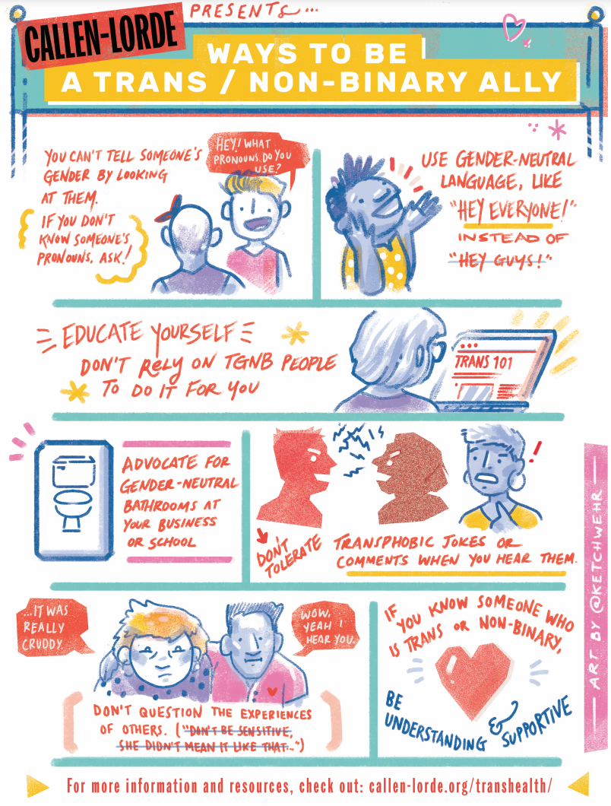
STRATEGIES & TIPS
Utilize shared decision-making framework
Ask for preferred pronouns and language for referring to body parts
8Ps as guidance for taking sexual history
Share information asynchronously, as well
Enhance privacy, confidentiality, and safety
Image: Callen-Lorde’s “Ways to be a trans/non-binary ally” comic
Notes:
Some strategies and tips to provide affirmative, supportive reproductive health care and primary care generally to transgender and gender expansive patients through telehealth
Utilize a shared-decision making framework: Offer information and education, but the patient decides what’s relevant, what services they want, how to proceed with their care, and how to follow up.
Ask for preferred pronouns, record them in their EMR, use gender neutral language medical language to describe health care. Can also introduce the topic of care (i.e. contraception) and ask the kinds of words they prefer for you to refer to body parts. This approach also works well for cis-gender patients. Examples: Some people may prefer using the word vagina, genital canal, or front hole.
Use the 8Ps when doing clinical history/sexual history with your patients: Preferences, Partners, Practices, protection for STIs, Past History of STIs, Pregnancy, Pleasure, Partner Violence. This expands upon the CDC’s 5Ps. https://fenwayhealth.org/wp-content/uploads/Taking-a-Sexual-Health-History-Cavanaugh-1.pdf (See slides 13-15 for specific example questions)
If you don’t know someone’s preferred pronouns, use neutral language. Try to avoid misgendering people, and apologize in a healthy way if you do. Quickly correct yourself. Don’t make it about you.
Offer asynchronous models of care -- sharing information through text message, health record portal, ensuring your info sheets are informative and reflective of your patients needs.
Pay attention to privacy, confidentiality, and safety considerations -- gender-affirming care may not be something that is safe to talk about at home. Support the patient in deciding when and how visits happen and who is with them (if anyone)
Optional Resources to Share and Discuss during the workshop
https://callen-lorde.org/transhealth/
Callen-Lorde Video (1:55) Pronouns Matter (why using correct pronouns can be a powerful tool in creating a more welcoming, safe, and respectful atmosphere for transgender and gender non-conforming people): https://www.youtube.com/watch?v=QQIVjE_P5jA
https://www.ncbi.nlm.nih.gov/pmc/articles/PMC7510534/
https://www.yourhormones.info/news/item/16143/telemedicine-may-improve-access-to-gender-affirming-care-for-transgender-people
Innovating Education
Understanding Identity: The Gender Opossum: https://www.innovating-education.org/2020/12/understanding-identity-the-gender-opossum/
Do’s and Don’ts (common mistakes around language, pronouns, assumptions and how to fix them): https://www.innovating-education.org/2020/12/dos-and-donts/
Clinical Care of the Transgender Patient: https://www.youtube.com/watch?v=1a6HZ6TdhkA (15:27)
Additional Resources:
https://fenwayhealth.org/the-fenway-institute/education/the-national-lgbtia-health-education-center/
FOLXhealth: https://www.folxhealth.com/

Slide 14

TELEHEALTH FOR PRENATAL AND POSTPARTUM CARE
BENEFITS
Improve accessibility and possibility of frequent prenatal care, education, care coordination
Enhance patient autonomy
Potential to improve outcomes for pregnant person and fetus
Can involve family, partners
Notes:
Typically, a pregnant person has 10-15 prenatal care visits -- they have a pregnancy visit every 4 weeks until the 3rd trimester, then every 2 weeks, then every 1 week. Only 3-4 of those visits (for lower risk pregnancies) is where labwork and ultrasound is necessary. Most other visits are about checking-in with the person and their pregnancy and providing counseling and education. Even before the COVID-19 pandemic, some have been moving in this direction. Additionally, ACOG recommends patient contact within 3 weeks of delivery, but 40% women (*limitation of study where data point comes from) do not attend any postpartum visit.
Telehealth provides a unique opportunity to make prenatal care/postpartum, education, and care coordination more accessible and possible, especially for people who have trouble making so many in-person visits (barriers like having to take time off from work, coordinate childcare, figure out/pay for transportation, etc). A 2020 systematic review has found that telehealth prenatal care interventions improved obstetric outcomes related to smoking cessation and breastfeeding and decreased the need for high-risk obstetric monitoring office visits while maintaining positive maternal and fetal outcomes, including: lower risk of delivering low-birth weight infant, higher likelihood of completing prenatal care appointments.
Image Source: https://nappy.co/photo/502
Sources:
DeNicola N, Grossman D, Marko K, Sonalkar S, Butler Tobah YS, Ganju N, Witkop CT, Henderson JT, Butler JL, Lowery C. Telehealth Interventions to Improve Obstetric and Gynecologic Health Outcomes: A Systematic Review. Obstet Gynecol. 2020 Feb;135(2):371-382. doi: 10.1097/AOG.0000000000003646. PMID: 31977782; PMCID: PMC7012339.

Slide 15
TELEHEALTH FOR PRENATAL AND POSTPARTUM CARE
STRATEGIES
Develop schedule of virtual visits that work for patient
Provide resources for remote monitoring (i.e. Blood Pressure cuff, scale)
Assess fetal well-being by talking about fetal movement
Telemedicine for lactation support, postpartum follow-up, mental health visits
Allow for increased collaborations with doula care, multiple providers, and including family members in visit
Notes:
For prenatal visits requiring ultrasound, physical exams, and labs, patient should come into the clinic. If not necessary, work on developing a schedule of virtual visits that work for them. This could involve a mix of video chats, phone calls, asynchronous communications over health care portal/text messages, remote patient monitoring, etc.
Some aspects of physical exams can be done over telehealth by the pregnant person themselves with a clinician’s guidance:
Provide home blood pressure cuff and teach them how to take their own blood pressure
Can send patients home with a fetal Dopler to monitor baby’s heart rate.
Use smartphone applications to monitor blood pressure, track weight gain, and provide prenatal education
Lower technology approaches exist too
After 20 weeks, you can assess fetal well-being through ways that midwives did so pre-ultrasound times: by talking about fetal movement to assess well-being (quickening)
Fetal movement is often a better indicator of fetal well-being than a fetal heart tone check alone. If there is good and consistent fetal movement, we know fetal heart rate is good too.
May be able to teach and encourage patients to measure their own fundal height or ask if their belly has grown at 4 week intervals
Ask patients to send in their own vital signs: blood pressure, heart rate, weight
Examples of alternate or reduced prenatal care schedules compiled by ACOG: https://www.acog.org/clinical-information/physician-faqs/-/media/287cefdb936e4cda99a683d3cd56dca1.ashx Evidence is limited regarding the safety and efficacy of these approaches, particularly regarding their impact on clinical outcomes and accessibility of care for all populations. Until further data and guidance are available, plans for modified care schedules are best made at the local level with consideration of patient populations and available resources. Note: these schedules are not explicitly endorsed or developed by ACOG.
Lactation Support
Telemedicine platforms can also allow individuals with lactation difficulties to access consultants from their home, improving convenience, eliminating costs, and improving timely delivery of services
Postpartum care:
This does not necessarily have to happen in-person -- in-person requirements may delay patients’ appointments even though problems may arise sooner
Using telemedicine can help address this -- app-based support, enhanced phone or text communication, at-home blood pressure monitoring and other remote monitoring programs
Virtual mental health visits can support diagnosis and treatment of postpartum depression without imposing the barriers of coming into the clinic for mental health visits
Other considerations and supports:
Allow for increased collaboration with doula care and other providers -- setting up the video or audio platform to allow doula or another provider to join the call, or other support person (whether they are in the room with the patient or elsewhere).
Limitations and potential inequities still exist: a study in New York during the pandemic should that people with public insurance were less likely to have at least 1 telehealth visit than people with public insurance; internet access and computer literacy are barriers, safety considerations at home may not be fully addressed through telehealth
**Many institutions have rules about prenatal care and schedules, so some of these practices may not be able to be implemented
Reflection Question: How do you think telehealth has the potential to improve maternal health and birthing outcomes and the racial disparities that underpin these outcomes? Where might telehealth fall short?
Sources:
DeNicola N, Grossman D, Marko K, Sonalkar S, Butler Tobah YS, Ganju N, Witkop CT, Henderson JT, Butler JL, Lowery C. Telehealth Interventions to Improve Obstetric and Gynecologic Health Outcomes: A Systematic Review. Obstet Gynecol. 2020 Feb;135(2):371-382. doi: 10.1097/AOG.0000000000003646. PMID: 31977782; PMCID: PMC7012339.
Limaye MA, Lantigua-Martinez M, Trostle ME, Penfield CA, Conroy EM, Roman AS, Mehta-Lee SS. Differential Uptake of Telehealth for Prenatal Care in a Large New York City Academic Obstetrical Practice during the COVID-19 Pandemic. Am J Perinatol. 2021 Feb;38(3):304-306. doi: 10.1055/s-0040-1721510. Epub 2020 Dec 10. PMID: 33302308.
Weigel G, Frederiksen B, Ranji U. Telemedicine and pregnancy care. 2020. KFF. https://www.kff.org/womens-health-policy/issue-brief/telemedicine-and-pregnancy-care/
American College of Obstetricians and Gynecologists. COVID-19 FAQs for Obstetrician-Gynecologists, Obstetrics. https://www.acog.org/clinical-information/physician-faqs/covid-19-faqs-for-ob-gyns-obstetrics

Slide 16

TELEHEALTH FOR PRENATAL AND POSTNATAL CARE
VIRTUAL CENTERING MODEL
Group sessions can continue virtually
Incorporate private time with clinician(s) and group time for education and support
Have staff members support patients’ technology difficulties
Provide incentives that can be delivered in a virtual format
Notes:
CenteringPregnancy group prenatal care has been shown to be a promising approach for improving maternal health outcomes and addressing racial disparities. The Centering model shifted to telehealth during the COVID-19 pandemic and presents lessons learned as to how to provide this kind of support and care virtually and continue to enhance maternal health and fetal outcomes.
90-minute sessions with private time with clinicians and group counseling and education
Have staff support members manage difficulties with accessing technology and navigating virtual platforms
Provide incentives that can be delivered in a virtual format
Image Source: unsplash.com
Sources:
https://www.healthaffairs.org/do/10.1377/hblog20210428.468372/full/

Slide 17
CONTRACEPTION
NEW PRESCRIPTIONS: ESTROGEN CONTAINING METHODS
Pill, Patch, and Ring
Screen for contraindications to estrogen
If normal blood pressure documented in the past year, send Rx to pharmacy
If high blood pressure unlikely by history, send Rx to pharmacy.
12 month prescribing
Notes:
Estrogen contraindications include: migraines with aura, uncontrolled HTN, history of or current DVT, history of bariatric surgery for pills, smoking > 15 cigarettes/day and over age 35.
Teens or others may call or walk in for EC and it should be dispensed or prescribed liberally.
May ask the patient to check blood pressure on a family member’s home cuff or in the pharmacy

Slide 18
CONTRACEPTION
REFILLS
For pill/patch/ring: dispense or send Rx to pharmacy with refills for one year
Telehealth visits for patients that haven’t been seen in over a year for interim medical history
For depo-provera: offer subcutaneous injectable 104mg that patient can fill at pharmacy and self-inject
Notes:
MEC - eligibility for continuing or starting contraceptive methods
Keep front of mind historical context of reproductive coercion in the US -- important in telehealth setting bc we are gatekeepers for patients to come in for in-person
Shared-decision making helps bring trust and rapport, promotes equity and non-coercive care
Tool that allows us to prioritize patient choice and autonomy

Slide 19
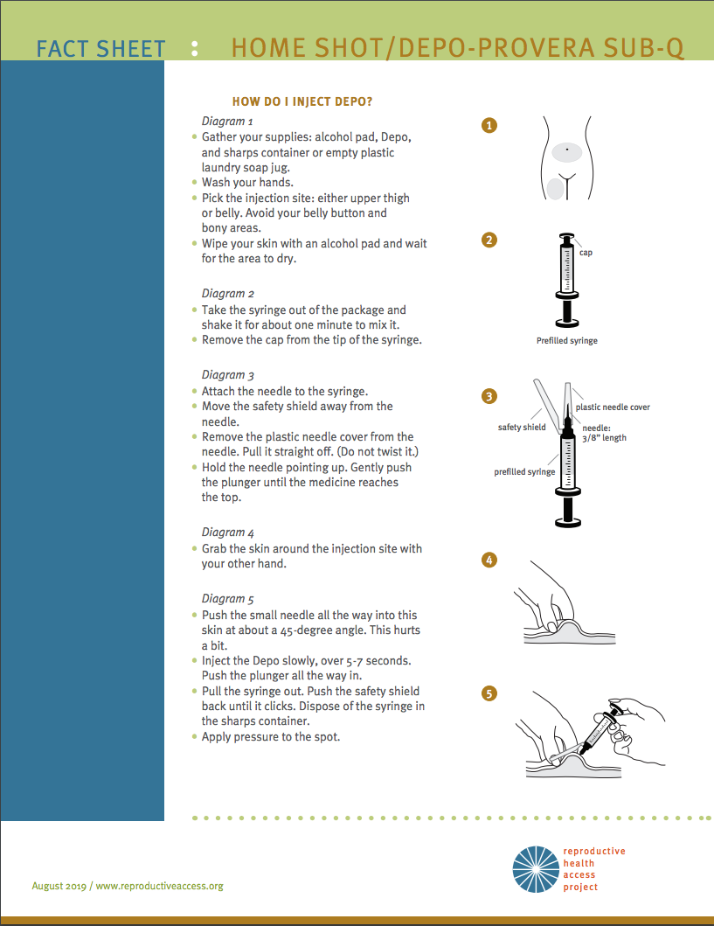

For medroxyprogesterone users: Consider SUB-Q DEPO
Source: https://www.reproductiveaccess.org/resource/depo-subq-user-guide/
Notes:
You can do the consult as a telehealth phone call and offer a follow up visit via video to talk the patient through the injecting if they need it.

Slide 20
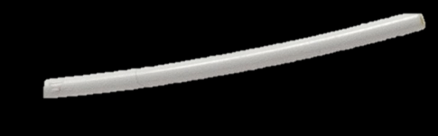
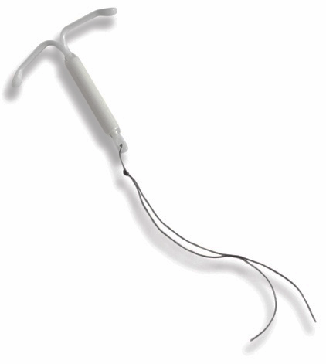
CONTRACEPTION
IUDS & IMPLANTS: PLACEMENTS
Schedule in-person appointment as soon as possible
Offer a bridge method in the meantime
Notes:
Being patient-centered in contraceptive counseling means providing all the information a patient needs to make a decision about their birth control. Contraceptive counseling can happen via telemedicine. If the patient decides on an implant or IUD, schedule an appointment as soon as possible. You can offer a bridge method if there will be a delay between the counseling visit and the insertion appointment.
Source:
https://www.reproductiveaccess.org/resource/3585/

Slide 21
CONTRACEPTION
IUDS & IMPLANTS: REMOVALS
Duration
  Copper IUD: 12 years
  Progestin IUDs Liletta & Mirena: 7 years
  Progestin IUDs Kyleena: 5 years; Skyla: 3 years
  Implant: 5 years
  People who are over 35 when the Copper IUD is placed can use it until menopause with negligible risk of pregnancy
  Expired IUDs and implants can be left in temporarily with another method added
For IUD Removals: offer to teach patient IUD self-removal via telemedicine
Notes:
Reminder about patient-centeredness: not everyone wants to keep their LARC until it is no longer effective. Some patients may just not want it anymore, some may have uncomfortable side effects, and some may want to get pregnant. Always respect patients’ desires and preferences and provide evidence-based, patient-centered, compassionate counseling.
There are multiple options: the patient could leave in the LARC. Copper IUD works for 12 years, the progestin IUDs liletta and mirena work for 7 years, Kyleena works for 5 years, and Skyla works for 3 years. The implant works for 5 years.
People who are over 35 when the Copper IUD is placed can use it until menopause with negligible risk of pregnancy. The Copper IUD likely does not have to be removed after it’s expiration if the patient is over 35.
If an IUD or implant is expired, it can be left in with another method added - temporarily - if the patient wants a new birth control method. For example, if someone isn’t immediately able to travel to see their clinician at the health center to remove their IUD and implant, but wants a new birth control method - you can set up a telehealth appointment for contraceptive counseling and prescribing a new method. Patients do not have to come in first to remove their IUD/implant before starting a new method, they can start a new method first and remove the IUD/implant after.
You can also teach a patient how to remove their IUD on their own via telemedicine appointment.
Sources:
Wu JP, Pickle S. Extended use of the intrauterine device: a literature review and recommendations for clinical practice. Contraception. 2014;89(6):495-503. https://doi.org/10.1016/j.contraception.2014.02.011.
https://www.reproductiveaccess.org/resource/iud-facts/
https://www.reproductiveaccess.org/resource/iud-self-removal/
https://www.reproductiveaccess.org/resource/contraceptive-pearls-iud-self-removal/
https://www.contraceptionjournal.org/article/S0010-7824(14)00058-4/fulltext

Slide 22
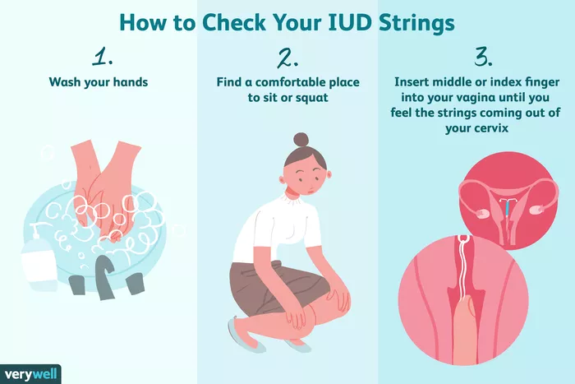
CONTRACEPTION
IUD SELF-REMOVAL: position and string length are important
Notes:
IUD self-removal by the patient is a safe alternative to usual office removal. The most effective position for self-removal is squatting or lying down. The patient can try sitting with one foot up on chair to push cervix down. The patient uses their fingers to feel for the IUD strings. Using an exam glove can help improve grip. The patient can try to twirl strings around one finger and then grasp strings with that finger and thumb to pull firmly toward the opening of the vagina. Works best when strings have been left long. Patients should expect light bleeding and cramping a few days after removal. They can get pregnant as soon as the IUD is removed. If they were using a progestin IUD, it may take a few months for monthly bleeding to return.
Patients should call their clinician if they can’t feel their IUD strings – an in-office visit would be needed to remove the IUD. If the IUD does not come out with gentle pulling, they should stop and schedule an in-office visit.
Image source: https://www.verywellhealth.com/how-to-check-your-iud-strings-906659
Source: https://www.reproductiveaccess.org/resource/iud-self-removal/
https://www.reproductiveaccess.org/resource/contraceptive-pearls-iud-self-removal/

Slide 23
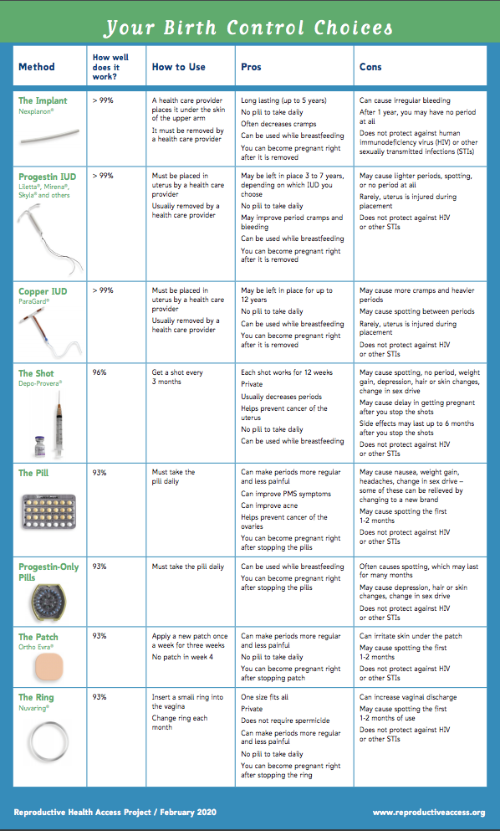
CONTRACEPTION
UNDECIDED ABOUT METHOD
Schedule telemedicine visit
Send information sheet first prior to visit so patient is ready
Shared decision-making and a reproductive justice lens in contraceptive counseling
Notes:
Contraceptive counseling involves asking patients what matters most to them, and respecting their preferences. Starting with open-ended questions to learn about patients’ preferences and desires is a great idea. Patients’ priorities regarding birth control vary widely. Some include: minimizing menstrual bleeding, avoiding hormones, hiding method from a parent or partner, lowering the risk of STIs, maximizing efficacy, cost and other issues related to access, impact on pleasure and sex life. It is vital that we preserve and enhance patient autonomy in selecting a method and in choosing when or if to use birth control. This kind of patient-centered counseling can be done over telemedicine and in-person.
Source: https://www.reproductiveaccess.org/resource/contraceptive-pearl-contraceptive-counseling-through-the-lens-of-reproductive-justice/

Slide 24
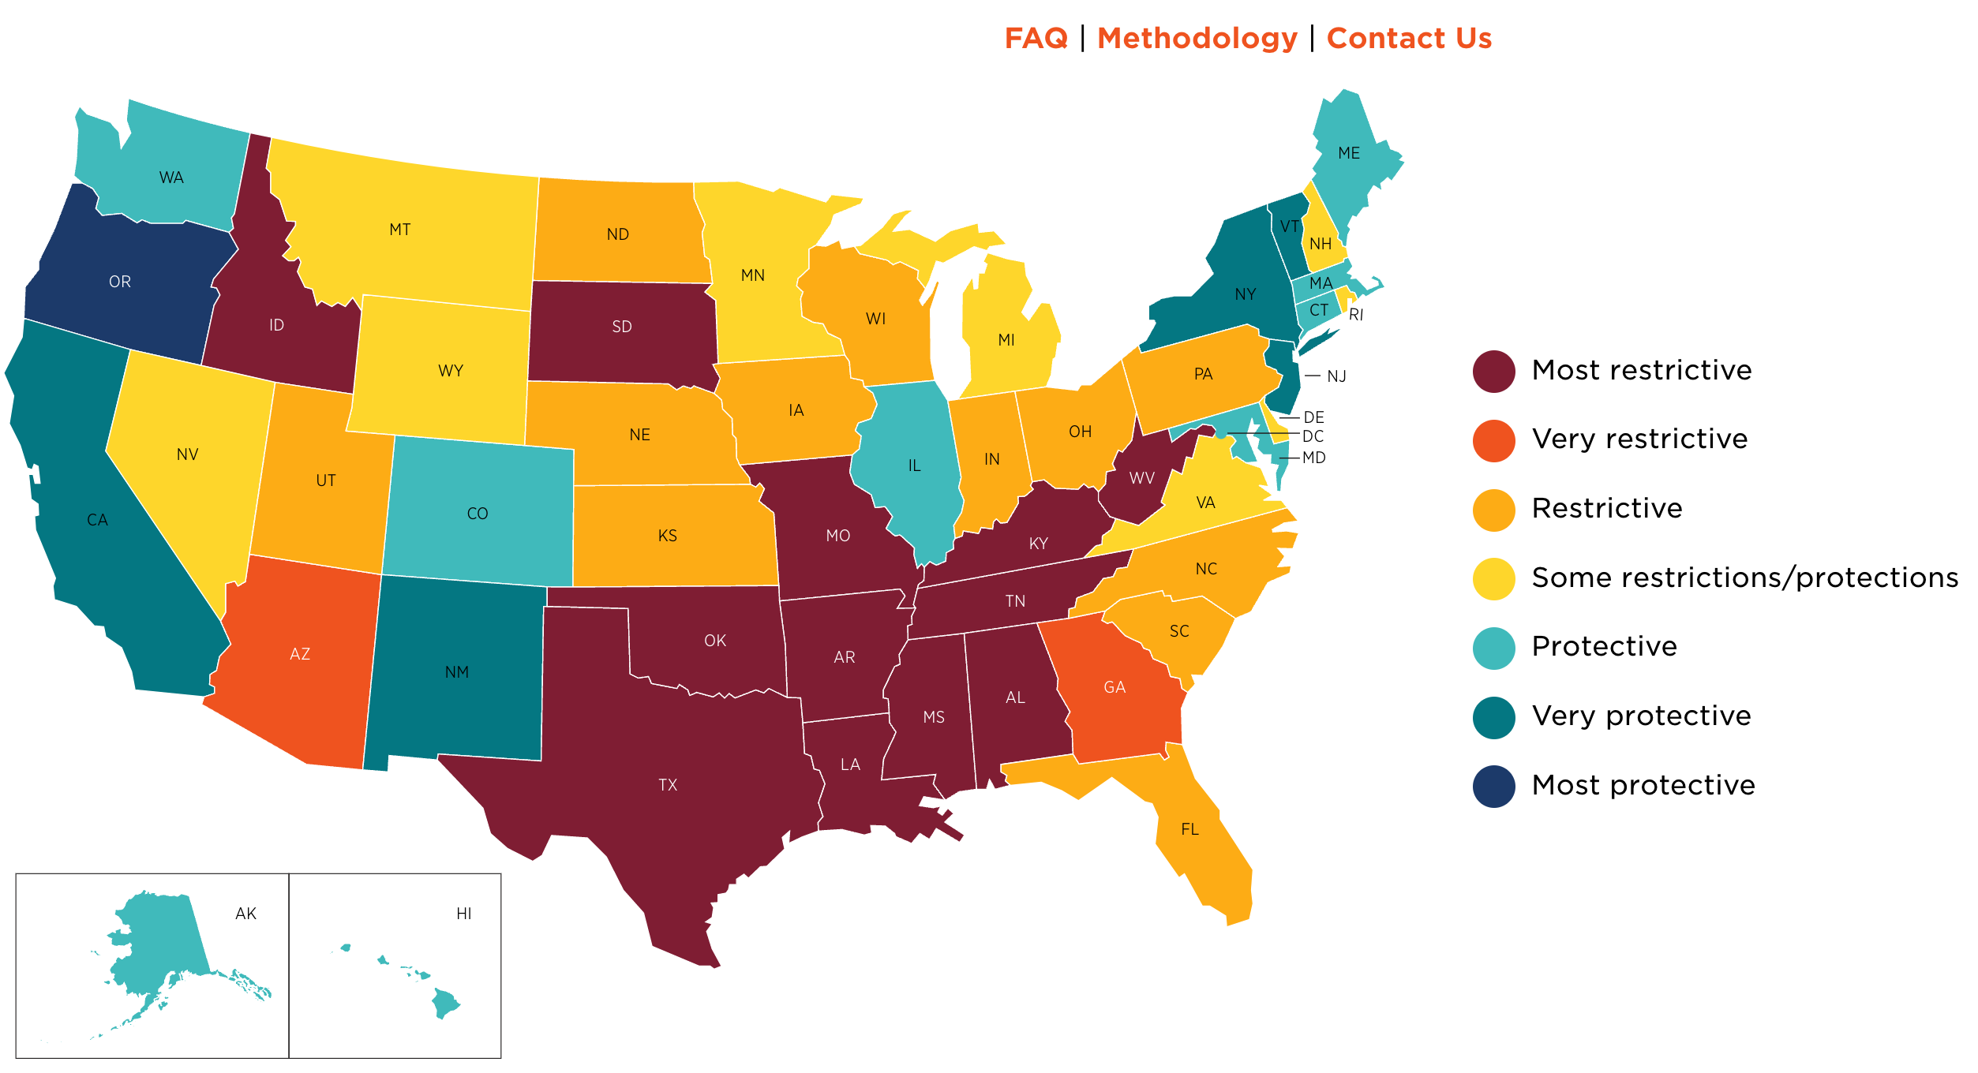
ABORTION ACCESS
https://states.guttmacher.org/policies/
Notes:
As of January 12, 2023, abortion is banned in 12 states with limited exceptions and is unavailable in an additional 2 states. In the first 100 days since Roe was overturned, at least 66 clinics in 15 states stopped providing care, many closing down altogether. 29% of the total US population of women of reproductive age are living in states where abortion is unavailable or severely restricted. While the overturn of Roe decimated abortion access, anti-abortion policymakers have long been making abortion care burdensome or impossible to obtain. This strategy has led to more than 1,300 abortion restrictions having been enacted since Roe v. Wade was decided in 1973, and is layered on top of failures of the health care and economic systems to provide Black, Indigenous and Latino* communities and communities living with low incomes access to high-quality, affordable health care, and safe and sustainable communities. Thus, while abortion bans and other legal restrictions harm all people who are or may become pregnant, they cause even greater harm to those already subject to systemic racism and economic injustice.
There’s been an increase in demand for abortion from out-of-state travelers in states that still allow or have expanded access to abortion. This demand is leading to delays in obtaining care and capacity pressures on abortion clinics.
Sources:
https://states.guttmacher.org/policies/
https://www.guttmacher.org/2023/01/inequity-us-abortion-rights-and-access-end-roe-deepening-existing-divides

Slide 25
SAFETY OF ABORTION
First trimester abortions do not increase risk of:
      Infertility
      Ectopic pregnancy
      Miscarriage
      Birth defect
      Preterm or low-birthweight delivery
National Academies of Sciences, Engineering, and Medicine. 2018. The Safety and Quality of Abortion Care in the United States. Washington, DC: The National Academies Press. https://doi.org/10.17226/24950
Notes:
First trimester abortions do not increase the risk of infertility, ectopic pregnancy, miscarriage, birth defects, or preterm/low birthweight delivery.
What does create barriers to safe and effective care are abortion-specific regulations in many states. These regulations may outright ban abortion, prohibit qualified providers from performing abortions, misinform pregnant people of the risks of the procedures they are considering, or require medically unnecessary services, and ultimately delay care.
The vast majority of abortions can be provided safely in office-based settings and do not require hospital admitting privileges.
Studies have shown that telehealth medication abortion can be just as safe as in-clinic abortion. Telehealth abortion has similar rates of effectiveness and safety as in-person provision of medication abortion care and is highly acceptable to patients.
Offering medication abortion in primary care and expanding telehealth services may help reduce the demand we’re seeing in higher-access states post-Dobbs and decrease delays.
Sources:
National Academies of Sciences, Engineering, and Medicine. 2018. The Safety and Quality of Abortion Care in the United States. Washington, DC: The National Academies Press. https://doi.org/10.17226/24950.
Upadhyay UD, Koenig LR, Meckstroth KR. Safety and Efficacy of Telehealth Medication Abortions in the US During the COVID-19 Pandemic. JAMA Netw Open. 2021;4(8):e2122320. Published 2021 Aug 2. doi:10.1001/jamanetworkopen.2021.22320
Aiken ARA, Romanova EP, Morber JR, Gomperts R. Safety and effectiveness of self-managed medication abortion provided using online telemedicine in the United States: A population based study. Lancet Reg Health Am. 2022;10:100200. doi:10.1016/j.lana.2022.100200
Thompson TA, Northcraft D, Carrión F. Addressing Structural Inequities, a Necessary Step Toward Ensuring Equitable Access to Telehealth for Medication Abortion Care During and Post COVID-19. Front Glob Womens Health. 2022;3:805767. Published 2022 Mar 17. doi:10.3389/fgwh.2022.805767

Slide 26

THE MOST COMMON REGIMEN IN THE U.S
Notes:
Medication abortion with mifepristone and misoprostol has been available in the US since 2000 since it was approved by the FDA. It currently makes up about just over half of all facility-based abortions in the US (53%).
The FDA approves mifepristone for us up to 70 days from LMP, but studies demonstrate that it can be used safely and effectively for up to 77 days from LMP.
Administration (Buccal):
Mifepristone 200 mg orally
Misoprostol 800 mcg buccally (4 tablets)
Take misoprostol 24-48 hours after mifepristone
Both mife and miso can be taken at home
Follow up optional 7-14 days after mife, but not required
Administration (Vaginal):
Mifepristone 200 mg orally
Misoprostol 800 mcg vaginally (4 tablets)
Take misoprostol 6-72 hours after mifepristone
Both mife and miso can be taken at home
Follow up optional 7-14 days after mife, but not required
Sources:
https://www.guttmacher.org/article/2022/11/abortion-incidence-and-service-availability-united-states-2020
https://www.reproductiveaccess.org/wp-content/uploads/2014/12/mifepristone_protocol.pdf

Slide 27
MIFEPRISTONE REMS
  Prescribers must be certified: complete a form attesting that they can:
    Accurately date pregnancies
    Diagnose ectopic pregnancies
    Provide care or refer for incomplete abortion or bleeding
Patients must sign a Patient Agreement Form (FDA consent)
No longer need to dispense mifepristone in-office
Pharmacies must be “certified” to dispense
Notes:
Mifepristone is regulated by the FDA under a program called the Risk Evaluation and Mitigation Strategy (REMS). It states that mifepristone must follow certain Elements to Assure Safe Use:
- Prescribers must be certified, which involves completing a form attesting that they can accurately date pregnancies, diagnose ectopic pregnancies, and provide care or refer for incomplete abortion, bleeding, or other potential complications. Signing this prescriber form does not make clinician’s information public – this just goes to manufacturer, Danco or GenBioPro
Patients must sign a patient agreement form, which is basically an FDA consent form. This has been updated since 2016 and is more streamlined. It no longer includes gestational age limits.
In 2021 the FDA removed the in person dispensing requirement for mifepristone, allowing mail-order and brick-and-mortar pharmacies to dispense mifepristone. In January 2023, the FDA finalized and published the rules and process for this pharmacy certification process.
Several mail order pharmacies are already certified – like Honeybee Health and the American Mail Order Pharmacy.
CVS and Walgreens have indicated interest in becoming certified prescribers.
Source:
https://www.fda.gov/drugs/postmarket-drug-safety-information-patients-and-providers/mifeprex-mifepristone-information
https://honeybeehealth.com/conditions/medication-abortion
https://amoprx.com/

Slide 28
MEDICATION ABORTION
TELEHEALTH PROTOCOL: MINIMIZING TESTS
Need sure LMP under 11 weeks
No labs except patient reported positive urine test
No Rhogam under 12 weeks
No ultrasound required if sure LMP
Remote counseling and consent (available on RHAP website)
Mail mifepristone and misoprostol or dispense to local certified pharmacy
Always counsel on all abortion options – remain person-centered
Follow-up can be done with telehealth or in-person visit (or not at all), depending on patient preference
Notes:
Clinicians have been providing telehealth medication abortion and using protocols that involve fewer tests for some time, but the COVID-19 pandemic and efforts to minimize risks to patients have enabled the implementation of a routine protocol that minimizes tests before a medication abortion. For a telehealth visit with medication abortion counseling, make sure you incorporate the following:
Make sure the patient’s LMP is under 11 weeks. Rather than determining LMP by ultrasound all the time, we can ask our patients: when did pregnancy symptoms start, do you remember what month you were in when you had your last period, etc. Studies have shown that LMP is a reliable way to measure gestational age and that people who have periods largely know when their last period was.
Fundamentals of pregnancy dating: sure LMP (normal period, history of regular periods, not recently been on contraception that may be messing with their periods); no risk factors for ectopic pregnancy; no history of pelvic infection, sharp pelvic pain - can forgo US
US may be needed
If gestational age is determined to be > 77 days by patient LMP (consider bimanual exam first and if consistent with <11 weeks proceed with MAB. If exam suggests >11 weeks, sono/MVA)
Patient had no menses and it has been more than 77 days since delivery or abortion
Pregnancy occurs while amenorrheic from using long-acting progestin contraceptive (i.e., Depo, implant)
Ultrasound is not a requirement for medication abortion. If the patient is uncertain about their LMP, has irregular menstrual cycles, or if you are concerned about ectopic pregnancy risk because of certain risk factors, then ultrasound may be needed.
You can also offer remote consent. RHAP has a remote consent form on the website: https://www.reproductiveaccess.org/wp-content/uploads/2020/03/03-2020-med_ab_consent_form_eng.pdf
There have been a variety of options for clinics, like online pharmacies (Honeybee Health). Some community health centers have set up their own courier service, delivering to their patients.
Follow-up care can be done via telehealth (quick phone or video call) or in-person or not at all, depending on patient preference. Though ultrasound is not needed to confirm whether the abortion was complete.
Sources:
https://www.reproductiveaccess.org/wp-content/uploads/2020/03/03-2020-no-touch-MAB.pdf
https://rhedi.org/limited-ultrasound-protocol-for-medication-abortion/
https://www.reproductiveaccess.org/resource/telehealth-care-for-mab-workflow/
Schonberg D, Wang LF, Bennett AH, Gold M, Jackson E. The accuracy of using last menstrual period to determine gestational age for first trimester medication abortion: a systematic review. Contraception. 2014 Nov;90(5):480-7. doi: 10.1016/j.contraception.2014.07.004.

Slide 29
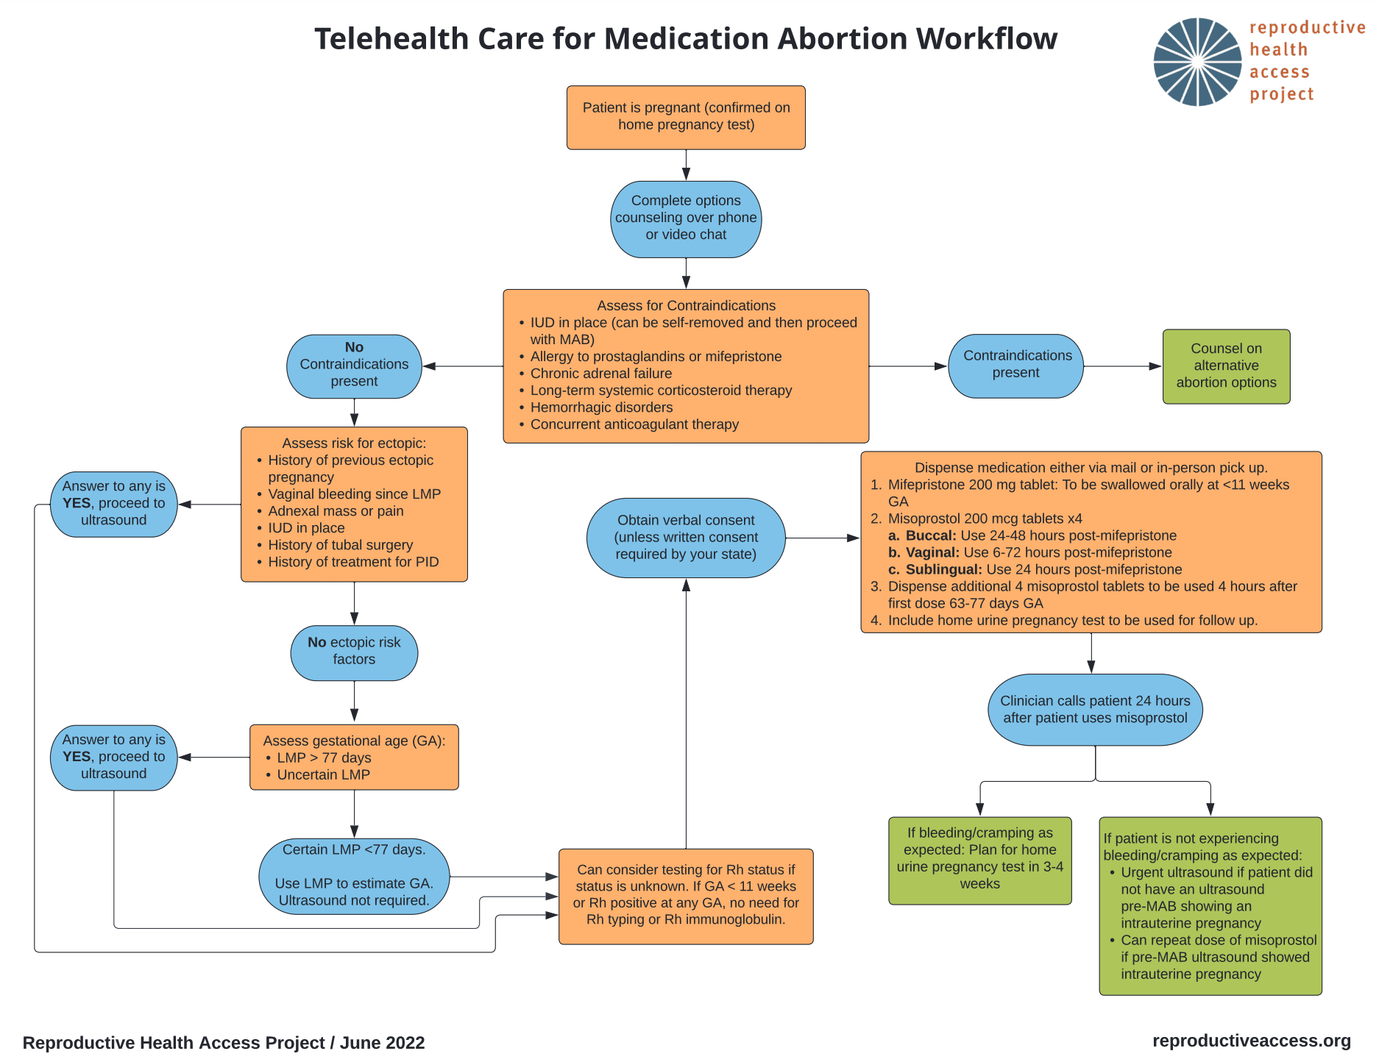
TELEHEALTH MEDICATION ABORTION WORKFLOW
Notes:
Can review steps of telehealth medication abortion or refer to resources:
Sources:
https://www.reproductiveaccess.org/wp-content/uploads/2020/03/03-2020-no-touch-MAB.pdf
https://www.reproductiveaccess.org/resource/telehealth-care-for-mab-workflow/

Slide 30
PHONE CALLS AFTER MEDICATION ABORTION
“There wasn’t much blood.”
“Am I still pregnant?”
Was there some bleeding? Any cramping? Did you take the misoprostol?
Ask if pregnancy symptoms have disappeared.
“I’m bleeding and cramping a lot.”
“I’m still bleeding after 2 weeks.”
That’s normal unless you’re soaking two heavy pads an hour for two consecutive hours.
That’s normal unless you’re soaking two heavy pads an hour for two consecutive hours.
Offer follow-up appointment.
Notes:
Patients may call with symptoms that worry them. For the vast majority, the only necessary interventions are listening and reassuring.
RHAP Telephone Follow Up for MAB: http://www.reproductiveaccess.org/wp-content/uploads/2020/03/Phone-follow-up-for-med-ab.docx

Slide 31
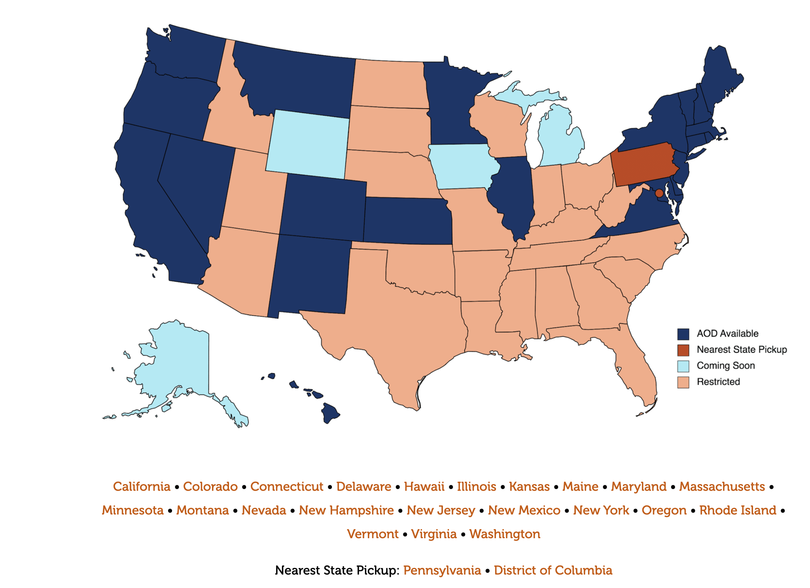
ACCESS & ADVOCACY
Abortion On Demand
https://abortionondemand.org
Notes:
Due to the patchwork of abortion laws, restrictions, and bans pre and post-Dobbs, the landscape for providing telehealth abortion care is complex. Telehealth abortion is legal in 22 states and DC. Other states outright ban abortion, prohibit telehealth abortion, and/or or require a clinician providing MAB to be physically present when the medication is administered.
Other medication abortion state-level barriers to access: 32 states require clinicians who administer MAB to be physicians (physician-only laws); 1 state prohibits the use of MAB starting at 10 weeks of pregnancy.
Organizations like Aid Access create work arounds to provide self-managed abortion information and pills to those in restricted access states, but most telehealth platforms operate in states where telehealth abortion is legal (like the Abortion on Demand map shows here). Patients do not have to be residents of those states, but most likely need to be physically present during the telehealth appointment and to pick up the pills. This still remains a legal gray area.
There are numerous advocacy efforts underway to expand telehealth and meet patients’ needs for medication abortion care.
Countering state efforts to undermine FDA approval of mifepristone
States may try to pass their own versions of REMS on mifepristone
Shield laws to protect patients and providers in high-access states who provide telehealth abortions for patients in ban states
Strengthening legal protections for those who self-manage
Women’s Health Protection Act
Equal Access to Abortion Coverage in Health Insurance Act (EACH)
HEAL for Immigrant Families Act
Restricting anti-abortion and crisis pregnancy centers
Expand public and private insurance coverage of abortion
Remove parental involvement laws and physician only requirements
Sources:
https://www.kff.org/policy-watch/medication-abortion-telemedicine-innovations-and-barriers-during-the-covid-19-emergency/
https://www.guttmacher.org/state-policy/explore/medication-abortion
https://www.npr.org/sections/health-shots/2022/05/20/1099179361/telehealth-abortions-are-simple-and-private-but-restricted-in-many-states
https://www.kff.org/womens-health-policy/issue-brief/the-intersection-of-state-and-federal-policies-on-access-to-medication-abortion-via-telehealth/
https://lawatlas.org/datasets/post-dobbs-state-abortion-restrictions-and-protections
https://www.guttmacher.org/2023/01/eight-ways-state-policymakers-can-protect-and-expand-abortion-rights-and-access-2023

Slide 32






TELEHEALTH & MIFE BY MAIL OPTIONS
Notes:
Options for patients and clinicians:
There is also Hey Jane, an online abortion clinic with abortion pill delivery (https://www.heyjane.co/)
NAF’s Abortion on Demand: https://abortionondemand.org/
Many primary care, academic centers, and even FQHCs that already dispensed medication abortion have been working on mailing – some use online pharmacies like Honeybee Health, and others have developed their own courier service.
Access Delivered/Plan C in collaboration with UW, has developed a Provider Toolkit that offers a step by step guide for initiating medication abortion services remotely in primary care practice. It provides information on setting up the service, patient-centered standards of care, and resources for understanding federal and state regulations on abortion care: https://familymedicine.uw.edu/accessdelivered/
Clinic-based abortion care isn’t the only way people may want or seek medication abortion. So there are many hotlines and support services to support people who are self-managing their abortion like: M&A Hotline (https://www.mahotline.org/) If When how’s legal helpline for people with legal issues or questions (http://www.reprolegalhelpline.org/), Plan C also has a wealth of resources on how to get and use the pills: https://www.plancpills.org/guide-how-to-get-abortion-pills#support

Slide 33

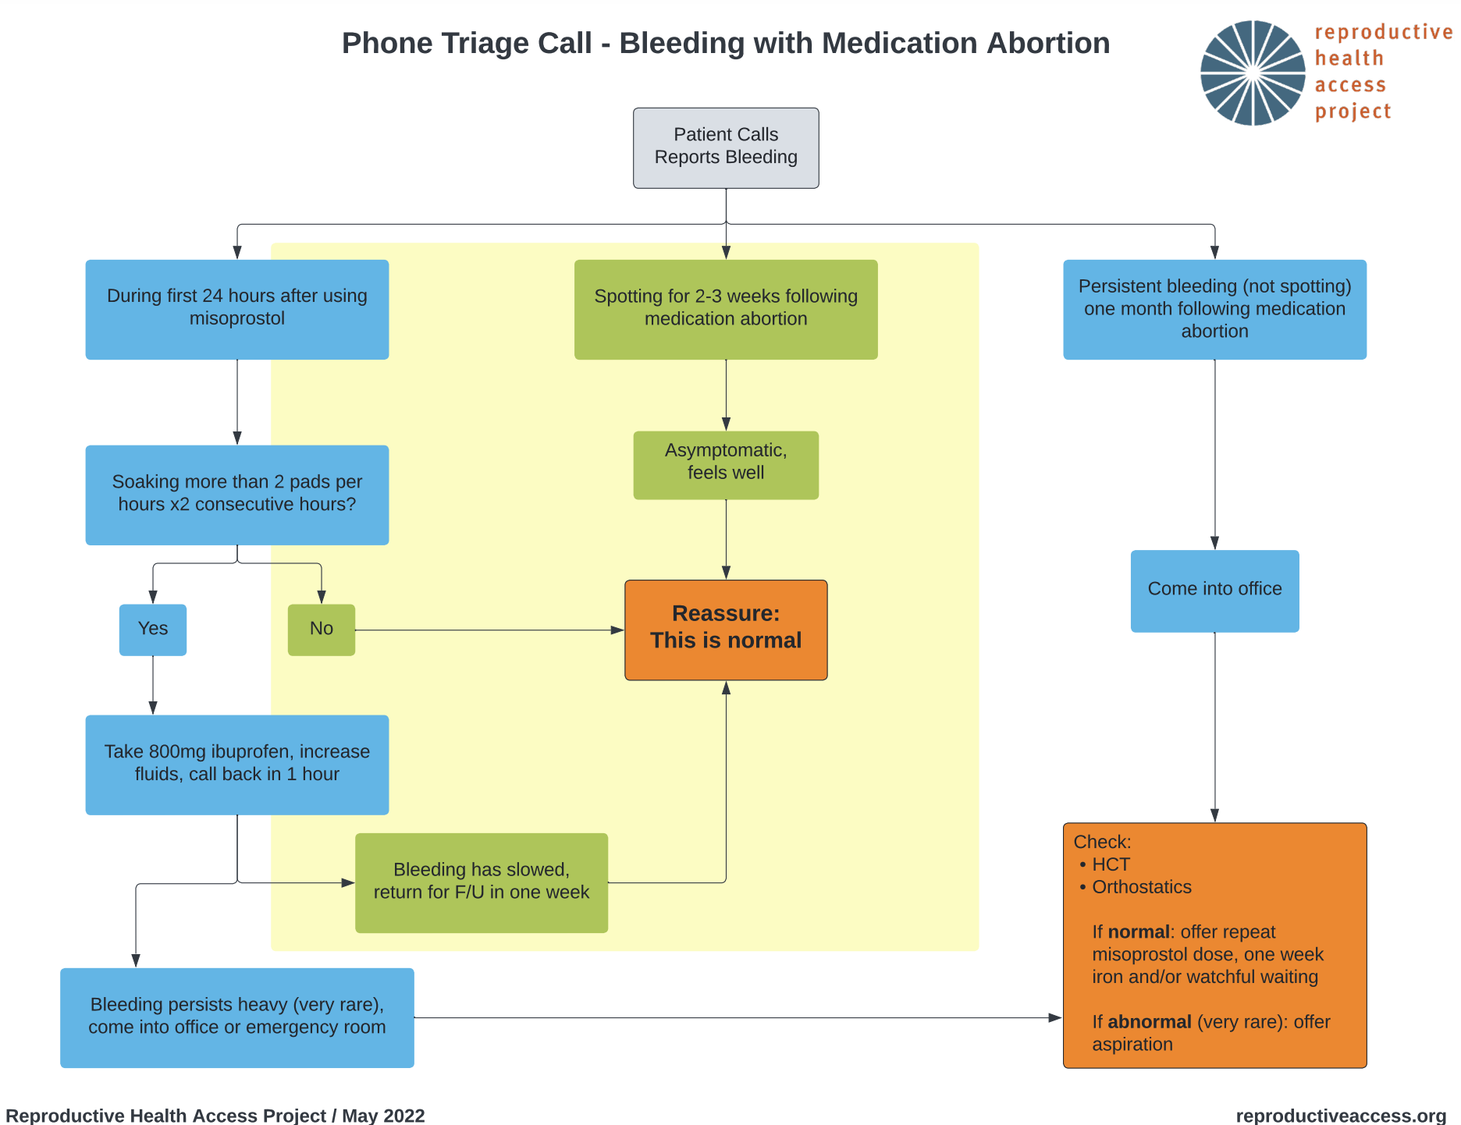
CALLS ABOUT
SELF MANAGED
ABORTION
Notes:
Clinic-based abortion care isn’t the only way people may want or seek abortion pills. We can support patients who have self-managed their abortion with medications by providing information over phone, text, or video call on what is normal and what may need in-clinic support.
This triage sheet applies to medication abortion with Mife and misoprostol: https://www.reproductiveaccess.org/resource/algorithm-phone-triage-bleeding-medication-abortion/
This resource outlines common questions patients have about SMA and suggestions for handling these questions and concerns. https://www.reproductiveaccess.org/resource/approach-to-patients-undergoing-self-managed-medication-abortion/
Here are some resources that you can offer to patients on self-managed abortion or use yourselves to support patients self-manage their abortion. Others include:
plancpills.org
repro care hotline: https://abortionhotline.org/
M&A hotline: https://www.mahotline.org/
IfWhenHow legal repro helpline (for legal not medical issues): https://www.reprolegalhelpline.org/
Sam’s Medication abortion: reproductiveaccess.org/resource/sams-medication-abortion-zine/
SASS: abortionpillinfo.org/en/sass

Slide 34
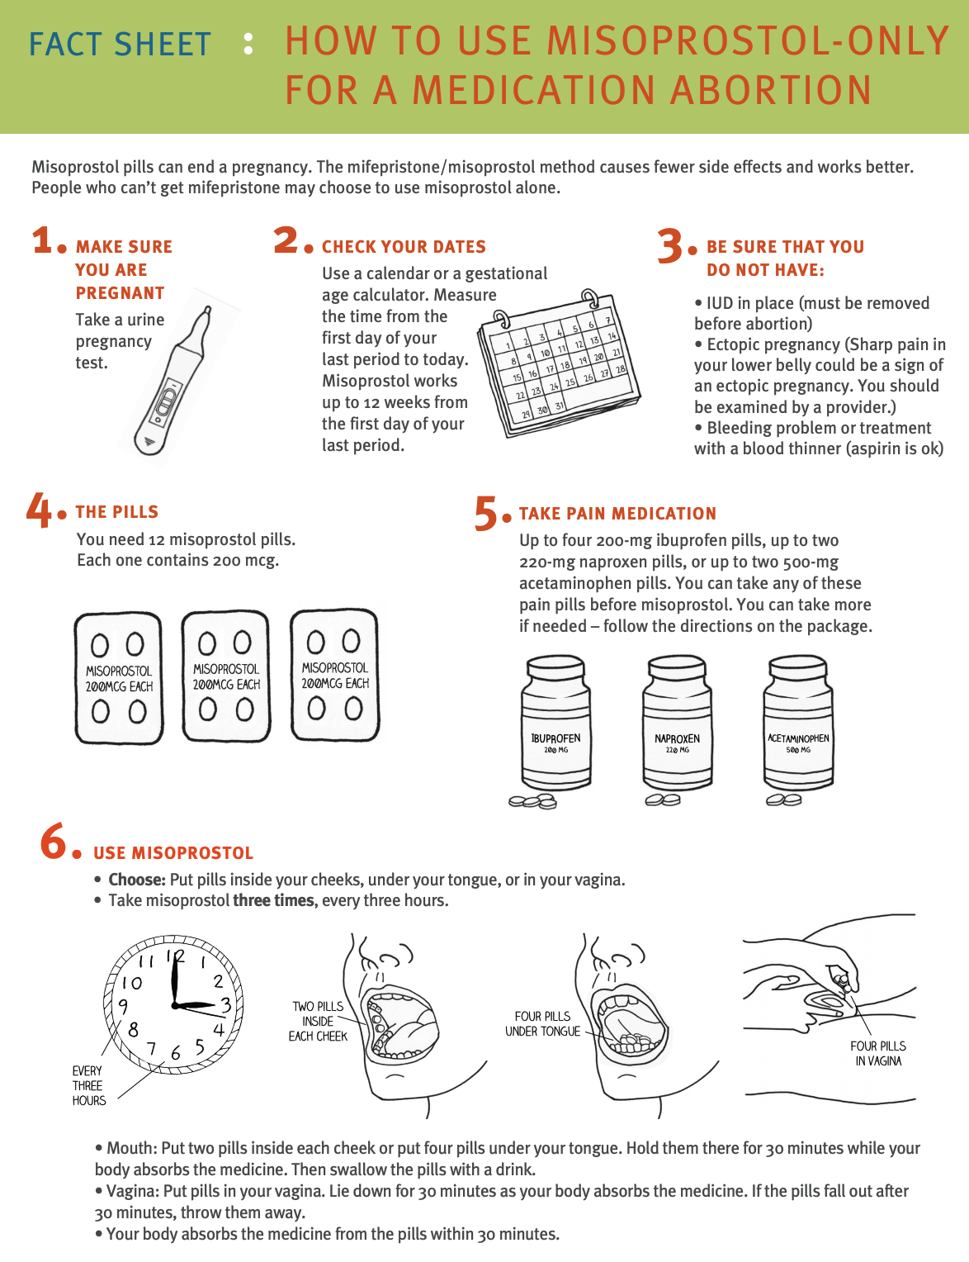
MISOPROSTOL ALONE FOR MEDICATION ABORTION
Often the only option for online ordering of abortion
medications
Notes:
Misoprostol is inexpensive and readily available in most countries.
The patient will need 12 misoprostol pills, each one contains 200 mcg. They can take pain medication (like ibuprofen, naproxen, or acetaminophen) before the misoprostol. They can put the pills inside their cheeks, under their tongue, or in their vagina repeating the dosage and administration 3 times, every 3 hours: 2 pills inside cheek, 4 pills under tongue, or 4 pills in vagina.
Availability of this method has decreased maternal morbidity and mortality in countries where abortion remains illegal.
RHAP has a factsheet guiding patients and clinicians on how to use misoprostol only for medication abortion and a factsheet to help patients compare and contrast the two medication abortion protocols.
https://www.reproductiveaccess.org/resource/mabfactsheet-miso/
https://www.reproductiveaccess.org/resource/abortion-pills-comparison/
Studies of Misoprostol Alone Regimens
Ho PC, Blumenthal PD, Gemzell-Danielsson K, Gómez Ponce de León R, Mittal S, Tang OS. Misoprostol for the termination of pregnancy with a live fetus at 13 to 26 weeks. Int J Gynaecol Obstet. 2007 Dec;99 Suppl 2:S178-81
Moreno-Ruiz NL, Borgatta L, Yanow S, Kapp N, Wiebe ER, Winikoff B. Alternatives to mifepristone for early medical abortion. Int J Gynaecol Obstet. 2007 Mar;96(3):212-8
van Bogaert LJ, Sedibe TM. Efficacy of a single misoprostol regimen in the first and second trimester termination of pregnancy. J Obstet Gynaecol. 2007 Jul;27(5):510-2
Wiebe ER, Trouton KJ, Lima R. Misoprostol alone vs. methotrexate followed by misoprostol for early abortion. Int J Gynaecol Obstet. 2006 Dec;95(3):286-7
Blanchard K, Shochet T, Coyaji K, Thi Nhu Ngoc N, Winikoff B. Misoprostol alone for early abortion: an evaluation of seven potential regimens. Contraception. Aug 2005;72(2):91-97.
Blanchard K, Winikoff B, Ellertson C. Misoprostol used alone for the termination of early pregnancy. A review of the evidence. Contraception. Apr 1999;59(4):209-217.
Jain JK, Dutton C, Harwood B, Meckstroth KR, Mishell DR, Jr. A prospective randomized, double-blinded, placebo-controlled trial comparing mifepristone and vaginal misoprostol to vaginal misoprostol alone for elective termination of early pregnancy. Hum Reprod. Jun 2002;17(6):1477-1482.
https://www.ibisreproductivehealth.org/publications/misoprostol-alone-medication-abortion-safe-and-effective (SAFE Study)

Slide 35
EARLY PREGNANCY LOSS (EPL)
PREGNANT AND BLEEDING
Remotely order ultrasound for patient, and other labs
Counseling & treatments that may not need in person care: expectant and medication (with exception of mifepristone pickup)
Shared decision making regarding treatment
Involve support people: care for the whole person & whole family
Counseling: debunk myths, misconceptions
Notes:
Because ultrasound is still needed to diagnose early pregnancy loss, not all aspects of this care can happen over telehealth.
Always offer all three forms of EPL management so the patient can decide what is best for them.
Telehealth and virtual visits/communication can happen through
Remotely ordering ultrasound for patient, and other labs (bHCG)
Counseling for expectant management of EPL
Medication management of EPL - electronically prescribe medications (misoprostol); mifepristone requires in-person pick up
Whether the pregnancy is planned or not desired or wherever on the spectrum of these feelings, someone having an EPL can experience profound emotions. Telehealth allows us to connect patients to therapists and mental health services, to provide supportive and validating counseling, and bringing in their support people in one call. This is a place where you can care for the whole family and whole person. Validate what they are going through, don’t take away from the impact.
Have real conversations about EPL: debunk myths, stigma, misconceptions
Be available to (or set up a system) answer calls and messages from patients outside of visit time.
Provide a space for patient advocacy -- what needs to happen in a hospital vs outpatient setting

Slide 36

OTHER TELEHEALTH ISSUES: LEARNERS
Notes:
For many health centers, residents and medical students and other clinical learners rotate in and out for training. Telehealth is a new setting to provide clinical training to these learners. Here are some considerations and best practices to support learners provide telehealth care without overwhelming or negatively affecting patient care.
When learner/teacher can't be in the same room, use a telehealth platform that allows multiple people to join (ex. Zoom's HIPAA compliant platform)
It's still important to get a patient's consent before bringing a learner in. If you're using a platform with a waiting room feature, have the learner stay in the waiting room while you get the patient's consent. You can also share the link to the virtual exam room with the learner only after the patient provides consent.
Have a back-up plan for how learner and teacher will communicate if there are A/V issues.
To improve patient comfort in video visits, learners should have their camera on
Supervision requirements vary by learner type and level
For learners who need direct observation of patient encounter, it’s hard to teach remotely - learner and teacher must be in the same location
Additional tips for medical student involvement in telehealth: https://compliance.bsd.uchicago.edu/Documents/Telehealth%20Medical%20Student%20Tip%20Sheet%207-21-20.pdf
This document outlines potential scenarios of how to involve medical students, residents, and teaching physicians, and offers advice on attestation processes.
Image source: unsplash.com

Slide 37

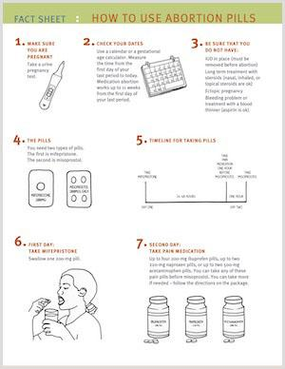
RESOURCES
Reproductive Health Access Project
Toolkit on Meeting Family Planning Needs
Telehealth for Family Planning Providers
Telehealth Resource Center
Beyond the Pill
Notes:
Can add more here**
https://emaaproject.org/

Slide 38
REFERENCES.
Foster DG, Karasek D, Grossman D, Darney P, Schwarz EB. Interest in using intrauterine contraception when the option of self-removal is provided. Contraception. 2012;85(3):257-262. doi: 10.1016/j.contraception.2011.07.003.
Hendriks E, MacNaughton H, MacKenzie MC. First Trimester Bleeding: Evaluation and Management. Am Fam Physician. 2019;99(3):166-174.
Hendricks E, Rosenberg R, Prine L. Ectopic Pregnancy: Diagnosis and Management. Am Fam Physician. 2020 May 15;101(10):599-606.
National Academies of Sciences, Engineering, and Medicine. 2018. The Safety and Quality of Abortion Care in the United States. Washington, DC: The National Academies Press. https://doi.org/10.17226/24950.
Raymond EG, Grossman D, Mark A, et al. Commentary: No-test medication abortion: A sample protocol for increasing access during a pandemic and beyond. Contraception. 2020;101(6):361-366. doi: 10.1016/j.contraception.2020.04.005.
Schonberg D, Wang LF, Bennett AH, Gold M, Jackson E. The accuracy of using last menstrual period to determine gestational age for first trimester medication abortion: a systematic review. Contraception. 2014 Nov;90(5):480-7. doi: 10.1016/j.contraception.2014.07.004.
US CDC Medical Eligibility for Contraceptive Use, 2016.
Wu JP, Pickle S. Extended use of the intrauterine device: a literature review and recommendations for clinical practice. Contraception. 2014;89(6):495-503. doi: 10.1016/j.contraception.2014.02.011.

Slide 39
THANK YOU.

