Slide 1



EARLY PREGNANCY LOSS
OFFICE EVALUATION AND MANAGEMENT
Notes:
Updated January 2024

Slide 2

CE PRE-TEST.
Please complete this pre-test on your phone or computer in order to receive CE credit for participation in this workshop. You can access the pre-test at:
https://www.surveymonkey.com/r/eplpre
Notes:
If you haven’t already, please complete this pre-test on your phone in order to get CME or CNE for your participation in this workshop. You can access the pre-test at…..
https://www.surveymonkey.com/r/eplpre

Slide 3

DISCLOSURES
Participants must attend 100% of this workshop.
Participants must complete the evaluation survey at the beginning and end of the workshop
No relevant financial relationships to disclose with ineligible companies.
Notes:
Note for Facilitators: Please UPDATE if any presenters DO disclose a relevant financial relationship. Examples of how to word disclosures can be found in Identification, Mitigation, and Disclosure Toolkit (CME/CNE Materials folder)

Slide 4
LEARNING OBJECTIVES.
  Conduct a history and physical exam for first trimester bleeding to help distinguish normal from abnormal pregnancies.
  Interpret ultrasound and labs results to diagnose early pregnancy loss (EPL)
  Describe the three options for management of EPL
      - Expectant management
      - Medical management
      - Aspiration procedure management

Slide 5

TERMINOLOGY
MISCARRIAGE
EARLY PREGNANCY LOSS (EPL)
SPONTANEOUS ABORTION
Interchangeable for a nonviable pregnancy in the first trimester (<13 weeks of gestation); preferred terminology is early pregnancy loss (EPL)
Notes:
Discuss: the term that is most patient-centered is pregnancy loss. Spontaneous abortion has an association for patients with a choice to stop a pregnancy and miscarriage sounds like they somehow “miss- carried” or did something wrong. This is rarely the case, and it is important for you and your patient to understand this.
Reference: American College of Obstetricians and Gynecologists. "Early Pregnancy Loss. ACOG Practice Bulletin No. 200." Obstet Gynecol vol. 132, no. 5 (2018): e197-207.
American College of Obstetricians and Gynecologists. “Early Pregnancy Loss: Frequently Asked Questions”. https://www.acog.org/womens-health/faqs/early-pregnancy-loss. Accessed 25 Oct 2023.

Slide 6
Additional Terminology
Threatened Abortion
Incomplete Abortion
Missed Abortion
Anembryonic Pregnancy
Embryonic or Fetal Demise
Ectopic Pregnancy
Pregnancy of Unknown Location (PUL)
Notes:
Ask audience to define
Definitions:
Threatened Abortion: Bleeding before 20 weeks of pregnancy with a closed cervix. Pregnancy is viable at time of diagnosis.
Incomplete Abortion: Some, but not all products of conception have passed.
Missed Abortion: Early pregnancy loss is diagnosed on ultrasound but patient is asymptomatic.
Anembryonic Pregnancy: Pregnancy in which a gestational sac develops without any embryonic structures (no yolk sac or fetal pole). Previously referred to as “empty sac” or blighted ovum
Embryonic or Fetal Demise: Subcategory of early pregnancy loss in which an embryonic or fetal tissue is present but is not viable
Ectopic Pregnancy: Any pregnancy outside of the endometrium. Most commonly in the fallopian tube, but can also be in the cervix, ovary, or abdomen
Pregnancy of Unknown Location: When a patient presents with a positive pregnancy test, but no pregnancy is seen on ultrasound. Differential includes early intrauterine pregnancy, early pregnancy loss, and ectopic pregnancy.
Reference: Prine, Linda W., and Honor MacNaughton. "Office management of early pregnancy loss." American family physician 84.1 (2011).

Slide 7
EPIDEMIOLOGY
1 in 4 women* will experience EPL
10% of clinically diagnosed pregnancies
50% caused by chromosomal abnormalities
Notes:
One in four women will experience early pregnancy loss in her lifetime*
Note to facilitator: At RHAP we recommend mentioning that many times if we’re showing data or quoting studies they may describe their patient population as “women” – what they are referring to is cisgender women. We know that people of all genders can experience early pregnancy loss, use contraception, birth children, and have abortions. That is why we talk about our patients and we do not use the word WOMEN to describe the people who come to our clinics/offices, because that leaves out a significant portion of our patient population.
10% of diagnosed pregnancies result in a pregnancy loss - increasing in frequency with age, up to 80% at age 45
Some may only form a gestational sac, also sometimes called an anembryonic pregnancy, or the demise may occur after the embryo forms.
Most miscarriages happen at 6 weeks, with another smaller peak at 10 weeks gestational age.
The cause of approximately 50% of EPL is chromosomal abnormalities.
Reference: American College of Obstetricians and Gynecologists. "Early Pregnancy Loss. ACOG Practice Bulletin No. 200." Obstet Gynecol vol. 132, no. 5 (2018): e197-207.

Slide 8
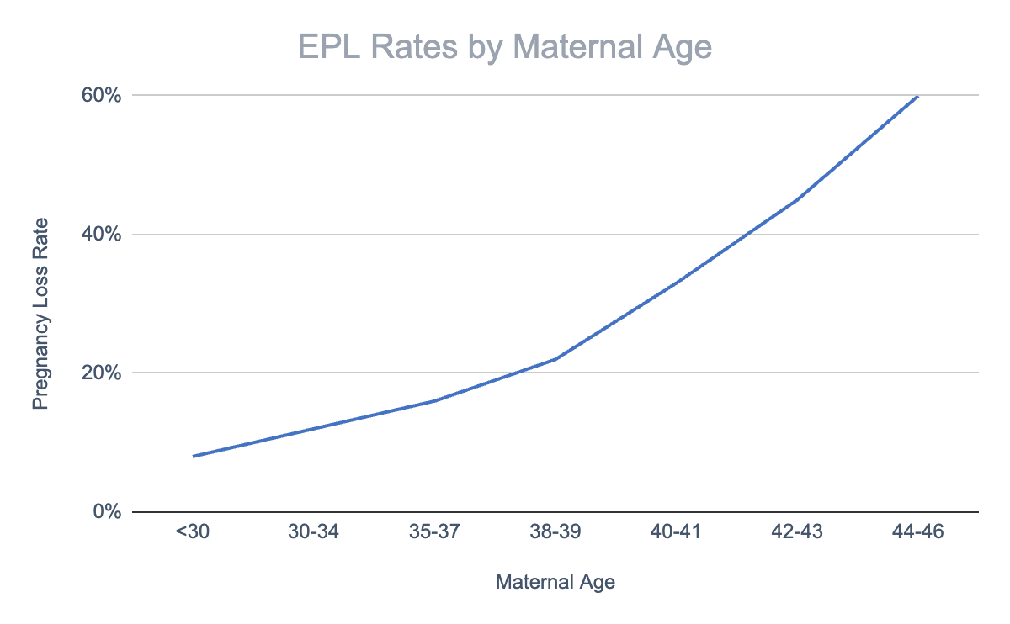
RISK FACTORS
The most common risk factors are advanced maternal age and a previous pregnancy loss
Working, exercising, stress, arguments, having sex, morning sickness, and/or having used birth control prior to getting pregnant do not cause EPL
Notes:
Advanced maternal age and a previous pregnancy loss are the most commonly associated risk factors with EPL. However, given the prevalence, further testing is not recommended until patients experience 2 or more episodes of EPL.
Sometimes, the language used in medicine can perpetuate stigma. While you may have to note “Advanced maternal age” and/or “geriatric pregnancy” in a patient’s chart, you should shift the language you use with patients. For example, you can say something like, “There are many benefits to becoming pregnant later in life, but one risk is that it can increase your risk for early pregnancy loss.”
Early pregnancy loss is typically a random event. Activities like working, exercising, stress, arguments, having sex, morning sickness, and/or having used birth control pills before getting pregnant do not cause EPL. Few medications can cause EPL.
Reference: American College of Obstetricians and Gynecologists. "Early Pregnancy Loss. ACOG Practice Bulletin No. 200." Obstet Gynecol vol. 132, no. 5 (2018): e197-207.
Data for chart: Advanced Fertility Center of Chicago. “Maternal age and Pregnancy Loss Rate.” https://advancedfertility.com/patient-education/causes-of-infertility/age-and-fertility/, Accessed 25 Oct 2023.

Slide 9
SIGNS AND SYMPTOMS OF EPL
    Vaginal bleeding
    Pelvic pain or cramping
    Absent fetal heart tones on Doppler when pregnancy should be > 10 weeks
    Size-dates discrepancy on bimanual exam
    POCs seen by clinician at cervical os or in vaginal vault on speculum exam
Notes:
Especially in desired pregnancies, it is important to distinguish between viable and nonviable pregnancies with a high degree of certainty before proceeding with treatment. The history and physical exam can be combined with Beta HCG levels and ultrasound results to make this diagnosis.
Clinical findings that are suspicious for EPL include:
Vaginal bleeding (common, occurring in up to 25% of pregnancies- can be normal but generally requires further evaluation)
- Pelvic pain or cramping (with or without bleeding) and a positive pregnancy test
- No fetal heart tones on doppler exam after 10 weeks
Bimanual exam with a size-dates discrepancy
Speculum exam with an open cervical os or POCs seen in the vaginal vault or at the cervix
You should take a patient centered approach when counseling patients about early pregnancy loss. If EPL has not been confirmed, be sure to manage patient’s expectations appropriately. If EPL has been confirmed, you can use open ended questions and allow the patient to express openly how they are feeling. However they are feeling is valid. In either scenario, make sure they know what the next steps are and when you will be in touch.
Ask the group: How would you approach counseling a patient who is experiencing symptoms of EPL? Can you draw on any past experience you might have delivering difficult news to a patient?
Reference: Prine, Linda W., and Honor MacNaughton. "Office management of early pregnancy loss." American family physician 84.1 (2011).

Slide 10
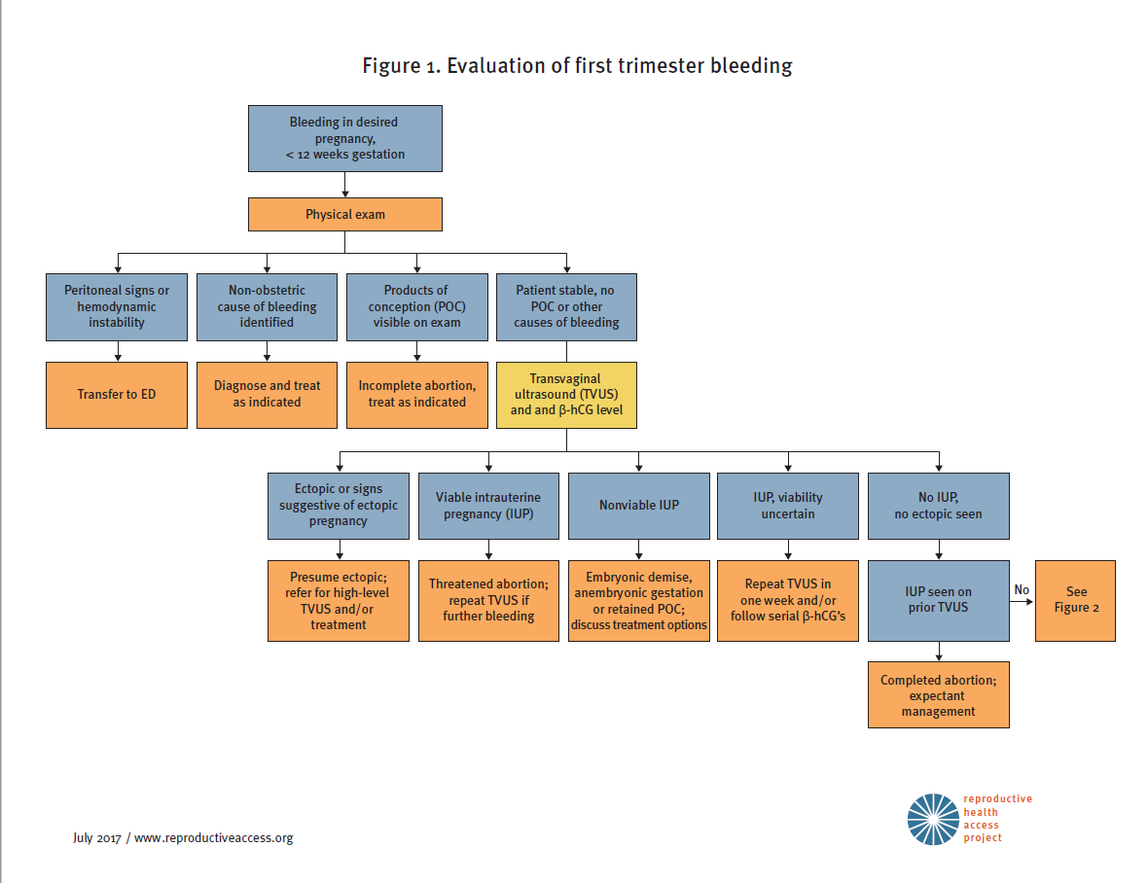
1ST TRIMESTER BLEEDING ALGORITHM
Notes:
Introduce the Algorithm, will be going through this along with the cases.

Slide 11
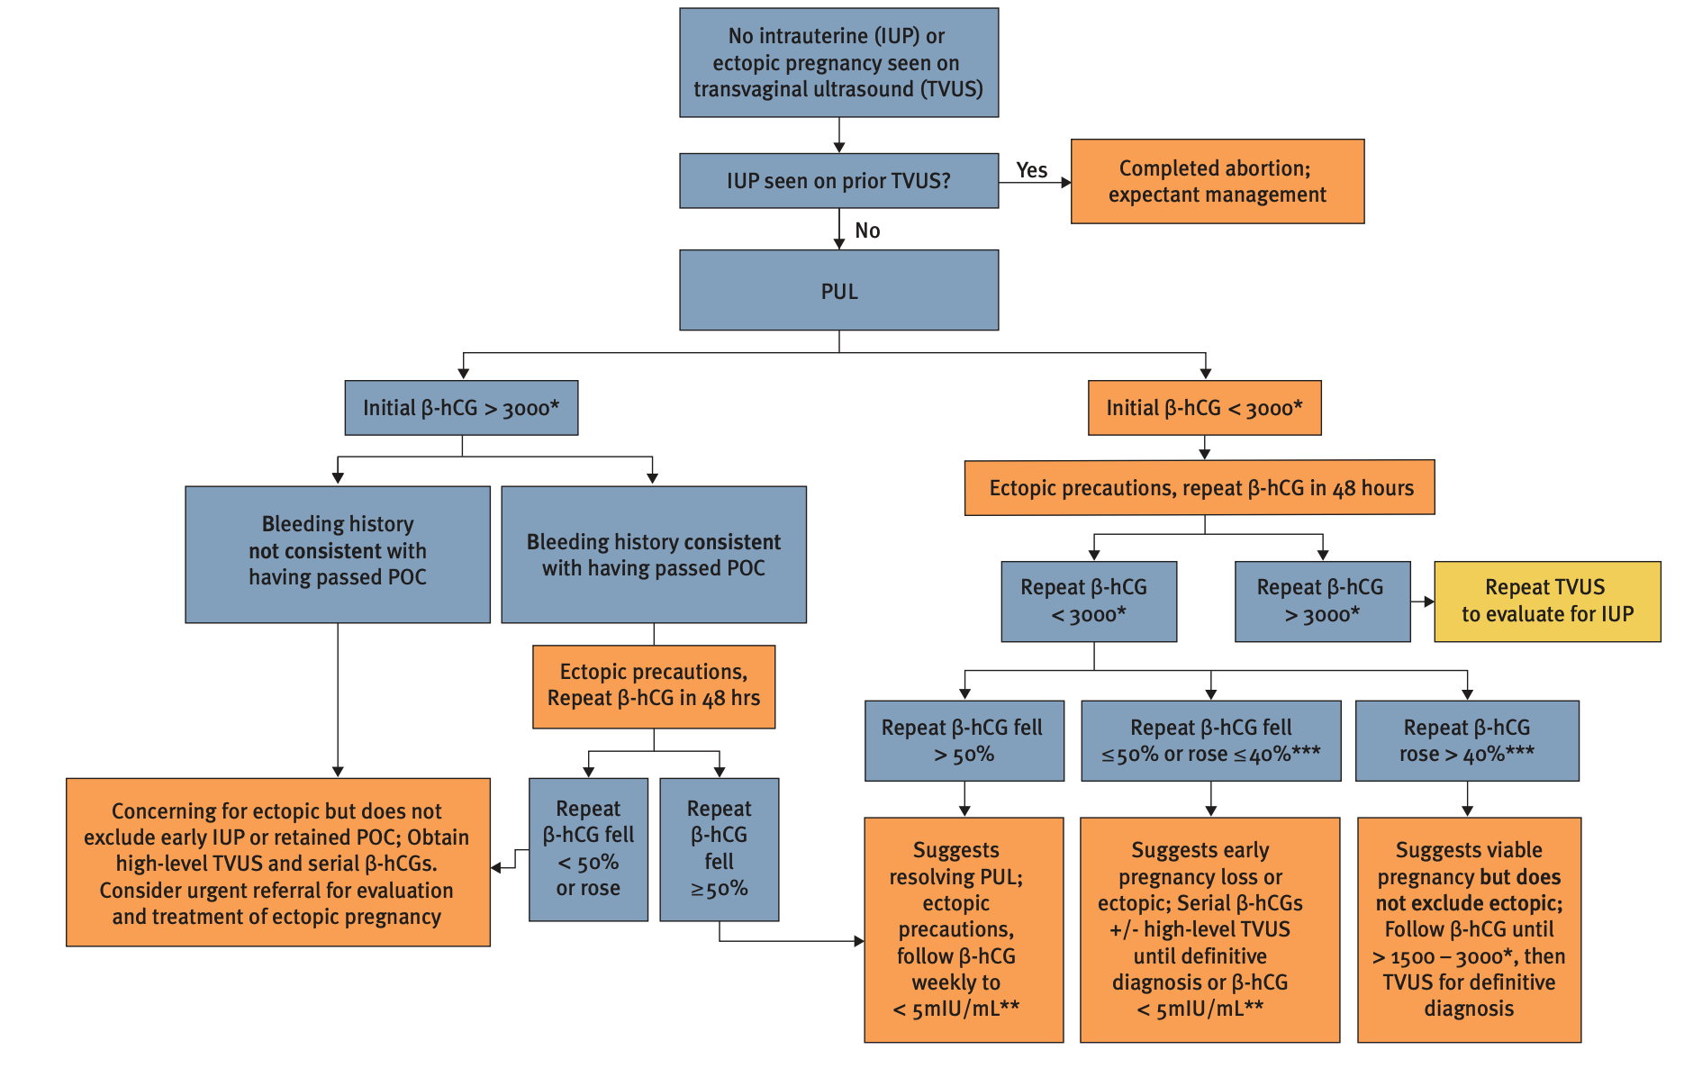
ALGORITHM FOR DIAGNOSIS OF PREGNANCY OF UNKNOWN LOCATION (PUL)
Notes:
Resource: https://www.reproductiveaccess.org/wp-content/uploads/2014/10/2017-11-EPL-algorithm.pdf

Slide 12
DIAGNOSIS – ULTRASOUND FINDINGS
Table 2. Guidelines for Transvaginal Ultrasonographic Diagnosis of Pregnancy Failure in a Woman with an Intrauterine Pregnancy of Uncertain Viability
Findings Diagnostic of Pregnancy Failure | Findings Suspicious for, but not Diagnostic of, Pregnancy Failure
Crown-rump length of ≥ 7 mm and no heartbeat Mean sac diameter of ≥ 25 mm and no embryo Absence of embryo with heartbeat ≥ 2 wk after a scan that showed a gestational sac without a yolk sac Absence of embryo with heartbeat ≥ 11 days after a scan that showed a gestational sac with a yolk sac | Crown-rump length of < 7 mm and no heartbeat Mean sac diameter of 16-24 mm and no embryo Absence of embryo with heartbeat 7-13 days after a scan that showed a gestational sac without a yolk sac Absence of embryo with heartbeat 7-10 days after a scan that showed a gestational sac with a yolk sac Absence of embryo ≥ 6 wk after last menstrual period Empty amnion (amnion seen adjacent to yolk sac, with no visible embryo) Enlarged yolk sac (> 7 mm) Small gestational sac in relation to the size of the embryo (< 5 mm difference between mean sac diameter and crown-rump length)
Notes:
These new guidelines are very conservative, and are designed to have nearly a 0% false positive rate.
Reference: Doubilet, Peter M., et al. "Diagnostic criteria for nonviable pregnancy early in the first trimester." New England Journal of Medicine 369.15 (2013): 1443-1451.

Slide 13
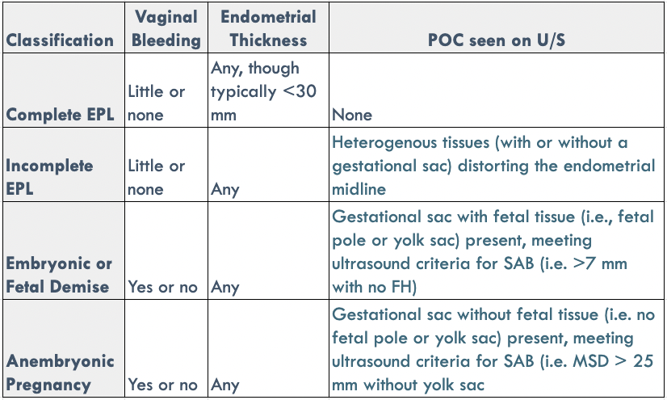
DIAGNOSIS – ULTRASOUND FINDINGS
Notes:
If the quant hcg is greater than 3,000-3,500, a gestational sac should be visible on Ultrasound - if not, suspect ectopic (multiple gestations would be the exception- where hcg levels are often higher than singletons)
References:
Prine, Linda W., and Honor MacNaughton. "Office management of early pregnancy loss." American family physician 84.1 (2011).
Schauberger CW, Mathiason MA, Rooney BL. Ultrasound assessment of first-trimester bleeding. Obstet Gynecol. 2005;105(2):333-338.

Slide 14
OTHER FACTORS TO CONSIDER
    Patient’s desire to continue pregnancy
    Patient’s willingness to postpone intervention to confirm pregnancy loss with 100% certainty
    Potential consequences of waiting for intervention (i.e., spontaneous passage of pregnancy tissue, the need/difficulty of an unscheduled procedure, anxiety)
Notes:
Other factors to consider are the patient’s desire to continue the pregnancy and their willingness to postpone intervention in order to confirm pregnancy loss with 100% certainty.
You will also want to review with the patient what to expect if they decide to wait for intervention. Help them assess how they feel about the potential for spontaneous passage of pregnancy tissue, and their ability to accommodate an unscheduled procedure (is their employer going to be flexible with time off, do they have any childcare or other concerns that could be a factor?), and if they are concerned about the anxiety this experience can induce for some people.
Remember, everyone is different – what is important to the patient in front of you might not be what is important to the patient you saw last week. Keep the patient’s individual wants, needs, and concerns centered throughout treatment planning.
Reference: American College of Obstetricians and Gynecologists. "Early Pregnancy Loss. ACOG Practice Bulletin No. 200." Obstet Gynecol vol. 132, no. 5 (2018): e197-207

Slide 15



OUTPATIENT MANAGEMENT
EXPECTANT
MEDICATION
PROCEDURE
Watchful waiting
Mifepristone*
+
Misoprostol
Uterine Aspiration
* Mifepristone is not always available. With mifepristone, the success rate is 84% overall. With only misoprostol, the success rate is 67% overall.
Notes:
Counsel patients on all 3 options and support them in their decision making process by asking open ended questions about their values and preferences. Some factors to take into consideration are the physical experience (pain, bleeding, safety, time), privacy, and past experiences.
Different patients will have different preferences, and it is your job to give them the information they need in order to make the decision that is best for them – not direct them on what you think is best. Patients report higher levels of satisfaction when their treatment plan follows the preferences that they have voiced to their provider.
References:
Kim C, Barnard S, Neilson JP, Hickey M, Vazquez JC, Dou L. Medical treatments for incomplete miscarriage. Cochrane Database Syst Rev. 2017;(1):CD007223.
Hendriks E, MacNaughton H, MacKenzie MC. First Trimester Bleeding: Evaluation and Management. Am Fam Physician. 2019;99(3):166-174.
Innovating Education in Reproductive Health. “Counseling and Decision-making for EPL Management.” https://www.innovating-education.org/2021/02/counseling-and-decision-making-for-epl-management/. Accessed Oct 26 2023.

Slide 16
Counseling: Expectant
    Wait for the pregnancy tissue to pass on its own
    May occur at any time with cramps and bleeding
    Bleeding may be heavier than a period, cramps may be intense (can use pain relief meds, heating pad)
    Works 70-80% of the time, but can work better if they already have some bleeding
    Can take a few weeks
    If it doesn’t work or takes too long, patient can return for medication or procedure
EXPECTANT
Watchful waiting
Notes:
When counseling patients on their options, you will want to present thorough and unbiased information. This can be a lot for patients to absorb at once, so it can be helpful to use patient education materials for them to follow along and take with them after the visit.
You will want to cover how each option works, what will happen, expected pain, efficacy, length of time, and what will happen if it does not work or takes too long.
You will want to reiterate that all treatment options are safe, they can still become pregnant in the future if they want to, and that they did not cause the pregnancy loss.
References:
Reproductive Health Access Project. “What are my choices for Early Pregnancy Loss (Miscarriage) Treatment?” https://www.reproductiveaccess.org/resource/miscarriage-treatment-options/. Accessed 26 Oct 2023.

Slide 17
Counseling: Medication
    Mifepristone to stop pregnancy and misoprostol to pass pregnancy tissue
    Take mifepristone first, then 24 hours later place misoprostol in vagina or between cheek and gums
    Misoprostol may cause nausea, diarrhea, and/or low fever
    Bleeding may be heavier than a period, cramps may be intense (can use pain relief meds, heating pad)
    Works 75-90% of the time
    Works in 84% of patients within 2 days
    If it doesn’t work or takes too long, patient can get another dose of misoprostol or procedure
MEDICATION
Mifepristone*
+
Misoprostol
Notes:
References:
Reproductive Health Access Project. “What are my choices for Early Pregnancy Loss (Miscarriage) Treatment?” https://www.reproductiveaccess.org/resource/miscarriage-treatment-options/. Accessed 26 Oct 2023.

Slide 18
Counseling: Procedure
    Pregnancy tissue is removed by clinician during in-office procedure called Manual Vacuum Aspiration
    Can be done with local anesthesia or sedation
    May have mild to strong cramps during procedure, light bleeding/cramping for 3-7 days after
    Procedure takes 5-10 minutes
    Works 98-100% of the time
    If it doesn’t work (rare), patient can return for another procedure
PROCEDURE
Uterine Aspiration
Notes:
References:
Reproductive Health Access Project. “What are my choices for Early Pregnancy Loss (Miscarriage) Treatment?” https://www.reproductiveaccess.org/resource/miscarriage-treatment-options/. Accessed 26 Oct 2023.

Slide 19

PATIENT CASE: JENNIFER
She/Her pronouns
22 years old
LMP was 7 weeks ago
Positive urine pregnancy
She is having some vaginal bleeding
ADDITIONAL HISTORY? AND ON PHYSICAL?
Notes:
Ask participants about next steps.
History and Physical:
-Was her last period normal (is LMP accurate?)
-If pelvic pain - midline or lateral?
-Prior PID? Miscarriages? Surgeries?
-Uterine size
-Tissue or just blood from os? And how much bleeding is she having?
Clinical Signs of First Trimester Pregnancy Loss:
-Patient presents with pelvic pain with or without bleeding and a positive pregnancy test
-Vaginal bleeding
-No fetal heart tones on doppler exam after 10 weeks
-Report from radiology - Non-viable pregnancy on ultrasound
Clinicians can make this diagnosis and offer treatment to your patient. No need to send every patient with a positive pregnancy test and vaginal bleeding to the ER!
Image Source: https://unsplash.com/photos/U4JDjYmjn1g
Photo Credit: https://www.flickr.com/photos/wocintechchat/25900759582/

Slide 20
1ST TRIMESTER BLEEDING ALGORITHM
Notes:
For Jennifer:
-Blood is seen on speculum exam, but no tissue.
There was NO adnexal tenderness or mass on the physical exam
Walk through the algorithm
You, as the clinician, decide to proceed with an ultrasound which shows…

Slide 21
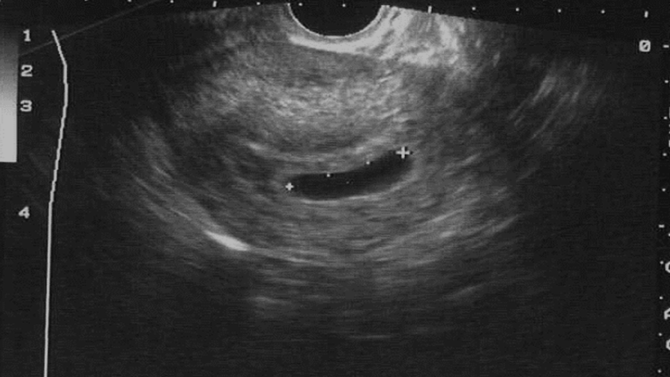
JENNIFER’S ULTRASOUND.
ANEMBRYONIC GESTATION
Mean sac diameter >25 mm with no embryo
Notes:
Complete and careful scanning of the sac both longitudinally and transverse to make sure one is not missing the yolk sac.
Image: Family Medicine Digital Resources Library (https://resourcelibrary.stfm.org/viewdocument/family-medicine-digital-resources-l)

Slide 22
DIAGNOSIS – ULTRASOUND FINDINGS
Table 2. Guidelines for Transvaginal Ultrasonographic Diagnosis of Pregnancy Failure in a Woman with an Intrauterine Pregnancy of Uncertain Viability
Findings Diagnostic of Pregnancy Failure | Findings Suspicious for, but not Diagnostic of, Pregnancy Failure
Crown-rump length of ≥ 7 mm and no heartbeat Mean sac diameter of ≥ 25 mm and no embryo Absence of embryo with heartbeat ≥ 2 wk after a scan that showed a gestational sac without a yolk sac Absence of embryo with heartbeat ≥ 11 days after a scan that showed a gestational sac with a yolk sac | Crown-rump length of < 7 mm and no heartbeat Mean sac diameter of 16-24 mm and no embryo Absence of embryo with heartbeat 7-13 days after a scan that showed a gestational sac without a yolk sac Absence of embryo with heartbeat 7-10 days after a scan that showed a gestational sac with a yolk sac Absence of embryo ≥ 6 wk after last menstrual period Empty amnion (amnion seen adjacent to yolk sac, with no visible embryo) Enlarged yolk sac (> 7 mm) Small gestational sac in relation to the size of the embryo (< 5 mm difference between mean sac diameter and crown-rump length)
Notes:
Our patient Jennifer had a MSD >25 with no embryo. This finding is diagnostic of early pregnancy loss.
These guidelines are very conservative, and are designed to have a 0% false positive rate.
Reference: Doubilet, Peter M., et al. "Diagnostic criteria for nonviable pregnancy early in the first trimester." New England Journal of Medicine 369.15 (2013): 1443-1451.

Slide 23

PATIENT CASE: JENNIFER
What does she need to know?
This is not her fault
She can decide on the management option
Notes:
Remember – half of all pregnancies are unintended, not everyone is sad to lose a pregnancy.
Very important to give info to the partner that pregnancy loss is no one’s fault.
Optional Activity: Have participants break into pairs (one will be Jennifer, one will be the provider) to role-play giving the diagnosis of early pregnancy loss and counseling for all three options. Jennifer will choose expectant management. Can use RHAP resource as a counseling guide: https://www.reproductiveaccess.org/resource/miscarriage-treatment-options/
Miscarriage myths:
Air travel
Blunt abdominal trauma
Contraceptive use
Exercise
HPV vaccine
Previous abortions
Sexual activity
Important in counseling: patient can decide on their management option. Better mental health outcomes when the patient is involved in the decision making.
Cochrane review found all options have pros and cons and that all should be offered.
Reference: Ghosh J, Papadopoulou A, Devall AJ, Jeffery HC, Beeson LE, Do V, Price MJ, Tobias A, Tunçalp Ö, Lavelanet A, Gülmezoglu AM, Coomarasamy A, Gallos ID. Methods for managing miscarriage: a network meta-analysis. Cochrane Database of Systematic Reviews 2021, Issue 6. Art. No.: CD012602. DOI: 10.1002/14651858.CD012602.pub2.
Photo Credit: https://www.flickr.com/photos/wocintechchat/25392468193/

Slide 24
EXPECTANT MANAGEMENT
Notes:
Many patients will need time to absorb the diagnosis and may not want any initial intervention. Important to reassure them that this is a safe option if patient is clinically stable (no hemorrhage or infection).

Slide 25
SUCCESS OF EXPECTANT MANAGEMENT
Group | N | Complete Day 7 | Complete Day 14 | Success Day 46
Incomplete | 221 | 117 (53%) | 185 (84%) | 201 (91%)
Fetal demise | 138 | 41 (30%) | 81 (59%) | 105 (76%)
Anembryonic | 92 | 23 (25%) | 48 (52%) | 61 (66%)
TOTAL | 451 | 181 (40%) | 314 (70%) | 367 (81%)
Notes:
When counseling patients about the likelihood of expectant management being successful, it is important to have a sense of how successful each option is. One can remember them by thinking that, of course, an incomplete will finish on it’s own most easily. Note though, that anembryonic pregnancies have the lowest success rate without intervention (they have the highest failure rate for medical management also). Not sure why this is, but that empty sac just hangs in there…while a demise is more likely to be rejected, and come out with less intervention…
The other important point to note is that these statistics came from a study, where there were established end points, as noted. In real clinical time, we might wait longer than 49 days, or try combinations of medication and expectant management.
Reference:
Prine, Linda W., and Honor MacNaughton. "Office management of early pregnancy loss." American family physician 84.1 (2011).

Slide 26

EXPECTANT MANAGEMENT
RISKS
BENEFITS
Timing not predictable
Less effective
Infection (rare)
Need for emergent uterine aspiration (rare)
Hemorrhage/transfusion (very rare)
Noninvasive
More Private
More “natural”
Inexpensive
No medication side effects
Availability
Butler et al J Fam Pract 2005 54:889-90
Notes:
Reference: Butler C, Kelsberg G, St Anna L, Crawford P. Clinical inquiries. How long is expectant management safe in first-trimester miscarriage? J Fam Pract 2005;54:889-90.

Slide 27
PATIENT INSTRUCTIONS: EXPECTANT MANAGEMENT
Expect cramping and heavy bleeding
Pain control: ibuprofen, heating pad
Call for “heavy bleeding”: soaking through ≥ 2 pads per hour for two hours in a row
Give contact information for reaching clinician
Patient does NOT need to bring products of conception back to the clinician
Notes:
Patients should call clinician for heavy bleeding defined as soaking two pads per hour for two hours back to back. This can usually be managed by phone.
Make sure patient is taking ibuprofen, ask about signs of hypovolemia. Encourage fluid intake & ibuprofen and call back in one hour.
Bleeding will generally abate during this time.
Risks – some studies show more trips to the ER. This may point to the need for better anticipatory guidance and misoprostol to have on hand.

Slide 28
MEDICAL MANAGEMENT: MIFEPRISTONE AND MISOPROSTOL
Jennifer does not want to wait anymore
Notes:
Ask if anyone has done this?
Patients often choose medication management because it feels more natural and yet happens more predictably
Standard dosing of 800mcg of miso administered vaginally required a second dose of miso in 15-40% of patients (schrieber). Now, with the addition of Mifepristone, we have improved success rates if a patient does decide to treat their early pregnancy loss with medication.
Administration of miso vaginally vs buccal does not have difference in success (cochrane 2017 review) but buccally can give more GI side-effects
References:
Kim C, Barnard S, Neilson JP, Hickey M, Vazquez JC, Dou L. Medical treatments for incomplete miscarriage. Cochrane Database Syst Rev 2017;1:CD007223-CD007223
Photo Credit: https://www.flickr.com/photos/wocintechchat/25900759582/

Slide 29
MEDICAL MANAGEMENT
RISKS
BENEFITS
Side effects from medications
Infection (rare)
Need for aspiration (rare)
Hemorrhage or transfusion (rare)
Mifepristone not available widely
Timing of bleeding more predictable than expectant management
Noninvasive
Private
Inexpensive
Flexible timing
Notes:
References:
American College of Obstetricians and Gynecologists. "Early Pregnancy Loss. ACOG Practice Bulletin No. 200." Obstet Gynecol vol. 132, no. 5 (2018): e197-207.
Butler, Charles et al. “Clinical Inquiries. How Long Is Expectant Management Safe in First-Trimester Miscarriage?” The Journal of family practice 54.10 (2005): 889–890.
Emily M. Godfrey, Lawrence Leeman, and Panna Lossy. “Early Pregnancy Loss Needn’t Require a Trip to the Hospital.” Journal of Family Practice 58.11 (2009): 585–590.
Prine LW, Macnaughton, H. “Office Management of Early Pregnancy Loss.” AAFP 84.1 (2011): 75–82.

Slide 30
SUCCESS RATES WITH MISOPROSTOL ALONE VS MIFEPRISTONE AND MISOPROSTOL
Medical management can be done with misoprostol alone or with the combination of mifepristone followed by misoprostol 24 hours later. While data shows higher effectiveness with mife vs. miso-only, miso-only can be used safely, effectively, and is more widely available in many places.
SUCCESS RATE (EXPULSION OF GESTATIONAL SAC) BY DAY 2 | MISOPROSTOL ALONE | MIFEPRISTONE AND MISOPROSTOL
ALL SUBCATEGORIES OF EPL | 67% | 84%
EMBRYONIC DEMISE | 68% | 85%
ANEMBRYONIC | 65% | 80%
Notes:
Schrieber’s study at two days of follow up showed an absolute difference in the rate of treatment success to be 16.7%
Incomplete = persistent sac OR endometrial lining >30mm
Again - we see that the empty sac is tougher to come out.
Reference: Schreiber, CA et al. Mifepristone Pretreatment for the Medical Management of Early Pregnancy Loss N Engl J Med 2018; 378:2161-2170

Slide 31
GUIDELINES FOR MEDICAL MANAGEMENT
1. Candidates
  Those with diagnosis of nonviable intrauterine pregnancy less than 12 weeks by ultrasound
2. Labs
    Rh screen if > 8 weeks (if status is not available)
    Hematocrit
    Quantitative serum hCG (quant not always needed if ultrasound diagnosis is definitive)
    Consider gonorrhea/chlamydia if patient is at risk
3. Consent forms
  Danco or GenBioPro Patient Agreement Form and Medication Guide; consider additional evidence-based, more patient centered consent form
Notes:
After 1st trimester may need hospital management
Danco and GenBioPro forms only needed if using mifepristone due to the Risk Evaluation and Management . Miso-only regimens do not require special
References:
Prine LW, Macnaughton, H. “Office Management of Early Pregnancy Loss.” AAFP 84.1 (2011): 75–82.

Slide 32
GUIDELINES FOR MEDICAL MANAGEMENT
1. Mifepristone 200mg (one tab) orally
    Dispensed in the office or by certified pharmacy
    Patient instructed to take when convenient
2. Misoprostol 800mcg (four tabs) vaginally
    If prescribed with mifepristone, use 24 hours following mifepristone
    If prescribed alone, use when convenient
    Repeat misoprostol dose if no bleeding or only light bleeding
3. Pain management
    Ibuprofen 600-800 mg Q6 hours
Notes:
Alternatives: can take misoprostol buccally or sublingually, but can result in more GI side effects (consider giving an anti-emetic as well)
Repeat misoprostol dose can be given as early as 3 hours after, or up to 1 week after; based on data from medication abortion, repeat dose may increase effectiveness if measuring 9+0 weeks or greater.
Vaginal Miso - patient should be instructed to lie down for 30 min following insertion of miso. It can be dispensed in the office if available or prescribed through a pharmacy. Consider prescribing a second dose of 800 mcg in case heavy bleeding does not occur within 12-24 hours of the first dose.
Ibuprofen: instruct patient to take prior to misoprostol and then every 6 hours as needed. Take ibuprofen (Motrin or Advil), naproxen (Aleve), or acetaminophen (Tylenol) for pain according to the instructions on the package. Take this with food to avoid an upset stomach.
Reference:
American College of Obstetricians and Gynecologists. "Early Pregnancy Loss. ACOG Practice Bulletin No. 200." Obstet Gynecol vol. 132, no. 5 (2018): e197-207.

Slide 33
SIDE EFFECTS OF MISOPROSTOL
Bleeding
Cramping
Low-grade fevers and/or chills
Nausea and vomiting
Diarrhea
All side effects should resolve within 24 hours
Notes:
Pre-treat with Ibuprofen
Bleeding - typically lasts up to 2 weeks with spotting until the next period
Cramping - usually starts within the first few hours, NSAIDs are very helpful
Fever and/or chills - common side effect. If lasts more than 24 hours, then evaluate for infection
Nausea and vomiting - more common after oral miso, should resolve in 6 hours
Diarrhea - also more common after oral, will resolve in 24 hours
References:
Prine LW, Macnaughton, H. “Office Management of Early Pregnancy Loss.” AAFP 84.1 (2011): 75–82.
Zhang, Jun et al. “A Comparison of Medical Management with Misoprostol and Surgical Management for Early Pregnancy Failure.” The New England journal of medicine 353.8 (2005): 761–769.

Slide 34
PATIENT INSTRUCTIONS
Lie down for 30 minutes after using misoprostol; okay if medication falls out after 30 minutes
Warning signs same as for expectant management:
    Call for “heavy bleeding,” fever, purulent vaginal discharge, or uncontrolled pain not improved with medication
    Patient does NOT need to bring products of conception back to the clinician
    Contact information for reaching clinician
Notes:
Heavy bleeding defined as soaking two pads per hour for two hours back to back - and still can usually be managed by phone for another hour, the bleeding generally abates
Make sure patient is taking ibuprofen, check for signs of hypovolemia. Encourage fluid intake & ibuprofen and call back in one hour
References:
Prine LW, Macnaughton, H. “Office Management of Early Pregnancy Loss.” AAFP 84.1 (2011): 75–82.

Slide 35





WHAT DO YOU NEED TO START USING MIFEPRISTONE FOR EPL IN YOUR PRACTICE?
A PLAN FOR WHEN MEDICATION DOESN’T WORK
PATIENT HANDOUTS
Office aspiration or referral
DANCO OR GENBIOPRO PATIENT AGREEMENT FORM AND MEDICATION GUIDE
COMPLETE PROVIDER CERTIFICATION PROCESS TO STOCK IN OFFICE
ON-CALL GROUP ALL FAMILIAR WITH MEDICAL MANAGEMENT
CLINICAL GUIDELINES
RESOURCE FOR HANDOUTS: WWW.REPRODUCTIVEACCESS.ORG
Notes:
A plan for when the misoprostol doesn’t work - either in office aspiration or referral - same as when expectant management doesn’t work.
Patient handouts
Danco or GenBioPro Patient Agreement Form and Medication Guide – using an additional evidence-based consent form can be helpful and more patient centered
On-call group all familiar with medication management
Resource for handouts: www.reproductiveaccess.org

Slide 36
DIAGNOSING COMPLETION AFTER MEDICAL MANAGEMNT OF EPL
Quant bHCG drop of more than 50% 48 hours or 80% by 7 days
Vaginal ultrasound with no sac or pregnancy after prior ultrasound documenting intrauterine pregnancy
Notes:
To confirm completion of EPL, clinicians may order a repeat beta HCG level or a repeat ultrasound.
Quant hcg with drop of more than 50% 48-72 hours later
Or vaginal ultrasound with no sac or pregnancy after one had been documented as being intrauterine
Discuss issue of endometrial thickness – leads to too much intervention…
Note: if either of these criteria are met, no further following of quant hcgs is needed

Slide 37

OFFICE PROCEDURE OPTION: UTERINE ASPIRATION
  Manual Vacuum Aspiration (MVA)
          Sharp curettage (D&C) no longer an acceptable option due to higher complication rates
Notes:
Uterine aspiration utilizes a vacuum source for the evacuation of the uterus. It can be performed on an outpatient basis with local anesthesia or analgesics. Vacuum aspiration can be used without electricity with a hand‐held vacuum syringe (Manual Vacuum Aspiration).
Good to have an MVA syringe and cannula here to pass around, and to spend a minute on this slide and the next for people who have no experience or exposure to abortion - since they will be counseling patients and need to have a sense of what their patients may be experiencing.
Office electric vacuum aspiration also an option, but less likely to be used in non-gyn offices
References:
Forna F, Gulmezoglu AM. Surgical procedures to evacuate incomplete abortion. Cochrane Database Syst Rev. 2001(1):CD001993
Tunçalp, Ozge, A. Metin Gülmezoglu, and João Paulo Souza. “Surgical Procedures for Evacuating Incomplete Miscarriage.” Cochrane database of systematic reviews 9 (2010): CD001993.

Slide 38
Compared to hospital management, office MVA offers these advantages:
Can help avoid repeated exams that occur in hospital
Costs can be higher than MAB, lower than hospital-based care
Avoid cumbersome OR protocols (NPO requirements, discharge criteria)
Can be easier to schedule and reduce wait time for patient vs. OR scheduling difficulties
Can allow patient to stay with care team they already know
Convenience, privacy, patient autonomy
Notes:
Main disadvantage is limits to sedation- generally can’t have deep or general anesthesia in the office. Otherwise, the procedure is exactly the same as what would happen in the operating room.
Reference:
Prine LW, Macnaughton, H. “Office Management of Early Pregnancy Loss.” AAFP 84.1 (2011): 75–82.

Slide 39
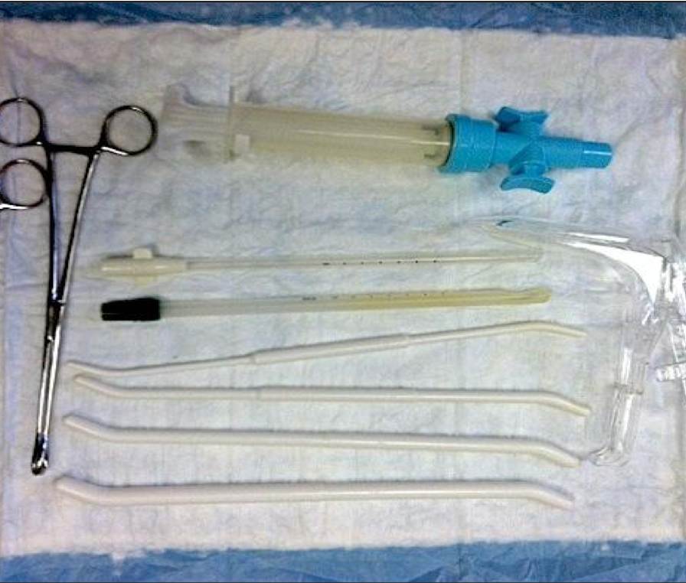
MVA INSTRUMENTS & SUPPLIES
Notes:
Necessary equipment includes:
MVA syringe
Cannulae
Speculum
Tenaculum
Dilators
Procedure takes 5–10 minutes.
Clinicians will:
Dilate cervix, insert cannula to fundus, aspirate
Examine tissue to confirm removal of products of conception
Light bleeding and cramping for 3-7 days.
MVA handouts at www.reproductiveaccess.org

Slide 40
MVA Aftercare
Pt can return to normal activities as soon as they feel ready
Period should return in 4-8 weeks, but varies
Pt may experience:
  Vaginal bleeding as light or heavy as a period for up to 2 weeks after the procedure
  Cramping for 1 week after the procedure
  Mixed emotions – this is normal and whatever the patient feels is okay, but can be offered BH support if desired
Pt should call clinic if:
  Bleeding more than 2 maxi pads per hour
  Severe cramps that do not improve with pain medication
  Dizziness
  Foul-smelling discharge, chills, fever > 101º
  Overwhelming feelings of sadness or grief
Notes:
Note for facilitator: After reviewing this slide, transition to going through the case studies in the Learners/Facilitator’s Guides (handouts). There are 4 case study options you can choose to work through with participants. You can work through them as an entire group or assign breakout groups for a small group of people to work on 1 or several cases, then come back together to talk through them.
Reference:
Prine LW, Macnaughton, H. “Office Management of Early Pregnancy Loss.” AAFP 84.1 (2011): 75–82.
https://www.reproductiveaccess.org/resource/mva-aftercare-instructions/

Slide 41
KEY
LEARNING POINTS.
There are three office options to be offered for miscarriage management:
                - Expectant
                - Medical (mifepristone and misoprostol, and misoprostol alone)
                - Procedure: MVA
Mental health outcomes for patients are best when they are involved in the decision-making around their care

Slide 42

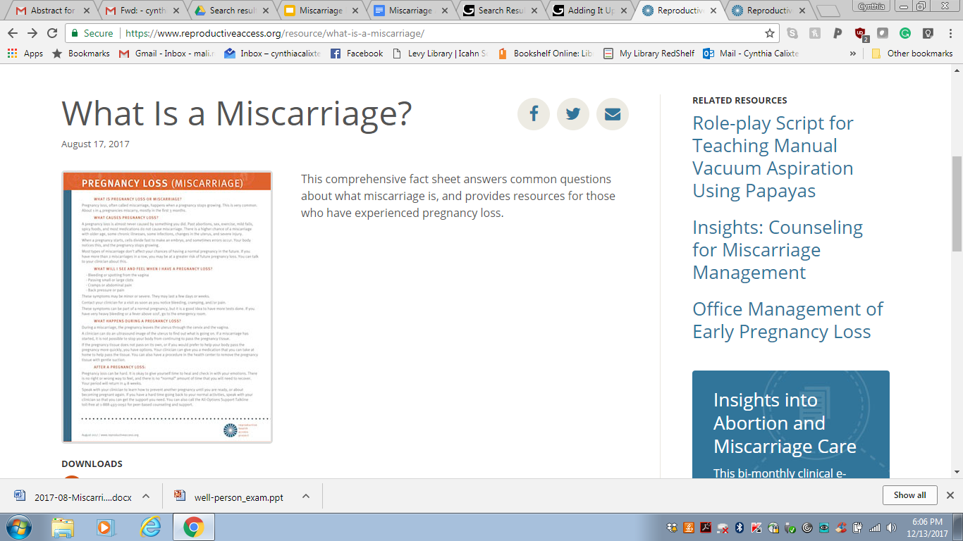

RESOURCES.
Notes:
RHAP factsheets:
https://www.reproductiveaccess.org/resource/what-is-a-miscarriage/ This comprehensive fact sheet answers common questions about what early pregnancy loss (miscarriage) is, and provides resources for those who have experienced pregnancy loss.
https://www.reproductiveaccess.org/resource/miscarriage-treatment-options/ This fact sheet explains three early pregnancy loss, or miscarriage, treatment options and the frequently asked questions patients may have such as “what causes an early pregnancy loss?” and “can I still have children afterward?”.
https://www.reproductiveaccess.org/resource/mva-aftercare-instructions/ Manual Vacuum Aspiration (MVA) Procedure Aftercare (Take home instructions)
https://www.reproductiveaccess.org/resource/early-pregnancy-loss-miscarriage-treatment-medication-management-with-misoprostol-only/ This patient fact sheet explains medication treatment (using misoprostol-only) and aftercare instructions for early pregnancy loss (miscarriage) and answers frequently asked patient questions.
https://www.reproductiveaccess.org/resource/miscarriage-treatment-medication/ This patient fact sheet explains medication treatment (using mifepristone and misoprostol) and aftercare instructions for early pregnancy loss (miscarriage) and answers frequently asked patient questions.
https://www.reproductiveaccess.org/2021/10/destigmatizing-early-pregnancy-loss-anitas-miscarriage-zine/ Anita’s Miscarriage: A Story of Early Pregnancy Loss is a zine that follows one couple’s experience with an early pregnancy loss. This evidence-based resource explains the treatment options a person can access when experiencing an early pregnancy loss. We have included a file to view online as well as a file you can print out and assemble into a booklet. The art in this zine is by illustrator Karina Shor.
https://www.reproductiveaccess.org/resource/protocol-medication-management-epl-miso-only/ Protocols for Medication Management of Early Pregnancy Loss – Miso Only
https://www.reproductiveaccess.org/resource/protocol-medication-management-epl-mife-miso/ Clinical protocol for medication management of miscarriage using mifepristone and misoprostol.

Slide 43
REFERENCES.
Allison JL, Sherwood RS, Schust DJ. “Management of first trimester pregnancy loss can be safely moved into the office.” Rev Obstet Gynecol; 2011;4(1):5-14
American College of Obstetricians and Gynecologists. "Early Pregnancy Loss. ACOG Practice Bulletin No. 200." Obstet Gynecol vol. 132, no. 5 (2018): e197-207.
Butler, Charles et al. “Clinical Inquiries. How Long Is Expectant Management Safe in First-Trimester Miscarriage?” The Journal of family practice 54.10 (2005): 889–890.
Chen B, Creinin M, “Contemporary Management of Early Pregnancy Failure.” Clin Obstet and Gynecol Volume 50, Number 1, (2007) 67–88.
Creinin, Mitchell D. et al. “Factors Related to Successful Misoprostol Treatment for Early Pregnancy Failure.” Obstetrics and gynecology 107.4 (2006): 901–907.
Doubilet, Peter M. et al. “Diagnostic Criteria for Nonviable Pregnancy Early in the First Trimester.” Ultrasound quarterly 30.1 (2014): 3–9.
Emily M. Godfrey, Lawrence Leeman, and Panna Lossy. “Early Pregnancy Loss Needn’t Require a Trip to the Hospital.” Journal of Family Practice 58.11 (2009): 585–590.
Ghosh J, Papadopoulou A, Devall AJ, Jeffery HC, Beeson LE, Do V, Price MJ, Tobias A, Tunçalp Ö, Lavelanet A, Gülmezoglu AM, Coomarasamy A, Gallos ID. Methods for managing miscarriage: a network meta-analysis. Cochrane Database of Systematic Reviews 2021, Issue 6. Art. No.: CD012602. DOI: 10.1002/14651858.CD012602.pub2.
Luise, Ciro et al. “Outcome of Expectant Management of Spontaneous First Trimester Miscarriage: Observational Study.” BMJ 324.7342 (2002): 873–875.
Milingos, D. S. et al. “Manual Vacuum Aspiration: A Safe Alternative for the Surgical Management of Early Pregnancy Loss.” BJOG: an international journal of obstetrics and gynaecology 116.9 (2009): 1268–1271.
Prine LW, Macnaughton, H. “Office Management of Early Pregnancy Loss.” AAFP 84.1 (2011): 75–82.
Tunçalp, Ozge, A. Metin Gülmezoglu, and João Paulo Souza. “Surgical Procedures for Evacuating Incomplete Miscarriage.” Cochrane database of systematic reviews 9 (2010): CD001993.
Wallace, Robin, Angela DiLaura, and Christine Dehlendorf. “‘Every Person’s Just Different’: Women’s Experiences with Counseling for Early Pregnancy Loss Management.” Women’s health issues: official publication of the Jacobs Institute of Women's Health 27.4 (2017): 456–462.
Wallace, Robin R. et al. “Counseling Women with Early Pregnancy Failure: Utilizing Evidence, Preserving Preference.” Patient education and counseling 81.3 (2010): 454–461.
Zhang, Jun et al. “A Comparison of Medical Management with Misoprostol and Surgical Management for Early Pregnancy Failure.” The New England journal of medicine 353.8 (2005): 761–769.
Notes:
Updated: October 2021

Slide 44

CE
POST-TEST.
Please complete this post-test on your phone or computer in order to receive CE credit for participation in this workshop. You can access the pre-test at:
https://www.surveymonkey.com/r/EPLPost
Notes:
Please complete this post-test on your phone in order to get CE credit for your participation in this workshop. You can access the post-test at…..
https://www.surveymonkey.com/r/EPLPost

Slide 45

THANK YOU.

