Slide 1



EARLY PREGNANCY LOSS
OFFICE EVALUATION AND MANAGEMENT
Notes:
Updated January 2024

Slide 2

CE PRE-TEST.
Please complete this pre-test on your phone or computer in order to receive CE credit for participation in this workshop. You can access the pre-test at:
https://www.surveymonkey.com/r/eplpre
Notes:
If you haven’t already, please complete this pre-test on your phone in order to get CME or CNE for your participation in this workshop. You can access the pre-test at…..
https://www.surveymonkey.com/r/eplpre

Slide 3

DISCLOSURES
Participants must attend 100% of this workshop.
Participants must complete the evaluation survey at the beginning and end of the workshop
No relevant financial relationships to disclose with ineligible companies.
Notes:
Please UPDATE if any presenters DO disclose a relevant financial relationship. Examples of how to word disclosures can be found in Identification, Mitigation, and Disclosure Toolkit (CME/CNE Materials folder)

Slide 4
LEARNING OBJECTIVES.
  Conduct a history and physical exam for first trimester bleeding to help distinguish normal from abnormal pregnancies.
  Interpret ultrasound and labs results to diagnose early pregnancy loss (EPL)
  Describe the three options for management of EPL
      - Expectant management
      - Medical management
      - Aspiration procedure management

Slide 5

TERMINOLOGY
MISCARRIAGE
EARLY PREGNANCY LOSS (EPL)
SPONTANEOUS ABORTION
Interchangeable for a nonviable pregnancy in the first trimester (<13 weeks of gestation); preferred terminology is early pregnancy loss (EPL)
Notes:
Discuss: the term that is most patient-centered is pregnancy loss. Spontaneous abortion has an association for patients with a choice to stop a pregnancy and miscarriage sounds like they somehow “miss- carried” or did something wrong. This is rarely the case, and it is important for you and your patient to understand this.
Reference: American College of Obstetricians and Gynecologists. "Early Pregnancy Loss. ACOG Practice Bulletin No. 200." Obstet Gynecol vol. 132, no. 5 (2018): e197-207.
American College of Obstetricians and Gynecologists. “Early Pregnancy Loss: Frequently Asked Questions”. https://www.acog.org/womens-health/faqs/early-pregnancy-loss. Accessed 25 Oct 2023.

Slide 6
Additional Terminology
Threatened Abortion
Incomplete Abortion
Missed Abortion
Anembryonic Pregnancy
Embryonic or Fetal Demise
Ectopic Pregnancy
Pregnancy of Unknown Location (PUL)
Notes:
Ask audience to define
Definitions:
Threatened Abortion: Bleeding before 20 weeks of pregnancy with a closed cervix. Pregnancy is viable at time of diagnosis.
Incomplete Abortion: Some, but not all products of conception have passed.
Missed Abortion: Early pregnancy loss is diagnosed on ultrasound but patient is asymptomatic.
Anembryonic Pregnancy: Pregnancy in which a gestational sac develops without any embryonic structures (no yolk sac or fetal pole). Previously referred to as “empty sac” or blighted ovum
Embryonic or Fetal Demise: Subcategory of early pregnancy loss in which an embryonic or fetal tissue is present but is not viable
Ectopic Pregnancy: Any pregnancy outside of the endometrium. Most commonly in the fallopian tube, but can also be in the cervix, ovary, or abdomen
Pregnancy of Unknown Location: When a patient presents with a positive pregnancy test, but no pregnancy is seen on ultrasound. Differential includes early intrauterine pregnancy, early pregnancy loss, and ectopic pregnancy.
Reference: Prine, Linda W., and Honor MacNaughton. "Office management of early pregnancy loss." American family physician 84.1 (2011).

Slide 7
EPIDEMIOLOGY
1 in 4 women* will experience EPL
10% of clinically diagnosed pregnancies
50% caused by chromosomal abnormalities
Notes:
One in four women will experience early pregnancy loss in her lifetime*
Note to facilitator: At RHAP we recommend mentioning that many times if we’re showing data or quoting studies they may describe their patient population as “women” – what they are referring to is cisgender women. We know that people of all genders can experience early pregnancy loss, use contraception, birth children, and have abortions. That is why we talk about our patients and we do not use the word WOMEN to describe the people who come to our clinics/offices, because that leaves out a significant portion of our patient population.
10% of diagnosed pregnancies result in a pregnancy loss - increasing in frequency with age, up to 80% at age 45
Some may only form a gestational sac, also sometimes called an anembryonic pregnancy, or the demise may occur after the embryo forms.
Most miscarriages happen at 6 weeks, with another smaller peak at 10 weeks gestational age.
The cause of approximately 50% of EPL is chromosomal abnormalities.
Reference: American College of Obstetricians and Gynecologists. "Early Pregnancy Loss. ACOG Practice Bulletin No. 200." Obstet Gynecol vol. 132, no. 5 (2018): e197-207.

Slide 8
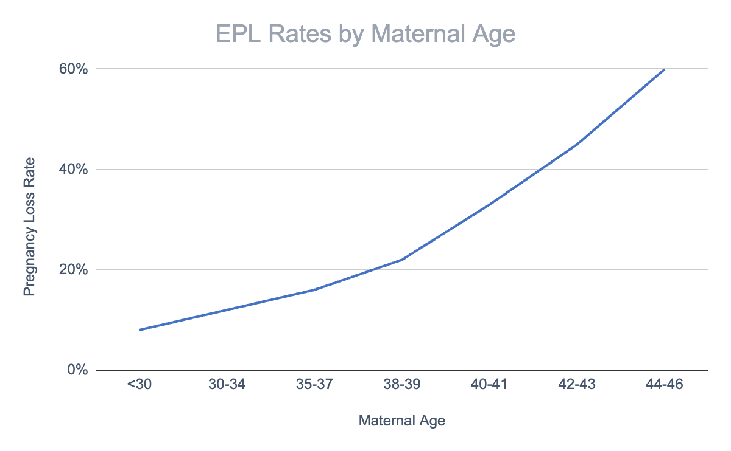
RISK FACTORS
The most common risk factors are advanced maternal age and a previous pregnancy loss
Working, exercising, stress, arguments, having sex, morning sickness, and/or having used birth control prior to getting pregnant do not cause EPL
Notes:
Advanced maternal age and a previous pregnancy loss are the most commonly associated risk factors with EPL. However, given the prevalence, further testing is not recommended until patients experience 2 or more episodes of EPL.
Sometimes, the language used in medicine can perpetuate stigma. While you may have to note “Advanced maternal age” and/or “geriatric pregnancy” in a patient’s chart, you should shift the language you use with patients. For example, you can say something like, “There are many benefits to becoming pregnant later in life, but one risk is that it can increase your risk for early pregnancy loss.”
Early pregnancy loss is typically a random event. Activities like working, exercising, stress, arguments, having sex, morning sickness, and/or having used birth control pills before getting pregnant do not cause EPL. Few medications can cause EPL.
Reference: American College of Obstetricians and Gynecologists. "Early Pregnancy Loss. ACOG Practice Bulletin No. 200." Obstet Gynecol vol. 132, no. 5 (2018): e197-207.
Data for chart: Advanced Fertility Center of Chicago. “Maternal age and Pregnancy Loss Rate.” https://advancedfertility.com/patient-education/causes-of-infertility/age-and-fertility/, Accessed 25 Oct 2023.

Slide 9
SIGNS AND SYMPTOMS OF EPL
    Vaginal bleeding
    Pelvic pain or cramping
    Absent fetal heart tones on Doppler when pregnancy should be > 10 weeks
    Size-dates discrepancy on bimanual exam
    POCs seen by clinician at cervical os or in vaginal vault on speculum exam
Notes:
Especially in desired pregnancies, it is important to distinguish between viable and nonviable pregnancies with a high degree of certainty before proceeding with treatment. The history and physical exam can be combined with Beta HCG levels and ultrasound results to make this diagnosis.
Clinical findings that are suspicious for EPL include:
Vaginal bleeding (common, occurring in up to 25% of pregnancies- can be normal but generally requires further evaluation)
- Pelvic pain or cramping (with or without bleeding) and a positive pregnancy test
- No fetal heart tones on doppler exam after 10 weeks
Bimanual exam with a size-dates discrepancy
Speculum exam with an open cervical os or POCs seen in the vaginal vault or at the cervix
You should take a patient centered approach when counseling patients about early pregnancy loss. If EPL has not been confirmed, be sure to manage patient’s expectations appropriately. If EPL has been confirmed, you can use open ended questions and allow the patient to express openly how they are feeling. However they are feeling is valid. In either scenario, make sure they know what the next steps are and when you will be in touch.
Ask the group: How would you approach counseling a patient who is experiencing symptoms of EPL? Can you draw on any past experience you might have delivering difficult news to a patient?
Reference: Prine, Linda W., and Honor MacNaughton. "Office management of early pregnancy loss." American family physician 84.1 (2011).

Slide 10
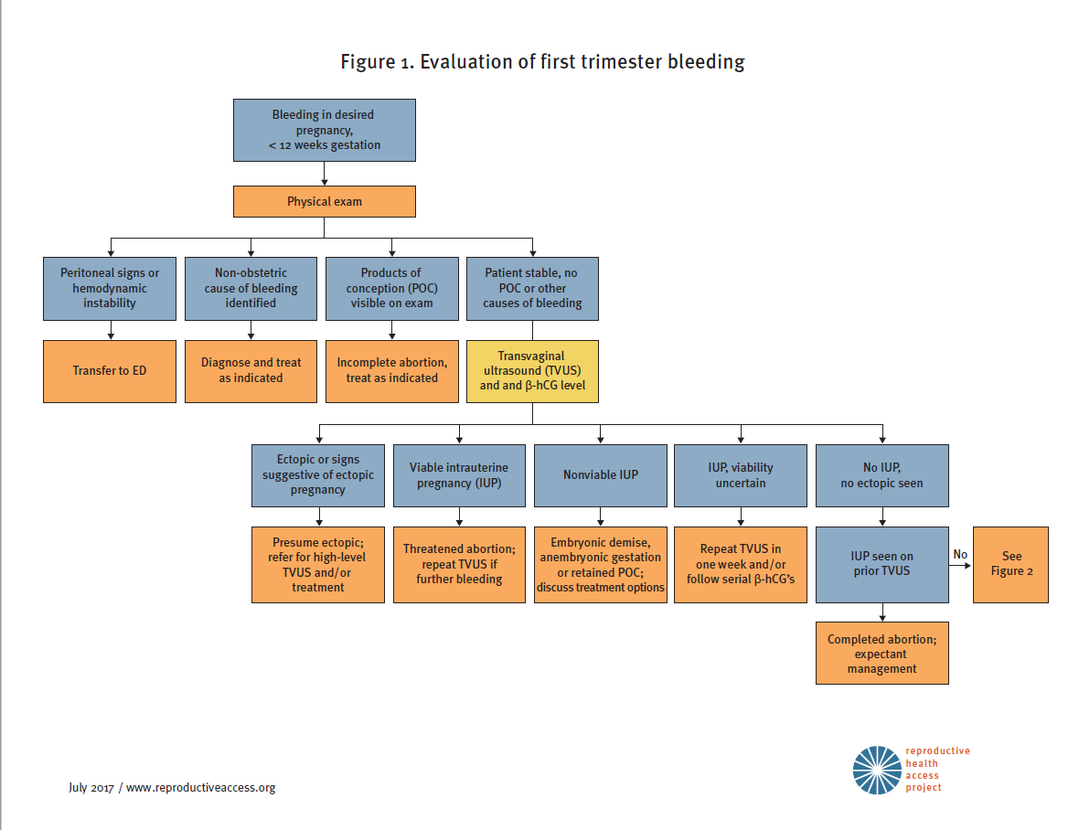
1ST TRIMESTER BLEEDING ALGORITHM
Notes:
Introduce the Algorithm, will be going through this along with the cases.

Slide 11
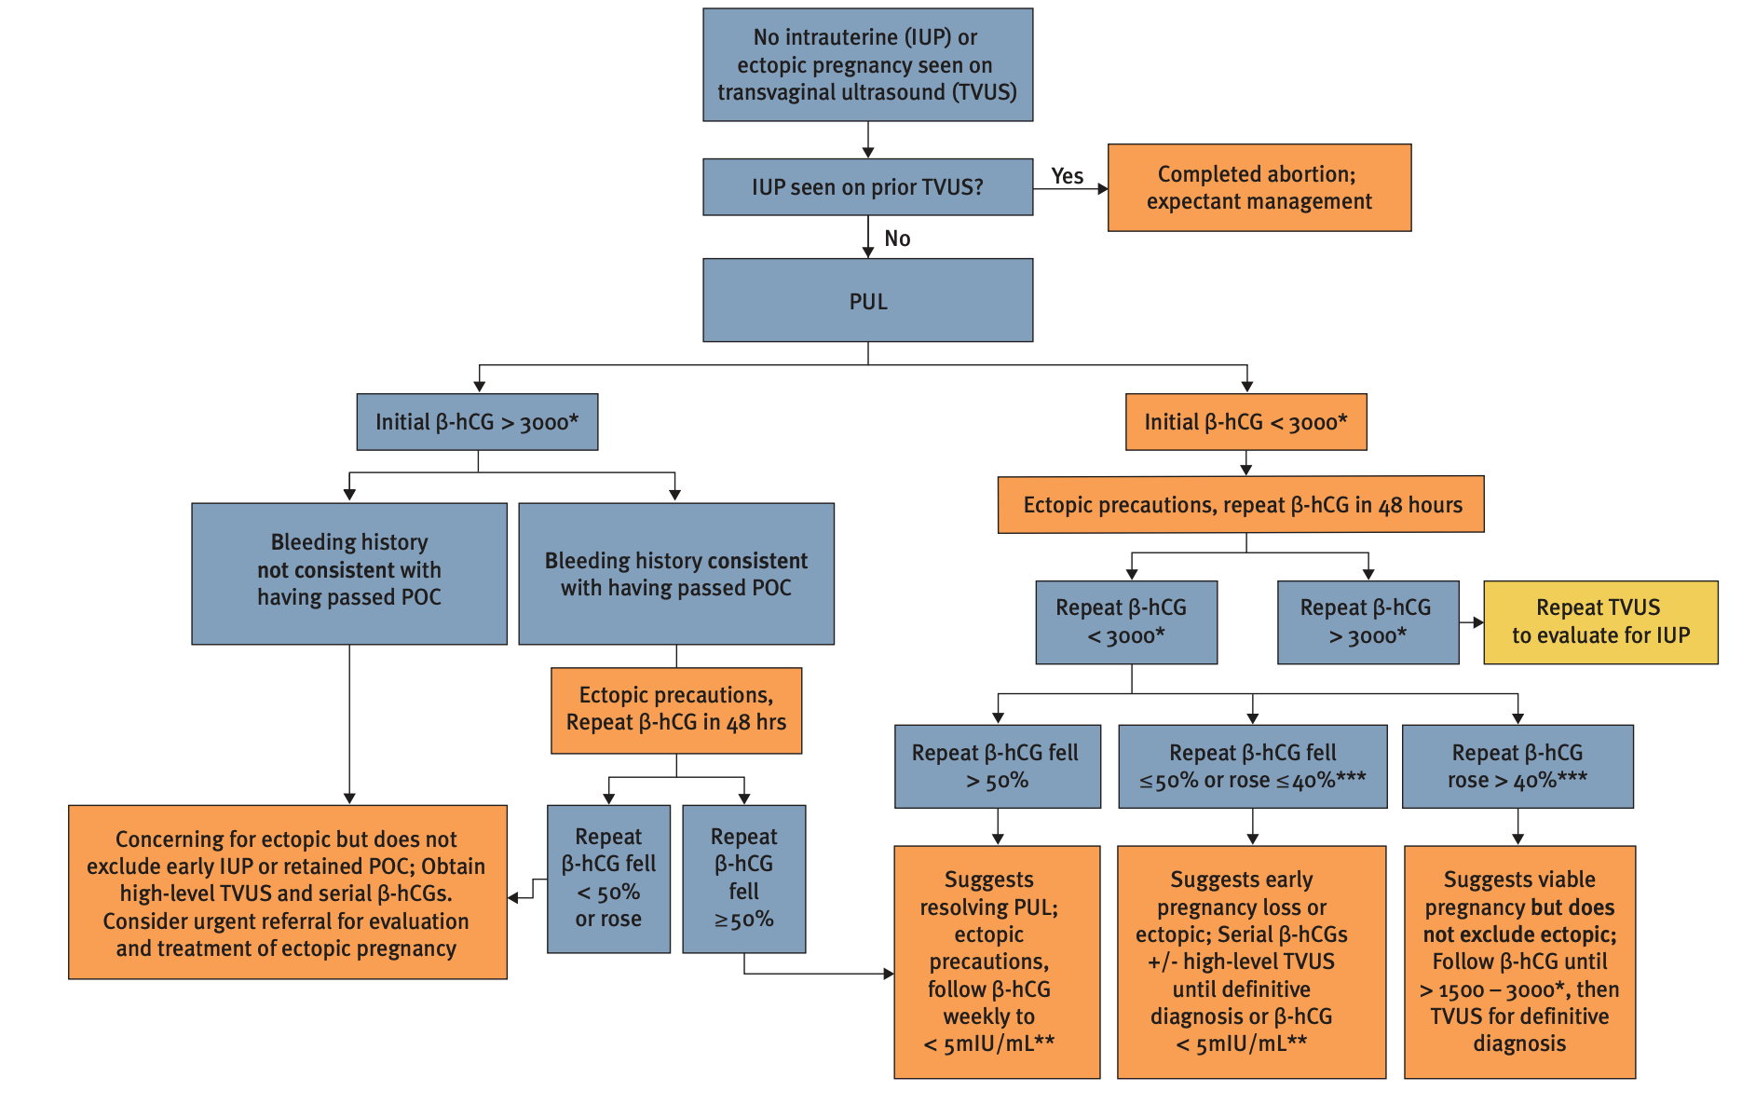
ALGORITHM FOR DIAGNOSIS OF PREGNANCY OF UNKNOWN LOCATION (PUL)
Notes:
Resource: https://www.reproductiveaccess.org/wp-content/uploads/2014/10/2017-11-EPL-algorithm.pdf

Slide 12
DIAGNOSIS – ULTRASOUND FINDINGS
Table 2. Guidelines for Transvaginal Ultrasonographic Diagnosis of Pregnancy Failure in a Woman with an Intrauterine Pregnancy of Uncertain Viability
Findings Diagnostic of Pregnancy Failure | Findings Suspicious for, but not Diagnostic of, Pregnancy Failure
Crown-rump length of ≥ 7 mm and no heartbeat Mean sac diameter of ≥ 25 mm and no embryo Absence of embryo with heartbeat ≥ 2 wk after a scan that showed a gestational sac without a yolk sac Absence of embryo with heartbeat ≥ 11 days after a scan that showed a gestational sac with a yolk sac | Crown-rump length of < 7 mm and no heartbeat Mean sac diameter of 16-24 mm and no embryo Absence of embryo with heartbeat 7-13 days after a scan that showed a gestational sac without a yolk sac Absence of embryo with heartbeat 7-10 days after a scan that showed a gestational sac with a yolk sac Absence of embryo ≥ 6 wk after last menstrual period Empty amnion (amnion seen adjacent to yolk sac, with no visible embryo) Enlarged yolk sac (> 7 mm) Small gestational sac in relation to the size of the embryo (< 5 mm difference between mean sac diameter and crown-rump length)
Notes:
These new guidelines are very conservative, and are designed to have nearly a 0% false positive rate.
Reference: Doubilet, Peter M., et al. "Diagnostic criteria for nonviable pregnancy early in the first trimester." New England Journal of Medicine 369.15 (2013): 1443-1451.

Slide 13
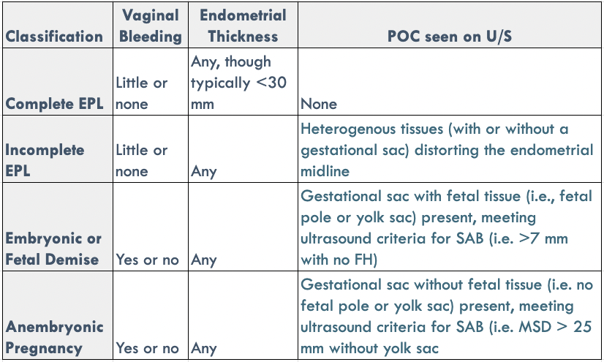
DIAGNOSIS – ULTRASOUND FINDINGS
Notes:
If the quant hcg is greater than 3,000-3,500, a gestational sac should be visible on Ultrasound - if not, suspect ectopic (multiple gestations would be the exception- where hcg levels are often higher than singletons)
References:
Prine, Linda W., and Honor MacNaughton. "Office management of early pregnancy loss." American family physician 84.1 (2011).
Schauberger CW, Mathiason MA, Rooney BL. Ultrasound assessment of first-trimester bleeding. Obstet Gynecol. 2005;105(2):333-338.

Slide 14
OTHER FACTORS TO CONSIDER
    Patient’s desire to continue pregnancy
    Patient’s willingness to postpone intervention to confirm pregnancy loss with 100% certainty
    Potential consequences of waiting for intervention (i.e., spontaneous passage of pregnancy tissue, the need/difficulty of an unscheduled procedure, anxiety)
Notes:
Other factors to consider are the patient’s desire to continue the pregnancy and their willingness to postpone intervention in order to confirm pregnancy loss with 100% certainty.
You will also want to review with the patient what to expect if they decide to wait for intervention. Help them assess how they feel about the potential for spontaneous passage of pregnancy tissue, and their ability to accommodate an unscheduled procedure (is their employer going to be flexible with time off, do they have any childcare or other concerns that could be a factor?), and if they are concerned about the anxiety this experience can induce for some people.
Remember, everyone is different – what is important to the patient in front of you might not be what is important to the patient you saw last week. Keep the patient’s individual wants, needs, and concerns centered throughout treatment planning.
Reference: American College of Obstetricians and Gynecologists. "Early Pregnancy Loss. ACOG Practice Bulletin No. 200." Obstet Gynecol vol. 132, no. 5 (2018): e197-207

Slide 15



OUTPATIENT MANAGEMENT
EXPECTANT
MEDICATION
PROCEDURE
Watchful waiting
Mifepristone*
+
Misoprostol
Uterine Aspiration
* Mifepristone is not always available. With mifepristone, the success rate is 84% overall. With only misoprostol, the success rate is 67% overall.
* Mifepristone is not always available. With mifepristone, the success rate is 84% overall. With only misoprostol, the success rate is 67% overall.
Notes:
Counsel patients on all 3 options and support them in their decision making process by asking open ended questions about their values and preferences. Some factors to take into consideration are the physical experience (pain, bleeding, safety, time), privacy, and past experiences.
Different patients will have different preferences, and it is your job to give them the information they need in order to make the decision that is best for them – not direct them on what you think is best. Patients report higher levels of satisfaction when their treatment plan follows the preferences that they have voiced to their provider.
References:
Kim C, Barnard S, Neilson JP, Hickey M, Vazquez JC, Dou L. Medical treatments for incomplete miscarriage. Cochrane Database Syst Rev. 2017;(1):CD007223.
Hendriks E, MacNaughton H, MacKenzie MC. First Trimester Bleeding: Evaluation and Management. Am Fam Physician. 2019;99(3):166-174.
Innovating Education in Reproductive Health. “Counseling and Decision-making for EPL Management.” https://www.innovating-education.org/2021/02/counseling-and-decision-making-for-epl-management/. Accessed Oct 26 2023.

Slide 16
Counseling: Expectant
    Wait for the pregnancy tissue to pass on its own
    May occur at any time with cramps and bleeding
    Bleeding may be heavier than a period, cramps may be intense (can use pain relief meds, heating pad)
    Works 70-80% of the time, but can work better if they already have some bleeding
    Can take a few weeks
    If it doesn’t work or takes too long, patient can return for medication or procedure
EXPECTANT
Watchful waiting
Notes:
When counseling patients on their options, you will want to present thorough and unbiased information. This can be a lot for patients to absorb at once, so it can be helpful to use patient education materials for them to follow along and take with them after the visit.
You will want to cover how each option works, what will happen, expected pain, efficacy, length of time, and what will happen if it does not work or takes too long.
You will want to reiterate that all treatment options are safe, they can still become pregnant in the future if they want to, and that they did not cause the pregnancy loss.
References:
Reproductive Health Access Project. “What are my choices for Early Pregnancy Loss (Miscarriage) Treatment?” https://www.reproductiveaccess.org/resource/miscarriage-treatment-options/. Accessed 26 Oct 2023.

Slide 17
Counseling: Medication
    Mifepristone to stop pregnancy and misoprostol to pass pregnancy tissue
    Take mifepristone first, then 24 hours later place misoprostol in vagina or between cheek and gums
    Misoprostol may cause nausea, diarrhea, and/or low fever
    Bleeding may be heavier than a period, cramps may be intense (can use pain relief meds, heating pad)
    Works 75-90% of the time
    Works in 84% of patients within 2 days
    If it doesn’t work or takes too long, patient can get another dose of misoprostol or procedure
MEDICATION
Mifepristone*
+
Misoprostol
Notes:
References:
Reproductive Health Access Project. “What are my choices for Early Pregnancy Loss (Miscarriage) Treatment?” https://www.reproductiveaccess.org/resource/miscarriage-treatment-options/. Accessed 26 Oct 2023.

Slide 18
Counseling: Procedure
    Pregnancy tissue is removed by clinician during in-office procedure called Manual Vacuum Aspiration
    Can be done with local anesthesia or sedation
    May have mild to strong cramps during procedure, light bleeding/cramping for 3-7 days after
    Procedure takes 5-10 minutes
    Works 98-100% of the time
    If it doesn’t work (rare), patient can return for another procedure
PROCEDURE
Uterine Aspiration
Notes:
References:
Reproductive Health Access Project. “What are my choices for Early Pregnancy Loss (Miscarriage) Treatment?” https://www.reproductiveaccess.org/resource/miscarriage-treatment-options/. Accessed 26 Oct 2023.

Slide 19

PATIENT CASE: JENNIFER
She/Her pronouns
22 years old
LMP was 7 weeks ago
Positive urine pregnancy
She is having some vaginal bleeding
ADDITIONAL HISTORY? AND ON PHYSICAL?
Notes:
Ask participants about next steps.
History and Physical:
-Was her last period normal (is LMP accurate?)
-If pelvic pain - midline or lateral?
-Prior PID? Miscarriages? Surgeries?
-Uterine size
-Tissue or just blood from os? And how much bleeding is she having?
Clinical Signs of First Trimester Pregnancy Loss:
-Patient presents with pelvic pain with or without bleeding and a positive pregnancy test
-Vaginal bleeding
-No fetal heart tones on doppler exam after 10 weeks
-Report from radiology - Non-viable pregnancy on ultrasound
Clinicians can make this diagnosis and offer treatment to your patient. No need to send every patient with a positive pregnancy test and vaginal bleeding to the ER!
Image Source: https://unsplash.com/photos/U4JDjYmjn1g
Photo Credit: https://www.flickr.com/photos/wocintechchat/25900759582/

Slide 20
1ST TRIMESTER BLEEDING ALGORITHM
Notes:
For Jennifer:
-Blood is seen on speculum exam, but no tissue.
There was NO adnexal tenderness or mass on the physical exam
Walk through the algorithm
You, as the clinician, decide to proceed with an ultrasound which shows…

Slide 21
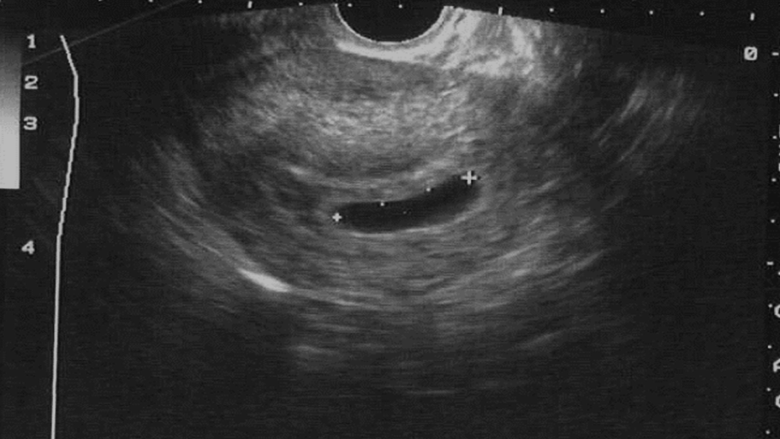
JENNIFER’S ULTRASOUND.
ANEMBRYONIC GESTATION
Mean sac diameter >25 mm with no embryo
Notes:
Complete and careful scanning of the sac both longitudinally and transverse to make sure one is not missing the yolk sac.
Image: Family Medicine Digital Resources Library (https://resourcelibrary.stfm.org/viewdocument/family-medicine-digital-resources-l)

Slide 22
DIAGNOSIS – ULTRASOUND FINDINGS
Table 2. Guidelines for Transvaginal Ultrasonographic Diagnosis of Pregnancy Failure in a Woman with an Intrauterine Pregnancy of Uncertain Viability
Findings Diagnostic of Pregnancy Failure | Findings Suspicious for, but not Diagnostic of, Pregnancy Failure
Crown-rump length of ≥ 7 mm and no heartbeat Mean sac diameter of ≥ 25 mm and no embryo Absence of embryo with heartbeat ≥ 2 wk after a scan that showed a gestational sac without a yolk sac Absence of embryo with heartbeat ≥ 11 days after a scan that showed a gestational sac with a yolk sac | Crown-rump length of < 7 mm and no heartbeat Mean sac diameter of 16-24 mm and no embryo Absence of embryo with heartbeat 7-13 days after a scan that showed a gestational sac without a yolk sac Absence of embryo with heartbeat 7-10 days after a scan that showed a gestational sac with a yolk sac Absence of embryo ≥ 6 wk after last menstrual period Empty amnion (amnion seen adjacent to yolk sac, with no visible embryo) Enlarged yolk sac (> 7 mm) Small gestational sac in relation to the size of the embryo (< 5 mm difference between mean sac diameter and crown-rump length)
Notes:
Our patient Jennifer had a MSD >25 with no embryo. This finding is diagnostic of early pregnancy loss.
These guidelines are very conservative, and are designed to have a 0% false positive rate.
Reference: Doubilet, Peter M., et al. "Diagnostic criteria for nonviable pregnancy early in the first trimester." New England Journal of Medicine 369.15 (2013): 1443-1451.

Slide 23

PATIENT CASE: JENNIFER
What does she need to know?
This is not her fault
She can decide on the management option
Notes:
Remember – half of all pregnancies are unintended, not everyone is sad to lose a pregnancy.
Very important to give info to the partner that pregnancy loss is no one’s fault.
Optional Activity: Have participants break into pairs (one will be Jennifer, one will be the provider) to role-play giving the diagnosis of early pregnancy loss and counseling for all three options. Jennifer will choose expectant management. Can use RHAP resource as a counseling guide: https://www.reproductiveaccess.org/resource/miscarriage-treatment-options/
Miscarriage myths:
Air travel
Blunt abdominal trauma
Contraceptive use
Exercise
HPV vaccine
Previous abortions
Sexual activity
Important in counseling: patient can decide on their management option. Better mental health outcomes when the patient is involved in the decision making.
Cochrane review found all options have pros and cons and that all should be offered.
Reference: Ghosh J, Papadopoulou A, Devall AJ, Jeffery HC, Beeson LE, Do V, Price MJ, Tobias A, Tunçalp Ö, Lavelanet A, Gülmezoglu AM, Coomarasamy A, Gallos ID. Methods for managing miscarriage: a network meta-analysis. Cochrane Database of Systematic Reviews 2021, Issue 6. Art. No.: CD012602. DOI: 10.1002/14651858.CD012602.pub2.
Photo Credit: https://www.flickr.com/photos/wocintechchat/25392468193/

Slide 24
EXPECTANT MANAGEMENT
Notes:
Many patients will need time to absorb the diagnosis and may not want any initial intervention. Important to reassure them that this is a safe option if patient is clinically stable (no hemorrhage or infection).

Slide 25
SUCCESS OF EXPECTANT MANAGEMENT
Group | N | Complete Day 7 | Complete Day 14 | Success Day 46
Incomplete | 221 | 117 (53%) | 185 (84%) | 201 (91%)
Fetal demise | 138 | 41 (30%) | 81 (59%) | 105 (76%)
Anembryonic | 92 | 23 (25%) | 48 (52%) | 61 (66%)
TOTAL | 451 | 181 (40%) | 314 (70%) | 367 (81%)
Notes:
When counseling patients about the likelihood of expectant management being successful, it is important to have a sense of how successful each option is. One can remember them by thinking that, of course, an incomplete will finish on it’s own most easily. Note though, that anembryonic pregnancies have the lowest success rate without intervention (they have the highest failure rate for medical management also). Not sure why this is, but that empty sac just hangs in there…while a demise is more likely to be rejected, and come out with less intervention…
The other important point to note is that these statistics came from a study, where there were established end points, as noted. In real clinical time, we might wait longer than 49 days, or try combinations of medication and expectant management.
Reference:
Prine, Linda W., and Honor MacNaughton. "Office management of early pregnancy loss." American family physician 84.1 (2011).

Slide 26

EXPECTANT MANAGEMENT
RISKS
BENEFITS
Timing not predictable
Less effective
Infection (rare)
Need for emergent uterine aspiration (rare)
Hemorrhage/transfusion (very rare)
Noninvasive
More Private
More “natural”
Inexpensive
No medication side effects
Availability
Butler et al J Fam Pract 2005 54:889-90
Notes:
Reference: Butler C, Kelsberg G, St Anna L, Crawford P. Clinical inquiries. How long is expectant management safe in first-trimester miscarriage? J Fam Pract 2005;54:889-90.

Slide 27
PATIENT INSTRUCTIONS: EXPECTANT MANAGEMENT
Expect cramping and heavy bleeding
Pain control: ibuprofen, heating pad
Call for “heavy bleeding”: soaking through ≥ 2 pads per hour for two hours in a row
Give contact information for reaching clinician
Patient does NOT need to bring products of conception back to the clinician
Notes:
Patients should call clinician for heavy bleeding defined as soaking two pads per hour for two hours back to back. This can usually be managed by phone.
Make sure patient is taking ibuprofen, ask about signs of hypovolemia. Encourage fluid intake & ibuprofen and call back in one hour.
Bleeding will generally abate during this time.
Risks – some studies show more trips to the ER. This may point to the need for better anticipatory guidance and misoprostol to have on hand.

Slide 28
MEDICAL MANAGEMENT: MIFEPRISTONE AND MISOPROSTOL
Jennifer does not want to wait anymore
Notes:
Ask if anyone has done this?
Patients often choose medication management because it feels more natural and yet happens more predictably
Standard dosing of 800mcg of miso administered vaginally required a second dose of miso in 15-40% of patients (schrieber). Now, with the addition of Mifepristone, we have improved success rates if a patient does decide to treat their early pregnancy loss with medication.
Administration of miso vaginally vs buccal does not have difference in success (cochrane 2017 review) but buccally can give more GI side-effects
References:
Kim C, Barnard S, Neilson JP, Hickey M, Vazquez JC, Dou L. Medical treatments for incomplete miscarriage. Cochrane Database Syst Rev 2017;1:CD007223-CD007223
Photo Credit: https://www.flickr.com/photos/wocintechchat/25900759582/

Slide 29
MEDICAL MANAGEMENT
RISKS
BENEFITS
Side effects from medications
Infection (rare)
Need for aspiration (rare)
Hemorrhage or transfusion (rare)
Mifepristone not available widely
Timing of bleeding more predictable than expectant management
Noninvasive
Private
Inexpensive
Flexible timing
Notes:
References:
American College of Obstetricians and Gynecologists. "Early Pregnancy Loss. ACOG Practice Bulletin No. 200." Obstet Gynecol vol. 132, no. 5 (2018): e197-207.
Butler, Charles et al. “Clinical Inquiries. How Long Is Expectant Management Safe in First-Trimester Miscarriage?” The Journal of family practice 54.10 (2005): 889–890.
Emily M. Godfrey, Lawrence Leeman, and Panna Lossy. “Early Pregnancy Loss Needn’t Require a Trip to the Hospital.” Journal of Family Practice 58.11 (2009): 585–590.
Prine LW, Macnaughton, H. “Office Management of Early Pregnancy Loss.” AAFP 84.1 (2011): 75–82.

Slide 30
SUCCESS RATES WITH MISOPROSTOL ALONE VS MIFEPRISTONE AND MISOPROSTOL
Medical management can be done with misoprostol alone or with the combination of mifepristone followed by misoprostol 24 hours later. While data shows higher effectiveness with mife vs. miso-only, miso-only can be used safely, effectively, and is more widely available in many places.
SUCCESS RATE (EXPULSION OF GESTATIONAL SAC) BY DAY 2 | MISOPROSTOL ALONE | MIFEPRISTONE AND MISOPROSTOL
ALL SUBCATEGORIES OF EPL | 67% | 84%
EMBRYONIC DEMISE | 68% | 85%
ANEMBRYONIC | 65% | 80%
Notes:
Schrieber’s study at two days of follow up showed an absolute difference in the rate of treatment success to be 16.7%
Incomplete = persistent sac OR endometrial lining >30mm
Again - we see that the empty sac is tougher to come out.
Reference: Schreiber, CA et al. Mifepristone Pretreatment for the Medical Management of Early Pregnancy Loss N Engl J Med 2018; 378:2161-2170

Slide 31
GUIDELINES FOR MEDICAL MANAGEMENT
1. Candidates
  Those with diagnosis of nonviable intrauterine pregnancy less than 12 weeks by ultrasound
2. Labs
    Rh screen if > 8 weeks (if status is not available)
    Hematocrit
    Quantitative serum hCG (quant not always needed if ultrasound diagnosis is definitive)
    Consider gonorrhea/chlamydia if patient is at risk
3. Consent forms
  Danco or GenBioPro Patient Agreement Form and Medication Guide; consider additional evidence-based, more patient centered consent form
Notes:
After 1st trimester may need hospital management
Danco and GenBioPro forms only needed if using mifepristone due to the Risk Evaluation and Management . Miso-only regimens do not require special
References:
Prine LW, Macnaughton, H. “Office Management of Early Pregnancy Loss.” AAFP 84.1 (2011): 75–82.

Slide 32
GUIDELINES FOR MEDICAL MANAGEMENT
1. Mifepristone 200mg (one tab) orally
    Dispensed in the office or by certified pharmacy
    Patient instructed to take when convenient
2. Misoprostol 800mcg (four tabs) vaginally
    If prescribed with mifepristone, use 24 hours following mifepristone
    If prescribed alone, use when convenient
    Repeat misoprostol dose if no bleeding or only light bleeding
3. Pain management
    Ibuprofen 600-800 mg Q6 hours
Notes:
Alternatives: can take misoprostol buccally or sublingually, but can result in more GI side effects (consider giving an anti-emetic as well)
Repeat misoprostol dose can be given as early as 3 hours after, or up to 1 week after; based on data from medication abortion, repeat dose may increase effectiveness if measuring 9+0 weeks or greater.
Vaginal Miso - patient should be instructed to lie down for 30 min following insertion of miso. It can be dispensed in the office if available or prescribed through a pharmacy. Consider prescribing a second dose of 800 mcg in case heavy bleeding does not occur within 12-24 hours of the first dose.
Ibuprofen: instruct patient to take prior to misoprostol and then every 6 hours as needed. Take ibuprofen (Motrin or Advil), naproxen (Aleve), or acetaminophen (Tylenol) for pain according to the instructions on the package. Take this with food to avoid an upset stomach.
Reference:
American College of Obstetricians and Gynecologists. "Early Pregnancy Loss. ACOG Practice Bulletin No. 200." Obstet Gynecol vol. 132, no. 5 (2018): e197-207.

Slide 33
SIDE EFFECTS OF MISOPROSTOL
Bleeding
Cramping
Low grade fevers and/or chills
Nausea and vomiting
Diarrhea
All side effects should resolve within 24 hours
Notes:
Pre-treat with Ibuprofen
Bleeding - typically lasts up to 2 weeks with spotting until the next period
Cramping - usually starts within the first few hours, NSAIDs are very helpful
Fever and/or chills - common side effect. If lasts more than 24 hours, then evaluate for infection
Nausea and vomiting - more common after oral miso, should resolve in 6 hours
Diarrhea - also more common after oral, will resolve in 24 hours
References:
Prine LW, Macnaughton, H. “Office Management of Early Pregnancy Loss.” AAFP 84.1 (2011): 75–82.
Zhang, Jun et al. “A Comparison of Medical Management with Misoprostol and Surgical Management for Early Pregnancy Failure.” The New England journal of medicine 353.8 (2005): 761–769.

Slide 34
PATIENT INSTRUCTIONS
Lie down for 30 minutes after using misoprostol; okay if medication falls out after 30 minutes
Warning signs same as for expectant management:
    Call for “heavy bleeding,” fever, purulent vaginal discharge, or uncontrolled pain not improved with medication
    Patient does NOT need to bring products of conception back to the clinician
    Contact information for reaching clinician
Notes:
Heavy bleeding defined as soaking two pads per hour for two hours back to back - and still can usually be managed by phone for another hour, the bleeding generally abates
Make sure patient is taking ibuprofen, check for signs of hypovolemia. Encourage fluid intake & ibuprofen and call back in one hour
References:
Prine LW, Macnaughton, H. “Office Management of Early Pregnancy Loss.” AAFP 84.1 (2011): 75–82.

Slide 35





WHAT DO YOU NEED TO START USING MIFEPRISTONE FOR EPL IN YOUR PRACTICE?
A PLAN FOR WHEN MEDICATION DOESN’T WORK
PATIENT HANDOUTS
Office aspiration or referral
DANCO OR GENBIOPRO PATIENT AGREEMENT FORM AND MEDICATION GUIDE
COMPLETE PROVIDER CERTIFICATION PROCESS TO STOCK IN OFFICE
ON-CALL GROUP ALL FAMILIAR WITH MEDICAL MANAGEMENT
CLINICAL GUIDELINES
RESOURCE FOR HANDOUTS: WWW.REPRODUCTIVEACCESS.ORG
Notes:
A plan for when the misoprostol doesn’t work - either in office aspiration or referral - same as when expectant management doesn’t work.
Patient handouts
Danco or GenBioPro Patient Agreement Form and Medication Guide – using an additional evidence-based consent form can be helpful and more patient centered
On-call group all familiar with medication management
Resource for handouts: www.reproductiveaccess.org

Slide 36
DIAGNOSING COMPLETION AFTER MEDICAL MANAGEMNT OF EPL
Quant bHCG drop of more than 50% 48 hours or 80% by 7 days
Vaginal ultrasound with no sac or pregnancy after prior ultrasound documenting intrauterine pregnancy
Notes:
To confirm completion of EPL, clinicians may order a repeat beta HCG level or a repeat ultrasound.
Quant hcg with drop of more than 50% 48-72 hours later
Or vaginal ultrasound with no sac or pregnancy after one had been documented as being intrauterine
Discuss issue of endometrial thickness – leads to too much intervention…
Note: if either of these criteria are met, no further following of quant hcgs is needed

Slide 37

OFFICE PROCEDURE OPTION: UTERINE ASPIRATION
  Manual Vacuum Aspiration (MVA)
          Sharp curettage (D&C) no longer an acceptable option due to higher complication rates
Notes:
Uterine aspiration utilizes a vacuum source for the evacuation of the uterus. It can be performed on an outpatient basis with local anesthesia or analgesics. Vacuum aspiration can be used without electricity with a hand‐held vacuum syringe (Manual Vacuum Aspiration).
Good to have an MVA syringe and cannula here to pass around, and to spend a minute on this slide and the next for people who have no experience or exposure to abortion - since they will be counseling patients and need to have a sense of what their patients may be experiencing.
Office electric vacuum aspiration also an option, but less likely to be used in non-gyn offices
References:
Forna F, Gulmezoglu AM. Surgical procedures to evacuate incomplete abortion. Cochrane Database Syst Rev. 2001(1):CD001993
Tunçalp, Ozge, A. Metin Gülmezoglu, and João Paulo Souza. “Surgical Procedures for Evacuating Incomplete Miscarriage.” Cochrane database of systematic reviews 9 (2010): CD001993.

Slide 38
Compared to hospital management, office MVA offers these advantages:
Can help avoid repeated exams that occur in hospital
Costs can be higher than MAB, lower than hospital-based care
Avoid cumbersome OR protocols (NPO requirements, discharge criteria)
Can be easier to schedule and reduce wait time for patient vs. OR scheduling difficulties
Can allow patient to stay with care team they already know
Convenience, privacy, patient autonomy
Notes:
Main disadvantage is limits to sedation- generally can’t have deep or general anesthesia in the office. Otherwise, the procedure is exactly the same as what would happen in the operating room.
Reference:
Prine LW, Macnaughton, H. “Office Management of Early Pregnancy Loss.” AAFP 84.1 (2011): 75–82.

Slide 39
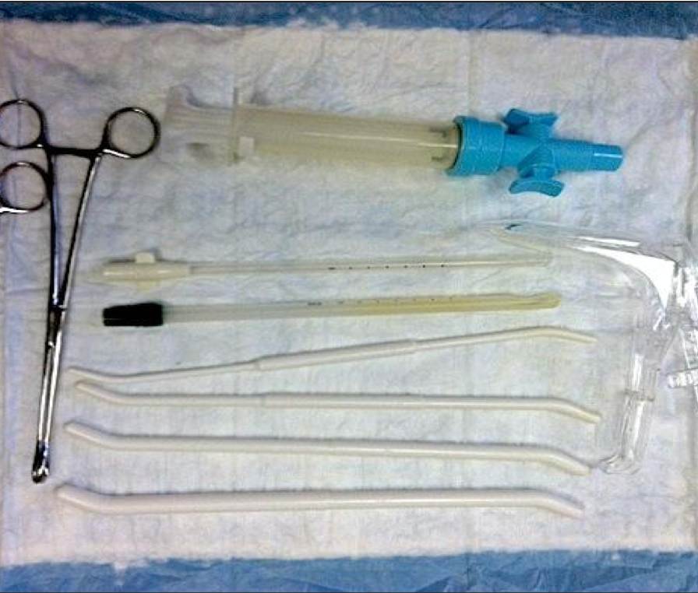
MVA INSTRUMENTS & SUPPLIES
Notes:
Necessary equipment includes:
MVA syringe
Cannulae
Speculum
Tenaculum
Dilators
Procedure takes 5–10 minutes.
Clinicians will:
Dilate cervix, insert cannula to fundus, aspirate
Examine tissue to confirm removal of products of conception
Light bleeding and cramping for 3-7 days.
MVA handouts at www.reproductiveaccess.org

Slide 40
MVA Aftercare
Pt can return to normal activities as soon as they feel ready
Period should return in 4-8 weeks, but varies
Pt may experience:
  Vaginal bleeding as light or heavy as a period for up to 2 weeks after the procedure
  Cramping for 1 week after the procedure
  Mixed emotions – this is normal and whatever the patient feels is okay, but can be offered BH support if desired
Pt should call clinic if:
  Bleeding more than 2 maxi pads per hour
  Severe cramps that do not improve with pain medication
  Dizziness
  Foul-smelling discharge, chills, fever > 101º
  Overwhelming feelings of sadness or grief
Notes:
Note for facilitator: After reviewing this slide, transition to going through the case studies in the Learners/Facilitator’s Guides (handouts). There are 4 case study options you can choose to work through with participants. You can work through them as an entire group or assign breakout groups for a small group of people to work on 1 or several cases, then come back together to talk through them.
Reference:
Prine LW, Macnaughton, H. “Office Management of Early Pregnancy Loss.” AAFP 84.1 (2011): 75–82.
https://www.reproductiveaccess.org/resource/mva-aftercare-instructions/

Slide 41

CASE #1: MELISSA
She/her
Pregnancy of unknown location → complete early pregnancy loss
Notes:
Note to facilitator: the following case studies are the same as those on the case study guides for facilitators and participants.
Image source: unsplash.com

Slide 42

Case #1: Melissa
You are the on-call clinician at night for your practice.
You receive a call at 6 am from Melissa, who reports she is early in pregnancy, and has had 3 days of vaginal spotting.
She is now calling because she is having more bleeding and clots for the last 2 hours.
She is wondering if she needs to go to the emergency room.
What additional information do you need?
Notes:
Pause here to hear responses from the audience. The next slide contains potential answers.

Slide 43
What additional information do you need from Melissa?
LMP, menstrual history (was LMP typical for her or could it have represented 1st tri bleeding?)
OB and pertinent medical history (h/o ectopic, bleeding problems, anemia)
Ask if she had an ultrasound this pregnancy (to confirm an intrauterine pregnancy, IUP)
Assess amount of bleeding; quantify how often changing pad, any symptoms of anemia
Assess for pelvic pain, especially unilateral, lightheadedness/dizziness, referred shoulder pain
Notes:
Note: Use the first trimester bleeding algorithm throughout this case

Slide 44
Melissa tells you she is a 34-year-old woman G4P3003 with no significant medical problems, and her only medication is a prenatal vitamin.
Her pregnancy test was first positive 2 weeks ago, after she missed her period. She tells you her LMP was 8 weeks ago.
She was seen last week in the office and was scheduled for an ultrasound, but has not had it done yet.
For the last 3 days, she describes a small amount of red blood when wiping each day but without cramping.
For the last 2 hours, she has had bleeding heavier than a period, with 2-3 clots the size of golf balls. She has soaked 3 maxi pads in the last 2 hours.
She has no history of bleeding problems or anemia, and has no lightheadedness or dizziness.
She has mild cramps like menses, but no other pelvic pain. She feels overall well, just worried.
What should you tell her?
Notes:
Pause here to hear responses from the audience. The next slide contains potential answers.

Slide 45
What should you tell Melissa?
She has no signs or symptoms of acute blood loss, so there is no need to go to emergency room right now
Drink plenty of fluids to stay hydrated
Come to clinic first thing this morning
Give warning signs (for ectopic or blood loss): fever, worsening or lateralizing pelvic pain, lightheadedness, dizziness, or soaking more than 2 pads per hour

Slide 46
Melissa comes to the office that morning to meet you.
She tells you she had about 2 more hours of heavy bleeding but it then slowed down.
She is now changing her pad every 4 hours and the cramping has improved.
You assess her feelings about the pregnancy and learn that she was trying to get pregnant with her 4th child.
Her urine pregnancy test is positive.
You do an exam which shows:
BP: 108/56, P: 74, R: 16, T= 98.6 Pox: 100%
Speculum: multiparous slightly open cervix, moderate amount of brown and red blood in vaginal vault. No products of conception or large clots are seen.
Bimanual exam: uterus 5-6 weeks size, no uterine or adnexal masses or tenderness
What can we tell Melissa about what’s going on?
Notes:
Note about Urine Pregnancy Test: don’t forget to check this since a negative pregnancy test confirms completed pregnancy loss and may save some worry.
Pause here to hear responses from the audience. The next slide contains potential answers.

Slide 47
What can we tell Melissa about what’s going on?
She is likely experiencing an early pregnancy loss by history
An ectopic pregnancy or an ongoing pregnancy is still a slight possibility. Further testing with an ultrasound and blood work will help us to differentiate between these three diagnoses.
We reassure her that she did not do anything that caused this to happen.
We also ask what support she will have at home, and if she wants her partner or another support person to come in during the evaluation.
What should we do next?
Notes:
Pause here to hear responses from the audience. The next slide contains potential answers.

Slide 48
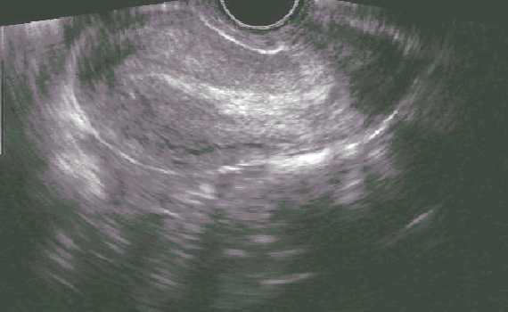
What should we do next?
Ultrasound (ideally a point of care ultrasound, otherwise she can be sent to radiology)
Labs: hemoglobin, quantitative bHCG
Consider CT/GC screening
You do a transvaginal ultrasound
Describe the results.
What is your differential diagnosis? What will you tell Melissa about what is going on?
Notes:
The ultrasound shows a mildly thickened endometrium. No gestational sac is present.
You may inform the learners that no adnexal masses or free fluid are evident.
Pause here to hear responses from the audience. The next slide contains potential answers.
You may want to pull up the First Trimester Bleeding Algorithm and PUL Algorithm on Slides 10 and 11
After discussion about differential diagnosis, ask the audience: Does not seeing any adnexal masses definitively rule out ectopic?

Slide 49
What can we tell Melissa about what’s going on?
Likely she has had a completed early pregnancy loss, but we cannot completely rule out ectopic pregnancy or early viable pregnancy since we do not have a prior ultrasound for comparison.
The lack of tenderness on bimanual exam, lack of unilateral pain, and absence of adnexal mass or free fluid on ultrasound is reassuring, and leans us away from ectopic pregnancy. The presence of these would make us more concerned.
At this point, a definitive diagnosis of early pregnancy loss could be made if the following had been true:
  1) she brought the passed tissue and we identified a gestational sac
  2) products of conception were identified on exam, or
  3) she had a prior ultrasound documenting an IUP
What is your plan? Are there any other labs you might want to get?
Notes:
Note that only about 20-25% of ectopic pregnancies will have a visible mass on ultrasound – a negative ultrasound is not adequate to rule out ectopic.
Pause here to hear responses from the audience. The next slide contains potential answers.

Slide 50
What is your plan?
If anemic, start iron
Follow serial quantitative beta-HCGs (every 48 hours)
Give ectopic warning signs: dizziness, referred shoulder pain, severe unilateral pelvic pain
Melissa’s initial beta-HCG level comes back at 8,150 and 48 hours later it is 1,094. Her hemoglobin is 11.4.
What is your diagnosis now?
Notes:
Pause here to hear responses from the audience. The next slide contains potential answers.

Slide 51
What is your diagnosis now?
Likely she has had a completed pregnancy loss, but we still cannot completely rule out ectopic pregnancy since we never saw an IUP.
The drop in beta-HCG excludes viable pregnancy at this point. Although fall of HCG > 50% in 48 hours suggests completed pregnancy loss, most experts agree that a drop of more than 80%, as seen in this case, is needed for diagnostic certainty.
Because only an endometrium is seen, it is likely that Melissa has had a complete pregnancy loss.
Do we need to follow the quants to zero? How long might they take to get there?
Notes:
“Spontaneous abortion (SAB)”, “miscarriage”, “early pregnancy failure (EPF)”, and “early pregnancy loss (EPL)” are all terms used to describe this diagnosis. The authors prefer “miscarriage” and “early pregnancy loss” which are more patient-centered terms.
Review algorithms (slide 10 and 11) and terminology of EPL (slide 13) if needed
Pause here to hear responses from the audience. The next slide contains potential answers.

Slide 52
Do we need to follow the quants to zero?
The beta-HCG level can drop in an ectopic pregnancy, and the risk of ectopic rupture persists until the beta-HCG is <10.
It would be reasonable to check a beta-HCG once week, then once every other week, until the level is <10. This may take up to 4 weeks.
Melissa asks when she can start trying to get pregnant again.
What should you say?
If Melissa didn’t want to get pregnant again, when could you offer an IUD (if that was her preference)?
Notes:
Many will say “yes”, since a pregnancy was never seen in the uterus and an ectopic pregnancy was never completely ruled out.
Pause here to hear responses from the audience. The next slide contains potential answers.

Slide 53
What should you say?
There is no medical reason to delay trying to get pregnant again; the evidence supports that this is safe and does not increase risk of future pregnancy loss.
Patients may wish to wait until they are emotionally and physically ready, and can be offered any birth control option.
An IUD can be inserted as soon as the pregnancy loss is confirmed to be complete.
She should be counseled that there is a slightly higher risk of expulsion if placed now, so waiting can be her informed decision.

Slide 54
Learning Points for Case 1
Early pregnancy loss is not an emergency, and does not warrant referral to the ER, unless there are signs and symptoms of acute blood loss or the history implies ectopic.
Ultrasound and bhCG can be used together to confirm a diagnosis when a patient presents with suspected early pregnancy loss. There are cases (such as this one), when the location of the pregnancy cannot be confirmed. These patients need to be followed more closely for ectopic and the bhCG levels should be followed to zero.
A fall of beta-HCG levels > 50% in 48 hours suggests a completed pregnancy loss. Most experts agree that a higher drop (>80%) is needed for diagnostic certainty.
Accurate and comprehensive counseling is crucial. This includes discussing etiology, prognosis for future pregnancies, reassurance, and offering emotional support.

Slide 55

CASE #2:
DEE
They/them
Anembryonic pregnancy
Notes:
Image source: https://genderspectrum.vice.com/

Slide 56

Dee is here for their first prenatal appointment with their partner, Max.
They are a 29-year-old G2P1001 with a history of gallstones but is otherwise healthy.
They had an uncomplicated vaginal delivery 3 years ago.
Dee tells you they are sure their LMP was 10 weeks ago, but notes that they had been taking birth control on and off for the last few months.
They are excited about the pregnancy, as Dee and their partner had been thinking about trying.
They had a positive pregnancy test at home and some nausea a few weeks ago which has since resolved.
They have not had bleeding, abdominal pain or cramping.
What should you do next?
56
Notes:
Pause here to hear responses from the audience. The next slide contains potential answers.

Slide 57
What should you do next?
Exam, including bimanual exam
Doppler ultrasound, to detect possible FH, given their gestational age and uncertain LMP due to be on OCPS
You do an exam which shows:
BP 114/62, HR 80, RR 12, SO2 99%
They appear comfortable and their abdomen is soft and nontender. There is no palpable fundus on abdominal exam.
Dopplers: No fetal heart rate is heard
Bimanual exam: uterus 6-week size, nontender. Adnexa are without mass and nontender.
What is your assessment? What is your plan?
57
Notes:
Pause here to hear responses from the audience. The next slide contains potential answers.

Slide 58
What is your assessment? Plan?
Size is less than dates. This could be from:
Early IUP with dates discordant from LMP due to recent oral contraceptive use or reporting error
10-week IUP with retroverted uterus or body habitus - difficult to palpate the uterine fundus and hear fetal heart tones
Ectopic pregnancy
Early pregnancy loss
Not pregnant - false positive pregnancy test at home
Plan
Confirm urine pregnancy test is positive
Do a point of care ultrasound, if available. Otherwise, refer to radiology.
Quantitative beta-HCG
58

Slide 59
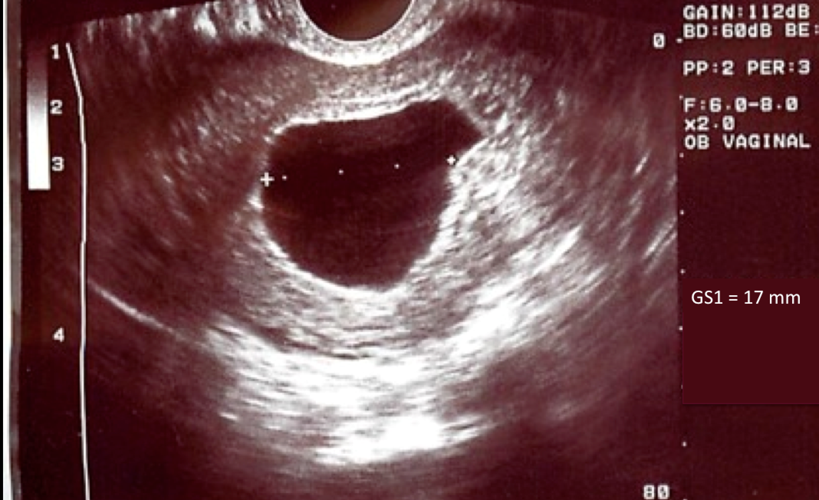
The urine pregnancy test is positive. You do a transvaginal ultrasound.
Describe the ultrasound.
How do you interpret this ultrasound result?
Notes:
Pause here to hear responses from the audience. The next slide contains potential answers.

Slide 60
Describe and interpret ultrasound
The ultrasound shows:
Intrauterine gestational sac
The gestational sac measurement is 17mm. For this case, though not listed, the mean sac diameter (MSD) is also 17 mm.
There is no visible yolk sac or embryonic pole
Suspicious of, but not diagnostic for, early pregnancy loss. There is a small chance that this is an early pregnancy and their menstrual dates were wrong.
What should we do next? How should we counsel Dee and Max?
60
Notes:
Can review ultrasound diagnostic criteria for EPL on Slide 12
Pause here to hear responses from the audience. The next slide contains potential answers.

Slide 61
Next Steps
Counsel Dee and Max about likely but not definitive pregnancy loss
Check Rh type hemoglobin and quantitative beta-HCG level
Come back in 2 days for repeat beta-HCG
Explain that, in the absence of vaginal bleeding, definitive diagnosis of early pregnancy loss will require a repeat ultrasound in 14 days which shows no embryo
May repeat an ultrasound earlier, however, to look for an embryo if waiting 14 days is too long. If no embryo is seen, however, Dee will still need a repeat ultrasound 14 days following the first.
Reassure them that if this is an early pregnancy loss it was not caused by anything they did, and that early pregnancy losses are very common, occurring in about 1 out of every 5 pregnancies.
61
Notes:
May review Slide 12 on ultrasound findings

Slide 62
Next Steps
Dee follows up with you 3 days later.
Their initial beta-HCG level was 12,480 and their repeat at 48 hours was 10,560.
They have had no new symptoms and overall feel well.
What is your diagnosis? What is your plan?
62
Notes:
Pause here to hear responses from the audience. The next slide contains potential answers.

Slide 63
Diagnosis? Plan?
Once the beta-HCG level reaches 5,000 its rate of rise or decline cannot be used to reliably confirm viability or non-viability. At approximately 9-weeks gestation, beta-HCG levels can decline in normal pregnancies. When accompanied by heavy bleeding, however, a decline in beta-HCG levels of >80% suggests completed early pregnancy loss.
Repeat the ultrasound
For definitive diagnosis using ultrasound criteria, you would need to wait 14 days to confirm early pregnancy loss.
The patient may not wish to wait the full 14 days before repeating the ultrasound and it is reasonable to repeat it at 7 days.
Also note that if this were an undesired pregnancy, they could be referred for termination of pregnancy (in some states), even if the viability of the pregnancy is still unknown.
Dee opts to repeat the ultrasound in 14 days to be 100% sure. The ultrasound shows the same large sac and still no fetal pole or yolk sac.
What is your diagnosis? What is your plan?
63
Notes:
In this patient, who has not had bleeding, the beta-HCG levels are non-diagnostic, and early pregnancy loss and viable pregnancy both continue to be possibilities.
When discussing repeating the ultrasound discuss why, and discuss when – based on the table on Slide 12
Pause here to hear responses from the audience. The next slide contains potential answers.

Slide 64
Diagnosis? Plan?
Confirmed early pregnancy failure (based on criteria from slide 12)
Discuss EPL management options – use patient-centered handouts on RHAP website: expectant management, medical management (with mifepristone and misoprostol or misoprostol alone), uterine aspiration
MVA can be done using local anesthesia in the office
If the patient desires sedation, they can be referred for procedure with sedation
Dee decides to pursue expectant management. They want to avoid any extra medications or procedures, if possible. You counsel them on what to expect and provide them with prescriptions for ibuprofen if desired to help with cramping pain if needed. Dee has a reliable way of contacting you or your colleagues in case they have questions or concerns.
How often does expectant management work?
64
Notes:
Pause here to hear responses from the audience. The next slide contains potential answers.

Slide 65
How often does expectant management work?
Various studies have examined expectant management.
The success rate (measured by complete passage of products of conception) within 4 weeks is approximately 60% with anembryonic pregnancies, 75% with asymptomatic fetal demise, and >90% with incomplete early pregnancy loss.
Although most studies measure outcomes at 4 weeks or less, there is no evidence suggesting that a longer waiting period is unsafe in the first trimester.
What anticipatory guidance do you give Dee
regarding when to call?
65
Notes:
Pause here to hear responses from the audience. The next slide contains potential answers.

Slide 66
Anticipatory Guidance
Dee should call if they have a fever or heavy bleeding.
Heavy bleeding is quantified as bleeding that soaks through more than 2 pads per hour for two hours in a row.
If they call to report this level of bleeding, and they are lightheaded or dizzy, they should be seen right away.
If they are otherwise asymptomatic, they can be instructed to stay hydrated, take 800mg ibuprofen, and call back in one hour.
Two weeks later, they ask to come for a follow up appointment to discuss their options. Dee has not had any heavy bleeding, and only a couple days of light spotting. They are tired of waiting and now want “all this to be over.”
What options would you now offer them?
66
Notes:
Pause here to hear responses from the audience. The next slide contains potential answers.

Slide 67

Options
Medical management with mifepristone and misoprostol
Medical management with misoprostol alone (if mifepristone not available)
Uterine aspiration
Dee decides to take the mifepristone and misoprostol.
How do you counsel them to use the medications?
67
Notes:
Pause here to hear responses from the audience. The next slide contains potential answers.

Slide 68
How do you counsel them to use the medications?
Using mifepristone in addition to misoprostol is more effective than misoprostol alone.
Due to FDA regulations, mifepristone must be dispensed by a certified provider or pharmacy, though it does not need to be dispensed in-person, in-office. Patients could receive mifepristone in the mail or at a certified pharmacy.
Misoprostol with or without mifepristone can be safely used to manage early pregnancy losses up to 12 weeks gestational age. Cramping and bleeding may be heavier between 9-12 weeks gestational age.
After 9 weeks gestational age patients may recognize products of conception in the pregnancy tissue that they pass.
68
Notes:
The success rate of completed early pregnancy loss with mifepristone and misoprostol is 84% at 4 days. The success rate using misoprostol alone (1 dose) is 67% at 4 days.
Prior to 9 weeks, patients are unlikely to see a fetus. Some patients may want to be prepared for what they may see.

Slide 69
Dee takes the mifepristone in the office. Twenty-four hours later, at home, they take 600 mg of ibuprofen, and inserts 800 mcg (four 200 mcg tablets) of misoprostol into the vagina. About one hour later they call you because they have a fever to 100.6 and shaking chills and is worried they have an infection.
Why is Dee having these symptoms?
69
Notes:
Pause here to hear responses from the audience. The next slide contains potential answers.

Slide 70
Why is Dee having these symptoms?
Low-grade fever, chills, and GI symptoms (such as nausea and diarrhea) are expected side effects from the misoprostol.
These side effects are not dangerous, and should resolve within 24 hours.
Symptoms more than 24 hours after misoprostol use should raise suspicion for infection, such as endometritis, and warrant uterine evaluation.
Ibuprofen should be taken before the misoprostol is inserted, to help with the pain from cramping.
70

Slide 71
Dee calls you the next day to let you know that they had about 4 hours of heavy bleeding and clots. Their bleeding has now slowed and it is more like a period. Their fever and chills resolved.
Dee returns in one week as planned and you do an ultrasound which no longer shows a gestational sac. You discuss their plans for pregnancy, tell them to continue their prenatal vitamins, and invite them back for prenatal care.
You also remind them that grief after an early pregnancy loss can be normal. Anticipatory guidance about grief can be helpful, and a referral to counseling can be considered.
71

Slide 72
Learning Points for Case 2
There is a broad differential diagnosis of size/date discrepancy in early pregnancy, and ultrasound is often used to help clarify the diagnosis.
Often a diagnosis will not be clear at the time of the first visit. Follow up bHCG levels and/or ultrasound can be used when a diagnosis of early pregnancy loss is suspected but not confirmed.
There are three management options of early pregnancy loss, and more than one option may be utilized for each patient. Options include expectant, medical management, and uterine aspiration.
Patients who choose expectant management should be given pain medications with anticipatory guidance and clinic contact information. Medication may include ibuprofen for pain, as well as misoprostol +/- mifepristone, as many people get “tired of waiting.”
The success rate for each management options depends on both the type of early pregnancy loss as well as the treatment selected.
Addendum: cases where infection or very heavy bleeding are involved should be managed in the hospital, but these are both extremely rare.
72

Slide 73

CASE #2:
MONA
She/her
Missed early pregnancy demise
Notes:
Image source: unsplash.com

Slide 74

You are in the middle of your morning in clinic, when the hospital ultrasonographer calls your office.
She is seeing your patient for a nuchal translucency measurement.
Your patient, Mona, is a 19-year-old G1who you are seeing for routine prenatal care following the diagnosis of her pregnancy, which she has decided to continue.
Today she should be at 11 weeks and 4 days gestation based on a 6-week ultrasound, which was consistent with LMP.
She had been sent to get a routine screening ultrasound, and there were no concerns.
The ultrasonographer notes that there is an intrauterine pregnancy, however the crown-rump length (CRL) is 7.2 mm and has no detectable heartbeat.
The patient reported no bleeding or cramping, but did notice that her breasts were less tender and her nausea had improved.
The ultrasonographer wants to know if she should send the patient to the ER.
74

Slide 75
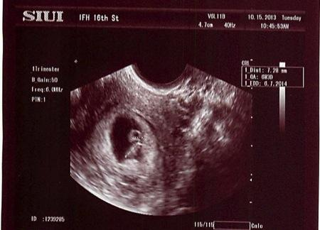
The ultrasound is shown.
What is your assessment?
What is your plan?
Notes:
Pause here to hear responses from the audience. The next slide contains potential answers.

Slide 76
What is your assessment? Plan?
Based on the ultrasound findings, we can confirm that she has had an early pregnancy loss
The CRL is > 7 mm without fetal heart activity, meeting definitive criteria for early pregnancy loss.
This case is a missed early pregnancy loss.
Note that she is 49 days gestation by CRL, not the expected 11 weeks. Demise likely occurred 4 weeks ago.
Have the patient come to clinic to see you today.
She does not need to go to the ER, since she has no signs or symptoms of infection or excessive bleeding.
You have the radiology suite send the patient to your clinic and you add her onto your schedule. You walk in the room to find Mona and her partner. They appear concerned and want to know what is going on.
What can you tell them about early pregnancy loss in general? How would you counsel them on next steps?
76
Notes:
Review Slide 12 for ultrasound diagnosis
Can review slide 13 for terminology
Pause here to hear responses from the audience. The next slide contains potential answers.

Slide 77
What can you tell them about EPL?
Early pregnancy loss is very common, about every one in five pregnancies end in early pregnancy loss.
There is nothing that they did wrong to cause this.
Early pregnancy loss is usually caused by a chromosomal abnormality, though definitive diagnosis and etiology is rarely known.
Most people who experience early pregnancy loss have normal subsequent pregnancies.
Bedrest or pelvic rest does not prevent early pregnancy loss.
Next Steps
Review the three management options for EPL
Use the RHAP handout: “Early Pregnancy Loss Treatment Options” if the decision-making process seems to warrant additional guidance.
77
Notes:
Review Slide 12 for ultrasound diagnosis
Can review slide 13 for terminology
Pause here to hear responses from the audience. The next slide contains potential answers.
https://www.reproductiveaccess.org/resource/miscarriage-treatment-options/

Slide 78
Mona would like to get a manual vacuum aspiration (MVA) in your clinic.
She does not like the idea of having a nonviable pregnancy inside of her, and does not like the idea of bleeding at home.
You discuss contraception with her, and she decides she would like an IUD inserted today at the end of the MVA procedure.
You obtain consents for both of these procedures.
What are some things Mona should know about the
office-based MVA?
78
Notes:
Pause here to hear responses from the audience. The next slide contains potential answers.

Slide 79
Office-based MVA
MVA can be done using local anesthesia (a paracervical block) in an office setting up until 10 weeks gestational age. When treating an early pregnancy loss, the gestational dating is based on the ultrasound, not the dates by LMP. In this case, for example, we consider her to have a 7-week rather than 11-week gestation.
Contraindications to office-based MVA: active PID, hemodynamic instability, bleeding disorders. Patients with these can be referred to other centers for safe aspiration procedures. Relative contraindications or patients who require a higher level of expertise (ie. Bicornuate uterus) can also be referred.
Pain, bleeding, perforation, and infection – all extremely low risk
Compared to in-hospital D&C, office-based MVA has reduced waiting time, lower cost, low anesthesia requirement, and accessibility to services.
Higher success rate, more definitive outcome for patients, less bleeding and cramping at home compared to medical or expectant management of EPL
79

Slide 80

You perform an MVA with local anesthesia and insert the IUD. Mona tolerates the procedure very well, with her partner offering support. On gross tissue exam, you see a typical 7-week gestational sac, which does not need to be sent to pathology because this is her first early pregnancy loss.
The sac and villi size will vary based on gestational age, starting at a size less than a dime (~5 weeks) and increasing with gestational age. The sac and villi above are approximately the size of a quarter when suspended in water.
80
Notes:
To the bottom right of the photo is a typical 7-week gestational sac with villi, as seen using the "float" technique – placing the MVA contents into a clear container with a small amount of water, and using a backlight. One is able to differentiate the sac and villi from the surrounding decidua (on the left side of the photo) based on the increased vascularity and thickness of the decidual membrane. The villi and sac are less vascular and thinner. In an early pregnancy loss, the villi will be more blunted and may appear more vascular and/or hydropic due to tissue degeneration.
It is useful in the management of early pregnancy loss to learn to identify products of conception even in clinics that do not perform MVA. Finding POC on tissue brought by the patient, or found on exam, is a useful diagnostic tool.

Slide 81
Learning Points for Case 3
Manual vacuum aspiration (MVA) is a safe office-based option for management or early pregnancy loss.
MVA can usually be done in the office up to 10 weeks by gestational age (by ultrasound), even if the gestational age by LMP is higher.
There are few contraindications to MVA for early pregnancy loss management, but include: active PID, hemodynamic instability, and bleeding disorders. These patients can be referred to other centers for safe aspiration procedures, including medical centers or Planned Parenthood.
Review the common nature of early pregnancy loss, and the importance of reassuring patients that they did nothing to cause this.
81

Slide 82

CASE #2:
SONIA
She/her
Abortion aftercare or self-managed abortion
Notes:
Image source: unsplash.com

Slide 83
You’ve been providing comprehensive EPL care in your primary care office for a few years. Your state passes a severely restrictive law that bans abortions after 9 weeks gestation. This does not affect your provision of EPL care, but you know it affects your patients because you often provide pregnancy options counseling and referrals to abortion care.
You get a call from one of your patients, Sonia, who is a 32-year-old female, G4P3. She realized she was pregnant when she was already at 10 weeks’ gestation and knew she wouldn’t be able to get an abortion in state. As a result, the nearest abortion clinic would have been over 100 miles away and she would have had to wait an extra day between counseling and the abortion due to the state’s 24-hour mandatory waiting period. Sonia didn’t have the ability to take off work so long, so she obtained misoprostol pills and decided to self-manage her abortion on her own terms.
She explains that she took the misoprostol pills vaginally according to instructions on RHAP’s “How to use abortion pills with misoprostol” factsheet.
What else do you want to know?
83

Slide 84
What else do you want to know?
LMP?
How much has she been bleeding, how many pads per day or per hour?
Is she feeling light-headed or dizzy?
Any fever?
Did she see any tissue pass?
Did she get an ultrasound at some point to establish that her pregnancy was intrauterine?
Sonia tells you that her last period was about 11 weeks before she took the pills. After she took the medicines (4 pills every 3 hours x 3 times), she had heavy bleeding with clots for 4 hours and saw some gray/yellow tissue in the toilet. The bleeding after that was about four pads a day for a few days. For the past 3 weeks, she has had intermittent light bleeding. She’s worried.
What advice would you give Sonia?
84
Notes:
Pause here to hear responses from the audience. The next slide contains potential answers.

Slide 85
What advice would you give Sonia?
This could be a normal post-abortion course.
If Sonia is worried, she could see you in your office.
She’s really worried, so you offer to see her in the office. Before Sonia agrees, she asks whether something bad can happen because she self-sourced her abortion.
How do you respond?
85
Notes:
You can refer to RHAP’s how to use abortion pill factsheets
https://www.reproductiveaccess.org/resource/mabfactsheet/
https://www.reproductiveaccess.org/resource/mabfactsheet-miso/
Pause here to hear responses from the audience. The next slide contains potential answers.

Slide 86
How do you respond?
Because abortion care and EPL care look so similar, you can and should take care of Sonia like any patient who had a pregnancy loss: checking up on symptoms and assessing for completeness.
You do not and will not share any information about Sonia to the authorities because there is no reason to and no mandatory reporting around self-managed abortion. As clinicians, our responsibility is to take care of our patients’ health and well-being.
She comes to the office. What do you do?
86
Notes:
Pause here to hear responses from the audience. The next slide contains potential answers.

Slide 87
What do you do in-office?
Vitals, fingerstick, hemoglobin, urine bhCG
Her blood pressure is 110/60, her heart rate is 90, she does not appear pale, clammy, or cold.
Her urine pregnancy test is negative.
Her fingerstick Hgb is 9.0.
She reports that the bleeding has slowed down again.
Physical exam reveals no blood in the vagina, and a
normal-sized, nontender uterus.
What do you think now and what are your
next steps?
87
Notes:
Pause here to hear responses from the audience. The next slide contains potential answers.

Slide 88
What do you think now and what are your next steps?
Today’s exam confirms that she is no longer pregnant.
She is mildly anemic, but hemodynamically stable.
This is a typical medication abortion course, with several weeks of stop-and-start bleeding.
She needs oral iron supplementation
Ask if she’s interested in talking about any contraception options.
What if she hadn’t been willing or able to come to the office? Would you have been able to handle this by phone?
88
Notes:
Pause here to hear responses from the audience. The next slide contains potential answers.

Slide 89
Would you have been able to handle this by phone?
You can assess the severity of bleeding and symptoms of anemia/hemodynamic instability (dizziness, fatigue, shortness of breath, etc.) by phone.
If the patient is asymptomatic, you can advise them to take a home pregnancy test. A negative result makes an office visit unnecessary.
This history is not unusual for a medication abortion, some people do bleed up until their next period.
It is also important to know that the first period after a medication abortion is often quite heavy and patients may call when this happens if they have not been prepared for it.
What barriers to abortion care do people living in ban and restrictive states face? What might more underserved, marginalized communities – like immigrants, people of color, people living in rural areas, and folks working to make ends meet – face in particular?
89
Notes:
Pause here to hear responses from the audience. The next slide contains potential answers.

Slide 90
Barriers to accessing abortion care
Cost of taking extended time off work, finding childcare, finding transportation/lodging, long distances to travel
High cost of abortion care, especially as delays may push first trimester abortion to second trimester & lack of Medicaid coverage
Historically marginalized communities may have less access to social supports and resources to navigate the restrictions and rules and find abortion care in a timely way
Stigma, fear, confusion in terms of whether abortion care is legal, and the rules to navigate
Studies exploring why people self-manage / self-source their abortions find that people choose SMA because of the inaccessibility of in-clinic based care in states with highly restrictive abortion laws AND because of preference. Some people prefer to self-manage their abortion because of the privacy and autonomy this option offers, which may also highlight the experiences of racism and stigma people experience in the medical setting.
90
Notes:
Historically marginalized communities are most impacted by state surveillance of pregnant people. Medicaid beneficiaries are more likely to come to the attention of law enforcement for pregnancy-related issues and people of color are more likely to face arrest for their pregnancy outcomes.

Slide 91
KEY
LEARNING POINTS.
There are three office options to be offered for miscarriage management:
                - Expectant
                - Medical (mifepristone and misoprostol, and misoprostol alone)
                - Procedure: MVA
Mental health outcomes for patients are best when they are involved in the decision-making around their care

Slide 92

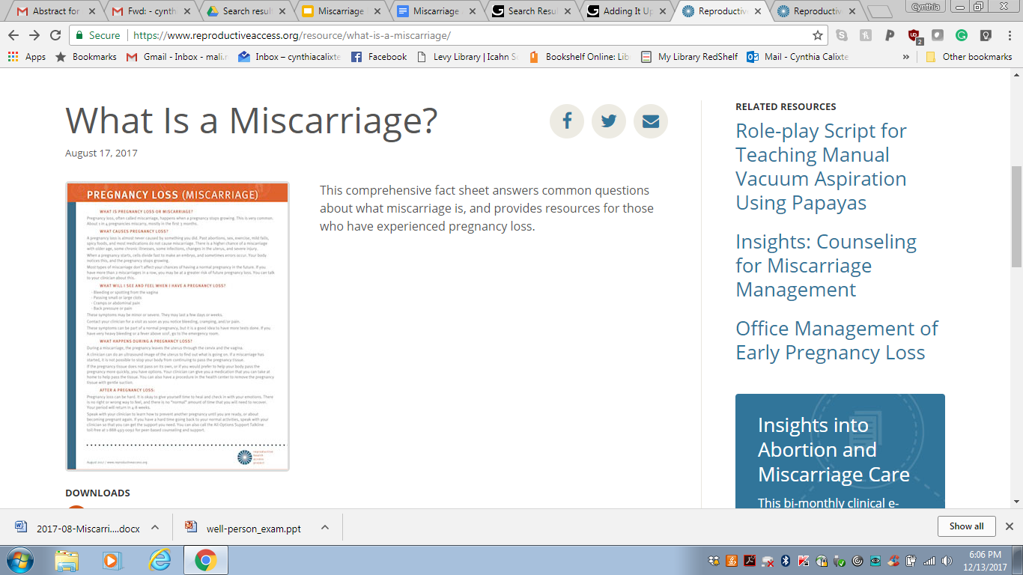
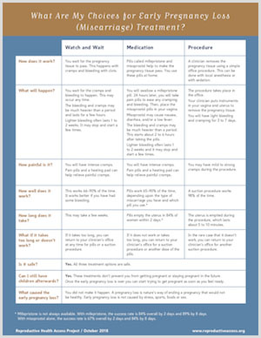
RESOURCES.
Notes:
RHAP factsheets:
https://www.reproductiveaccess.org/resource/what-is-a-miscarriage/ This comprehensive fact sheet answers common questions about what early pregnancy loss (miscarriage) is, and provides resources for those who have experienced pregnancy loss.
https://www.reproductiveaccess.org/resource/miscarriage-treatment-options/ This fact sheet explains three early pregnancy loss, or miscarriage, treatment options and the frequently asked questions patients may have such as “what causes an early pregnancy loss?” and “can I still have children afterward?”.
https://www.reproductiveaccess.org/resource/mva-aftercare-instructions/ Manual Vacuum Aspiration (MVA) Procedure Aftercare (Take home instructions)
https://www.reproductiveaccess.org/resource/early-pregnancy-loss-miscarriage-treatment-medication-management-with-misoprostol-only/ This patient fact sheet explains medication treatment (using misoprostol-only) and aftercare instructions for early pregnancy loss (miscarriage) and answers frequently asked patient questions.
https://www.reproductiveaccess.org/resource/miscarriage-treatment-medication/ This patient fact sheet explains medication treatment (using mifepristone and misoprostol) and aftercare instructions for early pregnancy loss (miscarriage) and answers frequently asked patient questions.
https://www.reproductiveaccess.org/2021/10/destigmatizing-early-pregnancy-loss-anitas-miscarriage-zine/ Anita’s Miscarriage: A Story of Early Pregnancy Loss is a zine that follows one couple’s experience with an early pregnancy loss. This evidence-based resource explains the treatment options a person can access when experiencing an early pregnancy loss. We have included a file to view online as well as a file you can print out and assemble into a booklet. The art in this zine is by illustrator Karina Shor.
https://www.reproductiveaccess.org/resource/protocol-medication-management-epl-miso-only/ Protocols for Medication Management of Early Pregnancy Loss – Miso Only
https://www.reproductiveaccess.org/resource/protocol-medication-management-epl-mife-miso/ Clinical protocol for medication management of miscarriage using mifepristone and misoprostol.

Slide 93
REFERENCES.
Allison JL, Sherwood RS, Schust DJ. “Management of first trimester pregnancy loss can be safely moved into the office.” Rev Obstet Gynecol; 2011;4(1):5-14
American College of Obstetricians and Gynecologists. "Early Pregnancy Loss. ACOG Practice Bulletin No. 200." Obstet Gynecol vol. 132, no. 5 (2018): e197-207.
Butler, Charles et al. “Clinical Inquiries. How Long Is Expectant Management Safe in First-Trimester Miscarriage?” The Journal of family practice 54.10 (2005): 889–890.
Chen B, Creinin M, “Contemporary Management of Early Pregnancy Failure.” Clin Obstet and Gynecol Volume 50, Number 1, (2007) 67–88.
Creinin, Mitchell D. et al. “Factors Related to Successful Misoprostol Treatment for Early Pregnancy Failure.” Obstetrics and gynecology 107.4 (2006): 901–907.
Doubilet, Peter M. et al. “Diagnostic Criteria for Nonviable Pregnancy Early in the First Trimester.” Ultrasound quarterly 30.1 (2014): 3–9.
Emily M. Godfrey, Lawrence Leeman, and Panna Lossy. “Early Pregnancy Loss Needn’t Require a Trip to the Hospital.” Journal of Family Practice 58.11 (2009): 585–590.
Ghosh J, Papadopoulou A, Devall AJ, Jeffery HC, Beeson LE, Do V, Price MJ, Tobias A, Tunçalp Ö, Lavelanet A, Gülmezoglu AM, Coomarasamy A, Gallos ID. Methods for managing miscarriage: a network meta-analysis. Cochrane Database of Systematic Reviews 2021, Issue 6. Art. No.: CD012602. DOI: 10.1002/14651858.CD012602.pub2.
Luise, Ciro et al. “Outcome of Expectant Management of Spontaneous First Trimester Miscarriage: Observational Study.” BMJ 324.7342 (2002): 873–875.
Milingos, D. S. et al. “Manual Vacuum Aspiration: A Safe Alternative for the Surgical Management of Early Pregnancy Loss.” BJOG: an international journal of obstetrics and gynaecology 116.9 (2009): 1268–1271.
Prine LW, Macnaughton, H. “Office Management of Early Pregnancy Loss.” AAFP 84.1 (2011): 75–82.
Tunçalp, Ozge, A. Metin Gülmezoglu, and João Paulo Souza. “Surgical Procedures for Evacuating Incomplete Miscarriage.” Cochrane database of systematic reviews 9 (2010): CD001993.
Wallace, Robin, Angela DiLaura, and Christine Dehlendorf. “‘Every Person’s Just Different’: Women’s Experiences with Counseling for Early Pregnancy Loss Management.” Women’s health issues: official publication of the Jacobs Institute of Women's Health 27.4 (2017): 456–462.
Wallace, Robin R. et al. “Counseling Women with Early Pregnancy Failure: Utilizing Evidence, Preserving Preference.” Patient education and counseling 81.3 (2010): 454–461.
Zhang, Jun et al. “A Comparison of Medical Management with Misoprostol and Surgical Management for Early Pregnancy Failure.” The New England journal of medicine 353.8 (2005): 761–769.
Notes:
Updated: October 2021

Slide 94

CE
POST-TEST.
Please complete this post-test on your phone or computer in order to receive CE credit for participation in this workshop. You can access the pre-test at:
https://www.surveymonkey.com/r/EPLPost
Notes:
Please complete this post-test on your phone in order to get CE credit for your participation in this workshop. You can access the post-test at…..
https://www.surveymonkey.com/r/EPLPost

Slide 95
THANK YOU.

