Slide 1



GENDER-AFFIRMING REPRODUCTIVE HEALTH WITHIN PRIMARY CARE
Presenter Name(s)
Notes:
Updated 01/2025
All presenters say their names and pronouns and affiliations.
Take a moment to acknowledge the political climate and how federal efforts to criminalize and stigmatize trans people is deeply harming the health, well-being, and bodily autonomy of these communities. Regardless, our job as clinicians is to provide comprehensive healthcare that all communities - especially those most vulnerable - need and deserve, with dignity and respect.

Slide 2

DISCLOSURES
Participants must attend 100% of this workshop.
Participants must complete the evaluation survey at the beginning and end of the workshop
No relevant financial relationships to disclose with ineligible companies.
Notes:
This slide is required for CE
Please UPDATE if any presenters DO disclose a relevant financial relationship. Examples of how to word disclosures can be found in Identification, Mitigation, and Disclosure Toolkit (CME/CNE Materials folder)

Slide 3


CE PRE-TEST.
Please complete this pre-test on your phone or computer in order to receive CE credit for participation in this workshop. You can access the pre-test at:
https://www.surveymonkey.com/r/GARHCPreTest
Notes:
Before we begin, if you haven’t already please complete this pre-test on your phone in order to get CME for your participation in this workshop. You can access the pre-test at…
https://www.surveymonkey.com/r/GARHCPreTest

Slide 4
LEARNING OBJECTIVES
  Explain how to take an appropriate, patient-centered sexual history.
  Describe core components of counseling and care provision relating to contraception, abortion, and fertility care, specific to the care of transgender, non-binary, and gender-diverse patients.

Slide 5
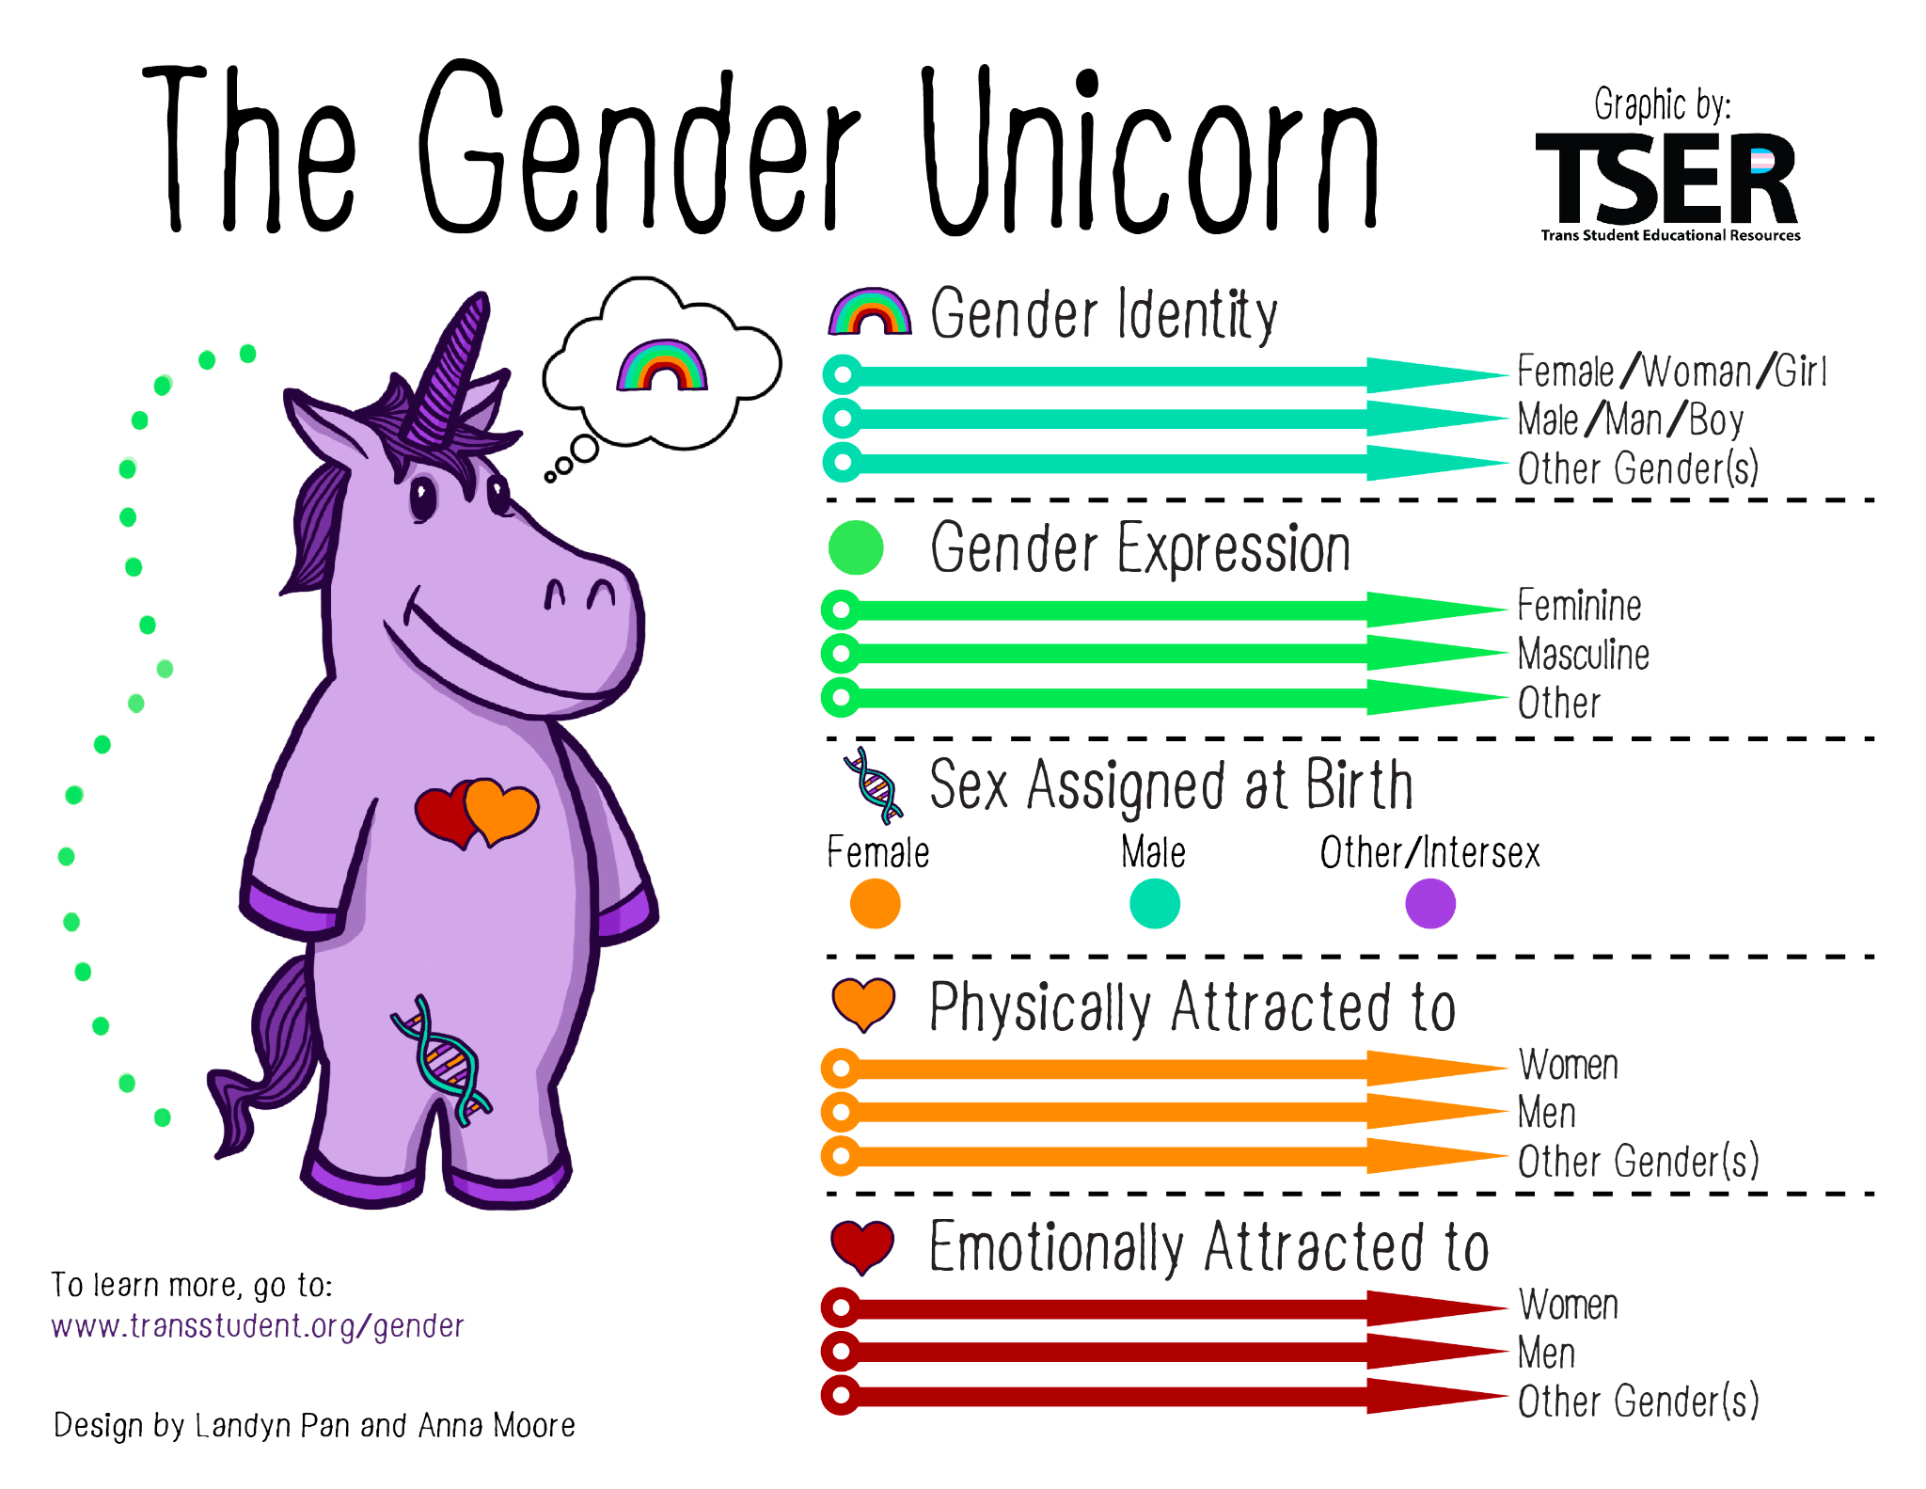
Understanding Identity
5
Notes:
Optional: Play 5 minute video (click link on “understanding identity): https://www.innovating-education.org/2020/12/understanding-identity-the-gender-opossum/
Review and Discuss Differences Between Gender and Sex
We can’t help how we are socialized around gender. But we can unlearn harmful beliefs and seek further education. Gender and sex are different, but have many things in common.
Gender
Gender is an internal part of personal identity, a socially constructed role.
In our society, gender is constructed and largely seen as binary, even though the reality of gender diversity has always been observed by humans. It may be expressed through language, clothing, makeup, etc -- the assigned meanings of which are subjective
And, it’s often viewed as a strict checkbox that is conflated with sex.
Gender Identity: One’s internal sense of being male, female, neither of these, both, or another gender(s). Everyone has a gender identity, including you. For transgender people, their sex assigned at birth and their own internal sense of gender identity are not the same. Female, woman, and girl and male, man, and boy are also not necessarily linked to each other but are just six common gender identities.
Gender Expression/Presentation: The physical manifestation of one’s gender identity through clothing, hairstyle, voice, body shape, etc. Many transgender people seek to make their gender expression (how they look) match their gender identity (who they are), rather than their sex assigned at birth.
Sex Assigned at Birth: The assignment and classification of people as male, female, intersex, or another sex based on a combination of anatomy, hormones, chromosomes. It is important we don’t simply use “sex” because of the vagueness of the definition of sex and its place in transphobia. Chromosomes are frequently used to determine sex from prenatal karyotyping (although not as often as genitalia). Chromosomes do not always determine genitalia, sex, or gender.
Physically Attracted To: Sexual orientation. It is important to note that sexual and romantic/emotional attraction can be from a variety of factors including but not limited to gender identity, gender expression/presentation, and sex assigned at birth.
Emotionally Attracted To: Romantic/emotional orientation. It is important to note that sexual and romantic/emotional attraction can be from a variety of factors including but not limited to gender identity, gender expression/presentation, and sex assigned at birth. There are other types of attraction related to gender such as aesthetical or platonic. These are simply two common forms of attraction.
Sex
Sex is used to describe some physical characteristics (ex: hormones, chromosomes, genitalia). It’s socially constructed
In our society, sex is constructed and largely seen as binary, though reality of sex diversity has always been observed in humans.
The categories used in our society are “male” and “female,” which are very gendered. People whose gonads, hormones, and/or chromosomes do not fit society’s traditional sex binary are often considered “intersex.” Those whose bodies do conform are considered “endosex”.
Sex is often viewed as a strict checkbox that is conflated with gender
Socially constructed doesn’t mean it’s imaginary. Language and money are socially constructed, but it’s not unreal.
There is no sexual or gender binary in nature.
Everyone has a gender AND a sexuality.
Avoid assumptions about a patient’s sexuality based on their sex at birth, gender identity, or gender presentation.
Optional Reflection Questions
In what ways have you adhered to gender roles and expectations at different points in your life? How have you benefited from adhering to these gender roles/expectations?
In what ways have you deviated from gender roles and expectations at different points in your life? Did you ever experience consequences for existing outside of the gender binary?
Sources:
Trans Student Educational Resources, 2015. “The Gender Unicorn.” http://www.transstudent.org/gender.
Innovating Education, Understanding Identity: The Gender Opossum
Sexual Health History: Talking Sex with Gender Non-Conforming & Trans Patients. Timothy Cavanaugh. Fenway Health: https://fenwayhealth.org/wp-content/uploads/Taking-a-Sexual-Health-History-Cavanaugh-1.pdf
NAF 2021 Presentation on Gender Affirming Care and Innovating Education Presentation: Cassandra Carver, Aspen Ruhlin, Julian Glover, Shanthi Ramesh

Slide 6

L, G, B, T, Q, I, A+
L – Lesbian
G – Gay
B – Bisexual
T – Transgender
Q – Queer/Questioning
I – Intersex
A – Asexual
INTERSEX
ASEXUAL
GAY
QUESTIONING
LGBTQIA+
QUEER
LESBIAN
TRANSGENDER
BISEXUAL
Notes:
Transgender is an umbrella term that encompasses a diversity of gender identities and/or expressions that vary from the social expectations associated with one’s sex at birth. Not everyone identifies this way or with these words. Some folks use “queer”. Take your patients’ cues.

Slide 7
Discrimination and Stigma in Health Care: 2015 US Transgender Survey – 28,000 Respondents
25% health insurance coverage denial related to being trans
55% surgery coverage denial
33% negative experience with a healthcare provider due being trans
  Ex: verbal harassment, refusal of treatment, had to teach provider to receive appropriate care
23% did not see a doctor when needed to due to fear of being mistreated
  Ex: Transgender man did not get needed cervical cancer screening
Notes:
2022 US Trans Survey early insights
92k pts
26% reported issues with insurance incl denials for both gender-affirming and routine care
No number reported specifically for rates of denial of surgical care
28% reported they had not been seen by a doctor within the last year due to cost
48% reported a negative experience while with a healthcare provider due to being trans
24% reported not being seen by a doctor due to fear of being mistreated
Why is it important that we provide high-quality, compassionate care especially for trans people?
An estimated 390 out of 100,000 adults in the US identify as transgender and/or gender nonbinary = more than 1 million individuals in the US alone.
The 2015 US Transgender Survey demonstrates a range of health care discrimination and stigma uniquely and disproportionately experienced by trans people. Mixed-race, Indigenous, trans people of color and trans people with disabilities, among others, are more likely to experience these negative health outcomes than white, able-bodied people.
“Transgender individuals face substantial barriers to accessing health care, including health care professionals’ bias and lack of general knowledge about best practices, as well as the failure of many health insurance plans to cover the cost of hormone therapy and supplies, mental health services, or gender affirmation surgery and restrictions on care imposed by prohibitive health care systems.”
To reduce the inequities, barriers, and disparities experienced by the transgender community, the provision of inclusive health care and creating a safe, affirming health care environment, is essential. It is critical that all types of clinicians understand this community’s needs and how to best care for them.
References:
James, S. E., Herman, J. L., Rankin, S., Keisling, M., Mottet, L., & Anafi, M. (2016). The Report of the 2015 U.S. Transgender Survey. Washington, DC: National Center for Transgender Equality. https://transequality.org/sites/default/files/docs/usts/USTS-Full-Report-Dec17.pdf
Meerwijk EL, Sevelius JM. Transgender population size inthe United States: a meta-regression of population-basedprobability samples.Am J Public Health. 2017;107(2):e1–e8.doi:10.2105/AJPH.2016.303578
https://fenwayhealth.org/wp-content/uploads/Taking-a-Sexual-Health-History-Cavanaugh-1.pdf
https://www.acog.org/clinical/clinical-guidance/committee-opinion/articles/2021/03/health-care-for-transgender-and-gender-diverse-individuals

Slide 8
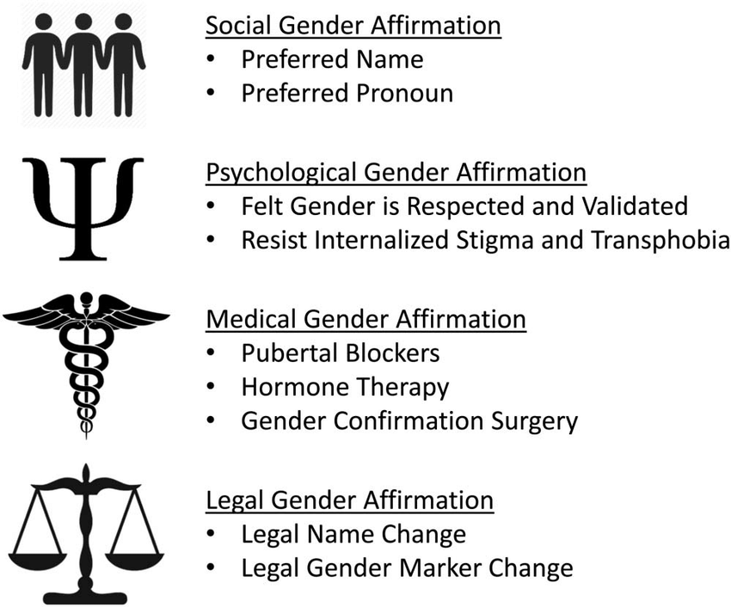

Gender Affirmation
Gender Affirming Surgery
Notes:
The use of problematic or inaccurate language (like mis-gendering) by health care teams is a well-documented and major barrier for trans and non-binary people seeking care. This can cause fundamental harm to their health and wellbeing and discourage them from seeking healthcare services.
Different ways to affirm gender- all of these things should be happening.
Preferred and felt is crossed out here - why do you think so?
Preferred and felt has a stigma and sense of othering to it
Let’s simply ask for what names and pronouns people USE (not what they prefer to use)
Add name change doc: https://www.masstpc.org/wp-content/uploads/Name-and-Gender-Marker-Change-Checklist-updated.pdf
Deadnaming: using a person’s given name can be very traumatizing to people.
References:
Roosevelt L, Pietzmeier S, Reed R. Clinically and Culturally Competent Care for Transgender and Nonbinary People. The Journal of Perinatal & Neonatal Nursing. 2021; 35 (2): 142-149. doi: 10.1097/JPN.0000000000000560.

Slide 9
Gender Affirming Language:
Instead of Saying This… | Say This..
Transgendered, a transgender, transsexual “Real” sex, “real” gender” It (when unsure of pronouns) Mom Breast, breastfeeding Period Panties Bra Vagina | Transgender, trans, transgender person Sex assigned at birth They (until you can clarify pronouns) Parent Chest, chestfeeding, bodyfeeding Bleeding Underwear, briefs Binder, underwear Ask patients their preferred terms. “Birth canal” or “genital opening” => “outside/inside”
Roosevelt L, Pietzmeier S, Reed R. Clinically and Culturally Competent Care for Transgender and Nonbinary People. The Journal of Perinatal & Neonatal Nursing. 2021; 35 (2): 142-149. doi: 10.1097/JPN.0000000000000560.
Notes:
Here are examples of more respectful and affirming language you can use instead of terms that may be offensive.
What are other words and phrases you could change to be more respectful and affirming?
Optional 3 minute video of do’s and don’ts: https://www.innovating-education.org/2020/12/dos-and-donts/
Optional 4 minute video of language and impact: https://www.innovating-education.org/2020/12/language-and-impact/
Reflection Questions to Consider Asking:
How do you feel about being asked to use or corrected to use they/them pronouns for an individual? What about ze/zir pronouns? Do those two pronoun sets feel different to you?
Can you think of a time when your implicit bias affected your interaction with a patient?
Have you witnessed the impact of implicit bias during a patient encounter? How did it make you feel to witness that?
Reflection Questions to Consider Asking:
When someone calls you out for saying or doing something hurtful or harmful, do you feel compelled to quickly defend yourself and your intentions? Why is that?
Do you feel attached to using the word “women” to describe people who are or who can become pregnant? What are some benefits transgender people might experience from the widespread use of inclusive language? How are all women harmed by equating womanhood to pregnancy?
How do you feel about “women only” spaces? Do you believe they should be for all women? How do all women benefit from a less restrictive definition of womanhood?
Image Source:
Roosevelt L, Pietzmeier S, Reed R. Clinically and Culturally Competent Care for Transgender and Nonbinary People. The Journal of Perinatal & Neonatal Nursing. 2021; 35 (2): 142-149. doi: 10.1097/JPN.0000000000000560.

Slide 10

How we create a more safe, inclusive environment?
Appropriate training for ALL staff
Update intake forms and medical records to include pronouns, chosen name, gender
Use inclusive language
Using appropriate signage, including for bathrooms
Posters/art with inclusive representation of people
Image Source: The Gender Spectrum Collection. https://genderphotos.vice.com/
Notes:
**fenway for training staff
Some ways we can create a more safe, inclusive environment include:
Increase health care professional knowledge of and comfort with providing care for transgender and gender nonconforming individuals. This includes avoiding making assumptions about patients’ sexual orientation, sexual practices, and surgeries and being cognizant of what questions are appropriate (eg, is the question relevant to the care being provided?).
Having appropriate training for ALL people patient could come in contact with, training that includes trans-competency. This means call centers, front desk staff, billing staff, health education, and advocacy teams. Training should empower staff on appropriate ways to ask about names and pronouns.
Update intake forms and medical records to include pronouns, chosen name, gender. Create a system where this information is used for that patient every time they come in. Ask all patients what pronouns they use.
Use inclusive language: For example, instead of saying “We provide compassionate abortion care to women who need it” say “We provide compassionate abortion care to people who need it”
Ask patients for the name and pronouns they use, not what they prefer.
Use language for your patients that honors them: It’s fine to use gendered language for patients if it’s in-line with the gender they say they are. Don’t make assumptions; and if a patient has not disclosed their gender, use neutral language (like person, they, folks).
Share your own pronouns.
When unsure, just ask:
What do you like to be called?
What pronouns do you use?
What words do you use to talk about your body and body parts?
Using appropriate signage, including for bathrooms. Even better, offer single-occupancy, all-gender bathrooms when possible.
Hanging posters/art with inclusive representation of all people and bodies = review the office space to ensure images represent all individuals who may seek health care
Ask Audience: Beyond what we say / our own personal interactions, are there other ways that our clinic can make people feel safe and included?
Other examples if people don’t share:
State loud and proud on websites or health center marketing materials that you provide gender affirming and inclusive care
Use pictures and anatomy to describe what you’ll do in a procedure or a treatment, instead of using words that may be offensive -- some people experience significant discomfort with their bodies, some do not - be aware of internal bias and expectations of how a trans person relates to their body
Ensure medical exams are relevant to anatomy, not gender identity of the patient
Buttons, t-shirts, lanyards that convey messages of gender inclusivity and supporting people of all genders -- create a space that makes it feel like your patient can trust you and be open here.
Include trans people and trans community members in our working groups/advisory boards
Clearly post a sign with the office’s nondiscrimination policy
Ensure at least one restroom is gender neutral and accessible to all patients
Remember, you’re human -- be open to change and apologize when you make a mistake. Make sure not to use the harmful word again/harmful action and move on. Train staff on how to apologize for mistakes if they happen.
Sources: Innovating Education
https://www.acog.org/clinical/clinical-guidance/committee-opinion/articles/2021/03/health-care-for-transgender-and-gender-diverse-individuals
Image Source: The Gender Spectrum Collection. https://genderphotos.vice.com/

Slide 11

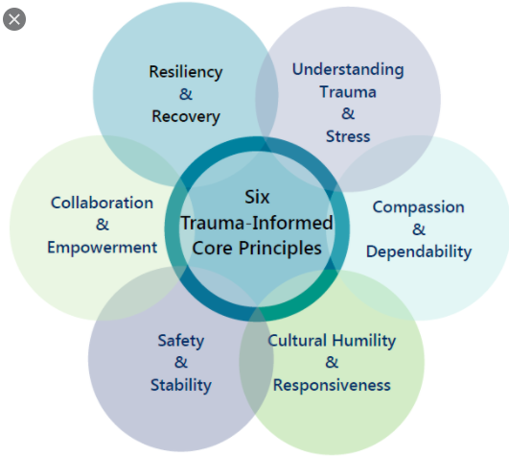
Trauma Informed Care
“Universal precautions”
Strengths based framework
Grounded in an understanding and responsiveness to the impact of trauma
Emphasizes physical, psychological, emotional safety
Rebuild sense of control and empowerment
Communication and care provision that are truly patient-centered
Underscore patient autonomy
Notes:
Everyone brings own biases and traumas to any situation. We don’t know. Many, though not all, trans and non-binary people have had negative or discriminatory past experiences with health care providers. They may come into the clinic with anxiety in certain health care situations. They may also have gender dysphoria (a sense of distress in the mismatch between sex assigned at birth and their gender identity), especially related to body parts that a clinician may want to examine when talking about sexual and reproductive health. Some may have experienced physical or sexual violence that can be triggered by invasive exams. Others may have other kinds of trauma history or concerns about physical examinations or being in a health care setting. Don’t assume a person’s needs, rather incorporate a trauma-informed approach for all people to create more collaboration and less traumatic interactions between clinicians and patients. We must strive to provide the least biased, and most respectful, care we can.
Trauma informed care is for everyone.
Trauma informed care: “a strengths based framework that is grounded in an understanding of and responsiveness to the impact of trauma, that emphasizes physical, psychological, and emotional safety for both the healthcare team and survivors, and that creates opportunities for survivors to rebuild a sense of control and empowerment”
The basis of trauma-informed care is communication and care provision that are truly patient-centered, using shared decision making, and underscoring patient autonomy, which happens in the context of a collaborative relationship.
Ask before an exam: Is there anything I can do to make you feel more comfortable today?
Follow the person’s lead
Acknowledge that a past trauma history may impact their experience and ensure before starting that they know they can pause or stop the exam at any point
Control remains with the patient
Intentionally shift the power dynamic between clinician and patient to emphasize the patient’s autonomy
Resources
Roosevelt L, Pietzmeier S, Reed R. Clinically and Culturally Competent Care for Transgender and Nonbinary People. The Journal of Perinatal & Neonatal Nursing. 2021; 35 (2): 142-149. doi: 10.1097/JPN.0000000000000560.
Hopper EK, Bassuck EL, Olivet J. Shelter from the storm: trauma-informed care in homelessness services settings. Open Health Serv Policy J. 2010;3:80–100. https:// benthamopen.com/ABSTRACT/TOHSPJ-3-80.
Sperlich M, Seng JS, Li Y, Taylor J, Bradbury-Jones C. Integrating trauma-informed care into maternity care practice: conceptual and practical issues. J Midwifery Womens Health. 2017;62(6):661–672. doi:10.1111/jmwh.12674.
Sciolla AF. An overview of trauma-informed care. In: Trauma, Resilience, and Health Promotion in LGBT Patients: What Every Healthcare Provider Should Know. New York, NY: Springer International Publishing; 2017:165–181. doi:10.1007/978-3-319-54509-7_14.

Slide 12
Shared Decision-Making and Informed Consent
Shared Decision-making | Informed Consent
Provider holds space to Stay connected to the process Offer options Consider values and preferences of the patient Shared evaluation of patient decision, including family input, as appropriate (ACNM, 2022) | Provider Maintains awareness of the history of forced sterilization and coercion in gynecology and family planning spaces Educates patient about methods as well as risks and benefits Answer questions Confirms that the patient understands the above Confirms that the patient is clear and confident in their decision
Notes:
Cultural humility
Diversity in beliefs/values/goals
Health literacy
Trauma-informed model

Slide 13

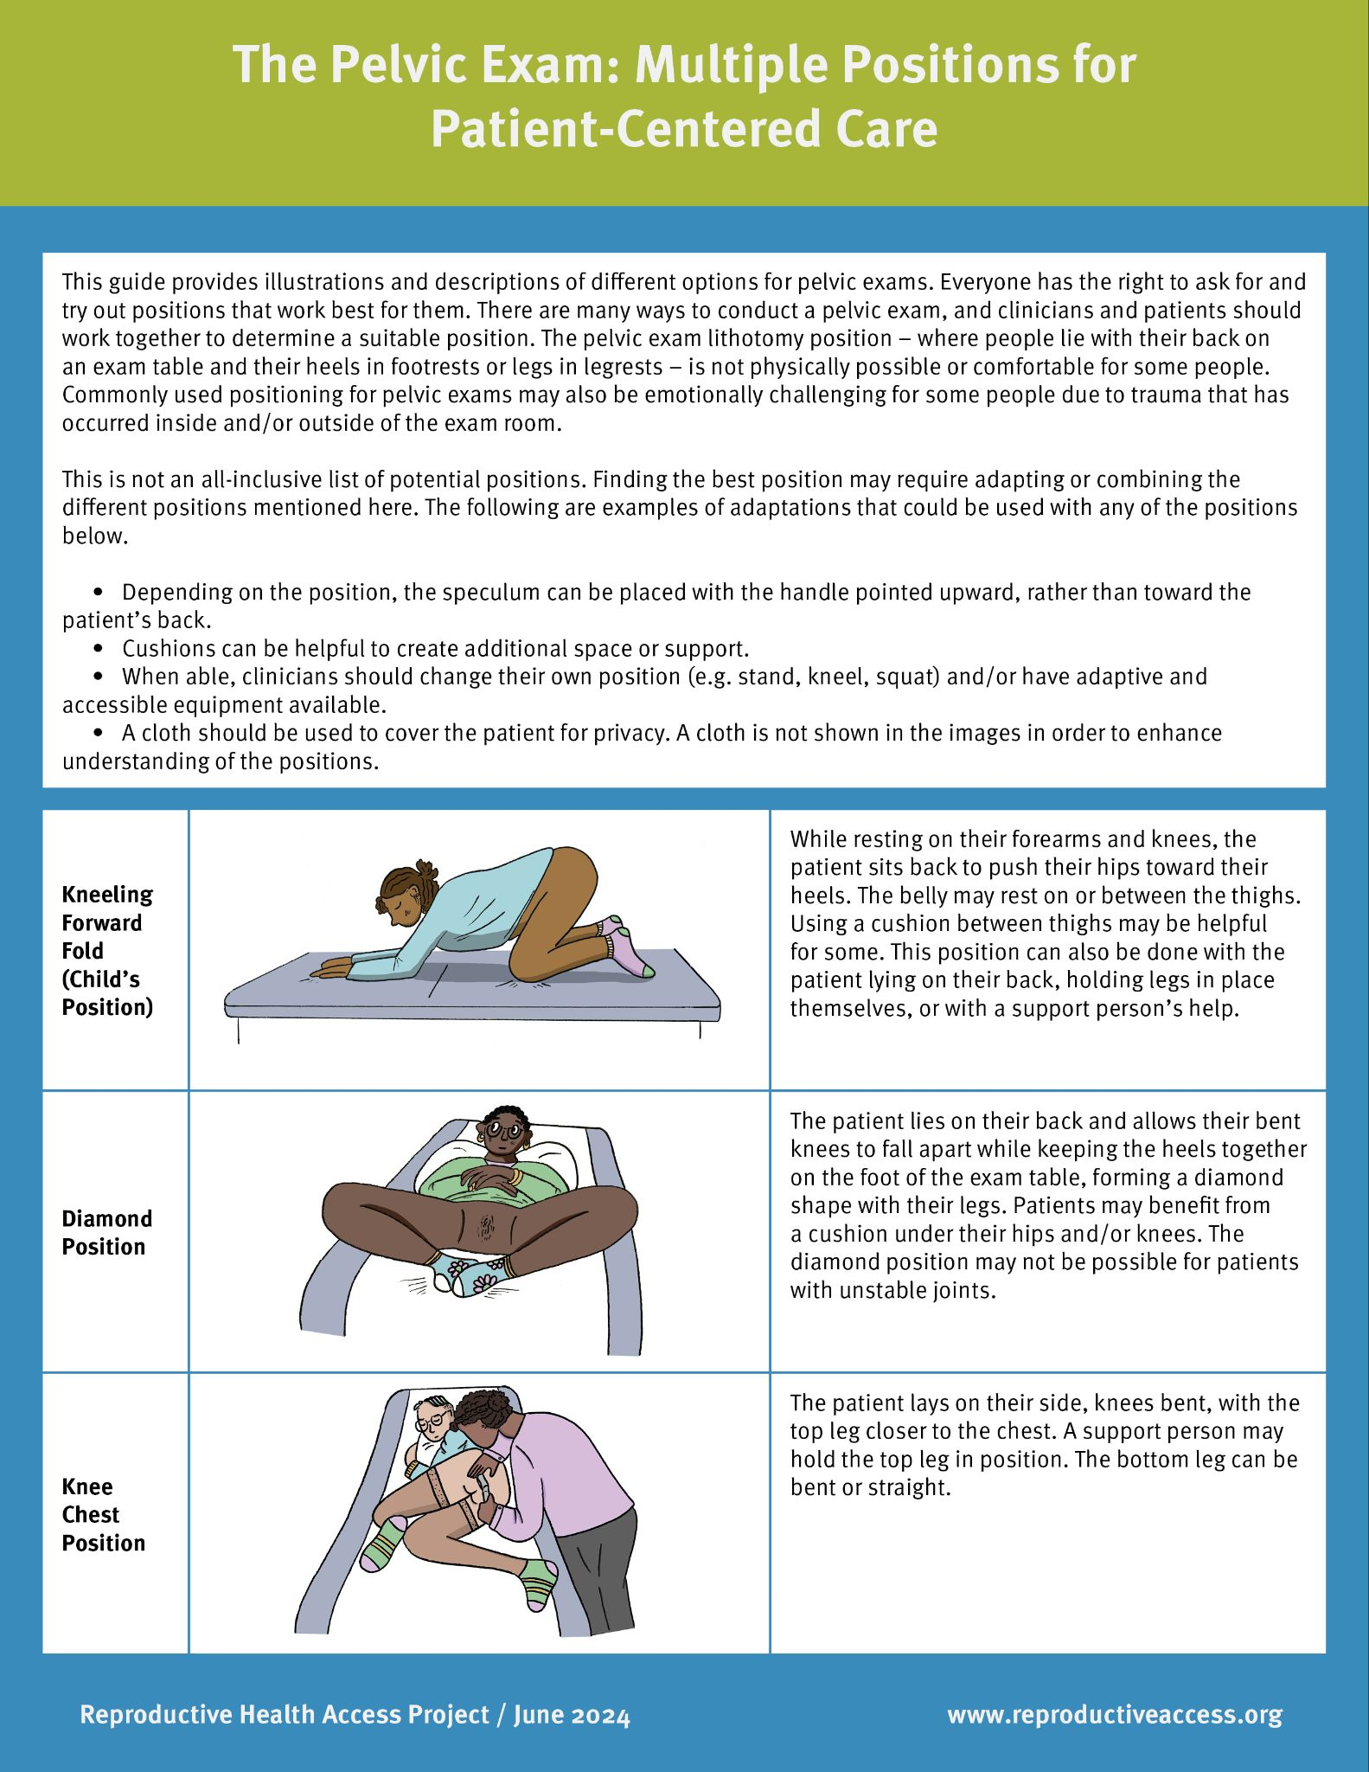
Exams: Patient-Centered Techniques
Establish rapport
Invite the patient to suggest strategies to improve comfort
Allow a support person
Allow patient to choose examiner
Obtain informed consent
Stop if the patient asks/signals
Keep the patient’s body covered, exposing only the areas being examined
Encourage the patient to breathe abdominally to relax pelvic floor
Offer self-insertion of speculum
Offer frog-leg positioning without footrests - (do not call them stirrups)
Refer to surface as table, not bed
Notes:
Here are a range of patient-centered techniques that can help alleviate patients’ discomfort or anxiety (note: consider not walking through all of the below and ask participants the discussion question below first)
Establish rapport before the exam. In some cases, this means doing the exam at a separate visit.
Invite the patient to suggest measures for more comfort with the exam.
Allow a support person to accompany the patient during the exam.
Allow the patient to choose examiner
Before starting, obtain informed consent
Inform the patient that the exam will stop if they ask/signal. Assure that they have control
Tell the patient about each step of the exam right before it happens, if this is what they prefer.
Keep the patient’s body covered, exposing only the areas being examined.
Encourage the patient to breathe abdominally in order to relax their pelvic floor muscles.
Use the smallest possible speculum.
Use lubricant.
Offer self-insertion of the speculum.
Offer frog-leg positioning without footrests - (do not call them stirrups). Offer other positions that enhance comfort and are most helpful given someone’s mobility levels and comfort.
Refer to surface as table not bed
ASK: What other techniques have you practice or do you think you could practice to reduce patients’ anxiety and enhance their comfort and autonomy?
ASK: What other positions could you offer a patient for a pelvic exam that would enhance their comfort? Positions that may be more helpful for people with different kinds of mobility issues?

Slide 14
AAFP: Key Points to Ensuring a Productive Sexual Health Conversation
Avoid moral or religious judgment of the patient’s behavior
Avoid terms that make assumptions about sexual behavior or orientation
Ensure shared understanding around terminology and pronunciation for patient concerns to avoid confusion
Establish rapport and consent before addressing sensitive topics
Respect the patient’s right to decline answering questions or sharing information
Use a sensitive tone that normalizes the topics you are discussing
Use neutral and inclusive terms that avoid assumptions about orientation (e.g., partner)
Notes:
The AAFP offers key points to ensuring a productive sexual health conversation. Let’s look at them and also critique some of them.
Avoid moral or religious judgment of the patient’s behavior
Avoid terms that make assumptions about sexual behavior or orientation
Note: Always refer to “partners” and not “partner” - otherwise you could be making a value judgement as to whether someone should only have one partner.
Never use the word “monogamous”
You don’t need to know how many partners a patient has or has had - it’s more important to know about health and risks, so don’t ask “How many partners have you had in the past year?”
All you need to know to assess risk and make recommendations are body parts and what goes where.
Ensure shared understanding around terminology and pronunciation for patient concerns to avoid confusion
Interestingly, AAFP says: “if the patient provides a slang term for their anatomy, gently connect the slang word to the medical terminology by answering them using the corresponding anatomy in your response”
Note: this is something we should not do. Words that patients use for their anatomy can be reflective of how they understand and feel about their anatomy. It’s usually best to use the words patients use to describe something (examples: front hole instead of vagina).
Other thoughts about this?
Establish rapport and consent before addressing sensitive topics
Respect the patient’s right to decline answering questions or sharing information
Use a sensitive tone that normalizes the topics you are discussing
Use neutral and inclusive terms that avoid assumptions about sexual orientation (e.g., partner)
Ask: What other recommendations do you all have for ensuring a productive sexual health conversation?

Slide 15
Recommendations for Taking an Inclusive Sexual History
“P” | Example Questions
General | Have you ever had sex?
Preferences | Do you have preferred language that you use to refer to your body (i.e., genitals)? Are you currently on hormone therapy, have you had any gender confirming surgeries or procedures?
Partners | “Tell me about the genders and bodies of your partners.” - from Bedsider
Practices | Do you have any other types of sex that haven’t been asked about?
Past History of STIs | Have you ever been tested for STIs? If yes… Do you remember the site (where on your body was it?)
Protection from STIs | Have you had sex since last being tested for STIs? If so, what kind? What do you do to protect yourself from STIs, including HIV?
Pregnancy | Do you want to become a parent/have more children?
Pleasure | Do you have any questions or concern about your sexual functioning? Is there anything about your (or your partner’s) sexual activity (as individuals or as a couple) that you would like to change?
Partner Abuse | Has anyone ever forced or compelled you to do anything sexually that you did not want to do? *Remember universal trauma precautions, treat everyone as though they’ve been traumatized
Notes:
There are many different frameworks for taking a sexual history - but it’s important that you only ask questions that are clinically relevant, and always using inclusive language. “Acknowledge that some of the questions may be of a sensitive or personal nature and be respectful if they decline to answer. If inquiring about a current pregnancy or future plans for chestfeeding, for example, asking about hormone therapy use or gender-affirming surgery is relevant. If the history is not relevant to the task at hand, asking about it would center the healthcare provider’s personal curiosity over the needs of the patient.”
What we present here is informed by the AAFP’s 5 Ps, the National Coalition for Sexual Health’s 6 Ps, a presentation by Timothy Cavanuagh from Fenway Health on Talking Sex with Gender Non-Conforming & Trans Patients, and Bedsider’s article on taking a trans-inclusive sexual history.
We recommend starting with the question “have you ever had sex?” instead of asking about being sexually active or being sexually active in some sort of time frame.
[Walk through the remaining “P” categories and example questions to ask. Ask the audience or offer to the audience other examples of questions you feel are clinically relevant for taking a sexual history.]
Some follow-up questions about pregnancy that you can ask are:
If yes: Would you like to talk about pregnancy planning today? How important would it be for you to have biological children in the future?
If no: Would you like to talk about birth control options today?
To help your patient feel a bit more comfortable talking about pleasure, start this part of the conversation with something like: “It is part of my routine to ask about sexual health, including sexual functioning and pleasure, as part of your visit.” Then introduce some questions about pleasure and sex life. [Ask the audience if they have other examples of introducing a discussion about pleasure to help a patient feel more comfortable].
When talking about partner abuse, these may be helpful follow-up questions if someone does tell you that they were forced or compelled to do something sexually that they did not want to do:
Does that experience affect your current sex life or sexual relationships? (Probe: In what ways?)
Does that make seeing a health care provider or having a physical exam difficult or uncomfortable?
Other key components for talking about sex (by Fenway Health)
Introductory language
Acknowledge and affirm differences in identity and language use. Specify terms used.
Establish from the beginning what words you and the patient will use. Check in to make certain that the both you and the patient have the same understanding of these terms. Clitoris, phallus, dick, penis Vagina, genital canal, front hole Penetrative sex, vaginal sex, frontal sex Anus/anal, back hole, butt
Example language:
Sex is a personal issue that can sometimes be sensitive or hard to talk about. This is especially true for those of us who are transgender or gender non-conforming because the bodies we have don’t always reflect who we are. As transgender and gender nonconforming people, we do not all use the same words or names to talk about our body parts.
Questions to capture diverse sexual behaviors
Validate all sexual practices by asking about both high and low risk activities.
Don’t assume people are limited to certain kinds of sex based on genitalia (i.e. include questions about insertive sex)
Specify if activity was performed with or without a prosthetic or toy
Diverse partner types to allow for contextualization
Serious or causal relationship
Poly/open relationship
Sleep with, but not dating
Dom/sub
Exchange partner/sex work client
Open-ended questions at the end
Anything else you feel to be important that we did not address?
Optional Discussion: [If you’d like, share a few examples of the below AAFP recommended questions for taking a sexual history and discuss the audience’s thoughts on the language.]
Here are some recommended questions from AAFP on taking a sexual history. What are your thoughts on some of this language? Is this how you ask your patients sexual history questions? What suggestions have you made or would you make to have more inclusive language when asking about sexual history?
Suggestions:
“How do your partners identify? Do they identify as male, female, or another? or What are the genders of your partners?”
There is no time when this question is clinically relevant. All we need to know to assess risk and make recommendations are body parts and what goes where.
“How many partners have you had in the past month? The past six months? Your lifetime?”
No matter if a person has had sex with 1 person or thousands, they need to be tested for STIs. Clinically, all we need to know is if you've ever been tested for STIs and if you've had sex since last being tested. If so, what kind? Remember, a patient with only 1 lifetime partner can still have STIs.
Do you (or your partners) use any particular devices or substances to enhance your sexual pleasure?
The phrasing of this question could be uncomfortable.
Overall, these pleasure questions appear overly medicalized. It’s better to ask general questions around any issues or problems coming up with sex and then see what comes up.
Sources
Savoy M, Brown-James A. Sexual health history: techniques and tips. Am Fam Physician. 2020;101(5):286-293.
Sexual Health History: Talking Sex with Gender Non-Conforming & Trans Patients. Timothy Cavanaugh. Fenway Health: https://fenwayhealth.org/wp-content/uploads/Taking-a-Sexual-Health-History-Cavanaugh-1.pdf
https://nationalcoalitionforsexualhealth.org/tools/for-healthcare-providers/sexual-health-questions-to-ask-all-patients
https://providers.bedsider.org/articles/taking-a-transgender-inclusive-sexual-health-history
Roosevelt L, Pietzmeier S, Reed R. Clinically and Culturally Competent Care for Transgender and Nonbinary People. The Journal of Perinatal & Neonatal Nursing. 2021; 35 (2): 142-149. doi: 10.1097/JPN.0000000000000560.

Slide 16
Contraception
“Because infertility is not absolute or universal in transgender people undergoing hormone therapy, all transgender people who have gonads and engage in sexual activity that could result in pregnancy should be counseled on the need for contraception. Gender affirming hormone therapy alone is not a reliable form of contraception, and testosterone is a teratogen that is contraindicated in pregnancy.“
UCSF Center of Excellence for Transgender Health
Notes:
Gender affirming hormone therapy is not effective contraception.
“Sexually active individuals with retained gonads who do not wish to become pregnant or cause pregnancy in others should be counseled about the possibility of pregnancy if they are having sexual activity that involves sperm and oocytes.”
Resource:
https://www.acog.org/clinical/clinical-guidance/committee-opinion/articles/2021/03/health-care-for-transgender-and-gender-diverse-individuals
https://transcare.ucsf.edu/guidelines/fertility

Slide 17
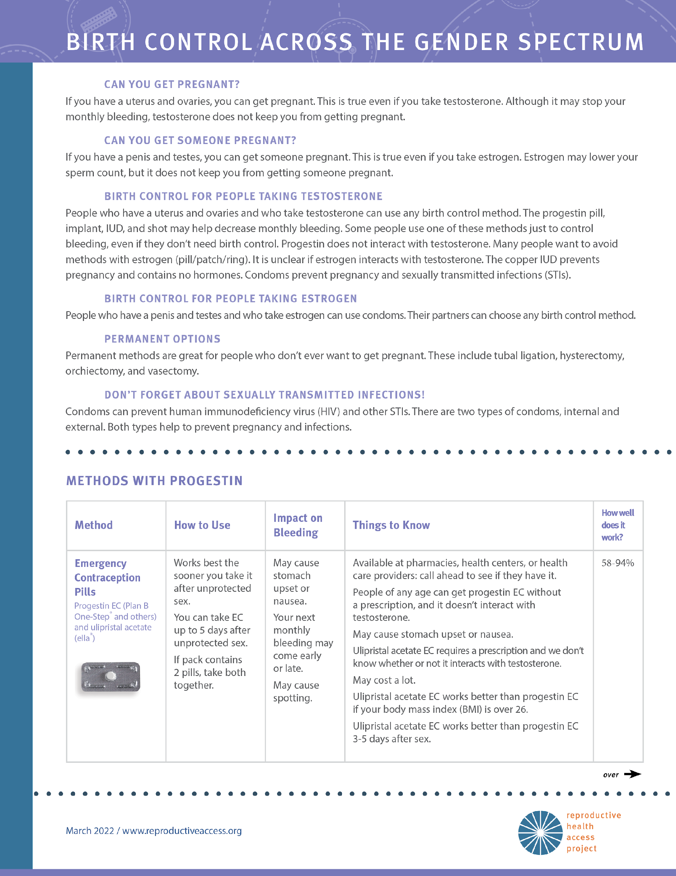
Contraception Options and Considerations
Testosterone provides incomplete ovulatory suppression, still active endometrium
Non-hormonal
Hormonal (pill, patch, etc)
Hormonal LARC
  Pre-procedural anticipatory counseling
EC counseling
Notes:
Testosterone provides incomplete ovulatory suppression, still active endometrium
Discussion of dysphoric effects of CHCs
Concerns over estrogen effects on T changes - balancing patient concern with evidence
Desired bleeding pattern: amenorrhea?
Breast/chest discomfort (estrogen vs progesterone)
Cramping effects
Dosing/concealability
Pre-procedural anticipatory counseling
Anxiolytics
Consideration of vaginal atrophy especially on T
Estradiol cream
Smaller IUD
(Atrophy also likely to cause unsatisfactory Paps)
EC counseling
Gender Dysphoria is the distress that accompanies the incongruence between one's experienced and expressed gender and one's assigned or natal gender. This doesn’t occur for all people who identify and express with genders different from their assigned gender, but it’s possible and can be exacerbated in reproductive health care. For many, dysphoria is not persistent if appropriately addressed. Hysterectomy with or without bilateral salpingo-oophorectomy is medically necessary for patients with gender dysphoria who desire this procedure.
RHAP also has a resource called Birth Control Across the Gender Spectrum to help clinicians counsel and to help patients patients learn about and make decisions about birth control options around needs and considerations related to hormones and one’s gender identity. [Option to walk through resource and highlight key points and organizing structure].
Resource:
https://www.reproductiveaccess.org/resource/birth-control-across-the-gender-spectrum/
https://www.acog.org/clinical/clinical-guidance/committee-opinion/articles/2021/03/health-care-for-transgender-and-gender-diverse-individuals

Slide 18
Contraception Options and Considerations
Non-hormonal
  Pull out
  Gels
  Barrier
    Condoms/dams/garments
  Cycle tracking
  Copper IUD
Notes:
Testosterone provides incomplete ovulatory suppression, still active endometrium
Discussion of dysphoric effects of CHCs
Concerns over estrogen effects on T changes - balancing patient concern with evidence
Desired bleeding pattern: amenorrhea?
Breast/chest discomfort (estrogen vs progesterone)
Cramping effects
Dosing/concealability
Pre-procedural anticipatory counseling
Anxiolytics
Consideration of vaginal atrophy especially on T
Estradiol cream
Smaller IUD
(Atrophy also likely to cause unsatisfactory Paps)
EC counseling
Gender Dysphoria is the distress that accompanies the incongruence between one's experienced and expressed gender and one's assigned or natal gender. This doesn’t occur for all people who identify and express with genders different from their assigned gender, but it’s possible and can be exacerbated in reproductive health care. For many, dysphoria is not persistent if appropriately addressed. Hysterectomy with or without bilateral salpingo-oophorectomy is medically necessary for patients with gender dysphoria who desire this procedure.
RHAP also has a resource called Birth Control Across the Gender Spectrum to help clinicians counsel and to help patients patients learn about and make decisions about birth control options around needs and considerations related to hormones and one’s gender identity. [Option to walk through resource and highlight key points and organizing structure].
Resource:
https://www.reproductiveaccess.org/resource/birth-control-across-the-gender-spectrum/
https://www.acog.org/clinical/clinical-guidance/committee-opinion/articles/2021/03/health-care-for-transgender-and-gender-diverse-individuals

Slide 19
Contraception Options and Considerations
Hormonal (pill, patch, etc)
  Pills
    Either estrogen + progesterone component
    Progesterone only
  Patch
  Shot
  Ring
  LARCs
Notes:
Testosterone provides incomplete ovulatory suppression, still active endometrium
Discussion of dysphoric effects of CHCs
Concerns over estrogen effects on T changes - balancing patient concern with evidence
Desired bleeding pattern: amenorrhea?
Breast/chest discomfort (estrogen vs progesterone)
Cramping effects
Dosing/concealability
Pre-procedural anticipatory counseling
Anxiolytics
Consideration of vaginal atrophy especially on T
Estradiol cream
Smaller IUD
(Atrophy also likely to cause unsatisfactory Paps)
EC counseling
Gender Dysphoria is the distress that accompanies the incongruence between one's experienced and expressed gender and one's assigned or natal gender. This doesn’t occur for all people who identify and express with genders different from their assigned gender, but it’s possible and can be exacerbated in reproductive health care. For many, dysphoria is not persistent if appropriately addressed. Hysterectomy with or without bilateral salpingo-oophorectomy is medically necessary for patients with gender dysphoria who desire this procedure.
RHAP also has a resource called Birth Control Across the Gender Spectrum to help clinicians counsel and to help patients patients learn about and make decisions about birth control options around needs and considerations related to hormones and one’s gender identity. [Option to walk through resource and highlight key points and organizing structure].
Resource:
https://www.reproductiveaccess.org/resource/birth-control-across-the-gender-spectrum/
https://www.acog.org/clinical/clinical-guidance/committee-opinion/articles/2021/03/health-care-for-transgender-and-gender-diverse-individuals

Slide 20
Contraception Options and Considerations
LARCs (Long-acting reversible contraception
  Implant (nexplanon)
  Hormonal IUDs
    Mirena, Kylena etc
**Preprocedure considerations
  Pain meds, anxiety meds, calming techniques
Permanent
  Salpingectomy
  Vasectomy
Notes:
Testosterone provides incomplete ovulatory suppression, still active endometrium
Discussion of dysphoric effects of CHCs
Concerns over estrogen effects on T changes - balancing patient concern with evidence
Desired bleeding pattern: amenorrhea?
Breast/chest discomfort (estrogen vs progesterone)
Cramping effects
Dosing/concealability
Pre-procedural anticipatory counseling
Anxiolytics
Consideration of vaginal atrophy especially on T
Estradiol cream
Smaller IUD
(Atrophy also likely to cause unsatisfactory Paps)
EC counseling
Gender Dysphoria is the distress that accompanies the incongruence between one's experienced and expressed gender and one's assigned or natal gender. This doesn’t occur for all people who identify and express with genders different from their assigned gender, but it’s possible and can be exacerbated in reproductive health care. For many, dysphoria is not persistent if appropriately addressed. Hysterectomy with or without bilateral salpingo-oophorectomy is medically necessary for patients with gender dysphoria who desire this procedure.
RHAP also has a resource called Birth Control Across the Gender Spectrum to help clinicians counsel and to help patients patients learn about and make decisions about birth control options around needs and considerations related to hormones and one’s gender identity. [Option to walk through resource and highlight key points and organizing structure].
Resource:
https://www.reproductiveaccess.org/resource/birth-control-across-the-gender-spectrum/
https://www.acog.org/clinical/clinical-guidance/committee-opinion/articles/2021/03/health-care-for-transgender-and-gender-diverse-individuals

Slide 21
Reproductive Justice for Trans and Non-Binary Communities
Reproductive justice is the human right to maintain personal bodily autonomy, have children, not have children, and parent the children we have in safe and sustainable communities (SisterSong).
Parenting decisions and RJ are constrained for trans and non-binary people
Long history of denial of fertility-related services
Notes:
Reproductive justice is the human right to maintain personal bodily autonomy, have children, not have children, and parent the children we have in safe and sustainable communities (SisterSong).
Trans people can have children. Practicing reproductive justice means to counsel patients on all their reproductive options, enhance their autonomy to have power over choices and decisions around pregnancy, birth control, and childbearing, and support them in achieving their reproductive goals.
However, parenting decisions and reproductive justice are constrained for trans and non-binary people. There is a long history of denial of services to trans and non-binary people seeking fertility preservation or assisted reproductive technology services.
Sources:
National Center for Transgender Equality. Summary of state birth certificate gender change laws. www.TransEquality.org. https://transequality.org/sites/default/files/docs/resources/Summary%20of%20State%20Birth%20Certificate%20Laws%20Jan%202020.pdf. Published 2020. Accessed February 14, 2022.
Roosevelt L, Pietzmeier S, Reed R. Clinically and Culturally Competent Care for Transgender and Nonbinary People. The Journal of Perinatal & Neonatal Nursing. 2021; 35 (2): 142-149. doi: 10.1097/JPN.0000000000000560.
Image Source: The Gender Spectrum Collection. https://genderphotos.vice.com/

Slide 22

Fertility & Reproductive Wish & Pregnancy
Survey of 50 transmen after Gender Affirming Surgery, Wierckx, et al 2012
54% were interested in having children at time of study
37.5% would have considered fertility preservation if available
Pregnancy experiences of Transgender Men (N=41), Light, et al 2014
Pregnancy, delivery, and birth outcomes did not differ by prior T use (range of <1 yr to >10 yrs)
20% were still amenorrheic at the time of becoming pregnant
Assisted reproductive technology outcomes in female-to-male transgender patients compared with cisgender patients (N=26), Leung, et al 2019
Transgender men were able to retrieve comparable* amounts of oocytes via ART, regardless of prior testosterone use
Photo Sources: https://genderphotos.vice.com/
Notes:
Transgender men are individuals who have a male or masculine gender identity, but were assigned female at birth. The gender affirmation process may include social, medical, and surgical aspects of transition - though not all transgender men desire medical intervention. Many transgender men desire children. Most are capable of becoming pregnant and doing so safely before or after use of testosterone therapy for medical gender affirmation. In a survey of 50 transmen after gender affirming surgery, 54% were interested in having children at the time of the study, 37.5% would have considered fertility preservation if available.
UCSF Center for Excellence on Transgender Health Guidelines state: “It is recommended that prior to transition all transgender persons be counseled on the effects of transition on their fertility as well as regarding options for fertility preservation and reproduction.
Pregnancy Experiences of Transgender Men - Light, et al
In a survey of 41 transgender men who had been pregnant and delivered after transitioning, researchers found that transgender men are achieving pregnancy after having socially, medically, or both transitioned.
61% had used T before pregnancy -- pregnancy, delivery, and birth outcomes did not differ by prior T use
Out of the 25 people who reported being on T prior to pregnancy, 5 were on T for 10+ years, 10 were on T for <1 year, 15 were on T for 1-10 years
88% of oocytes came from participants’ own ovaries
Most transgender men became pregnant within 4 months of trying; 15% had a preconception medical consultation and 7% used fertility drugs to become pregnant
20% were still amenorrheic at the time of becoming pregnant
Half received prenatal care from a physician -- 40% OBGYN, 10% FP; 78% delivered in a hospital
Reported a variety of perinatal complications: hypertension (12%), preterm labor (10%), placental abruption (10%), and anemia (7%) -- anemia was not reported by participants who had previously used testosterone
Those who had previously used T were statistically less likely to chestfeed than those who had not previously used T
Assisted reproductive technology outcomes in female-to-male transgender patients compared with cisgender patients - Leung et al
In a retrospective cohort study comparing outcomes of assisted reproductive technology (ART) outcomes in female-to-male transgender patients compared with cisgender patients (matched for age, BMI, antiMüllerian hormone levels)
-61% of transgender patients were on testosterone therapy prior to beginning ART (range 3 months - 17 years), which was discontinued prior to ART
-On average, transgender couples were able to retrieve more oocytes than matched cisgender couples, but did require higher total gonadotropin doses
-Study was powered to examine feasibility of pregnancy in transgender couples, not to compare oocyte yield directly
-Transgender couples did require higher total doses of gonadotropin
In open-ended questions, common themes and experiences included:
Effect of pregnancy on concepts of family structure
For some, necessary step in creating the family they desired
Used words like “dad” “carrier” “gestational parent” to affirm gender identity and describe parenting role
Isolation
Feelings of isolation, lack of support, lack of resources available to support pregnant transgender men
Invisibility: not being recognized by society as someone who could be pregnant
Gender dysphoria and pregnancy
Some reported improvements in gender dysphoria, feeling new connections with their bodies
Others felt increase in dysphoria and for some it continued into postpartum period
Many mentioned having postpartum depression - depression seemed to amplify by a lack of gender-sensitive resources for postpartum depression
Interactions with healthcare providers
Some had positive interactions with their health care teams: using proper pronouns, using words to reference the person’s parenting role, calling body parts by the words that the patient used
Others had negative experiences: improper pronoun use, rude treatment, being turned away and denied treatment
Many called for better treatment from the health care system through acknowledging the unique identities of pregnant transgender men and grounding health care provider-patient interactions in compassion and respect
Though clinicians may have been respectful, this was not always the case with office staff, nurses, and other health care workers
Note: Pubertal blockers may have different implications on future fertility, but it is outside the scope of this presentation to discuss this.
Source:
Wierckx K, Van Caenegem E, Pennings G, Elaut E, Dedecker D, Van de Peer F, et al. Reproductive wish in transsexual men. Hum Reprod 2012;27:483–7
https://transcare.ucsf.edu/guidelines/fertility
Roosevelt L, Pietzmeier S, Reed R. Clinically and Culturally Competent Care for Transgender and Nonbinary People. The Journal of Perinatal & Neonatal Nursing. 2021; 35 (2): 142-149. doi: 10.1097/JPN.0000000000000560.
Light AD, Obedin-Maliver J, Sevelius JM, Kerns JL. Transgender men who experienced pregnancy after female-to-male gender transitioning. Obstetrics and gynecology. 2014;124(6):1120-1127. http://dx.doi.org/10.1097/aog.0000000000000540. Retrieved from https://escholarship.org/uc/item/3dz427qw.
Leung, Angela et al. Assisted reproductive technology outcomes in female-to-male transgender patients compared with cisgender patients: a new frontier in reproductive medicine. Fertility and Sterility.2019;112(5):858 - 865
https://www.fertstert.org/article/S0015-0282(19)30619-3/fulltext
Image Source: The Gender Spectrum Collection. https://genderphotos.vice.com/
Survey of 50 transmen after Gender Affirming Surgery, Wierckx, et al 2012
54% were interested in having children at time of study
37.5% would have considered fertility preservation if available
Pregnancy experiences of Transgender Men (N=41), Light, et al. 2014
25 reported being on T prior to pregnancy
10: < 1 year
15: 1-10 years
5: 10+ years
Pregnancy, delivery, and birth outcomes did not differ by prior T use
20% were still amenorrheic at the time of becoming pregnant

Slide 23

Family Building Options
Adoption
Carrying pregnancy
Alternative insemination (donor sperm)
Assisted Reproductive Treatment (IVF):
Donor sperm/egg
Cryopreserved sperm/egg
Surrogacy
Image Source: The Gender Spectrum Collection. https://genderphotos.vice.com/
Notes:
Ideally, fertility and parenting desires should be discussed early in the process of transition, before the initiation of hormone therapy or gender affirmation surgery.
Fertility preservation options for transgender individuals are the same as for those cisgender individuals who desire preservation before gonadotoxic cancer therapy or for elective preservation. These options include sperm banking, oocyte preservation, embryo preservation, and in some cases, ovarian or testicular tissue cryopreservation. In addition to the expected pregnancy outcomes with these procedures, patients should be informed of the potential for out-of-pocket costs, which vary by state and insurance coverage.
Resource
https://www.acog.org/clinical/clinical-guidance/committee-opinion/articles/2021/03/health-care-for-transgender-and-gender-diverse-individuals
https://fenwayhealth.org/wp-content/uploads/Reproductive-Options-for-Transgender-Persons-Viloria-1.pdf
Image Source: The Gender Spectrum Collection. https://genderphotos.vice.com/

Slide 24

Estrogen Effect
Estrogen therapy decreases testosterone production
  sperm count and motility
Stopping estrogen therapy may/may not reverse effects
Notes:
Resource:
https://fenwayhealth.org/wp-content/uploads/Reproductive-Options-for-Transgender-Persons-Viloria-1.pdf
https://transcare.ucsf.edu/guidelines/fertility

Slide 25

Fertility Preservation
Sperm cryopreservation
Testicular sperm extraction
Testicular tissue preservation
Image Source: unsplash.com
Notes:
Resource:
https://fenwayhealth.org/wp-content/uploads/Reproductive-Options-for-Transgender-Persons-Viloria-1.pdf
https://transcare.ucsf.edu/guidelines/fertility
Image Source: unsplash.com

Slide 26
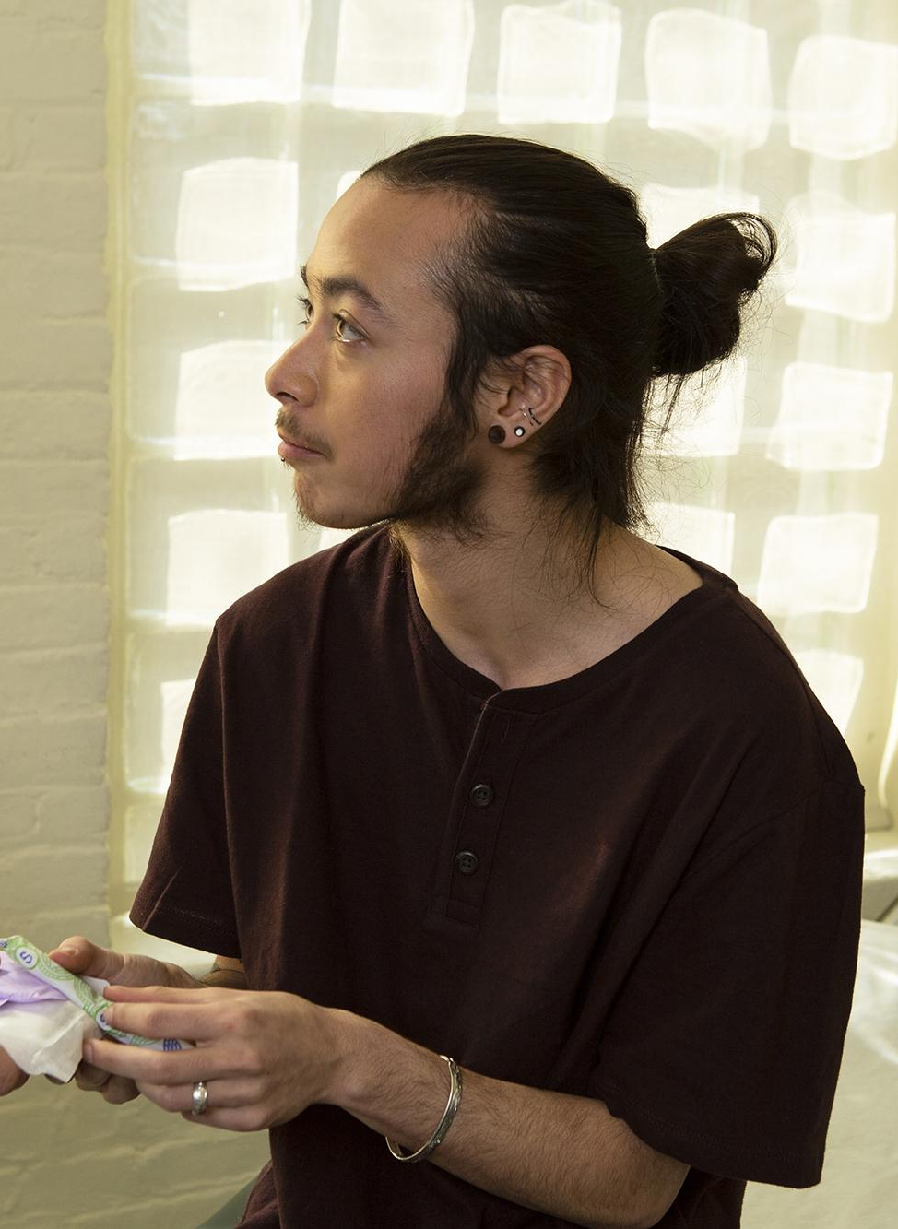
Testosterone Effect
Testosterone therapy often leads to anovulation and amenorrhea, however a person can still become pregnant
Stopping testosterone therapy may/may not reverse effects
80% regain a regular period within 6 months after ceasing testosterone therapy
Image Source: The Gender Spectrum Collection. https://genderphotos.vice.com/
Notes:
Resource:
https://fenwayhealth.org/wp-content/uploads/Reproductive-Options-for-Transgender-Persons-Viloria-1.pdf
https://transcare.ucsf.edu/guidelines/fertility
Roosevelt L, Pietzmeier S, Reed R. Clinically and Culturally Competent Care for Transgender and Nonbinary People. The Journal of Perinatal & Neonatal Nursing. 2021; 35 (2): 142-149. doi: 10.1097/JPN.0000000000000560.
Image Source: The Gender Spectrum Collection. https://genderphotos.vice.com/

Slide 27

Egg/Embryo Preservation
Ovarian tissue cryopreservation (OTC)
Oocyte Cryopreservation (OC)
    Hormone-induced ovulation
    Ultrasound guided retrieval under anesthesia
Embryo Banking (EB)
    Egg retrieval with immediate fertilization with chosen donor sperm
Image Source: By Amethyst Studio, TH. In the Human Organs 2 Line Black 00158 Collection. https://thenounproject.com/term/ovaries/4133511/.
Notes:
Resource:
https://fenwayhealth.org/wp-content/uploads/Reproductive-Options-for-Transgender-Persons-Viloria-1.pdf
https://transcare.ucsf.edu/guidelines/fertility
Image Source: By Amethyst Studio, TH. In the Human Organs 2 Line Black 00158 Collection. https://thenounproject.com/term/ovaries/4133511/.

Slide 28
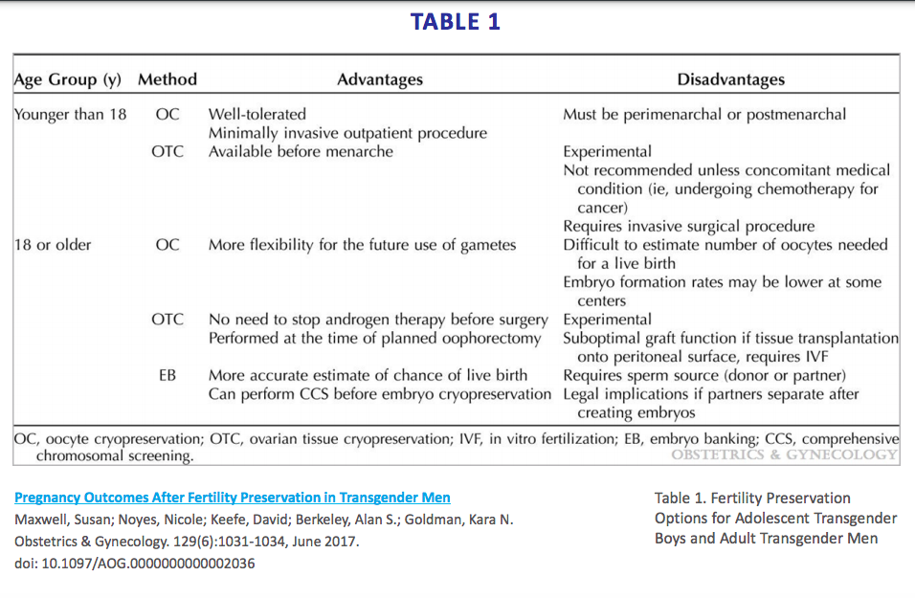
28
https://fenwayhealth.org/wp-content/uploads/Reproductive-Options-for-Transgender-Persons-Viloria-1.pdf
Notes:
Resource:
https://fenwayhealth.org/wp-content/uploads/Reproductive-Options-for-Transgender-Persons-Viloria-1.pdf
https://journals.lww.com/greenjournal/abstract/2017/06000/pregnancy_outcomes_after_fertility_preservation_in.10.aspx

Slide 29

Cost
Donor sperm: $500-2,000 per vial
Sperm banking and FDA testing: $1,000 *yearly storage fee
Intrauterine insemination: $400
In vitro fertilization: $15,000 - $20,000 per cycle
In vitro fertilization with egg donation: $25,000 per cycle
Oocyte/embryo cryopreservation: $10,000
Gestational surrogacy: $50,000 - $100,000
29
Notes:
Assisted reproductive options are expensive and potentially complex.
Resource: P. Amato MD. Fertility Options for Transgender Persons. Endocrine Society Annual Meeting, San Diego, CA March 2015

Slide 30

Preconception Counseling
Legal considerations (donors/adoption)
Preconception and pregnancy health
When to start/stop testosterone
Return of menses
Preparing for exams
Gender dysphoria
Postpartum
Breast/chest feeding
Image Source: The Gender Spectrum Collection. https://genderphotos.vice.com/
Notes:
Legal considerations include thinking about contracts with sperm/egg donors or surrogates: financial obligations? visitation agreements? child custody? Consider varying state laws and policies.
Preconception and pregnancy health may include discussing smoking cessation, diet and nutrition, prenatal vitamin with folic acid, routine screening, medications and vitamins, hypertension, STIs, and other conditions that may affect a healthy pregnancy and pregnant person. This also may include discussing anatomic pathology.
We don’t have enough data on how long someone needs to be off T before trying to conceive. In the Light 2014 study of 41 transgender men who experienced pregnancy after transitioning found that two-thirds had used testosterone before pregnancy. Many of the respondents became pregnant within 4 months of stopping testosterone therapy. UCSF Transgender Care and Treatment Guidelines also say it is unknown how long a testosterone washout period is appropriate in transgender men prior to pregnancy. Even for those who are amenorrheic on T, 80% regain a regular period within 6 months after ceasing T. Individuals can stop taking T before trying to become pregnant with no risk for teratogenic effects on the fetus.
Work with the patient to help them develop a calendar to think about and plan when their menses may return. Menses may return to regular or irregular patterns of bleeding.
Help inform and prepare the patient with the kinds of exams they may need to monitor a healthy pregnancy (i.e. ultrasound, endometrial biopsy)
Labs: testosterone, cycle day 3 labs, CBC, Hgb a1c and LFT
Overall, providers who care for gender diverse patients, especially transmasculine individuals, during pregnancy should keep in mind that pregnancy is a gendered experience and may trigger or exacerbate feelings of dysphoria. Be mindful of the language you use to refer to the person’s parenting role. Additionally, many transmasculine people struggle with feelings of loneliness during this time. Some patients may benefit from care from mental health professionals with experience caring for this community.
Pregnancy can also be a high risk period for IPV. Trans and non-binary people are generally at a higher risk of IPV than cis-gender women.
While navigating identity, loneliness, and IPV are not unknown to cis-gender women, there are unique dimensions to these feelings and experiences for trans and non-binary people.
During the postpartum period, patients will need to decide if and when they want to restart T.
Note this term - Chestfeeding: Some masculine-identified individuals or non-binary folks use this term to describe the act of feeding their child from their chest regardless of whether they have had chest surgery.
Provide counseling and support for breast/chestfeeding.
T has been shown to suppress lactation
It may be possible to chestfeed even after having chest reconstruction (“top surgery”)
Recommended that one not be on T while chest feeding
While many transmasculine individuals experience joyful pregnancy or report that it brought them deeper into connection with themselves and their bodies, the healthcare team’s role in being a welcoming source of support is particularly critical in this community.
Note: A person’s pregnancy is NOT higher risk because they are not cis-gender.
Resources
Obedin-Maliver, J., & Makadon, H. J. (2016). Transgender men and pregnancy. Obstetric medicine, 9(1), 4–8. https://doi.org/10.1177/1753495X15612658
https://fenwayhealth.org/wp-content/uploads/Reproductive-Options-for-Transgender-Persons-Viloria-1.pdf
Transmasculine individuals’ experiences with lactation, chestfeeding, and gender identity: a qualitative study Trevor MacDonald, Joy Noel-Weiss, Diana West, Michelle Walks, MaryLynne Biener, Alanna Kibbe and Elizabeth Myler BMC Pregnancy and Childbirth, May 2016
https://www.acog.org/clinical/clinical-guidance/committee-opinion/articles/2021/03/health-care-for-transgender-and-gender-diverse-individuals
https://transcare.ucsf.edu/guidelines/fertility
Light AD, Obedin-Maliver J, Sevelius JM, Kerns JL. Transgen-der men who experienced pregnancy after female-to-malegender transitioning.Obstet Gynecol. 2014;124(6):1120–1127.doi:10.1097/AOG.0000000000000540.
Ellis SA, Wojnar DM, Pettinato M. Conception, pregnancy, and birth experiences of male and gender variant gestational parents: it’s how we could have a family. J Midwifery Womens Health. 2015;60(1):62–69. doi:10.1111/jmwh.12213.
Roosevelt L, Pietzmeier S, Reed R. Clinically and Culturally Competent Care for Transgender and Nonbinary People. The Journal of Perinatal & Neonatal Nursing. 2021; 35 (2): 142-149. doi: 10.1097/JPN.0000000000000560.
Image Source: The Gender Spectrum Collection. https://genderphotos.vice.com/

Slide 31

Breast/Chestfeeding
Can chestfeed while on T!
People that have chest surgery may still be able to lactate
Choice to feed is personal, may exacerbate dysphoria
Offer lactation support
Image Source: https://www.maxpixel.net/Breastfeeding-Mother-Baby-Infant-Mother-And-Child-2730855
Notes:
A person can chestfeed while on T. No significant increase in testosterone in milk. There is no detectable increase in testosterone in the infant and no apparent harmful effects. (Glaser, et al; Int J Pharm Compd. 2009 Jul-Aug;13(4):314-7.)
Some transgender men defer chest reconstruction surgery in light of a planned desire to chest feed. Those who have had masculinizing chest surgery - may still be able to lactate or can engage in chest feeding with assistance of a support device. The choice to chest or breast feed is a personal one and may cause one to experience dysphoria as they take on (and challenge) this traditionally “feminine” role. Balancing well-known health benefits of milk and infant feeding with the medical, surgical, logistical, and social challenges that this might incur for transmen or people who identify as men or nonbinary, indicates that—how one feeds their child—should be an informed personal choice supported by health care providers—as for any parent.”
It’s possible that for transmen with prior chest surgery, they may experience some growth in chest tissue, engorgement, and mastitis post-partum.
Offering support for lactation is crucial: use non-gendered language, use appropriate pronouns and parental role, avoid touching without permission, privacy is important, support all decisions around feeding.
Share resources to support new parents looking to chestfeed, like this one: https://www.llli.org/breastfeeding-info/transgender-non-binary-parents/
Infants have the same feeding options as any other infant: human milk from their parent(s), donor human milk, formula, or a mix of these.
Ways to support drying up milk should also be discussed
Resources
https://fenwayhealth.org/wp-content/uploads/Reproductive-Options-for-Transgender-Persons-Viloria-1.pdf
https://journals.sagepub.com/doi/full/10.1177/1753495X15612658
Image Source: https://www.maxpixel.net/Breastfeeding-Mother-Baby-Infant-Mother-And-Child-2730855

Slide 32


CASE STUDIES
Notes:
Use the rest of your time to break your participants up into small groups or as a full group work through one or several of the case studies attached and the discussion questions. All case studies are attached or in the following slides if you wish to screen share the PPT.
If you divide into groups, after some allotted time, have each group explain their case and answers to the discussion questions to the larger group. Invite the larger group to provide feedback on or add to each small group’s analysis of their case.

Slide 33


Abortion Care Case #1: Sky
45-year old patient assigned female at birth
On T for 20 years
Under 11 weeks pregnant, would like abortion care
How would you counsel them on their questions? What are key things to remember while counseling?
Is it safe for me to have a medication abortion?
Is it safe for me to have a suction procedure?
33
Notes:
We’re going to walk through key points in providing abortion care through two case studies. First, we have a 45 year-old patient Assigned Female at Birth (AFAB) who has been on T for 20 years. They are under 11 weeks pregnant and would like to have an abortion. They ask you about the safety of their options. How would you counsel them on their questions? What are key things for you to remember as their clinician as you counsel them on abortion care?
Is it safe for me to have a medication abortion?
Yes, there are no contraindications for a person on testosterone having a medication abortion
Mifepristone is considered a medication that can have a hypoglycemic effect. Testosterone can enhance this effect. Important consideration for people with diabetes
Yes, you will have bleeding and pelvic cramping that may trigger dysphoria.
Don’t make assumptions about a person’s (dis)comfort with vaginal misoprostol
Is it safe for me to have a suction procedure?
Yes, you may want to consider topical estrogen and/or lidocaine for speculum placement
If referring, think about whether the referral environment will be welcoming for the patient. Abortion clinics and their educational materials can be cis-gendered and heteronormative. The patient may want to be accompanied by a female-presenting companion to avoid the discomfort in sitting in the waiting room alone, or standing when their name is called.
Other key points:
Importance of telehealth options
Ultrasound is not required to confirm gestational age or to confirm completed abortion. There are only a few considerations when you may need an ultrasound: https://www.reproductiveaccess.org/resource/indications-sonography-medication-abortion/
Confirm with pregnancy symptoms, patients can do urine pregnancy test at home
Bleeding from the abortion may exacerbate gender dysphoria
There may be potential difficulties with atrophy and speculum exams
Hormone therapy is not a contraindication to medical or surgical abortion

Slide 34

Abortion Care Case 2: Michael
How could this health center create a more welcoming, inclusive space for all people who may need abortion care?
Image Source: The Gender Spectrum Collection. https://genderphotos.vice.com/
Notes:
Scenario:
Michael takes an at-home pregnancy test after his period is late, and finds that he is unexpectedly pregnant. He turns to the Internet to find information on abortion services. Every clinic’s website assumes that the client is a woman, and some are women-only spaces. Since Michael doesn’t identify as a woman, he decides against the women-only clinics and picks another to call for an appointment. The person who answers the phone is polite, but almost immediately says that they need to speak to the client herself, and could she please come to the phone. Michael tries to explain that he is a trans man, and that he needs the abortion. The person on the other end does not seem to understand. He needs to explain that he was assigned female at birth, that his provincial healthcare would name him Michelle and list his sex as female, but that his name is Michael and he identifies as a man, that he is pregnant and would like an appointment. Eventually, he is able to book an appointment.
Ask: How could this health center create a more welcoming, inclusive space for all people who may need abortion care?
Potential Answers:
Comprehensive staff training in trauma-informed care, gender and sex diversity, and LGBTQIA+ health and needs
Hiring diverse staff who better reflect and understand the needs of the wider patient community, including LGBTQIA communities
Re-evaluate “women-only” clinics or “women” in clinic names/department names
Assess language spoken and language on your forms
Use gender-expansive imagery on website, brochures, etc.
Image Source: The Gender Spectrum Collection. https://genderphotos.vice.com/

Slide 35


Case Study #3: Lee
Will T make me infertile?
29-year old transmale patient assigned female at birth
Planning on starting testosterone (T) and would like to become pregnant in the future.
How would you counsel Lee on their questions?
Do I have to have a hysterectomy after a certain age?
How long do I need to be off T before I try to get pregnant?
Can I still carry a pregnancy after I’ve been on T?
35
Notes:
Case #1: Lee
Lee is a 29-year-old transmale patient assigned female at birth. Lee is planning on starting testosterone (T) and would like to become pregnant in the future. These are the questions Lee has that you counsel them on:
Will T make me infertile?
We don’t have great data on fertility and testosterone. Ideally, a person who wants to use their genetic material should use some form of fertility preservation prior to the initiation of hormone therapy
A person is not guaranteed to become infertile if they start taking testosterone. However, fertility decreases as dosage and total time on T increases.
Do I have to have a hysterectomy after a certain age?
You do not have to remove your uterus or ovaries after you’ve been on T for a certain period of time
Can I still carry a pregnancy after I’ve been on T?
Yes! It’s not safe for the fetus if the pregnant person is taking testosterone while pregnant. But it is safe to carry a pregnancy after you’ve been on testosterone and to go back on testosterone after a pregnancy
How long do I need to be off T before I try to get pregnant?
There aren’t medical studies that suggest a specific period of time. For now we can assume that the person needs to be off T long enough for it to exit their system, which varies depending on route and dose. For IM testosterone cypionate it is likely about 2-4 weeks. Can still get pregnant while taking T. *6 months for fertility
We still don’t have enough data on how long someone needs to be off T before trying to conceive. In the Light 2014 study of 41 transgender men who experienced pregnancy after transitioning found that two-thirds had used testosterone before pregnancy. Many of the respondents became pregnant within 4 months of stopping testosterone therapy. UCSF Transgender Care and Treatment Guidelines also say it is unknown how long a testosterone washout period is appropriate in transgender men prior to pregnancy.
Additional Counseling Points
Legal considerations include thinking about contracts with sperm/egg donors or surrogates: financial obligations? visitation agreements? child custody? Consider varying state laws and policies.
Preconception and pregnancy health may include discussing smoking cessation, diet and nutrition, prenatal vitamin with folic acid, routine screening, medications and vitamins, hypertension, STIs, and other conditions that may affect a healthy pregnancy and pregnant person. This also may include discussing anatomic pathology.
Work with the patient to help them develop a calendar to think about and plan when their menses may return. Menses may return to regular or irregular patterns of bleeding.
Help inform and prepare the patient with the kinds of exams they may need to monitor a healthy pregnancy (i.e. ultrasound, endometrial biopsy)
Labs: testosterone, cycle day 3 labs, CBC, Hgb a1c and LFT
Overall, providers who care for gender diverse patients, especially transmasculine individuals, during pregnancy should keep in mind that pregnancy is a gendered experience and may trigger or exacerbate feelings of dysphoria. Be mindful of the language you use to refer to the person’s parenting role. Some patients may benefit from care from mental health professionals with experience in this area.
During the postpartum period, patients will need to decide if and when they want to restart T.
Note this term - Chestfeeding: Some masculine-identified individuals or non-binary folks use this term to describe the act of feeding their child from their chest regardless of whether they have had chest surgery.
Provide counseling and support for breast/chestfeeding.

Slide 36

Case Study #4: Chloe
24-year old transgender woman, assigned male at birth. Interested in starting hormone therapy
In discussing the risks and benefits of starting estrogen and spironolactone, she endorses a strong desire for biological children in the future.
How do you counsel her on the impact of hormone therapy on fertility?
What options does she have if she doesn’t want to risk infertility?
Do her options change if she is interested in pursuing bottom surgery as well?
Image Source: https://genderphotos.vice.com/
Notes:
Chloe is a 24-year-old transgender woman assigned male at birth. She is interested in starting hormone therapy. In discussing the risks and benefits of starting estrogen and spironolactone, she endorses a strong desire for biological children in the future.
How do you counsel her on the impact of hormone therapy on fertility?
Evidence is limited, but fertility can be possible after stopping hormones. For some patients, this can happen within 3-6 months of stopping hormones. Some evidence suggests that long term exposure to estrogen is more detrimental to future fertility.
Some people may experience permanent infertility after being on hormone therapy.
What options does she have if she doesn’t want to risk infertility?
Sperm cryopreservation (or sperm banking) prior to starting any hormones is the safest bet. There is typically a cost associated with the initial freezing, and a yearly maintenance fee.
This can be done through infertility clinics, urologists, and on-line services.
Most insurances do not provide coverage for this.
Do her options change if she is interested in pursuing bottom surgery as well?
Testicular cryopreservation is also an option for fertility preservation
This is less widely available compared to sperm cryopreservation and would require more specialized care for sperm retrieval once fertility is desired
References:
Amato, P. “Fertility options for transgender persons.” June 17, 2016. https://transcare.ucsf.edu/guidelines/fertility
Hembree WC, et al. Endocrine Treatment of Gender-Dysphoric/Gender-Incongruent Persons: An Endocrine Society Clinical Practice Guideline. J Clin Endocrinol Metab. 2017 Nov 1;102(11):3869-3903. doi: 10.1210/jc.2017-01658. Erratum in: J Clin Endocrinol Metab. 2018 Feb 1;103(2):699. Erratum in: J Clin Endocrinol Metab. 2018 Jul 1;103(7):2758-2759. PMID: 28945902.
Weigel G, Ranji U, Long M, Salganicoff A. “Coverage and Use of Fertility Services in the U.S.” Sept 15, 2020. https://www.kff.org/womens-health-policy/issue-brief/coverage-and-use-of-fertility-services-in-the-u-s/
Image Source: https://genderphotos.vice.com/

Slide 37

Case Study #5: Clark
22-year-old (he/him)
Trans male patient
Started testosterone 4 months ago
Wants birth control that stops monthly bleeding
What are Clark’s birth control options?
Does testosterone interact with hormonal contraceptives?
If Clark chooses an IUD, are there special considerations for insertion?
Transgender Man Laughing With Eyes Closed Isolated On Dark Background by Jacob Lund Photography from NounProject.com
Notes:
What are Clark’s birth control options?
People who have a uterus and ovaries and who take testosterone can use any birth control method.
The progestin pill, implant, IUD, and shot may help decrease monthly bleeding. Some people use one of these methods just to control bleeding, even if they don’t need birth control. Progestin does not interact with testosterone.
Many people want to avoid methods with estrogen (pill/patch/ring).
The copper IUD prevents pregnancy and contains no hormones.
Does testosterone interact with hormonal contraceptives?
We don’t know whether or not estrogen interacts with testosterone.
If Clark chooses an IUD, are there special considerations for insertion?
Pre-treatment with topical estrogen can help with vaginal atrophy.
Use the patient’s chosen language for body parts.
Ask whether or not the patient wants to hear about each step of the procedure.
Anticipate possible dysphoria or triggering of trauma with vaginal exam/procedure, and ask the patient which support measures will help. Examples include music, a support person, choice of position, self insertion of speculum.
References:
https://www.reproductiveaccess.org/wp-content/uploads/2018/06/bc-across-gender-spectrum.pdf
Light A, Wang LF, Zeymo A, Gomez-Lobo V. Family planning and contraception use in transgender men. Contraception. 2018 Oct;98(4):266-269. doi: 10.1016/j.contraception.2018.06.006. Epub 2018 Jun 23. PMID: 29944875.
Taub RL, Ellis SA, Neal-Perry G, Magaret AS, Prager SW, Micks EA. The effect of testosterone on ovulatory function in transmasculine individuals. Am J Obstet Gynecol. 2020 Aug;223(2):229.e1-229.e8. doi: 10.1016/j.ajog.2020.01.059. Epub 2020 Feb 8. PMID: 32044312; PMCID: PMC8238053.
Photo: https://genderspectrum.vice.com/#Lifestyle

Slide 38


RESOURCES.
Birth Control Across the Gender Spectrum
Notes:
https://www.reproductiveaccess.org/resource/birth-control-across-the-gender-spectrum/

Slide 39

CE
POST -TEST.
Please complete this post-test on your phone or computer in order to receive CE credit for participation in this workshop. You can access the post-test at:
https://www.surveymonkey.com/r/GARHCPostTest
Notes:
Please complete this pst-test on your phone in order to get CME for your participation in this workshop. You can access the post-test at…
https://www.surveymonkey.com/r/GARHCPostTest

Slide 40
REFERENCES.
UCSF: https://transcare.ucsf.edu/welcome
Wpath: https://www.wpath.org/
Fenway: https://fenwayhealth.org/the-fenway-institute/education/the-national-lgbt-health-education-center/
DEFENDING REPRODUCTIVE JUSTICE: AN ACTIVIST RESOURCE KIT: http://www.politicalresearch.org/issues/reproductive-justice/
Transgender Health Care Curriculum (for providers) by Daphna Stroumsa, MD, MPH at Michigan Medicine: https://medicine.umich.edu/dept/obgyn/education/continuing-medical-education-cme/transgender-healthcare-curriculum
Caring for Transgender/Gender Nonconforming Patients and Visitors (for all staff) by Halley Crissman, MD, MPH at Michigan Medicine: https://ohei.med.umich.edu/news/video-series-caring-transgendergender-nonconforming-patients-and-visitors
Bonnington A, Dianat S, Kerns J, et al. Society of Family Planning clinical recommendations: Contraceptive counseling for transgender and gender diverse people who were female sex assigned at birth. Contraception. 2020;102(2):70-82. doi:10.1016/j.contraception.2020.04.001.
Krempasky C, Harris M, Abern L, Grimstad F. Contraception across the transmasculine spectrum. American Journal of Obstetrics and Gynecology. 2020;222(2):134-143. doi:10.1016/j.ajog.2019.07.043.
Fenway Reproductive Health and Obstetric Care in Transgender Patients - Excellence in Transgender Care conference 10/2020
TRANS-INCLUSIVE ABORTION SERVICES A manual for providers on operationalizing trans-inclusive policies and practices in an abortion setting British Columbia. https://www.optionsforsexualhealth.org/wp-content/uploads/2019/07/FQPN18-Manual-EN-BC-web.pdfb
Notes:
Note to facilitator:
Share these resources with your learners.
UCSF: https://transcare.ucsf.edu/welcome
Wpath: https://www.wpath.org/
Fenway: https://fenwayhealth.org/the-fenway-institute/education/the-national-lgbt-health-education-center/
DEFENDING REPRODUCTIVE JUSTICE: AN ACTIVIST RESOURCE KIT: http://www.politicalresearch.org/issues/reproductive-justice/
Transgender Health Care Curriculum (for providers) by Daphna Stroumsa, MD, MPH at Michigan Medicine: https://medicine.umich.edu/dept/obgyn/education/continuing-medical-education-cme/transgender-healthcare-curriculum
Caring for Transgender/Gender Nonconforming Patients and Visitors (for all staff) by Halley Crissman, MD, MPH at Michigan Medicine: https://ohei.med.umich.edu/news/video-series-caring-transgendergender-nonconforming-patients-and-visitors
Bonnington A, Dianat S, Kerns J, et al. Society of Family Planning clinical recommendations: Contraceptive counseling for transgender and gender diverse people who were female sex assigned at birth. Contraception. 2020;102(2):70-82. doi:10.1016/j.contraception.2020.04.001.
Krempasky C, Harris M, Abern L, Grimstad F. Contraception across the transmasculine spectrum. American Journal of Obstetrics and Gynecology. 2020;222(2):134-143. doi:10.1016/j.ajog.2019.07.043.
Fenway Reproductive Health and Obstetric Care in Transgender Patients - Excellence in Transgender Care conference 10/2020
TRANS-INCLUSIVE ABORTION SERVICES A manual for providers on operationalizing trans-inclusive policies and practices in an abortion setting British Columbia. https://www.optionsforsexualhealth.org/wp-content/uploads/2019/07/FQPN18-Manual-EN-BC-web.pdfb

Slide 41
REFERENCES.
Amato P. Fertility options for transgender persons. UCSF Transgender Care. https://transcare.ucsf.edu/guidelines/fertility. Published June 17, 2016. Accessed April 21, 2022.
Cavanaugh T. Sexual Health History: Talking Sex with Gender Non-Conforming & Trans Patients. fenwayhealth.org. https://fenwayhealth.org/wp-content/uploads/Taking-a-Sexual-Health-History-Cavanaugh-1.pdf. Accessed April 21, 2022.
Chor J, Stulberg DB, Tillman S. Shared decision-making framework for pelvic examinations in asymptomatic, nonpregnant patients. Obstet Gynecol. 2019;133(4):810–814. doi:10.1097/AOG.0000000000003166.
Do's and Dont's. Bixby Center for Global Reproductive Health; 2021. https://www.innovating-education.org/2020/12/dos-and-donts/. Accessed April 21, 2022.
Ellis SA, Wojnar DM, Pettinato M. Conception, pregnancy, and birth experiences of male and gender variant gestational parents: it’s how we could have a family. J Midwifery Womens Health. 2015;60(1):62–69. doi:10.1111/jmwh.12213.
Harris M. Taking a transgender-inclusive sexual health history. Bedsider Providers. https://providers.bedsider.org/articles/taking-a-transgender-inclusive-sexual-health-history. Published June 18, 2020. Accessed April 21, 2022.
Health Care for transgender and gender diverse individuals. ACOG. https://www.acog.org/clinical/clinical-guidance/committee-opinion/articles/2021/03/health-care-for-transgender-and-gender-diverse-individuals. Published March 2021. Accessed April 21, 2022.
Hembree WC, Cohen-Kettenis PT, Gooren L, et al. Endocrine Treatment of Gender-Dysphoric/Gender-Incongruent Persons: An Endocrine Society Clinical Practice Guideline [published correction appears in J Clin Endocrinol Metab. 2018 Feb 1;103(2):699] [published correction appears in J Clin Endocrinol Metab. 2018 Jul 1;103(7):2758-2759]. J Clin Endocrinol Metab. 2017;102(11):3869-3903. doi:10.1210/jc.2017-01658
Hopper EK, Bassuck EL, Olivet J. Shelter from the storm: trauma-informed care in homelessness services settings. Open Health Serv Policy J. 2010;3:80–100. https:// benthamopen.com/ABSTRACT/TOHSPJ-3-80.
James, S. E., Herman, J. L., Rankin, S., Keisling, M., Mottet, L., & Anafi, M. (2016). The Report of the 2015 U.S. Transgender Survey. Washington, DC: National Center for Transgender Equality. https://transequality.org/sites/default/files/docs/usts/USTS-Full-Report-Dec17.pdf
Language and Impact. A project of the Bixby Center for Global Reproductive Health; 2021. https://www.innovating-education.org/2020/12/language-and-impact/. Accessed April 21, 2022.
Light A, Wang LF, Zeymo A, Gomez-Lobo V. Family planning and contraception use in transgender men. Contraception. 2018 Oct;98(4):266-269. doi: 10.1016/j.contraception.2018.06.006. Epub 2018 Jun 23. PMID: 29944875.
Light AD, Obedin-Maliver J, Sevelius JM, Kerns JL. Transgender men who experienced pregnancy after female-to-male gender transitioning. Obstetrics and gynecology. 2014;124(6):1120-1127. http://dx.doi.org/10.1097/aog.0000000000000540. Retrieved from https://escholarship.org/uc/item/3dz427qw.
Meerwijk EL, Sevelius JM. Transgender population size inthe United States: a meta-regression of population-basedprobability samples.Am J Public Health. 2017;107(2):e1–e8.doi:10.2105/AJPH.2016.303578
NAF 2021 Presentation on Gender Affirming Care and Innovating Education Presentation: Cassandra Carver, Aspen Ruhlin, Julian Glover, Shanthi Ramesh
National Center for Transgender Equality. Summary of state birth certificate gender change laws. www.TransEquality.org. https://transequality.org/sites/default/files/docs/resources/Summary%20of%20State%20Birth%20Certificate%20Laws%20Jan%202020.pdf. Published 2020. Accessed February 14, 2022.
Obedin-Maliver, J., & Makadon, H. J. (2016). Transgender men and pregnancy. Obstetric medicine, 9(1), 4–8. https://doi.org/10.1177/1753495X15612658
P. Amato MD. Fertility Options for Transgender Persons. Endocrine Society Annual Meeting, San Diego, CA March 2015
Roosevelt L, Pietzmeier S, Reed R. Clinically and Culturally Competent Care for Transgender and Nonbinary People. The Journal of Perinatal & Neonatal Nursing. 2021; 35 (2): 142-149. doi: 10.1097/JPN.0000000000000560.
Savoy M, Brown-James A. Sexual health history: techniques and tips. Am Fam Physician. 2020;101(5):286-293.
Sexual health questions to ask all patients. National Coalition for Sexual Health. https://nationalcoalitionforsexualhealth.org/tools/for-healthcare-providers/sexual-health-questions-to-ask-all-patients. Accessed April 21, 2022.
Sciolla AF. An overview of trauma-informed care. In: Trauma, Resilience, and Health Promotion in LGBT Patients: What Every Healthcare Provider Should Know. New York, NY: Springer International Publishing; 2017:165–181. doi:10.1007/978-3-319-54509-7_14.
Sperlich M, Seng JS, Li Y, Taylor J, Bradbury-Jones C. Integrating trauma-informed care into maternity care practice: conceptual and practical issues. J Midwifery Womens Health. 2017;62(6):661–672. doi:10.1111/jmwh.12674.
Taub RL, Ellis SA, Neal-Perry G, Magaret AS, Prager SW, Micks EA. The effect of testosterone on ovulatory function in transmasculine individuals. Am J Obstet Gynecol. 2020 Aug;223(2):229.e1-229.e8. doi: 10.1016/j.ajog.2020.01.059. Epub 2020 Feb 8. PMID: 32044312; PMCID: PMC8238053.
Transmasculine individuals’ experiences with lactation, chestfeeding, and gender identity: a qualitative study Trevor MacDonald, Joy Noel-Weiss, Diana West, Michelle Walks, MaryLynne Biener, Alanna Kibbe and Elizabeth Myler BMC Pregnancy and Childbirth, May 2016
Trans Student Educational Resources, 2015. “The Gender Unicorn.” http://www.transstudent.org/gender.
Understanding identity: The gender opossum. Innovating Education in Reproductive Health. https://www.innovating-education.org/2020/12/understanding-identity-the-gender-opossum/. Published May 27, 2021. Accessed April 21, 2022.
Weigel G, Ranji U, Long M, Salganicoff A. “Coverage and Use of Fertility Services in the U.S.” Sept 15, 2020. https://www.kff.org/womens-health-policy/issue-brief/coverage-and-use-of-fertility-services-in-the-u-s/
Wierckx K, Van Caenegem E, Pennings G, Elaut E, Dedecker D, Van de Peer F, et al. Reproductive wish in transsexual men. Hum Reprod 2012;27:483–7
Notes:
Amato P. Fertility options for transgender persons. UCSF Transgender Care. https://transcare.ucsf.edu/guidelines/fertility. Published June 17, 2016. Accessed April 21, 2022.
Cavanaugh T. Sexual Health History: Talking Sex with Gender Non-Conforming & Trans Patients. fenwayhealth.org. https://fenwayhealth.org/wp-content/uploads/Taking-a-Sexual-Health-History-Cavanaugh-1.pdf. Accessed April 21, 2022.
Chor J, Stulberg DB, Tillman S. Shared decision-making framework for pelvic examinations in asymptomatic, nonpregnant patients. Obstet Gynecol. 2019;133(4):810–814. doi:10.1097/AOG.0000000000003166.
Do's and Dont's. Bixby Center for Global Reproductive Health; 2021. https://www.innovating-education.org/2020/12/dos-and-donts/. Accessed April 21, 2022.
Ellis SA, Wojnar DM, Pettinato M. Conception, pregnancy, and birth experiences of male and gender variant gestational parents: it’s how we could have a family. J Midwifery Womens Health. 2015;60(1):62–69. doi:10.1111/jmwh.12213.
Harris M. Taking a transgender-inclusive sexual health history. Bedsider Providers. https://providers.bedsider.org/articles/taking-a-transgender-inclusive-sexual-health-history. Published June 18, 2020. Accessed April 21, 2022.
Health Care for transgender and gender diverse individuals. ACOG. https://www.acog.org/clinical/clinical-guidance/committee-opinion/articles/2021/03/health-care-for-transgender-and-gender-diverse-individuals. Published March 2021. Accessed April 21, 2022.
Hembree WC, Cohen-Kettenis PT, Gooren L, et al. Endocrine Treatment of Gender-Dysphoric/Gender-Incongruent Persons: An Endocrine Society Clinical Practice Guideline [published correction appears in J Clin Endocrinol Metab. 2018 Feb 1;103(2):699] [published correction appears in J Clin Endocrinol Metab. 2018 Jul 1;103(7):2758-2759]. J Clin Endocrinol Metab. 2017;102(11):3869-3903. doi:10.1210/jc.2017-01658
Hopper EK, Bassuck EL, Olivet J. Shelter from the storm: trauma-informed care in homelessness services settings. Open Health Serv Policy J. 2010;3:80–100. https:// benthamopen.com/ABSTRACT/TOHSPJ-3-80.
James, S. E., Herman, J. L., Rankin, S., Keisling, M., Mottet, L., & Anafi, M. (2016). The Report of the 2015 U.S. Transgender Survey. Washington, DC: National Center for Transgender Equality. https://transequality.org/sites/default/files/docs/usts/USTS-Full-Report-Dec17.pdf
Language and Impact. A project of the Bixby Center for Global Reproductive Health; 2021. https://www.innovating-education.org/2020/12/language-and-impact/. Accessed April 21, 2022.
Light A, Wang LF, Zeymo A, Gomez-Lobo V. Family planning and contraception use in transgender men. Contraception. 2018 Oct;98(4):266-269. doi: 10.1016/j.contraception.2018.06.006. Epub 2018 Jun 23. PMID: 29944875.
Light AD, Obedin-Maliver J, Sevelius JM, Kerns JL. Transgender men who experienced pregnancy after female-to-male gender transitioning. Obstetrics and gynecology. 2014;124(6):1120-1127. http://dx.doi.org/10.1097/aog.0000000000000540. Retrieved from https://escholarship.org/uc/item/3dz427qw.
Meerwijk EL, Sevelius JM. Transgender population size inthe United States: a meta-regression of population-basedprobability samples.Am J Public Health. 2017;107(2):e1–e8.doi:10.2105/AJPH.2016.303578
NAF 2021 Presentation on Gender Affirming Care and Innovating Education Presentation: Cassandra Carver, Aspen Ruhlin, Julian Glover, Shanthi Ramesh
National Center for Transgender Equality. Summary of state birth certificate gender change laws. www.TransEquality.org. https://transequality.org/sites/default/files/docs/resources/Summary%20of%20State%20Birth%20Certificate%20Laws%20Jan%202020.pdf. Published 2020. Accessed February 14, 2022.
Obedin-Maliver, J., & Makadon, H. J. (2016). Transgender men and pregnancy. Obstetric medicine, 9(1), 4–8. https://doi.org/10.1177/1753495X15612658
P. Amato MD. Fertility Options for Transgender Persons. Endocrine Society Annual Meeting, San Diego, CA March 2015
Roosevelt L, Pietzmeier S, Reed R. Clinically and Culturally Competent Care for Transgender and Nonbinary People. The Journal of Perinatal & Neonatal Nursing. 2021; 35 (2): 142-149. doi: 10.1097/JPN.0000000000000560.
Savoy M, Brown-James A. Sexual health history: techniques and tips. Am Fam Physician. 2020;101(5):286-293.
Sexual health questions to ask all patients. National Coalition for Sexual Health. https://nationalcoalitionforsexualhealth.org/tools/for-healthcare-providers/sexual-health-questions-to-ask-all-patients. Accessed April 21, 2022.
Sciolla AF. An overview of trauma-informed care. In: Trauma, Resilience, and Health Promotion in LGBT Patients: What Every Healthcare Provider Should Know. New York, NY: Springer International Publishing; 2017:165–181. doi:10.1007/978-3-319-54509-7_14.
Sperlich M, Seng JS, Li Y, Taylor J, Bradbury-Jones C. Integrating trauma-informed care into maternity care practice: conceptual and practical issues. J Midwifery Womens Health. 2017;62(6):661–672. doi:10.1111/jmwh.12674.
Taub RL, Ellis SA, Neal-Perry G, Magaret AS, Prager SW, Micks EA. The effect of testosterone on ovulatory function in transmasculine individuals. Am J Obstet Gynecol. 2020 Aug;223(2):229.e1-229.e8. doi: 10.1016/j.ajog.2020.01.059. Epub 2020 Feb 8. PMID: 32044312; PMCID: PMC8238053.
Transmasculine individuals’ experiences with lactation, chestfeeding, and gender identity: a qualitative study Trevor MacDonald, Joy Noel-Weiss, Diana West, Michelle Walks, MaryLynne Biener, Alanna Kibbe and Elizabeth Myler BMC Pregnancy and Childbirth, May 2016
Trans Student Educational Resources, 2015. “The Gender Unicorn.” http://www.transstudent.org/gender.
Understanding identity: The gender opossum. Innovating Education in Reproductive Health. https://www.innovating-education.org/2020/12/understanding-identity-the-gender-opossum/. Published May 27, 2021. Accessed April 21, 2022.
Weigel G, Ranji U, Long M, Salganicoff A. “Coverage and Use of Fertility Services in the U.S.” Sept 15, 2020. https://www.kff.org/womens-health-policy/issue-brief/coverage-and-use-of-fertility-services-in-the-u-s/
Wierckx K, Van Caenegem E, Pennings G, Elaut E, Dedecker D, Van de Peer F, et al. Reproductive wish in transsexual men. Hum Reprod 2012;27:483–7

Slide 42

CONNECT.
ADDRESS
Reproductive Health Access Project
PO Box 21191
New York, NY 10025
PHONE
+1 646-895-6464: RHAP
+1 234 567 8910
EMAIL
person@email.com
person@email.com
info@reproductiveaccess.org
Notes:
[Fill in facilitators contact information (phone & email)

Slide 43

THANK YOU.

