Slide 1



MEDICATION ABORTION IN EARLY PREGNANCY
PRESENTER NAME HERE
Notes:
Invite participants to:
Take the pre-survey for CE if they haven’t already
Download the participant’s guide, which provides guided note-taking instructions throughout the session to enhance their learning.
Two minutes to write down a “KWL” (first instruction on the note-taking guide): write down 2-3 things you know about medication abortion, 2-3 things you WANT to know about medication abortion, and at the end of the session we’ll give you time to write down 2-3 things that you’ve learned.
UPDATED 5/2025
Legislative and policy updates
New introductory activities
Simplified grounded information on reproductive justice and use of medication abortion
Data/chart/maps
Guided note-taking
More slides and images to illustrate the medication abortion protocol
UPDATED 10/2024
Data/chart/maps, related speaker notes, and references on slide 7, 8, 9, 10, 29, 36, 37
Speaker notes to reflect current legal landscape on slide 11, 14
Simplify table and add “sublingual” on slide 17
Anticipatory guidance to reflect updated protocol in speaker notes on slide 24
Speaker notes on slide 30 + adding slide 31 for more information on how to get Mife and pharmacy dispensing
Delete slide 35 (VC on SMA)
UPDATED 06/2022
Minor update to slide 14 on 01/2023
02/2023: Updates to slides 9 and 10
06/2023: Updates to slides 8, 9, 10, added slide 24
This presentation was revised by RHAP’s Clinical Committee.

Slide 2

DISCLOSURES
Participants must attend 100% of this workshop.
Participants must complete the evaluation survey at the beginning and end of the workshop
No relevant financial relationships to disclose with ineligible companies.
Notes:
Note to RHAP Staff: Please UPDATE if any presenters DO disclose a relevant financial relationship. Examples of how to word disclosures can be found in Identification, Mitigation, and Disclosure Toolkit (CME/CNE Materials folder)
Note: if this workshop is not being facilitated through RHAP, there is no CE credit or contact hours available

Slide 3

CE PRE-TEST.
Please complete this pre-test on your phone or computer in order to receive CE hours for participation in this workshop. You can access the pre-test at:
Notes:
Before we begin, if you haven’t already please complete this pre-test on your phone in order to get CE contact hours for this workshop. You can access the pre-test at…
https://forms.gle/WsokUPT66JFKwvJV7
Note: if this workshop is not being facilitated through RHAP, there is no CE credit or contact hours available

Slide 4
LEARNING OBJECTIVES.
Describe the steps to provide two medication abortion care regimens:
1) mifepristone and misoprostol, and
2) misoprostol alone
Apply knowledge on medication abortion regimens to answer questions or provide follow-up care, including for people who may self-manage/self-source their abortion.
Access resources to solve logistical and administrative barriers to providing medication abortion in primary care.

Slide 5
WHY I PROVIDE ABORTION CARE
Notes:
Note to facilitators: Introduce yourselves and tell a short story about why you are an abortion provider. Why do you provide abortion care? You are in charge of your story and your boundaries: you can share as much or as little about yourself and why you provide abortion as you like.
Some prompts to help you shape your story (adapted from PRH and We Testify): What was a moment that things changed for you as a provider? What was a moment that you will never forget as a provider? What is a value you hold and why does it tie into your work?
If you need guidance on how to craft your story or talk about abortion, look at these resources:
https://prh.org/talkaboutabortion/
https://nwlc.org/resource/abortion-values-messaging-guides/
https://www.theguardian.com/world/2019/aug/05/doctors-who-provide-abortions-us-choice
https://www.nytimes.com/2019/10/22/opinion/abortion-clinic-doctor.html

Slide 6

TERMINOLOGY
Reproductive Justice
The human right to maintain personal bodily autonomy, have children, not have children, and parent the children we have in safe and sustainable communities.
- Sister Song
Notes:
Let’s start by first grounding ourselves in an understanding of reproductive justice, reproductive autonomy, and how these principles relate to providing abortion care.
As we’ve seen, the legal right to abortion is not enough to ensure everyone has safe and equitable access to abortion. What good is a right if not all communities can access the services that right is supposed to provide?
This is the premise of reproductive justice: reproductive justice links reproductive rights with the social, political, and economic inequalities that affect a community’s ability to access reproductive health care, to exercise their ”right to choose” when and whether to have kids, and to parent their kids in safe, sustainable environments. It asserts people’s rights to “express sexuality without oppression” and to “control their own body and self-expression, free from any form of sexual or reproductive oppression.”
Reproductive justice was coined in 1994, by a group of black female activists that grew frustrated with the limitations of the pro choice movement. The RJ framework articulated the lived and intersectional experiences of women of color and low-income women. It’s a framework that centers on changing the systems to ensure people can actually exercise ”choices” over their bodies and reproductive lives.
Optional Videos to Share with Audience (from 2018)
What is Reproductive Justice? (1:53) https://www.youtube.com/watch?v=I4mwQhKLBiM
The History of Reproductive Justice (2:08) https://www.youtube.com/watch?v=ihwvHHInrlU
What is Reproductive Justice, New Orleans Abortion Fund (3:27): https://www.youtube.com/watch?v=li8a-dC3YbI
References:
https://blackrj.org/our-issues/reproductive-justice/
https://www.sistersong.net/reproductive-justice
https://www1.nyc.gov/site/doh/health/health-topics/sexual-reproductive-justice-nyc.page
https://www.law.berkeley.edu/php-programs/courses/fileDL.php?fID=4051

Slide 7
TERMINOLOGY
Reproductive Autonomy
The power to freely make decisions and control matters regarding contraceptive use, pregnancy, and childbearing.
Notes:
Much of what we have learned in family planning care focuses on unintended pregnancies. But let’s think about reproductive autonomy instead.
Researchers have been measuring unintended pregnancy for decades, but this approach to categorizing pregnancy desires does not capture the complexity of people’s experiences, contexts, and preferences. What’s important is that we improve access for people to make their own decisions related to their reproduction and bodies – whether or not people want to use contraception, to have an abortion, or to get pregnant and carry a pregnancy. It’s not just about free choice, it’s about power to control decisions and act on one’s desires to control reproduction.
Unintended Pregnancy Notes if the Audience Wants More Context
Definitions
Unintended pregnancy is one that occurred when someone wanted to become pregnant in the future, but not at the time they became pregnant (wanted later/mistimed) or one that occurred when they did not want to become pregnant then or at any time in the future (unwanted).
All other pregnancies are often termed intended.
~45% of all pregnancies in the US are unintended.
Among women of reproductive age who are not looking to get pregnant but could (no sterilization/hysterectomy), 86% report using a method of contraception46%percent of women who have unintended pregnancies report using a contraceptive method during the month they became pregnant, although only 5% reported consistent use (41% inconsistent use).
Structural inequities in unintended pregnancies
Unintended pregnancy is increasingly concentrated among low-income women: income less than 200% of federal poverty level
Higher among women ages 18-24 and women of color; lowest among higher income women, white women, and college graduates
People with less access to financial resources, education, and employment opportunities may have more difficulty paying for contraception or accessing services to obtain contraception – including publicly funded services like Title X and FQHCs, without which they are at a higher risk of unwanted, unintended, or mistimed pregnancies.
Remember, not everyone wants to use contraception and people can still get pregnant while using contraception.
References:
Finer LB and Zolna MR, Declines in Unintended Pregnancy in the United States, 2008–2011; The New England Journal of Medicine 2016, 374(9):843-52.
https://www.guttmacher.org/fact-sheet/unintended-pregnancy-united-states
https://www.ncbi.nlm.nih.gov/pmc/articles/PMC6919552
https://pubmed.ncbi.nlm.nih.gov/24615573/

Slide 8
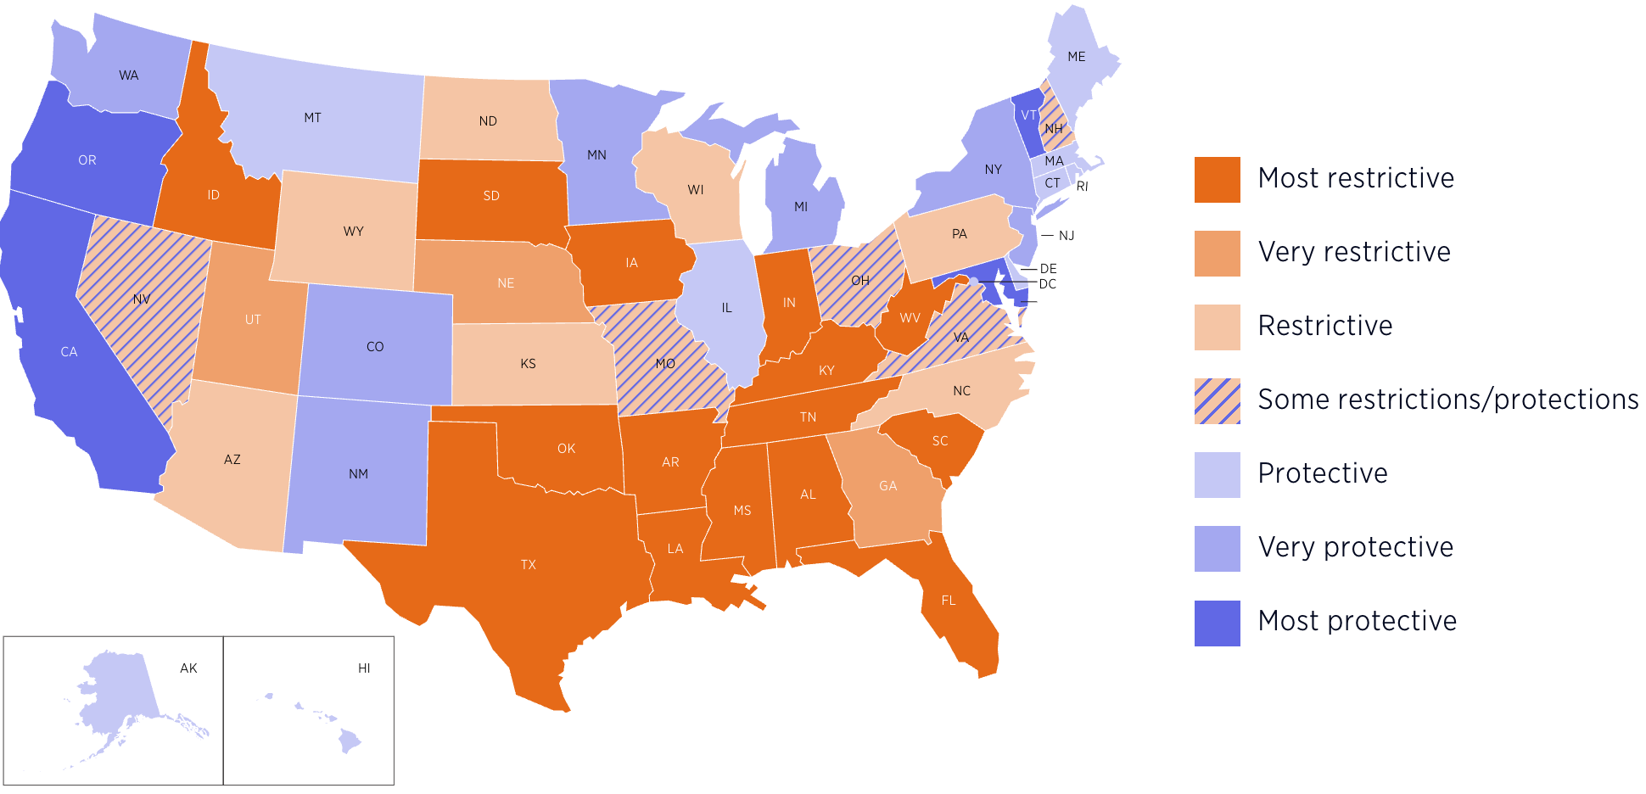
Source: https://states.guttmacher.org/policies/
Map Updated: April 22, 2025
Notes:
In June 2022, the Supreme Court’s decision on Dobbs v. Jackson Women’s Health overturned Roe v. Wade and Planned Parenthood v. Casey, meaning that the right to abortion would be determined by the states.
The dark orange states are considered the most restrictive, where abortion is banned completely. Lighter orange have gestational age bans with few exceptions. As of today, 13 states have a total ban on abortion. But there are many other state-based restrictions creating a deeply inequitable landscape for accessing care – access depends on where you live, the resources you have to travel out of state, and the sense of safety you may have to obtain a self-managed abortion or telehealth abortion when you may be surveilled by your government or family.
Abortion bans aren’t the only legal challenges. Restrictive laws like limits on gestational age, procedures that are allowed, mandated counseling, waiting periods, TRAP laws, telemedicine bans, in-person requirements, and attempts to criminalize abortion seekers and those who help people access abortion care also make it harder and more stigmatizing to obtain care.
Note for sessions that involve a national audience: In this session today, the medication abortion protocol we’ll be talking about will assume there are no state-specific restrictions. We can try to answer state-specific questions throughout the session, like what the protocol may look like with waiting periods or mandated ultrasound, etc.
Optional Discussion Question: What does this patchwork of abortion access mean for people who are trying to get abortion care in your state or community? Who are the people and communities most affected? Why?
Optional: use this map to explore with the audience the lay of the land in your state or surrounding states: https://states.guttmacher.org/policies/abortion-policies or https://reproductiverights.org/maps/what-if-roe-fell/
Users can select any state to see details about abortion policies in place, characteristics of state residents and key abortion statistics, including driving distance to the nearest abortion clinic.
Optional: use this dashboard to look at what travel out of state looks like to/from your state: https://www.guttmacher.org/monthly-abortion-provision-study#interstate-travel
References:
https://states.guttmacher.org/policies/abortion-policies

Slide 9
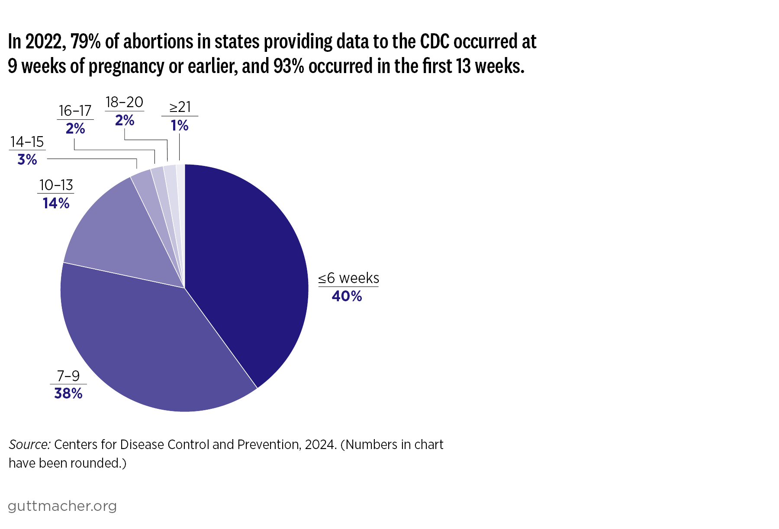
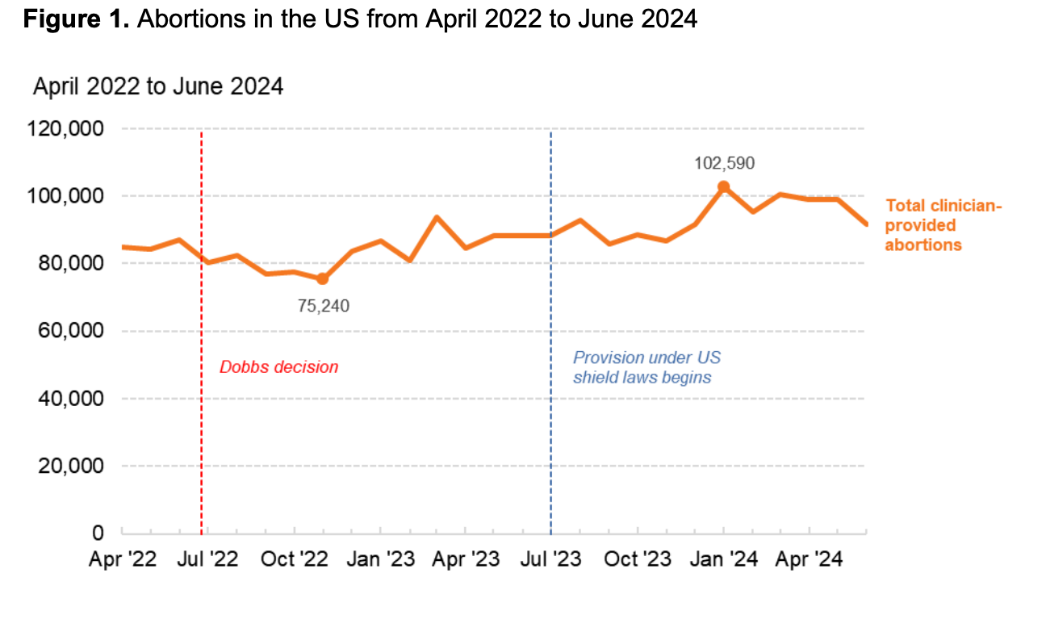
https://www.guttmacher.org/fact-sheet/induced-abortion-united-states
https://societyfp.org/research/wecount/
Notes:
Before we look at data, we want to remind us all that much of the data collected in the studies we present throughout this workshop look at the experiences of cis-gender women. Studies often do not examine data for all birthing people. We recognize that people of all genders, including transgender and non-binary people, also experience pregnancy, use contraception, and have abortions.
Abortion is an extremely common experience for people in the US, and rates have actually increased since before the Dobbs decision.
2/3 of those obtaining an abortion are in their 20s
Adolescents make up 10% of people obtaining an abortion
55% of people who have abortions have already had at least 1 birth
41% of people accessing abortion have an income below the federal poverty level.
In 2023, in the US:
93% of abortions in the formal healthcare system occurred in the first 13 weeks.
79% of abortions were performed before nine weeks
1% of abortions were after 20 weeks. This has stayed consistent since before 2020.
As of 2025, nearly 1 in 5 abortion patients have had to travel out of state to obtain care. Doubling the pre-Dobbs rate.
Sources:
Abortion in the United States, April 2025, Fact Sheet, https://www.guttmacher.org/fact-sheet/induced-abortion-united-states
https://www.guttmacher.org/monthly-abortion-provision-study
https://societyfp.org/research/wecount/

Slide 10
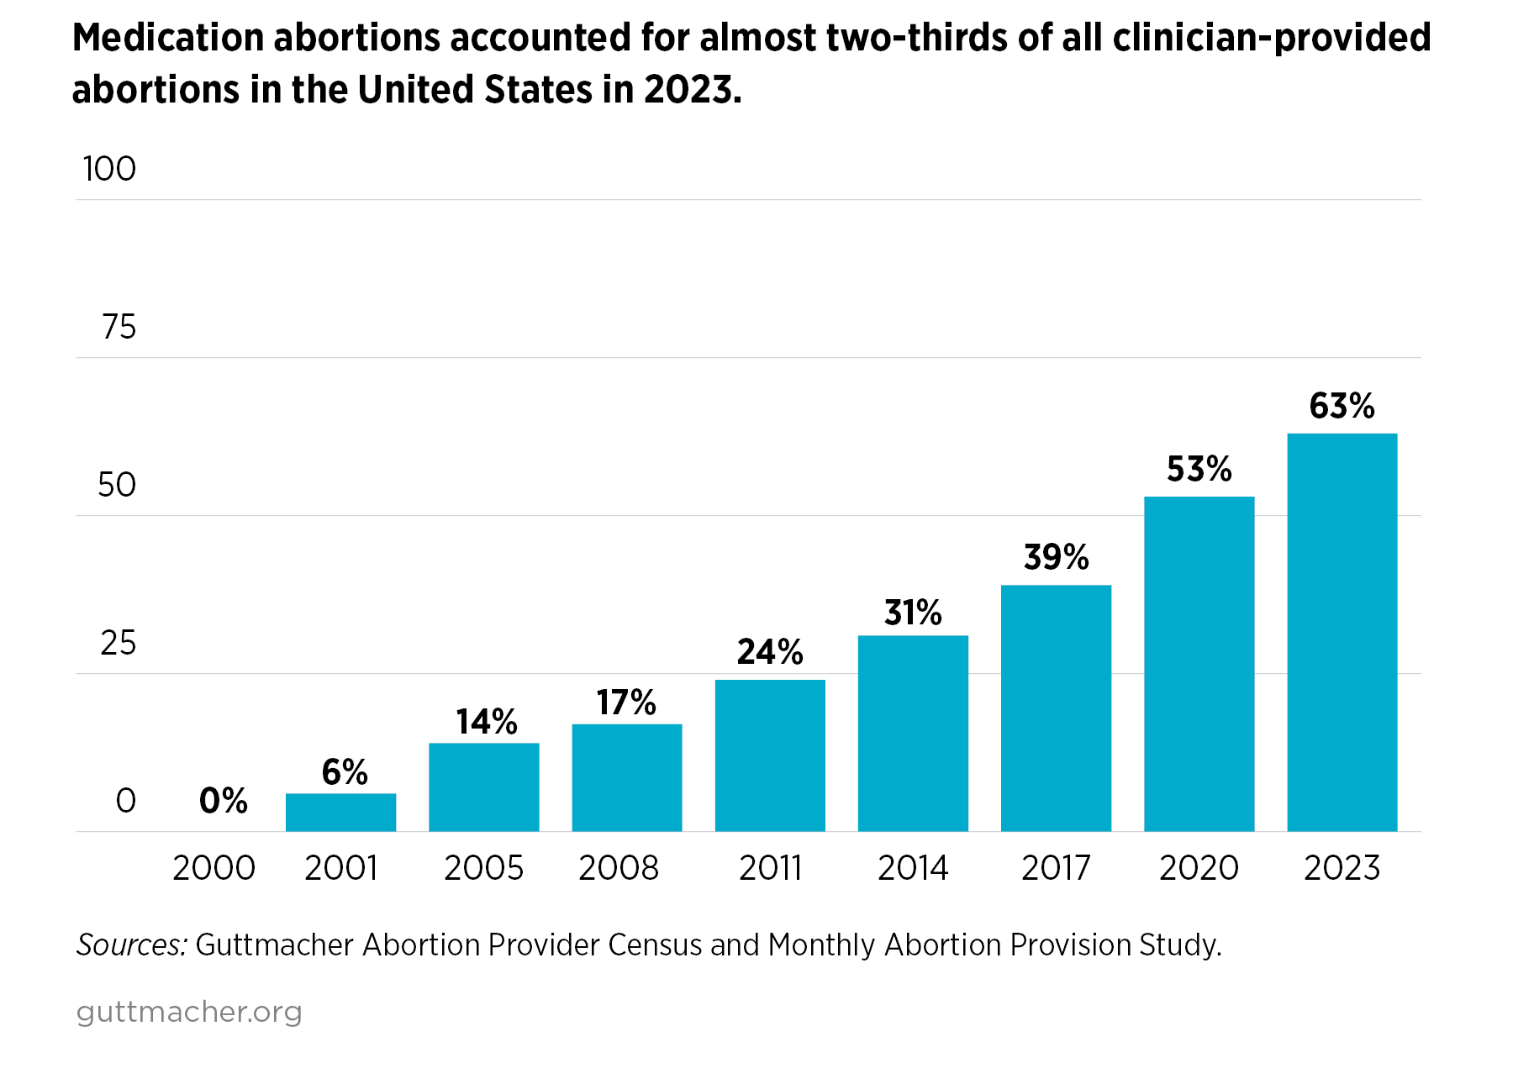
https://www.guttmacher.org/fact-sheet/induced-abortion-united-states
Notes:
Medication abortion accounts for 63% of all clinician-provided abortions in the US, up from 53% in 2020, which was the first time medication abortion become the majority of all abortions.
Medication abortion has gained really broad acceptance from patients and clinicians. Online-only or virtual clinics have come to play an important role in abortion access. They provide safe telemedicine medication abortion. In 2024, they accounted for about 20% of clinician-provided abortions, an increase from 10% in 2023. This also includes shield law provision of telemedicine abortion where providers located in states with provider protections like Washington, California, New York, and Massachusetts and they are able to provide care to patients located in states with abortion bans.
This trend underscores how central medication abortion is to US abortion provision. And how safe, effective, and feasible it is.
Reference:
Abortion in the United States, April 2025, Fact Sheet, https://www.guttmacher.org/fact-sheet/induced-abortion-united-states

Slide 11
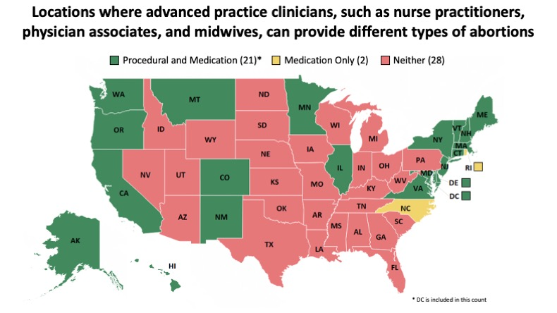
https://aptoolkit.org/advancing-scope-of-practice-to-include-abortion-care/state-abortion-laws-and-their-relationship-to-scope-of-practice/
Notes:
Primary care clinicians can provide and do provide abortion care.
Not just OBGYNs, but family physicians, pediatricians, internists and advanced practice clinicians like nurse practitioners, nurse midwives, and physician assistants – though there are some states with unnecessary restrictions that do not allow APCs to provide abortion. There are 14 states where abortion is legal where medication abortion must be provided by a physician (21 states where APCs can provide MAB and procedural abortion).
You may have also heard of an OBGYN subspecialty in Complex Family Planning. While these fellows are receiving intensive training in abortion care and other family planning care, this sub-specialty status or accreditation is not necessary to provide safe abortion care.
References
https://prochoice.org/store/clinical-policy-guidelines/
https://www.kff.org/womens-health-policy/state-indicator/state-requirements-for-the-provision-of-medication-abortion/
https://www.guttmacher.org/state-policy/explore/overview-abortion-laws
Weitz, T. A., Taylor, D., Desai, S., Upadhyay, U. D., Waldman, J., Battistelli, M. F., & Drey, E. A. (2013). Safety of Aspiration Abortion Performed by Nurse Practitioners, Certified Nurse Midwives, and Physician Assistants Under a California Legal Waiver. American Journal of Public Health, 103(3), 454–461. https://doi-org.unh.idm.oclc.org/10.2105/AJPH.2012.301159
https://www.apha.org/policies-and-advocacy/public-health-policy-statements/policy-database/2014/07/28/16/00/provision-of-abortion-care-by-advanced-practice-nurses-and-physician-assistants
https://aptoolkit.org/advancing-scope-of-practice-to-include-abortion-care/state-abortion-laws-and-their-relationship-to-scope-of-practice/

Slide 12
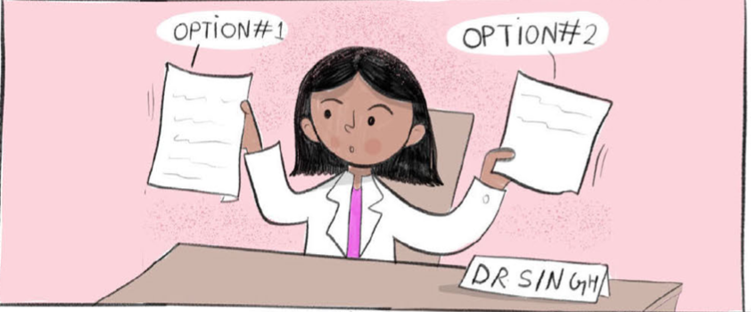
Safety of Abortion
First trimester abortions do not increase risk of:
  Infertility
  Ectopic pregnancy
  Miscarriage
  Birth defect
  Preterm or low-birthweight delivery
Image Source: Elena’s Aspiration Abortion Zine
Notes:
The most common early abortion options are medication abortion and aspiration abortion. They are both safe, effective, acceptable ways to end an early pregnancy and can be done in an outpatient setting.
Many people have misconceptions and misunderstandings about abortion that you can and should demystify: There are no increased risks of infertility, ectopic pregnancy, miscarriage, birth defect, or preterm/low birth weight delivery. Having one or more abortions does not increase any health risks or cause any of these issues.
Optional Discussion Question: What are common questions or concerns you’ve heard about abortion?
*Depending on responses – you can demystify those concerns now or throughout the session
Reference:
National Academies of Sciences, Engineering, and Medicine. 2018. The Safety and Quality of Abortion Care in the United States. Washington, DC: The National Academies Press. https://doi.org/10.17226/24950.
Image Source: Elena’s Aspiration Abortion Zine, https://www.reproductiveaccess.org/resource/elenas-aspiration-abortion-zine/

Slide 13


Medication Abortion Regimens: Two Choices
Mifepristone
Misoprostol Only
+
Misoprostol
* Mifepristone is not always available. With mifepristone, the success rate is 98-99%. With only misoprostol, the success rate is 80-95%.
Notes:
There are two common abortion regimens that use medications.
Mifepristone + misoprostol is the main protocol used currently in the US. We’ll spend most of our time today talking about this.
There’s also misoprostol only. While less common in the US, using misoprostol only is still extremely safe and effective. It’s most commonly used in a global setting outside the US. There are a few clinics that offer it as an option of MAB, but it is more commonly used when people self-manage or self-source their abortion outside of the medical setting. It can be 82-100% effective in completed abortion without procedural intervention
Also to note, mifepristone + misoprostol and misoprostol alone are two evidence-based protocols for managing early pregnancy loss with medications.
Note to Facilitator: New evidence-based medication abortion regimens are suggesting offering MAB to 12-weeks gestational age. We are waiting to update this slide deck until the National Abortion Federation Clinical Practice Guidelines are updated.

Slide 14


FDA REMS Regulations on Mifepristone
No longer need to dispense mifepristone in-office
Providers & pharmacists must be “certified” to prescribe & dispense
Sign FDA patient agreement
Image Source: RHAP
Photo: RHAP
Notes:
Before looking at the protocol, it’s important to understand how these medications are regulated – because they are.
Mifepristone is regulated under the FDA’s Risk Evaluation and Mitigation Strategy. It’s gone through many changes as evidence has consistently shown how safe and effective mifepristone is.
The current REMS requirements entail the following:
There is no more in-person dispensing requirement: allows mifepristone to be mailed or picked up in a pharmacy
Providers and pharmacists must be “certified” to prescribe and dispense, which entails completing a Prescriber Agreement Form with the manufacturer of mifepristone (GenBioPro or Danco).
Patients must sign the FDA patient agreement form, regardless if they are using mifepristone for abortion or miscarriage management.
Depending on your institution’s policies, most clinicians at a health center can work under the supervision of 1 certified Prescriber. This means only one clinician has to complete the Prescriber agreement. However, if you plan to have your patients pick up medicines from an outside pharmacy, then every Prescribing clinician will need to complete the form and send their form to the pharmacy they plan to use.
Can drop links in the chat:
- Sign FDA patient agreement: https://www.reproductiveaccess.org/resource/mifepristone-patient-agreement/ (can find links to all forms and multiple languages here)
- How to order mifepristone: https://www.reproductiveaccess.org/resource/order-mifepristone/
- Provider and pharmacy agreements https://www.accessdata.fda.gov/scripts/cder/rems/index.cfm?event=RemsDetails.page&REMS=390
Image Source: RHAP

Slide 15
Medication Abortion With Mifepristone + Misoprostol: Things to Know
98-99% effective
Avoids surgical and anesthetic risk
Greater patient autonomy and privacy
Less invasive
More “natural”
Bleeding can be very heavy, last longer
77 days (11 weeks) gestation
Telehealth option (for some states)
Image Source: RHAP
Photo: RHAP
Notes:
So let’s imagine you are providing abortion options counseling to a patient who decides they want an abortion, but aren’t sure about which type of abortion care they want - procedural abortion or medication abortion? Your job is to counsel them on their options, presenting them unbiased, evidence-based information about the different options for abortion care and what they would find helpful to guide their decision-making.
Medication abortion mife + miso things to consider:
Highly effective (98-99%)
It’s a treatment employing counseling and medication – NOT a procedure, which avoids any surgical or anesthetic risk or discomfort
May offer enhanced privacy/sense of control & autonomy over when, where, and with whom the abortion will happen
Some people comment that it feels more “natural” as though you are having a miscarriage
Bleeding can be very heavy and last longer than with a procedural abortion
Takes several days to complete the abortion
Can be provided up to 77 days (11 weeks) gestation [note: upcoming guideline changes from NAF and others may be recommending going up to 12 weeks GA]
Can also be provided by telehealth in some states. Telehealth abortion care is a safe option and for most patients, testing before a medication abortion – including ultrasound is not required for most patients. However, not at states allow telehealth for abortion care.
Can continue breast/chestfeeding without concern for side effects in infants
Resource
https://www.reproductiveaccess.org/resource/early-abortion-options/
Image Source: RHAP

Slide 16
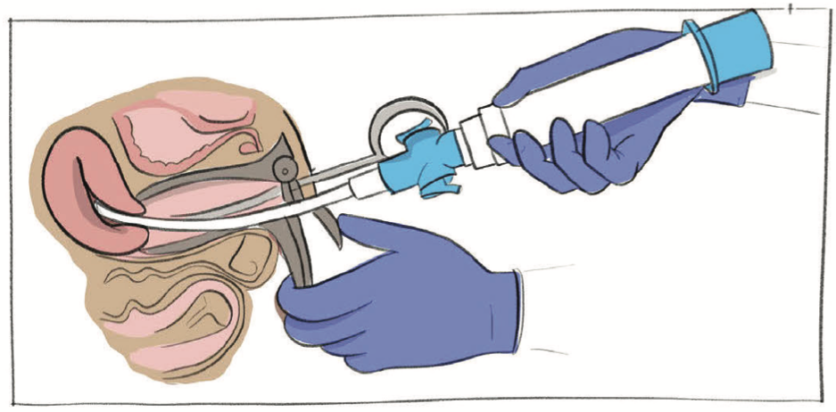
Aspiration Abortion: Things to Know
Slightly more effective (>99%)
Shorter time to completion
Shorter bleeding duration
Can be performed later in gestation
Image Source: Elena’s Aspiration Abortion Zine
Notes:
The other abortion option to counsel on is aspiration abortion. Aspiration = suction/vacuum/procedural – this is not the same as D&C
Things to know about aspiration/procedural abortion:
>99% effective: very rarely is there an incomplete abortion.
Shorter time to completion compared to medication abortion (procedure takes 5-10 minutes)
Shorter bleeding duration compared to medication abortion, light bleeding 1-7 days after procedure
Manual vacuum aspiration can be performed until up to 12 weeks gestation
Image Source: Elena’s Aspiration Abortion Zine

Slide 17
Misoprostol Route and Timing
Misoprostol Route | Buccal/sublingual | Vaginal
Misoprostol Dose | Up to 9 weeks: 1 dose, 800 mcg (4 tablets total)
 | 9-11 Weeks: 2 doses, 800 mcg each dose (8 tablets total)
Misoprostol Timing | Dose 1: 24-48 hours after Mifepristone | Dose 1: 6-72 hours after Mifepristone
 | 9-11 weeks 2nd Dose: 4 Hours after 1st miso dose
Notes:
Now let’s go over the administration of medication abortion with mifepristone and misoprostol before working through some case study examples.
Mifepristone
The patient takes one 200 mg dose of mifepristone orally. It’s up to the patient where and when they take it: in-office or at home at a time of their convenience.
Misoprostol
There are three effective routes to take the misoprostol: buccal, sublingual and vaginal. Buccal means the misoprostol is held and absorbed in the patient’s cheeks for 30 minutes, then they swallow the pills with a drink. Sublingual means the misoprostol is held and absorbed under the patient’s tongue for 30 minutes, then they swallow the pills with a drink. Vaginal means the person inserts misoprostol pills into their vagina and they lay down for 30 minutes for their body to absorb the pills. If the pills fall out, the person can throw them away.
You’ll see a distinction of misoprostol dose and timing by gestational age (up to 9 weeks and between 9-11 weeks) for both methods. The second dose of 800 mcg (four more tablets) helps to enhance efficacy of completing the medication abortion for those with higher gestations.
For those who take their misoprostol buccally or sublingually, they would take the first dose of misoprostol 24-48 hours after taking mifepristone.
For those who take their misoprostol vaginally, they would take the first dose of misoprostol 6-72 hours after taking mifepristone.
For simplicity, it can be helpful to counsel patients to take misoprostol 24-48 hours after their first dose of mifepristone, especially if they aren’t sure which route they plan on taking.
For those at higher gestational ages, they would take their second dose of misoprostol 4 hours after their first dose. They can do this buccally, sublingually, or vaginally.
*Refer to aftercare sheets for patients to have instructions on remembering this, or the how to use abortion pills handout.
RHAP Resources to Reference
https://www.reproductiveaccess.org/resource/medication-abortion-aftercare-instructions-vaginal-miso/
https://www.reproductiveaccess.org/resource/medication-abortion-aftercare-instructions-buccal/
https://www.reproductiveaccess.org/resource/mabfactsheet/
Protocol Guidance
NAF Clinical Policy Guidelines 2024: https://prochoice.org/wp-content/uploads/2024-CPGs-FINAL-1.pdf
https://www.acog.org/clinical/clinical-guidance/practice-bulletin/articles/2020/10/medication-abortion-up-to-70-days-of-gestation
References for extended gestational limit
Beverly W, Dzuba IG, Chong E, et al. Extending Outpatient Medical Abortion Services Through 70 Days of Gestational Age. Obstetrics & Gynecology. 2012;120(5):1070-1076. doi:10.1097/AOG.0b013e31826c315f.
Bracken, H., N.T.N. Ngoc, E. Schaff, K. Coyaji, S. Ambardekar, E. Westheimer, B. Winikoff. Mifepristone Followed in 24 Hours to 48 Hours by Misoprostol for Late First-Trimester Abortion. Obstetrics and Gynecology (Apr 2007), 109 pp.895-901.
Kapp N, Eckersberger E, Lavelanet A, Rodriguez MI. Medical abortion in the late first trimester: a systematic review. Contraception. 2019;99(2):77-86. doi: 10.1016/j.contraception.2018.11.002.
Dzuba I et al. A Non-Inferiority Study of Outpatient Mifepristone-Misoprostol Medical Abortion at 64-70 Days and 71-77 Days of Gestation. Contraception. 2020. 101(5):302-308.
References for lower mifepristone dose
Li C-L, Chen D-J, Song L-P, et al. Effectiveness and Safety of Lower Doses of Mifepristone Combined With Misoprostol of the Termination of Ultra-Early Pregnancy: A Dose-Ranging Randomized Controlled Trial. Reproductive Sciences. 2014;22(6):706-711.
World Health Organization Task Force on Post-Ovulatory Methods of Fertility Regulation. Comparison of two doses of mifepristone in combination with misoprostol for early medical abortion: a randomized trial. BJOG 2000 107(4): 524-530
Schaff EA, Eisinger SH, Stadalius LS, Franks P, Gore BZ, Poppema S. Low-dose mifepristone 200 mg and vaginal misoprostol for abortion. Contraception. Jan 1999;59(1):1-6.
References for higher misoprostol dose
Coyaji,K., U. Krishna, S. Ambardekar, H. Bracken, V. Raote, A. Mandlekar, B. Winikoff. Are two doses of misoprostol after mifepristone for early abortion better than one? British Journal of Obstetrics and Gynaecology, (Mar 2007), 114 (3), pp. 271–278.
Castillo P, Sanhueza P, Hernandez EML, Bousieguez M, Dzuba I. Does a repeat dose of 800mcg misoprostol following mifepristone improve outcomes in the later first trimester? A retrospective chart review in Mexico City. Paper presented at: National Abortion Federation Annual Meeting; April 22, 2017; Montreal, Quebec.
References for non-oral misoprostol route
Schaff EA, Fielding SL, Westhoff C. Randomized trial of oral versus vaginal misoprostol at one day after mifepristone for early medical abortion. Contraception. Aug 2001;64(2):81-85.
Schaff EA, Fielding SL, Westhoff C. Randomized trial of oral versus vaginal misoprostol 2 days after mifepristone 200 mg for abortion up to 63 days of pregnancy. Contraception. Oct 2002;66(4):247-250.
Winikoff B. Oral vs buccal administration of misoprostol after mifepristone for medication abortion up to 63 days. Obstetrics and Gynecology 2008
References for misoprostol timing
Guest J, Chien P, Thomson M, Kosseim ML. Randomised controlled trial comparing efficacy of same day administration of mifepristone and misoprostol for termination of pregnancy with the standard 36- to 48-hour protocol. Bjog. Oct 2005;112(10):1457.
Schaff EA, Fielding SL, Westhoff C, et al. Vaginal misoprostol administered 1, 2, or 3 days after mifepristone for early medical abortion: A randomized trial. Jama. Oct 18 2000;284(15):1948-1953.
Shannon C., E. Wiebe, F. Jacot, E. Guilbert, S. Dunn, W.R. Sheldon, B. Winikoff. Regimens of misoprostol with mifepristone for early medical abortion: a randomised trial. British Journal of Obstetrics and Gynaecology (Jun 2006), 113(6), pp 62-628.
Creinin MD, Fox MC, Teal S, Chen A, Schaff EA, Meyn LA: MOD Study Trial Group: A randomized comparison of misoprostol 6 to 8 hours versus 24 hours after mifepristone for abortion. Obstet. Gynecol. 2004 103(5 Pt. 1): 851-859

Slide 18
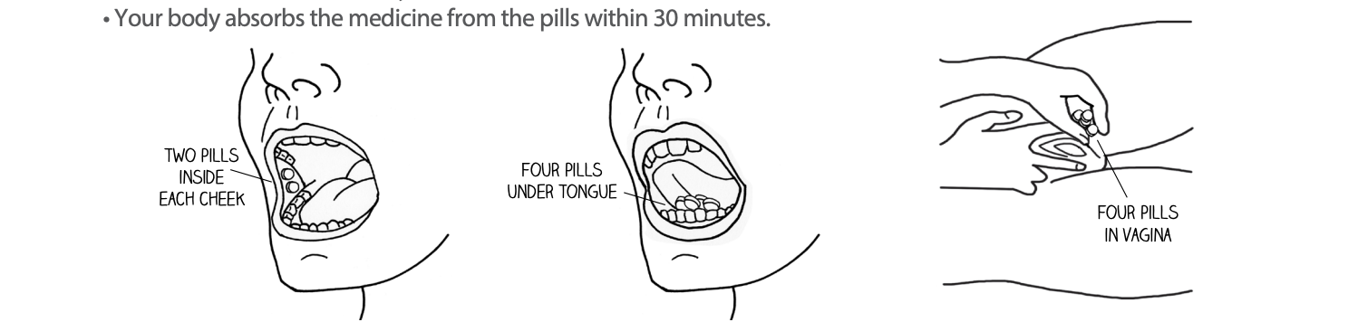
Misoprostol Routes
https://www.reproductiveaccess.org/resource/mabfactsheet/
Notes:
This illustration is from RHAP’s how to use abortion pills factsheet. This illustrates what it looks like to take a dose of misoprostol through the various routes – buccal, sublingual, and vaginal.
Image source: https://www.reproductiveaccess.org/resource/mabfactsheet/

Slide 19
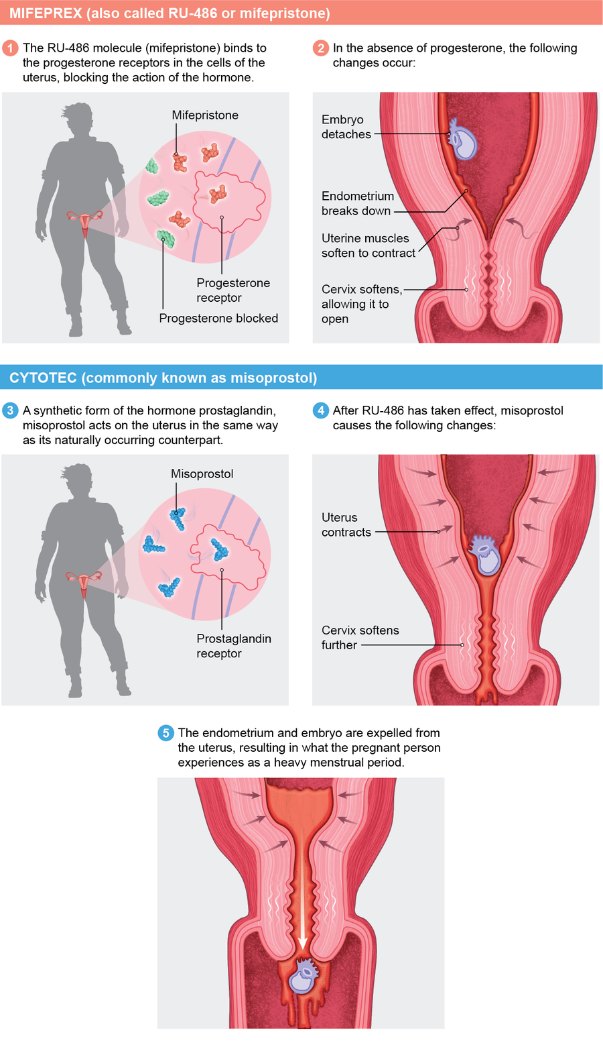
Mifepristone
Causes progesterone blockade
Decidual necrosis
Cervical ripening
Detachment
Misoprostol
https://www.scientificamerican.com/article/how-medication-abortion-with-ru-486-mifepristone-works/
Causes uterine cramping and expulsion
Notes:
How does mifepristone and misoprostol actually work?
Mifepristone, an anti-progesterone, interferes with early pregnancy by binding to progesterone receptors in the cells of the uterus. In the absence of progesterone, the embryo detaches, endometrium (uterine lining) breaks down, uterine muscles soften to contract, and cervical ripening happens: the softening and dilation of the cervix. This all prevents pregnancy from growing. These effects occur within a few hours after mifepristone administration.
Then misoprostol, a synthetic form of the hormone prostaglandin, causes further cervical softening, uterine contractions, and expulsion of pregnancy. The uterine lining and embryo are expelled from the uterus, resulting in what the pregnant person experiences as a heavy period.
References:
https://www.scientificamerican.com/article/how-medication-abortion-with-ru-486-mifepristone-works/
Image used with permission from author and under “educational fair use”

Slide 20

PATIENT CASE:
Sophia
22 years old
She/her pronouns
Requests a pregnancy test
In-clinic
Image Source: https://unsplash.com/photos/Wh-Gj7ADV6s (by Omar Lopez on Unsplash)
Notes:
[Pause and ask audience if there are any questions]
Let’s walk through a case study of an in-clinic medication abortion to demonstrate the various steps and important counseling points. Remember, you can follow along and take notes on the workshop participant guide.
Sophia’s last menstrual period was 6 weeks ago: she’s certain of the date.
Her pregnancy test is positive.
She tells you she’s married, with a young son; she works full-time and will complete college in 1 year; she is not ready to have another child.
NOTE: It’s not necessary to ask why someone wants an abortion, but sometimes our patients tell us about what’s going on in their lives and what’s bringing them to this decision.
Image Source: https://unsplash.com/photos/Wh-Gj7ADV6s (by Omar Lopez on Unsplash)

Slide 21

Counseling Sophia
Review options
Ensure the decision is hers
Your role is to facilitate the patient’s choice
Image Source: Photo by Omar Lopez on Unsplash https://unsplash.com/photos/Gx5-zf_HE9w
Notes:
How do we approach our conversation with Sophia?
Counseling
First may be pregnancy options counseling. This is simple for people who are firm in their decision – and it’s more complex for someone who is unsure.
Always ask permission if you can share and explore other options. Take a non-judgmental, trauma-informed approach to counseling
The options for a positive pregnancy test include: continuing the pregnancy and parenting, continuing the pregnancy and adoption, or abortion: medication/aspiration abortion if in early pregnancy.
If someone is sure, then that is the decision we support them with. Trust patients as the experts of their own health care.
But you do want to determine that she wants an abortion -- make sure it is Sophia, not a mother/husband/partner anyone else, who thinks they should have an abortion.
Overall, our role is to facilitate the patient’s choice or help them navigate their feelings and emotions if they are unsure or conflicted about that decision.
Sophia is sure she wants an abortion and we are certain that the decision comes from her, now we review abortion options: medication abortion and aspiration.
Image Source: Photo by Omar Lopez on Unsplash https://unsplash.com/photos/Gx5-zf_HE9w
Resources
NAF Clinical Guideline 2022: https://prochoice.org/providers/quality-standards/
https://rhedi.org/education/rhedi-curriculum/patient-centered-pregnancy-options-counseling/
https://www.all-options.org/

Slide 22

Sophia: Next Steps
Confirm gestational age
Rule out contraindications:
          Allergy to meds
          Chronic adrenal failure
          Long-term systemic corticosteroid therapy
          Anticoagulant use (excluding aspirin)
          IUD in place
          No access to follow-up
          Ectopic pregnancy
          Create safety plan, if needed
Photo Source: Unsplash by Omar Lopez https://unsplash.com/photos/0-uzdU3gUYw
Notes:
Sophia wants a medication abortion, so we move forward to assess if she has any contraindications.
1. Establish gestational age: MAB with mifepristone and misoprostol can be done up to 77 days
Sophia is certain of her last menstrual period. LMP is a good indicator for establishing GA. Studies show that people are accurately able to remember their LMP – this emphasizes the importance of trusting our patients with information about their own health.
Some patients may be more uncertain about their LMP – like if they have an inconsistent menstrual cycle or use birth control. So other ways to confirm are:
Size = dates based on bimanual exam. Not always necessary, but could be offered if there is uncertainty.
If any doubts or discrepancy between LMP and bimanual: could order or perform a sonogram/ultrasound to establish GA.
2. Rule out contraindications:
Mifepristone is an anti-progestin and anti-steroid – you want to see if Sophia has a history of chronic adrenal failure or long-term systemic corticosteroid therapy in efforts to not precipitate adrenal crisis. Nasal, inhaled, or topical steroids are okay.
Pregnancy with IUD in place is likely going to be an ectopic pregnancy -- mifepristone & misoprostol will not work for an ectopic pregnancy
Ask: Any other contraindications?
It may be worth helping Sophia think about her home/living situation
Will she need a support person to help care for her 2-year-old while she is bleeding?
Is there anyone in Sophia’s home who may become violent if they find out what is going on?
Medication abortion is private, but as it’s happening, it’s hard to keep it a secret from those who live with the person experiencing it.
OPTIONAL: How to assess safety, specifically intimate partner violence:
Do you feel safe in your current relationship?
(Note: With pregnancy options counseling, it’s good to ask if anyone is supporting them through the process. In this conversation you may learn whether the patient feels safe in their current relationship)
OPTIONAL: If Sophia says that there may be an issue of intimate partner violence if her husband find out what’s going on, how can you support Sophia navigate this situation at home and keep her abortion private from her partner? Some examples:
MAB cannot be distinguished from an EPL (unless there is pill residue). Can discuss writing letters from you as their provider stating "patient was pregnant, no longer pregnant."
Consider providing electronic copies of instructional materials or sharing a website with patient instructions to prevent a partner from finding paperwork related to the abortion.
Does she have a private place to store mifepristone (if not taken immediately) and misoprostol prior to taking it? Will she be able to get to a pharmacy to pick up other medicines (i.e. pain/anti-nausea medicines)? Will she be able to take the misoprostol in private? Is birth control sabotage happening/being forced to become pregnant? These are conversations to consider having with her and following up on in future appointments.
If Sophia really wants to keep this a secret, consider recommending that she take misoprostol buccally to avoid the risk of finding pill fragments in the vagina hours later.
Discuss Safe Horizons or other local IPV organizations. Have Sophia save the hotline phone number in their phone under an alias name.
Consider talking to Sophia about identifying a person (friend/family) who could be informed of the safety concern
Potentially identify a place to stay if Sophia is living in an unsafe situation.
Recommend scheduling a follow-up visit to check-in about safety
Photo Source: Unsplash by Omar Lopez https://unsplash.com/photos/0-uzdU3gUYw

Slide 23
Indications for Sonography: Ultrasound As Needed Protocol
Uncertain last menstrual period (LMP)
No menses after delivery, abortion, recently taking or stopping contraception
Gestational age by LMP > 77 days
Size/date discrepancy or uncertainty
History of/suspected ectopic or ectopic risk factors
Notes:
NAF 2025 clinical guideline state: “The use of ultrasound is not a requirement for the provision of first trimester abortion care.” It is acceptable to confirm gestational age prior to abortion with a sure LMP with or without uterine size on pelvic exam that is consistent with gestational age.
Requiring ultrasound can limit access to medication abortion care due to the high costs for clinic, difficulty obtaining necessary training, lack of availability of ultrasound in primary care/outpatient settings, financial cost to patients, delays in care for getting that one extra step, and patient discomfort or trauma related to GYN exams. Minimizing the need for ultrasound is important for enhancing timely and accessible care in a way that meets patients preferences and needs. But we know this isn’t possible in all states due to medically unnecessary and harmful restrictions on abortion. So if you live in a state that requires ultrasound to date gestational age, then you’ll need to do so.
In reality and in states without ultrasound requirements, a sonogram is indicated in the following situations:
Uncertain LMP
No menses after delivery, abortion, recently taking or stopping contraception
If gestational age is over 77 days by patient LMP → but if there is ultrasound on-site, consider performing ultrasound first (if the patient prefers MAB over aspiration) to confirm GA. If the ultrasound is off-site, consider bimanual exam first. If exam is consistent with <11 weeks, proceed with MAB.
Size/date discrepancy or uncertainty
History of/suspected ectopic or risk factors for ectopic (history of ectopic, PID history, tubal surgery in past): Remember, mifepristone and misoprostol will not induce abortion if it is an ectopic pregnancy
To assess for ectopic risk, look at history of previous ectopic, becoming pregnant with IUD in place, vaginal bleeding, unilateral pelvic pain, adnexal mass on exam
If low suspicion of ectopic: discuss ease, comfort, and cost of sonogram vs. initiating medication abortion with close (3 day) follow-up
If high-suspicion of ectopic: provide or refer for definitive care as appropriate
If we can get good history, medication abortion is very safe and effective without US.
References:
NAF 2024 Clinical Guidelines: https://prochoice.org/wp-content/uploads/2024-CPGs-FINAL-1.pdf
https://www.reproductiveaccess.org/resource/indications-sonography-medication-abortion/
Ralph LJ, Baba CF, Biggs MA, McNicholas C, Hagstrom Miller A, Grossman D. Comparison of No-Test Telehealth and In-Person Medication Abortion. JAMA. 2024;332(11):898–905. doi:10.1001/jama.2024.10680

Slide 24
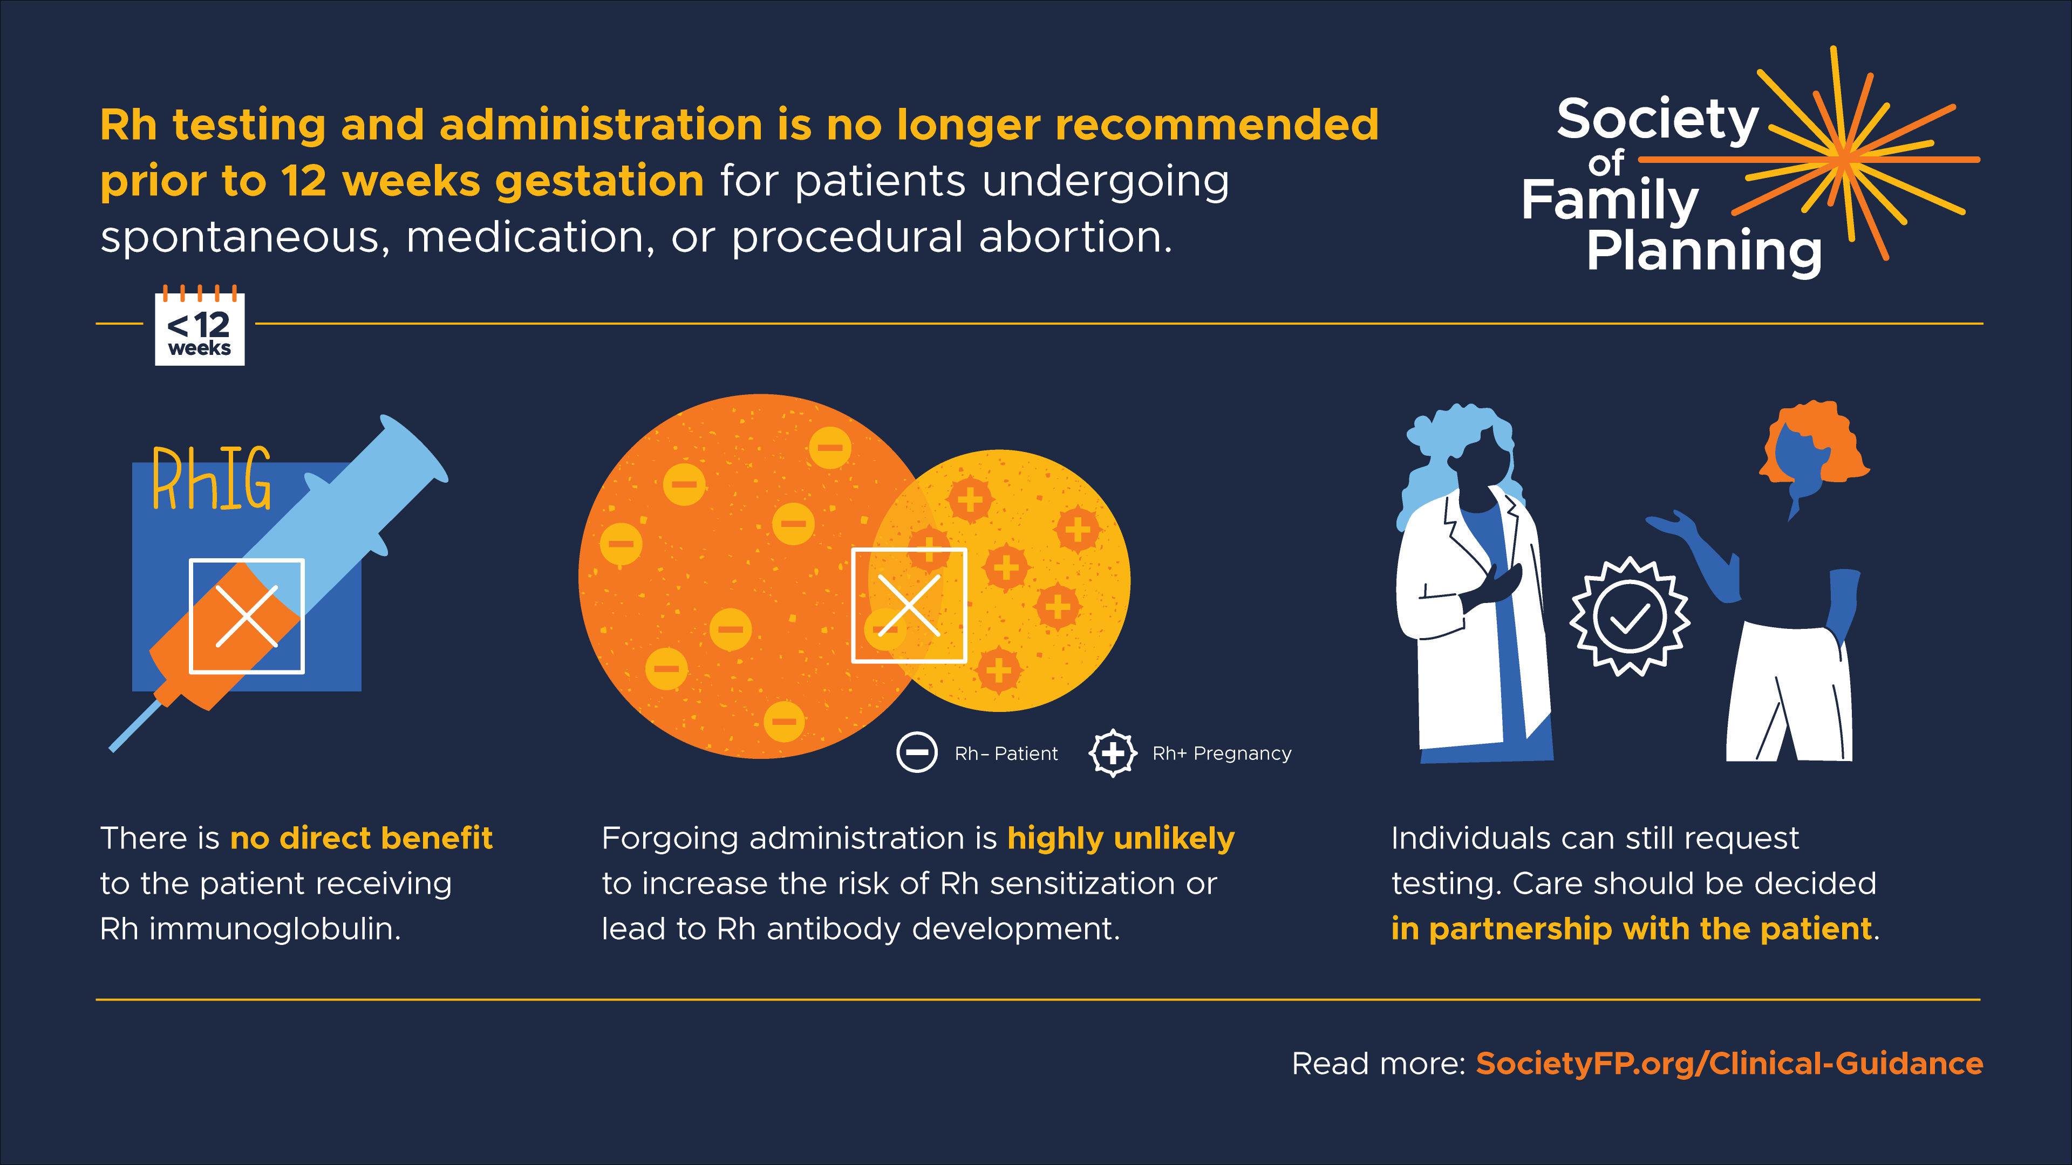
Notes:
ACOG, Society of Family Planning, and National Abortion Federation say you can forego Rh testing and/or rhogam administration up to 12 weeks gestation for MAB or procedural abortion.
What’s important is using shared decision-making with your patient -- counseling on probability of risks and allowing the patient to come to an informed conclusion of what works best for them. The risk of fetal Rh alloimmunization is very low in first trimester and likely beyond.
Institutional policies may vary and it is important to be familiar with the standards for your practice setting or to advocate for policy changes to facilitate more timely access to medication abortion.
Slide from Society of Family Planning
References:
Horvath S, Goyal V, Traxler S, Prager S. Society of Family Planning committee consensus on Rh testing in early pregnancy. Contraception. 2022;114:1-5. doi:10.1016/j.contraception.2022.07.002
ACOG Clinical Practice Update: Rh D Immune Globulin Administration After Abortion or Pregnancy Loss at Less Than 12 Weeks of Gestation. Obstetrics & Gynecology 144(6):p e140-e143, December 2024. | DOI: 10.1097/AOG.0000000000005733
NAF 2024 Clinical Guidelines: https://prochoice.org/wp-content/uploads/2024-CPGs-FINAL-1.pdf

Slide 25

Next Steps
Serum hCG (optional)
Hemoglobin/hematocrit (optional)
Anticipatory guidance
Patient agreement (required!)
Mifepristone and misoprostol pills (dispensed in-clinic, mail-order pharmacy order, or prescription for pharmacy pick-up)
Image Source: https://unsplash.com/photos/a8cWVqHa0nA by Omar Lopez on Unsplash
Notes:
So you don’t need to do Rh testing. It’s optional if you’d like to test your patient’s hCG level before medication abortion and again at a future follow-up visit to monitor the success of the abortion. Serum hCG does not date the pregnancy, but it allows for a comparison of hCG levels before and after abortion. A drop of >80% at one week after cramping and bleeding is a sign of successful abortion.
Another optional test is the baseline hemoglobin or hematocrit level, especially if there is a history of anemia.
Again, both of these are optional for in-clinic medication abortion. As you can imagine, telehealth providers of medication abortion often do not do these labs.
To recap: We walked through the patient’s history: Sophia’s LMP indicates 6 weeks gestational age. She wants a medication abortion. There are no contraindications to MAB. We’re almost ready to dispense medications…but first we want to talk to Sophia about what to expect when she takes the pills and she needs to sign the FDA patient agreement form.
References:
NAF 2024 Clinical Guidelines: https://prochoice.org/providers/quality-standards/
Image Source: https://unsplash.com/photos/a8cWVqHa0nA by Omar Lopez on Unsplash

Slide 26
Anticipatory Guidance
Anticipatory Guidance: within 24 hours – cramping, heavy bleeding, clots, sometimes GI side effects
Sophia takes mifepristone in your office, or later at home
At home, Sophia takes pain meds, then misoprostol
Notes:
You counsel Sophia on how to take the pills and what to expect. Offer a handout on MAB aftercare instructions so she can refer back to this.
Sophia can take mifepristone in the office or at home. She chooses to take it in the office. You advise her that she probably won’t have any symptoms until she uses misoprostol at home. She may have some spotting, or may have nothing at all. This is normal.
Anticipatory Guidance: within 24 hours after taking misoprostol, patient can expect:
Bleeding: The heaviest bleeding (usually heavier than with menses) will likely occur several hours after taking the Misoprostol and will last 1-2 days. Bleeding/spotting is typical up to 9-16 days. A small number of patients (8%) may experience some type of bleeding for 30 days or more. The amount and duration of bleeding is likely to increase with gestational age. There is a very small risk of prolonged bleeding requiring uterine aspiration.
Seeing tissue and clots: The size of the pregnancy tissue increases with gestational age. So it’s important to advise the patient that you may see tissue from the pregnancy.
Cramping and uterine pain: Cramping is expected for up to a few days. Pain pills can help.
GI-related side effects are more common with buccal/sublingual administration of miso, like loose stools and nausea

Slide 27
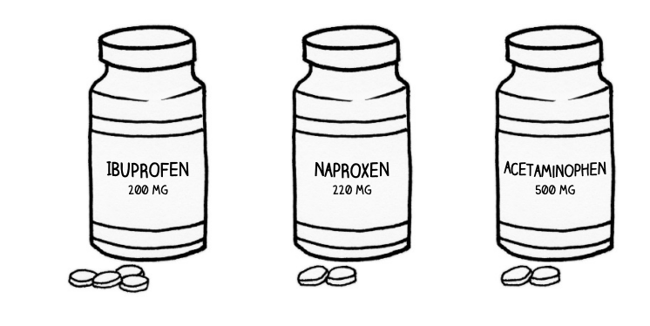
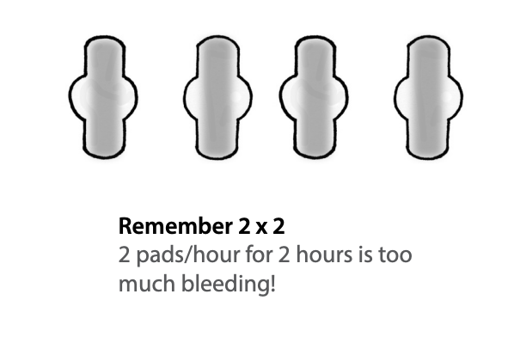
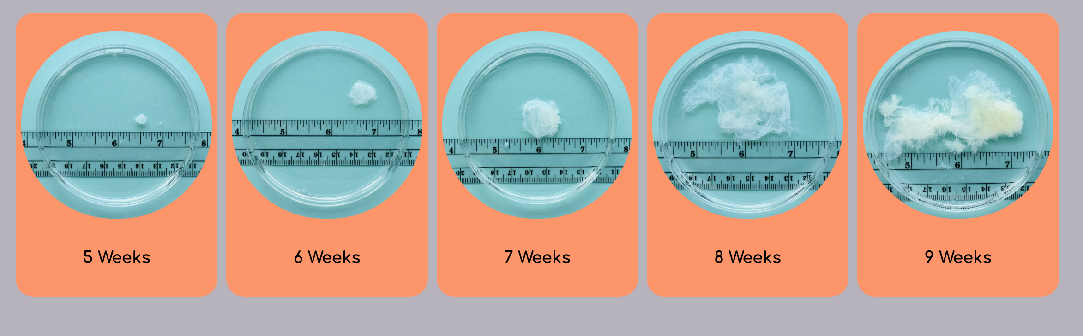
Offer prescriptions for pain medication to take at home or advise taking whatever Sophia normally takes for menstrual cramps. Advise patient to take it shortly before taking misoprostol in anticipation of some cramping.
https://myanetwork.org/the-issue-of-tissue/
Notes:
Instruct Sophia on how much bleeding is too much. Use the 2x2 rule: If they are soaking through more than 2 pads per hour for 2 hours in a row, they should call you.
It can be helpful to advise patients that you may see tissue from the pregnancy. You can use these pictures from the Mya Network to help prepare patients for what they should expect to see based on their gestational age. [Drop in chat: https://myanetwork.org/the-issue-of-tissue/]
These photos are the gestational sac. They rinsed off blood and menstrual lining for these photographs. Most people will experience a heavy period which may include blood clots of varying sizes, so it can be difficult to see the pregnancy tissue unless they purposefully look for it. Sophia may not see anything. Patients over 9 weeks may see an early embryo.
There are other commonly reported side effects that should not last longer than 24 hours after taking misoprostol. If these last longer, patient should be instructed to contact the office to determine if they should seek care. These include:
-Diarrhea, nausea, and vomiting
-Weakness
-Fever/chills
-Headache
-Dizziness
*For fever, risk of infection is VERY low, but we’d want to hear if the patient is having sustained fevers and chills after 24 hours.
AND, If the patient is not having any bleeding after using misoprostol, they should reach out.
Image Sources:
https://myanetwork.org/the-issue-of-tissue/
https://www.reproductiveaccess.org/resource/mabfactsheet/

Slide 28
Options for Contraception
- Same Day: estrogen/progestin pill, patch, ring, implant, progestin-only pill, barrier methods
- Same Day: DMPA injection (may decrease mifepristone effectiveness)
Other options: prescription for Sub-Q Depo, return for shot after MAB is complete
- 4 Days After Misoprostol: Copper or Hormonal IUD
*Advise on back-up methods if patient starts contraception more than 7 days after mifepristone
Notes:
Talk to Sophia about contraception if she is interested
Depending on a patient’s medical eligibility, these contraceptive methods are safe and effective post-abortion though timing may differ on when the person can start the contraception.
Estrogen/progestin pill, patch, ring (can start same day they use mifepristone)
Progestin-only pill, depo injection, implant (can start same day they use mifepristone though some evidence that depo injection decreases effectiveness of mifepristone).
For Depo, a patient can receive the shot the same day if they accept possible decrease in effectiveness; they can return for the shot after the medication abortion is complete; or they can receive a prescription for sub-q Depo Provera and self-administer at home after the abortion is complete.
IUD can be inserted 4 days after misoprostol.
Barrier methods (can start same day they use mifepristone)
If the patient starts contraception more than 7 days after taking mifepristone, advise on using back-up methods like condoms for the first 7 days.
Copper IUD, Mirena and Liletta IUDs are effective immediately.
No back-up methods are needed for those who start contraception within the first 7 days after taking mifepristone.
Sources
Cansino C, Lichtenberg ES, Perriera LK, et al. Do women want to talk about birth control at the time of a first-trimester abortion? Contraception. 2018 Dec;98(6):535-540. doi: 10.1016/j.contraception.2018.08.005.
Matulich M, Cansino C, Culwell KR, Creinin MD. Contraception. Understanding women’s desires for contraceptive counseling at the time of first-trimester surgical abortion. 2014;89(1):36.
Raymond EG, Weaver MA, Louie KS, et al. Effects of depot medroxyprogesterone acetate injection timing on medication abortion efficacy and repeat pregnancy random controlled trial. Obstet Gynecol. 2016;128(4):739.
Raymond EG, Weaver MA, Tan YL, et al. Effect of immediate compared with delayed insertion of etonogestrel implants on medical abortion efficacy and repeat pregnancy: A randomized controlled trial. Obstet Gynecol. 2016 Feb;127(2):306-12.
https://www.reproductiveaccess.org/resource/contraceptive-pearls-post-abortion-contraception/
Curtis KM, et al. US Selected Practice Recommendations for Contraceptive Use. CDC Morbidity and Mortality Weekly Report. 2024 Aug; 73(3);1-77. https://www.cdc.gov/mmwr/volumes/73/rr/rr7303a1.htm

Slide 29
Options for Follow Up
Follow-up is not required, but can be offered
Patient-driven follow-up: repeat home pregnancy test in 4 weeks
Follow-Up Points:
  Assure completion: 4 cardinal questions
    Did you take the pills? Did you have bleeding?
    Did you have cramping? Do you still feel pregnant?
  Process experience
  Review contraceptive choice, if desired
Notes:
You end the visit by giving Sophia information on how to reach the on-call provider who is available to answer questions if needed (My Chart Message, phone number). We’ve seen that with good counseling and informational hand-outs, many patients don’t call with questions. But always make some sort of source available to answer patient questions during normal clinic hours and after-hours.
Remember, routine follow-up is not required or necessary in most cases, it mainly serves to confirm whether the abortion is complete and to talk through any side effects or concerns.
You can offer to schedule Sophia an in-person or telehealth visit to follow-up in 7-14 days to ensure the abortion is complete. You can also follow-up by phone instead of a formal visit.
You encourage Sophia to do her own follow-up too, with another home pregnancy test in 4 weeks: at home pregnancy tests are highly sensitive and may still show as pregnant if done before 4 weeks.
If you follow-up with the patient over phone, video, or in-person, use these 4 cardinal questions to assess complete abortion:
Did you take the pills?
Did you have bleeding?
Did you have cramping?
Do you still feel pregnant?
Some people have pregnancy symptoms (breast tenderness, nausea). So it’s important to document those in your initial visit, and follow up on those symptoms to assess if the MAB is complete and the person isn’t pregnant anymore.
If the person comes in for a follow up visit AND if a beta hCG was taken in the initial visit, you can follow up on that and draw a sequential beta and evaluate the trend (decline). You can offer a sonogram to visualize if the pregnancy has been evacuated from the uterus. This is only needed in some cases, like:
If history and symptoms not consistent with successful medication abortion (no bleeding or cramping)
Patient reports still feeling pregnant
Serum HCG has not declined by 50% in 4-5 days or by 80% in 7 days
No initial HCG was drawn and urine HCG is still positive more than 3 weeks later
It can also be helpful to process the experience. It can be normal for patients to be dealing with different emotions or not having any emotions about it at all. It’s good to leave space for that kind of conversation. You may want to make connections to post-abortion counseling services like Exhale (https://exhaleprovoice.org/) or counseling/support services in your own clinic.
In a follow-up visit, you can also review contraceptive options or previous choices if interested.

Slide 30
Phone Calls After Medication Abortion
“There wasn’t much blood.”
“Am I still pregnant?”
Was there some bleeding? Any cramping? Did you take the misoprostol?
Ask if pregnancy symptoms have disappeared.
“I’m bleeding and cramping a lot.”
“I’m still bleeding after 2 weeks.”
That’s normal unless you’re soaking two heavy pads an hour for two consecutive hours.
That’s normal unless you’re soaking two heavy pads an hour for two consecutive hours.
Offer follow-up appointment.
Notes:
Before follow-up, patients may call with symptoms that worry them. For the majority, the only necessary interventions are listening and reassuring.
There wasn’t much blood.
Ask: Was there some bleeding? Any cramping? Did you take the misoprostol?
For folks in the 9-11 week protocol, ask: did you take 2 doses of misoprostol?
I’m bleeding and cramping a lot.
Reassure: bleeding and cramping are normal, unless the 2x2 rule applies – if you are soaking through 2 pads an hour or more for 2 consecutive hours.
Am I still pregnant?
Ask: do you still feel pregnant? Have your pregnancy symptoms disappeared?
I’m still bleeding after 2 weeks.
Ask about 2x2 rule? If the bleeding is very heavy, ask for the patient to come in.
Offer a follow up appointment if they are concerned.
Note to facilitator: Feel free to share other commonly asked questions you may have received from patients.
You can invite the audience to share any commonly asked questions they’ve received from patients or that they anticipate from patients.
You can also check out more FAQs people ask about MAB if you want to foster more discussion on this topic: https://www.reproductiveaccess.org/resource/medication-abortion-faqs/
Any questions so far?
Resources:
https://www.reproductiveaccess.org/resource/medication-abortion-faqs/

Slide 31
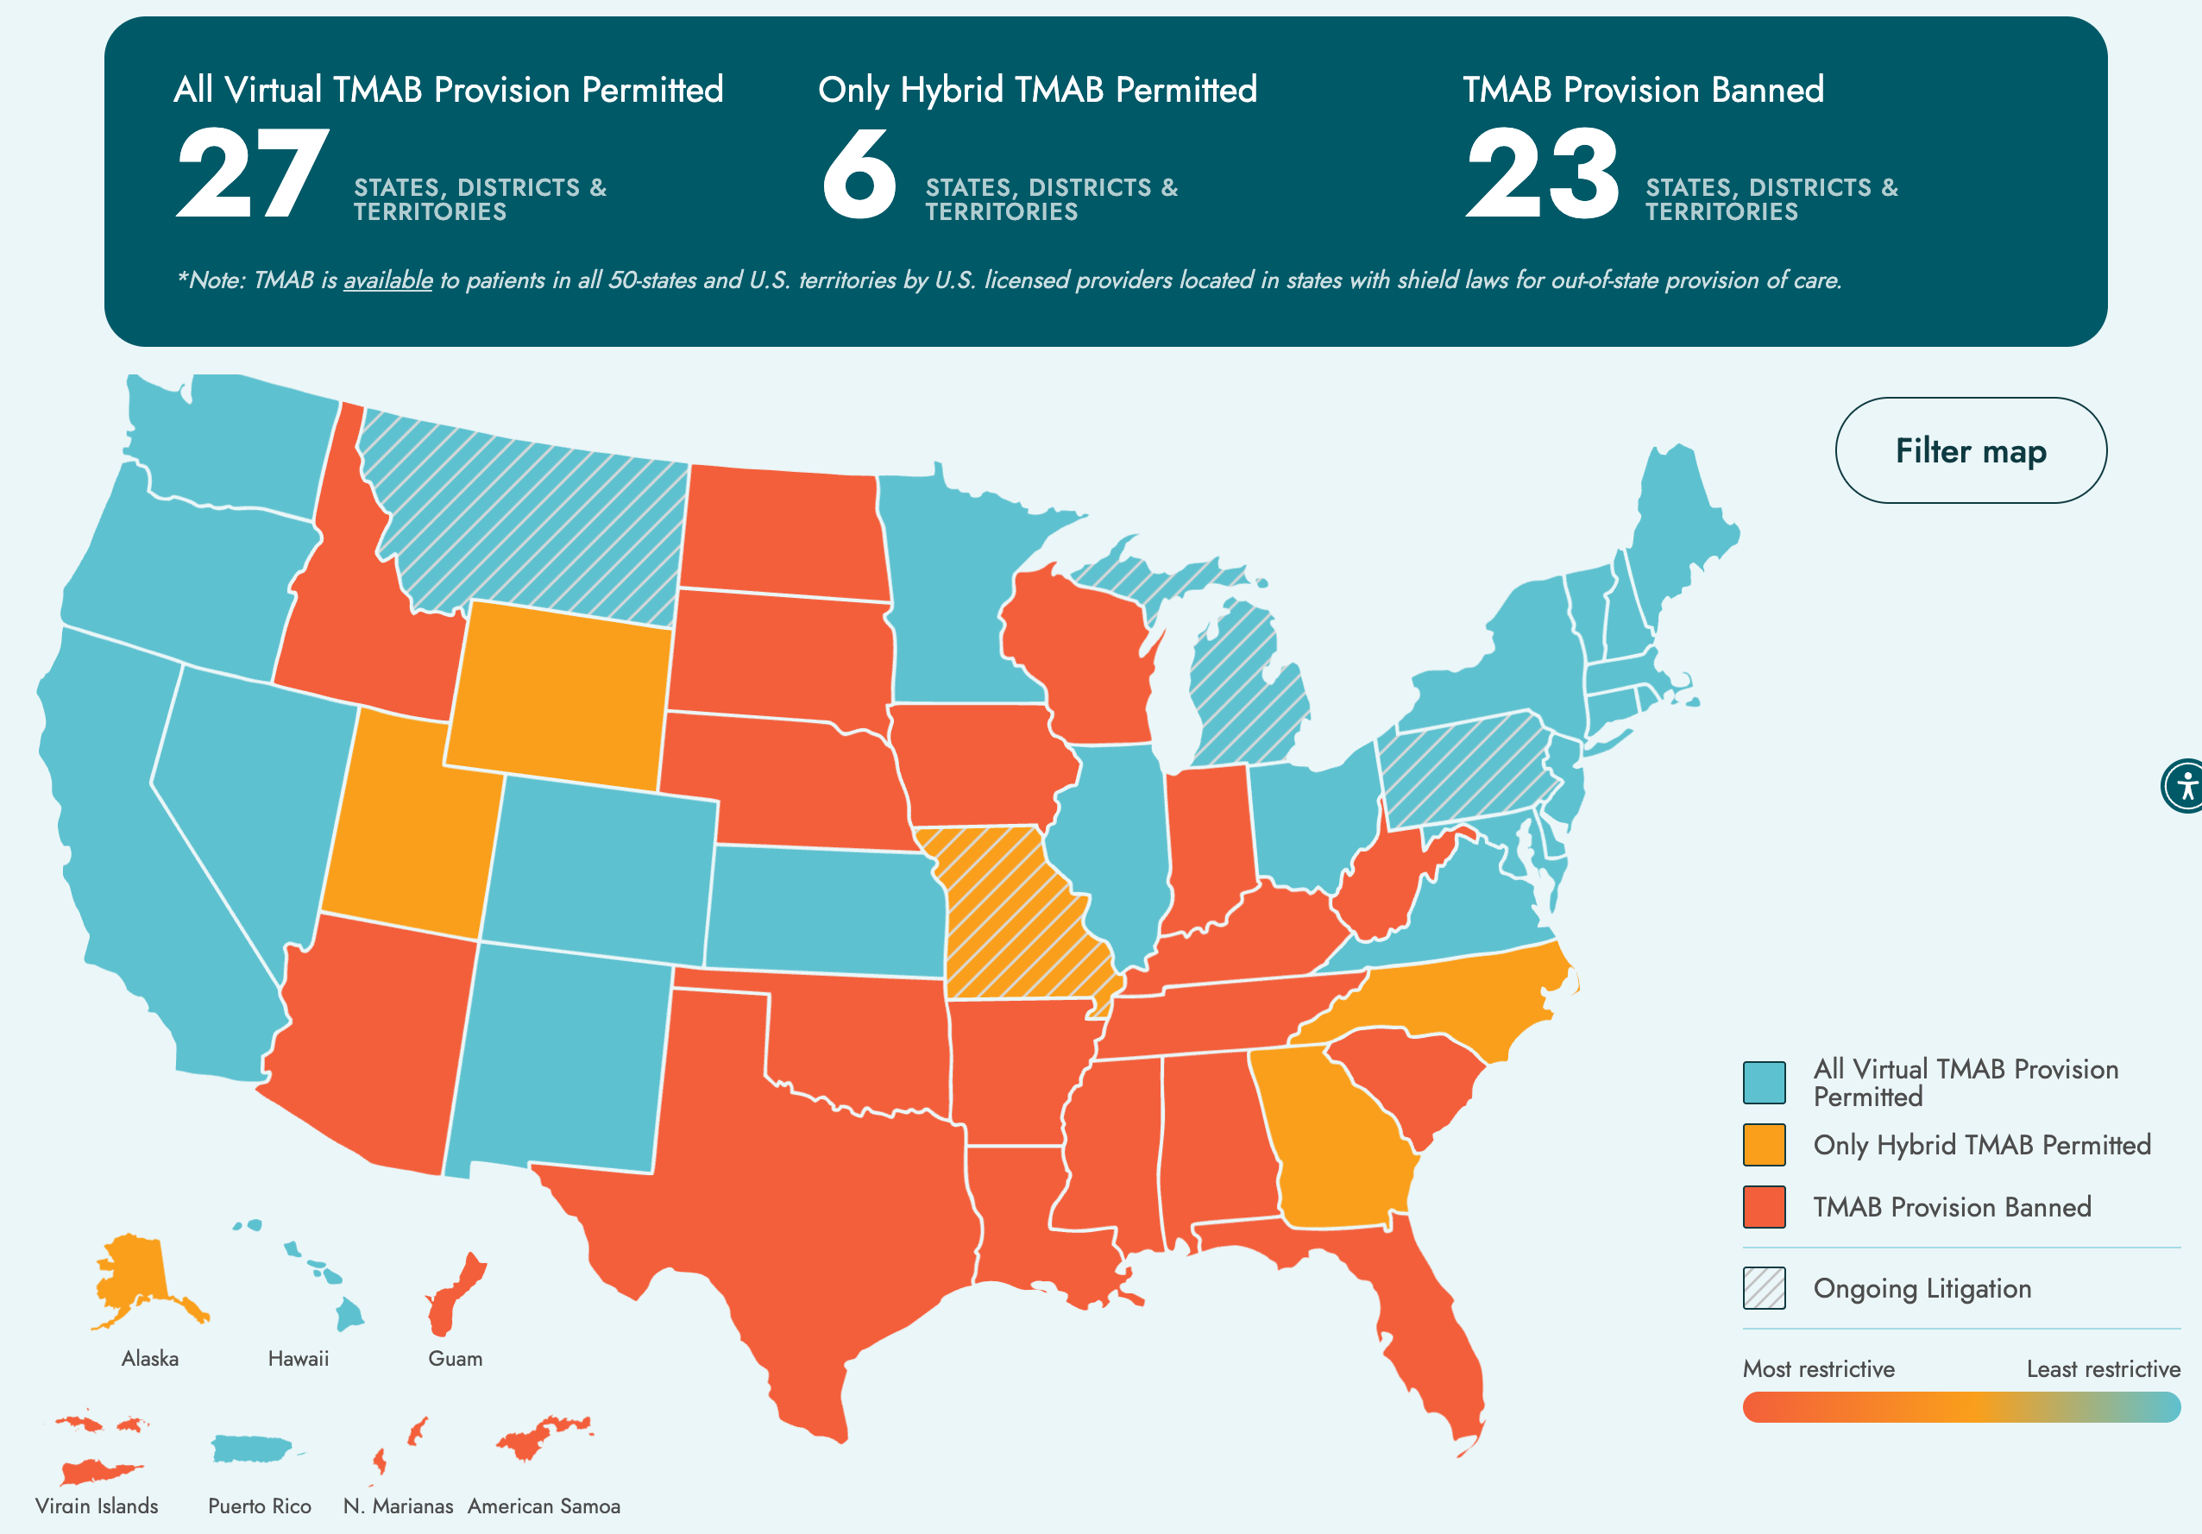
https://www.rhites.org/maps
Notes:
Note to Facilitator: If the audience works primarily in states where telehealth medication abortion is banned, feel free to skip this case study.
As of May 2025, 23 states, districts, and territories ban the use of telehealth medication abortion and 6 only allow a hybrid model. 27 states, districts, and territories permit telemedicine abortion. But, telemedicine abortion is available to patients in all 50 states and US territories by a licensed US clinician located in states with shield law protections – which essentially legally protect providers licensed in one state to provide abortion care in another state.
Let’s walk through a situation where someone comes to you for a telehealth medication abortion. Here we are going to assume that there aren’t additional restrictions and we’re in a state with full telemedicine abortion access OR that this is a shield law provider offering telemedicine abortion to someone in a restricted state.
The main things to know about a telehealth abortion is that the clinician should counsel the patient by phone, text, or video about pregnancy options. Those who choose medication abortion can be counseled about the process. Patient information sheets can be emailed, faxed, texted through patient portals. And, the medications can be mailed directly to the patient.
References:
https://www.rhites.org/tmab-map
https://www.kff.org/womens-health-policy/slide/state-restrictions-on-telehealth-abortion/
Image Source: https://www.rhites.org/maps

Slide 32

PATIENT CASE:
Ty
28 years old
They/them pronouns
Took a pregnancy test
Booked telehealth appointment with you.
Image source: https://genderphotos.vice.com/
Notes:
So here we have Ty, they are a 28-year old non binary person. They took a pregnancy test and booked a telehealth appointment with you because they want an abortion.
Image source: https://genderphotos.vice.com/

Slide 33
Telehealth Abortion Discussion Points
Abortion options counseling
Medical history, including LMP for gestational dating
Explain protocol and steps for taking mifepristone and misoprostol
Review of expected effects & signs to call clinician
E-sign patient agreement
Talk about options for getting the pills: mailing or in-office pick up
  Mail: include mifepristone, 4-8 200mcg pills of misoprostol, pain medicine, urine pregnancy test, instruction sheet in package
Offer follow-up visit in-person, via telehealth/phone call
Home urine pregnancy test 4 weeks later
Notes:
Initial assessment – discussion of MAB for Ty
We start with abortion options counseling
We review their medical history, including asking about LMP to confirm gestational age and confirming that they did a home urine pregnancy test. If we’re reasonably certain about their gestational age, then we can move forward with a medication abortion without additional labs. Remember your criteria for needing an ultrasound.
ASK: What are some contraindications to medication abortion we should find out about for our medical history?
Then we the process and steps to the patient for taking medication. ASK: what are the steps for taking the medications?
Then, we review of expected effects of medication abortion. ASK: what are some expected effects? What are signs to call a clinician:
Bleeding and cramping, heavier and more painful than with menses, are expected. Taking pain medications one hour before misoprostol can help.
Diarrhea and gastrointestinal effects are common
Small risk of prolonged bleeding requiring aspiration/MVA
Call if: too much bleeding, no bleeding, fever and chills after 24 hours
May sure Ty knows how to reach you or another clinician on call if they need to talk to you or have any questions.
You have the patient e-sign the patient agreement form. This can be done verbally or you can send the forms via patient portal through DocuSign or other platforms, depending on our institution. The main piece from the REMS is to document the consent of the patient in the patient chart. Many services have uploaded the text into a smartset in their EHR and patients are able to review and consent within the EHR portal. Many services also do the signatures asynchronously, the patient and clinician do not need to sign the form at the same time.
Talk about options for how they want to get the pills, for example coming to the office to pick them up, getting them mailed, going to a pharmacy with a prescription to pick them up.
If you are able to mail them directly from the office, or if you contract with a mail order pharmacy like HoneyBee, it’s useful to include mifepristone, 1-2 doses of misoprostol, pain medication, a urine pregnancy test for them to use 4 weeks later, and patient instructions all in the same package
Option to review contraceptive options if Ty is interested.
And of course, offer a follow-up visit in 7-14 days if they’d like, in person or via a phone call or video telehealth visit. Follow up is not required, but the option is recommended. Ty can take a home urine pregnancy test 4 weeks after the abortion to confirm whether the pills worked.
Note: remember, there may be state requirements to comply with like mandatory waiting periods, parental notification, etc. Consult with Center for Reproductive Rights for more information (reproductiverights.org) or Abortion Defense Network if you need guidance specific to your state.
Resources:
https://familymedicine.uw.edu/accessdelivered/
https://www.reproductiveaccess.org/resource/telehealth-care-for-mab-protocol/
https://www.reproductiveaccess.org/resource/telehealth-care-for-mab-workflow/

Slide 34
Options for Picking up the Pills
Mail from the health center
  Include mifepristone, 4-8 200mcg pills of misoprostol, pain medicine, urine pregnancy test, instruction sheet in package
Mail order pharmacy
  HoneyBee, American Mail Order Pharmacy, Manifest
Pharmacy dispensing
  CVS and Walgreens in many states are certified to dispense
  Local/independent pharmacies may also become certified
  Prescriber must obtain NDC/lot number
Notes:
There are different options for mailing the pills
Your health center may have a courier service or way of mailing the pills that are already stocked at your institution. If mailing is an option, include both mifepristone and 1-2 doses of misoprostol (4-8 200 mcg pills). Include a urine pregnancy test for follow-up testing, take home instructions, contact info, a copy of the consent if possible, and pain medicine like ibuprofen.
Mail Order Pharmacy
Mail order pharmacies such as HoneyBee, American Mail Order Pharmacy, and Manifest are certified to dispense mifepristone.
Honeybee is located in nearly all states that allow mailing abortion pills and does not accept insurance, it is considered a “service” but they work with health centers to negotiate payment plans and structures, and have an “abortion fund”-like system to support payment for patients that can’t afford the MAB cost.
These services often allow you to customize patient packages with things other than the pills (i.e. pregnancy test, pain medication, heating pack, your instructions, consent form, etc)
Pharmacy Dispensing
As of May 2025, CVS and Walgreens’ pharmacies in CA, CO, CT, DC, DE, HI, IL, MA, MD, ME, MI, MN, NH, NJ, NM, NV, NY, OR, PA, RI, VA, VT, and WA are certified to dispense mifepristone. The specific locations have not been made public.
Some pharmacies have elected to be listed on GenBioPro’s Pharmacy Directory. Certified prescribers may locate additional pharmacies by contacting GenBioPro at info@genbiopro.com or Danco at 1-877-4 Early Option (1-877-432-7596).
Prescribers must provide the certified pharmacy their Prescriber Agreement Form by email or fax. You can do this prior to sending a prescription or the first time you send a prescription. You only need to do this once per pharmacy location. You can submit a Prescriber Agreement Form from either manufacturer, regardless of which medication the pharmacy dispenses. Each individual clinician that is prescribing mifepristone needs to complete a prescriber agreement form and send it to the pharmacy.
You must obtain the NDC and lot number of the package of mifepristone received by the patient.
The patient must pick up the prescription within 4 calendar days of the day the prescription was sent to the pharmacy. If this does not happen, the pharmacy will contact the prescriber.
We recommend talking to your local pharmacies where your patients tend to get their medications to see if you can set up agreements between certified prescribers at your health center and the pharmacy.
[Note to facilitator: if you are familiar with other pharmacies that provide and/or mail the abortion pills, please share your experiences and information with the audience]
Resources:
https://www.reproductiveaccess.org/resource/order-mifepristone/
https://familymedicine.uw.edu/accessdelivered/
https://www.reproductiveaccess.org/resource/telehealth-care-for-mab-protocol/
https://www.reproductiveaccess.org/resource/telehealth-care-for-mab-workflow/

Slide 35
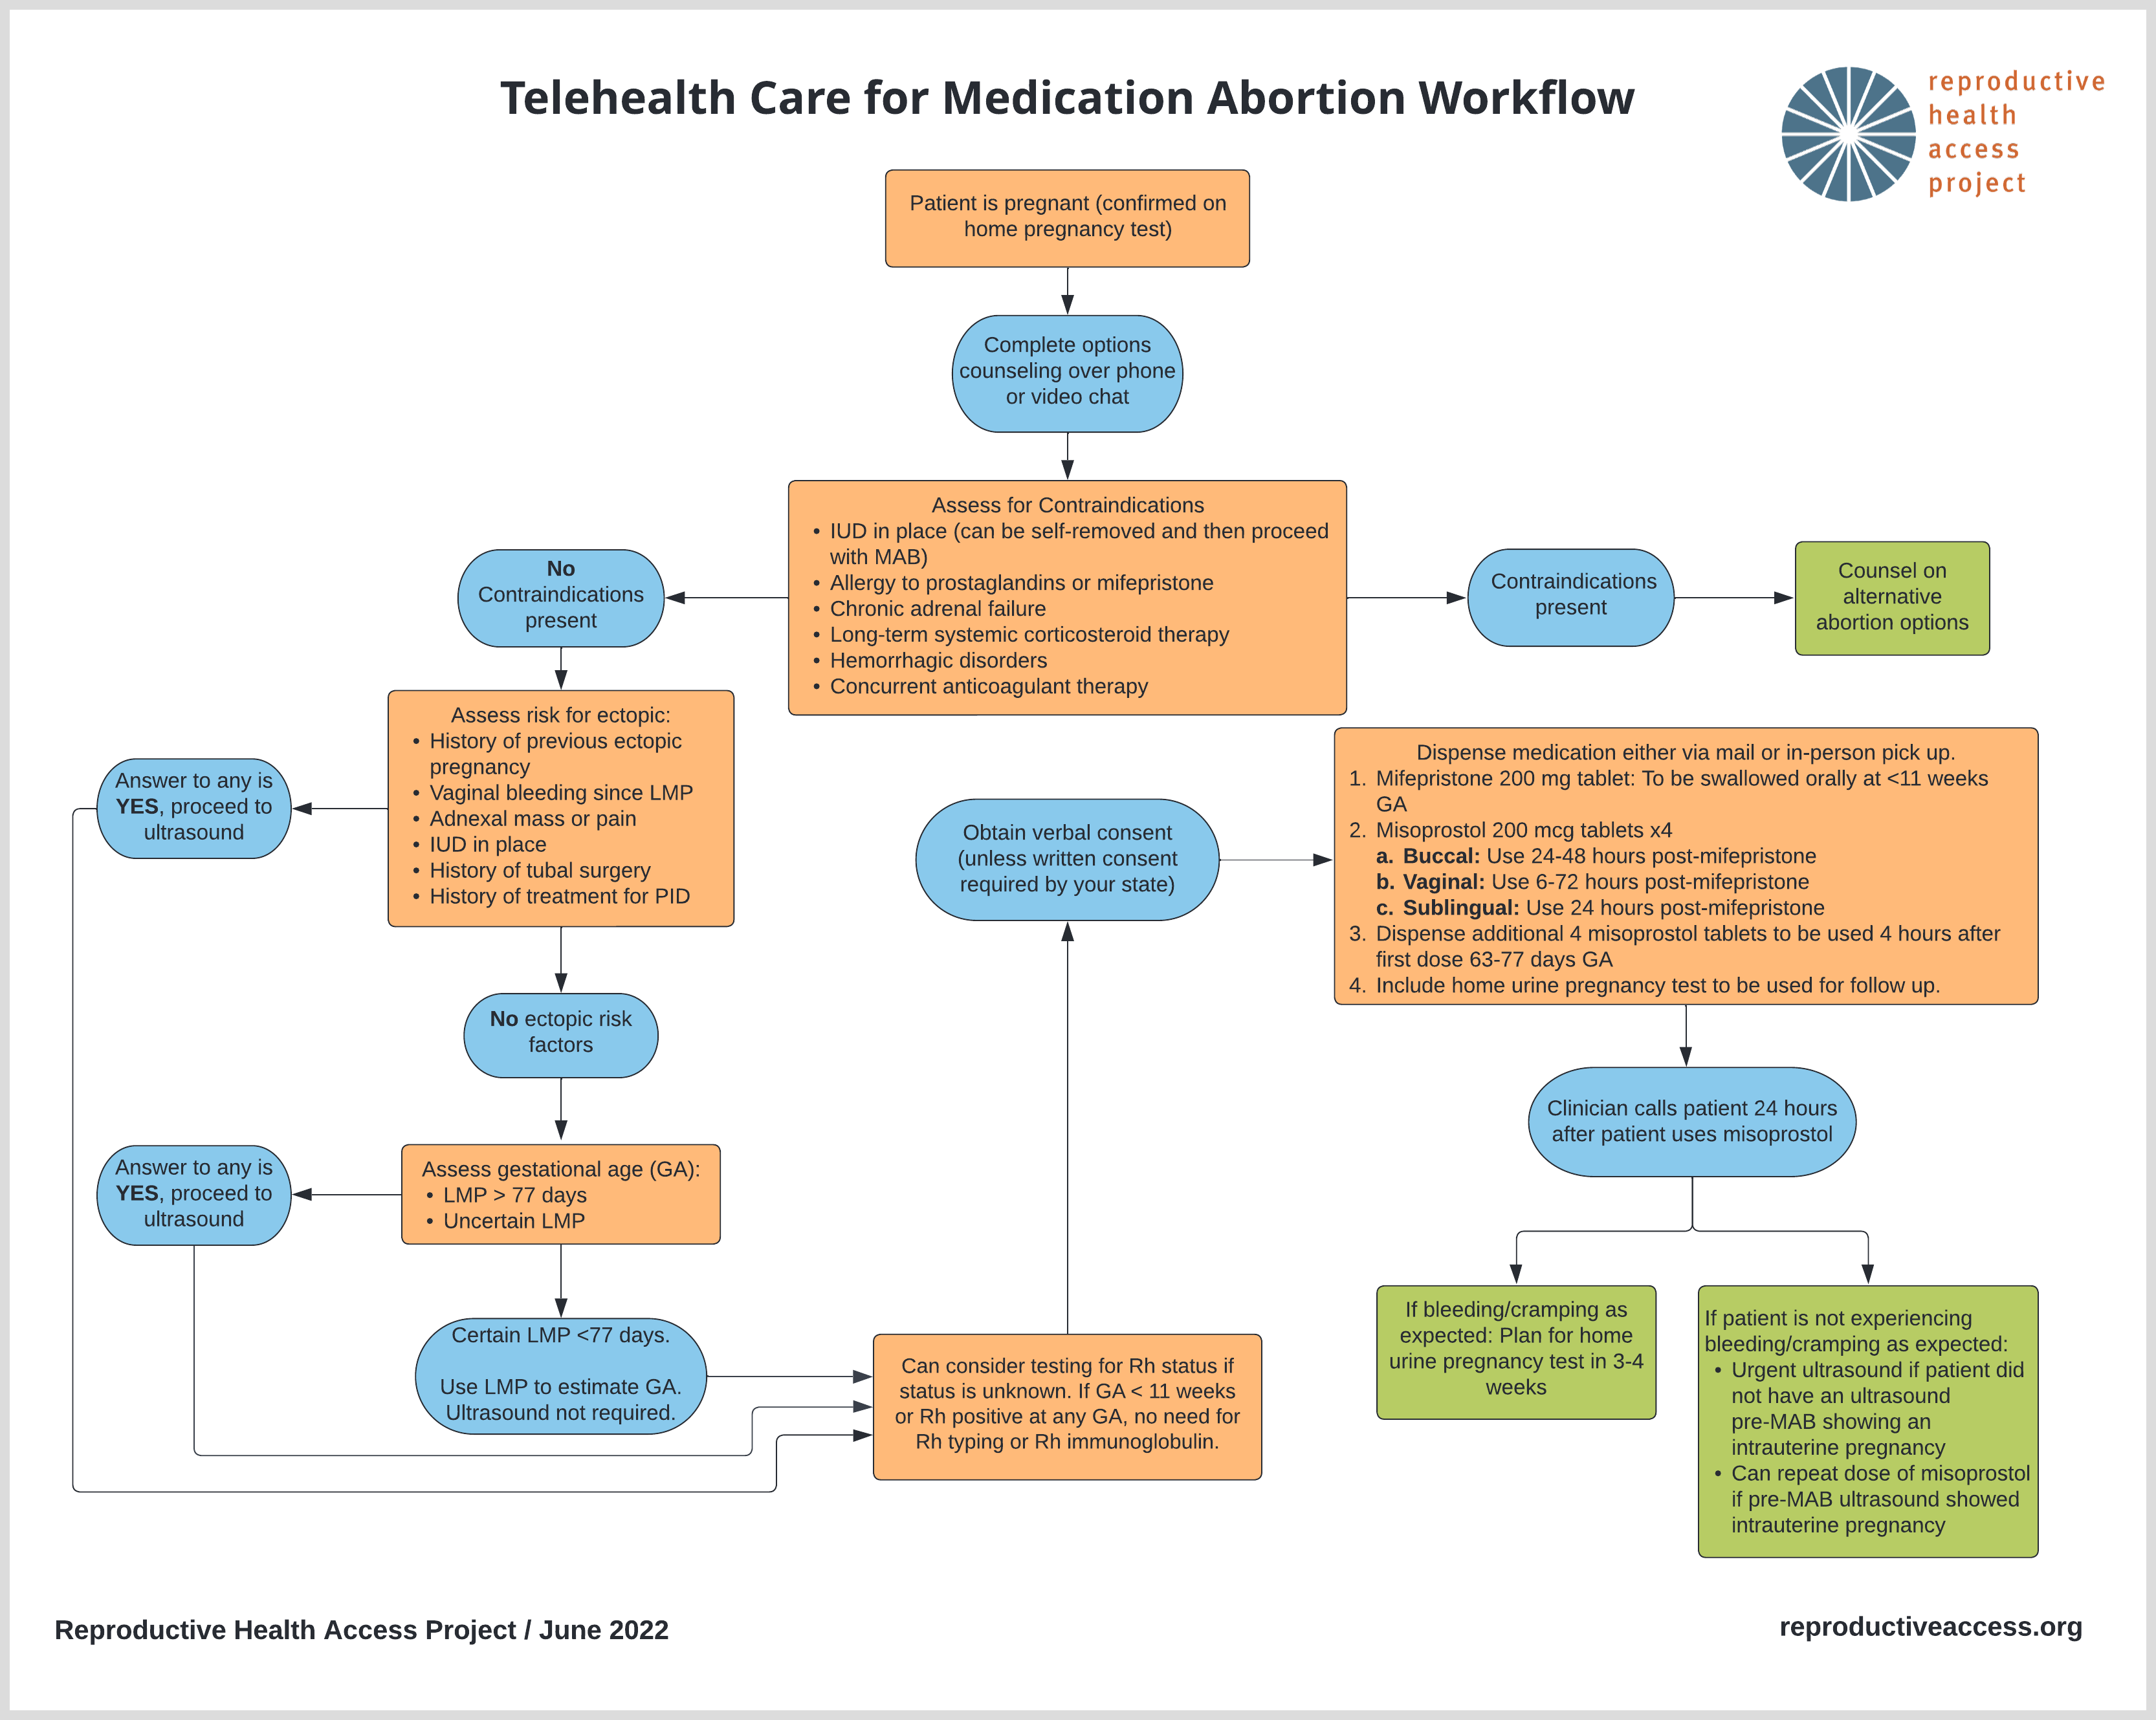
TELEHEALTH CARE FOR MEDICATION ABORTION WORKFLOW
Notes:
Note to Facilitator: option to use this to review steps of telehealth medication abortion or refer audience to the resource
Sources:
https://www.reproductiveaccess.org/resource/telehealth-care-for-mab-workflow/

Slide 36

Ty: Additional Considerations
Clinician set-up
Screening for privacy
Screening for IPV and safety
Gender-affirming care
Image Source: https://genderphotos.vice.com/
Notes:
Additional considerations for telehealth & non-binary or trans patients
For telehealth:
Make sure you are set up for a telehealth appointment: natural or warm lighting, use simple backgrounds or blur filter for privacy, ensure you are in a quiet and private space with a reliable internet connection
Check with Ty first about whether they can talk freely and safely. This is very important for young people who may not feel safe to talk about reproductive health care at home around family, or people who may experience abuse/violence
Ask audience: What are some skills and strategies you can do to assess patient’s sense of privacy and confidentiality?
Ask Ty: Is it safe for you to speak over the phone/video? Is it safe for you to have a medication abortion at home?
For trans and non-binary people, abortion care can be an added difficult experience. Many clinics that provide abortion care use women-centered and women-facing language that can be highly marginalizing to these communities. Many trans and non-binary people have had traumatic or harmful experiences with health care providers. Being pregnant can also exacerbate gender dysphoria for some.
Trauma informed care is for everyone. It centers communication and care provision that is truly patient-centered, focuses on the patient’s autonomy and decision-making, and creates opportunities for a sense of control and empowerment.
Use gender inclusive language, ask for what names and pronouns people use, share your own, ask about how they refer to body parts before using your own language.
Ask: how else would you support Ty in these situations?
Note to facilitator: option to use these resources to expand upon safety screening/IPV support and gender-affirming abortion care
More resources on screening for safety and providing IPV support:
https://www.futureswithoutviolence.org/wp-content/uploads/Telehealth-Covid-19-IPV_Clinical-Pathway.pdf (page 2)
https://jamanetwork.com/journals/jama/fullarticle/2780630#jit210005b1
https://www.statnews.com/2020/07/17/rising-to-the-challenge-of-screening-for-intimate-partner-violence-during-covid-19/
Simon MA. Responding to Intimate Partner Violence During Telehealth Clinical Encounters. JAMA. 2021;325(22):2307–2308. doi:10.1001/jama.2021.1071
More resources on gender affirming abortion care
Optional 3 minute video of do’s and don’ts: https://www.innovating-education.org/2020/12/dos-and-donts/
Optional 4 minute video of language and impact: https://www.innovating-education.org/2020/12/language-and-impact/
Roosevelt L, Pietzmeier S, Reed R. Clinically and Culturally Competent Care for Transgender and Nonbinary People. The Journal of Perinatal & Neonatal Nursing. 2021; 35 (2): 142-149. doi: 10.1097/JPN.0000000000000560
https://transequality.org/issues/us-trans-survey
https://www.lgbtqiahealtheducation.org/resources/in/reproductive-health/
RHAP Gender-Affirming Reproductive Health in Primary Care Presentation: https://www.reproductiveaccess.org/resource/gender-affirming-reproductive-health-in-primary-care/
Image Source: https://genderphotos.vice.com/

Slide 37

PATIENT CASE:
Sonia
29 years old
She/Her pronouns
Wants a medication abortion
Unsure LMP:
- When was your last menstrual period?
- How many weeks pregnant do you think you are?
- When do you believe you became pregnant?
Image Source: Unsplash, https://unsplash.com/photos/YcX2e-X6aBE
Notes:
Let’s briefly walk through a situation where someone comes to you for a medication abortion, but is unsure of their LMP.
After abortion options counseling, you start to confirm Sonia’s medical history. You ask, “when was your last menstrual period?” Sonia is unsure and describes a range of time 10-13 weeks ago when she thinks she had her LMP.
Before jumping to requiring an ultrasound or additional tests/exams, we can try to first expand the screening questions we ask for determining gestational age to 3 questions:
When was your last menstrual period?
How many weeks pregnant do you think you are?
When do you believe you became pregnant?
These questions have demonstrated an increased sensitivity and accuracy, and reduces the number of people who screen eligible, but who are actually farther along.
You ask the next two questions to Sonia:
How many weeks pregnant do you think you are?
When do you believe you became pregnant?
She says that she thinks she’s 10 or 11 weeks pregnant and points out a day on the calendar when she thinks she became pregnant that corresponds to between 10 and 11 weeks.
You can confirm now that Sonia is eligible for medication abortion care. You move forward with the rest of the medication abortion counseling.
Any questions on the MAB protocol or these different cases?
References:
Ralph LJ, Ehrenreich K, Barar R, et al. Accuracy of self-assessment of gestational duration among people seeking abortion [published online ahead of print, 2021 Dec 17]. Am J Obstet Gynecol. 2021;S0002-9378(21)02683-1. doi:10.1016/j.ajog.2021.11.1373
Image Source: Unsplash, https://unsplash.com/photos/YcX2e-X6aBE

Slide 38
Self-Managed Abortion (SMA)
Self-Managed Abortion: an abortion that someone does outside of the medical system, without clinician supervision
  Most commonly by self-sourcing mifepristone and misoprostol or misoprostol alone (same medications as a clinician-supervised abortion)
  Also may use herbs, botanicals, menstrual extraction
Medication Abortion: an abortion with medicines provided by a clinician in-clinic or via telemedicine
No one should be criminalized for their abortion
Notes:
We can’t talk about medication abortion and the landscape of abortion access in this country without talking about self-managed abortion (SMA).
In the US, self managed abortion refers to abortions that take place outside of the formal healthcare system. People have been self managing abortions for centuries.
It is often supported by friends, family members, partners, and/or community members. It’s most commonly done with the same medications used as a clinician-supervised medication abortion: mifepristone and misoprostol or misoprostol alone. What’s different is that someone who self-manages OR is in a restricted access state and obtains shield law protected telemedicine abortion faces more legal risks, criminalization, and threats of harm compared to someone who seeks care in a traditional medical context or legal context.
Ultimately, no one should be criminalized for their abortion, regardless of method. And clinicians can play a role in ensuring all people have a trusted source to go to if they self-manage their abortion or need healthcare before or after an abortion.
Note: You can review RHAP’s resource, “Approach to Patients Undergoing Self-managed Medication Abortion” which shares common questions and concerns clinicians may hear about self-managed abortion (SMA) and how you can answer patient questions and share important information. https://www.reproductiveaccess.org/resource/approach-to-patients-undergoing-self-managed-medication-abortion/
Note to Facilitator: Depending on your audience’s comfort level and familiarity with self-managed abortion/self-sourced medication abortion, you may choose to fully go through the section or tailor it to your audience’s needs. We believe talking about SMA/SSMA as part of the abortion care landscape in the US is crucial, especially given the likelihood of becoming more and more common as states continue to chip away at or outright ban abortion rights.
References:
Moseson H, Herold S, Filippa S, Barr-Walker J, Baum SE, Gerdts C. Self-managed abortion: A systematic scoping review. Best Pract Res Clin Obstet Gynaecol. 2020;63:87-110. doi:10.1016/j.bpobgyn.2019.08.002
https://www.guttmacher.org/2024/02/medication-abortion-within-and-outside-formal-us-health-care-system-what-you-need-know

Slide 39
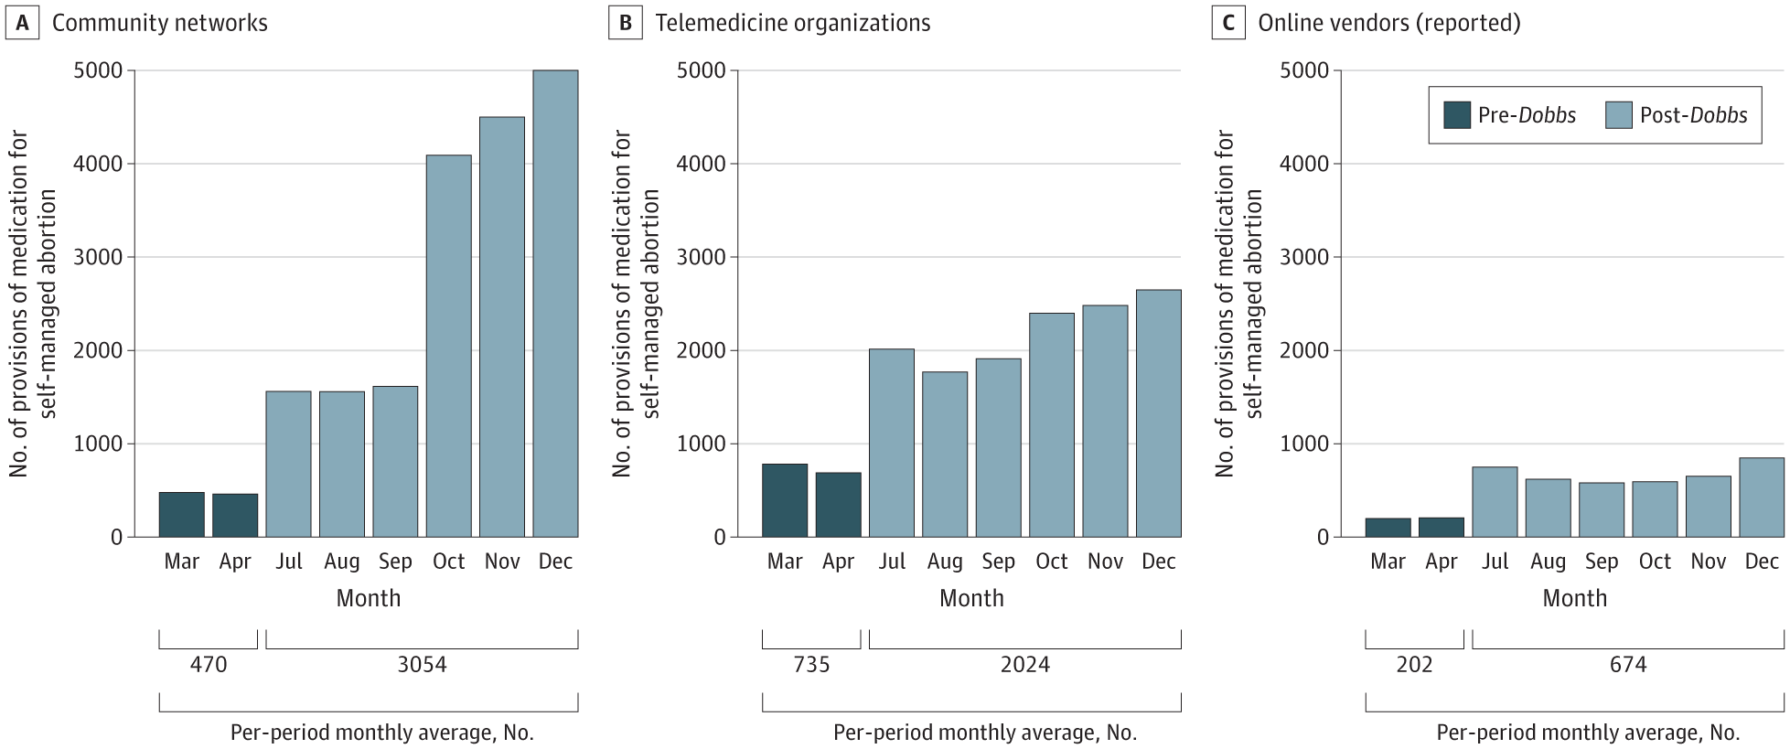
US Data & Demand for Self-Managed Abortion
Why SMA?
  State-based abortion restrictions
  Privacy, comfort, autonomy, convenience
  Avoid risks & harms of discrimination, etc.
Image Source: Aiken et al 2024: doi:10.1001/jama.2024.4266
Image Source: RHAP
Notes:
Let’s talk about data and demand for SMA/self-sourced abortion
Self managed abortion has grown significantly during the COVID-19 pandemic and after the Dobbs decision
Studies have shown that requests to the online medication abortion service Aid Access have doubled since the Dobb decision – Aid Access used to operate outside of the legal and traditional medical system, but now they are an official shield law telemedicine provider.
And this chart here shows the growth of certain pathways to SMA, like community networks, telemedicine organizations, and online vendors. But the growth is likely much higher because legal risks, especially under today’s political context, may have to drive community networks into more secrecy.
Why do people self-manage/self-source? The main push & pull factors are state-based restrictions, discrimination, systems of oppression:
Some people self-manage financial and logistical barriers caused by state-based abortion restrictions that have made it difficult, time consuming, expensive, and even impossible to access in-clinic care, especially in states with abortion bans.
Some have this preference over in-clinic care due to privacy, comfort, autonomy, and convenience.
Communities who are over-policed, over-surveilled, over-incarcerated – like immigrants and low-income Black people may want to avoid in-clinic care due to fears of being targeted by law enforcement, being questioned for citizenship status, or stopped at checkpoints while in transit between cities and states.
People who experience health care discrimination, especially BIPOC and LGBTQ people may want to avoid in-clinic abortion care due to these experiences of persistent discrimination and harm in health care settings.
Some may be concerned with protesters at abortion clinics and the stigma associated with abortion in their communities
Women-centered places may not feel safe or comfortable for trans and gender-non-binary folks.
Image Source:
Aiken ARA, Wells ES, Gomperts R, Scott JG. Provision of Medications for Self-Managed Abortion Before and After the Dobbs v Jackson Women's Health Organization Decision. JAMA. 2024;331(18):1558-1564. doi:10.1001/jama.2024.4266
References:
Aiken ARA, Broussard K, Johnson DM, Padron E. Motivations and experiences of people seeking medication abortion online in the United States. Perspect Sex Reprod Health. 2018;50(4):157–163.
Aiken ARA, Starling JE, Gomperts R, Tec M, Scott JG, Aiken CE. Demand for self-managed online telemedicine abortion in the United States during the coronavirus disease 2019 (COVID-19) pandemic. Obstet Gynecol. 2020;136(4):835–837.
Aiken ARA, Wells ES, Gomperts R, Scott JG. Provision of Medications for Self-Managed Abortion Before and After the Dobbs v Jackson Women's Health Organization Decision. JAMA. 2024;331(18):1558-1564. doi:10.1001/jama.2024.4266
Ralph L, Foster DG, Raifman S. Prevalence of self-managed abortion among women of reproductive age in the United States. JAMA Netw Open. 2020;3(12):e2029245.
Aiken A, Starling J, Gomperts R. Factors associated with use of an online telemedicine service to access self-managed medical abortion in the US. JAMA Netw Open. 2021;4(5):e2111852.
Aiken ARA, Starling JE, Scott JG, Gomperts R. Requests for Self-managed Medication Abortion Provided Using Online Telemedicine in 30 US States Before and After the Dobbs v Jackson Women's Health Organization Decision. JAMA. 2022;328(17):1768-1770. doi:10.1001/jama.2022.18865
Moseson H, Herold S, Filippa S, Barr-Walker J, Baum SE, Gerdts C. Self-managed abortion: a systematic scoping review. Best Pract Res Clin Obstet Gynaecol. 2020;63:87–110.
Verma N, Grossman D. Self-Managed Abortion in the United States. Curr Obstet Gynecol Rep. 2023;12(2):70-75. doi:10.1007/s13669-023-00354-x
https://www.guttmacher.org/2024/02/medication-abortion-within-and-outside-formal-us-health-care-system-what-you-need-know

Slide 40
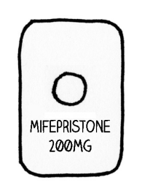
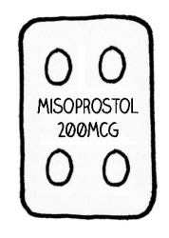
Safety of SMA
WHO components: self-assessment of eligibility, self-administration of abortion medications, self-assessment of abortion success
Mife & Miso:
  Patients take the pills at home, manage their abortion, get follow-up if/when they need it
  Telemedicine is no less safe than in-clinic
Miso-only:
  With accurate information, miso is a safe & effective alternative to mife + miso
  Repeat doses may be necessary
  Accompaniment models
Image Source: RHAP “How to Use Abortion Pills” Factsheet
Notes:
MAB pills, the increase of information, and increase in the availability of pills and support networks has changed the safety of self-managed abortion dramatically since pre-Roe times. Self managed abortion with medications is JUST AS SAFE as a clinician-managed abortion via telehealth or in-clinic.
WHO guidance recommends the option of self-managed medication abortion with mifepristone and misoprostol or miso only. They highlight that patients need three key things for this process of self management to be high-quality, safe, and effective: the ability to self-assess one’s eligibility to use mife and miso, the ability to take the abortion medications, and being able to assess abortion completion and when you may need to seek additional clinical care. And WHO concludes that people CAN safely and effectively manage each of these components
Mife + Miso
We already know that abortion with mifepristone and misoprostol is safe and that patients can take the pills at home, manage their abortion, and get follow-up care in the rare cases they need it.
The FDA confirms that medication abortion’s “efficacy and safety have become well-established” and “serious complications have proven to be extremely rare.”
Studies on telemedicine abortion – as well as using services like Aid Access – demonstrate that telemedicine abortion is no less safe than in-clinic abortion
Miso-alone for SMA is a much more accessible and affordable option compared to using mifepristone outside of the health care setting, and one of the safest and most effective options for SMA.
WHO states that SMA with miso alone – with accurate information on how to use the pills – is very safe and effective. Patients using misoprostol-only may experience more immediate, intense, and prolonged side effects than those using a combination of mife + miso.
Patients should take 3-4 doses of misoprostol. Repeat doses of misoprostol may be necessary to complete the abortion.
The SAFE study shows in global health practice, with accompaniment from community groups (like doulas, midwives, and other community experts but otherwise not necessarily trained health care experts), more than 95% of participants had complete abortions = 1.5% needed surgical intervention, 1% received antibiotics
Studies of harm reduction approaches and accompaniment models have shown that when providers counsel on how to use misoprostol safely to induce an abortion and when to seek emergency care, country-wide abortion-related morbidity and mortality declines.
- A program called Iniciativas Sanitarias in Uruguay did just that. This led to the decriminalization of abortion in Uruguay.
Note to Facilitator: [If you as a facilitator are comfortable leading this conversation, consider introducing a discussion about herbal abortions below, consider asking some values clarification questions to help participants uncover their values and attitudes around herbal abortions]
OPTIONAL DISCUSSION: Herbs, Botanicals, and other methods rooted in culture and ancestry
Non traditional methods, cultural methods passed down generations have not been studied for safety and efficacy to the extent of Western medicines, but that does not mean in itself they are unsafe
In a population based study estimating experience of SMA, researchers found that HERBS were the most common method people used to self-manage their abortion (38.4%) – while some had to go to the clinic to complete the abortion, there were very few complications.
The question of “are herbal abortions safe and effective” is not as clear cut as we think. Safety is a spectrum – what is safe for one person may not be the same for another. Data is lacking in this area, so the nuance is needed right now. A certified herbalist ad creator of the zine “Holistic Abortions, Grow Your Own Abortion” is a co-author in a CBPR Home Abortion Provider Study going on right now. Some initial findings:
There is no straightforward protocol, but different regimens they saw were: combining herbs with miso to help lower the dosage of miso necessary, herbs to manage heavy bleeding and severe pain, herbs being used to integrate spiritual, ritual, and cultural practices that the patient highly valued
An understanding that efficacy is not always the only priority – people wanted to try herbal-only abortions in the CBPR study despite being informed of a decreased possibility of completion and despite having access to other methods (i.e. telemedicine abortion)
We do NOT need to provide information on herbal abortions if it’s something we don’t understand or aren’t comfortable, but we should acknowledge and respect that forms of knowledge grow and exist outside of medicalized institutions and respecting patients’ expertise, knowledge, and desires is also part of bodily autonomy and reproductive justice
References:
Moseson H, Jayaweera R, Egwuatu I, et al. Effectiveness of self-managed medication abortion with accompaniment support in Argentina and Nigeria (SAFE): a prospective, observational cohort study and non-inferiority analysis with historical controls. Lancet Glob Health. 2022;10(1):e105-e113. doi:10.1016/S2214-109X(21)00461-7
Moseson H, Jayaweera R, Raifman S, et al. Self-managed medication abortion outcomes: results from a prospective pilot study. Reprod Health. 2020;17:164.
Moseson H, Bullard K, Cisternas C, Grosso B, Vera V, Gerdts C. Effectiveness of self-managed medication abortion between 13 and 24 weeks gestation: a retrospective review of case records from accompaniment groups in Argentina, Chile, and Ecuador. Contraception. 2020;102(2):91–98.
Aiken ARA, Romanova EP, Morber JR, Gomperts R. Safety and effectiveness of self-managed medication abortion provided using online telemedicine in the United States: A population based study. Lancet Reg Health Am. 2022;10:100200. doi:10.1016/j.lana.2022.100200
https://www.ibisreproductivehealth.org/publications/feminist-medication-abortion-accompaniment-101
U.S. Food and Drug Administration. Mifeprex medical review. Available at: https://www.accessdata.fda.gov/drugsatfda_docs/nda/2016/020687Orig1s020MedR.pdf. Published 2021. Accessed April 25, 2025.
Moseson H, Herold S, Filippa S, Barr-Walker J, Baum SE, Gerdts C. Self-managed abortion: a systematic scoping review. Best Pract Res Clin Obstet Gynaecol. 2020;63:87–110.
Donovan MK. Self-managed medication abortion: expanding the available options for U.S. abortion care. Guttmacher Policy Rev. 2018;21:41–47.
https://www.who.int/reproductivehealth/self-care-interventions/medical-abortion/en/
Moseson H, Jayaweera R, Raifman S, et al. Self-managed medication abortion outcomes: results from a prospective pilot study. Reprod Health. 2020;17:164.
Moseson H, Bullard K, Cisternas C, Grosso B, Vera V, Gerdts C. Effectiveness of self-managed medication abortion between 13 and 24 weeks gestation: a retrospective review of case records from accompaniment groups in Argentina, Chile, and Ecuador. Contraception. 2020;102(2):91–98.
Aiken ARA, Digol I, Trussell J, Gomperts R. Self reported outcomes and adverse events after medical abortion through online telemedicine: population based study in the Republic of Ireland and Northern Ireland. BMJ. 2017;357:j2011.
Jayaweera R, Egwuatu I, Nmezi S, et al. Medication Abortion Safety and Effectiveness With Misoprostol Alone. JAMA Netw Open. 2023;6(10):e2340042. Published 2023 Oct 2. doi:10.1001/jamanetworkopen.2023.40042
Image Source: RHAP “How to Use Abortion Pills” Factsheet
Herbal Abortion References
Instagram: @holistic.abortions
Holistic Abortions, Grow Your Abortion, the Holistic Abortion Guide

Slide 41
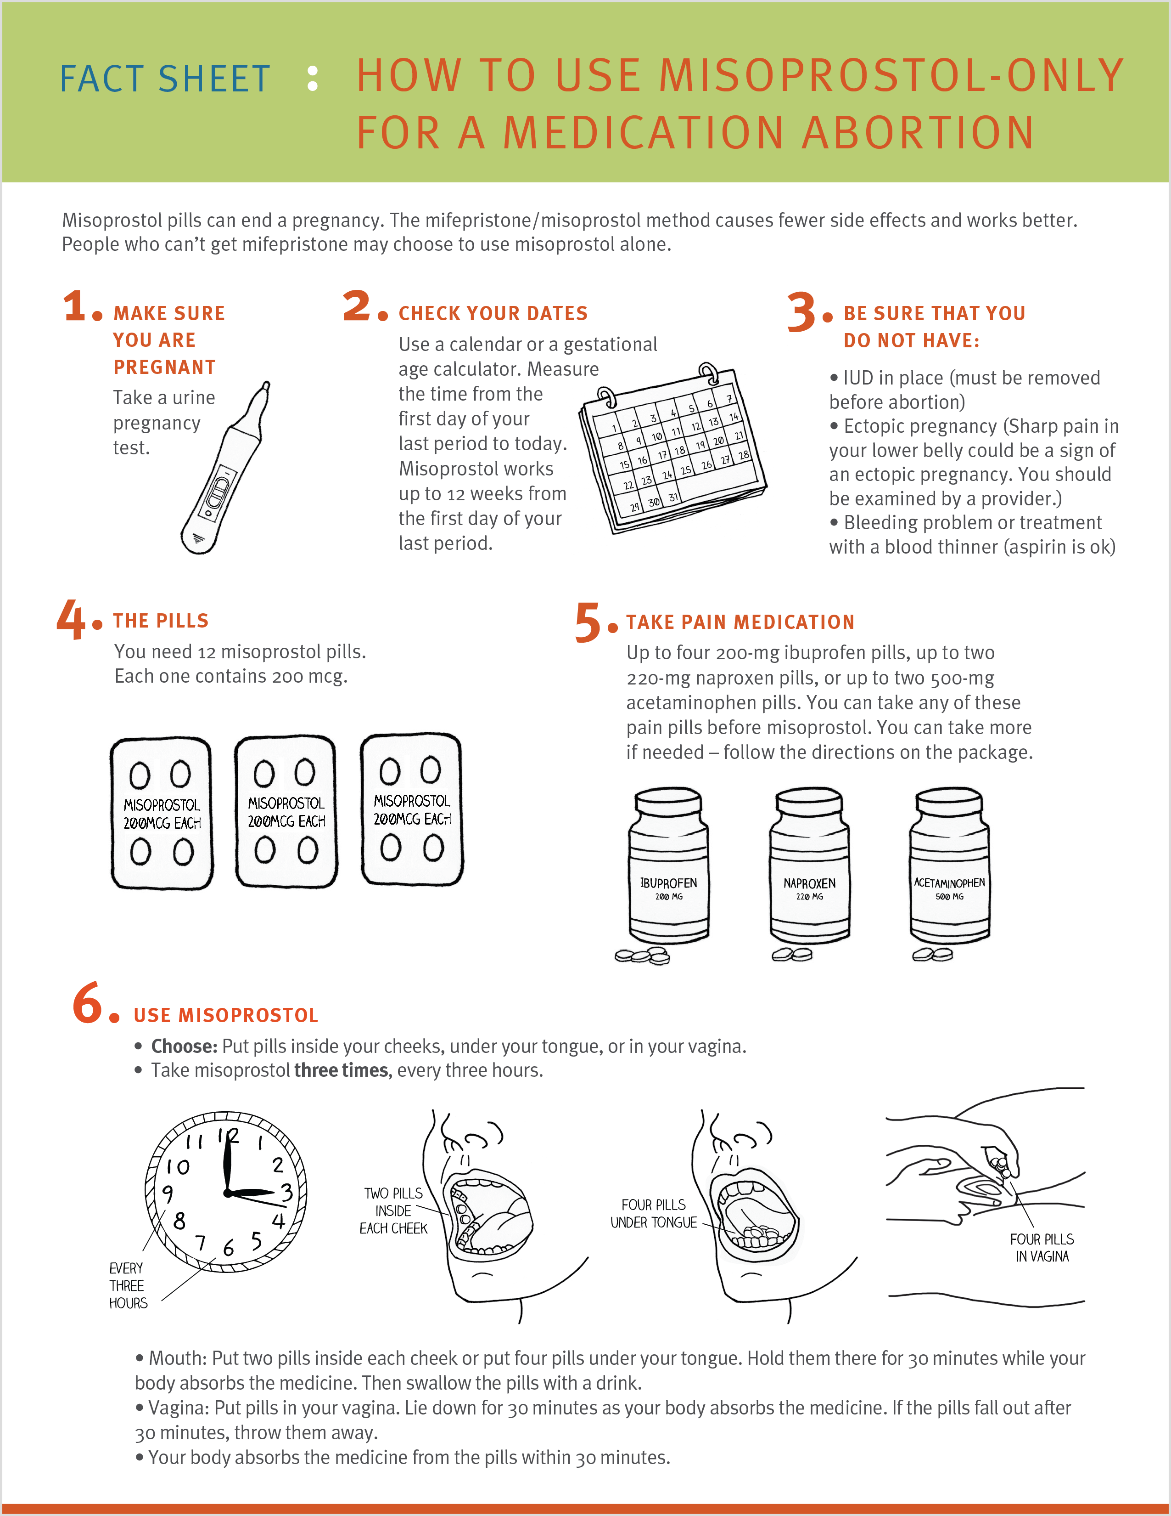
Misoprostol Alone Medication Abortion
Have 12 pills, 200 mcg each
Pain medicine before misoprostol
4 misoprostol tablets every 3 hours for at least 3 doses
More doses may be needed
Image Source: RHAP, “How to Use Misoprostol-Only For a Medication Abortion” Factsheet
Notes:
All of you are able to counsel and provide information about having an abortion with mife and miso. So let’s walk through a miso-only abortion protocol so if you ever had to counsel a patient on the process, information, and when to seek medical attention, you have the knowledge to do so.
Walk through protocol (how to use miso-only for medication abortion factsheet or protocol)
First, rule out contraindications: IUD in place (can be removed before MAB), allergy to prostaglandins or misoprostol, bleeding problems or treatment with a blood thinner (aspirin is okay), ectopic pregnancy (unilateral pelvic pain or bilateral pelvic pain within past week can be a sign)
The regimen includes taking 4 tablets (800 mcg total: 200 mcg each) of misoprostol every 3 hours for at least 3 times (total of 12 pills) buccally, sublingually, or vaginally.
Instruct the patient to take pain medication before misoprostol (ibuprofen, naproxen, acetaminophen – follow instructions on package, take more if needed
So they’ll take 4 tablets of misoprostol 3x every 3 hours – inside cheeks, under tongue, or in vagina
Remember that buccal means to put 2 pills inside each cheek, sublingual means 4 pills under tongue. The patient holds it there for 30 minutes. Swallow pills with a drink. Repeat 2 more times, every 3 hours.
Vaginal means to put 4 pills inside vagina, lie down for 30 minutes, if pills fall out after 30 minutes throw them away. Repeat 2 more times, every 3 hours.
Image Source/Resources:
https://www.reproductiveaccess.org/resource/mabfactsheet-miso/
https://www.reproductiveaccess.org/resource/protocol-for-medication-abortion-using-misoprostol-only/
References:
Raymond, E., Harrison, M, & Weaver, M. (2019). Efficacy of misoprostol alone for first-trimester medical abortion: A systematic review. Obstetrics & Gynecology, 133, 137-147.
https://www.ipas.org/clinical-update/english/recommendations-for-abortion-before-13-weeks-gestation/medical-abortion/misoprostol-only-recommended-regimen/
Raymond EG, Mark A, Grossman D, et al. Medication abortion with misoprostol-only: A sample protocol. Contraception. 2023;121:109998. doi:10.1016/j.contraception.2023.109998
World Health Organization (WHO). Abortion care guideline. 2022. https://srhr.org/abortioncare/
Baum S, Moseson H, Jayaweera R, Gerdts C. Misoprostol Only is Safe and Effective. Society of Family Planning. August 2023. https://societyfp.org/wp-content/uploads/2023/02/SFP_ScienceSays_misoprostol.pdf
National Abortion Federation. 2024 Clinical Policy Guidelines for Abortion Care. 2024. https://prochoice.org/providers/qualitystandards/

Slide 42
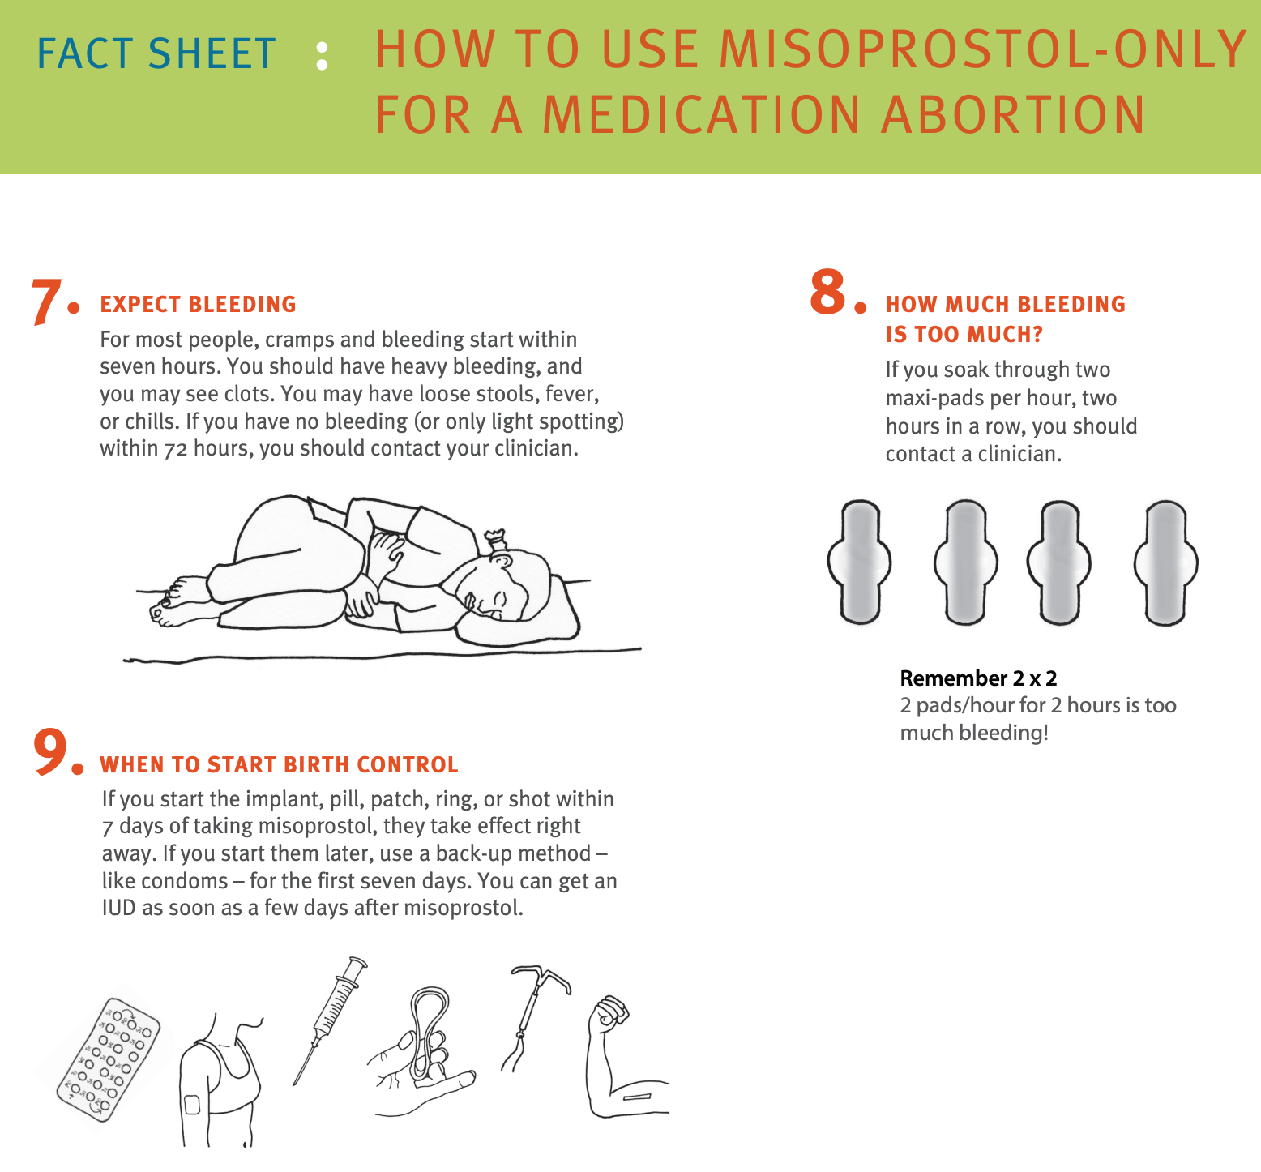
More intense and prolonged side effects (fever, chills, diarrhea, nausea, cramping) than MAB with mifepristone
Bleeding may begin within 1-4 hours after first miso dose
Heaviest bleeding usually starts after 3rd dose and will last 1-3 days
Bleeding can last ~2 week
Remember 2x2 rule
Image Source: RHAP, “How to Use Misoprostol-Only For a Medication Abortion” Factsheet
Notes:
Counsel your patient on symptoms to expect.
Patients may have more intense and prolonged side effects (fever, chills, diarrhea, nausea, cramping) when using misoprostol only for medication abortion compared to regimens using mifepristone and misoprostol. They’ll have bleeding and may see clots. Bleeding may begin within 1-4 hours after the first dose of misoprostol.
The heaviest bleeding (usually heavier than menses) usually starts after the 3rd dose and will last 1-3 days.
Bleeding can last 2 weeks or sometimes longer. The amount and duration of bleeding is likely to increase with gestational age. There is a very small risk of prolonged bleeding requiring uterine aspiration. Most people will notice expulsion of the products of conception within 24 hours of taking the first dose of misoprostol
May have gastrointestinal side effects (loose stools) and fever, chills. GI effects are more common when taking misoprostol buccally or sublingually.
When to contact clinician: no bleeding or only light spotting within 72 hours, soaking through 2 maxi pads per hour; side effects last longer than 24 hours after taking last dose of misoprostol.
Image Source/Resources:
https://www.reproductiveaccess.org/resource/mabfactsheet-miso/
https://www.reproductiveaccess.org/resource/protocol-for-medication-abortion-using-misoprostol-only/

Slide 43

SMA and Criminalization
It is not illegal for pregnant people to manage their own abortions
Legal landscape is murky – threat of being investigated or criminalized for self-managing an abortion is still real
Cases of criminalization on patients often reported by health care workers
Laws often misapplied by police and prosecutors
Criminalization (or fear of) is the main barrier that prevents people from safely managing their abortion
Image Source: https://www.interruptingcriminalization.com/decriminalize-abortion
Photo: RHAP
Notes:
Despite the patchwork of abortion bans and restrictions – many of which actively criminalize providers for offering abortion care - it is not illegal in most places for pregnant people to manage their own abortions. Only Nevada bans self-managed abortion explicitly after 24 weeks of pregnancy.
But, the legal landscape is murky and under today’s political environment of increasing surveillance, arrests, and criminalization of pregnancy and people broadly, the threat of being investigated or punished for self-managing an abortion or having a miscarriage is real.
Most cases of criminalization have been providers or other healthcare workers reporting patients, even though there are NO mandatory reporting requirements around abortion. As health care settings become sites of surveillance and policing, rather than places for health and well-being, we end up perpetuating the distrust communities may have of the medical system and causing harm instead of improving health.
If/When/How Lawyering for Reproductive Justice has seen a pattern of misuse of laws to criminalize people during pregnancy – primarily people of color and people living in poverty. State laws, some even not specific to pregnancy are being misapplied by police and prosecutors to punish people who self manage their abortion, creating stigma and fear. They misuse pre-Roe laws on the books banning SMA, pre-Roe laws criminalizing abortion generally, drug laws, fetal harm laws, etc.
Criminalization and fear of criminalization is the largest barrier that prevents people from safely managing their abortion with support. And, ACOG finds that fear of prosecution increases the risk of negative health outcomes by deterring those who self manage from seeking care for complications. And we’ve seen this recently in some of the ProPublica reporting on maternal mortality in states like Texas and Georgia.
References:
https://www.interruptingcriminalization.com/decriminalize-abortion
https://www.guttmacher.org/2024/02/medication-abortion-within-and-outside-formal-us-health-care-system-what-you-need-know
https://www.ifwhenhow.org/wp-content/uploads/2023/10/Self-Care-Criminalized-2023-Report.pdf
https://www.propublica.org/series/life-of-the-mother
ACOG Committee Statement No. 13: Self-Managed Abortion. Obstet Gynecol. 2024;144(6):e152-e159. doi:10.1097/AOG.0000000000005755
Image Source: https://www.interruptingcriminalization.com/decriminalize-abortion

Slide 44

How can we as clinicians support self-managed abortion as part of the full range of safe abortion options?
Image Source: Abortiononourownterms.org
Notes:
So what do you think are ways we as clinicians can support self-managed abortion as part of the full range of safe abortion options?
Optional Reflection Questions
Is abortion treated as a human right in your practice setting? Why or why not?
What are the policies and protocols in your practice regarding involving patients in the criminal justice system? How might they affect the lives of your patients?
How can you support patients who managed their own abortions in your practice?
Image Source: Abortiononourownterms.org

Slide 45
Supporting SMA as clinicians
No mandatory reporting – use your discretion
Provide INFORMATION and COUNSELING about abortion options, including how to use abortion pills
Post abortion care mimics clinical presentation of EPL
Educate colleagues using values clarification
Review written policies and create policies
Get mandatory reporting & HIPAA/privacy trainings for your institution
Speak about SMA with compassion, respect
Abortion Defense Network: abortiondefensenetwork.org
Notes:
Clinicians and other health care personnel typically do not have mandatory reporting requirements for SMA
Reporting may be a HIPAA violation and violation of patient privacy and confidentiality laws
Clinicians have a lot of discretion and power in reporting
Know the mandatory reporting laws in your state
Be judicious in what you record in the EMR (only record what you need to provide and document appropriate healthcare)
Regardless of our personal beliefs, we have responsibilities as health care providers:
Provide pregnancy options counseling, which includes information about abortion
Refer patients to sources of care if you cannot provide it at your clinic
Uphold core values: patient autonomy, patients’ health care needs above our personal beliefs
Provide information on safe self-management : what are the medications, how to take them, what to expect, when/where to seek help if you need it
Support people with the information they need after an SMA, provide follow-up care for people who want to confirm their completed abortion, and support them if they come in with heavy bleeding, pain, fevers, or complications – which we know from studies is rare. These are the same symptoms and potential complications of miscarriage care. Depending on the state you are in (e.g. LA, TX), there may be some nuances to figure out in terms of where is the line between providing information and “supporting” someone have an abortion.
Post abortion care mimics the clinical presentation of a miscarriage. There is no reason to assume or record self-management in the patient’s chart. A patient who is bleeding with a positive pregnancy test and non-viable fetus should be treated like anyone pregnant and bleeding.
EDUCATE colleagues about self-managed abortion – values clarification is a great place to start.
Review written policies on mandatory reporting: are there ways to change the policy so that it does not go beyond what is required by the state and upholds patient privacy and autonomy? See this mandatory reporting factsheet: https://ifwhenhow.org/resources/mandatory-reporting-fact-sheet/
Support your institution with HIPAA and mandatory reporting trainings (If/When/How can help)
Speak about SMA with compassion and respect: Judgment or discouragement from someone in the medical profession may increase feelings of shame and deter people from seeking medical care in the rare event of a post-self-managed abortion complication.
Note: This is not legal advice, this is information we have learned thus far. If you want more information about legal issues, mandatory reporting, your state laws and requirements affecting SMA, contact the Abortion Defense Network
https://abortiondefensenetwork.org/
References
https://www.innovating-education.org/course/when-abortion-is-not-available/
If/When/How. Self-Managed Abortion and the Law. What health care providers need to know.
https://www.reproductiveaccess.org/resource/insights-self-managed-abortion-what-clinicians-need-to-know/
If/When/How Repro Legal Helpline: http://www.reprolegalhelpline.org/
https://abortiondefensenetwork.org/
https://ifwhenhow.org/resources/mandatory-reporting-fact-sheet/

Slide 46
Optional Case Studies
Notes:
Optional Activity (20-30 minutes)
Note to facilitator: There are two more case studies in this PPT and in the case study facilitator guide and workshop participant guide. Consider these options:
Divide participants into small groups or breakout rooms to go through and discuss the two case studies. After, you can come back as a large group and ask a representative to answer the case study discussion questions or field any questions that came out of the cases.
Walk through the case studies as 1 large group (pause screen share and ask participants to read the text in the guide aloud or you can read the text in the guide]. Invite participants to answer the discussion questions aloud and use your guide to help facilitate discussion.
Or, for time, skip these case studies and invite participants to work on them at home.
Participant Guide [link].
Find the Facilitator’s Case Study Guide here [link].

Slide 47
What challenges do you anticipate if you were to try to provide medication abortion care in your office?
Notes:
Note to facilitator: This discussion may not be appropriate in states that are highly restrictive toward abortion care. Consider your audience before discussing this part of the presentation.
If you include this part of the presentation, you can:
- Ask the audience this discussion question and have them share their ideas first
- Share your experiences providing medication abortion in a primary care setting. If you implemented new services, talk about challenges and strategies you’ve taken on.
- Or, go through issues to think about on the next slide, then ask the audience for other concerns and barriers they are thinking about.

Slide 48

Issues to think about
Special considerations if you receive federal funding
Laws regulating abortion in your state
Organize a planning committee
Staff support
Pharmacy
Clinical policies + procedures
Billing and reimbursement
Professional liability insurance
Notes:
Note to facilitator: Share your own experiences starting new MAB services, if possible!
Here are some of the big picture issues to think about. We’re going to briefly summarize them, but please visit the RHAP website which contains a lot of tools and resources that can help you with these issues. RHAP staff can provide technical assistance to any clinician or organization needing help to integrate abortion care. Reach out to program@reproductiveaccess.org.
[Drop links in the chat]
The main resource to review is this toolkit which goes through many ideas on getting started with medication abortion in primary care. https://www.reproductiveaccess.org/resource/toolkit-medication-abortion/
1. If you receive federal funding, you can still provide abortion care, but you’ll have key things to consider and navigate to ensure in your accounting that any funding that goes toward providing abortion services is not federal funds or otherwise restricted funds. RHAP can help you navigate this.
2. Depending upon your state, this could be a complicated discussion. Please make sure to connect with RHAP and your local cluster to understand if any laws or policies affect abortion care in your state. Guttmacher Institute has excellent resources on up to date information about state laws and policies.
3. Start by identifying other clinicians, administrators, and staff who might be allies and champions in introducing abortion services. Form a planning committee that can meet regularly to discuss tasks, timeline, barriers, and potential solutions. It’s helpful for this team to be multidisciplinary and to include an administrator.
4. Starting conversations with staff around providing abortion care is critical. Include all staff at all levels. Many start with Values Clarification exercises to help process feelings. https://www.reproductiveaccess.org/resource/values-clarification-workshop/. Some places do a staff and patient attitude survey: Patient attitude survey example: https://www.reproductiveaccess.org/resource/patient-attitude-survey/. Staff attitude survey example: https://www.reproductiveaccess.org/resource/staff-attitude-survey/
5. Your pharmacy or someone in your organization needs to sign up with a manufacturer to dispense or prescribe mifepristone. There are two : GenBioPro (generic) and Danco (branded, Mifeprex). Here is a step by step guide: https://www.reproductiveaccess.org/resource/order-mifepristone/.
6. RHAP has sample policies, protocols and procedures you can adapt for your setting and context: https://www.reproductiveaccess.org/resource/medication-abortion-protocol/
7. Reimbursement varies by state and insurance plan. Only a few states provide Medicaid reimbursement of abortion. https://www.reproductiveaccess.org/resource/medication-abortion-coding/. It is possible to provide abortion in health centers that receive federal funding, including FQHCs. Special care needs to be taken to segregate costs/visits so that no federal dollars are spent on abortion care. But it is possible! RHAP can help. See this billing guide and practical guide for FQHCs and Title X Clinics:
https://www.reproductiveaccess.org/resource/abortion-administrative-guide/
https://www.reproductiveaccess.org/resource/practical-guide-to-understanding-restrictions-on-the-use-of-federal-funds-for-abortion-services/
8. Definitely check to make sure your professional liability insurance/malpractice will cover medication abortion. If you work in a federally qualified health center, you will likely have to get additional insurance to cover medication abortion care. Lots of FQHCs have gap coverage in place for services like L&D and hospital care -- it’s possible to add abortion care to gap coverage too.
Image Source: Created by Adrien Coquet from the Noun Project

Slide 49
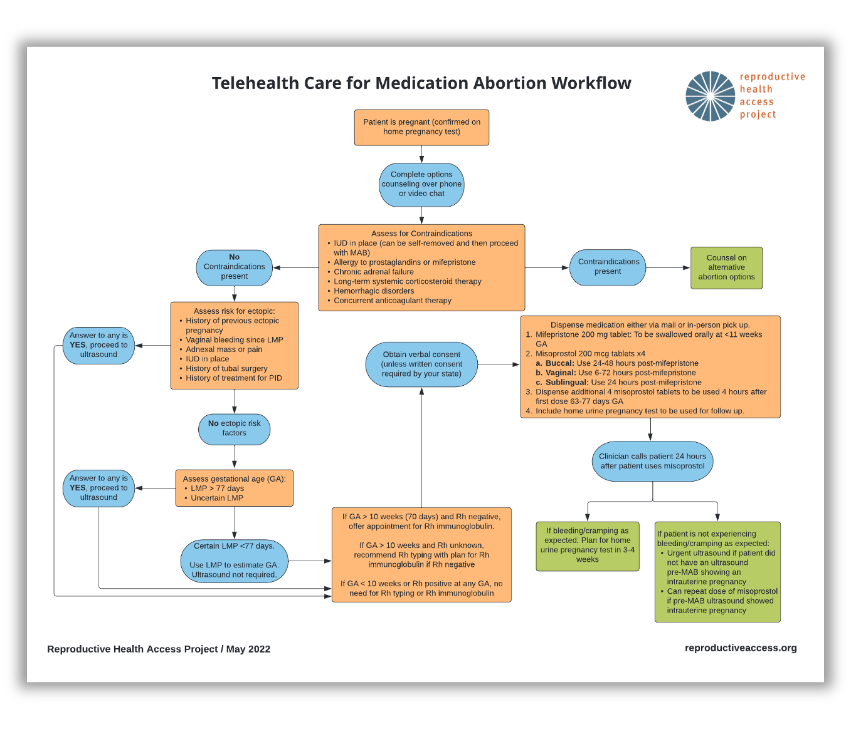

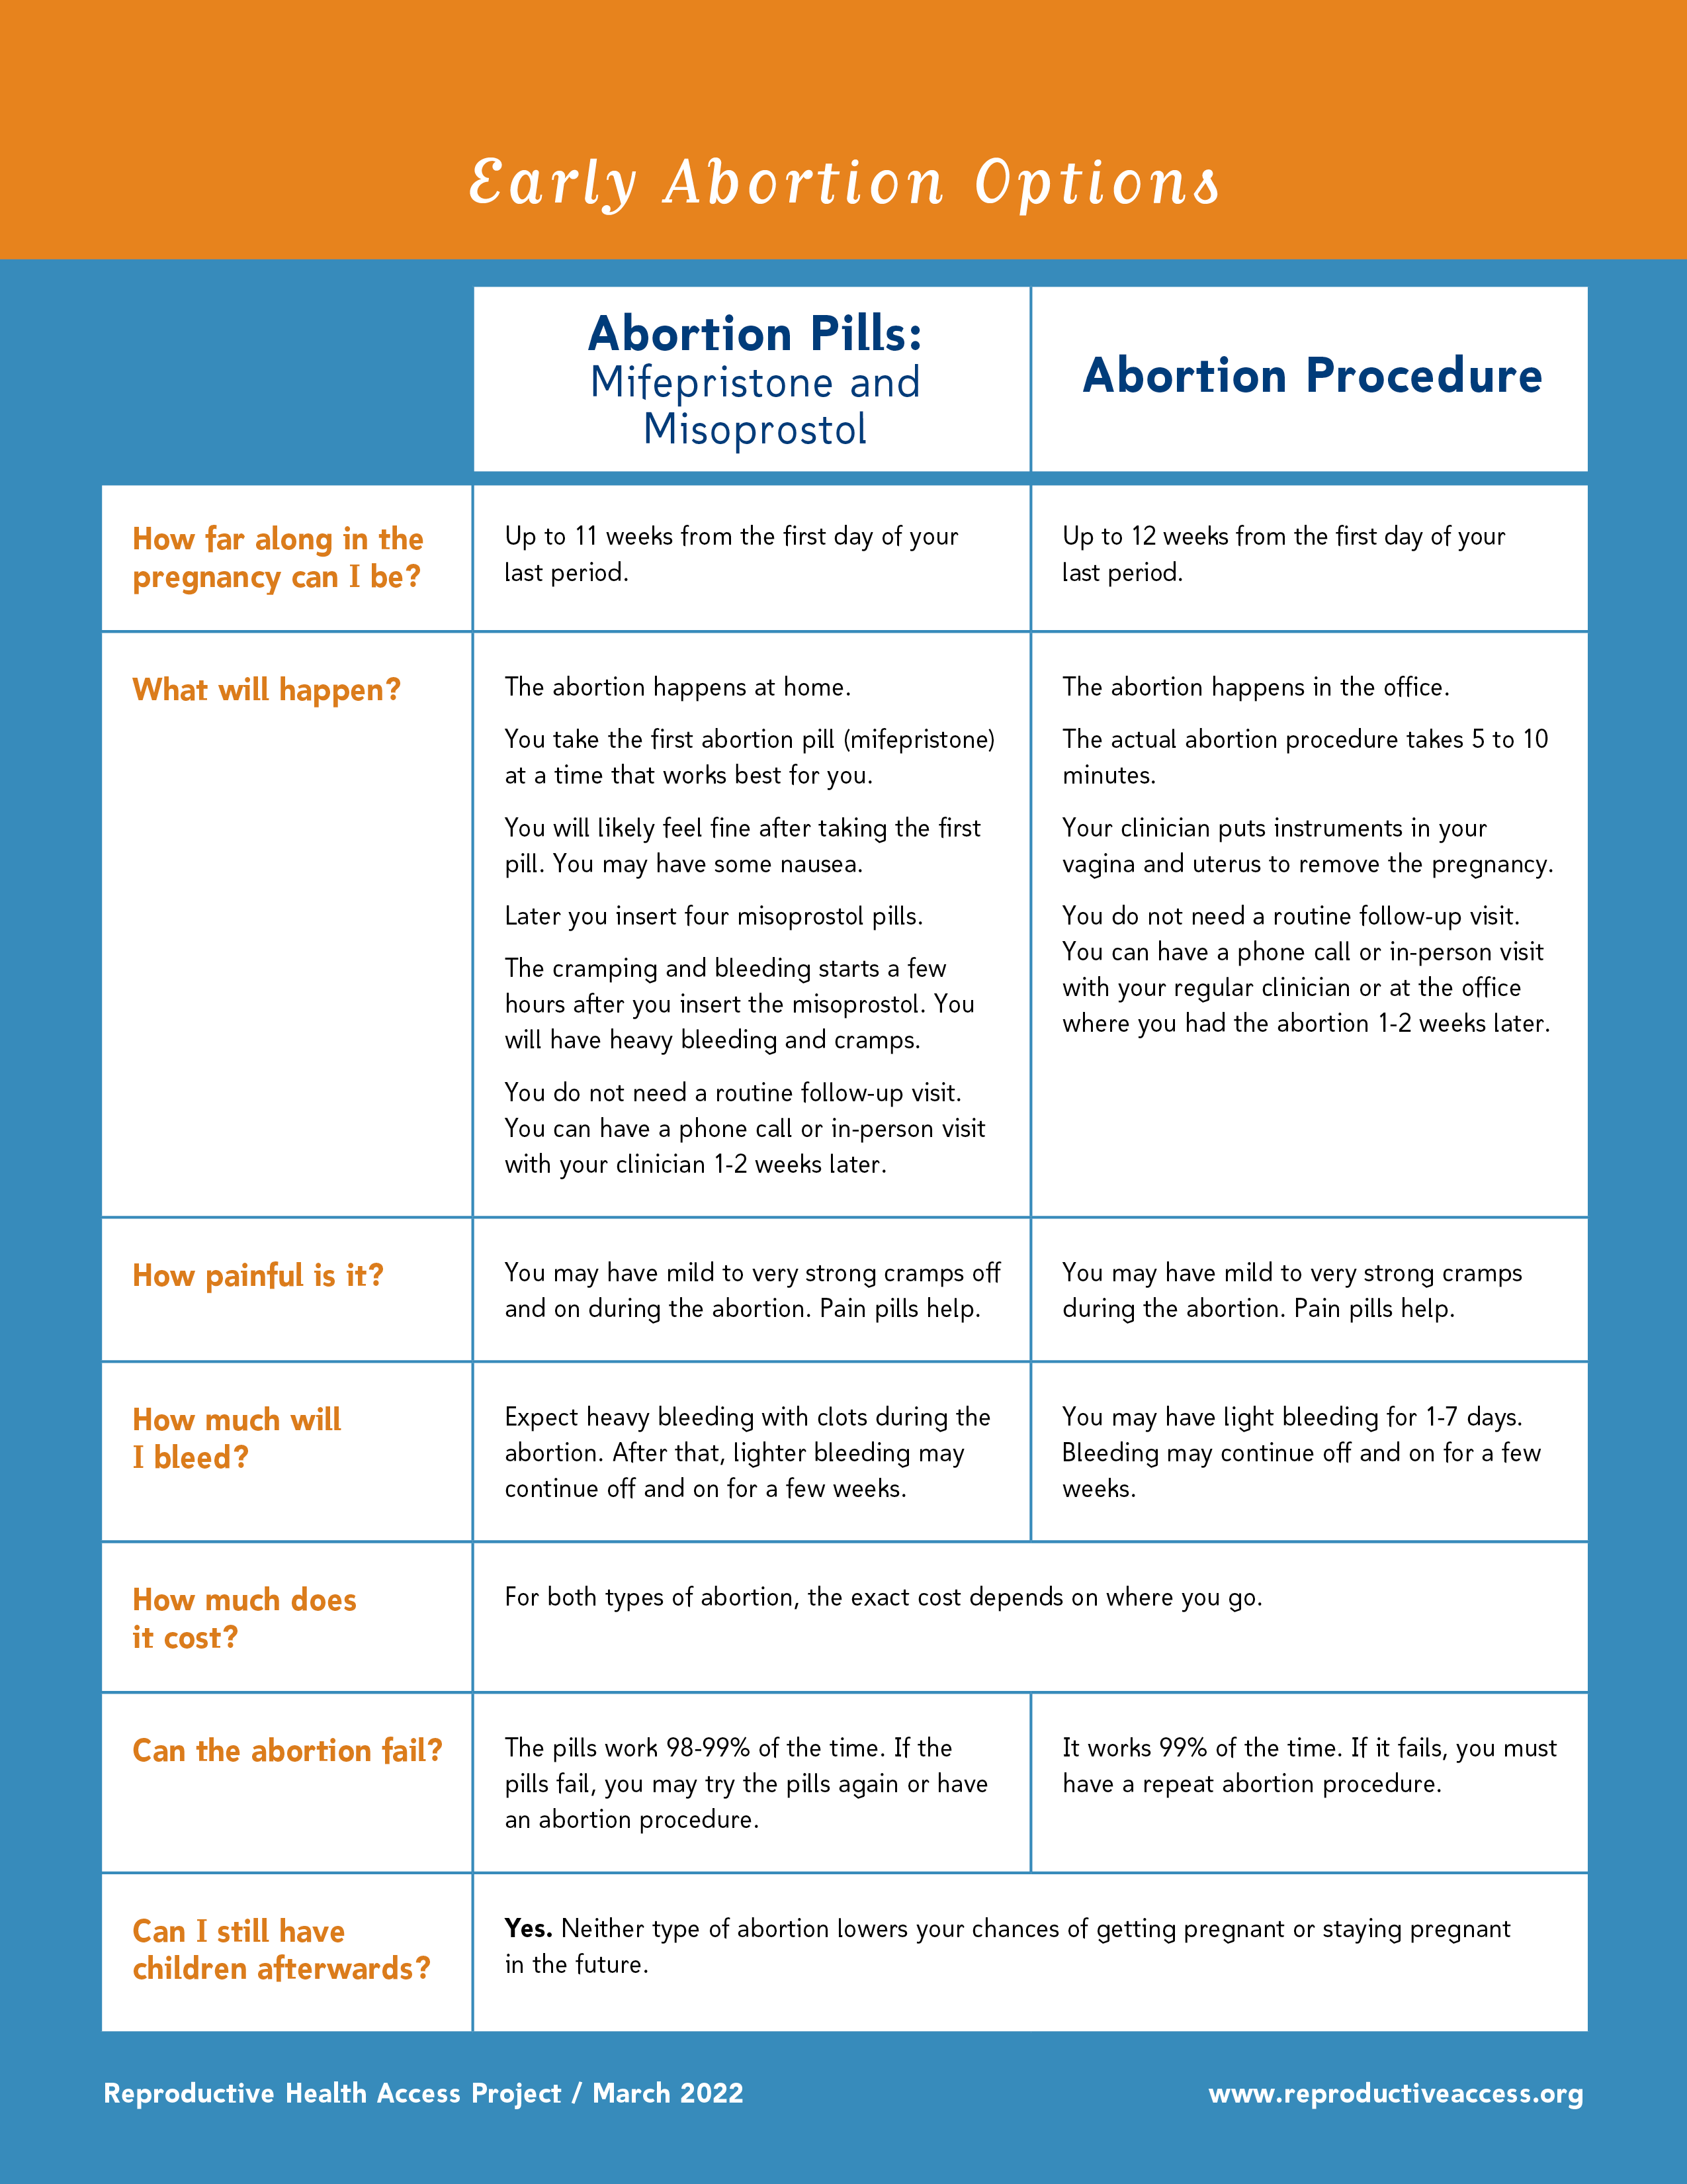
RESOURCES.
Telehealth Care for Medication Abortion Workflow
Early Abortion Options
Medication Abortion FAQ
Protocol for Medication Abortion Using Mifepristone and Misoprostol
Coding for Medication Abortion using Mifepristone and Misoprostol
Sam’s Medication Abortion Zine
Algorithm for Phone Triage of Bleeding with Medication Abortion
Notes:
I just want to highlight some more resources from RHAP. You can find a range of patient education materials, clinical tools, and implementation guidance to support providing medication abortion in your health center.
Before we take questions, I want you to return to your KWL from the beginning of the session: Take a moment to write down 2-3 things that you’ve learned.
Okay, any questions?
https://www.reproductiveaccess.org/resource/telehealth-care-for-mab-workflow/
https://www.reproductiveaccess.org/resource/early-abortion-options/
https://www.reproductiveaccess.org/resource/medication-abortion-faqs/
https://www.reproductiveaccess.org/resource/medication-abortion-protocol/
https://www.reproductiveaccess.org/resource/medication-abortion-coding/
https://www.reproductiveaccess.org/resource/sams-medication-abortion-zine/
https://www.reproductiveaccess.org/resource/algorithm-phone-triage-bleeding-medication-abortion/

Slide 50
REFERENCES.
Abortion care guideline. Geneva: World Health Organization; 2022. Licence: CC BY-NC-SA 3.0 IGO.
Access Delivered A Toolkit for Providers Offering Medication Abortion. Familymedicine.uw.edu. https://familymedicine.uw.edu/accessdelivered/. Published 2022. Accessed May 19, 2022.
Aiken ARA, Broussard K, Johnson DM, Padron E. Motivations and experiences of people seeking medication abortion online in the United States. Perspect Sex Reprod Health. 2018;50(4):157–163.
Aiken ARA, Digol I, Trussell J, Gomperts R. Self reported outcomes and adverse events after medical abortion through online telemedicine: population based study in the Republic of Ireland and Northern Ireland. BMJ. 2017;357:j2011.
Aiken A, Romanova E, Morber J, Gomperts R. Safety and effectiveness of self-managed medication abortion provided using online telemedicine in the United States: A population based study. The Lancet Regional Health - Americas. 2022:100200. doi:10.1016/j.lana.2022.100200
Aiken ARA, Starling JE, Gomperts R, Tec M, Scott JG, Aiken CE. Demand for self-managed online telemedicine abortion in the United States during the coronavirus disease 2019 (COVID-19) pandemic. Obstet Gynecol. 2020;136(4):835–837.
Aiken A, Starling J, Gomperts R. Factors associated with use of an online telemedicine service to access self-managed medical abortion in the US. JAMA Netw Open. 2021;4(5):e2111852.
All-Options: All-options pregnancy support. All-options.org. https://www.all-options.org/. Published 2022. Accessed May 19, 2022.
Anderson E, Salganicoff A, Sobel L. State Restrictions on Telehealth Abortion. KFF. https://www.kff.org/womens-health-policy/slide/state-restrictions-on-telehealth-abortion/. Published 2021. Accessed May 19, 2022.
An Overview of Abortion Laws. Guttmacher Institute. https://www.guttmacher.org/state-policy/explore/overview-abortion-laws. Published 2022. Accessed May 19, 2022.
Baird D. Mode of action of medical methods of abortion. JAMWA. 2000; 35(3): S121-126.
Beverly W, Dzuba IG, Chong E, et al. Extending Outpatient Medical Abortion Services Through 70 Days of Gestational Age. Obstetrics & Gynecology. 2012;120(5):1070-1076. doi:10.1097/AOG.0b013e31826c315f.
Blanchard K, Shochet T, Coyaji K, Thi Nhu Ngoc N, Winikoff B. Misoprostol alone for early abortion: an evaluation of seven potential regimens. Contraception. Aug 2005;72(2):91-97.
Blanchard K, Winikoff B, Ellertson C. Misoprostol used alone for the termination of early pregnancy. A review of the evidence. Contraception. Apr 1999;59(4):209-217.
Bracken, H., N.T.N. Ngoc, E. Schaff, K. Coyaji, S. Ambardekar, E. Westheimer, B. Winikoff. Mifepristone Followed in 24 Hours to 48 Hours by Misoprostol for Late First-Trimester Abortion. Obstetrics and Gynecology (Apr 2007), 109 pp.895-901.
Cansino C, Lichtenberg ES, Perriera LK, et al. Do women want to talk about birth control at the time of a first-trimester abortion? Contraception. 2018 Dec;98(6):535-540. doi: 10.1016/j.contraception.2018.08.005.
Castillo P, Sanhueza P, Hernandez EML, Bousieguez M, Dzuba I. Does a repeat dose of 800mcg misoprostol following mifepristone improve outcomes in the later first trimester? A retrospective chart review in Mexico City. Paper presented at: National Abortion Federation Annual Meeting; April 22, 2017; Montreal, Quebec.
Chong E, Shochet T, Raymond E et al. Expansion of a direct-to-patient telemedicine abortion service in the United States and experience during the COVID-19 pandemic. Contraception. 2021;104(1):43-48. doi:10.1016/j.contraception.2021.03.019
Contraceptive Pearls: Post Abortion Contraception. Reproductiveaccess. https://www.reproductiveaccess.org/resource/contraceptive-pearls-post-abortion-contraception/. Published 2021. Accessed May 19, 2022.
Coyaji,K., U. Krishna, S. Ambardekar, H. Bracken, V. Raote, A. Mandlekar, B. Winikoff. Are two doses of misoprostol after mifepristone for early abortion better than one? British Journal of Obstetrics and Gynaecology, (Mar 2007), 114 (3), pp. 271–278.
Creinin MD, Fox MC, Teal S, Chen A, Schaff EA, Meyn LA: MOD Study Trial Group: A randomized comparison of misoprostol 6 to 8 hours versus 24 hours after mifepristone for abortion. Obstet. Gynecol. 2004 103(5 Pt. 1): 851-859
Curtis KM, Jatlaoui TC, Tepper NK, et al. U.S. selected practice recommendations for contraceptive use, 2016. MMWR Recomm Rep. 2016;65(4):1.
Denny C. How to start birth control after an abortion. Bedsider website. August 2019. Accessed May 2021. https://www.bedsider.org/features/1319-how-to-start-birth-control-after-an-abortion.
Diaz-Tello F, Grant E, Lin C et al. Abortion Decriminalization Is Part Of The Larger Struggle Against Policing And Criminalization: How Our Movements Can Organize In Solidarity With Each Other. Interrupting Criminalization; 2022. https://static1.squarespace.com/static/5ee39ec764dbd7179cf1243c/t/6194235775f2a0615ea53cde/1637098383973/Decriminalize+Abortion. Accessed May 19, 2022.
Donovan MK. Self-managed medication abortion: expanding the available options for U.S. abortion care. Guttmacher Policy Rev. 2018;21:41–47.
Do's and Dont's. Bixby Center for Global Reproductive Health; 2021. https://www.innovating-education.org/2020/12/dos-and-donts/. Accessed April 21, 2022.
Early Abortion Options. Reproductive Health Access Project; 2022. https://www.reproductiveaccess.org/resource/early-abortion-options/. Accessed May 19, 2022.
Feminist Medication Abortion Accompaniment 101. Ibis Reproductive Health; 2021. https://www.ibisreproductivehealth.org/sites/default/files/files/publications/Abortion%20accompaniment%20101.pdf. Accessed May 19, 2022.
Finer LB and Zolna MR, Declines in Unintended Pregnancy in the United States, 2008–2011; The New England Journal of Medicine 2016, 374(9):843-52.
Guest J, Chien P, Thomson M, Kosseim ML. Randomised controlled trial comparing efficacy of same day administration of mifepristone and misoprostol for termination of pregnancy with the standard 36- to 48-hour protocol. Bjog. Oct 2005;112(10):1457.
Herrmann WL et al. Effects of the antiprogesterone RU 486 in early pregnancy and during the menstrual cycle. Future aspects in contraception. 1984 Ch. 22:249-70.
Ho PC, Blumenthal PD, Gemzell-Danielsson K, Gómez Ponce de León R, Mittal S, Tang OS. Misoprostol for the termination of pregnancy with a live fetus at 13 to 26 weeks. Int J Gynaecol Obstet. 2007 Dec;99 Suppl 2:S178-81
Holistic Abortions [@holistic.abortions]. (n.d.). Posts [Instagram profile]. Retrieved May 19, 2022, from https://www.instagram.com/holistic.abortions
If/When/How. Self-Managed Abortion and the Law. What health care providers need to know.
If/When/How. Supporting people who end pregnancies: necessary for reproductive justice. Available at: https://www.ifwhenhow.org/wp-content/uploads/2020/04/FINAL-Fact-Sheet-Self-Managed-Abortion-.pdf. Accessed February 11, 2021.
Indications For Sonography For Medication Abortion. Reproductive Health Access Project; 2019. https://www.reproductiveaccess.org/resource/indications-sonography-medication-abortion/. Accessed May 19, 2022.
Induced Abortion in the United States, Sept 2019 Fact Sheet, https://www.guttmacher.org/fact-sheet/induced-abortion-united-states
Jain JK, Dutton C, Harwood B, Meckstroth KR, Mishell DR, Jr. A prospective randomized, double-blinded, placebo-controlled trial comparing mifepristone and vaginal misoprostol to vaginal misoprostol alone for elective termination of early pregnancy. Hum Reprod. Jun 2002;17(6):1477-1482.
Jain J, Dutton C, Nicosia A, et al. Pharmacokinetics, ovulation suppression and return to ovulation following a lower dose subcutaneous formulation of Depo-Provera. Contraception. 2004;70(1):11.
Jerman J, Jones R, Onda T. Characteristics of U.S. Abortion Patients in 2014 and Changes Since 2008. Guttmacher Institute. https://www.guttmacher.org/report/characteristics-us-abortion-patients-2014. Published 2016. Accessed May 18, 2022.
Jones R, Jerman J. Abortion Incidence and Service Availability In the United States, 2014. Perspect Sex Reprod Health. 2017;49(1). doi:10.1363/psrh.12015
Jones R, Jerman J. Population Group Abortion Rates and Lifetime Incidence of Abortion: United States, 2008–2014. Am J Public Health. 2017;107(12):1904-1909. doi:10.2105/ajph.2017.304042
Jones R, Nash E, Cross L, Philbin J, Kristein M. Medication Abortion Now Accounts for More Than Half of All US Abortions. Guttmacher Institute. https://www.guttmacher.org/article/2022/02/medication-abortion-now-accounts-more-half-all-us-abortions. Published 2022. Accessed May 18, 2022.
Kapp N, Eckersberger E, Lavelanet A, Rodriguez MI. Medical abortion in the late first trimester: a systematic review. Contraception. 2019;99(2):77-86. doi: 10.1016/j.contraception.2018.11.002.
Language and Impact. A project of the Bixby Center for Global Reproductive Health; 2021. https://www.innovating-education.org/2020/12/language-and-impact/. Accessed April 21, 2022.
Learning Resources - Reproductive Health. lgbtqiahealtheducation.org. https://www.lgbtqiahealtheducation.org/resources/in/reproductive-health/. Published 2022. Accessed May 19, 2022.
Li C-L, Chen D-J, Song L-P, et al. Effectiveness and Safety of Lower Doses of Mifepristone Combined With Misoprostol of the Termination of Ultra-Early Pregnancy: A Dose-Ranging Randomized Controlled Trial. Reproductive Sciences. 2014;22(6):706-711.
Luo E, Golen T, Kimball A. Rising to the challenge of screening for intimate partner violence during Covid-19. STAT. https://www.statnews.com/2020/07/17/rising-to-the-challenge-of-screening-for-intimate-partner-violence-during-covid-19/. Published 2020. Accessed May 19, 2022.
Notes:
Abortion care guideline. Geneva: World Health Organization; 2022. Licence: CC BY-NC-SA 3.0 IGO.
Access Delivered A Toolkit for Providers Offering Medication Abortion. Familymedicine.uw.edu. https://familymedicine.uw.edu/accessdelivered/. Published 2022. Accessed May 19, 2022.
Aiken ARA, Broussard K, Johnson DM, Padron E. Motivations and experiences of people seeking medication abortion online in the United States. Perspect Sex Reprod Health. 2018;50(4):157–163.
Aiken ARA, Digol I, Trussell J, Gomperts R. Self reported outcomes and adverse events after medical abortion through online telemedicine: population based study in the Republic of Ireland and Northern Ireland. BMJ. 2017;357:j2011.
Aiken A, Romanova E, Morber J, Gomperts R. Safety and effectiveness of self-managed medication abortion provided using online telemedicine in the United States: A population based study. The Lancet Regional Health - Americas. 2022:100200. doi:10.1016/j.lana.2022.100200
Aiken ARA, Starling JE, Gomperts R, Tec M, Scott JG, Aiken CE. Demand for self-managed online telemedicine abortion in the United States during the coronavirus disease 2019 (COVID-19) pandemic. Obstet Gynecol. 2020;136(4):835–837.
Aiken A, Starling J, Gomperts R. Factors associated with use of an online telemedicine service to access self-managed medical abortion in the US. JAMA Netw Open. 2021;4(5):e2111852.
All-Options: All-options pregnancy support. All-options.org. https://www.all-options.org/. Published 2022. Accessed May 19, 2022.
Anderson E, Salganicoff A, Sobel L. State Restrictions on Telehealth Abortion. KFF. https://www.kff.org/womens-health-policy/slide/state-restrictions-on-telehealth-abortion/. Published 2021. Accessed May 19, 2022.
An Overview of Abortion Laws. Guttmacher Institute. https://www.guttmacher.org/state-policy/explore/overview-abortion-laws. Published 2022. Accessed May 19, 2022.
Baird D. Mode of action of medical methods of abortion. JAMWA. 2000; 35(3): S121-126.
Beverly W, Dzuba IG, Chong E, et al. Extending Outpatient Medical Abortion Services Through 70 Days of Gestational Age. Obstetrics & Gynecology. 2012;120(5):1070-1076. doi:10.1097/AOG.0b013e31826c315f.
Blanchard K, Shochet T, Coyaji K, Thi Nhu Ngoc N, Winikoff B. Misoprostol alone for early abortion: an evaluation of seven potential regimens. Contraception. Aug 2005;72(2):91-97.
Blanchard K, Winikoff B, Ellertson C. Misoprostol used alone for the termination of early pregnancy. A review of the evidence. Contraception. Apr 1999;59(4):209-217.
Bracken, H., N.T.N. Ngoc, E. Schaff, K. Coyaji, S. Ambardekar, E. Westheimer, B. Winikoff. Mifepristone Followed in 24 Hours to 48 Hours by Misoprostol for Late First-Trimester Abortion. Obstetrics and Gynecology (Apr 2007), 109 pp.895-901.
Cansino C, Lichtenberg ES, Perriera LK, et al. Do women want to talk about birth control at the time of a first-trimester abortion? Contraception. 2018 Dec;98(6):535-540. doi: 10.1016/j.contraception.2018.08.005.
Castillo P, Sanhueza P, Hernandez EML, Bousieguez M, Dzuba I. Does a repeat dose of 800mcg misoprostol following mifepristone improve outcomes in the later first trimester? A retrospective chart review in Mexico City. Paper presented at: National Abortion Federation Annual Meeting; April 22, 2017; Montreal, Quebec.
Chong E, Shochet T, Raymond E et al. Expansion of a direct-to-patient telemedicine abortion service in the United States and experience during the COVID-19 pandemic. Contraception. 2021;104(1):43-48. doi:10.1016/j.contraception.2021.03.019
Contraceptive Pearls: Post Abortion Contraception. Reproductiveaccess. https://www.reproductiveaccess.org/resource/contraceptive-pearls-post-abortion-contraception/. Published 2021. Accessed May 19, 2022.
Coyaji,K., U. Krishna, S. Ambardekar, H. Bracken, V. Raote, A. Mandlekar, B. Winikoff. Are two doses of misoprostol after mifepristone for early abortion better than one? British Journal of Obstetrics and Gynaecology, (Mar 2007), 114 (3), pp. 271–278.
Creinin MD, Fox MC, Teal S, Chen A, Schaff EA, Meyn LA: MOD Study Trial Group: A randomized comparison of misoprostol 6 to 8 hours versus 24 hours after mifepristone for abortion. Obstet. Gynecol. 2004 103(5 Pt. 1): 851-859
Curtis KM, Jatlaoui TC, Tepper NK, et al. U.S. selected practice recommendations for contraceptive use, 2016. MMWR Recomm Rep. 2016;65(4):1.
Denny C. How to start birth control after an abortion. Bedsider website. August 2019. Accessed May 2021. https://www.bedsider.org/features/1319-how-to-start-birth-control-after-an-abortion.
Diaz-Tello F, Grant E, Lin C et al. Abortion Decriminalization Is Part Of The Larger Struggle Against Policing And Criminalization: How Our Movements Can Organize In Solidarity With Each Other. Interrupting Criminalization; 2022. https://static1.squarespace.com/static/5ee39ec764dbd7179cf1243c/t/6194235775f2a0615ea53cde/1637098383973/Decriminalize+Abortion. Accessed May 19, 2022.
Donovan MK. Self-managed medication abortion: expanding the available options for U.S. abortion care. Guttmacher Policy Rev. 2018;21:41–47.
Do's and Dont's. Bixby Center for Global Reproductive Health; 2021. https://www.innovating-education.org/2020/12/dos-and-donts/. Accessed April 21, 2022.
Early Abortion Options. Reproductive Health Access Project; 2022. https://www.reproductiveaccess.org/resource/early-abortion-options/. Accessed May 19, 2022.
Feminist Medication Abortion Accompaniment 101. Ibis Reproductive Health; 2021. https://www.ibisreproductivehealth.org/sites/default/files/files/publications/Abortion%20accompaniment%20101.pdf. Accessed May 19, 2022.
Finer LB and Zolna MR, Declines in Unintended Pregnancy in the United States, 2008–2011; The New England Journal of Medicine 2016, 374(9):843-52.
Guest J, Chien P, Thomson M, Kosseim ML. Randomised controlled trial comparing efficacy of same day administration of mifepristone and misoprostol for termination of pregnancy with the standard 36- to 48-hour protocol. Bjog. Oct 2005;112(10):1457.
Herrmann WL et al. Effects of the antiprogesterone RU 486 in early pregnancy and during the menstrual cycle. Future aspects in contraception. 1984 Ch. 22:249-70.
Ho PC, Blumenthal PD, Gemzell-Danielsson K, Gómez Ponce de León R, Mittal S, Tang OS. Misoprostol for the termination of pregnancy with a live fetus at 13 to 26 weeks. Int J Gynaecol Obstet. 2007 Dec;99 Suppl 2:S178-81
Holistic Abortions [@holistic.abortions]. (n.d.). Posts [Instagram profile]. Retrieved May 19, 2022, from https://www.instagram.com/holistic.abortions
If/When/How. Self-Managed Abortion and the Law. What health care providers need to know.
If/When/How. Supporting people who end pregnancies: necessary for reproductive justice. Available at: https://www.ifwhenhow.org/wp-content/uploads/2020/04/FINAL-Fact-Sheet-Self-Managed-Abortion-.pdf. Accessed February 11, 2021.
Indications For Sonography For Medication Abortion. Reproductive Health Access Project; 2019. https://www.reproductiveaccess.org/resource/indications-sonography-medication-abortion/. Accessed May 19, 2022.
Induced Abortion in the United States, Sept 2019 Fact Sheet, https://www.guttmacher.org/fact-sheet/induced-abortion-united-states
Jain JK, Dutton C, Harwood B, Meckstroth KR, Mishell DR, Jr. A prospective randomized, double-blinded, placebo-controlled trial comparing mifepristone and vaginal misoprostol to vaginal misoprostol alone for elective termination of early pregnancy. Hum Reprod. Jun 2002;17(6):1477-1482.
Jain J, Dutton C, Nicosia A, et al. Pharmacokinetics, ovulation suppression and return to ovulation following a lower dose subcutaneous formulation of Depo-Provera. Contraception. 2004;70(1):11.
Jerman J, Jones R, Onda T. Characteristics of U.S. Abortion Patients in 2014 and Changes Since 2008. Guttmacher Institute. https://www.guttmacher.org/report/characteristics-us-abortion-patients-2014. Published 2016. Accessed May 18, 2022.
Jones R, Jerman J. Abortion Incidence and Service Availability In the United States, 2014. Perspect Sex Reprod Health. 2017;49(1). doi:10.1363/psrh.12015
Jones R, Jerman J. Population Group Abortion Rates and Lifetime Incidence of Abortion: United States, 2008–2014. Am J Public Health. 2017;107(12):1904-1909. doi:10.2105/ajph.2017.304042
Jones R, Nash E, Cross L, Philbin J, Kristein M. Medication Abortion Now Accounts for More Than Half of All US Abortions. Guttmacher Institute. https://www.guttmacher.org/article/2022/02/medication-abortion-now-accounts-more-half-all-us-abortions. Published 2022. Accessed May 18, 2022.
Kapp N, Eckersberger E, Lavelanet A, Rodriguez MI. Medical abortion in the late first trimester: a systematic review. Contraception. 2019;99(2):77-86. doi: 10.1016/j.contraception.2018.11.002.
Language and Impact. A project of the Bixby Center for Global Reproductive Health; 2021. https://www.innovating-education.org/2020/12/language-and-impact/. Accessed April 21, 2022.
Learning Resources - Reproductive Health. lgbtqiahealtheducation.org. https://www.lgbtqiahealtheducation.org/resources/in/reproductive-health/. Published 2022. Accessed May 19, 2022.
Li C-L, Chen D-J, Song L-P, et al. Effectiveness and Safety of Lower Doses of Mifepristone Combined With Misoprostol of the Termination of Ultra-Early Pregnancy: A Dose-Ranging Randomized Controlled Trial. Reproductive Sciences. 2014;22(6):706-711.
Luo E, Golen T, Kimball A. Rising to the challenge of screening for intimate partner violence during Covid-19. STAT. https://www.statnews.com/2020/07/17/rising-to-the-challenge-of-screening-for-intimate-partner-violence-during-covid-19/. Published 2020. Accessed May 19, 2022.
M, Pinckney J, White L. Ensuring Access To Safe Abortion Care For Black Women. National Black Women’s Reproductive Justice Agenda; 2020. http://blackrj.org/wp-content/uploads/2020/04/6217-IOOV_Abortion.pdf. Accessed May 18, 2022.
Matulich M, Cansino C, Culwell KR, Creinin MD. Contraception. Understanding women’s desires for contraceptive counseling at the time of first-trimester surgical abortion. 2014;89(1):36.
Medicaid Coverage of Abortion. Guttmacher Institute. https://www.guttmacher.org/evidence-you-can-use/medicaid-coverage-abortion. Published 2021. Accessed May 18, 2022.
Medication Abortion: State Laws and Policies. Guttmacher Institute. https://www.guttmacher.org/state-policy/explore/medication-abortion. Published 2022. Accessed May 18, 2022.
Misoprostol only: Recommended regimen. Ipas. https://www.ipas.org/clinical-update/english/recommendations-for-abortion-before-13-weeks-gestation/medical-abortion/misoprostol-only-recommended-regimen/. Published 2021. Accessed May 19, 2022
Moreno-Ruiz NL, Borgatta L, Yanow S, Kapp N, Wiebe ER, Winikoff B. Alternatives to mifepristone for early medical abortion. Int J Gynaecol Obstet. 2007 Mar;96(3):212-8
Moseson H, Bullard K, Cisternas C, Grosso B, Vera V, Gerdts C. Effectiveness of self-managed medication abortion between 13 and 24 weeks gestation: a retrospective review of case records from accompaniment groups in Argentina, Chile, and Ecuador. Contraception. 2020;102(2):91–98.
Moseson H, Herold S, Filippa S, Barr-Walker J, Baum SE, Gerdts C. Self-managed abortion: A systematic scoping review. Best Pract Res Clin Obstet Gynaecol. 2020;63:87-110. doi:10.1016/j.bpobgyn.2019.08.002
Moseson H, Jayaweera R, Egwuatu I et al. Effectiveness of self-managed medication abortion with accompaniment support in Argentina and Nigeria (SAFE): a prospective, observational cohort study and non-inferiority analysis with historical controls. The Lancet Global Health. 2022;10(1). doi:10.1016/s2214-109x(21)00461-7
Moseson, H., Jayaweera, R., Raifman, S. et al. Self-managed medication abortion outcomes: results from a prospective pilot study. Reprod Health 17, 164 (2020). https://doi.org/10.1186/s12978-020-01016-4
National Academies of Sciences, Engineering, and Medicine. 2018. The Safety and Quality of Abortion Care in the United States. Washington, DC: The National Academies Press. https://doi.org/10.17226/24950.
Paltrow L, Flavin J. Arrests of and forced interventions on pregnant women in the United States, 1973–2005: implications for women’s legal status and public health. J Health Polit Policy Law. 2013;38(2):299–343.
Patient-Centered Pregnancy Options Counseling. Rhedi.org. https://rhedi.org/education/rhedi-curriculum/patient-centered-pregnancy-options-counseling/. Published 2022. Accessed May 19, 2022.
Potter JE, Stevenson AJ, Coleman-Minahan K, et al. Challenging unintended pregnancy as an indicator of reproductive autonomy. Contraception. 2019;100(1):1-4. doi:10.1016/j.contraception.2019.02.005
Prager S, Carlisle S, Chaiten L et al. Clinical Policy Guidelines For Abortion Care. National Abortion Federation; 2020. https://5aa1b2xfmfh2e2mk03kk8rsx-wpengine.netdna-ssl.com/wp-content/uploads/2020_CPGs.pdf. Accessed May 18, 2022.
Prager S, Carlisle S, Chaiten L et al. Clinical Guidelines For Abortion Care. National Abortion Federation; 2022. https://prochoice.org/providers/quality-standards/. Accessed May 19, 2022.
Provision of Abortion Care by Advanced Practice Nurses and Physician Assistants. Apha.org. https://www.apha.org/policies-and-advocacy/public-health-policy-statements/policy-database/2014/07/28/16/00/provision-of-abortion-care-by-advanced-practice-nurses-and-physician-assistants. Published 2011. Accessed May 19, 2022.
Rachel K. Jones, Jenna Jerman, “Population Group Abortion Rates and Lifetime Incidence of Abortion: United States, 2008–2014”, American Journal of Public Health 107, no. 12 (December 1, 2017): pp. 1904-1909.
Ralph LJ, Ehrenreich K, Barar R, et al. Accuracy of self-assessment of gestational duration among people seeking abortion [published online ahead of print, 2021 Dec 17]. Am J Obstet Gynecol. 2021;S0002-9378(21)02683-1. doi:10.1016/j.ajog.2021.11.1373
Ralph L, Foster DG, Raifman S. Prevalence of self-managed abortion among women of reproductive age in the United States. JAMA Netw Open. 2020;3(12):e2029245.
Raymond EG, Harrison MS, Weaver MA. Efficacy of misoprostol alone for first-trimester medical abortion: a systematic review. Obstet Gynecol. 2019;133(1):137–147.
Raymond EG, Weaver MA, Louie KS, et al. Effects of depot medroxyprogesterone acetate injection timing on medication abortion efficacy and repeat pregnancy random controlled trial. Obstet Gynecol. 2016;128(4):739.
Raymond EG, Weaver MA, Tan YL, et al. Effect of immediate compared with delayed insertion of etonogestrel implants on medical abortion efficacy and repeat pregnancy: A randomized controlled trial. Obstet Gynecol. 2016 Feb;127(2):306-12.
Reproductive Justice Briefing Book: A Primer on Reproductive Justice and Social Change. Law.berkeley.edu. https://www.law.berkeley.edu/php-programs/courses/fileDL.php?fID=4051. Published 2022. Accessed May 18, 2022.
Reproductive Justice – In Our Own Voice. Blackrj.org. https://blackrj.org/our-issues/reproductive-justice/. Published 2022. Accessed May 18, 2022.
Reproductive Justice — Sister Song. Sister Song. https://www.sistersong.net/reproductive-justice. Published 2022. Accessed May 18, 2022.
Roosevelt L, Pietzmeier S, Reed R. Clinically and Culturally Competent Care for Transgender and Nonbinary People. The Journal of Perinatal & Neonatal Nursing. 2021; 35 (2): 142-149. doi: 10.1097/JPN.0000000000000560
Schaff EA, Eisinger SH, Stadalius LS, Franks P, Gore BZ, Poppema S. Low-dose mifepristone 200 mg and vaginal misoprostol for abortion. Contraception. Jan 1999;59(1):1-6.
Schaff EA, Fielding SL, Eisinger SH, Stadalius LS, Fuller L. Low-dose mifepristone followed by vaginal misoprostol at 48 hours for abortion up to 63 days. Contraception. Jan 2000;61(1):41-46.
Schaff EA, Fielding SL, Westhoff C. Randomized trial of oral versus vaginal misoprostol 2 days after mifepristone 200 mg for abortion up to 63 days of pregnancy. Contraception. Oct 2002;66(4):247-250.
Schaff EA, Fielding SL, Westhoff C. Randomized trial of oral versus vaginal misoprostol at one day after mifepristone for early medical abortion. Contraception. Aug 2001;64(2):81-85.
Schaff EA, Fielding SL, Westhoff C, et al. Vaginal misoprostol administered 1, 2, or 3 days after mifepristone for early medical abortion: A randomized trial. Jama. Oct 18 2000;284(15):1948-1953.
Schaff EA, et al. Vaginal misoprostol administered at home after mifepristone (RU486) for abortion. J Fam Pract 1997;44:353-60.
Sexual and Reproductive Justice (SRJ). Www1.nyc.gov. https://www1.nyc.gov/site/doh/health/health-topics/sexual-reproductive-justice-nyc.page. Published 2022. Accessed May 18, 2022.
Shannon C., E. Wiebe, F. Jacot, E. Guilbert, S. Dunn, W.R. Sheldon, B. Winikoff. Regimens of misoprostol with mifepristone for early medical abortion: a randomised trial. British Journal of Obstetrics and Gynaecology (Jun 2006), 113(6), pp 62-628.
Simon MA. Responding to Intimate Partner Violence During Telehealth Clinical Encounters. JAMA. 2021;325(22):2307–2308. doi:10.1001/jama.2021.1071
Swahn ML, Cekan S, Wang G, Lujndstrom V, Bygdeman M. Pharmacokinetic and clinical studies of RU 486 for fertility regulation. In: Beaulieu EE, Siegel S, eds. The Antiprogestin Steroid RU 486 and Human Fertility Control. New York, NY: Plenum; 1985:249-258.
Taylor D, Safriet B, Dempsey G, Kruse B, Jackson C. Providing abortion care: A professional toolkit for nurse-midwives, nurse practitioners and physician assistants. University of California San Francisco. 2009.
Telehealth Care For Medication Abortion Protocol. Reproductive Health Access Project; 2021. https://www.reproductiveaccess.org/resource/telehealth-care-for-mab-protocol/. Accessed May 19, 2022.
Telehealth Care For Medication Abortion Workflow. Reproductive Health Access Project; 2022. https://www.reproductiveaccess.org/resource/telehealth-care-for-mab-workflow/. Accessed May 19, 2022.
Telehealth, COVID-19, And Intimate Partner Violence: Increasing Safety For People Surviving Abuse. Futures Without Violence; 2022. https://www.futureswithoutviolence.org/wp-content/uploads/Telehealth-Covid-19-IPV_Clinical-Pathway.pdf. Accessed May 19, 2022.
The Availability and Use of Medication Abortion Care. KFF. https://www.kff.org/infographic/the-availability-and-use-of-medication-abortion-care/. Published 2021. Accessed May 18, 2022.
Ultrasound-as-Needed Protocol for Medication Abortion. Rhedi.org. https://rhedi.org/limited-ultrasound-protocol-for-medication-abortion/. Published 2022. Accessed May 19, 2022.
Unintended Pregnancy in the United States. Guttmacher Institute. https://www.guttmacher.org/fact-sheet/unintended-pregnancy-united-states. Published 2022. Accessed May 18, 2022.
Upadhyay UD, Dworkin SL, Weitz TA, Foster DG. Development and validation of a reproductive autonomy scale. Stud Fam Plann. 2014;45(1):19-41. doi:10.1111/j.1728-4465.2014.00374.x
U.S. Food and Drug Administration. Mifeprex medical review. Available at: https://www.accessdata.fda.gov/drugsatfda_docs/nda/2016/020687Orig1s020MedR.pdf. Published 2021. Accessed February 4, 2021.
U.S. Transgender Survey. National Center for Transgender Equality. https://transequality.org/issues/us-trans-survey. Published 2022. Accessed May 19, 2022.
van Bogaert LJ, Sedibe TM. Efficacy of a single misoprostol regimen in the first and second trimester termination of pregnancy. J Obstet Gynaecol. 2007;27(5):510-512. doi:10.1080/01443610701478967
Weeks AD and Stewart P. The use of low dose mifepristone and vaginal misoprostol for first trimester termination of pregnancy. Br J Fam Planning 1995;21:85-86.
Weitz, T. A., Taylor, D., Desai, S., Upadhyay, U. D., Waldman, J., Battistelli, M. F., & Drey, E. A. (2013). Safety of Aspiration Abortion Performed by Nurse Practitioners, Certified Nurse Midwives, and Physician Assistants Under a California Legal Waiver. American Journal of Public Health, 103(3), 454–461. https://doi-org.unh.idm.oclc.org/10.2105/AJPH.2012.301159
What If Roe Fell? - Center for Reproductive Rights. Center for Reproductive Rights. https://reproductiverights.org/maps/what-if-roe-fell/. Published 2022. Accessed May 18, 2022.
Wiebe ER, Trouton KJ, Lima R. Misoprostol alone vs. methotrexate followed by misoprostol for early abortion. Int J Gynaecol Obstet. 2006 Dec;95(3):286-7
Winikoff B. Oral vs buccal administration of misoprostol after mifepristone for medication abortion up to 63 days. Obstetrics and Gynecology 2008, accepted for publication.
When Abortion is Not Available. Innovating Education in Reproductive Health. https://innovating-education.org/course/when-abortion-is-not-available/. Published 2022. Accessed May 19, 2022.
WHO guideline on self-care interventions for health and well-being. Geneva: World Health Organization; 2021. Licence: CC BY-NC-SA 3.0 IGO.
World Health Organization. Medical management of abortion. Available at: https://apps.who.int/iris/bitstream/handle/10665/278968/9789241550406-eng.pdf?ua=1. Accessed January 26, 2021.
World Health Organization Task Force on Post-Ovulatory Methods of Fertility Regulation. Comparison of two doses of mifepristone in combination with misoprostol for early medical abortion: a randomized trial. BJOG 2000 107(4): 524-530

Slide 51
REFERENCES.
M, Pinckney J, White L. Ensuring Access To Safe Abortion Care For Black Women. National Black Women’s Reproductive Justice Agenda; 2020. http://blackrj.org/wp-content/uploads/2020/04/6217-IOOV_Abortion.pdf. Accessed May 18, 2022.
Matulich M, Cansino C, Culwell KR, Creinin MD. Contraception. Understanding women’s desires for contraceptive counseling at the time of first-trimester surgical abortion. 2014;89(1):36.
Medicaid Coverage of Abortion. Guttmacher Institute. https://www.guttmacher.org/evidence-you-can-use/medicaid-coverage-abortion. Published 2021. Accessed May 18, 2022.
Medication Abortion: State Laws and Policies. Guttmacher Institute. https://www.guttmacher.org/state-policy/explore/medication-abortion. Published 2022. Accessed May 18, 2022.
Misoprostol only: Recommended regimen. Ipas. https://www.ipas.org/clinical-update/english/recommendations-for-abortion-before-13-weeks-gestation/medical-abortion/misoprostol-only-recommended-regimen/. Published 2021. Accessed May 19, 2022
Moreno-Ruiz NL, Borgatta L, Yanow S, Kapp N, Wiebe ER, Winikoff B. Alternatives to mifepristone for early medical abortion. Int J Gynaecol Obstet. 2007 Mar;96(3):212-8
Moseson H, Bullard K, Cisternas C, Grosso B, Vera V, Gerdts C. Effectiveness of self-managed medication abortion between 13 and 24 weeks gestation: a retrospective review of case records from accompaniment groups in Argentina, Chile, and Ecuador. Contraception. 2020;102(2):91–98.
Moseson H, Herold S, Filippa S, Barr-Walker J, Baum SE, Gerdts C. Self-managed abortion: A systematic scoping review. Best Pract Res Clin Obstet Gynaecol. 2020;63:87-110. doi:10.1016/j.bpobgyn.2019.08.002
Moseson H, Jayaweera R, Egwuatu I et al. Effectiveness of self-managed medication abortion with accompaniment support in Argentina and Nigeria (SAFE): a prospective, observational cohort study and non-inferiority analysis with historical controls. The Lancet Global Health. 2022;10(1). doi:10.1016/s2214-109x(21)00461-7
Moseson, H., Jayaweera, R., Raifman, S. et al. Self-managed medication abortion outcomes: results from a prospective pilot study. Reprod Health 17, 164 (2020). https://doi.org/10.1186/s12978-020-01016-4
National Academies of Sciences, Engineering, and Medicine. 2018. The Safety and Quality of Abortion Care in the United States. Washington, DC: The National Academies Press. https://doi.org/10.17226/24950.
Paltrow L, Flavin J. Arrests of and forced interventions on pregnant women in the United States, 1973–2005: implications for women’s legal status and public health. J Health Polit Policy Law. 2013;38(2):299–343.
Patient-Centered Pregnancy Options Counseling. Rhedi.org. https://rhedi.org/education/rhedi-curriculum/patient-centered-pregnancy-options-counseling/. Published 2022. Accessed May 19, 2022.
Potter JE, Stevenson AJ, Coleman-Minahan K, et al. Challenging unintended pregnancy as an indicator of reproductive autonomy. Contraception. 2019;100(1):1-4. doi:10.1016/j.contraception.2019.02.005
Prager S, Carlisle S, Chaiten L et al. Clinical Policy Guidelines For Abortion Care. National Abortion Federation; 2020. https://5aa1b2xfmfh2e2mk03kk8rsx-wpengine.netdna-ssl.com/wp-content/uploads/2020_CPGs.pdf. Accessed May 18, 2022.
Prager S, Carlisle S, Chaiten L et al. Clinical Guidelines For Abortion Care. National Abortion Federation; 2022. https://prochoice.org/providers/quality-standards/. Accessed May 19, 2022.
Provision of Abortion Care by Advanced Practice Nurses and Physician Assistants. Apha.org. https://www.apha.org/policies-and-advocacy/public-health-policy-statements/policy-database/2014/07/28/16/00/provision-of-abortion-care-by-advanced-practice-nurses-and-physician-assistants. Published 2011. Accessed May 19, 2022.
Rachel K. Jones, Jenna Jerman, “Population Group Abortion Rates and Lifetime Incidence of Abortion: United States, 2008–2014”, American Journal of Public Health 107, no. 12 (December 1, 2017): pp. 1904-1909.
Ralph LJ, Ehrenreich K, Barar R, et al. Accuracy of self-assessment of gestational duration among people seeking abortion [published online ahead of print, 2021 Dec 17]. Am J Obstet Gynecol. 2021;S0002-9378(21)02683-1. doi:10.1016/j.ajog.2021.11.1373
Ralph L, Foster DG, Raifman S. Prevalence of self-managed abortion among women of reproductive age in the United States. JAMA Netw Open. 2020;3(12):e2029245.
Raymond EG, Harrison MS, Weaver MA. Efficacy of misoprostol alone for first-trimester medical abortion: a systematic review. Obstet Gynecol. 2019;133(1):137–147.
Raymond EG, Weaver MA, Louie KS, et al. Effects of depot medroxyprogesterone acetate injection timing on medication abortion efficacy and repeat pregnancy random controlled trial. Obstet Gynecol. 2016;128(4):739.
Raymond EG, Weaver MA, Tan YL, et al. Effect of immediate compared with delayed insertion of etonogestrel implants on medical abortion efficacy and repeat pregnancy: A randomized controlled trial. Obstet Gynecol. 2016 Feb;127(2):306-12.
Reproductive Justice Briefing Book: A Primer on Reproductive Justice and Social Change. Law.berkeley.edu. https://www.law.berkeley.edu/php-programs/courses/fileDL.php?fID=4051. Published 2022. Accessed May 18, 2022.
Reproductive Justice – In Our Own Voice. Blackrj.org. https://blackrj.org/our-issues/reproductive-justice/. Published 2022. Accessed May 18, 2022.
Reproductive Justice — Sister Song. Sister Song. https://www.sistersong.net/reproductive-justice. Published 2022. Accessed May 18, 2022.
Roosevelt L, Pietzmeier S, Reed R. Clinically and Culturally Competent Care for Transgender and Nonbinary People. The Journal of Perinatal & Neonatal Nursing. 2021; 35 (2): 142-149. doi: 10.1097/JPN.0000000000000560
Schaff EA, Eisinger SH, Stadalius LS, Franks P, Gore BZ, Poppema S. Low-dose mifepristone 200 mg and vaginal misoprostol for abortion. Contraception. Jan 1999;59(1):1-6.
Schaff EA, Fielding SL, Eisinger SH, Stadalius LS, Fuller L. Low-dose mifepristone followed by vaginal misoprostol at 48 hours for abortion up to 63 days. Contraception. Jan 2000;61(1):41-46.
Schaff EA, Fielding SL, Westhoff C. Randomized trial of oral versus vaginal misoprostol 2 days after mifepristone 200 mg for abortion up to 63 days of pregnancy. Contraception. Oct 2002;66(4):247-250.
Schaff EA, Fielding SL, Westhoff C. Randomized trial of oral versus vaginal misoprostol at one day after mifepristone for early medical abortion. Contraception. Aug 2001;64(2):81-85.
Schaff EA, Fielding SL, Westhoff C, et al. Vaginal misoprostol administered 1, 2, or 3 days after mifepristone for early medical abortion: A randomized trial. Jama. Oct 18 2000;284(15):1948-1953.
Schaff EA, et al. Vaginal misoprostol administered at home after mifepristone (RU486) for abortion. J Fam Pract 1997;44:353-60.
Sexual and Reproductive Justice (SRJ). Www1.nyc.gov. https://www1.nyc.gov/site/doh/health/health-topics/sexual-reproductive-justice-nyc.page. Published 2022. Accessed May 18, 2022.
Shannon C., E. Wiebe, F. Jacot, E. Guilbert, S. Dunn, W.R. Sheldon, B. Winikoff. Regimens of misoprostol with mifepristone for early medical abortion: a randomised trial. British Journal of Obstetrics and Gynaecology (Jun 2006), 113(6), pp 62-628.
Simon MA. Responding to Intimate Partner Violence During Telehealth Clinical Encounters. JAMA. 2021;325(22):2307–2308. doi:10.1001/jama.2021.1071
Swahn ML, Cekan S, Wang G, Lujndstrom V, Bygdeman M. Pharmacokinetic and clinical studies of RU 486 for fertility regulation. In: Beaulieu EE, Siegel S, eds. The Antiprogestin Steroid RU 486 and Human Fertility Control. New York, NY: Plenum; 1985:249-258.
Taylor D, Safriet B, Dempsey G, Kruse B, Jackson C. Providing abortion care: A professional toolkit for nurse-midwives, nurse practitioners and physician assistants. University of California San Francisco. 2009.
Telehealth Care For Medication Abortion Protocol. Reproductive Health Access Project; 2021. https://www.reproductiveaccess.org/resource/telehealth-care-for-mab-protocol/. Accessed May 19, 2022.
Telehealth Care For Medication Abortion Workflow. Reproductive Health Access Project; 2022. https://www.reproductiveaccess.org/resource/telehealth-care-for-mab-workflow/. Accessed May 19, 2022.
Telehealth, COVID-19, And Intimate Partner Violence: Increasing Safety For People Surviving Abuse. Futures Without Violence; 2022. https://www.futureswithoutviolence.org/wp-content/uploads/Telehealth-Covid-19-IPV_Clinical-Pathway.pdf. Accessed May 19, 2022.
The Availability and Use of Medication Abortion Care. KFF. https://www.kff.org/infographic/the-availability-and-use-of-medication-abortion-care/. Published 2021. Accessed May 18, 2022.
Ultrasound-as-Needed Protocol for Medication Abortion. Rhedi.org. https://rhedi.org/limited-ultrasound-protocol-for-medication-abortion/. Published 2022. Accessed May 19, 2022.
Unintended Pregnancy in the United States. Guttmacher Institute. https://www.guttmacher.org/fact-sheet/unintended-pregnancy-united-states. Published 2022. Accessed May 18, 2022.
Upadhyay UD, Dworkin SL, Weitz TA, Foster DG. Development and validation of a reproductive autonomy scale. Stud Fam Plann. 2014;45(1):19-41. doi:10.1111/j.1728-4465.2014.00374.x
U.S. Food and Drug Administration. Mifeprex medical review. Available at: https://www.accessdata.fda.gov/drugsatfda_docs/nda/2016/020687Orig1s020MedR.pdf. Published 2021. Accessed February 4, 2021.
U.S. Transgender Survey. National Center for Transgender Equality. https://transequality.org/issues/us-trans-survey. Published 2022. Accessed May 19, 2022.
van Bogaert LJ, Sedibe TM. Efficacy of a single misoprostol regimen in the first and second trimester termination of pregnancy. J Obstet Gynaecol. 2007;27(5):510-512. doi:10.1080/01443610701478967
Weeks AD and Stewart P. The use of low dose mifepristone and vaginal misoprostol for first trimester termination of pregnancy. Br J Fam Planning 1995;21:85-86.
Weitz, T. A., Taylor, D., Desai, S., Upadhyay, U. D., Waldman, J., Battistelli, M. F., & Drey, E. A. (2013). Safety of Aspiration Abortion Performed by Nurse Practitioners, Certified Nurse Midwives, and Physician Assistants Under a California Legal Waiver. American Journal of Public Health, 103(3), 454–461. https://doi-org.unh.idm.oclc.org/10.2105/AJPH.2012.301159
What If Roe Fell? - Center for Reproductive Rights. Center for Reproductive Rights. https://reproductiverights.org/maps/what-if-roe-fell/. Published 2022. Accessed May 18, 2022.
Wiebe ER, Trouton KJ, Lima R. Misoprostol alone vs. methotrexate followed by misoprostol for early abortion. Int J Gynaecol Obstet. 2006 Dec;95(3):286-7
Winikoff B. Oral vs buccal administration of misoprostol after mifepristone for medication abortion up to 63 days. Obstetrics and Gynecology 2008, accepted for publication.
When Abortion is Not Available. Innovating Education in Reproductive Health. https://innovating-education.org/course/when-abortion-is-not-available/. Published 2022. Accessed May 19, 2022.
WHO guideline on self-care interventions for health and well-being. Geneva: World Health Organization; 2021. Licence: CC BY-NC-SA 3.0 IGO.
World Health Organization. Medical management of abortion. Available at: https://apps.who.int/iris/bitstream/handle/10665/278968/9789241550406-eng.pdf?ua=1. Accessed January 26, 2021.
World Health Organization Task Force on Post-Ovulatory Methods of Fertility Regulation. Comparison of two doses of mifepristone in combination with misoprostol for early medical abortion: a randomized trial. BJOG 2000 107(4): 524-530
Notes:
Abortion care guideline. Geneva: World Health Organization; 2022. Licence: CC BY-NC-SA 3.0 IGO.
Access Delivered A Toolkit for Providers Offering Medication Abortion. Familymedicine.uw.edu. https://familymedicine.uw.edu/accessdelivered/. Published 2022. Accessed May 19, 2022.
Aiken ARA, Broussard K, Johnson DM, Padron E. Motivations and experiences of people seeking medication abortion online in the United States. Perspect Sex Reprod Health. 2018;50(4):157–163.
Aiken ARA, Digol I, Trussell J, Gomperts R. Self reported outcomes and adverse events after medical abortion through online telemedicine: population based study in the Republic of Ireland and Northern Ireland. BMJ. 2017;357:j2011.
Aiken A, Romanova E, Morber J, Gomperts R. Safety and effectiveness of self-managed medication abortion provided using online telemedicine in the United States: A population based study. The Lancet Regional Health - Americas. 2022:100200. doi:10.1016/j.lana.2022.100200
Aiken ARA, Starling JE, Gomperts R, Tec M, Scott JG, Aiken CE. Demand for self-managed online telemedicine abortion in the United States during the coronavirus disease 2019 (COVID-19) pandemic. Obstet Gynecol. 2020;136(4):835–837.
Aiken A, Starling J, Gomperts R. Factors associated with use of an online telemedicine service to access self-managed medical abortion in the US. JAMA Netw Open. 2021;4(5):e2111852.
All-Options: All-options pregnancy support. All-options.org. https://www.all-options.org/. Published 2022. Accessed May 19, 2022.
Anderson E, Salganicoff A, Sobel L. State Restrictions on Telehealth Abortion. KFF. https://www.kff.org/womens-health-policy/slide/state-restrictions-on-telehealth-abortion/. Published 2021. Accessed May 19, 2022.
An Overview of Abortion Laws. Guttmacher Institute. https://www.guttmacher.org/state-policy/explore/overview-abortion-laws. Published 2022. Accessed May 19, 2022.
Baird D. Mode of action of medical methods of abortion. JAMWA. 2000; 35(3): S121-126.
Beverly W, Dzuba IG, Chong E, et al. Extending Outpatient Medical Abortion Services Through 70 Days of Gestational Age. Obstetrics & Gynecology. 2012;120(5):1070-1076. doi:10.1097/AOG.0b013e31826c315f.
Blanchard K, Shochet T, Coyaji K, Thi Nhu Ngoc N, Winikoff B. Misoprostol alone for early abortion: an evaluation of seven potential regimens. Contraception. Aug 2005;72(2):91-97.
Blanchard K, Winikoff B, Ellertson C. Misoprostol used alone for the termination of early pregnancy. A review of the evidence. Contraception. Apr 1999;59(4):209-217.
Bracken, H., N.T.N. Ngoc, E. Schaff, K. Coyaji, S. Ambardekar, E. Westheimer, B. Winikoff. Mifepristone Followed in 24 Hours to 48 Hours by Misoprostol for Late First-Trimester Abortion. Obstetrics and Gynecology (Apr 2007), 109 pp.895-901.
Cansino C, Lichtenberg ES, Perriera LK, et al. Do women want to talk about birth control at the time of a first-trimester abortion? Contraception. 2018 Dec;98(6):535-540. doi: 10.1016/j.contraception.2018.08.005.
Castillo P, Sanhueza P, Hernandez EML, Bousieguez M, Dzuba I. Does a repeat dose of 800mcg misoprostol following mifepristone improve outcomes in the later first trimester? A retrospective chart review in Mexico City. Paper presented at: National Abortion Federation Annual Meeting; April 22, 2017; Montreal, Quebec.
Chong E, Shochet T, Raymond E et al. Expansion of a direct-to-patient telemedicine abortion service in the United States and experience during the COVID-19 pandemic. Contraception. 2021;104(1):43-48. doi:10.1016/j.contraception.2021.03.019
Contraceptive Pearls: Post Abortion Contraception. Reproductiveaccess. https://www.reproductiveaccess.org/resource/contraceptive-pearls-post-abortion-contraception/. Published 2021. Accessed May 19, 2022.
Coyaji,K., U. Krishna, S. Ambardekar, H. Bracken, V. Raote, A. Mandlekar, B. Winikoff. Are two doses of misoprostol after mifepristone for early abortion better than one? British Journal of Obstetrics and Gynaecology, (Mar 2007), 114 (3), pp. 271–278.
Creinin MD, Fox MC, Teal S, Chen A, Schaff EA, Meyn LA: MOD Study Trial Group: A randomized comparison of misoprostol 6 to 8 hours versus 24 hours after mifepristone for abortion. Obstet. Gynecol. 2004 103(5 Pt. 1): 851-859
Curtis KM, Jatlaoui TC, Tepper NK, et al. U.S. selected practice recommendations for contraceptive use, 2016. MMWR Recomm Rep. 2016;65(4):1.
Denny C. How to start birth control after an abortion. Bedsider website. August 2019. Accessed May 2021. https://www.bedsider.org/features/1319-how-to-start-birth-control-after-an-abortion.
Diaz-Tello F, Grant E, Lin C et al. Abortion Decriminalization Is Part Of The Larger Struggle Against Policing And Criminalization: How Our Movements Can Organize In Solidarity With Each Other. Interrupting Criminalization; 2022. https://static1.squarespace.com/static/5ee39ec764dbd7179cf1243c/t/6194235775f2a0615ea53cde/1637098383973/Decriminalize+Abortion. Accessed May 19, 2022.
Donovan MK. Self-managed medication abortion: expanding the available options for U.S. abortion care. Guttmacher Policy Rev. 2018;21:41–47.
Do's and Dont's. Bixby Center for Global Reproductive Health; 2021. https://www.innovating-education.org/2020/12/dos-and-donts/. Accessed April 21, 2022.
Early Abortion Options. Reproductive Health Access Project; 2022. https://www.reproductiveaccess.org/resource/early-abortion-options/. Accessed May 19, 2022.
Feminist Medication Abortion Accompaniment 101. Ibis Reproductive Health; 2021. https://www.ibisreproductivehealth.org/sites/default/files/files/publications/Abortion%20accompaniment%20101.pdf. Accessed May 19, 2022.
Finer LB and Zolna MR, Declines in Unintended Pregnancy in the United States, 2008–2011; The New England Journal of Medicine 2016, 374(9):843-52.
Guest J, Chien P, Thomson M, Kosseim ML. Randomised controlled trial comparing efficacy of same day administration of mifepristone and misoprostol for termination of pregnancy with the standard 36- to 48-hour protocol. Bjog. Oct 2005;112(10):1457.
Herrmann WL et al. Effects of the antiprogesterone RU 486 in early pregnancy and during the menstrual cycle. Future aspects in contraception. 1984 Ch. 22:249-70.
Ho PC, Blumenthal PD, Gemzell-Danielsson K, Gómez Ponce de León R, Mittal S, Tang OS. Misoprostol for the termination of pregnancy with a live fetus at 13 to 26 weeks. Int J Gynaecol Obstet. 2007 Dec;99 Suppl 2:S178-81
Holistic Abortions [@holistic.abortions]. (n.d.). Posts [Instagram profile]. Retrieved May 19, 2022, from https://www.instagram.com/holistic.abortions
If/When/How. Self-Managed Abortion and the Law. What health care providers need to know.
If/When/How. Supporting people who end pregnancies: necessary for reproductive justice. Available at: https://www.ifwhenhow.org/wp-content/uploads/2020/04/FINAL-Fact-Sheet-Self-Managed-Abortion-.pdf. Accessed February 11, 2021.
Indications For Sonography For Medication Abortion. Reproductive Health Access Project; 2019. https://www.reproductiveaccess.org/resource/indications-sonography-medication-abortion/. Accessed May 19, 2022.
Induced Abortion in the United States, Sept 2019 Fact Sheet, https://www.guttmacher.org/fact-sheet/induced-abortion-united-states
Jain JK, Dutton C, Harwood B, Meckstroth KR, Mishell DR, Jr. A prospective randomized, double-blinded, placebo-controlled trial comparing mifepristone and vaginal misoprostol to vaginal misoprostol alone for elective termination of early pregnancy. Hum Reprod. Jun 2002;17(6):1477-1482.
Jain J, Dutton C, Nicosia A, et al. Pharmacokinetics, ovulation suppression and return to ovulation following a lower dose subcutaneous formulation of Depo-Provera. Contraception. 2004;70(1):11.
Jerman J, Jones R, Onda T. Characteristics of U.S. Abortion Patients in 2014 and Changes Since 2008. Guttmacher Institute. https://www.guttmacher.org/report/characteristics-us-abortion-patients-2014. Published 2016. Accessed May 18, 2022.
Jones R, Jerman J. Abortion Incidence and Service Availability In the United States, 2014. Perspect Sex Reprod Health. 2017;49(1). doi:10.1363/psrh.12015
Jones R, Jerman J. Population Group Abortion Rates and Lifetime Incidence of Abortion: United States, 2008–2014. Am J Public Health. 2017;107(12):1904-1909. doi:10.2105/ajph.2017.304042
Jones R, Nash E, Cross L, Philbin J, Kristein M. Medication Abortion Now Accounts for More Than Half of All US Abortions. Guttmacher Institute. https://www.guttmacher.org/article/2022/02/medication-abortion-now-accounts-more-half-all-us-abortions. Published 2022. Accessed May 18, 2022.
Kapp N, Eckersberger E, Lavelanet A, Rodriguez MI. Medical abortion in the late first trimester: a systematic review. Contraception. 2019;99(2):77-86. doi: 10.1016/j.contraception.2018.11.002.
Language and Impact. A project of the Bixby Center for Global Reproductive Health; 2021. https://www.innovating-education.org/2020/12/language-and-impact/. Accessed April 21, 2022.
Learning Resources - Reproductive Health. lgbtqiahealtheducation.org. https://www.lgbtqiahealtheducation.org/resources/in/reproductive-health/. Published 2022. Accessed May 19, 2022.
Li C-L, Chen D-J, Song L-P, et al. Effectiveness and Safety of Lower Doses of Mifepristone Combined With Misoprostol of the Termination of Ultra-Early Pregnancy: A Dose-Ranging Randomized Controlled Trial. Reproductive Sciences. 2014;22(6):706-711.
Luo E, Golen T, Kimball A. Rising to the challenge of screening for intimate partner violence during Covid-19. STAT. https://www.statnews.com/2020/07/17/rising-to-the-challenge-of-screening-for-intimate-partner-violence-during-covid-19/. Published 2020. Accessed May 19, 2022.
M, Pinckney J, White L. Ensuring Access To Safe Abortion Care For Black Women. National Black Women’s Reproductive Justice Agenda; 2020. http://blackrj.org/wp-content/uploads/2020/04/6217-IOOV_Abortion.pdf. Accessed May 18, 2022.
Matulich M, Cansino C, Culwell KR, Creinin MD. Contraception. Understanding women’s desires for contraceptive counseling at the time of first-trimester surgical abortion. 2014;89(1):36.
Medicaid Coverage of Abortion. Guttmacher Institute. https://www.guttmacher.org/evidence-you-can-use/medicaid-coverage-abortion. Published 2021. Accessed May 18, 2022.
Medication Abortion: State Laws and Policies. Guttmacher Institute. https://www.guttmacher.org/state-policy/explore/medication-abortion. Published 2022. Accessed May 18, 2022.
Misoprostol only: Recommended regimen. Ipas. https://www.ipas.org/clinical-update/english/recommendations-for-abortion-before-13-weeks-gestation/medical-abortion/misoprostol-only-recommended-regimen/. Published 2021. Accessed May 19, 2022
Moreno-Ruiz NL, Borgatta L, Yanow S, Kapp N, Wiebe ER, Winikoff B. Alternatives to mifepristone for early medical abortion. Int J Gynaecol Obstet. 2007 Mar;96(3):212-8
Moseson H, Bullard K, Cisternas C, Grosso B, Vera V, Gerdts C. Effectiveness of self-managed medication abortion between 13 and 24 weeks gestation: a retrospective review of case records from accompaniment groups in Argentina, Chile, and Ecuador. Contraception. 2020;102(2):91–98.
Moseson H, Herold S, Filippa S, Barr-Walker J, Baum SE, Gerdts C. Self-managed abortion: A systematic scoping review. Best Pract Res Clin Obstet Gynaecol. 2020;63:87-110. doi:10.1016/j.bpobgyn.2019.08.002
Moseson H, Jayaweera R, Egwuatu I et al. Effectiveness of self-managed medication abortion with accompaniment support in Argentina and Nigeria (SAFE): a prospective, observational cohort study and non-inferiority analysis with historical controls. The Lancet Global Health. 2022;10(1). doi:10.1016/s2214-109x(21)00461-7
Moseson, H., Jayaweera, R., Raifman, S. et al. Self-managed medication abortion outcomes: results from a prospective pilot study. Reprod Health 17, 164 (2020). https://doi.org/10.1186/s12978-020-01016-4
National Academies of Sciences, Engineering, and Medicine. 2018. The Safety and Quality of Abortion Care in the United States. Washington, DC: The National Academies Press. https://doi.org/10.17226/24950.
Paltrow L, Flavin J. Arrests of and forced interventions on pregnant women in the United States, 1973–2005: implications for women’s legal status and public health. J Health Polit Policy Law. 2013;38(2):299–343.
Patient-Centered Pregnancy Options Counseling. Rhedi.org. https://rhedi.org/education/rhedi-curriculum/patient-centered-pregnancy-options-counseling/. Published 2022. Accessed May 19, 2022.
Potter JE, Stevenson AJ, Coleman-Minahan K, et al. Challenging unintended pregnancy as an indicator of reproductive autonomy. Contraception. 2019;100(1):1-4. doi:10.1016/j.contraception.2019.02.005
Prager S, Carlisle S, Chaiten L et al. Clinical Policy Guidelines For Abortion Care. National Abortion Federation; 2020. https://5aa1b2xfmfh2e2mk03kk8rsx-wpengine.netdna-ssl.com/wp-content/uploads/2020_CPGs.pdf. Accessed May 18, 2022.
Prager S, Carlisle S, Chaiten L et al. Clinical Guidelines For Abortion Care. National Abortion Federation; 2022. https://prochoice.org/providers/quality-standards/. Accessed May 19, 2022.
Provision of Abortion Care by Advanced Practice Nurses and Physician Assistants. Apha.org. https://www.apha.org/policies-and-advocacy/public-health-policy-statements/policy-database/2014/07/28/16/00/provision-of-abortion-care-by-advanced-practice-nurses-and-physician-assistants. Published 2011. Accessed May 19, 2022.
Rachel K. Jones, Jenna Jerman, “Population Group Abortion Rates and Lifetime Incidence of Abortion: United States, 2008–2014”, American Journal of Public Health 107, no. 12 (December 1, 2017): pp. 1904-1909.
Ralph LJ, Ehrenreich K, Barar R, et al. Accuracy of self-assessment of gestational duration among people seeking abortion [published online ahead of print, 2021 Dec 17]. Am J Obstet Gynecol. 2021;S0002-9378(21)02683-1. doi:10.1016/j.ajog.2021.11.1373
Ralph L, Foster DG, Raifman S. Prevalence of self-managed abortion among women of reproductive age in the United States. JAMA Netw Open. 2020;3(12):e2029245.
Raymond EG, Harrison MS, Weaver MA. Efficacy of misoprostol alone for first-trimester medical abortion: a systematic review. Obstet Gynecol. 2019;133(1):137–147.
Raymond EG, Weaver MA, Louie KS, et al. Effects of depot medroxyprogesterone acetate injection timing on medication abortion efficacy and repeat pregnancy random controlled trial. Obstet Gynecol. 2016;128(4):739.
Raymond EG, Weaver MA, Tan YL, et al. Effect of immediate compared with delayed insertion of etonogestrel implants on medical abortion efficacy and repeat pregnancy: A randomized controlled trial. Obstet Gynecol. 2016 Feb;127(2):306-12.
Reproductive Justice Briefing Book: A Primer on Reproductive Justice and Social Change. Law.berkeley.edu. https://www.law.berkeley.edu/php-programs/courses/fileDL.php?fID=4051. Published 2022. Accessed May 18, 2022.
Reproductive Justice – In Our Own Voice. Blackrj.org. https://blackrj.org/our-issues/reproductive-justice/. Published 2022. Accessed May 18, 2022.
Reproductive Justice — Sister Song. Sister Song. https://www.sistersong.net/reproductive-justice. Published 2022. Accessed May 18, 2022.
Roosevelt L, Pietzmeier S, Reed R. Clinically and Culturally Competent Care for Transgender and Nonbinary People. The Journal of Perinatal & Neonatal Nursing. 2021; 35 (2): 142-149. doi: 10.1097/JPN.0000000000000560
Schaff EA, Eisinger SH, Stadalius LS, Franks P, Gore BZ, Poppema S. Low-dose mifepristone 200 mg and vaginal misoprostol for abortion. Contraception. Jan 1999;59(1):1-6.
Schaff EA, Fielding SL, Eisinger SH, Stadalius LS, Fuller L. Low-dose mifepristone followed by vaginal misoprostol at 48 hours for abortion up to 63 days. Contraception. Jan 2000;61(1):41-46.
Schaff EA, Fielding SL, Westhoff C. Randomized trial of oral versus vaginal misoprostol 2 days after mifepristone 200 mg for abortion up to 63 days of pregnancy. Contraception. Oct 2002;66(4):247-250.
Schaff EA, Fielding SL, Westhoff C. Randomized trial of oral versus vaginal misoprostol at one day after mifepristone for early medical abortion. Contraception. Aug 2001;64(2):81-85.
Schaff EA, Fielding SL, Westhoff C, et al. Vaginal misoprostol administered 1, 2, or 3 days after mifepristone for early medical abortion: A randomized trial. Jama. Oct 18 2000;284(15):1948-1953.
Schaff EA, et al. Vaginal misoprostol administered at home after mifepristone (RU486) for abortion. J Fam Pract 1997;44:353-60.
Sexual and Reproductive Justice (SRJ). Www1.nyc.gov. https://www1.nyc.gov/site/doh/health/health-topics/sexual-reproductive-justice-nyc.page. Published 2022. Accessed May 18, 2022.
Shannon C., E. Wiebe, F. Jacot, E. Guilbert, S. Dunn, W.R. Sheldon, B. Winikoff. Regimens of misoprostol with mifepristone for early medical abortion: a randomised trial. British Journal of Obstetrics and Gynaecology (Jun 2006), 113(6), pp 62-628.
Simon MA. Responding to Intimate Partner Violence During Telehealth Clinical Encounters. JAMA. 2021;325(22):2307–2308. doi:10.1001/jama.2021.1071
Swahn ML, Cekan S, Wang G, Lujndstrom V, Bygdeman M. Pharmacokinetic and clinical studies of RU 486 for fertility regulation. In: Beaulieu EE, Siegel S, eds. The Antiprogestin Steroid RU 486 and Human Fertility Control. New York, NY: Plenum; 1985:249-258.
Taylor D, Safriet B, Dempsey G, Kruse B, Jackson C. Providing abortion care: A professional toolkit for nurse-midwives, nurse practitioners and physician assistants. University of California San Francisco. 2009.
Telehealth Care For Medication Abortion Protocol. Reproductive Health Access Project; 2021. https://www.reproductiveaccess.org/resource/telehealth-care-for-mab-protocol/. Accessed May 19, 2022.
Telehealth Care For Medication Abortion Workflow. Reproductive Health Access Project; 2022. https://www.reproductiveaccess.org/resource/telehealth-care-for-mab-workflow/. Accessed May 19, 2022.
Telehealth, COVID-19, And Intimate Partner Violence: Increasing Safety For People Surviving Abuse. Futures Without Violence; 2022. https://www.futureswithoutviolence.org/wp-content/uploads/Telehealth-Covid-19-IPV_Clinical-Pathway.pdf. Accessed May 19, 2022.
The Availability and Use of Medication Abortion Care. KFF. https://www.kff.org/infographic/the-availability-and-use-of-medication-abortion-care/. Published 2021. Accessed May 18, 2022.
Ultrasound-as-Needed Protocol for Medication Abortion. Rhedi.org. https://rhedi.org/limited-ultrasound-protocol-for-medication-abortion/. Published 2022. Accessed May 19, 2022.
Unintended Pregnancy in the United States. Guttmacher Institute. https://www.guttmacher.org/fact-sheet/unintended-pregnancy-united-states. Published 2022. Accessed May 18, 2022.
Upadhyay UD, Dworkin SL, Weitz TA, Foster DG. Development and validation of a reproductive autonomy scale. Stud Fam Plann. 2014;45(1):19-41. doi:10.1111/j.1728-4465.2014.00374.x
U.S. Food and Drug Administration. Mifeprex medical review. Available at: https://www.accessdata.fda.gov/drugsatfda_docs/nda/2016/020687Orig1s020MedR.pdf. Published 2021. Accessed February 4, 2021.
U.S. Transgender Survey. National Center for Transgender Equality. https://transequality.org/issues/us-trans-survey. Published 2022. Accessed May 19, 2022.
van Bogaert LJ, Sedibe TM. Efficacy of a single misoprostol regimen in the first and second trimester termination of pregnancy. J Obstet Gynaecol. 2007;27(5):510-512. doi:10.1080/01443610701478967
Weeks AD and Stewart P. The use of low dose mifepristone and vaginal misoprostol for first trimester termination of pregnancy. Br J Fam Planning 1995;21:85-86.
Weitz, T. A., Taylor, D., Desai, S., Upadhyay, U. D., Waldman, J., Battistelli, M. F., & Drey, E. A. (2013). Safety of Aspiration Abortion Performed by Nurse Practitioners, Certified Nurse Midwives, and Physician Assistants Under a California Legal Waiver. American Journal of Public Health, 103(3), 454–461. https://doi-org.unh.idm.oclc.org/10.2105/AJPH.2012.301159
What If Roe Fell? - Center for Reproductive Rights. Center for Reproductive Rights. https://reproductiverights.org/maps/what-if-roe-fell/. Published 2022. Accessed May 18, 2022.
Wiebe ER, Trouton KJ, Lima R. Misoprostol alone vs. methotrexate followed by misoprostol for early abortion. Int J Gynaecol Obstet. 2006 Dec;95(3):286-7
Winikoff B. Oral vs buccal administration of misoprostol after mifepristone for medication abortion up to 63 days. Obstetrics and Gynecology 2008, accepted for publication.
When Abortion is Not Available. Innovating Education in Reproductive Health. https://innovating-education.org/course/when-abortion-is-not-available/. Published 2022. Accessed May 19, 2022.
WHO guideline on self-care interventions for health and well-being. Geneva: World Health Organization; 2021. Licence: CC BY-NC-SA 3.0 IGO.
World Health Organization. Medical management of abortion. Available at: https://apps.who.int/iris/bitstream/handle/10665/278968/9789241550406-eng.pdf?ua=1. Accessed January 26, 2021.
World Health Organization Task Force on Post-Ovulatory Methods of Fertility Regulation. Comparison of two doses of mifepristone in combination with misoprostol for early medical abortion: a randomized trial. BJOG 2000 107(4): 524-530

Slide 52

CE
POST-TEST.
Please complete this post-test on your phone or computer in order to receive CE hours for participation in this workshop. You can access the post-test at:
Notes:
Please complete this post-test on your phone or computer in order to receive CE hours for participation in this workshop.
https://forms.gle/S5fvcJ8ZdkVhUYL87

Slide 53
CONNECT.
ADDRESS
Reproductive Health Access Project
228 Park Ave S
# 45671
New York, New York 10003
PHONE
+1 646-895-6464: RHAP
EMAIL
person@email.com
person@email.com
info@reproductiveaccess.org
Notes:
[Fill in facilitators contact information (phone & email)

Slide 54

THANK YOU.
Notes:
Leave room to answer questions about the medication abortion protocol, integrating medication abortion into clinical practice, self-managed/self-sourced abortion, and other topics that may have come up.

