Slide 1


Options Counseling
Supporting Pregnant Patients with Information on All Pregnancy Options
Date
Notes:
Updated 12/2025

Slide 2



Learning Objectives
Explain standard protocols for adoption, parenting, and medication and procedural abortion
Discuss positive pregnancy results in a patient-centered and unbiased manner
Demonstrate appropriate options counseling

Slide 3
Values Clarification
Think about a time that a client made a decision or shared something with you that you did not agree with.
How did it feel to be part of that conversation/hear about their decision?
Were you still able to support them and provide care? How so? What was your thought process like in that moment?
Notes:
Before we jump in, we want to give you all a moment to think about your own values. Values clarification exercises are often used in the reproductive health world. They allow us to self-reflect about how our own values impact our opinions and the way we provide care. So let’s take 2 minutes to think about a time that a client made a decision or shared something with you that you did not agree with. How did it feel to be part of that conversation or to hear about that decision? Were you still able to support them and provide care? What was your thought process like in that moment?
You can make this is an individual exercise - allowing time for learners to think or write for the next two minutes, and not ask you to report back.
[After 2 minutes] Thank you everyone for taking that moment to reflect. Let your reflections serve as a reminder of why we are all here and why we work in this space -- we care about the health and well-being of our patients. We believe everyone deserves access to care and the resources that allow them to have agency over their bodies, lives, and futures. You are allowed to have varied beliefs on abortion - shaped by your identity, lived experiences, and values. We are not here to tell you how to feel. We’re here to help you consider different ways of providing the healthcare that your clients and patients may need.

Slide 4


Reproductive Justice
The human right to maintain personal bodily autonomy, have children, not have children, and parent the children we have in safe and sustainable communities. - SisterSong
Notes:
To ground ourselves, let’s begin by understanding reproductive justice, reproductive autonomy, and how these principles relate to options counseling.
Reproductive justice links reproductive rights with the social, political, and economic inequalities that affect a person’s / community’s ability to access reproductive health care services, to exercise when and whether to have kids, and to parent their kids in safe, dignified environments.
Reproductive justice was coined in 1994, by a group of black female activists that grew frustrated with the limitations of the pro choice movement – reflecting on the minimal choices Black women and other people of color experienced. They knew that the world needed a framework for understanding the lived and intersectional experiences of women of color and low-income women: one that centered on bodily autonomy and improving the policies and systems for people to exercise decision-making power over their bodies and reproductive lives.
Reproductive health and rights are limited by the “pro-choice” framework, because many people may have no “choice” at all. Individual pregnancy experiences are shaped by structural forces that impact people differently due to their race, gender, class, sexual orientation, geography, immigration status, and age. Not all patients have the same access to care or the same ability to realize their reproductive autonomy. So in order to provide people with accurate and comprehensive information about the resources available to them, we must recognize the factors that create and perpetuate reproductive oppression, and how they intersect to create obstacles that limit people’s autonomy and access to care.
References:
https://blackrj.org/our-issues/reproductive-justice/
https://www.sistersong.net/reproductive-justice
https://www1.nyc.gov/site/doh/health/health-topics/sexual-reproductive-justice-nyc.page
https://www.law.berkeley.edu/php-programs/courses/fileDL.php?fID=4051

Slide 5



Reproductive Autonomy
The power to freely make decisions and control matters regarding contraceptive use, pregnancy, and childbearing.
Notes:
Much of what we have learned in family planning care focuses on unintended pregnancies. But we want to encourage clinicians to replace unintended pregnancy with concepts better aligned with reproductive autonomy.
Although researchers have been measuring unintended pregnancy for decades, this approach to categorizing pregnancy desires does not capture the complexity of people’s desires, experiences, contexts, and preferences. What’s important is that we improve access and opportunities for people to make their own decisions related to their reproduction and bodies – whether or not people want to use contraception, to have an abortion, or to get pregnant and carry a pregnancy. It’s not just about free choice, it’s about power to control decisions and act on one’s desires to control reproduction.
Unintended Pregnancy Information if the Audience Wants More Context
Definitions
Unintended pregnancy is one that occurred when someone wanted to become pregnant in the future, but not at the time they became pregnant (wanted later/mistimed) or one that occurred when they did not want to become pregnant then or at any time in the future (unwanted).
All other pregnancies are often termed intended, including those desired at the time they occurred or were wanted sooner than they occurred.
Pregnancies to those who are indifferent or unsure about desires to become pregnant are typically combined with pregnancies that were wanted then or sooner. Intended pregnancy does not necessarily mean they had an expressed intention or plan to become pregnant.
45% of all pregnancies in the US are unintended.
Mistimed pregnancies (or wanted later) refer to those who did not want to become pregnant at the time the pregnancy occurred, but did want to become pregnant at some point in the future.
Unwanted pregnancies refer to those who did not want to become pregnant then or at any time in the future.
Among women of reproductive age who are not looking to get pregnant but could (no sterilization/hysterectomy), 86% report using a method of contraception
Forty-six percent of women who have unintended pregnancies report using a contraceptive method during the month they became pregnant, although only 5% reported consistent use (41% inconsistent use).
In 2011, 42% of unintended pregnancies resulted in abortion
Structural inequities in unintended pregnancies
Unintended pregnancy is increasingly concentrated among low-income women: income less than 200% of federal poverty level
Higher among women ages 18-24 and women of color; lowest among higher income women, white women, and college graduates
People with less access to financial resources, education, and employment opportunities may have more difficulty paying for contraception or accessing services to obtain contraception – including publicly funded services like Title X and FQHCs, without which they are at a higher risk of unwanted, unintended, or mistimed pregnancies.
Remember, not everyone wants to use contraception and people can still get pregnant while using contraception.
References:
Finer LB and Zolna MR, Declines in Unintended Pregnancy in the United States, 2008–2011; The New England Journal of Medicine 2016, 374(9):843-52.
https://www.guttmacher.org/fact-sheet/unintended-pregnancy-united-states
https://www.ncbi.nlm.nih.gov/pmc/articles/PMC6919552
https://pubmed.ncbi.nlm.nih.gov/24615573/

Slide 6


Notes:
This is why all-options counseling is so critical -
All pregnant patients should be offered information on all pregnancy options, including continuing the pregnancy to parenthood or adoption, or ending the pregnancy with medication or procedural abortion.
Remind patients that they do not have to make all, or any, of their decisions during the visit. Some patients may need more time to think about ending or continuing the pregnancy. Some patients may decide to end the pregnancy, but need more time to think about whether they want a medication or procedural abortion. Similarly, some patients may decide they want to continue the pregnancy, but are undecided about parenting or adoption.
Image source: https://providecare.org/practice-guide-all-options-pregnancy-counseling

Slide 7

All-Options Counseling
All-Options Model: “Change the conversation and build a movement toward reproductive justice where pregnancy, parenting, abortion, and adoption are accessible and supported for all people, without bias, coercion, or judgment.”
All-Options Definition: “Creating space and using active listening to explore someone’s pregnancy decisions, feelings, and experiences, with curiosity and empathy, and without an agenda.”
Notes:
Why is an all-options counseling model so important?
Silo-ing of abortion from other pregnancy related experiences contributes to stigma
Counseling patients on all pregnancy options in person-centered, nondirective, unbiased ways meets patient needs and leads to higher satisfaction regardless of their decision.
The organization All-options defines their model as one where “we can change the conversation and build a movement toward reproductive justice where pregnancy, parenting, abortion, and adoption are accessible and supported for all people, without bias, coercion, or judgment.
They define all-options counseling as creating space and using active listening to explore someone’s pregnancy decisions, feelings, and experiences, with curiosity and empathy, and without an agenda.
The current legal landscape of abortion care is varied and hostile. As more states ban or restrict abortion access, patients are facing more stigma and misinformation when navigating abortion care and other pregnancy-related care. It is our duty to advocate for patients by providing nonjudgmental and compassionate options counseling, and accurate information, not only about the safety of abortion or options of parenting and other resources, but the ever-changing legal and political landscape of abortion access.
References
https://providecare.org/client-experience-study/
https://www.all-options.org/trainings-tools/all-options-toolkit/

Slide 8


Pregnancy Options Counseling Approach
Affirm that reproductive decision-making can be complex
Create an open, inclusive, non-judgmental environment
Validate and normalize that people can have multiple and varied feelings
Clarify the facts
Reassure the patient that you will support them no matter what decision they make
Actively listen to the patient
Notes:
Values-based, person-centered options counseling is a key skill for all clinicians, nurses, and health educators. Facets of good options counseling include centering the pregnant person’s values, avoiding assumptions about their feelings or wishes, and honoring their goals when it comes to abortion and pregnancy/parenting.
These are the key principles surrounding a patient-centered approach to options counseling.
Affirm that reproductive decision-making can be complex and that their needs and desires should drive this decision-making.
Create an open, inclusive, non-judgmental environment where the patient feels safe to express their feelings and ask questions, understands your willingness to discuss all options, and trusts you for accurate information and care.
Validate and normalize that people can have multiple and varied feelings about pregnancy and that there is no specific way they are supposed to feel. Whatever they are feeling is valid and should be normalized. Some patients may have many emotions, some may have few. Some patients may come to a decision quickly, others may not.
Actively listen to the patient. Offer silence for the patient to process and share. Ask open-ended questions. Be open to, interested in, and curious about the patient’s process and feelings. Learn from the patient and reflect back your perception of what they are sharing
Clarify the facts – the timing of the pregnancy, option to take their time before deciding, how to proceed with either option, and the accessibility of resources.
Reassure the patient that you will support them no matter what decision they make. Offer information and referrals.
Resource: https://www.reproductiveaccess.org/resource/pregnancy-options-counseling-model/

Slide 9



Practice Recommendations for All-Options Pregnancy Counseling
1
Prepare patient for pregnancy test
Disclose pregnancy test results
Name all pregnancy options
Practice Guide for All-Options Pregnancy Counseling
Notes:
We’re going to through Practice Recommendations for All-Options Pregnancy Counseling developed by the organization Provide with team of experts, which outline the key steps for all-options pregnancy counseling.
Reference: https://providecare.org/practice-guide-all-options-pregnancy-counseling

Slide 10

Prepare Patient for Pregnancy Test
1
Ensure that the patient agrees to the test and understands how the result will be used
Let the patient know you are there to support them whatever the result and whatever the decisions they make
Practice Guide for All-Options Pregnancy Counseling
Notes:
Reference: https://providecare.org/practice-guide-all-options-pregnancy-counseling

Slide 11

Disclose the Pregnancy Test Result
Be clear and use a neutral tone
“Your pregnancy test came back positive, which means you are pregnant.”
Pause for patient response
If no response after a pause, offer some time alone
“Would you like a few minutes alone or would you like me to stay here with you?”
Seek understanding, pay attention to patient’s verbal and nonverbal responses
Ask open-ended questions: What thoughts or feelings are coming up for you right now?
Validate and normalize
It’s okay not to be happy about a pregnancy/have multiple feelings about a pregnancy.
Offer to share pregnancy options.
Let me know how I can be most helpful to you. We can discuss any options you are interested in hearing about, including options for ending or continuing your pregnancy, or you can take time to think things over on your own. Either way, you don’t have to make a decision today.
Practice Guide for All-Options Pregnancy Counseling
Notes:
Be clear and use a neutral tone.
Avoid any judgment or assumption about the patient’s feelings or preferences. A positive pregnancy test may not be “good news” for a patient. Results should be discussed neutrally and without judgement
→ “Your pregnancy test came back positive, which means you are pregnant.”
Pause for patient response.
Allow some time for the patient to absorb the information.
Pause in silence (try counting to 10).
If the patient has not responded after you pause, offer some time alone.
→ “Would you like a few minutes alone or would you like me to stay here with you?”
Seek understanding, and pay attention to patient’s verbal and nonverbal responses.
Ask open-ended questions.
If they have not already indicated their feelings, ask an open ended question.
→ “What thoughts or feelings are coming up for you right now?“
Reflect back.
If you are not sure if you have understood the patient, reflect back your understanding to check if it is correct.
→ “What I’m hearing is that you have a lot of different feelings about finding out that you are pregnant. Am I right about that?”
Keep in mind that not all patients will feel comfortable disclosing their true feelings.
Validate and normalize.
Validate and normalize the patient’s response by expressing understanding.
Communicate that it is okay for them to feel the way they do.
→ “It’s okay not to be happy about a pregnancy/have multiple feelings about a pregnancy. It’s normal to experience and go through several emotions as you are processing this information.”
Offer to share pregnancy options.
Offer the patient an opportunity to hear about options in a way that communicates your willingness to discuss all options without judgment.
→“Let me know how I can be most helpful to you. We can discuss any options you are interested in hearing about, including options for ending or continuing your pregnancy, or you can take time to think things over on your own. Either way, you don’t have to make a decision today.”
If they do not want to discuss options at this time, offer written information on all options for patients to read on their own (see resources at the end)
Reference: https://providecare.org/practice-guide-all-options-pregnancy-counseling

Slide 12
Empathetic Listening
Could it be that…
I wonder if…
As I hear it, you… Is that the way you feel?
You convey a sense of…
You must have felt…
I sense that you’re feeling…
Do you feel…
It sounds as though…
I hear you saying…
From what you say, I gather you’re feeling…
Leads for Empathetic Listening
Notes:
Ask: what examples of open-ended questions could you ask to explore the patient’s feelings after giving the positive test result?
Ask: what strategies would you use to validate feelings and create a brave space where patients could discuss their options?
This is a model from Provide on how to listen to what clients need – leads for empathetic listening
You can use these leads to comments or questions to help you:
Create a space where a person feels safe to ask questions
Listen without an agenda
Be a person who can be trusted to give accurate information
Use unbiased language to establish an environment free of stigma around pregnancy decisions

Slide 13


Name all Pregnancy Options
Name all pregnancy options in a neutral, professional manner (except those the patient expressed they do not want to discuss)
Naming each service without judgment respects patient autonomy, builds trust, makes space to ask honest questions, and is more likely to meet patients’ needs
If you do not want to continue the pregnancy, I can provide you with referrals for abortion services. If you want to continue the pregnancy, I can provide you with referrals for prenatal care or adoption resources. If you are not sure, we can discuss all of the options available as well as the timeline for abortion options.
Practice Guide for All-Options Pregnancy Counseling
Notes:
The last step is discussing pregnancy options.
Name all pregnancy options.
Name all pregnancy options (except those the patient expressed they do not want to discuss) in a neutral, professional manner: parenthood, adoption, abortion
Sample language if you do not offer the services in this clinic setting → “If you do not want to continue the pregnancy, I can provide you with referrals for abortion services. If you want to continue the pregnancy, I can provide you with referrals for prenatal care or adoption resources. If you are not sure, we can discuss all of the options available as well as the timeline for abortion options.”
Naming each service without bias or judgment respects patient autonomy, builds trust, makes space to ask honest questions and self advocate, and is more likely to meet patient needs.

Slide 14

Recap
Recommendations for All-Options Pregnancy Counseling
Explore the patient’s feelings after giving the positive test result
If unsure of plans, help patient to consider their options
Identify social supports
Help to reach a decision, or discuss a time table if still undecided
Refer or provide the appropriate service
Practice Guide for All-Options Pregnancy Counseling
Notes:
Let’s recap key points in these steps before talking skills and information to convey when discussing different pregnancy options.
-Pregnancy test results should be given in a straight-forward, direct and non-judgmental fashion without withholding the result.
-The patient should be allowed to react to the results and be counseled sensitively and appropriately to their needs. All their options should be discussed, unless they don’t want to talk about a particular option.
-Their support systems should also be explored. This is also a good opening to screen for abuse, using words like “partner abuse is more common during pregnancy, so we always ask if you feel safe in your relationship.”
-A patient should never be asked to make a decision right away. If they are not ready, most things can wait. NOTE: Many people who present with a positive pregnancy test have already made their decision about what they want to do prior to the visit, it’s a clinician’s job to ensure they have the information and resources to pursue that option.
-Clinicians are responsible to provide options counseling and refer patients to their needed services, even if it is against their own personal beliefs.
- In fact, it’s an ACGME requirement for family physicians: “Residents must have at least 100 hours (or one month) or 125 patient encounters dedicated to the care of women with gynecologic issues, including well-woman care, family planning, contraception, and options counseling for unintended pregnancy”. So even if a clinician does not provide abortions or sees abortion care as against their own personal beliefs, it is still important they know how to counsel their patients and provide resources on this option.
Resources:
ACGME Program Requirements for Graduate Medical Education in Family Medicine. https://www.acgme.org/Portals/0/PFAssets/ReviewandComment/120_family_medicine_PRs_RC.pdf. Published 6/2016.
https://providecare.org/practice-guide-all-options-pregnancy-counseling
Image Source: Pregnancy test by Mello from <a href="https://thenounproject.com/browse/icons/term/pregnancy-test/" target="_blank" title="Pregnancy test Icons">Noun Project</a> (CC BY 3.0)

Slide 15
If the Patient is Interested in Continuing the Pregnancy
Begin by:
Affirming the patient’s decision or interest
Offering appropriate prenatal care referrals or starting prenatal care with you
Not referring to services the patient is uninterested in
Screen patient for needs around referral or resources, like
Nutrition, food, housing security
Financial resources for prenatal care/parenting (i.e. presumptive eligibility for Medicaid, WIC, SNAP)
Support for parenting decisions including infant care, adoption, or foster care
Doula services
Childbirth education classes or resources
Offer follow-up
Practice Guide for All-Options Pregnancy Counseling
Notes:
This may include parenting or adoption
Begin by:
-Affirming the patients decision or interest
-Offering appropriate prenatal care referrals and healthcare provider type preference 🡪 or offering starting prenatal care with you, if you provide it
-Not referring to services the patient is uninterested in
-Screen patient for needs around referral or resources:
--Nutrition, food, and housing security
--Financial resources for prenatal care and/or parenting (presumptive eligibility for --Medicaid, WIC, SNAP)
--Overcoming barriers to prenatal care, including transportation, childcare, or translation
--Addiction treatment, HIV/STI screening and/or treatment, intimate partner violence or survivor support
--Early screening for fetal genetic anomalies
--Support for parenting decisions including infant care, adoption, or foster care
--Doula services
--Childbirth education classes or resources
Offer follow up:
If patient agrees, follow up to review referrals and support resources.
Resource: https://providecare.org/practice-guide-all-options-pregnancy-counseling

Slide 16
Interest in Parenting
Begin by affirming the patient’s decision or interest
Screen patient for needs around resources:
Community support (new parent groups, lactation support, trauma and healing support groups)
Childcare resources
Financial support available to parents
Child development education classes or resources
Prenatal care
Practice Guide for All-Options Pregnancy Counseling
Notes:
-Begin by affirming the patient’s decision or interest
-Screen patient for needs around resources:
--Community support (new parent groups, lactation support, trauma and healing support groups)
--Childcare resources (ie. Diaper support: "When we talk about parenting and reproductive justice issues, we often hear about paid
family leave, health coverage, childcare, living wage, etc. But how often do you hear
about diapers? In fact, diapers exist at the intersection of all these issues - they are a
necessity that costs money and can keep kiddos out of childcare, making it impossible for parents to go to work or school. Failing to ensure that all families have adequate diapers for their children is also a loud statement of disrespect and lack of care." - All-Options)
--Financial support available to parents
--Child development education classes or resources
--Prenatal care

Slide 17
Interest in Adoption
Affirm the patient’s decision or interest
Discuss types of adoption and provide resources
Refer and help schedule appointments
Can be arranged through any of the following:
Adoption agency
Attorney who specializes in adoption
“Exchange” or “consultant” who works with a specific population
Practice Guide for All-Options Pregnancy Counseling
Notes:
Begin by:
Affirming the patient’s decision or interest
Using affirming language: “planning an adoption” instead of “giving up your baby for adoption;” “birth parent/first parent or “adoptive mother/parent” instead of “real mother/parent”
Counsel patient and provide resources:
Discuss types of adoption (open, semi-open, closed, familial) – we’ll talk about them in a moment
Decision support: they can take as much time as needed to decide, and can change their decision up until the time of adoption
Refer and schedule appointments:
Schedule a visit if your agency provides adoption services. If not, use your agency-approved list of adoption services (i.e., All-Options Adoption Agency or National Pro-Choice Adoption Collaborative).
If patient is ready, connect them with legal help for reviewing documents and contracts (legal aid, bar association pro bono list).
Invite patient to follow up as needed.
Refer to or schedule prenatal care.
Resource: https://providecare.org/practice-guide-all-options-pregnancy-counseling
Image: Adoption by P Thanga Vignesh from <a href="https://thenounproject.com/browse/icons/term/adoption/" target="_blank" title="Adoption Icons">Noun Project</a> (CC BY 3.0)

Slide 18
Options for Adoption
Open
Birthing parent and adoptive parents have direct contact with each other
Semi-Open
Contact between birthing parent and adoptive family is through an agency or agent
Familial/Kinship
Placing child with relative until that family member can adopt
Closed
There is no contact between families
Notes:
1) Open adoption
The birthing parent assists with the full adoption process. They select the adoptive family (either via lawyer or agency), meets with them, and has direct contact with them through the entire process.
2) Semi-open adoption
The birthing parent helps select the adoptive parents with the option of being able to maintain mutual contact, but only through the lawyer/agency arranging the adoption. In this scenario, any contact must go through the adoption agent/agency first.
3) Familial/Kinship Adoption
This entails placing the child with a relative for an extended period until they are able to be adopted by that family member. This process can be facilitated by the social services department in your state under certain circumstances.
4) Closed adoption
The birthing parent is involved with selection of the adoptive family without contact between families. Adoptive families and the birthing parent will not be aware of any identifying information about each other.
Resource:
https://prochoiceadoption.org/
https://prochoice.org/patients/pregnancy-options/adoption/

Slide 19
Interest in Ending the Pregnancy
Begin by mirroring the patient’s language (e.g. “end the pregnancy” vs ‘abortion”)
Screen for patient needs around referral or resources
Financial aid needs/options: National Network of Abortion Funds
Navigating access to care: Apiary for Practical Support
Language, transportation, parental consent, abortion bans in state
Support/treatment for addiction, HIV/STIs, IPV, etc
Offer abortion referrals if you do not provide abortion care
AbortionFinder.org or INeedanA.com
Offer follow-up and emotional support resources
Practice Guide for All-Options Pregnancy Counseling
Notes:
NOTE: Visit AbortionFinder.org or https://www.ineedana.com/ to find accurate and up-to-date information on limits around gestational age and laws in your area.
Do not refer to crisis pregnancy centers – you can check to see if a clinic in your network is a CPC here: https://crisispregnancycentermap.com/ but use abortionfinder.org for trusted clinic and telehealth referrals
Begin by:
Mirroring patient language (ex.: “end the pregnancy” vs. “abortion” or “baby” vs. fetus/pregnancy
Screen patient for needs around referral or resources:
Medication vs. procedural abortion cost and financial aid options (National Network of Abortion Funds)
Access to services (e.g., language, transportation) 🡪 including if you are in a restricted access state
Parental consent or notification requirements and judicial bypass options (for patients <18 years)
Addiction treatment, HIV/STI screening and/or treatment, intimate partner violence or survivor support
Offer referral to abortion provider that meets patient’s needs if you do not offer abortion services
If possible, provide referrals in a written form with the name, address, and phone number of the provider.
Use AbortionFinder.org to help identify clinics and other supports most accessible to the patient. Offer to connect them to abortion funds and practical support organizations, especially if significant travel out of state may be needed.
If patient has questions about the procedure, provide as much information as you can and/or offer to call an abortion clinic with them.
If you work at a Title X clinic, you may have some restrictions on your ability to provide warm abortion referrals due to Title X rules.
Offer follow up:
If patient agrees, follow up to review referrals, and offer for them to reach out with questions.
Some people may want support after their abortion. You can offer these resources for further emotional and mental health supports
ALL OPTIONS A talkline that promotes unconditional and judgment-free support for people in all their decisions, feelings and experiences with pregnancy, parenting, adoption and abortion, both pre and post your decision. 1-888-493-0092 http://www.all-options.org/
Exhale A post-abortion textline that provides emotional support, resources and information. Click for number and times. 617-749-2948 https://exhaleprovoice.org/
Faith Aloud An organization of people of diverse religious faiths who support reproductive justice. Faith Aloud offers online resources and free telephone counseling with supportive religious clergy. Now answered by All Options who connect you with a clergy member https://www.faithaloud.org/
Connect and Breathe Connect & Breathe is an after-abortion, unbiased talkline, creating safe spaces to talk about abortion experiences, providing support and encouragement of self-care. Now answering Exhale’s talkline. Text line is still Exhale’s program. https://www.connectandbreathe.org/
Imagine Counseling A pro-choices counseling service that understands that for some women there are very difficult emotional issues that arise around the issue and experience of abortion. http://beforeandafterabortion.com/
Peace After Abortion If you are having distress after an abortion, you can begin the healing process by exploring these pages. https://www.peaceafterabortion.com/

Slide 20
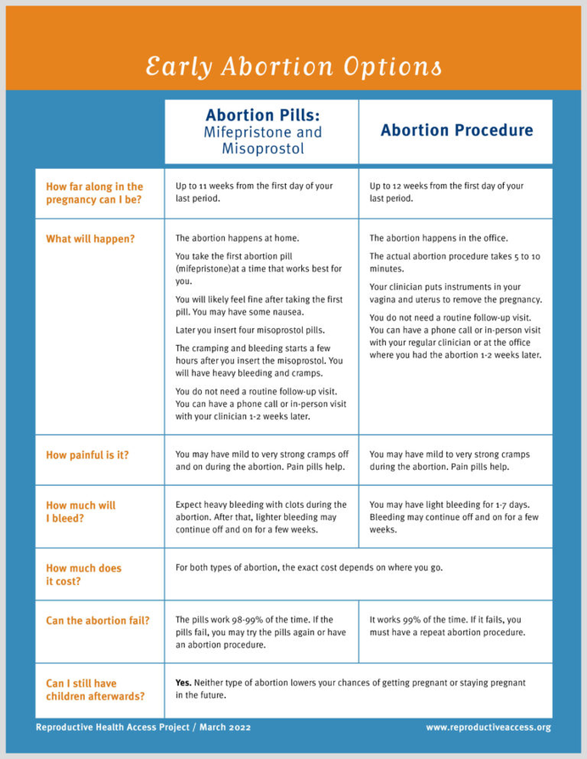



Abortion Options
Medication abortion
Procedural
Abortion
Notes:
A full training on counseling on abortion options is beyond this presentation’s scope, but we’ll highlight some key points to discuss with patients when helping them think through what type of abortion they want when they are in the first trimester of pregnancy.
There are some key actions to note about communicating on abortion
Provide a private space for counseling and ensure confidentiality
Demonstrate openness to listen and address any concerns
Be ready to discuss the patient’s personal and emotional needs, values, and coping strategies
Help the patient identify resources, like personal support systems and community resources
Help clarify any myths and misconceptions about abortion
Use non-stigmatizing language – like “end a pregnancy” instead of “abort a child” or “pregnant person” instead of “mother” or “more than one abortion” instead of “repeat/multiple abortions”
It’s important to note here that you aren’t limited to making referrals and providing information about in-clinic options only – there’s telehealth abortion services as well as options for self-managed abortion, especially in situations where abortion providers may be inaccessible or unacceptable to patients.
So we’ll talk about abortion generally, and then talk about some counseling and informational highlights for medication abortion – especially highlighting telehealth options and self-sourced or self-managed abortion.

Slide 21

Abortion Safety
First trimester abortions do not increase the risk of:
Infertility
Ectopic pregnancy
Miscarriage
Birth defect
Preterm or low-birthweight delivery
Notes:
General points of counseling that a patient may want to learn more about is abortion safety.
A first-trimester abortion is one of the safest medical procedures and carries minimal risk—less than 0.05%—of major complications that might need hospital care. First trimester abortions are much safer than carrying pregnancies to term (risk of death in childbirth is ~14x higher than first trimester abortion).
References:
Guttmacher Institute. Induced Abortion in the United States. Website https://www.guttmacher.org/fact-sheet/induced-abortion-united-states. Published 1/2017.
Raymond, Elizabeth G., and David A. Grimes. “The Comparative Safety of Legal Induced Abortion and Childbirth in the United States.” Obstetrics and gynecology 119.2 Pt 1 (2012): 215–219. Print.

Slide 22
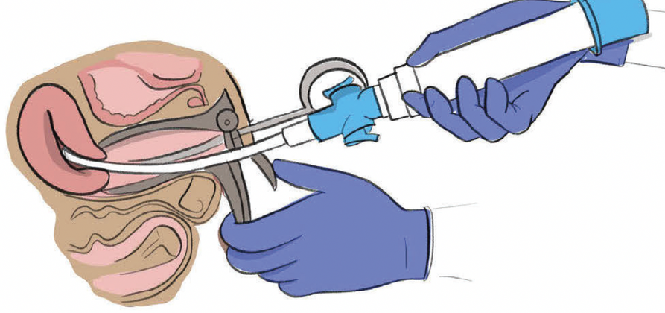
Manual Vacuum Aspiration
99% effective
Takes minutes to complete, no follow up needed
Multiple anesthesia options (including local)
Shorter bleeding duration
Can be performed later in pregnancy
Requires pelvic instrumentation
Less patient control over a procedure
Potential medication side effects (anesthesia and analgesia)
Notes:
Things to know
It works 99% of the time.
It is over in a few minutes. No follow up visit is required if the abortion is completed.
Multiple anesthesia options (including a local paracervical block and multiple options for conscious or deep sedation).
Can be performed in a primary care clinic
Less bleeding than with a pill abortion.
It can be done later in the pregnancy than a pill abortion (up to 12-13 weeks).
A health care provider must insert instruments inside the uterus.
Anesthetics and pain medicines may cause side effects.
Patients have less control over the abortion procedure. May not be able to choose who is present for support.
Anesthetics and pain medicines may cause side effects.

Slide 23
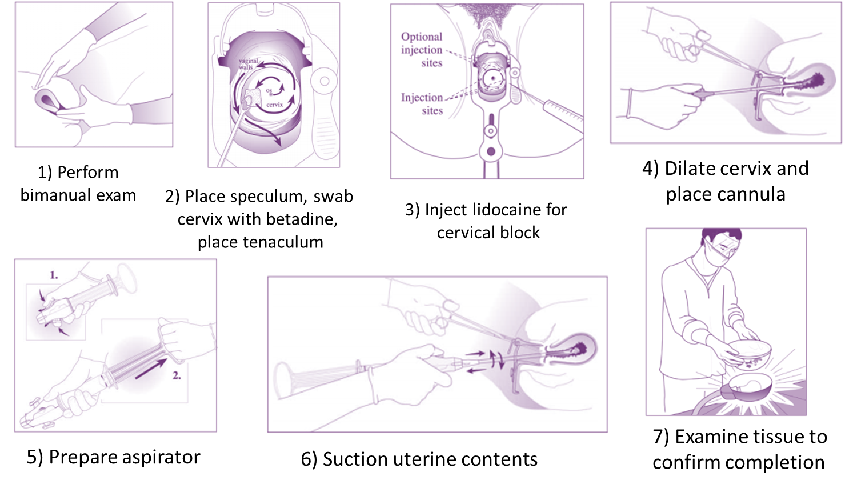
Manual Vacuum Aspiration
Notes:
To walk the patient through what an MVA would look like – you can talk about these steps.
Perform bimanual exam to assess position of uterus
Place speculum, swab cervix with betadine, place tenaculum.
Inject lidocaine for cervical block
Dilate cervix and place cannula
Prepare and attach aspirator to cannula
Suction uterine contents
Examine tissue to confirm completion
RHAP also has a Zine that walks through the story of Elena who is having an MVA at her primary care office: https://www.reproductiveaccess.org/resource/elenas-aspiration-abortion-zine/
Image: https://www.ipas.org/wp-content/uploads/2020/06/PERFMVA-E19.pdf

Slide 24

MVA: What to Expect
Can be done with local anesthesia or sedation
May have mild to strong cramps during procedure, light bleeding/cramping for 3-7 days after
Procedure takes 5-10 minutes
Notes:
Some other points you may want to highlight during options counseling about procedural abortion are around pain control:
Patients can feel a wide variety of sensations during the procedure, from mild cramping to severe, pressure and tugging. This may come from a patient’s prior experiences within the medical setting, prior trauma experiences, and obstetric history. Discussing the MVA process with the patient during counseling and (and while fully clothed) can help prepare patients and create an affirming space to ask questions and express emotions.
NSAIDs prior to the procedure can help with cramping. While it is safe and tolerable to provide the procedure under local anesthesia, patients may also opt for moderate or deep sedation.
You can offer non medical pain control options like using heat packs, having relaxing music, “talk therapy,” and deep breathing. etc
Triggering language includes language like “relax”, “open your legs” or “you’ll feel a pinch here” and can worsen patient pain and anxiety. Using patient-centered language like “let your pelvic muscles tilt downwards”, “have your knees fall to the side” or “I’m placing the numbing medicine now” may be better alternatives.
Support persons (either of the patient’s choosing or a staff person or doula) can also help provide distraction, support, guided imagery, breathing exercises, etc.
The procedure itself usually lasts about 5-10 minutes, and the events with the most potential for cramping and pain should last < 2 minutes.

Slide 25


Medication Abortion
mife + miso
Avoids surgical and anesthetic risk
Greater patient autonomy and privacy (can take the pills at home)
Less invasive
More “natural”
Bleeding can be heavy, last longer
84 days (12 weeks) gestation
Telehealth option (for some states)
98-99%
success
rate
.4% risk of major complications
miso-only
94-97%
success
rate
.7% risk of major complications
Notes:
Things to Know
MAB with mifepristone & misoprostol is 98-99% effective, can be performed up to 12 weeks. With misoprostol only, it’s still highly effective but may have more incomplete abortions that require follow-up pills or vacuum aspiration to complete.
Some people prefer it due to feeling more control and autonomy over their bodies and their abortion, potential for privacy (doing it at home), perceived as more natural (like an induced miscarriage rather than a procedure), discomfort with anesthesia or uterine instrumentation.
Can take several days to complete the abortion.
Bleeding can be very heavy and may last longer than with an MVA.
Cramps can be more intense than that of a period and may last longer than a procedure.
They can take the pills at home or in-clinic
Within 24 hours after taking misoprostol, they can expects lots of cramping, heavy bleeding (sometimes heavier than a period), passage of clots and possibly passage of grayish tissue, and sometimes some stomach/GI-related side effects
For more information on the details of these protocols and regimens, check out RHAP’s resources:
Protocol for mife + miso: https://www.reproductiveaccess.org/resource/medication-abortion-protocol/
Miso-only protocol resources: https://www.reproductiveaccess.org/resource/protocol-medication-abortion-using-misoprostol-alone/
Telehealth medication abortion protocol: https://www.reproductiveaccess.org/resource/telehealth-care-for-mab-protocol/
How to use abortion pills factsheet: https://www.reproductiveaccess.org/resource/mabfactsheet/
How to use abortion pills miso-only factsheet: https://www.reproductiveaccess.org/resource/mabfactsheet-miso/
Abortion Pill CME -- self-guided training: https://abortionpillcme.teachtraining.org/
References:
Winikoff B. Acceptability of medical abortion in early pregnancy. Fam Plan Perspectives, 1995;27:142-8, 185.
Henshaw RC, et al. Comparison of medical abortion with surgical vacuum aspiration: women’s preferences and acceptability of treatment. BMJ, 1993;307:714-7.
Henshaw SK. Abortion incidence and services in the United States, 1995-1996. Fam Plan Perspectives, 1998;30:263-70, 287. (Report based on Alan Guttmacher Institute Survey).
The Henry J Kaiser Family Foundation (Palo Alto, CA). Two national surveys: Views of Americans and health care providers on medical abortion. 1998.
Guttmacher Institute. Induced Abortion in the United States. Website https://www.guttmacher.org/fact-sheet/induced-abortion-united-states. Published 1/2017.
Image: RHAP

Slide 26

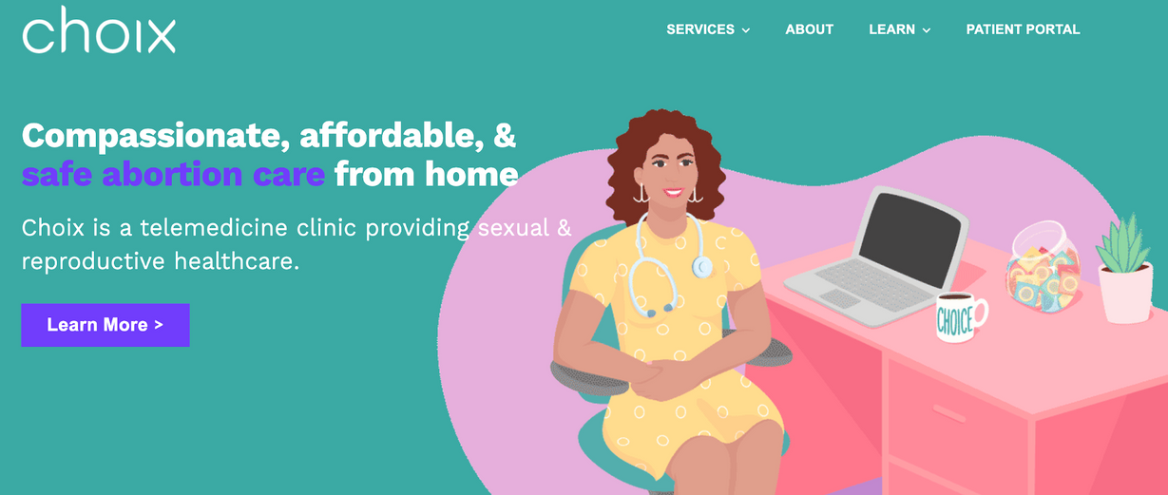


Telehealth MAB
Notes:
Patients can also have a medication abortion via telehealth, depending on the state they live in. You can connect a patient to a telehealth provider through the same resources, abortionfinder.org or IneedanA.com. Some common platforms include: Aid Access, Hey Jane, Choix, NAF, Abortion On Demand.
They work just like a medication abortion except the patient wouldn’t see the provider in-clinic and can receive the medicines by mail.
Telehealth abortion is no less safe than in-person care.
As a clinician, you can also provide continuity of care after a telehealth abortion by supporting the patient with any follow-up needs or refer them to trusted providers who can help.
Image sources:
https://choixhealth.com/
https://aidaccess.org/en/
https://www.heyjane.com/

Slide 27
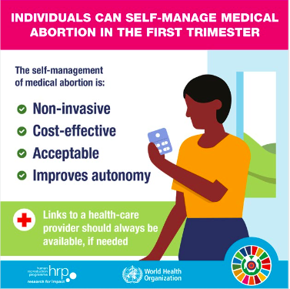
Self-Sourced/Self-Managed Abortion
SMA is safe and effective
You can provide information, support, and resources for patients looking to SMA as an option
In restrictive states: frame suggestions as general information rather than specific advice
Plan C: https://www.plancpills.org/
Notes:
The ability to self-source medications for one’s abortion has made SMA so much safer than ever before.
The advent of MAB pills and the increase of support networks, information, and availability has changed the safety of self-managed abortion dramatically since pre-Roe times.
As abortion restrictions and bans spread, primary care clinicians will encounter more patients who are interested in using abortion pills on their own – most patients simply need information and support.
Clinicians working in a state where abortion is illegal may want to frame suggestions as general information rather than as specific advice for ending a pregnancy. Clinicians should be aware of the laws in their state and consult an in-state attorney with specific legal questions.
Common questions or supports you can provide (SMA for clinicians)
If a patient is interested in SMA, you can share Plan C as a resource for information about authentic pills for medication abortion
You can help a patient determine how many weeks pregnant they are so they can use an appropriate dosage of medicines – help them by obtaining LMP and history, using a gestational age calculator, or providing a dating ultrasound (or referral)
You can offer instructions on how to use the pills for medication abortion – sharing factsheets and videos too to provide accurate information on how to use the pills – like RHAP resources or this video: https://www.ipas.org/our-work/self-managed-abortion/abortion-with-pills/
You can also offer information on what to expect – like how much bleeding is too much and what to do if there are certain side effects or too much bleeding.
Resources to share:
https://www.reproductiveaccess.org/resource/approach-to-patients-undergoing-self-managed-medication-abortion/
https://www.reproductiveaccess.org/abortion/sma/
https://www.ipas.org/our-work/self-managed-abortion/abortion-with-pills/
https://www.reproductiveaccess.org/resource/mabfactsheet-miso/
https://www.reproductiveaccess.org/resource/mabfactsheet/
Image Source: World Health Organization. Self-management of medical abortion in the 1st trimester infographic. https://www.who.int/reproductivehealth/publications/ self-care-infographics/en/

Slide 28
Build a Referral List
Visit ineedana.com or abortionfinder.org to learn about local and telehealth abortion providers, funding, and support
If you know of an abortion clinic near by, reach out directly to understand:
How referrals work
What gestational ages they care for
If they accept Medicaid
Any other information that might be important to your patients
Check the Crisis Pregnancy Center Map to make sure you are not referring to a CPC
Make sure staff and patients are aware of CPCs
Visit Guttmacher to understand abortion restrictions in your state

Slide 29
If the Patient is Unsure
Begin by offering to answer any questions
Discuss all options with the patient
Ask open-ended, non-directive questions: “Can you say more about what you are feeling?”
Consider pros and cons of each option, directed by patient concerns and preferences
Abortion restrictions may impact timing for decisions
Provide information on exposures that may be harmful to a developing pregnancy (e.g. medications, drugs/alcohol, etc)
Additional support: All Options Talkline, 1-888-493-0092
Reflection exercises
Practice Guide for All-Options Pregnancy Counseling
Notes:
Begin by:
Offering to answer any questions the patient may have related to pregnancy or abortion
Discuss all options with patient:
If patient is willing to discuss their feelings, ask open-ended questions in a non-directive manner (i.e. can you say more about what you are feeling?”
Allow patient to lead conversation as much as possible.
Validate and normalize their feelings
If patient wishes, consider the pros and cons of each choice, both in the short and long term.
Discuss pros and cons in a neutral way, directed by patient concerns and preferences.
State abortion restrictions may affect how much time the patient has to make a decision about whether or not to get abortion care in-state and the types of options available to them.
Provide information for what medications, drugs/alcohol, and other environmental exposures may be harmful to a developing pregnancy.
Recommend prenatal care screenings if needed.
If additional decision support is needed, refer only to providers who approach patients with full respect for any decision they make (All Options Talkline, 1-888-493-0092).
You can also encourage your patient to do a reflection exercise over the course of several days before making a follow-up appointment/conversation Like this:
Spend one day writing a list of all positive and negative feelings about keeping the pregnancy.
Spend the day with ambivalent feelings, not making any decisions.
Spend one day writing a list of all positive and negative feelings about not keeping the pregnancy. (Often, one recurrent theme or feeling will emerge to help the patient to make a decision.)
There’s also the pregnancy options workbook: https://www.pregnancyoptions.info/pregnancy-options-workbook
If patient comes to a decision, reassure and encourage them to trust themselves and their choice. Feelings of shame, disappointment, guilt or regret are normal regardless of the decision.

Slide 30
Other Tips
Frequently reflect on your biases, assumptions, and values
What scenarios are hard for you and why? Do you want patients to make certain decisions? Why and for whom do you feel that way? Work to mitigate those biases when you provide options counseling.
The patient has “the answer”, not you. Only the patient knows the right decision for themselves and their family.
Seek to understand how the patient is doing, their feelings and beliefs. Ask open-ended questions in a non-directive manner to help the patient explore their feelings and preferences
“Can you say more about what you are feeling?”
Keep in mind, not all patients will feel comfortable sharing their true feelings
Affirm that the patient’s choice not to be a parent now is not the same as choosing not to be a parent in the future.
Notes:
Frequently reflect on your biases, assumptions, and values. What scenarios are hard for you and why? Do you want patients to make certain decisions? Why and for whom do you feel that way? Work to mitigate those biases when you provide options counseling.
The patient has “the answer,” not you. Only the patient knows the right decision for themselves and their family.
Seek to understand how the patient is doing, their feelings and beliefs. Ask open-ended questions in a non-directive manner to help the patient explore their feelings and preferences (i.e. “can you say more about what you are feeling?”). Keep in mind, not all patients will feel comfortable sharing their true feelings.
Affirm that the patient’s choice not to be a parent now is not the same as choosing not to be a parent in the future.

Slide 31
Other Tips
Refer to the pregnancy, not the baby
Ask about other supports in the patient’s life
Express your gratitude to the patient for sharing their feelings and coming to you for support.
The patient may not come to a decision at the end of the visit or be ready to discuss options at this time. Offer written information on all options for them to read on their own. Offer to schedule a timely follow-up appointment or phone call.
People who decide to have an abortion are just as sure as those who choose to continue their pregnancy
Much of the stress that comes with having an abortion can be attributed to the barriers people face in obtaining care.
State restrictions on abortion will impact how much time the patient has to make a decision about whether or not to get abortion care, where they can go, and the types of care options available
Notes:
Refer to the pregnancy, not the baby.
Ask about other supports in the patient’s life.
Express your gratitude to the patient for sharing their feelings and coming to you for support.
The patient may not come to a decision at the end of the visit or be ready to discuss options at this time. Offer written information on all options for them to read on their own. Offer to schedule a timely follow-up appointment or phone call.
Research shows that people who decide to have an abortion are just as sure as those who choose to continue their pregnancy, and that much of the stress that comes with having an abortion can be attributed to the barriers people face in obtaining care.
Remember, state restrictions on abortion will impact how much time the patient has to make a decision about whether or not to get abortion care, where they can go, and the types of care options available.

Slide 32

OARS Model: Essential Communication Skills
Open-Ended Questions
Establish a safe environment
Explore, clarify, gain an understanding of your patient’s world and perspective
Affirming
Build rapport, demonstrate empathy, affirm your patient’s strengths and abilities
“It’s great that you are here today. It’s not always easy…”
Reflective Listening
Listen, observe, and share (reflect on) your own perceptions of what your patient shares
Reflect on the words they use and their behaviors/feelings
Summarizing
Collective summary, linking summary, transitional summary to close
Notes:
*Optional Slide: If you want to provide more training on counseling and communication skills, offer the OARS model as a framework.
Talk through the OARS framework using the notes on this job aid: https://rhntc.org/sites/default/files/resources/rhntc_oars_model_job_aid_12-20-2021.pdf
After, watch a video clip (link below, starting on 9 minutes 24 seconds) and discuss how the counselor used (or did not use) elements of the OARS model.
Ask the group:
How did the counselor use elements of the OARS model? How did they not use elements of this model?
Do you have any suggestions for approaching the counseling differently?
https://www.innovating-education.org/2016/03/informed-consent-decision-assessment-and-counseling-in-abortion-care-2/

Slide 33
Exercise: Pregnancy Options Counseling
Pair up/break out rooms
One person represents the clinician, the other is the patient – then switch
Practice all-options pregnancy counseling by disclosing a positive pregnancy test result and discussing pregnancy options. (As the patient – create your own backstory regarding how you feel about this pregnancy)
Notes:
OPTIONAL: Randomly assign pairs in breakout rooms for this exercise if you are on Zoom, otherwise for people to pair up.
Give each pair about 2-5 minutes each for this exercise. Bring everyone back together and ask the group about ways in which their clinician broke the news that seemed helpful (body language, affirming language, resources shared, empathy, etc)

Slide 34

Exercise: Effective Client-Centered Counseling
Notes:
OPTIONAL: You can work through this video series and discussion guide to conduct a facilitated discussion on effective client-centered counseling from the Reproductive Health National Training Center. Three video scenarios illustrate the decision-making process when a patient receives a positive pregnancy test result. Following each scenario, experts analyze the counseling and offer commentary.
Video: https://rhntc.org/resources/exploring-all-options-pregnancy-counseling-without-bias-video
Discussion guide: https://rhntc.org/sites/default/files/resources/2017-10/fpntc_expl_all_options2016.pdf

Slide 35

Options Counseling Videos
These videos model patient-centered, compassionate, non-directive counseling, and demonstrate reproductive health care as a part of the continuity of care family physicians provide their patients.
Each video has an accompanying set of discussion questions designed to deepen learners’ knowledge and skills about patient-centered pregnancy options counseling. They can be used for one-on-one or group didactic sessions, or in small-group discussion exercises.
Notes:
OPTIONAL: You can work through this video series and discussion guide to conduct a facilitated discussion on effective client-centered counseling from the Reproductive Health National Training Center. Three video scenarios illustrate the decision-making process when a patient receives a positive pregnancy test result. Following each scenario, experts analyze the counseling and offer commentary.
Video: https://rhntc.org/resources/exploring-all-options-pregnancy-counseling-without-bias-video
Discussion guide: https://rhntc.org/sites/default/files/resources/2017-10/fpntc_expl_all_options2016.pdf

Slide 36
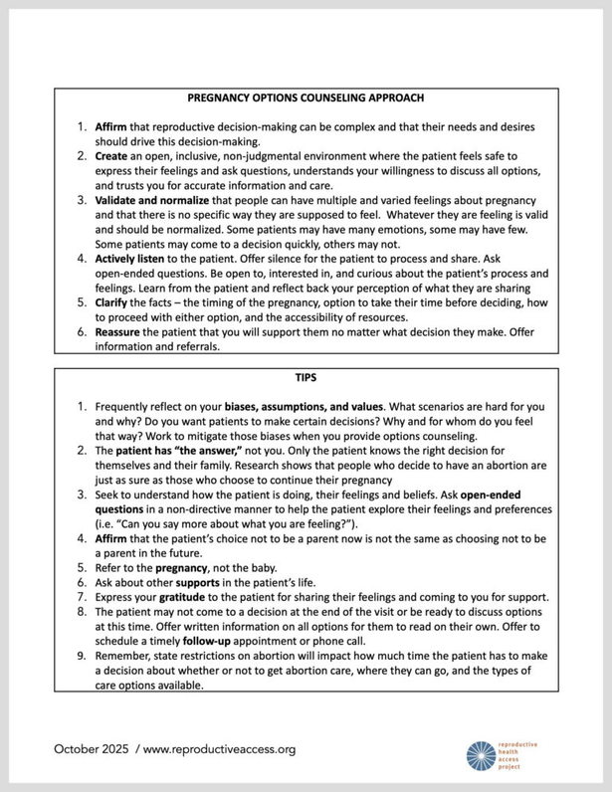
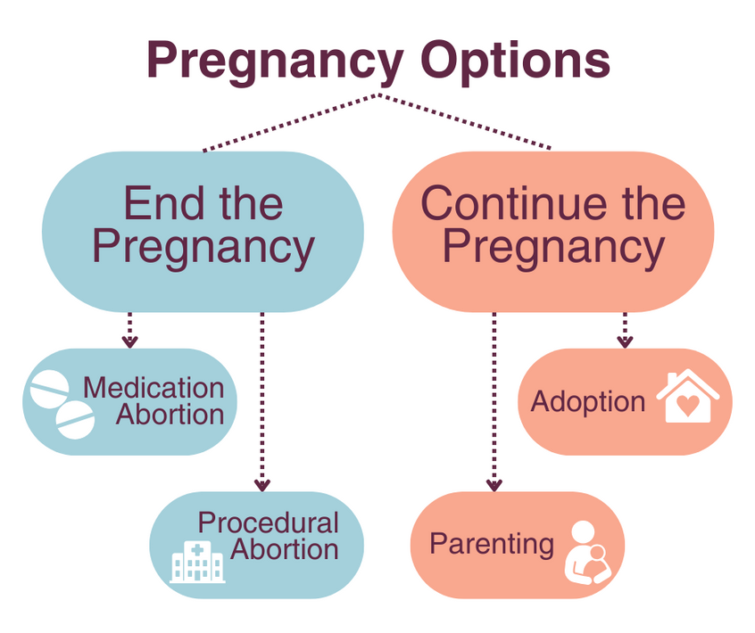
Resources
Notes:
All-Options has resources and a self-paced course and trainings you can bring to your staff virtually or in-person:
https://all-options-selfpacedpow.thinkific.com/collections
https://www.all-options.org/trainings-tools/
All-Options Resource Page: https://www.all-options.org/resources/
You can access the practice guide for all-options pregnancy counseling from Provide here: https://www.providecare.org/resources/practice-guide-for-all-options-pregnancy/
RHAP has resources to support options counseling, including our early abortion options fact sheet: https://www.reproductiveaccess.org/resource/early-abortion-options/
and options counseling model: https://www.reproductiveaccess.org/resource/pregnancy-options-counseling-model/

Slide 37

Thank you!

