Slide 1


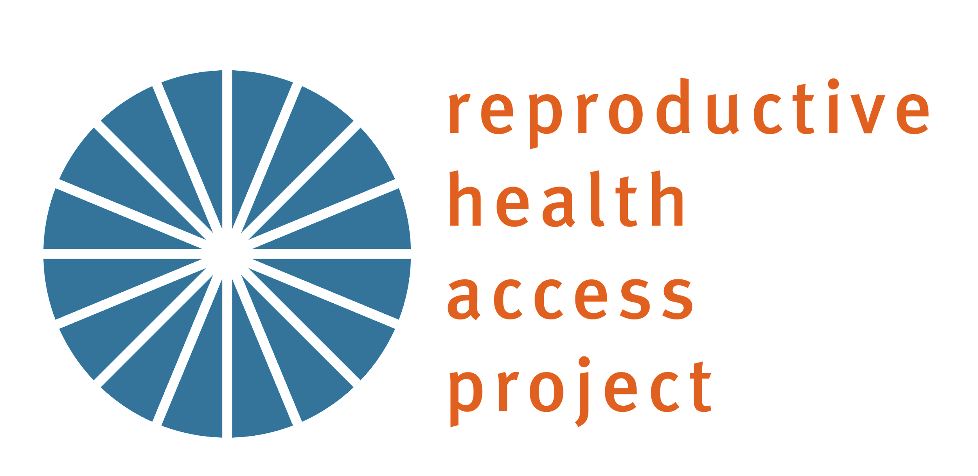
MEDICATION ABORTION 101
Introduction to Medication Abortion Care for Primary Care Staff

Slide 2
LEARNING OBJECTIVES
  Define the reproductive justice framework and how it relates to abortion provision
  Identify the benefits of providing abortion in primary care
  Recognize common myths about abortion
            Explain the basic process of a medication abortion
Notes:
Give staff an overview of what you will cover in this presentation. Feel free to add additional objectives if you plan to review data on abortion access in your region, explain how MAB care will work at your organization, etc. Examples: Understand abortion access in ________, Consider how providing medication abortion may work at this health center; Provide feedback on the process of providing medication abortion at this health center.

Slide 3


TERMINOLOGY
“The right to maintain personal bodily autonomy, have children, not have children, and parent the children we have in safe and sustainable communities”
- SisterSong
Reproductive Justice
Notes:
Start by grounding the group in the concept of reproductive justice.
We want to start by grounding ourselves in an understanding of reproductive justice and its relationship to providing abortion care. Reproductive justice places reproductive health and rights within a social justice framework. It is centered in the idea that all individuals, regardless of their position in society, should have the right to decide if and when they want to have children. This term was coined in 1994, by a group of Black female activists that grew frustrated with the limitations of the pro-choice movement – reflecting on the minimal choices Black women and other people of color experienced. They knew that the conversation around choice needed to shift to reflect the lived and intersectional experiences of people of color and those with low-incomes to center bodily autonomy; and to focus on transforming the systems that have created inequitable access to decision making power for all.
Ask the group how this resonates with them, and how they think it relates to abortion care. If participants are quiet, you can start by offering your thoughts or calling on a participant who is willing to share.

Slide 4





Abortion in Primary Care
Within scope of practice
Access to timely care
Continuity of care
Know and trust PCP
Familiarity with health system
Reduces stigma
Notes:
Introduce the concept of providing abortion in primary care. Remember, this may be new for people, so they may have assumptions about safety, the need for special equipment or training, etc. Share these points and ask participants if they can think of any other reasons some one might prefer to get this type of care with their primary care provider.
Within scope of practice: Medication abortion is within the scope of practice for primary care providers and “can be provided at the primary care level on an outpatient basis and does not require advanced technical knowledge or skills, expensive equipment such as ultrasound, or a full complement of hospital staff (e.g., anesthesiologist).”, according to the World Health Organization.
Access to timely care: If a patient gets primary care at your health center, it is likely that you are located in a convenient area in relation to where they live or work, reducing transportation barriers patients may face if they must seek care elsewhere. Additionally, FQHCs and other community providers are purposefully located in areas to best serve low-income communities and un-or-underinsured individuals. These health centers are in a position to provide key access points for those who may otherwise face barriers to receiving care. Also, referrals can sometimes cause delays which can result in people getting their abortions later in pregnancy, which can be more costly or complex.
Continuity of care: Seeing patients in-house also results in better continuity of care, which is beneficial for the patient’s overall health. For example, being able to connect them to other services like behavioral health support, contraception interested, continuing to monitor chronic conditions, or provide pediatric care to their children if they have them.
Know and trust PCP: It’s found that most patients prefer to get abortion care with their PCP who they know and trust.
Familiarity with the health system: Navigating a new healthcare system can be challenging and complex, especially for patients who may face language or technological barriers. Being able to get abortion care in primary care means that patients do not have to go to through the process of finding, scheduling, and registering with a new provider.
Reduces stigma: Lastly, when we treat abortion like any other health care service, when it can be accessed like any other health care service, it can greatly reduce the stigma that we know surrounds this care.

Slide 5

Abortion Access
Update this slide to explain what abortion access looks like for your state or region. Highlight anything relevant to the patient population you serve.
Notes:
Discuss what abortion access looks like in your state, region, and/or for your patient population. Guttmacher Institute can provide some state-specific information and statistics: https://states.guttmacher.org/policies/
Ask participants if they can think of barriers your patients might face when accessing abortion care.
‌

Slide 6
Mythbusting
What are some things you have heard about medication abortion? This could be from the internet, news, people in your community, family or friends, etc.
Notes:
Because abortion is often stigmatized and sensationalized, it is common for people to harbor misinformation about what it is, how it works, how common it is. etc. It is useful to take time to understand what participants believe about abortion so that if they have misinformation or misunderstandings, you can help correct it. We recommend making this portion interactive by asking participants to share myths they may have heard about abortion or things they have heard that they weren’t sure if they were true or not. You can also use a polling tool like Mentimeter to collect this information, especially if you think it will increase participation. If you elect to not make this portion participatory, you can skip this slide and go straight to the next slide where you can bust common myths about abortion.
Prior to facilitating this session, familiarize yourself with other common myths so you can have facts and data to bust them. You can review these resources to assist:
https://www.reproductiveaccess.org/resource/values-clarification-workshop/ (Appendix II – Myth Busting: Facts About Abortion)
https://www.guttmacher.org/fact-sheet/induced-abortion-united-states
https://www.acog.org/advocacy/facts-are-important/identifying-combating-abortion-myths-misinformation

Slide 7

Mythbusting
Myth | Fact
Getting an abortion has a negative impact on mental health. | There is no evidence that having an abortion is associated with negative mental health outcomes.
People regret their abortion. | It is uncommon. Studies have found 95-99% of people surveyed later on do not regret their decision.
Medication abortion is unsafe. | Serious complications are rare.
If made available, people will rely on abortions for birth control. | Half of abortion patients were using birth control when they became pregnant. 52% never had a previous abortion.
A lot of people get abortions late into pregnancy. | 85% of abortions happen in the first 9 wks of pregnancy. 94% of abortions happen in the first trimester.
https://www.kff.org/womens-health-policy/dashboard/abortion-in-the-u-s-dashboard/
Notes:
Here are some common myths about abortion. If these did not come up with the group, you can review them now.
Myth: Getting an abortion has a negative impact on a person’s mental health. Fact: Studies have found no evidence that having an abortion is associated with negative mental health outcomes. In fact, it has been found that not having access to a wanted abortion leads to more anxiety than if a patient were to receive care. Further, receiving abortion care in a familiar primary care environment where there is access to supportive mental health care if desired will be beneficial for a patient.
Myth: People regret having an abortion. Fact: While some people might regret their decision to have an abortion, it is uncommon. Studies have shown that 95-99% of people do not regret having an abortion. This is one reason why through options counseling and informed consent are so important – patients should have all the information necessary to make the best decision for themselves.
Myth: Medication abortion is unsafe. Fact: Medication abortion is incredibly safe, and serious complications are rare (.4% risk of major complications and associated mortality rate of <.001%. The risks of MAB are similar to the risks of commonly prescribed and over-the-counter medications such as antibiotics and NSAIDs. MAB is safer than childbirth.
Myth: If made available, people will rely on abortions for birth control. Fact: It has been found that half of patients who get abortions were using contraception when they became pregnant. Most people who have abortions have never had an abortion before, or have only had one previous abortion. If people were using abortion as birth control, they would likely experience a higher number of unintended pregnancies in their lifetime.
Myth: A lot of people get abortions late into pregnancy. Fact: The vast majority of abortions happen in the first trimester, with 85% happening in the first 9 weeks of pregnancy, when there is no visible embryo. Anti-abortion extremists purposefully use graphic and medically inaccurate pictures to invoke an emotional response out of those who view them. Abortion bans, lack of access to care, and mandatory waiting periods are all factors that force people into having abortions later in pregnancy.
Resources:
-Identifying and Combating Abortion Myths and Misinformation. www.acog.org. https://www.acog.org/advocacy/facts-are-important/identifying-combating-abortion-myths-misinformation
-Rocca CH, Samari G, Foster DG, Gould H, Kimport K. Emotions and decision rightness over five years following an abortion: An examination of decision difficulty and abortion stigma. Social Science & Medicine. 2020;248(112704):112704. doi:https://doi.org/10.1016/j.socscimed.2019.112704
-National Academies of Sciences, Engineering, and Medicine. 2018. The safety and quality of abortion care in the United States. Washington, DC: The National Academies Press. doi: https://doi.org/10.17226/24950.
-The Availability and Use of Medication Abortion. KFF. Published June 8, 2020. https://www.kff.org/womens-health-policy/fact-sheet/the-availability-and-use-of-medication-abortion/
-National Abortion Federation Revised. Women Who Have Abortions.; 2007. https://prochoice.org/wp-content/uploads/women_who_have_abortions.pdf
-The Issue of Tissue | myanetwork. https://myanetwork.org/the-issue-of-tissue/

Slide 8
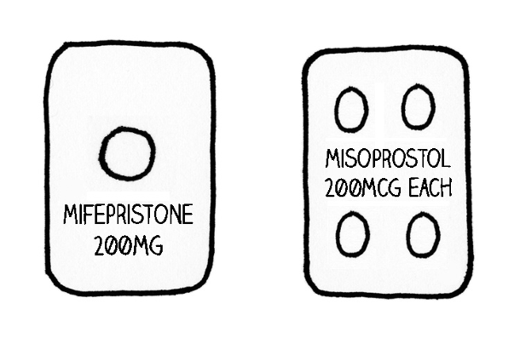
Medication Abortion 101
Uses two medications: mifepristone & misoprostol
    FDA-approved in 2000 for abortion through 7 wks, extended to 10 wks (70 days) in 2016
Can be used through 11-13 wks
Use of MAB is increasing in US
MAB is safe and effective → safer and more effective earlier in pregnancy
Notes:
Now that participants have a better understanding of medication abortion, you can review the basics of what it is and how it works.
Medication abortion is a process that uses two medications: mifepristone and misoprostol.
These two medications are approved in the US for abortion up to 10 weeks gestational age, but many studies have shown it to be safe and effective from 11-13 weeks as well
The use of MAB is increasing in the US, with almost 2/3 of all clinician-provided abortions in 2023 being via medication.
As we have already learned, MAB is incredibly safe and effective, with a .4% risk of major complications.
References
-Guttmacher Institute. Induced Abortion in the United States. Guttmacher Institute. Published June 2024. https://www.guttmacher.org/fact-sheet/induced-abortion-united-states
-The Availability and Use of Medication Abortion. KFF. Published March 2024. https://www.kff.org/womens-health-policy/fact-sheet/the-availability-and-use-of-medication-abortion/
‌
‌

Slide 9
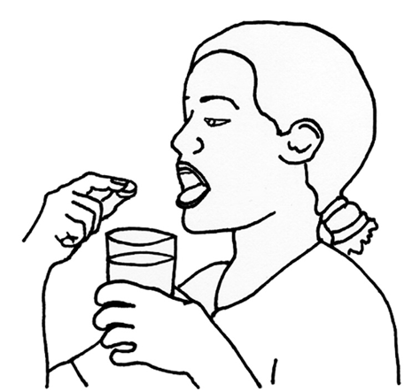
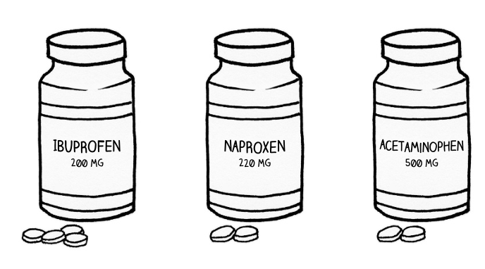
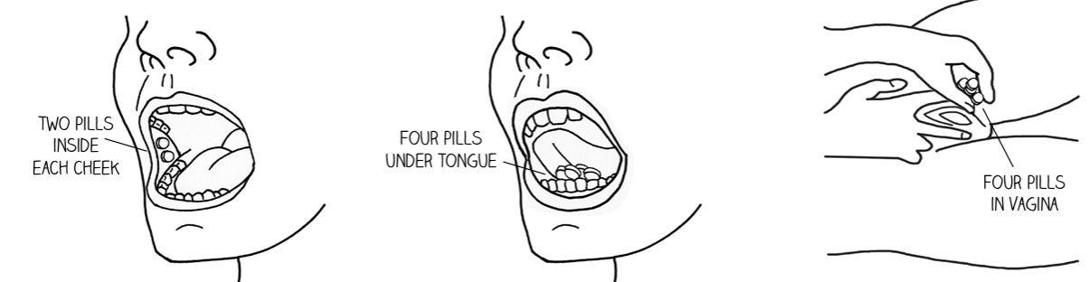
How does it work?
Mifepristone blocks the hormone that allows pregnancy to grow
Misoprostol contracts uterus to expel tissue
Take 200mg mifepristone, then 1 dose of misoprostol 24-48 hours later
Day 1: Take mifepristone
Day 2: Take pain medicine and misoprostol
Notes:
Briefly explain the process of a medication abortion. Adjust the level of detail and clinical terminology based on your audience. Share RHAP’s ”How to use Abortion Pills” fact sheet with participants: https://www.reproductiveaccess.org/resource/mabfactsheet/
‌
On the first day, the patient will take the mifepristone at a time that works for them. This will block the hormone that allows the pregnancy to grow.
24-48 hours later, the patient will use the misoprostol. This will contract the uterus to expel the tissue.
References:
-Reproductive Health Access Project. How to Use Abortion Pills Fact Sheet. Published June 25, 2024. https://www.reproductiveaccess.org/resource/mabfactsheet/
‌
‌

Slide 10

What to Expect
Cramps and heavy bleeding within 24 hours of using misoprostol
Possible blood clots, loose stools, fever, or chills
If no cramps or bleeding after 24 hours, use 4 more misoprostol pills
If no cramps or bleeding after 4 more misoprostol pills, contact clinician
Notes:
Briefly explain what patients can expect after taking mifepristone and misoprostol. Adjust the level of detail and clinical terminology based on your audience.
‌
Cramps and heavy bleeding should start within 24 hours after using the misoprostol.
The patient may see blood clots, have loose stools, fever, or chills.
If the patient does not experience cramps or bleeding, they can use 4 more misoprostol pills.
If they do not experience cramps or bleeding after that, they should contact the health center to be evaluated.
References:
-Reproductive Health Access Project. How to Use Abortion Pills Fact Sheet. Published June 25, 2024. https://www.reproductiveaccess.org/resource/mabfactsheet/
‌
‌

Slide 11
Common Patient Questions
How much should I expect to bleed? Remember 2X2 – if you soak through two maxi-pads per hour, two hours in a row, contact your clinician.
I threw up after taking the mifepristone, what should I do? If the pill was swallowed more than 1 hour before throwing up, it was likely absorbed. If not, repeat the mifepristone.
I started bleeding before using the misoprostol. Do I still need to take it? Yes, the process is more effective when both mifepristone and misoprostol are used.
How soon can I become pregnant? Most people will ovulate within 2-3 weeks and resume menstruation within 4-5 weeks after MAB. If interested, pts should be counseled on contraception at MAB visit or follow-up.
Notes:
Briefly explain common questions/concerns from patients after they have taken the medication. Adjust the level of detail and clinical terminology based on your audience. If you are presenting to an audience that will not be answering any clinical questions from MAB patients, feel free to skip. If you are presenting to an audience that will be triaging MAB patients, feel free to add more common patient questions: https://www.reproductiveaccess.org/resource/medication-abortion-faqs/ and/or watch this training video and the attached Guide to Phone Triage: https://www.reproductiveaccess.org/resource/triaging-medication-abortion-related-calls-video/ to discuss more scenarios that may arise.
‌
Patients may call after the MAB with questions about bleeding. If they are soaking through two maxi-pads per hour for two hours in a row, they should be evaluated by the clinician.
Patients may call if they have thrown up after taking the mifepristone and are wondering what to do. If they swallowed the pill more than 1 hour before throwing up, it was likely absorbed. If it has been less than an hour, they should take another dose of mifepristone. The clinician will need to send another prescription, or the patient will need to come get another dose from the health center.
Patients may call with questions about the timing of their bleeding and if they should still take the misoprostol. The medications work best when they are used together, so even if a patient started bleeding after the mifepristone, they should still use the misoprostol.
Patients may call with questions about birth control and becoming pregnant. Most people will ovulate 2-3 weeks after a MAB and will resume menstruation within 4-5 weeks. If they start the implant, pill, patch, ring, or shot within 7 days of taking the mifepristone, they take effect right away. There is some evidence that mifepristone is slightly less effective if the shot is received on the same day. Patients can get an IUD as soon as a few days after the misoprostol.
References:
-Reproductive Health Access Project. How to Use Abortion Pills Fact Sheet. Published June 25, 2024. https://www.reproductiveaccess.org/resource/mabfactsheet/
‌
‌

Slide 12
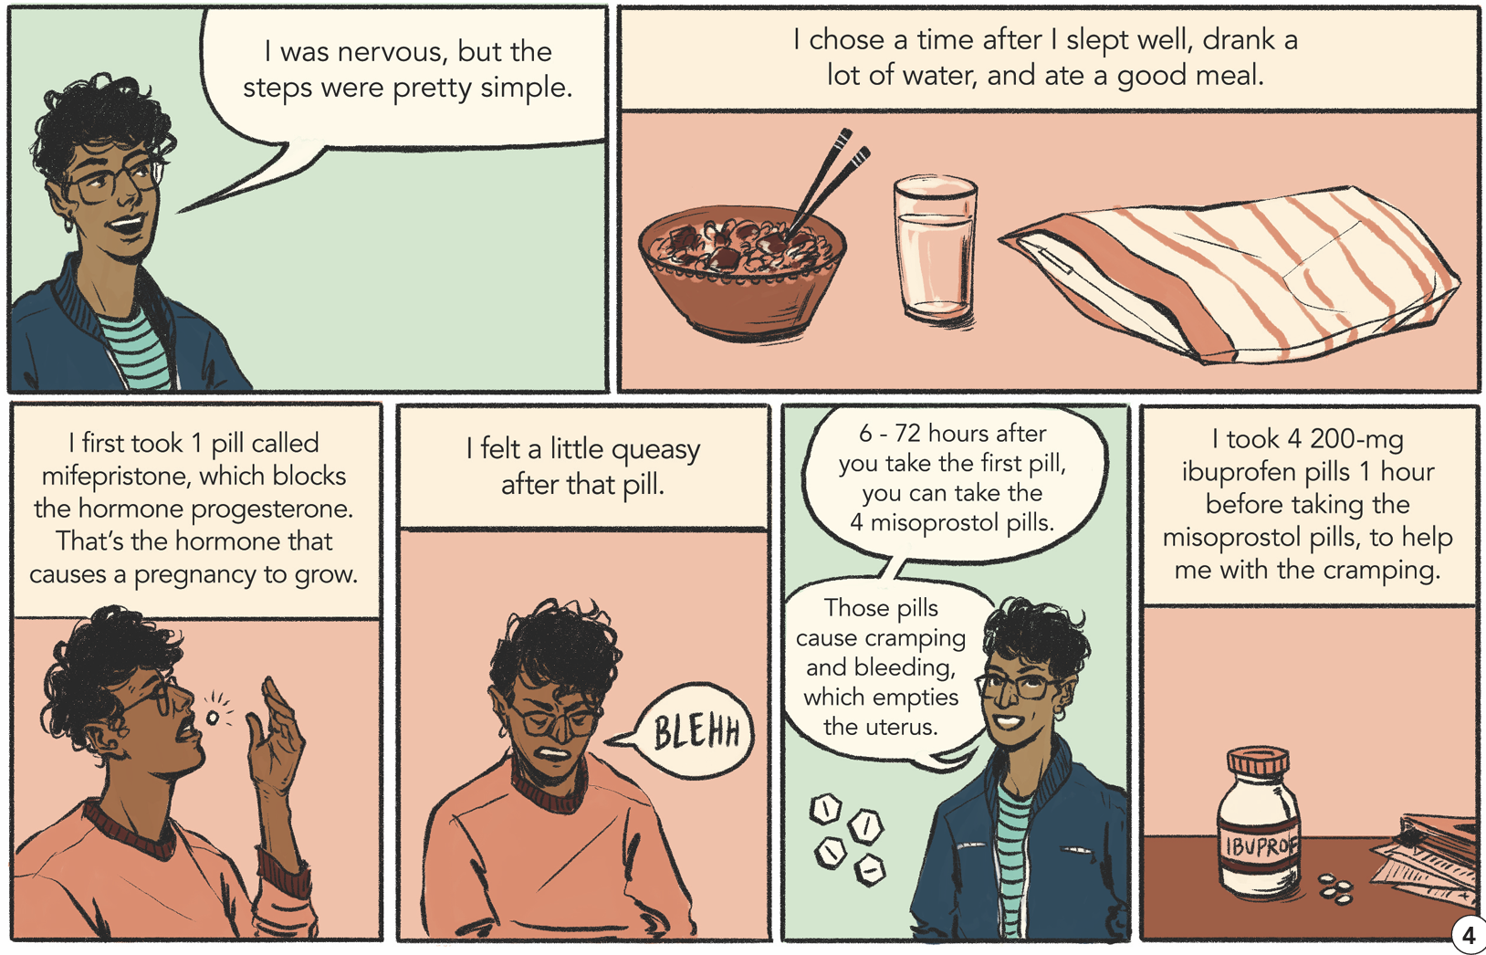
What are some things people like about MAB?
May offer more privacy and sense of control
Avoids a procedure
Can be done via telehealth
Similar to a miscarriage
Notes:
‌Discuss reasons some reasons people prefer MAB over procedural abortion.
It is important for people to be able to choose what type of abortion works best for them. For some people, getting a procedure in the office works better for them because it happens all in one place and feels like it’s over faster than a medication abortion. Other people choose medication abortion because:
It may offer more privacy and sense of control: people can take the pills at home or the place of their choosing, at the timing that works best for them. They can choose who they want to be there with them to support them and when.
For some people, using medication avoids having a procedure, which means avoiding sedation risk.
It can be done via telehealth: depending on where someone lives and where they are getting their care from, some people don’t have to go into the office at all. Many providers and online services offer appointments via telehealth with the option of using an online pharmacy to get the pills, or picking them up at the office at a time that is convenient for them.
Some people prefer this because it feels and appears very similar to a spontaneous pregnancy loss.

Slide 13
MAB vs. Procedural
MAB
Procedural
Can be done up to 11 weeks from LMP
The abortion happens at home and takes 1-2 days.
You take the first abortion pill (mifepristone) at a time that works best for you and insert the misoprostol 24-48 hours later.
Bleeding can be heavy and last longer than with a suction abortion procedure.
You do not need a routine follow-up visit.
Can be done up to 12 weeks from LMP
The abortion happens in the office and the actual procedure takes 5 to 10 minutes.
Your clinician puts instruments in your vagina and uterus to remove the pregnancy.
You may have light bleeding after.
You do not need a routine follow-up visit.
Notes:
Here are some common myths about abortion. If these did not come up with the group, you can review them now.
Myth: Getting an abortion has a negative impact on a person’s mental health. Fact: Studies have found no evidence that having an abortion is associated with negative mental health outcomes. In fact, it has been found that not having access to a wanted abortion leads to more anxiety than if a patient were to receive care. Further, receiving abortion care in a familiar primary care environment where there is access to supportive mental health care if desired will be beneficial for a patient.
Myth: People regret having an abortion. Fact: While some people might regret their decision to have an abortion, it is uncommon. Studies have shown that 95-99% of people do not regret having an abortion. This is one reason why through options counseling and informed consent are so important – patients should have all the information necessary to make the best decision for themselves.
Myth: Medication abortion is unsafe. Fact: Medication abortion is incredibly safe, and serious complications are rare (.4% risk of major complications and associated mortality rate of <.001%. The risks of MAB are similar to the risks of commonly prescribed and over-the-counter medications such as antibiotics and NSAIDs. MAB is safer than childbirth.
Myth: If made available, people will rely on abortions for birth control. Fact: It has been found that half of patients who get abortions were using contraception when they became pregnant. Most people who have abortions have never had an abortion before, or have only had one previous abortion. If people were using abortion as birth control, they would likely experience a higher number of unintended pregnancies in their lifetime.
Myth: A lot of people get abortions late into pregnancy. Fact: The vast majority of abortions happen in the first trimester, with 85% happening in the first 9 weeks of pregnancy, when there is no visible embryo. Anti-abortion extremists purposefully use graphic and medically inaccurate pictures to invoke an emotional response out of those who view them. Abortion bans, lack of access to care, and mandatory waiting periods are all factors that force people into having abortions later in pregnancy.
Resources:
-Identifying and Combating Abortion Myths and Misinformation. www.acog.org. https://www.acog.org/advocacy/facts-are-important/identifying-combating-abortion-myths-misinformation
-Rocca CH, Samari G, Foster DG, Gould H, Kimport K. Emotions and decision rightness over five years following an abortion: An examination of decision difficulty and abortion stigma. Social Science & Medicine. 2020;248(112704):112704. doi:https://doi.org/10.1016/j.socscimed.2019.112704
-National Academies of Sciences, Engineering, and Medicine. 2018. The safety and quality of abortion care in the United States. Washington, DC: The National Academies Press. doi: https://doi.org/10.17226/24950.
-The Availability and Use of Medication Abortion. KFF. Published June 8, 2020. https://www.kff.org/womens-health-policy/fact-sheet/the-availability-and-use-of-medication-abortion/
-National Abortion Federation Revised. Women Who Have Abortions.; 2007. https://prochoice.org/wp-content/uploads/women_who_have_abortions.pdf
-The Issue of Tissue | myanetwork. https://myanetwork.org/the-issue-of-tissue/

Slide 14
MAB Workflow
Update this slide to explain how MAB care will work at your organization. Take time to answer questions, get feedback, and address concerns.

Slide 15
Values Clarification Activity
Update this slide to reflect a Values Clarification activity if you choose to do one. You can choose one from our Values Clarification Activity Guide or use one that you are familiar with.
Notes:
If you feel it will be constructive at this time, do a Values Clarification activity. Review RHAP’s Values Clarification Workshop and select an activity: https://www.reproductiveaccess.org/resource/values-clarification-workshop/
Some organizations prefer to do Values Clarification with all staff, regardless of if they will be involved in abortion care or not. Other organizations find it is more effective to do just with the staff directly involved in abortion care. You can also do a full Values Clarification Workshop at another time. Take into account the size, culture, and bandwidth of your organization.

Slide 16

Timeline
Update this slide with a general timeline, important dates, or upcoming opportunities staff will have to hear about implementation progress
Notes:
In closing, let staff know what to expect next so that they have a realistic idea of how slowly or quickly MAB implementation will progress.

Slide 17
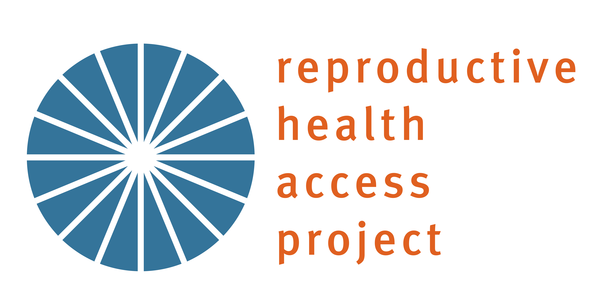
Questions/Feedback
ADDRESS
Update slide with any additional information and contact information for follow-up questions
Reproductive Health Access Project
228 Park Ave S
#45671
New York, New York 10003
PHONE
+1 646-895-6464: RHAP
+1 234 567 8910
EMAIL
person@email.com
person@email.com
info@reproductiveaccess.org
Notes:
Take time to answer questions and address concerns amongst staff. You do not need to have all the answers on the spot, but staff will appreciate being heard. Let them know you are interested in learning about their concerns so that they can be addressed as you go through this process.

Slide 18
THANK YOU.
Notes:
Leave room to answer questions about the medication abortion protocol, integrating medication abortion into clinical practice, self-managed/self-sourced abortion, and other topics that may have come up.

